Slide 1
Chapter 1
Canadian Politics

Slide 2
Chapter Overview
What is politics?
What is democracy?
What are the main cleavages in Canadian politics?
What have been the major issues in Canadian political history?

Slide 3
Inside Canadian Politics
Canada’s political system has changed considerably since 1867.
There are many different ideas and ideologies at play in Canadian politics.
The average citizen has many opportunities to make a difference in Canadian politics.

Slide 4
The Politics of Representation
Canada has different layers of political representation:
Member of provincial/territorial legislature
Member of Parliament
Senators
Local level gov’t. (mayor, reeve, councillor, etc.)
In addition, Indigenous peoples may be represented by:
Elders
Chiefs
Band councilors, etc.
Who do you go to for help with a particular government service or program?

Slide 5
The Politics of Representation, cont’d
Canadians are represented by heads of government.
Each province and territory is led by a premier; the country is headed by a prime minister.
These roles are chosen by representatives of the Queen, who are appointed to their positions (not elected).
Is this democratic?

Slide 6
Core Concepts
Politics refers to the activities involving the pursuit and exercise of collective decision-making.
Who gets what when?
Distribution of shared resources
The most prominent power struggles occur at the state level.
State: a structured political community with a single source of ultimate authority over its territory.
Federations like Canada, Argentina, and Germany consist of multiple orders of government.

Slide 7
Core Concepts, cont’d
The Canadian federation consists of 11 sovereign governments: one at country-wide level, 10 at the provincial level.
The federal (central) government has jurisdiction over the Armed Forces and defence, citizenship, and other national areas of jurisdiction.
In democratic states, most members of government are elected on a regular basis.
Citizens play a more active role in democratic states than subjects in autocracies.

Slide 8
Indigenous Peoples
Indigenous peoples’ rights reflect their ties to the land, their legal and political rights as original occupants of Canada, and their cultural distinctiveness.
Between the 17th-19th centuries, the Crown signed treaties with many First Nations that established nation-to-nation relationships between the British and (future) Canadian governments and Indigenous peoples.
First Nations: Indigenous groups descended from a variety of historical Indigenous nations; collectively, the earliest inhabitants of North America and their descendants, other than Métis and Inuit.

Slide 9
Indigenous Peoples, cont’d
For centuries, Indigenous peoples have been treated as responsibilities, even wards, of the state.
E.g. The Indian Act; the reserve system; forced relocation; residential school system
The Truth and Reconciliation Commission (TRC) labeled the residential school system “cultural genocide”.
Settler colonialism and its legacies have resulted in intergenerational trauma that continues to this day.
Reconciliation among Indigenous and non-Indigenous peoples is a pressing challenge facing Canada.

Slide 10
Three Elements of Canadian Politics
Canadian politics is defined by the cleavages of geography, demography, and ideology.
The institutions of Canadian democracy are Anglo-American hybrids.
Understanding Canadian politics requires some awareness of Canadian history.

Slide 11
1. Core Cleavages
The main cleavages of Canadian politics are geography, demography, and ideology.
Major debates are staged along matters of territory, culture and ethnicity, and core beliefs about the role of the state in society and the economy.
Other cleavages present in Canadian politics include gender, language, class, and religion (among others).
However, issues like reconciliation, gender equality, and income inequality are often overshadowed.

Slide 12
1. Core Cleavages: Geography
Canadian democracy has always been conducted along geographic lines.
Federal elections are waged in over 300 separate districts across Canada, and each province is allotted a number of senators.
Indigenous governance has always been focused around territory as well.

Slide 13
1. Core Cleavages: Geography, cont’d
Attitudes toward authority, community, distribution of wealth, mutual obligations, and other political beliefs vary depending on where a person lives.
Observers often divide Canada into several regional political cultures.
Provinces are playing a greater role than ever before, and are autonomous when it comes to defining their own priorities and direction.
Each province consists of its own unique political world.

Slide 14
1. Core Cleavages: Demography
Canada is divided into many ethnic communities, each with its own political outlook.
When they exist in large numbers, ethnic groups may exert significant influence on the political system.
Cultural differences between French- and English-speaking communities persist.

Slide 15
1. Core Cleavages: Demography, cont’d
Groups that are geographically dispersed, like many Muslims and other religious minorities, face steeper challenges when it comes to representation in the political system.
Multiculturalism is core to Canada’s self-image.
mosaic: a metaphor used to depict Canada’s multicultural character, which features many distinct yet interdependent ethnocultural communities.

Slide 16
1. Core Cleavages: Ideology
Ideology: a set of ideas that form a coherent political belief system.
The core political belief system that a group of citizens holds about the way power should be distributed or exercised.
It is sometimes argued that Canadian politics is relatively devoid of ideological debate or conflict.
Do you think this is true?

Slide 17
1. Core Cleavages: Ideology, cont’d
In politics, ideology is often imagined as a spectrum of views ranging from left to centre to right.
Left-wing: A political tendency that promotes a bigger role for government and proactive measures to achieve social and economic equality.
Right-wing: A political tendency that promotes a smaller role for government and a greater emphasis on individual responsibility and market-based competition.

Slide 18
1. Core Cleavages: Ideology, cont’d
Overall, the following dimensions separate the left and right in Canada:
Fiscal: left favours government spending on social program; right favours lower taxes and debt reduction.
Institutional: left favours reform of democratic structures; right favours tradition.
Social: left promotes inclusion; right promotes conformity.
Legal: left tends to want restrictions on law enforcement and military action; right tends to be more assertive and punitive.

Slide 19
1. Core Cleavages: Ideology, cont’d
The name of a political party does not necessarily signify its political ideology.
The Liberal Party of Canada: ideologically straddles the political centre; sometimes it is positioned centre-left, and sometimes centre-right.
The Conservative Party of Canada: ideology ranges from the centre-right to the right.
The New Democratic Party (NDP) of Canada: ideology spans the centre-left to the left.

Slide 20
2. Key Institutions
Canada has drawn its institutions and practices from British and American traditions.
From Britain, Canada has inherited its common-law and Westminster parliamentary traditions, meaning that it is a representative democracy featuring:
a government led by prime minister and cabinet, supported by majority of elected legislators
an opposition outside the governing party
a permanent public service, separate from government
a judiciary independent of government
a constitutional monarch

Slide 21
2. Key Institutions, cont’d
American influence in Canadian politics:
Federalism
Divide power among central government and series of provincial ones
Centralization: federal government has authority to impose common standards
Decentralization: preserve provincial autonomy
Charter of Rights and Freedoms
Election campaign strategies

Slide 22
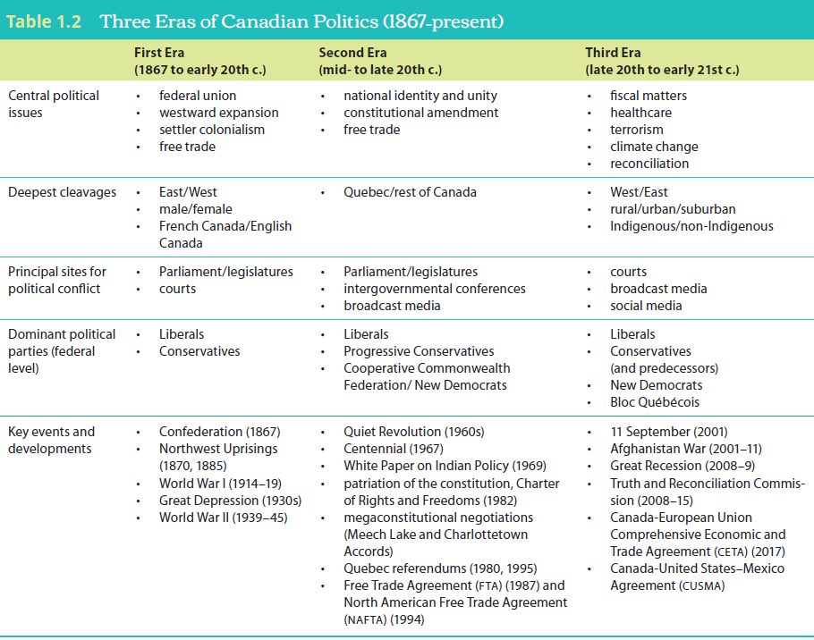
3. Historical Evolution

Slide 23
The Road to Confederation (Pre-1867)
During the 17th-19th centuries, a series of military and economic alliances formed among Indigenous, British, French, and Spanish peoples.
European diseases and settler colonial practices decimated Indigenous presence in North America.

Slide 24
The Road to Confederation (Pre-1867), cont’d
1763:
Britain gained jurisdiction over New France after the Seven Years’ War.
The Royal Proclamation—the foundation of Canada’s constitutional order—was signed.
1774:
The Quebec Act recognized French civil law, extended Quebec’s boundaries and granted religious freedom.

Slide 25
First Era of Canadian Politics (1867-early 1900s)
British Parliament passed the British North America (BNA) Act in 1867.
Established the institutional foundations for the new country.
Fell short of establishing complete sovereignty.
Attempted to extinguish Indigenous right to self-government by declaring “Indians and Lands Reserved for the Indians” to fall under the jurisdiction of the Canadian state.

Slide 26
First Era of Canadian Politics (1867-early 1900s), cont’d
Statute of Westminster, 1931: British law that permitted its Dominions to opt out of future legislation passed by the British Parliament.
Initially, Canadian federation consisted of four provinces: Ontario, Quebec, New Brunswick, and Nova Scotia.
Western expansion was far from smooth or uncontroversial.

Slide 27
First Era of Canadian Politics (1867-early 1900s), cont’d
Federal Indian Act, 1867: further entrenched Canadian state’s approach to Indigenous peoples; labelled them as an area of policy responsibility, established reserves, rejected their inherent rights to self-governance.

Slide 28
Second Era of Canadian Politics (mid-1900s-late 1900s)
Two World Wars and the Great Depression marked a long transition period between the first and second eras of modern Canadian politics.
Coming of age as a society, political culture, and democracy.

Slide 29
Second Era of Canadian Politics (mid-1900s-late 1900s), cont’d
Post-war period focused on questions of national identity and unity.
Quiet Revolution: Quebec government displaced the Catholic Church as the central institution in Quebec society; provincial government began to assert itself on federal level; reinforced growing national movement in Quebec.
Canadian population undergoing dramatic transition; increasingly multicultural; immigrant and visible minorities asserting themselves.

Slide 30
Second Era of Canadian Politics (mid-1900s-late 1900s), cont’d
1969: Federal government’s White Paper on Indian Policy signaled its intention to dismantle the Indian Act; attempt to assimilate First Nations into broader, predominantly European society.
Ultimately abandoned due to vocal opposition by Indigenous groups.

Slide 31
Second Era of Canadian Politics (mid-1900s-late 1900s), cont’d
The Constitution Act of 1982: brought the Canadian constitution under full domestic control; included a new Charter of Rights and Freedoms.
Opposed by Quebec; two referendums were held about separating from Canada, but both failed.
1995: just 50.6% of Quebecers voted to remain in Canada.

Slide 32
Third Era of Canadian Politics (late 1900s-early 2000s)
Focus shifted away from the constitution to budgets and slow economic growth.
Led to several rounds of fiscal restructuring, including strict spending cuts in healthcare, education, and social assistance.

Slide 33
Third Era of Canadian Politics (late 1900s-early 2000s), cont’d
Canadian government’s response to the 2008 global recession was a massive, cost-shared stimulus package involving significant, one-time investment in infrastructure across Canada.
Shift of economic and political influence from East to West, as strong petroleum-based economies in the West weathered economic storm much better than central and eastern Canada.

Slide 34
Third Era of Canadian Politics (late 1900s-early 2000s), cont’d
Significant social changes in Canadian politics.
Court decisions enforcing the Charter of Rights and Freedoms in areas such as same-sex marriage, prostitution, and physician-assisted death.
Legalization of cannabis.

Slide 35
Third Era of Canadian Politics (late 1900s-early 2000s), cont’d
New dimensions to ages-old geographic and ethnic cleavages.
Carbon pricing and the alienation of Western Canadians.
Regional tensions over pipelines.
Rural vs. urban divisions strengthened, with suburban emerging as a new, separate category.
Vast socioeconomic and cultural divide between Indigenous peoples and other people in Canada.

Slide 36
Situating Indigenous Politics
Should Indigenous and non-Indigenous politics be treated separately? Or are they common elements of the same political system?
Used to be treated as a distinct and often subordinate element of Canadian politics.
De-emphasizes the parallels between Indigenous and non-Indigenous politics, particularly on fundamental issues like diversity, representation, activism, and governance.

