Slide 1
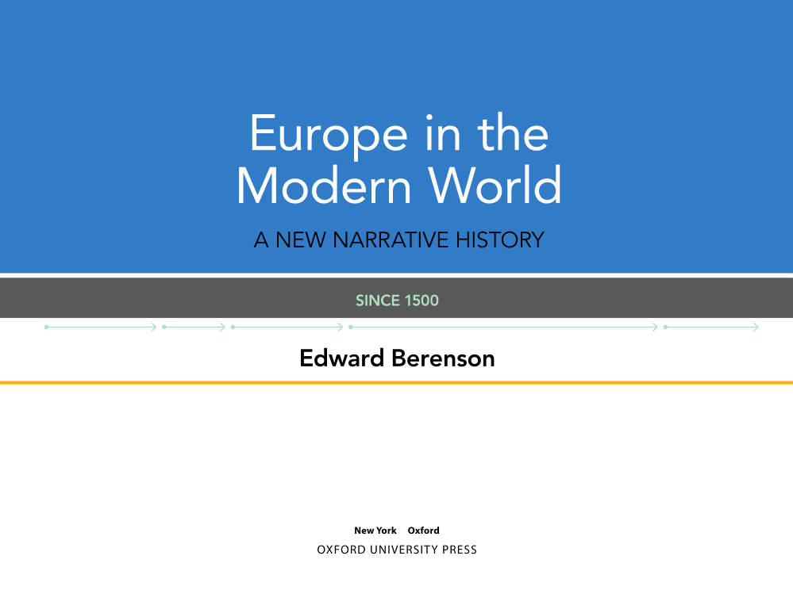

Slide 2

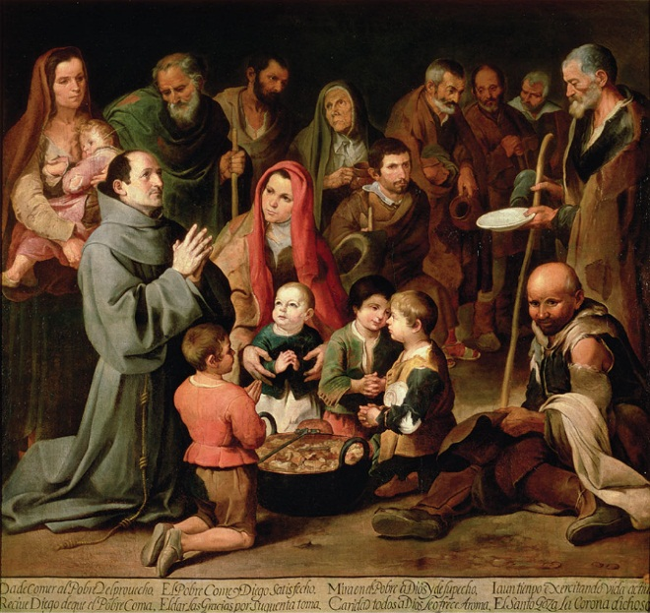
Chapter 3
Crises of the Seventeenth Century
Notes:
Feeding the Poor. In this painting from about 1646 by the Spanish painter Bartolomé Esteban Murillo, solemn-looking children and the elderly give thanks to the kneeling St. Diego of Alcala for a ration of food. Seville, where Murillo spent most of his life, suffered several crop failures, disastrous floods, and repeated outbreaks of famine and the plague between 1626 and 1679.

Slide 3

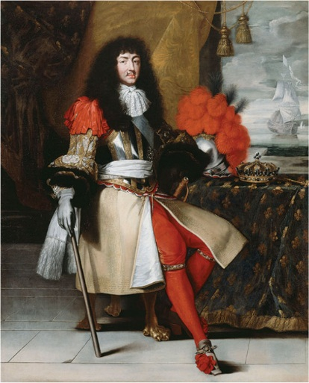
Louis XIV
Reigned from 1638-1715
Absolute government, masterminded by Richelieu and Mazarin
  Intendants
The Fronde (1648)
  rebellion of nobility
Convinced Louis that he needed to rule as well as reign
Courtiers

Slide 4
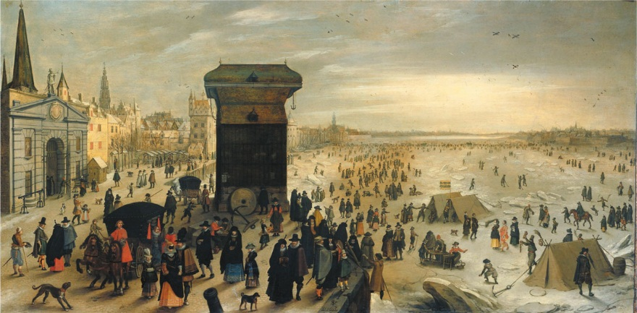
The Little Ice Age
16th-early 18th century
Frigid winters, floods, drought led to harvest failures
Cities were especially vulnerable to disease, food shortages
Economies shrank
Cause?
Notes:
Ice City. The citizens of Antwerp, Netherlands enjoy winter pastimes on one of the city’s many frozen waterways during the winter of 1622-1623.

Slide 5
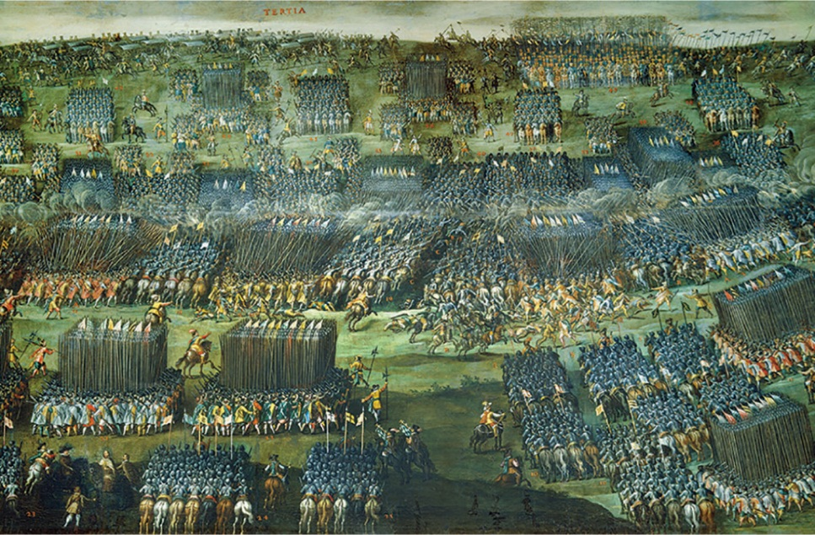
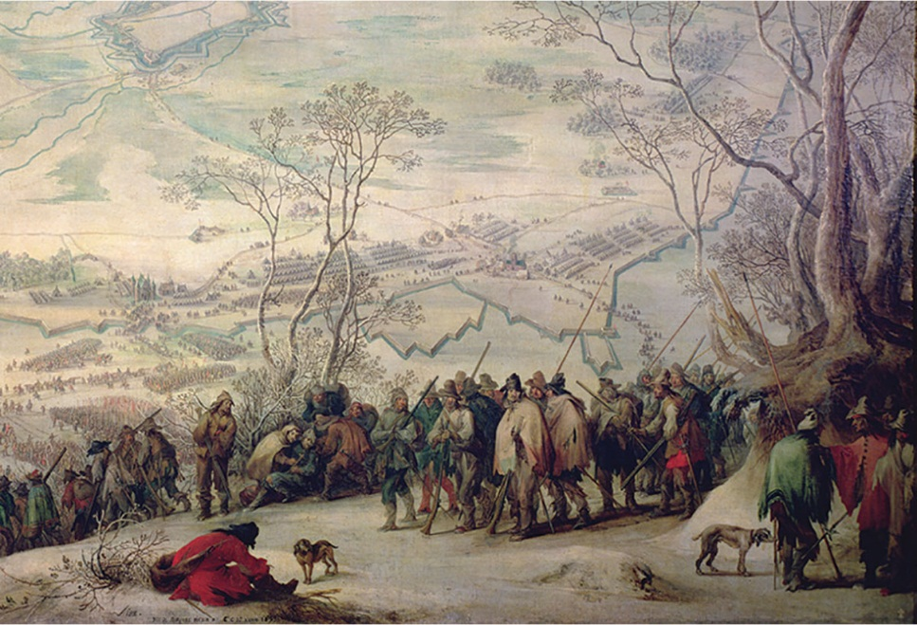
Wars of the Seventeenth Century
Thirty Years’ War coincided with the Little Ice Age
Devastated Germany
Treaty of Westphalia
Balance of power
Notes:
A World at Arms. These two paintings by the Flemish painter Pieter Snayers capture the immensity and terrible suffering of the constant fighting that ravaged Europe for most of the seventeenth century. Top: The Battle of White Mountain, a pivotal battle in the early phase of the Thirty Years’ War, in which 50,000 soldiers fought. Bottom: The siege of Aires-sur-la-Lys, in northern France, 1641. Starving Spanish soldiers freeze in the snow. Visible behind them are the fortifications of the town.

Slide 6
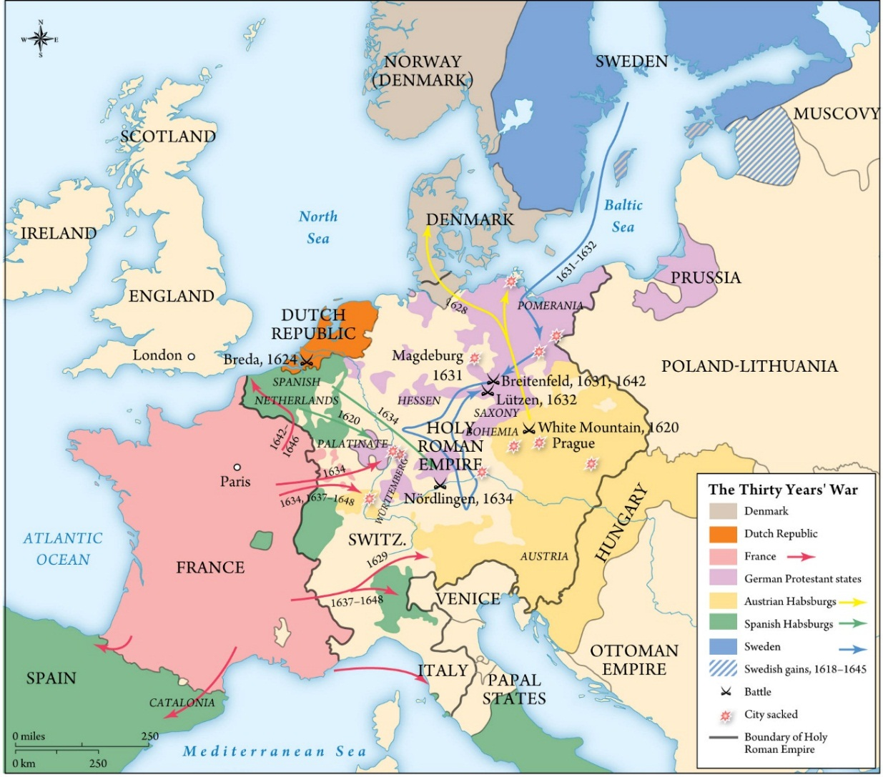
The Thirty Years’ War
Notes:
Map 3.1: The Thirty Year’s War

Slide 7
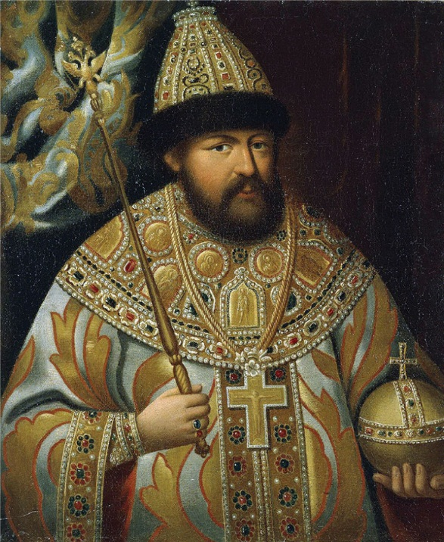
Russia in the Seventeenth Century
Time of Troubles ended by Michael Romanov
Raised taxes to build fortifications
Protests for representation
Dominated by the nobility
Serfdom
Russia became a great power
Notes:
Tsar Alexei of Russia. The long reign of Alexei (1645-1676) was filled with crises, and the tsar relied on advisers who often failed him. In this painting, Alexei wears the royal regalia that symbolize his sovereignty and legitimate his rule.

Slide 8
The Decline of the Polish-Lithuanian Commonwealth
Government, land ownership dominated by a handful of powerful nobles
Cossacks
Pogroms against Jews
Peasant rebellions
Invaded by both Russia and Sweden
Warfare paid for by ordinary citizens of all three countries

Slide 9
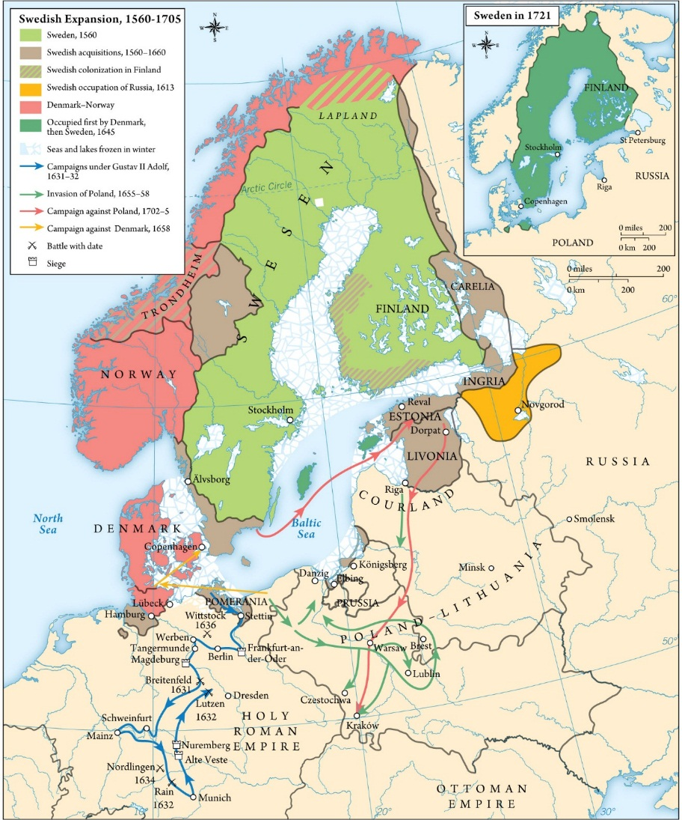
Rise and Fall of the Swedish Empire
Fought Russia, Poland-Lithuania and Denmark
Lutheranism
Swedish kings controlled the Riksdag and a salaried bureaucracy
Quasi-absolutist
Notes:
Map 3.2: Sweden, 1560-1721

Slide 10
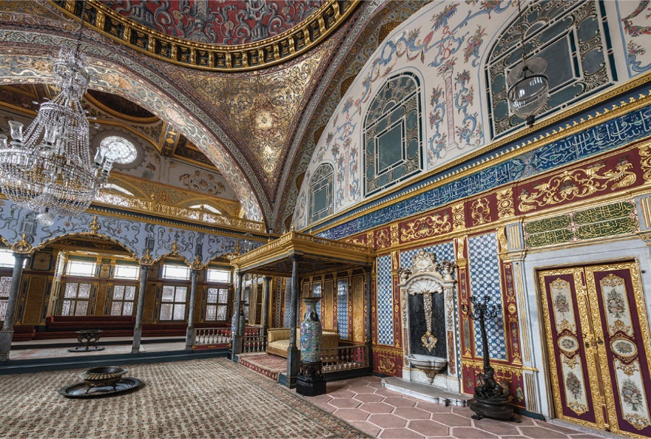
The Ottoman Empire Confronts the Little Ice Age
Famine resulting from the Little Ice Age
Political turmoil
Series of weak sultans
Wars with Hungary and Venice
Rivalry with the Habsburgs
Notes:
Imperial Hall, Topkapi Palace. Shortly after they conquered Constantinople, the Ottomans began the construction of a new palace for their sultans: Topkapi Saray. The Topkapi is a veritable mini-city, with schools, barracks, a hospital, an armory, and most important, the living quarters, or harem, for the ruling family. Located at the very center of the palace complex, were the private apartments of the sultan, which included the Imperial Hall where the sultan would receive members of his family and closest advisors.

Slide 11
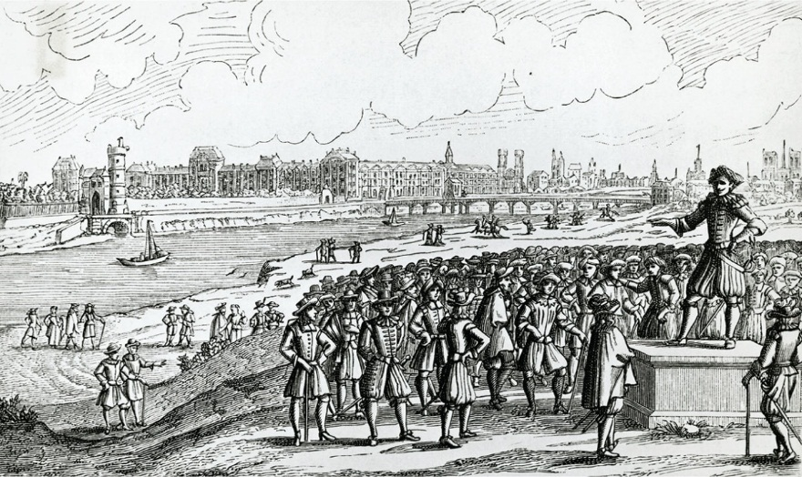
France and the Crisis of the Seventeenth Century
Wars with Huguenots, famine
The Croquants
  Rural rebellion
The Fronde
Cardinal Mazarin
Parlement
Notes:
The Fronde. A Fronde leader urges Parisians to revolt against Cardinal Mazarin. The Seine, visible in the background, flooded its banks numerous times in the seventeenth century.

Slide 12
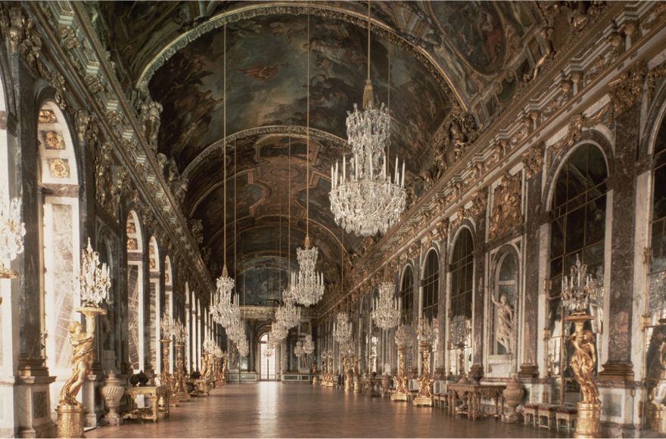
Absolutism and Its Limits
Divine right of kings
  Jacques-Benigne Bossuet
In reality, he was limited by finances
Louis sold offices, borrowed money to finance wars and the royal court
Notes:
The Chateau of Versailles – Hall of Mirrors. In this ornate palace, completed in 1682, King Louis XIV presided over some five thousand of his country’s leading nobles and shaped an ambitious, adventurous foreign policy.

Slide 13
The Wars of Louis XIV
Louis XIV started wars in attempts to expand his territory
Claimed the Spanish Netherlands
Revoked the Edict of Nantes
Nine Years’ War
War of the Spanish Succession
Louis lost land and resources
Prevented him from consolidating domestic power

Slide 14
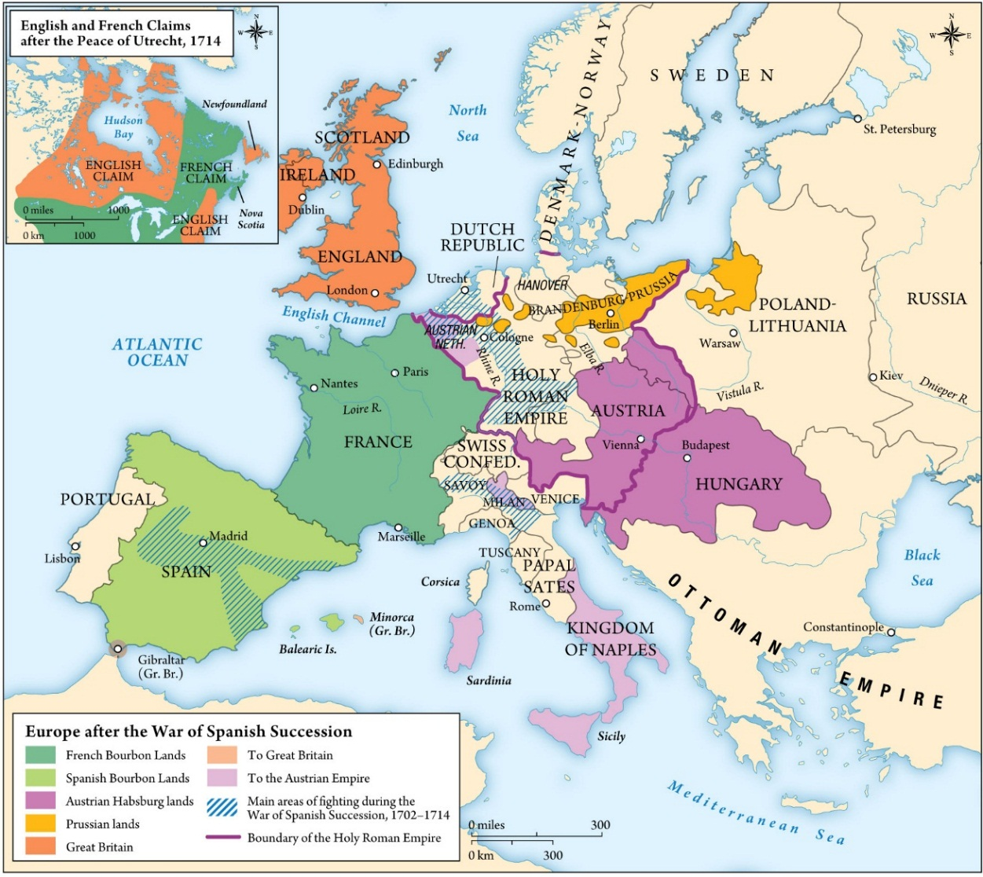
Europe after the War of the Spanish Succession
Notes:
Map 3.3: Europe after the War Of Spanish Succession

Slide 15
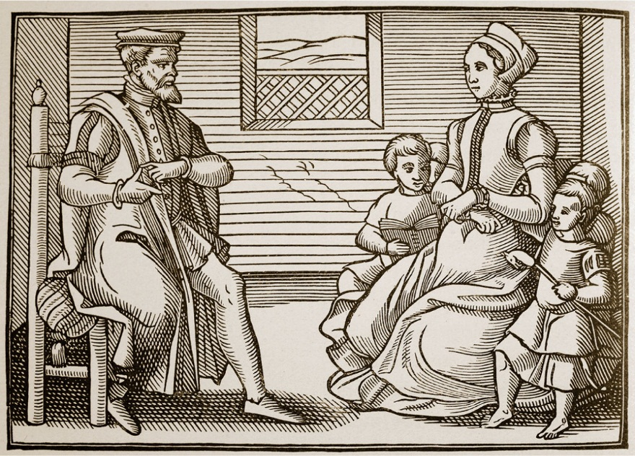
English Protestantism Divides in Two
Stuart kings favored divine right monarchy
Fought parliament’s financial oversight
Civil War broke out under Charles I
Anglicans
Puritans
Royalist vs Parliamentary
Notes:
Puritans. These Protestant purists disliked elaborate religious ritual and thought England’s sumptuous Anglican cathedrals smacked of Catholicism. Puritans considered William Laud, King Charles I’s Archbishop of Canterbury, a papist.

Slide 16
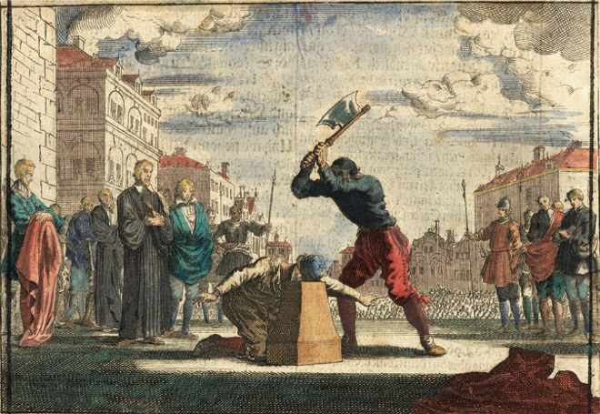
The English Revolution
Oliver Cromwell led parliamentary forces
New Model Army
Levellers
King Charles I beheaded in 1649
Cromwell seized dictatorial powers
Notes:
The Execution of Charles I. In January 1649, England’s revolutionary “Rump Parliament” indicted Charles for treason, and a newly created High Court sentenced him to death. The execution shocked a great many English people and polarized a deeply divided country all the more.

Slide 17
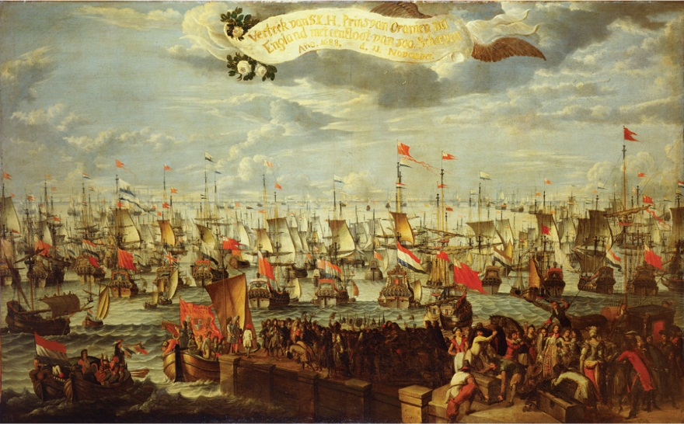
The Restoration
After Cromwell’s death the monarchy was restored under Charles II
Anti-Catholic feeling led to the downfall of James II
Replaced with William and Mary in the Glorious Revolution of 1689
Bill of Rights
Beginning of constitutional monarchy in England
Notes:
Glorious Revolution. This dramatic event deposed England’s quasi-Catholic King James II and imported a Dutch Protestant nobleman to take his place. The revolution forbade Catholics to occupy the English throne and increased the powers of Parliament at the monarchy’s expense.

Slide 18
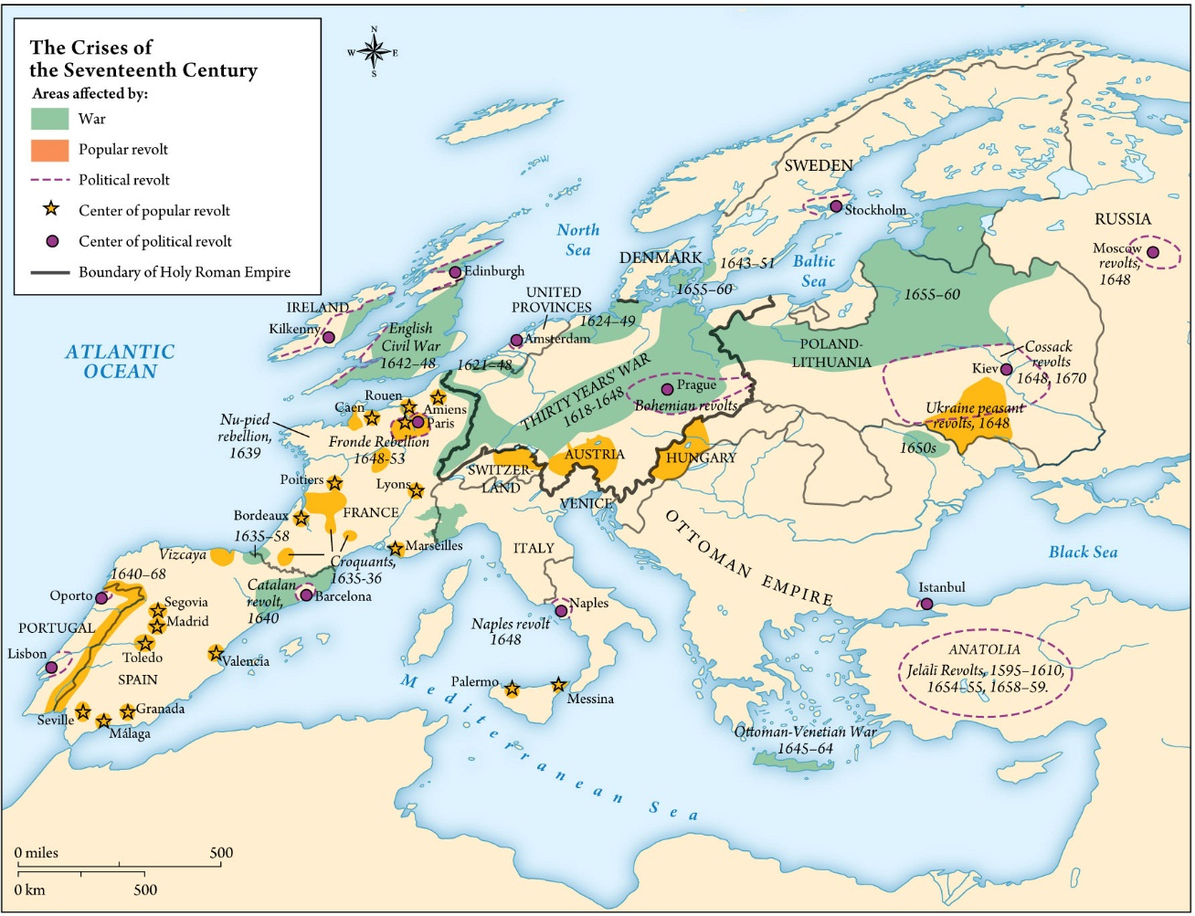
Crises of the Seventeenth Century
Notes:
Map 3.4/Table 3.1: The Crises of the Seventeenth Century

