Slide 1
Chapter 1
Conceptualizing Mental Health and Illness

Slide 2
Outline
Learning Objectives
Introduction
What is meant by mental health and mental illness?
  Defining mental health and mental illness
  Models of mental health and mental illness
  Determining mental health and mental illness
Why mental health matters

Slide 3
Learning Objectives
In this chapter you will be introduced to foundational concepts of mental health and illness, including:
How we define mental health and illness
Models of mental health and illness, including their underlying theories and treatment methods
Tools used by healthcare providers to make determinations about mental health

Slide 4
Introduction
There are many ways that professionals might interpret and respond to mental health symptoms
One interpretation is that a person has a disease with a biological cause
Another possibility is that a person has a disorder – a dysfunction that is mental in nature, whatever the cause
It may be possible that the symptoms and behaviours are within the spectrum of normal human responses to stressors

Slide 5
Introduction, cont’d.
Mental health and illness are complex issues
There are contradictory ideas, evidence and opinions about their causes, definitions, and the best ways to preserve health and treat illness
It is useful to consider these topics from multiple perspectives and to take a critical approach to evaluating our assumptions, definitions, and responses to mental health and illness

Slide 6
Introduction, cont’d.
In this chapter we will explore:
How we define mental health and illness
Diagnostic tools and instruments
Models and theories that contribute to our understanding of mental health and illness, and the solutions they each suggest
Different professions involved in the mental health field

Slide 7
What is meant by Mental Health and Illness?
The definitions of “Mental Health” and “Mental Illness” are not straightforward!
One possible definition: Mental health is the freedom from suffering, abnormal behaviour, and distress
Another possibility: Mental health is the absence of mental illness
Neither of these are very definitive! It might be useful to explore the concepts of distress, abnormality, and dysfunction…

Slide 8
What is meant by Mental Health and Illness?, cont’d.
Distress
“Mental”: Refers to feelings, awareness, cognition, behaviour
“Health” is associated with feeling good, while “Illness” is associated with feeling bad
However, bad feelings are a normal part of human experience – does having these make a person ill?
Would it be healthy to NEVER feel sad, anxious or fearful?

Slide 9
What is meant by Mental Health and Illness?, cont’d.
Abnormality
Another way to think of mental health and illness is to consider the constructs of NORMAL and ABNORMAL
We usually assume that abnormal = unhealthy
However, many disorders of mental health are very common…

Slide 10
What is meant by Mental Health and Illness?, cont’d.
Dysfunction
If a person’s mental status makes it difficult for them to meet their daily needs and fulfill typical responsibilities, this could be considered dysfunctional
Individual capacity is influenced by a person’s resources and environment

Slide 11
What is meant by Mental Health and Illness?, cont’d.
It may not be possible to arrive at a universal definition of mental health or mental illness

Slide 12
Defining Mental Health and Illness
World Health Organization (WHO) definition:
“a state of well-being in which the individual realizes his or her own abilities, can cope with the normal stresses of life, can work productively and fruitfully, and is able to make a contribution to his or her community” (WHO, 2013)
This definition points to the interaction of people with their community.

Slide 13
Defining Mental Health and Illness, cont’d.
The DSM, (Diagnostic and Statistical Manual of Mental Disorders), has a longer definition which refers to disturbances in cognition, emotion, or behaviour which can be attributed to mental functioning and which usually are associated with distress or disability (APA, 2013).
This definition touches on distress, abnormality, and disability and also relies on the professional judgement of a clinician for diagnosis.

Slide 14
Models of Mental Health and Illness
Biomedical, Psychological-Behavioural, and Social Models of mental health and illness all provide frameworks for understanding and explaining mental health problems
Most practitioners rely on more than one model in their practice
It is important to understand these because much of the theory regarding mental health and illness draws from these models

Slide 15
Models of Mental Health and Illness, cont’d.
Biomedical Model
Assumes that there is a binary – a person is either mentally ill OR mentally healthy.
Sees good mental health as the natural human state
Uses a model of disease to suggest that mental illnesses have specific causes, such as a dysfunction of the brain

Slide 16
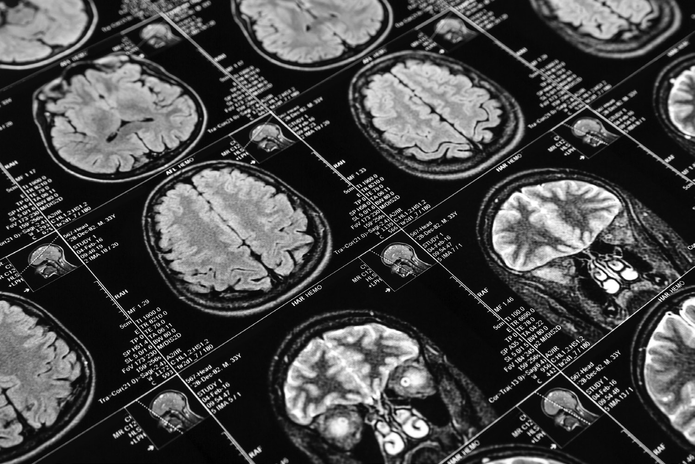
Models of Mental Health and Illness, cont’d.

Slide 17
Models of Mental Health and Illness, cont’d.
Biomedical Model, con’t.
In this model, brain-based interventions are considered the best way to treat mental illness. These include:
  Psychopharmaceuticals
  Electroconvulsive therapy (ECT)
  Genetic interventions (perhaps, in the future)

Slide 18
Models of Mental Health and Illness, cont’d.
Psychological-Behavioural Model
Considers mental disorders to be patterns of thinking, feeling, and behaving that are harmful to individuals
Does not assume a binary between mental health and mental illness
Assumes that symptoms exist along a continuum

Slide 19
Models of Mental Health and Illness, cont’d.
Psychological-Behavioural Model, cont’d.
There are several schools of thought/practice within this model
  Freudian Psychoanalysis
  Psychodynamic approaches
  Behaviourism
  Humanism
  Many others!
All of these support the idea that mental illness arises as a result of our personal experiences and perspectives.

Slide 20
Models of Mental Health and Illness, cont’d.
Psychological-Behavioural Model, con’t.
Treatment within this model relies on psychotherapy – talking and thinking in a collaborative relationship with a practitioner
There are many types of psychotherapy:
  Cognitive Behavioural Therapy
  Psychodynamic Treatment
  Humanistic therapies
  Existential approaches to therapy

Slide 21
Models of Mental Health and Illness, cont’d.
Social Model
Sees mental health as a social product
This means that good or bad mental health are socially constructed - defined by social relations and norms
This model places less emphasis on individual characteristics and qualities, and considers the individual in the context of their social environment

Slide 22
Models of Mental Health and Illness, cont’d.
Social Model, cont’d.
Suggests that power and culture lead to the labelling of some people, often those who are marginalized, as mentally ill
Social interventions are suggested as a response to mental illness – things like supported housing and employment
Demedicalization is also suggested – de-classifying a mental illness and looking at social causes rather than individual causes of mental distress

Slide 23
Models of Mental Health and Illness, cont’d.
Biopsychosocial Model
Suggests that biological factors, social conditions, and individual experiences all contribute to a person’s mental health
Social in this context refers to social determinants of health, such as income, housing, education, etc…
Considers all of these factors in responding to mental illness in an individual

Slide 24
Providers of Mental Health Care
A wide variety of professions are involved in the delivery of care and support to people with mental illness
Psychiatrists
Psychologists
Social Workers
Registered Psychiatric Nurses
Counsellors, therapists, psychotherapists
Life Coaches
Religious Advisors

Slide 25
Determining Mental Health and Illness
Diagnostic and Statistical Manual of Mental Disorders (DSM)
International Classification of Disease (ICD)
  These provide descriptions of the illness, and a checklist of diagnostic criteria
Clinical Scales
Clinical judgement of the practitioner

Slide 26
Determining Mental Health and Illness, cont’d.
Potential causes of bias in diagnosis:
Practitioner bias
Diagnostic criteria which label behaviours associated with certain demographic groups as pathological
Unrecognized class / race bias among those creating diagnostic criteria

Slide 27
Why Mental Health Matters
It influences how we experience the world
It helps us understand and explain our actions and behaviours
It has social meaning – it can be part of our identities

Slide 28
Why Mental Health Matters, cont’d.
Diagnosis is often the gateway to treatment
Diagnosis can also result in stigmatization and mistreatment
In extreme cases, diagnosis can result in involuntary treatment

