Slide 1
Defining the Field
CHAPTER 1

Slide 2
Media in an Ever-Changing Communications Universe
Media are central to the ways in which we come to know and understand the world.
Other media functions:
  Means through which governments communicate with residents and citizens;
  Primary way businesses develop and communicate with customers;
  Key agents in globalization;
  Central vehicle for controlling world economy;
  Work to generate global cultural consciousness.

Slide 3
Media in an Ever-Changing Communications Universe, cont’d
The internet isn’t so much replacing traditional media industries as it is incorporating them and serving as another vehicle for their distribution.
The internet has transformed once-passive consumers of media into producers of content.

Slide 4
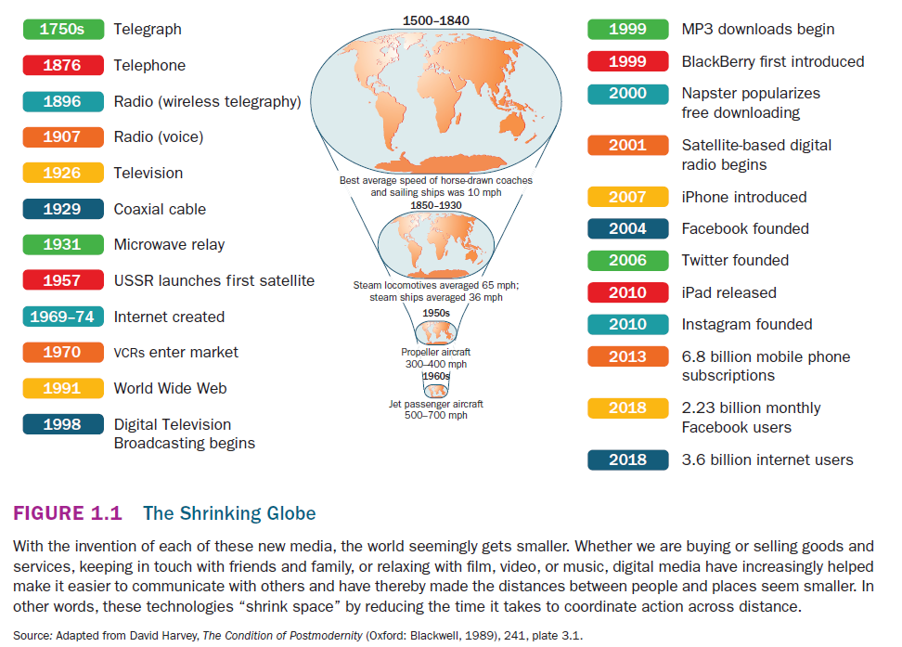

Slide 5
Back to the Future
The telegraph was a key technology in shrinking space through time.
Both the telephone and the radio were seen as inventions that shrank space.
  Like the telegraph, the telephone was seen as a means of closing the distance between businesses and customers.
  The radio was envisioned as creating a common consciousness between people.

Slide 6
Back to the Future, cont’d
Television extended and deepened social ties; became a gateway to a wide range of new information services.
Media development and changes in communication are ongoing processes, and build upon previous technologies.

Slide 7
Media and Technology: A Brave New World?
Promoters of digital media and communications technologies often present a utopian view of media development:
  More choice in information and entertainment;
  Increasingly available and convenient range of consumer products;
  Greater access to education and government services;
  Ushering in truly participatory democracy on a global scale.

Slide 8
Media and Technology: A Brave New World?, cont’d
Opposing views of new media technology:
  Communication systems designed on the basis of profit/market principles serve owners and investors, not citizens;
  Only media products that generate profit for advertisers are available to the public;
  Perspectives that don’t to meet the logic of increasing profits are sidelined or omitted;
  Lack of privacy: our actions and preferences are constantly being monitored and accessed by various agents;
  Not everyone has access to media systems (digital divide)

Slide 9
What Is Communication?
Some Definitions and Models
Communication
  The act of making something common between two or more people.
  A form of social action; implies the involvement of two or more people in a process of creating or sending and receiving or interpreting a message or idea.

Slide 10
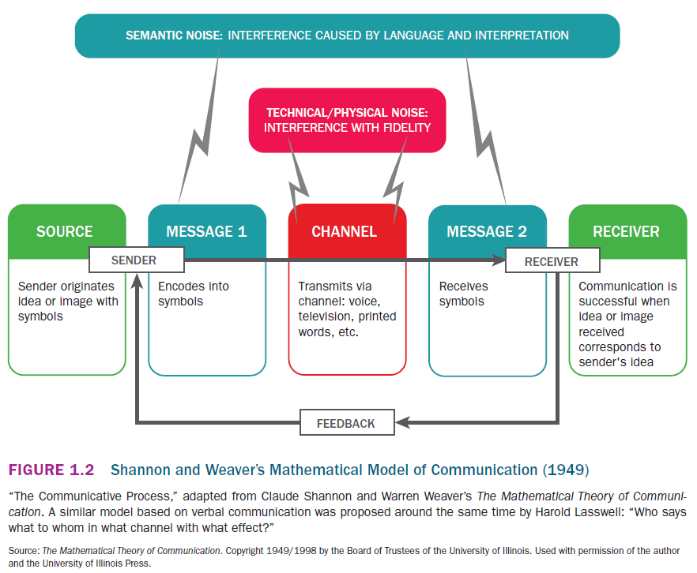

Slide 11
What Is Communication?
Some Definitions and Models, cont’d
The Shannon-Weaver Model of Communication
  Model’s strength is its simplicity: breaks the process of communication into a few very basic elements.
  Criticism: does not consider the larger social context of communication.
    Social variables (language, culture, media forms) influence the way communication takes place, and whether it takes place at all.

Slide 12
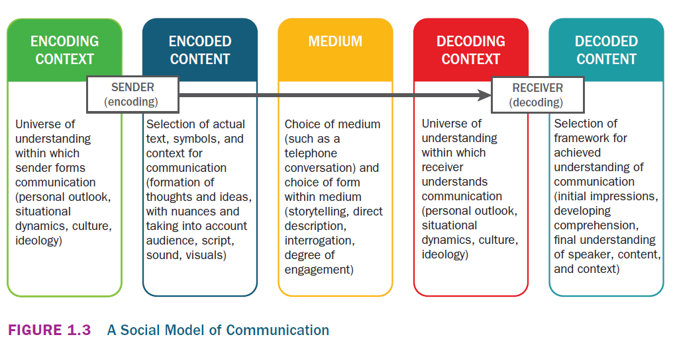

Slide 13
What Is Communication?
Some Definitions and Models, cont’d
The Social Model of Communication
  Emphasizes social and media-related variables that inform the process of communication.
  Communication as both structured by and contingent on some shared social element or space.
  Communication as the action of making a message or idea common to two or more people.

Slide 14
Communication: Mass Audiences and Mass Communication
“Mass communication” has traditionally referred to forms of communications addressing large audiences, but can carry other meanings:
  Sometimes carries with it the idea that audiences for forms of large-scale communication are unsophisticated and vulnerable to manipulation.

Slide 15
Communication: Mass Audiences and Mass Communication, cont’d
Mass Communication
  The transmission and transformation of information on a large scale.
  Three dimensions of mass communication:
    The production and dissemination of mass information and entertainment;
    The decentralized production and wide accessibility of information and entertainment;
    The interactive exchange of information to a number of recipients.

Slide 16
Media, Mass Media, and New Media
Medium
  Any vehicle that conveys information; media is the plural of medium.
Mass media
  Vehicles through which mass communication takes place.
  One form of mass media can involve multiple types of media.
New media (digital media)
  Emerged in the 90s; technologies, practices, and institutions designed to facilitate broad participation in information production and exchange on a mass scale.
  Broadens the reach and capabilities of traditional mass media.

Slide 17
Convergence
Convergence
  The bringing together of a wide range of previously separate and distinct communication technologies and media.
  Technological convergence of voice, video, data, and other communication media is at the heart of new media.
  Corporate convergence has led to the growth of increasingly large media companies with investments in a range of different kinds of media.
    Accompanied by changes in government regulation.

Slide 18
Convergence, cont’d
Convergence is shifting the way we understand and participate in media.
  Audiences can participate in the creation or remixing of media products.
  Program producers work to build audiences through transmedia storytelling.
  Development of a new political culture, as activists can use email and social media platforms to engage with political actors.

Slide 19
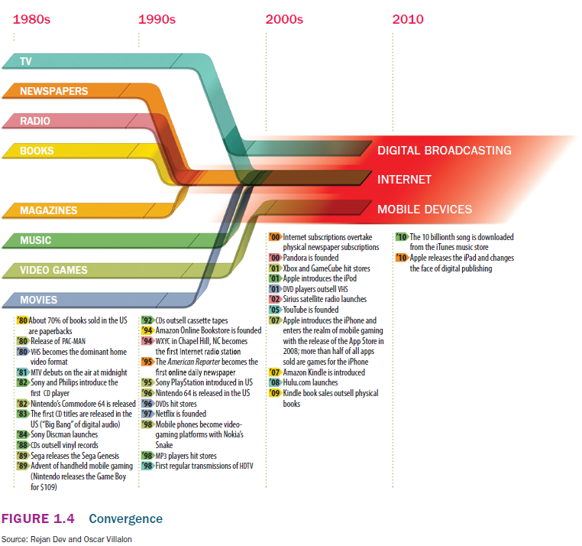

Slide 20
Some Social Roles of Media
A Political Role
  Media are the central vehicle for the production and distribution of information about events taking place at different levels of government.
  Some media provide interactive venues to debate and discuss political ideas and concerns.
  Media owners have a long history of using their products to influence political discussion and action.

Slide 21
Some Social Roles of Media, cont’d
  Governments strive to control media coverage and thereby public opinion.
  However, government communication is generally constrained by a concern with freedom of information, and people’s right to privacy.
  Websites like WikiLeaks provide a controversial vehicle for government or industry insiders to release secret information to the press and the public.

Slide 22
Some Social Roles of Media, cont’d
An Economic Role
  Media are key elements of our consumer culture, a growing information economy, and (according to some) an information society.
  Main vehicles through which our consumer lifestyle is symbolically negotiated.
  Media and communication industries make up one of the fastest-growing sectors of the economy.

Slide 23
Some Social Roles of Media, cont’d
  Recent rapid growth in information and communication technologies (ICTs).
  Information society
    Where the production, distribution, and consumption of information are the main drivers of the economy.
  Media and ICTs sometimes referred to as “shock troops” of global capitalism
    They spread, advertise, and promote the benefits of capitalist society in newly industrialized countries
    Promise of steady jobs and income, an endless supply and wide array of products, and the opportunity to live a rich and comfortable life.

Slide 24
Some Social Roles of Media, cont’d
An Individual Role: Media and Identity
  Through media, we enlarge our understanding of our place in the world.
    Play a large role in helping develop our social, cultural, political, and economic identities.
  Media generally encourage a consumerist view of the world, and reflect consumer culture back to us in many ways.
  Advertising in media encourages us to literally purchase who we are, or who we want to be.

