Slide 1

Global Environmental Politics
by Jean-Frédéric Morin, Amandine Orsini and Sikina Jinnah

Slide 2
Part 01
Defining global environmental issues
Chapter 01
Interconnections between science and politics

Slide 3
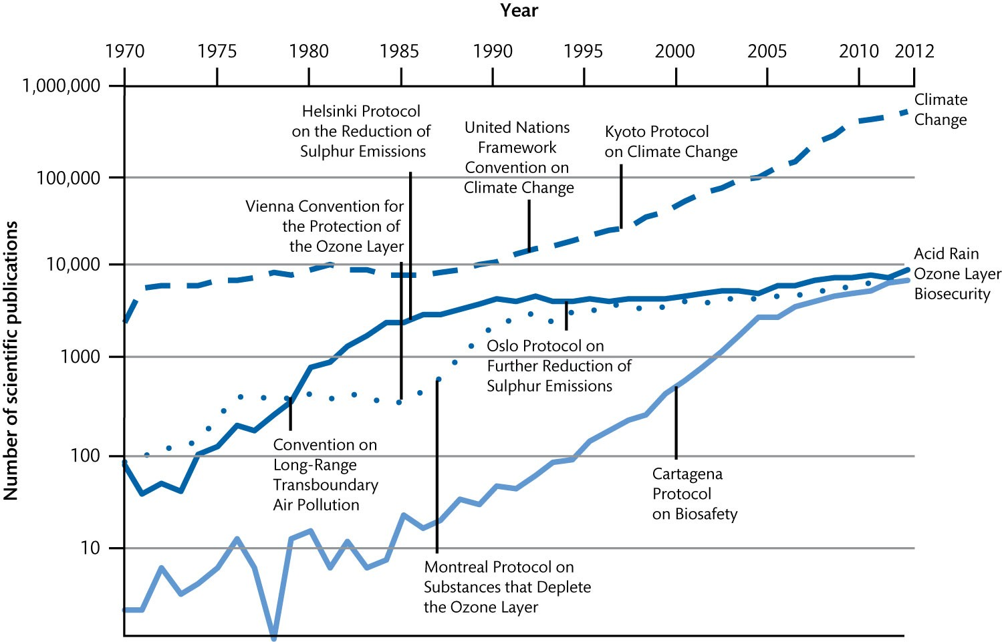
Figure 1.1 Annual number of scientific publications (1970–2012)

Slide 4
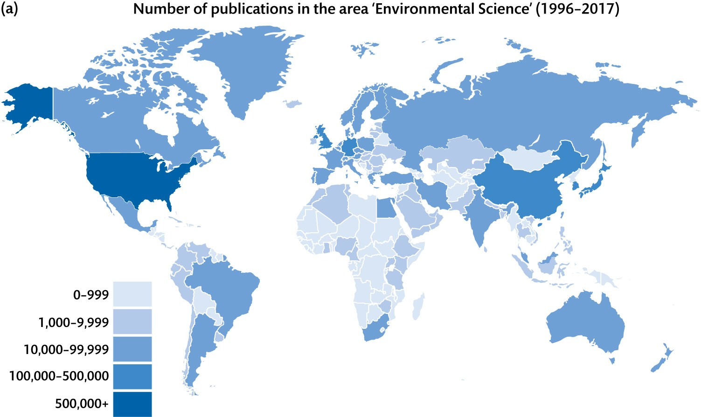
Figure 1.2 The inequalities in scientific production (Continued)

Slide 5
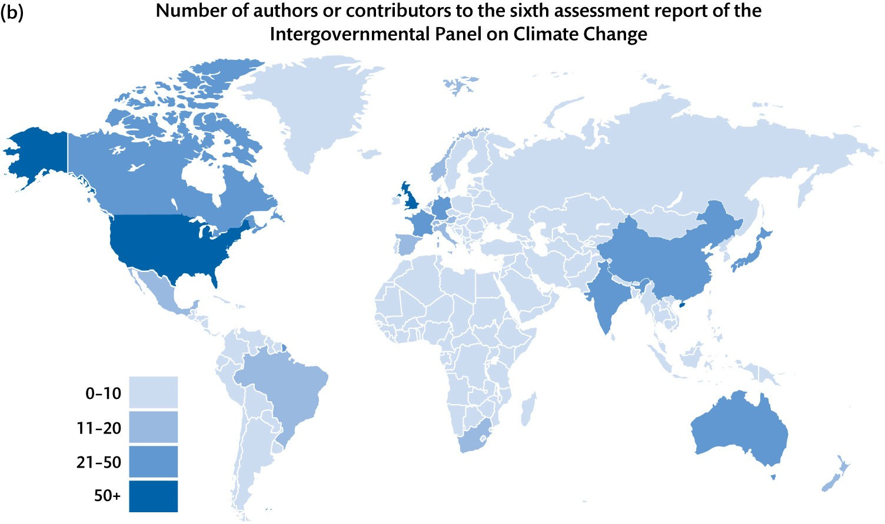
Figure 1.2 The inequalities in scientific production (Continued)

Slide 6
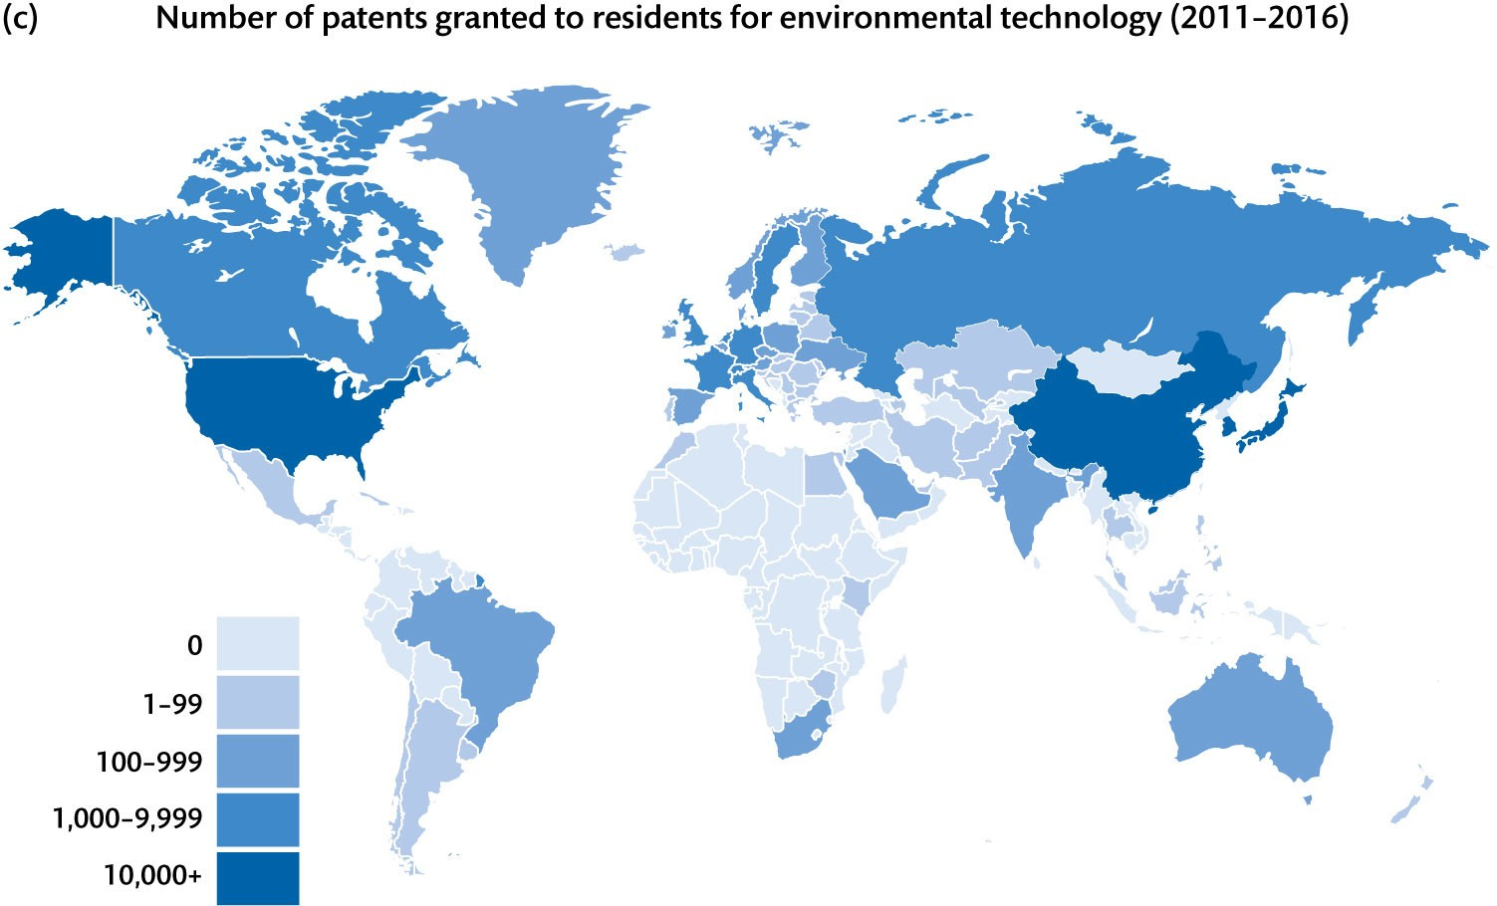
Figure 1.2 The inequalities in scientific production

