Slide 1
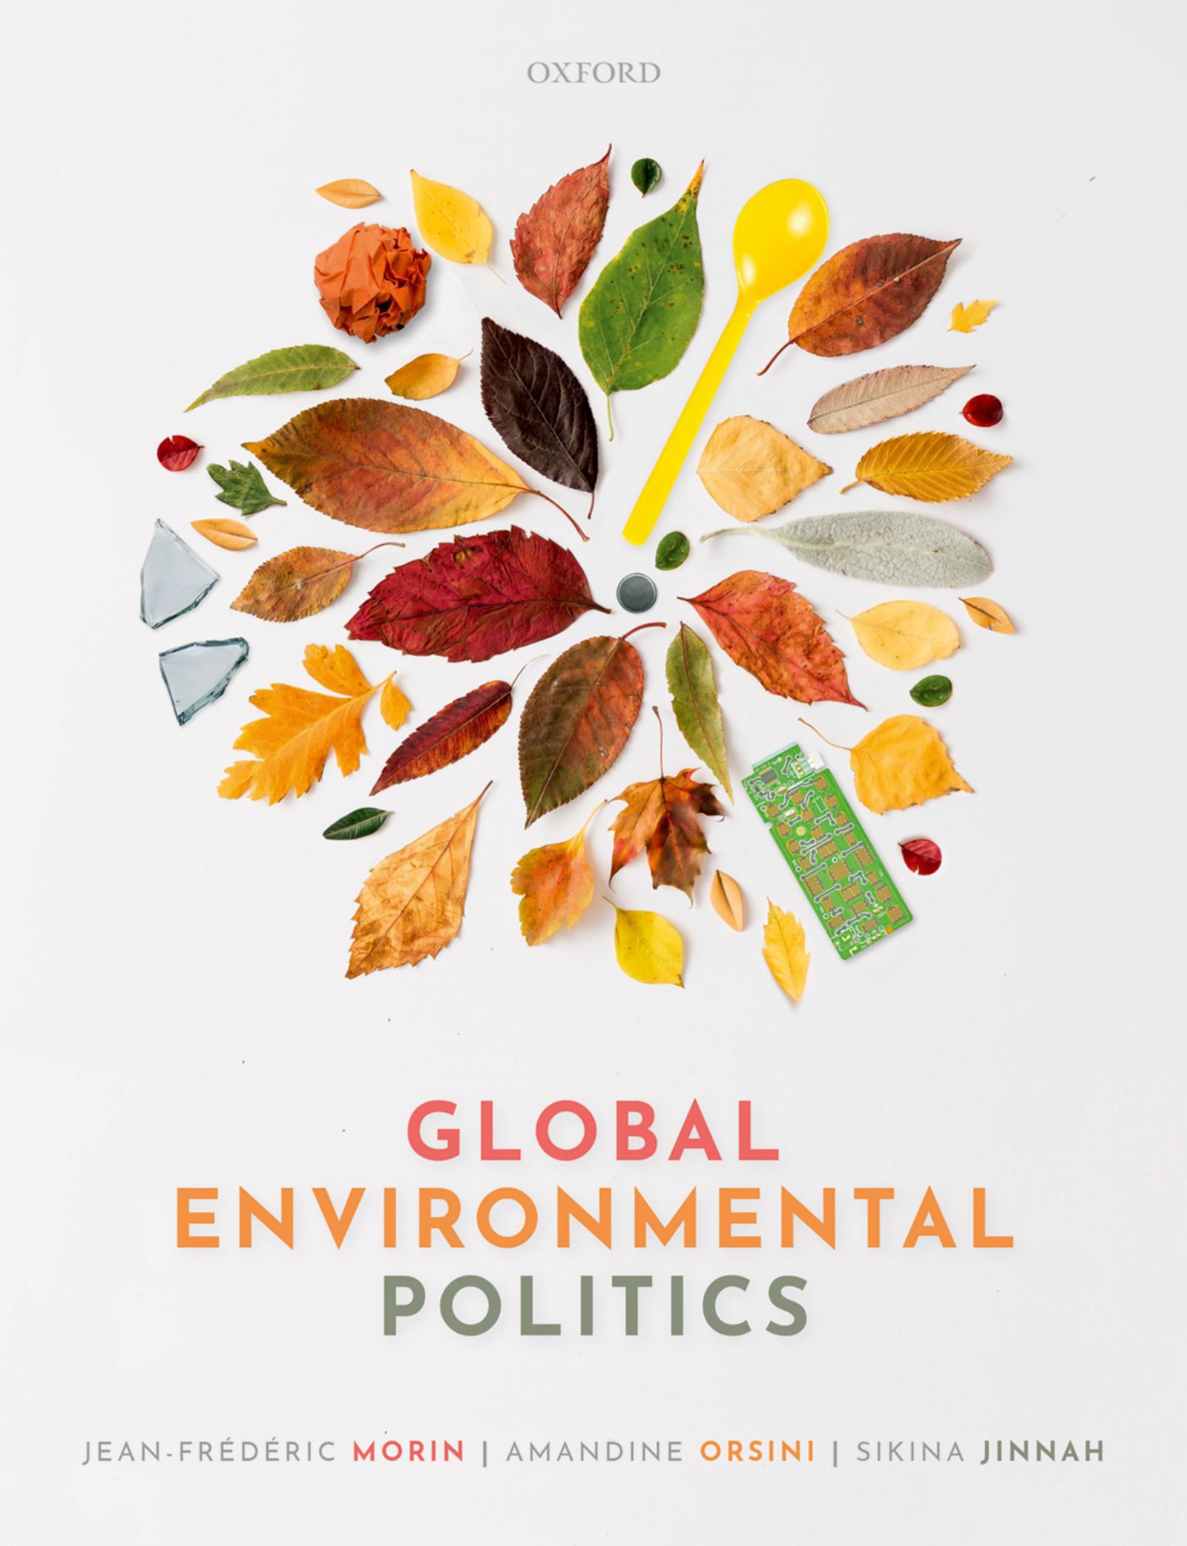
Global Environmental Politics
by Jean-Frédéric Morin, Amandine Orsini and Sikina Jinnah

Slide 2
Part 02
Actors and interests
Chapter 04
Non-state actors

Slide 3
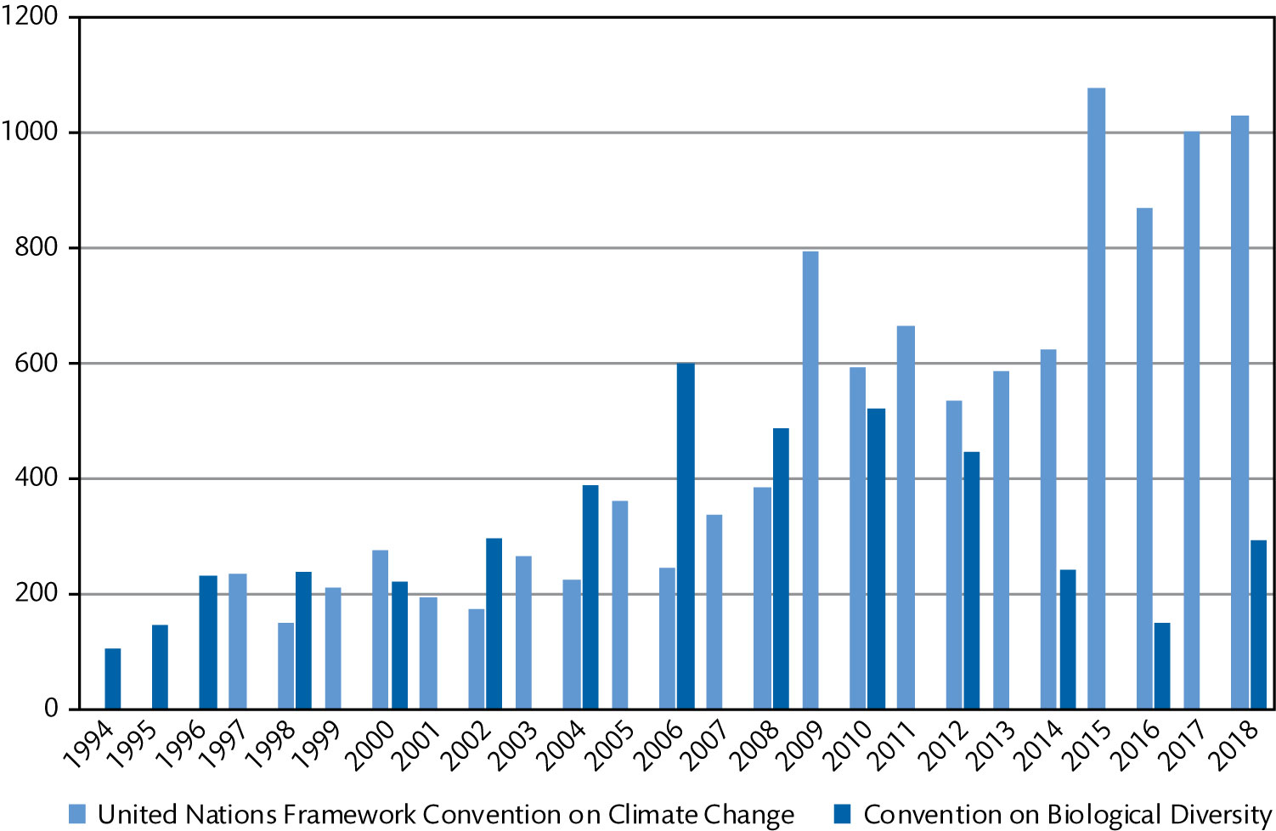
Figure 4.1 Number of non-state actors registered as observers—international negotiations on climate, and biodiversity (1994–2018)

Slide 4
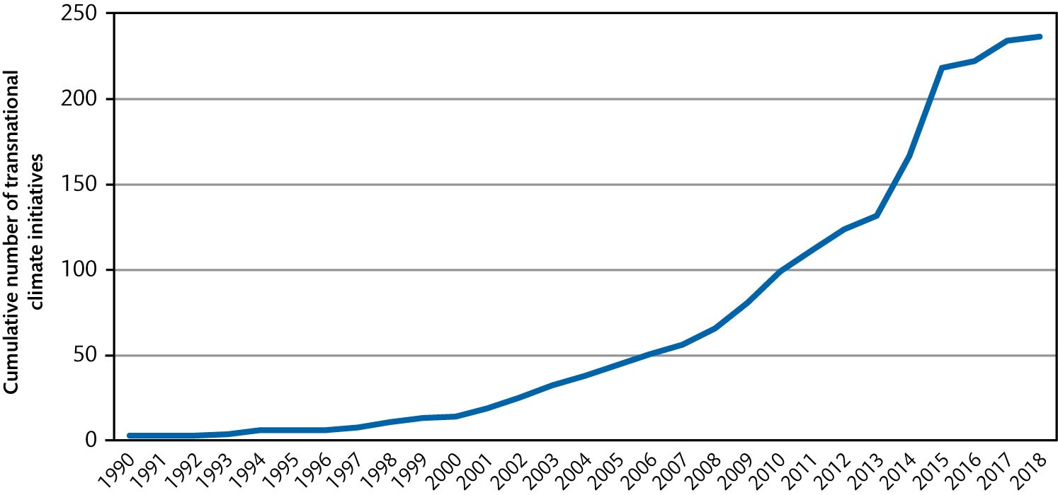
Figure 4.2 Cumulative number of transnational climate initiatives (1990–2018)

Slide 5
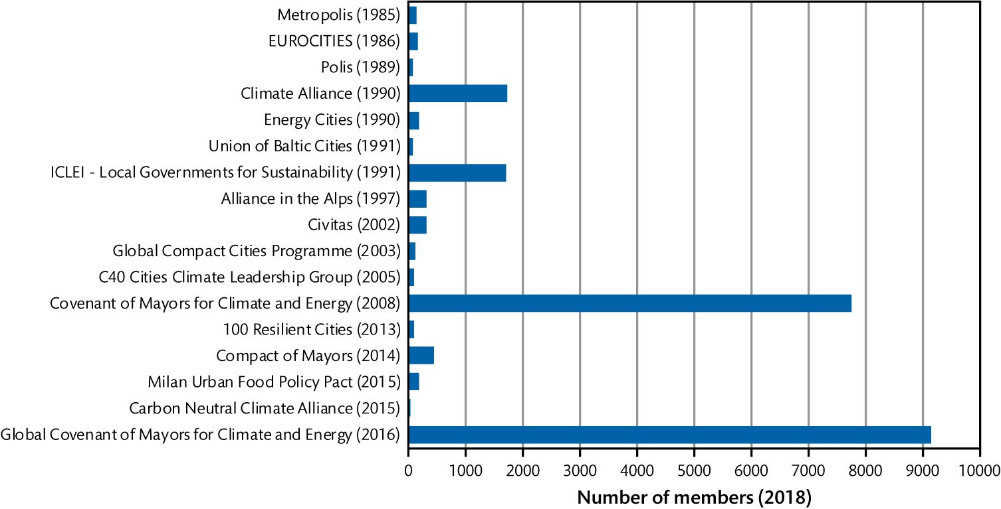
Figure 4.3 Selected transnational city networks involved in global environmental governance

Slide 6
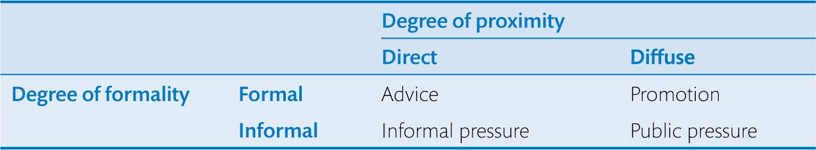
Table 4.1 Typology of modes of interaction between non-state actors and decision makers

