Slide 1

Land Law
by Chris Bevan

Slide 2
Chapter 12
Leasehold Covenants

Slide 3
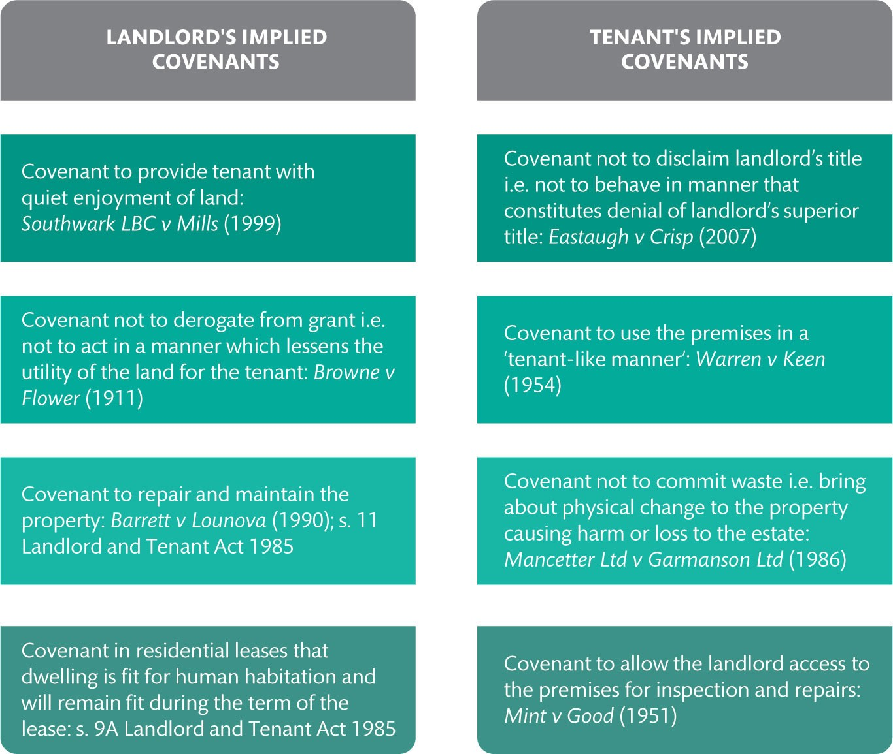
Figure 12.1 Examples of commonly implied leasehold covenants

Slide 4
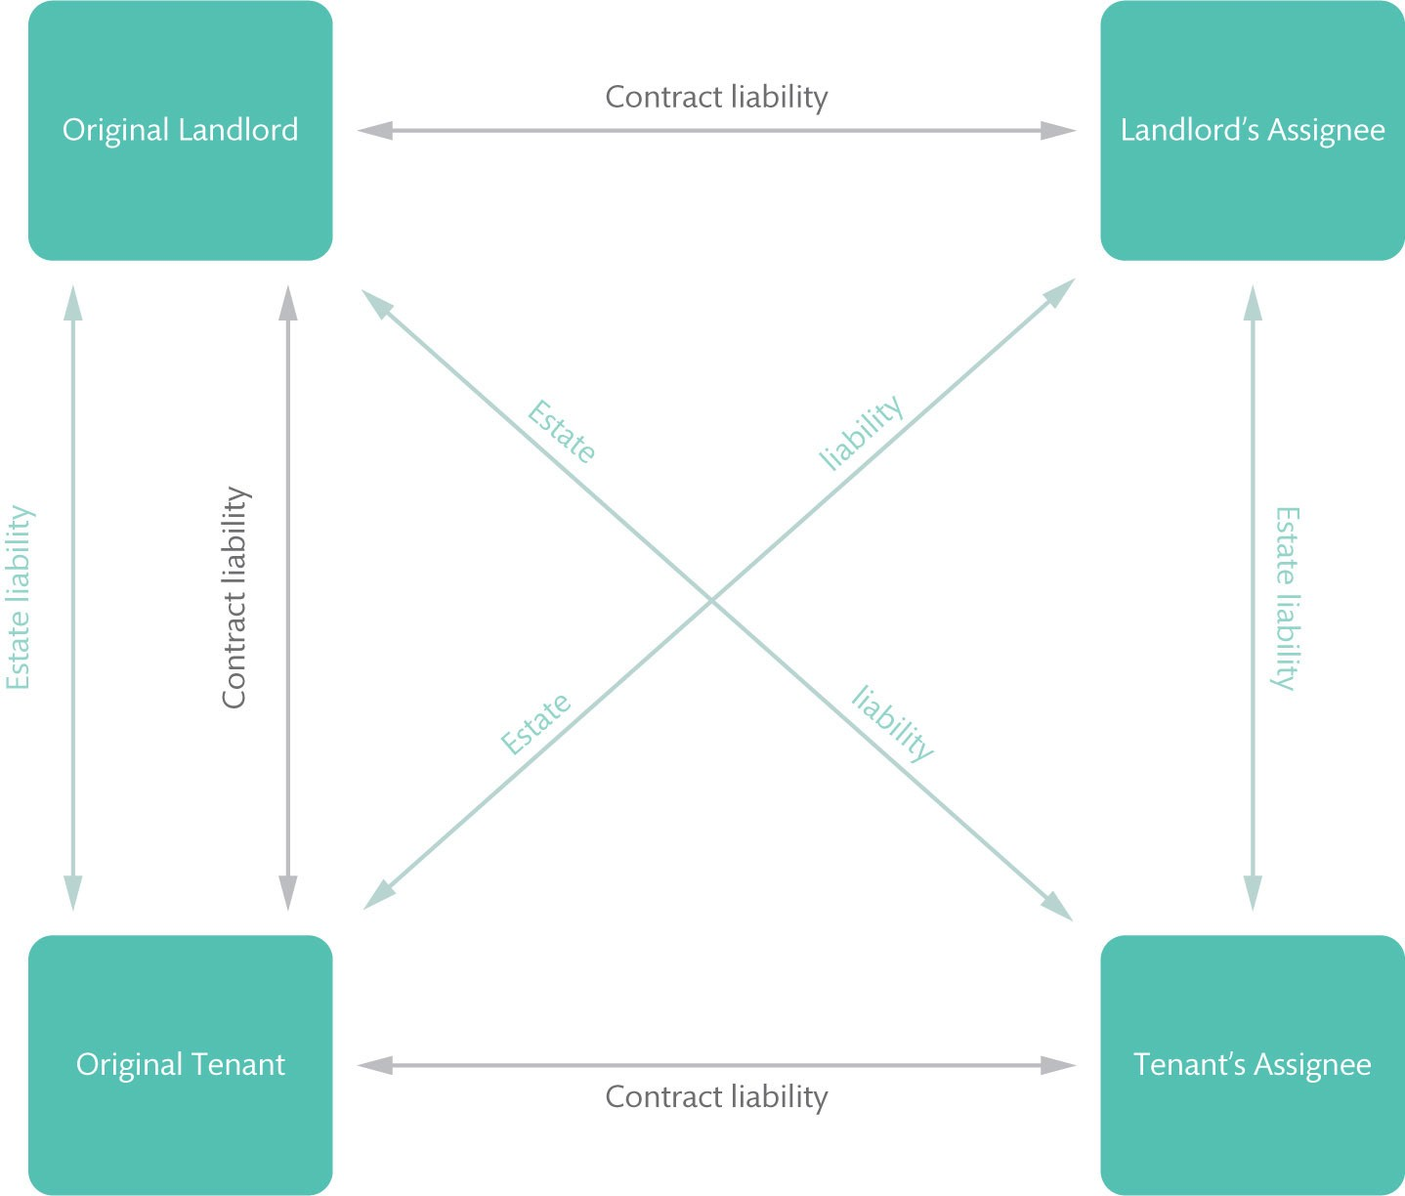
Figure 12.2 Privity of contract and privity of estate in leasehold dealings

Slide 5
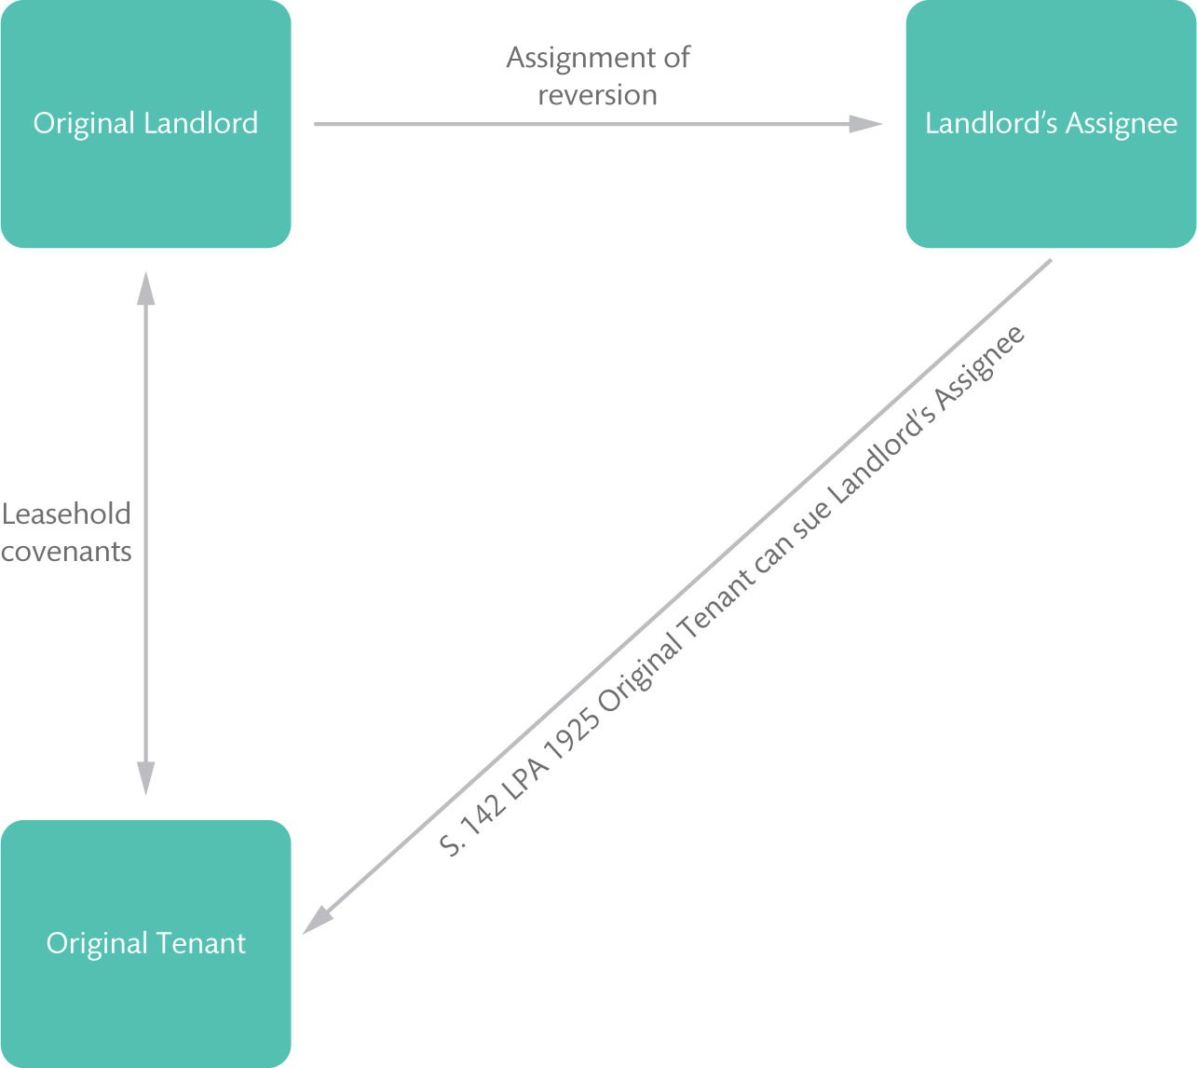
Figure 12.3 The operation of s. 141 of the LPA 1925 upon assignment of the landlord’s reversion

Slide 6
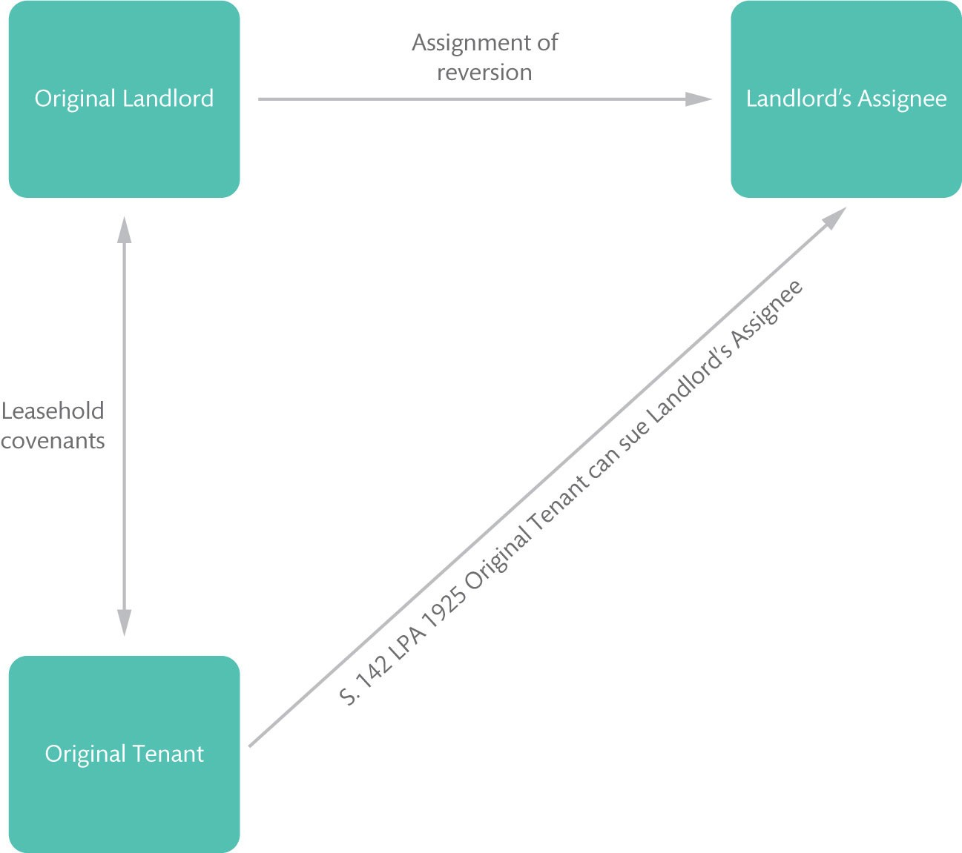
Figure 12.4 The operation of s. 142 LPA 1925 upon assignment of the landlord’s reversion

Slide 7
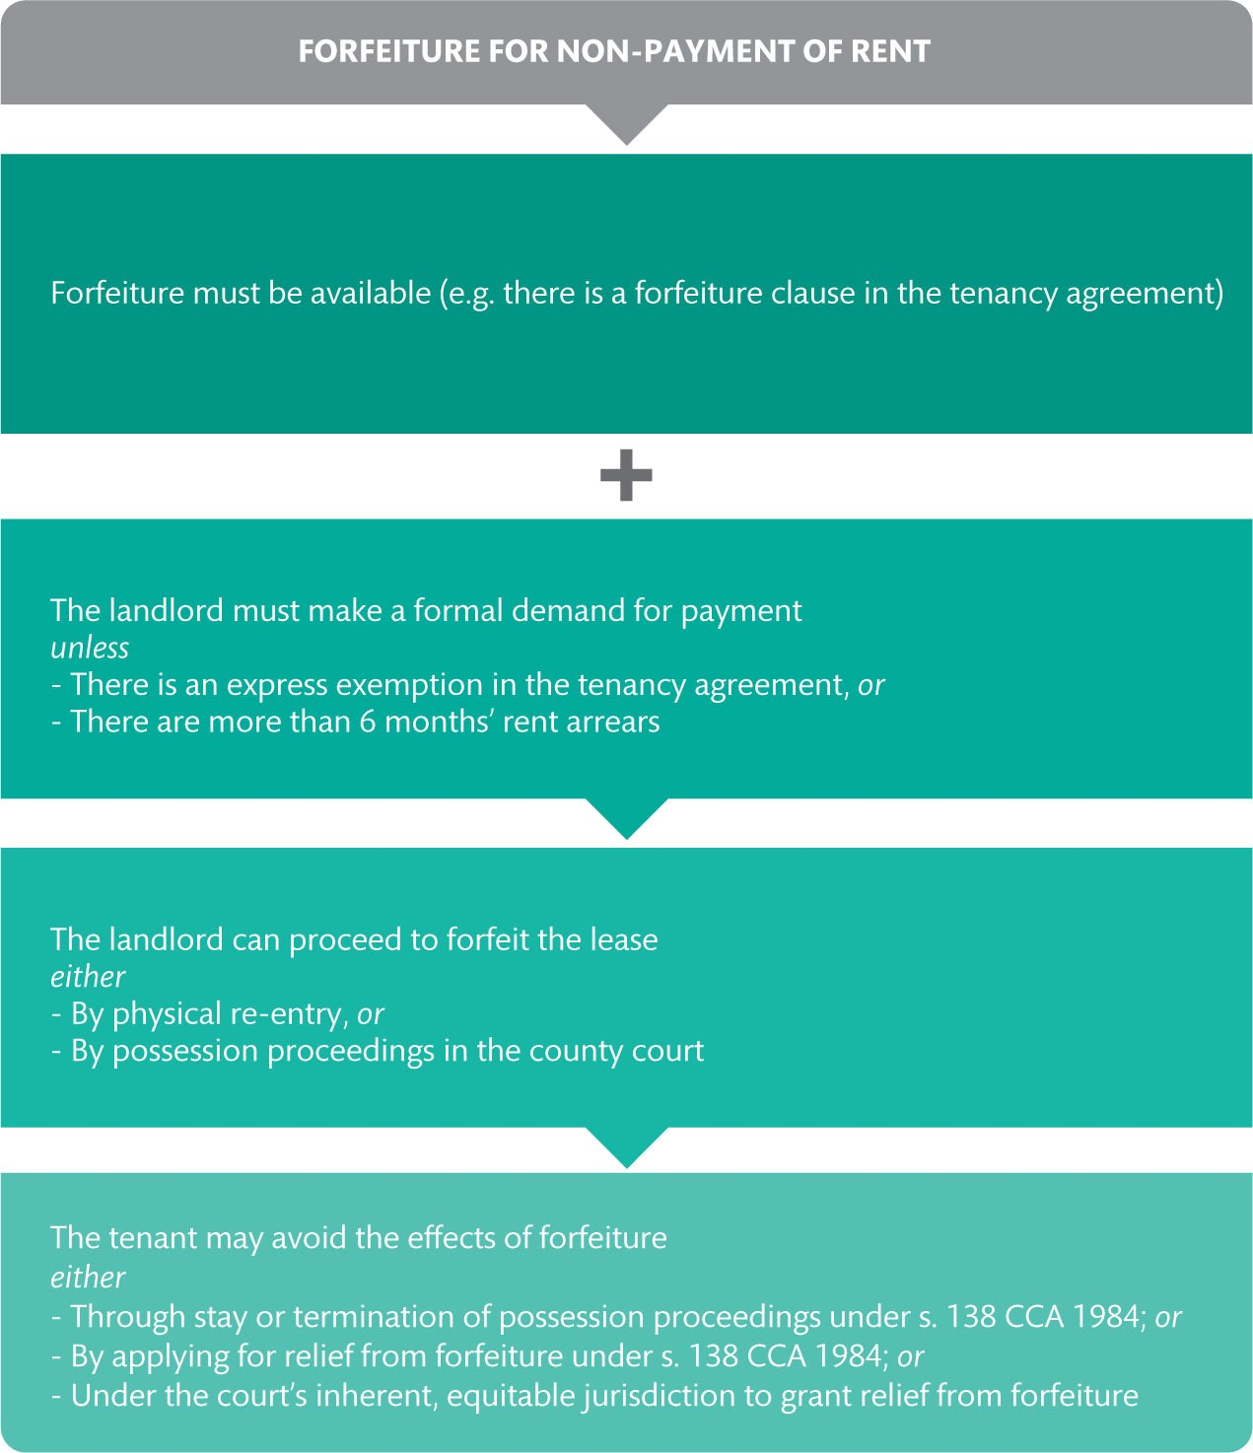
Figure 12.5 Forfeiture for breach of covenant as to non-payment of rent

Slide 8
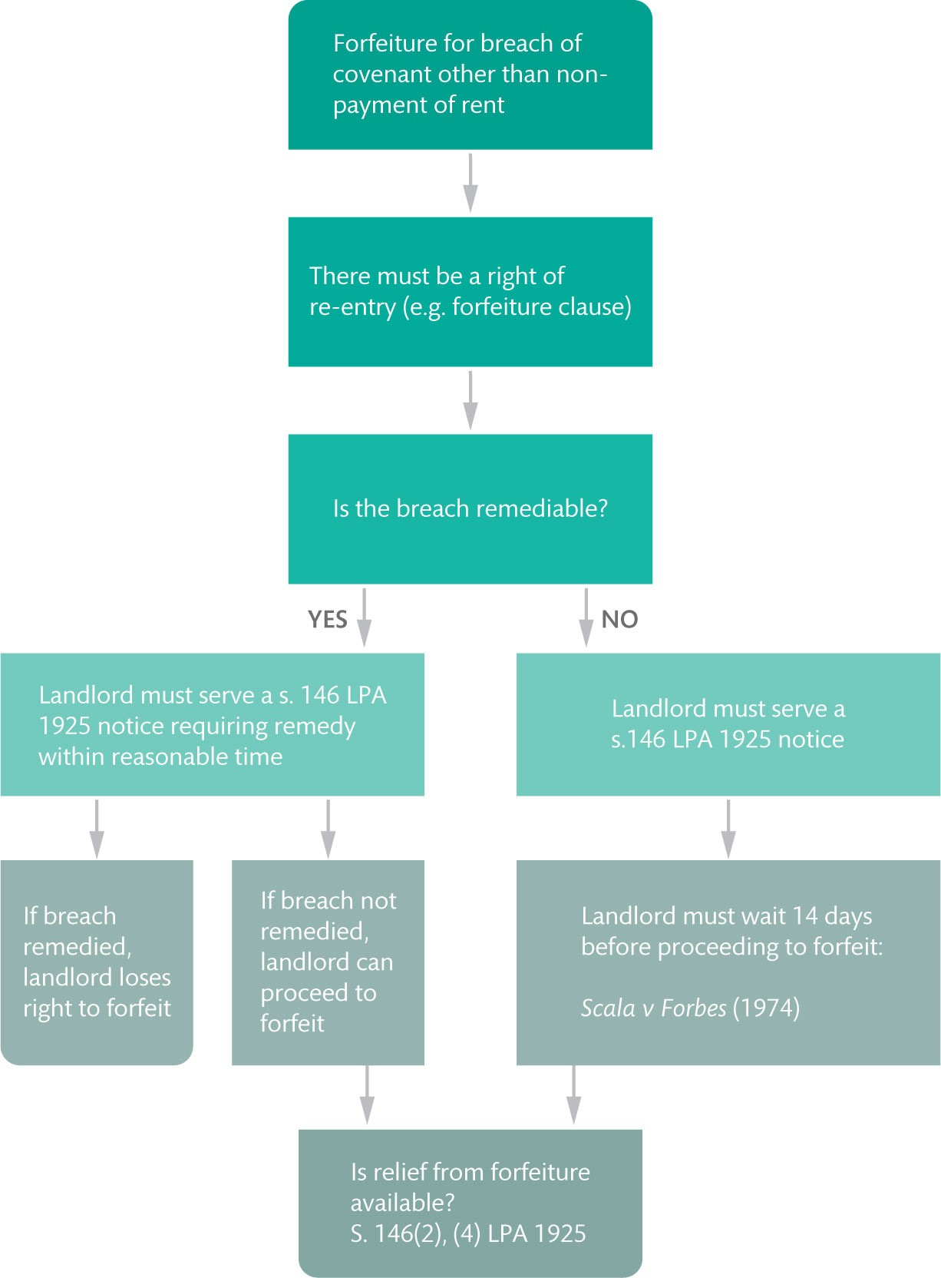
Figure 12.6 Forfeiture for breach of covenant other than for non-payment of rent

Slide 9
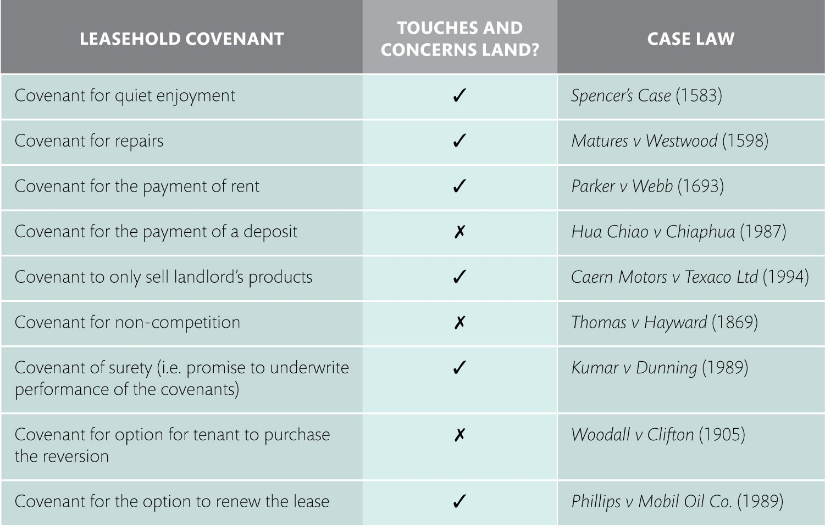
Table 12.1 Covenants that do and do not ‘touch and concern land’

