Slide 1

Land Law
by Chris Bevan

Slide 2
Chapter 09
Leases

Slide 3
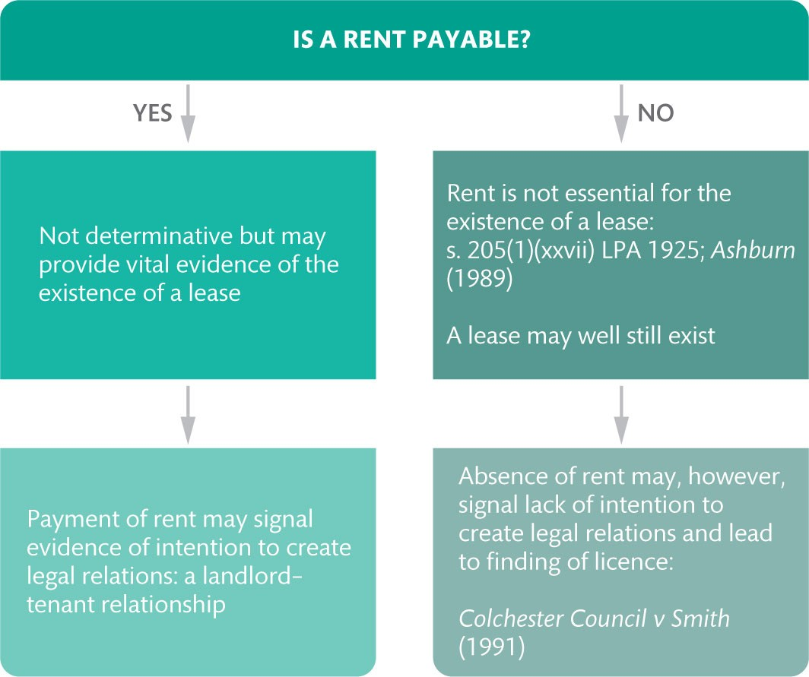
Figure 9.1 The evidential value of the payment or non-payment of rent

Slide 4
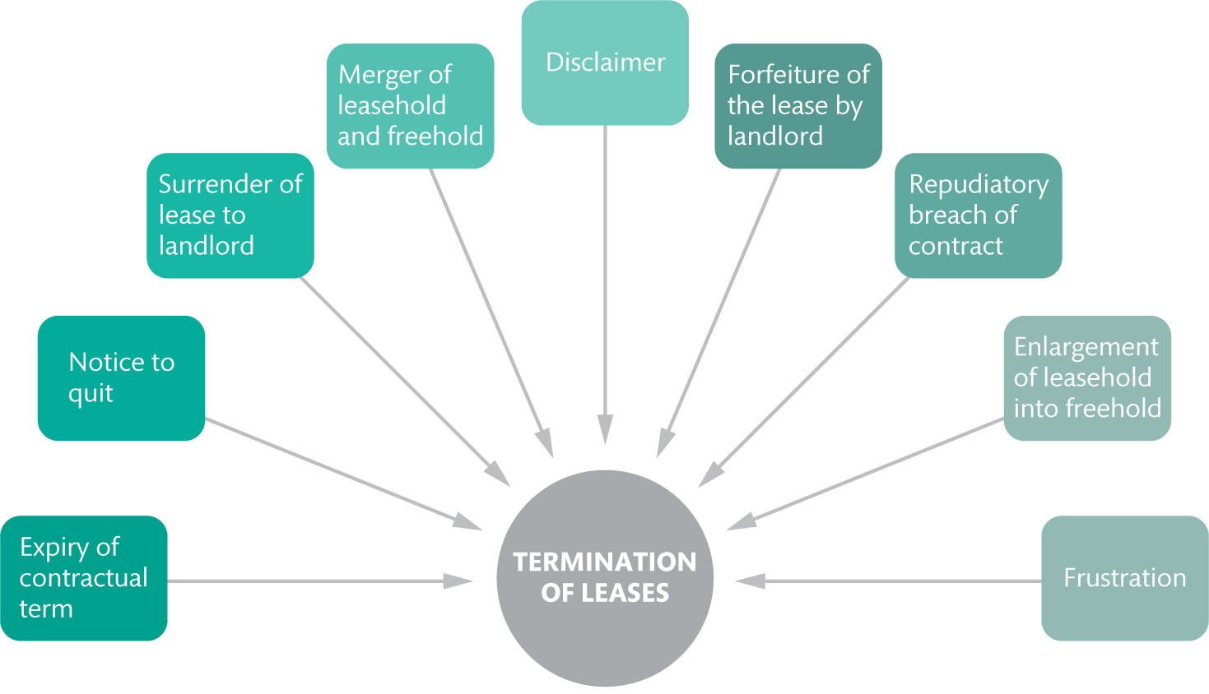
Figure 9.2 Methods of termination of leases

Slide 5
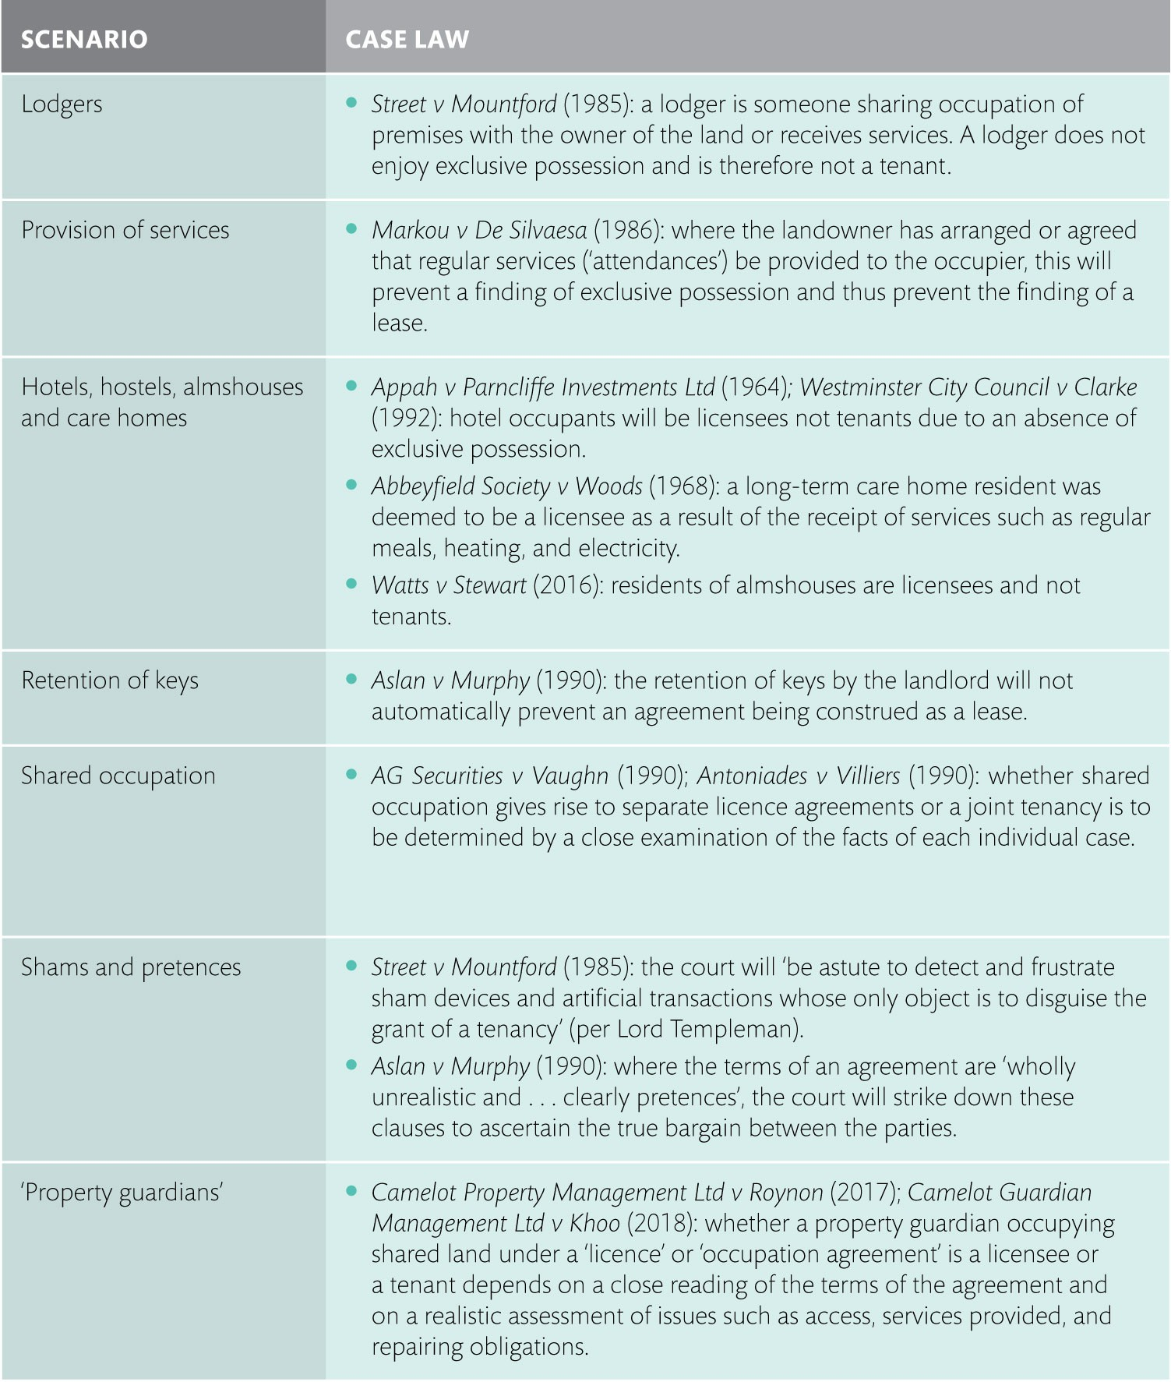
Table 9.1 Exclusive possession: Some common scenarios

Slide 6
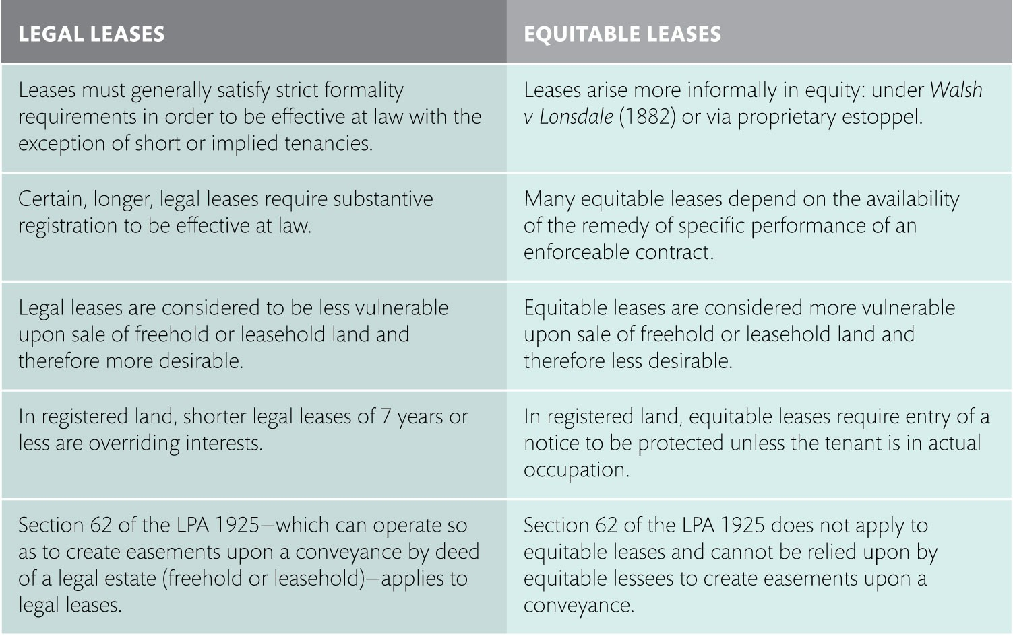
Table 9.2 Distinguishing legal and equitable leases

