Slide 1

Land Law
by Chris Bevan

Slide 2
Chapter 08
Proprietary Estoppel

Slide 3
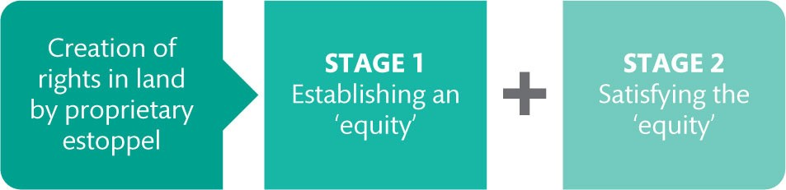
Figure 8.1 The two stages of a proprietary estoppel claim

Slide 4
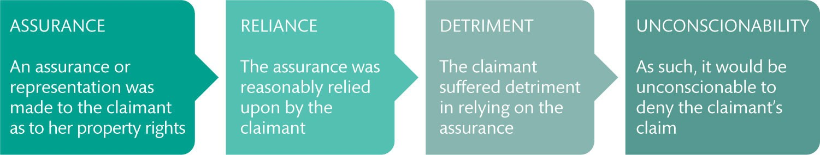
Figure 8.2 Proprietary estoppel: Features of the modern law

Slide 5
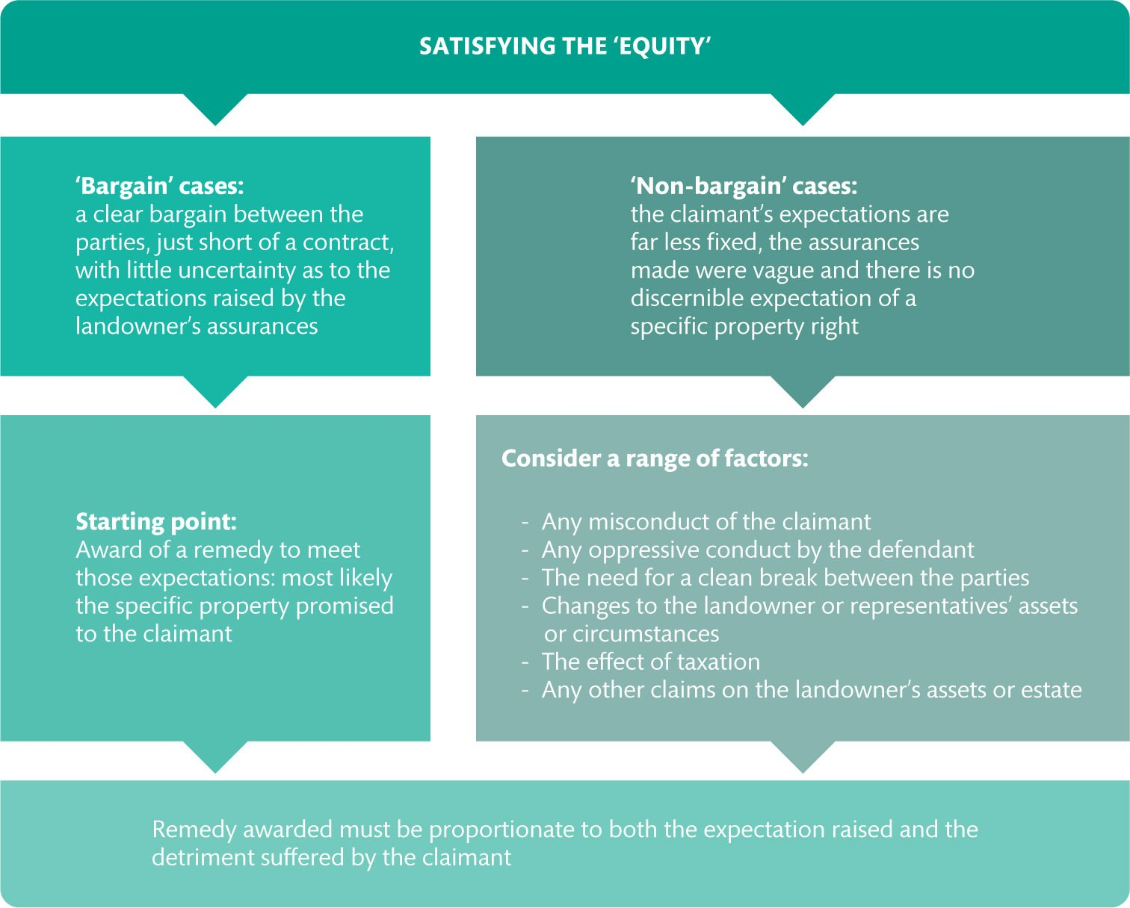
Figure 8.3 Satisfying the ‘equity’ and proportionality under Jennings v Rice

Slide 6
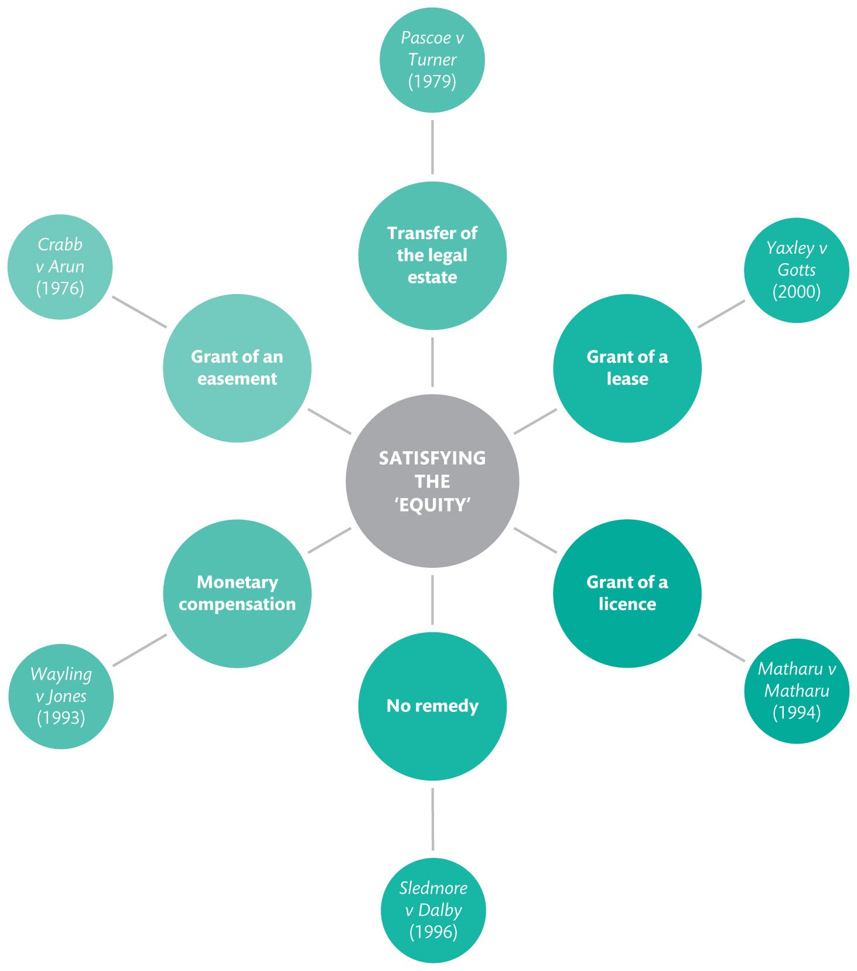
Figure 8.4 Remedial choices available to the court

Slide 7
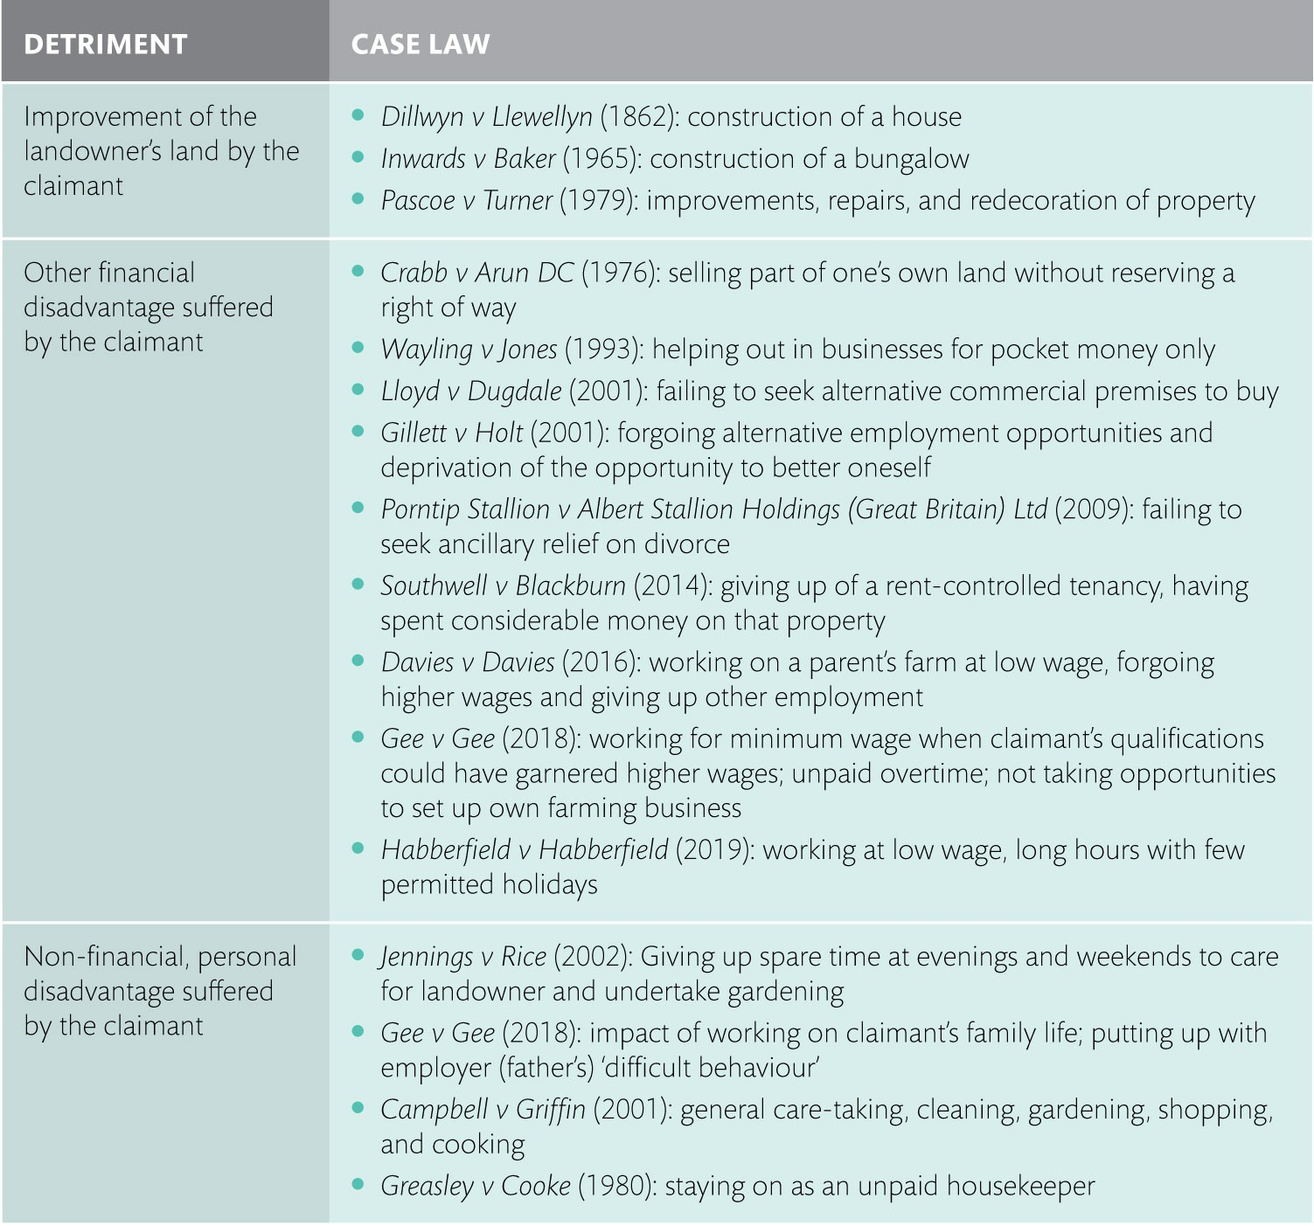
Table 8.1 Examples of detriment recognized by the court

Slide 8
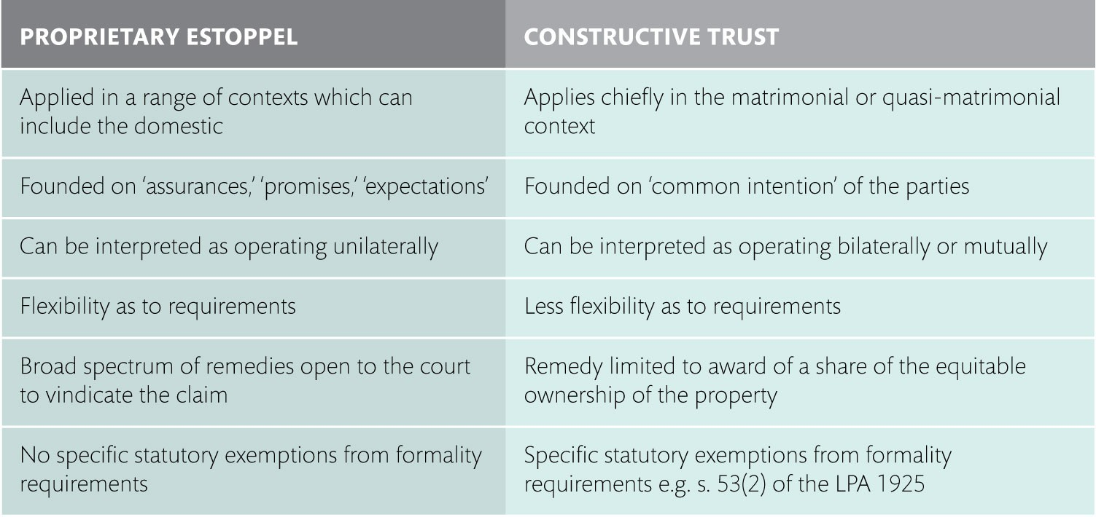
Table 8.2 Proprietary estoppel and constructive trusts compared

