Slide 1

Land Law
by Chris Bevan

Slide 2
Chapter 02
Registered Land

Slide 3
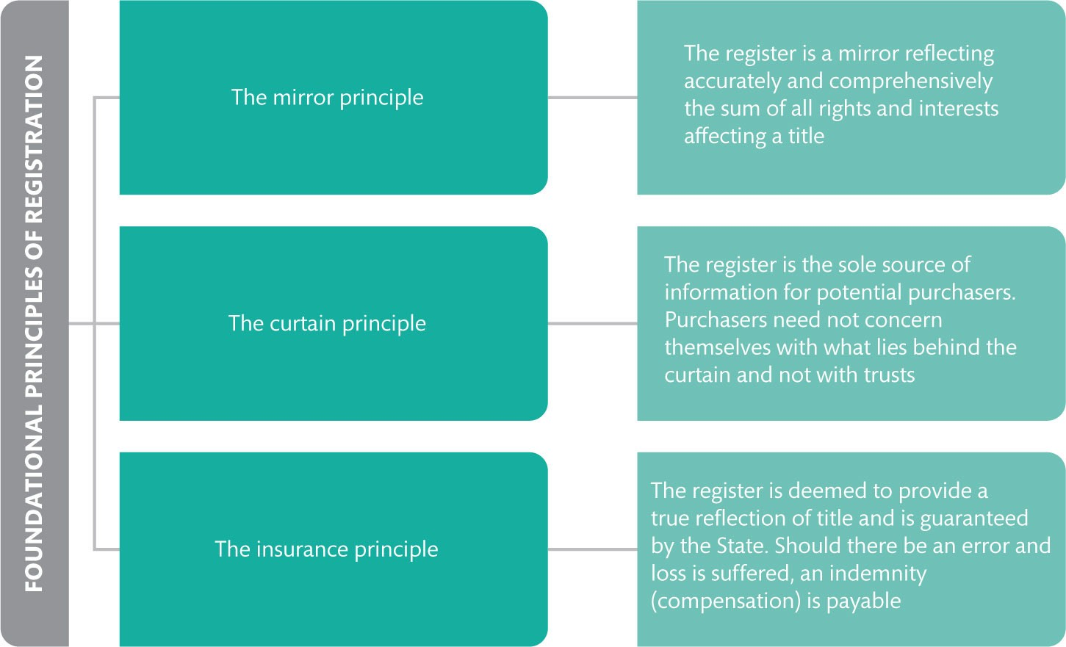
Figure 2.1 Ruoff’s three foundational principles of a system of registered title

Slide 4
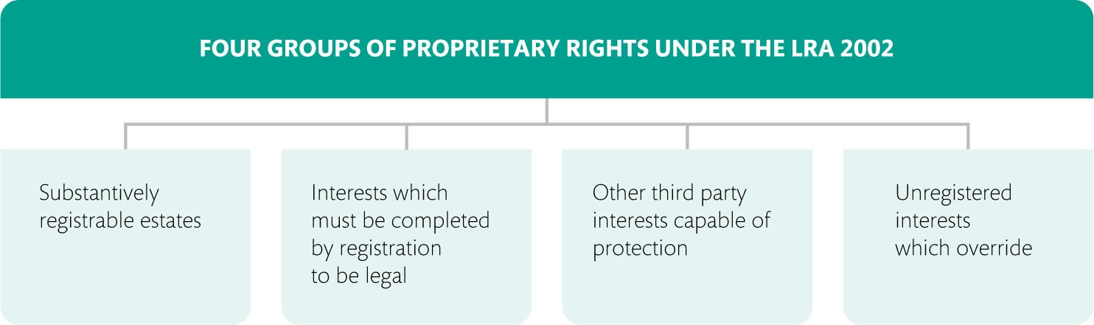
Figure 2.2 The four-group categorization of proprietary rights under the LRA 2002

Slide 5
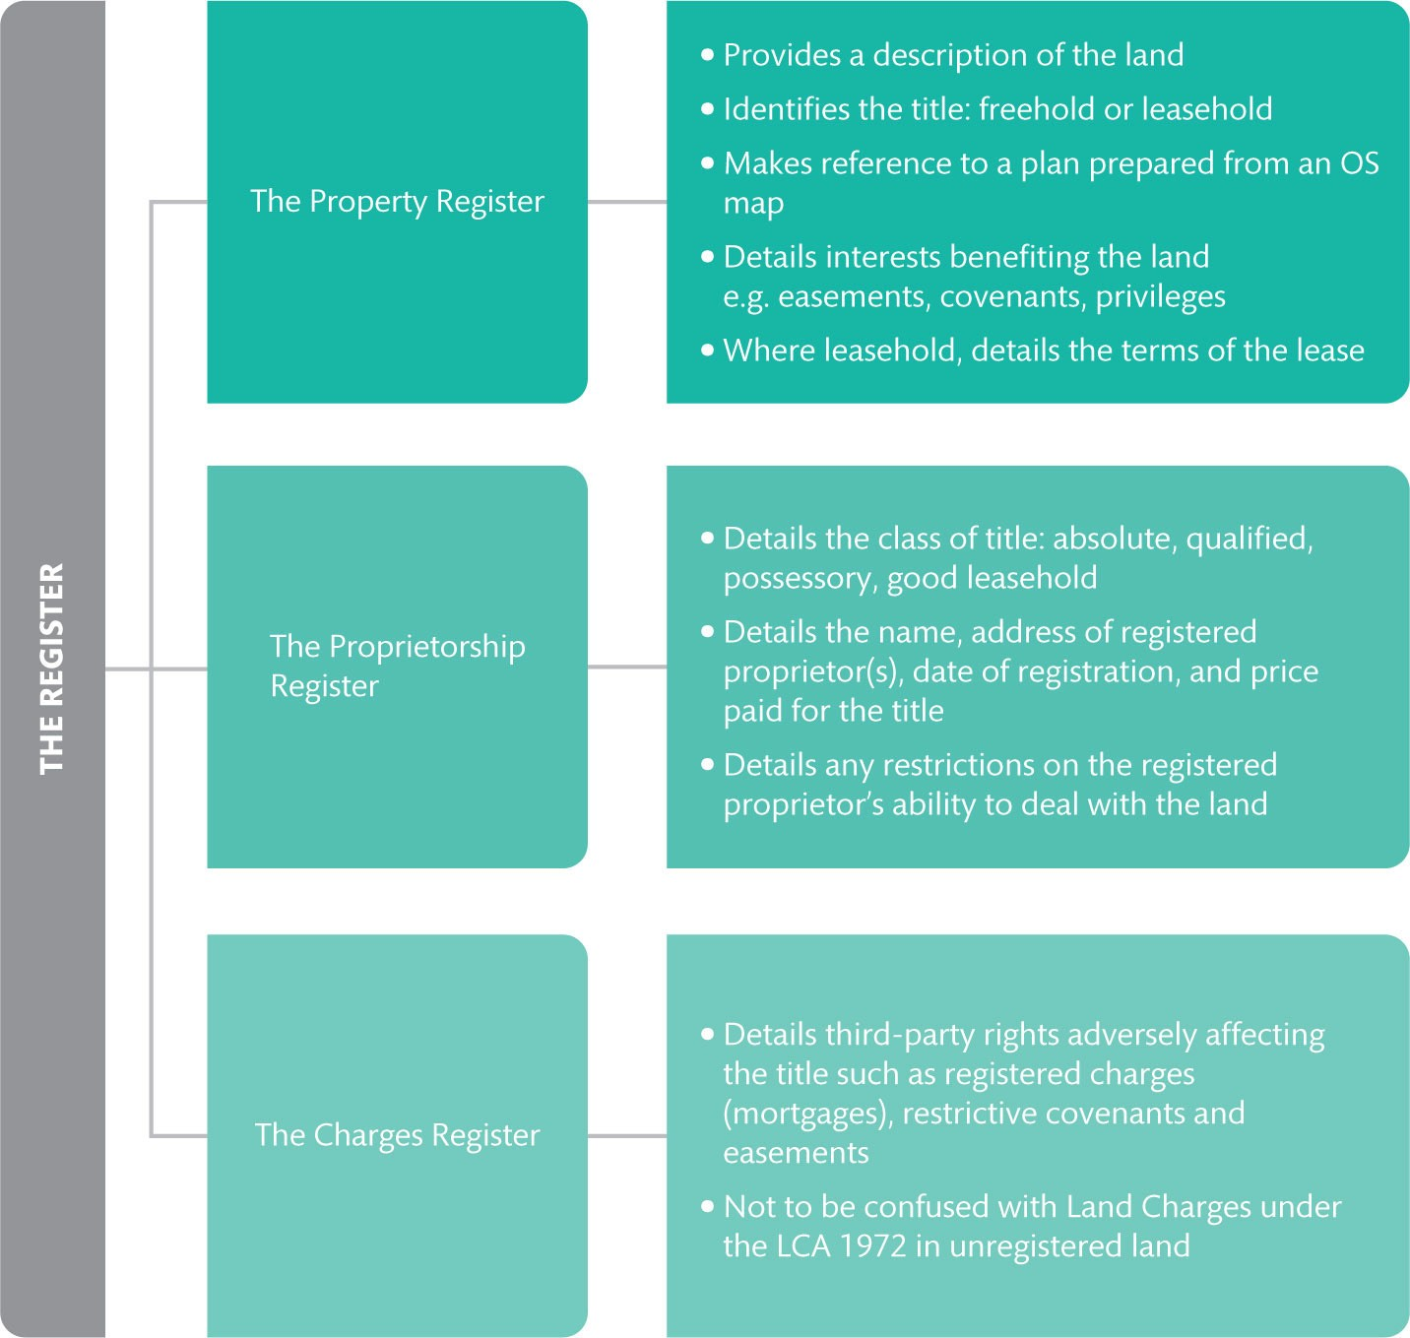
Figure 2.3 Details of the register held by Land Registry

Slide 6
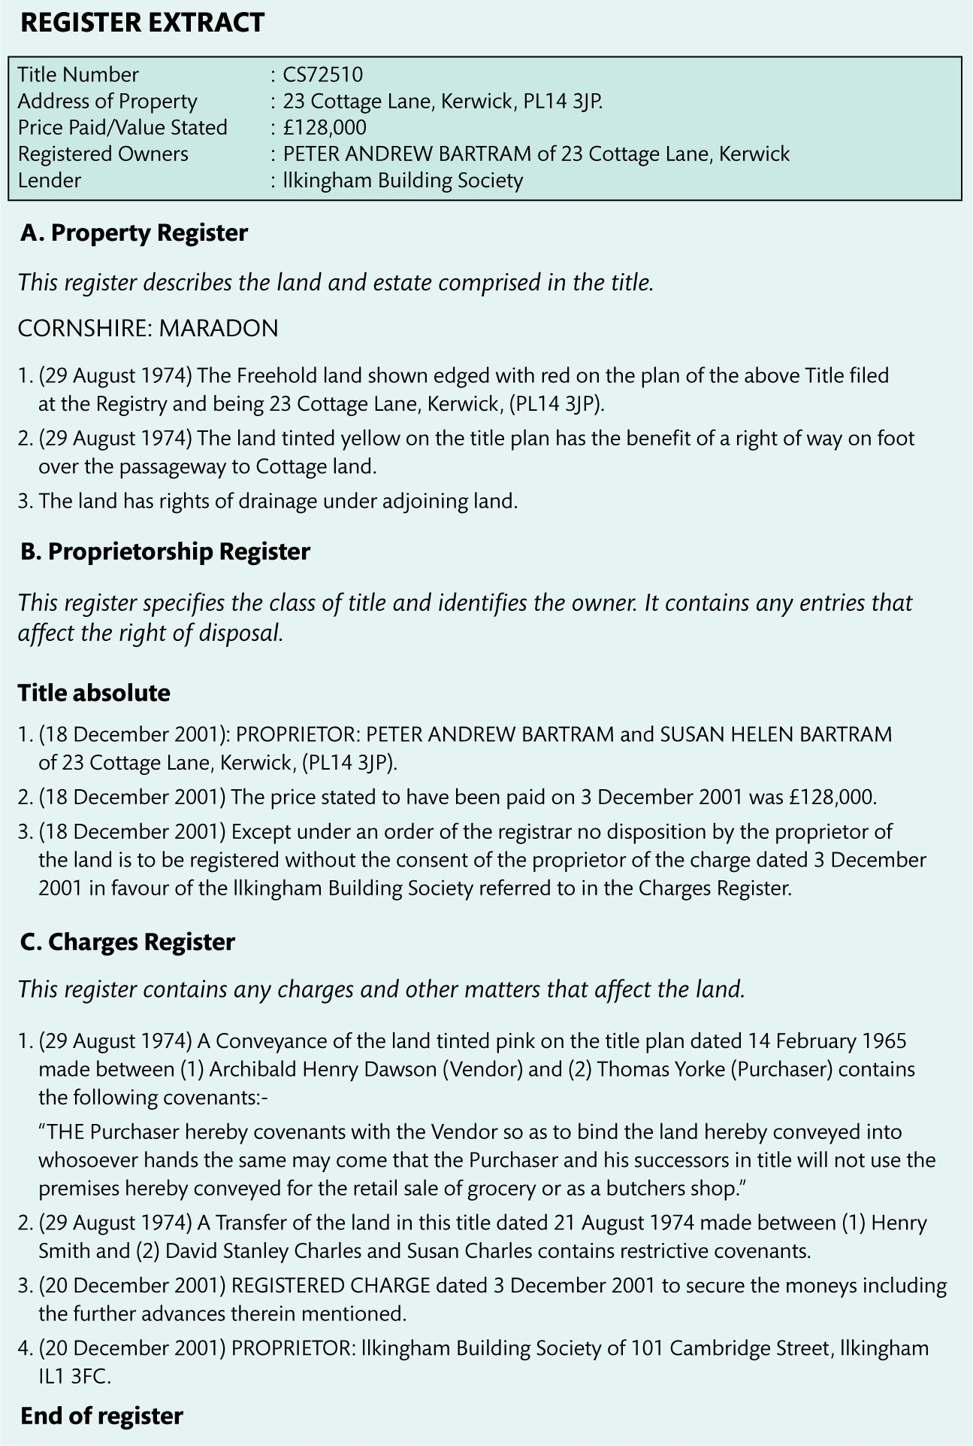
Figure 2.4 Sample register

Slide 7
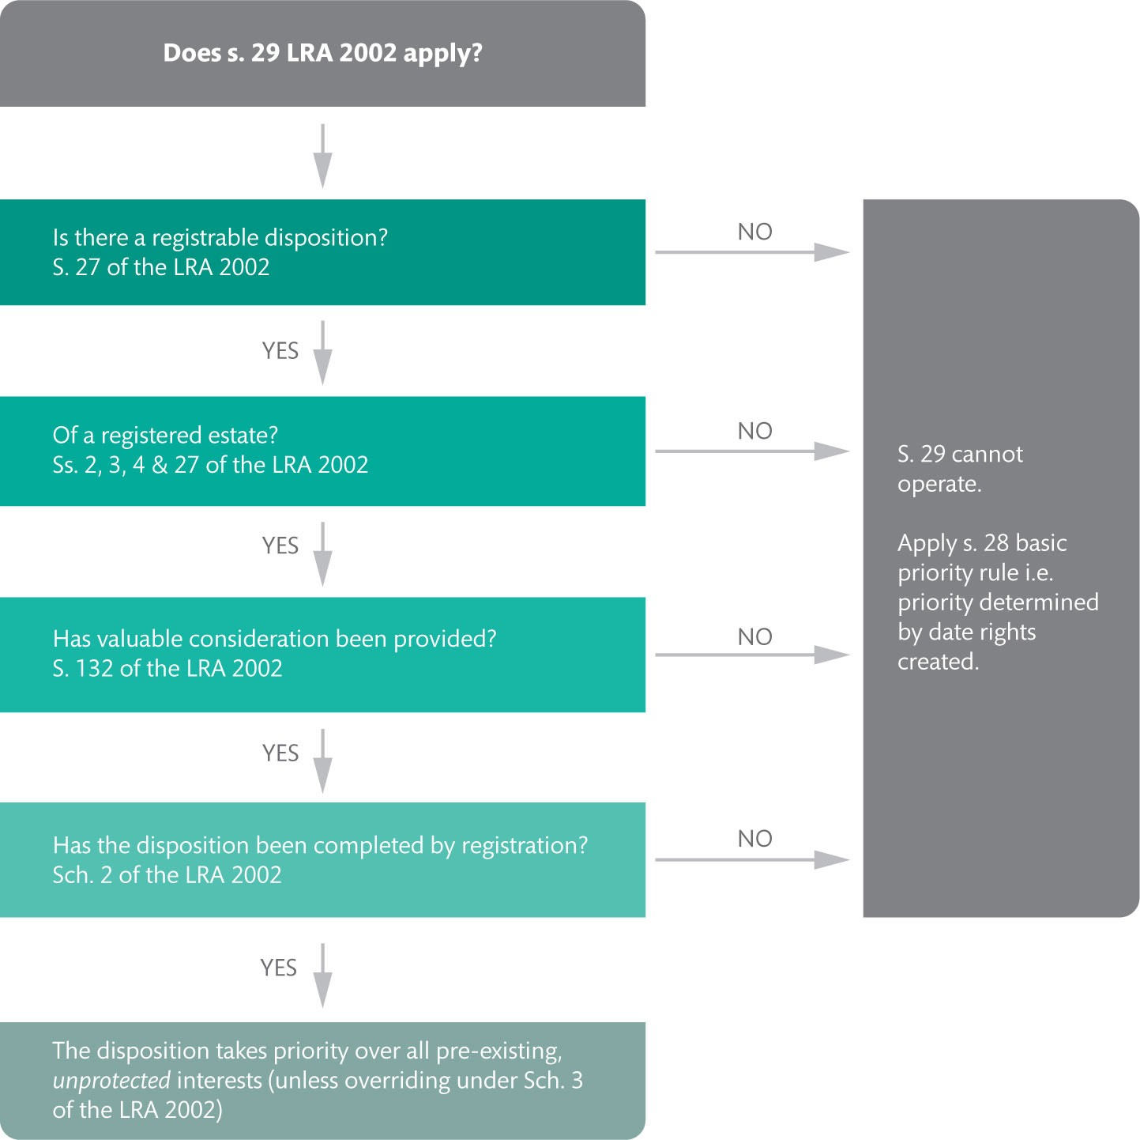
Figure 2.5 The operation of s. 29 of the LRA 2002

Slide 8
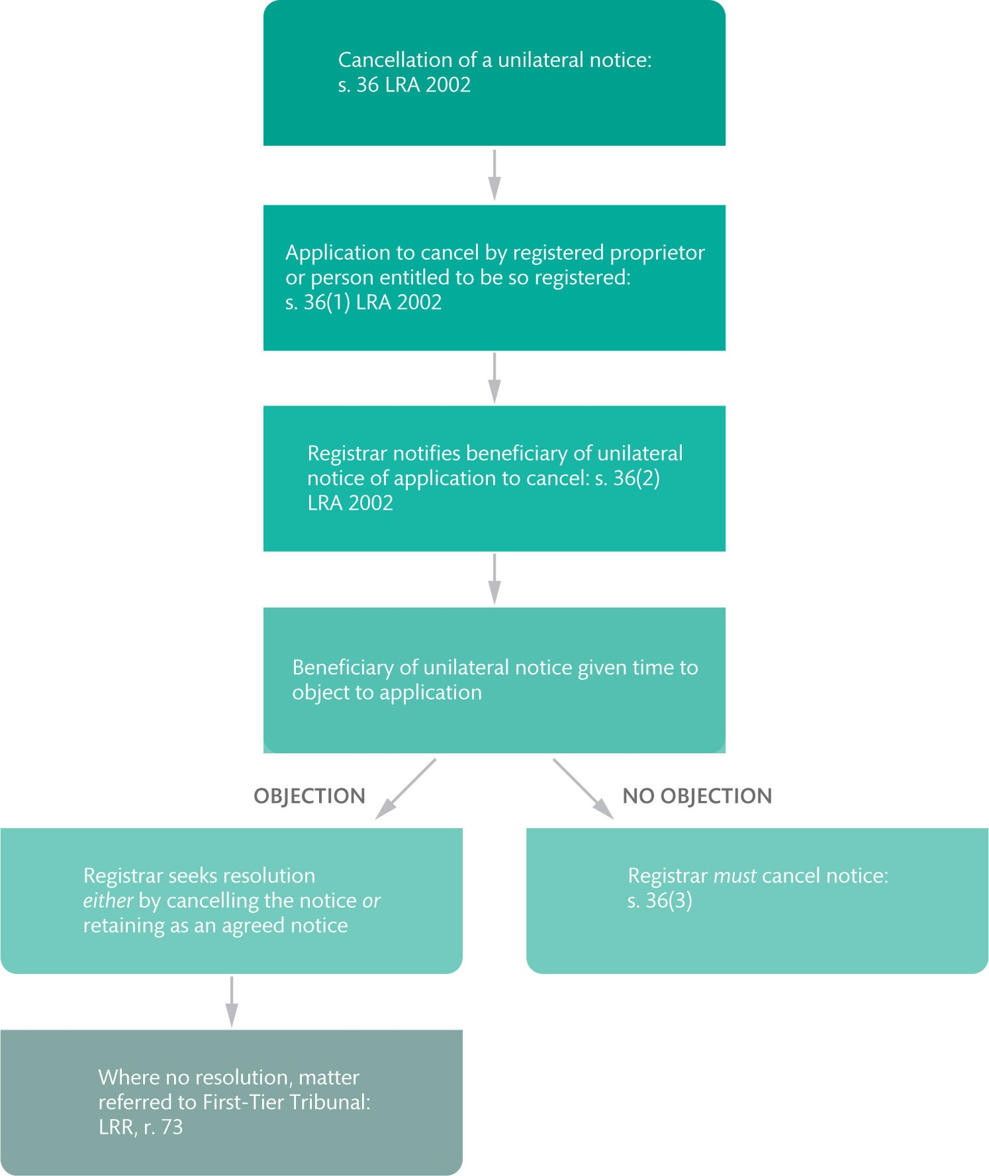
Figure 2.6 Application to cancel a unilateral notice under s. 36 of the LRA 2002

Slide 9
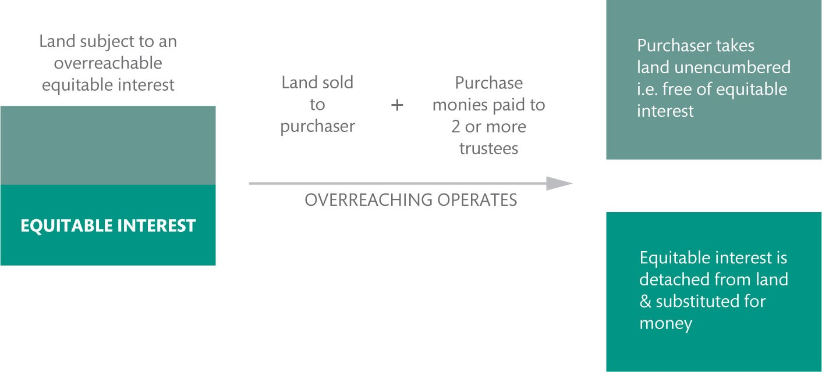
Figure 2.7 How overreaching works

Slide 10
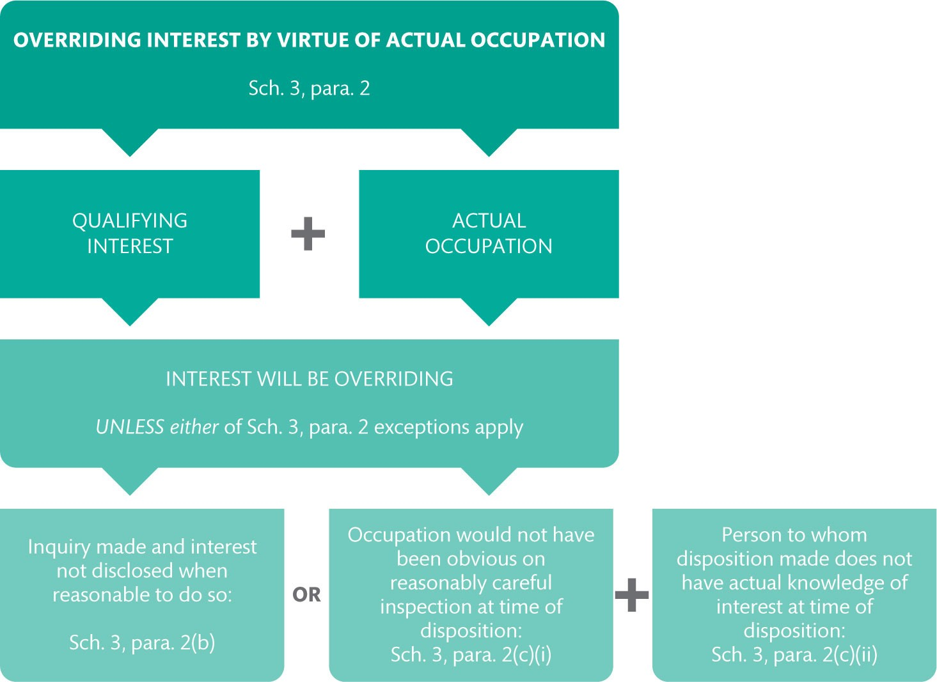
Figure 2.8 Establishing an overriding interest by virtue of actual occupation under Sch. 3, para. 2.

Slide 11
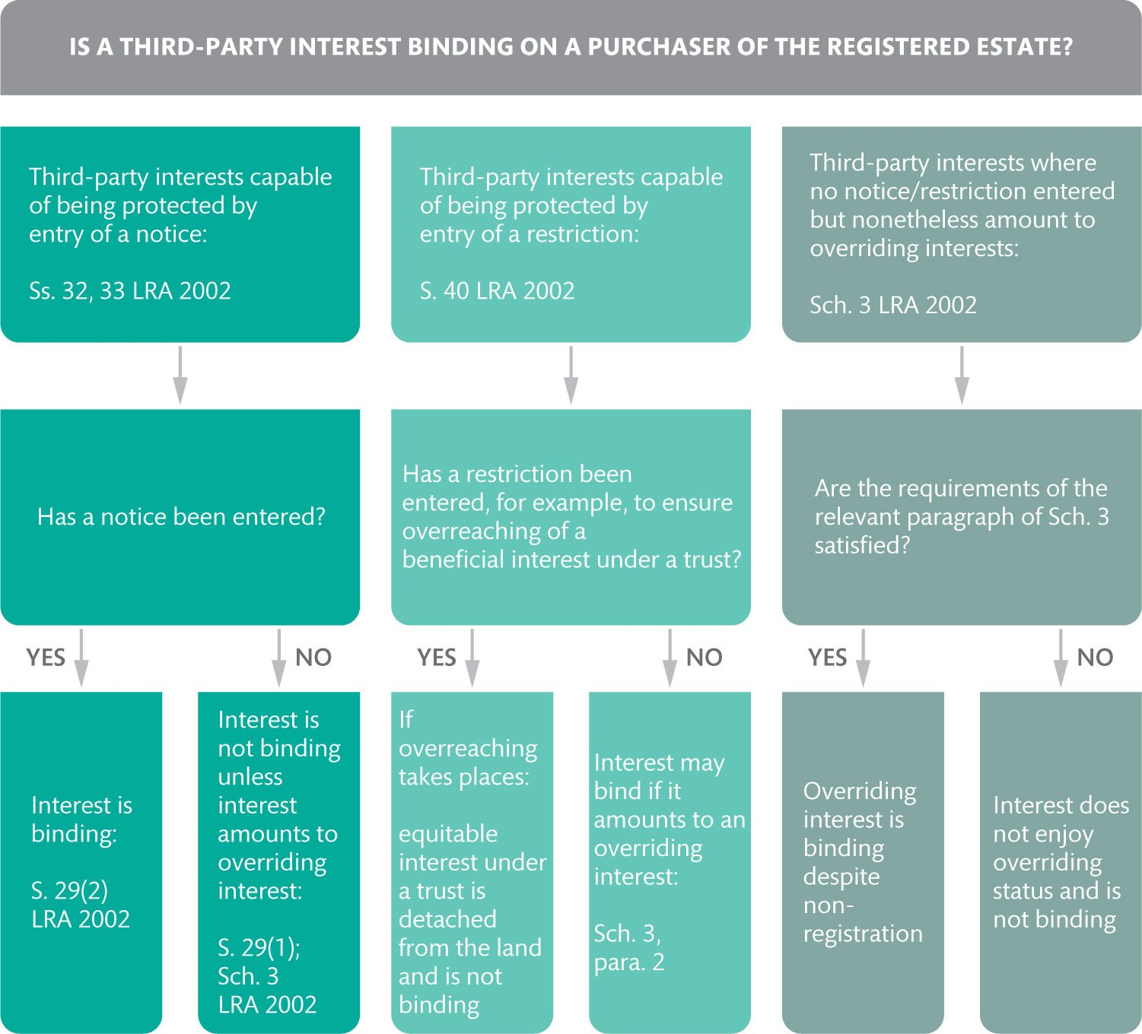
Figure 2.9 The priority of third party rights in registered land

Slide 12
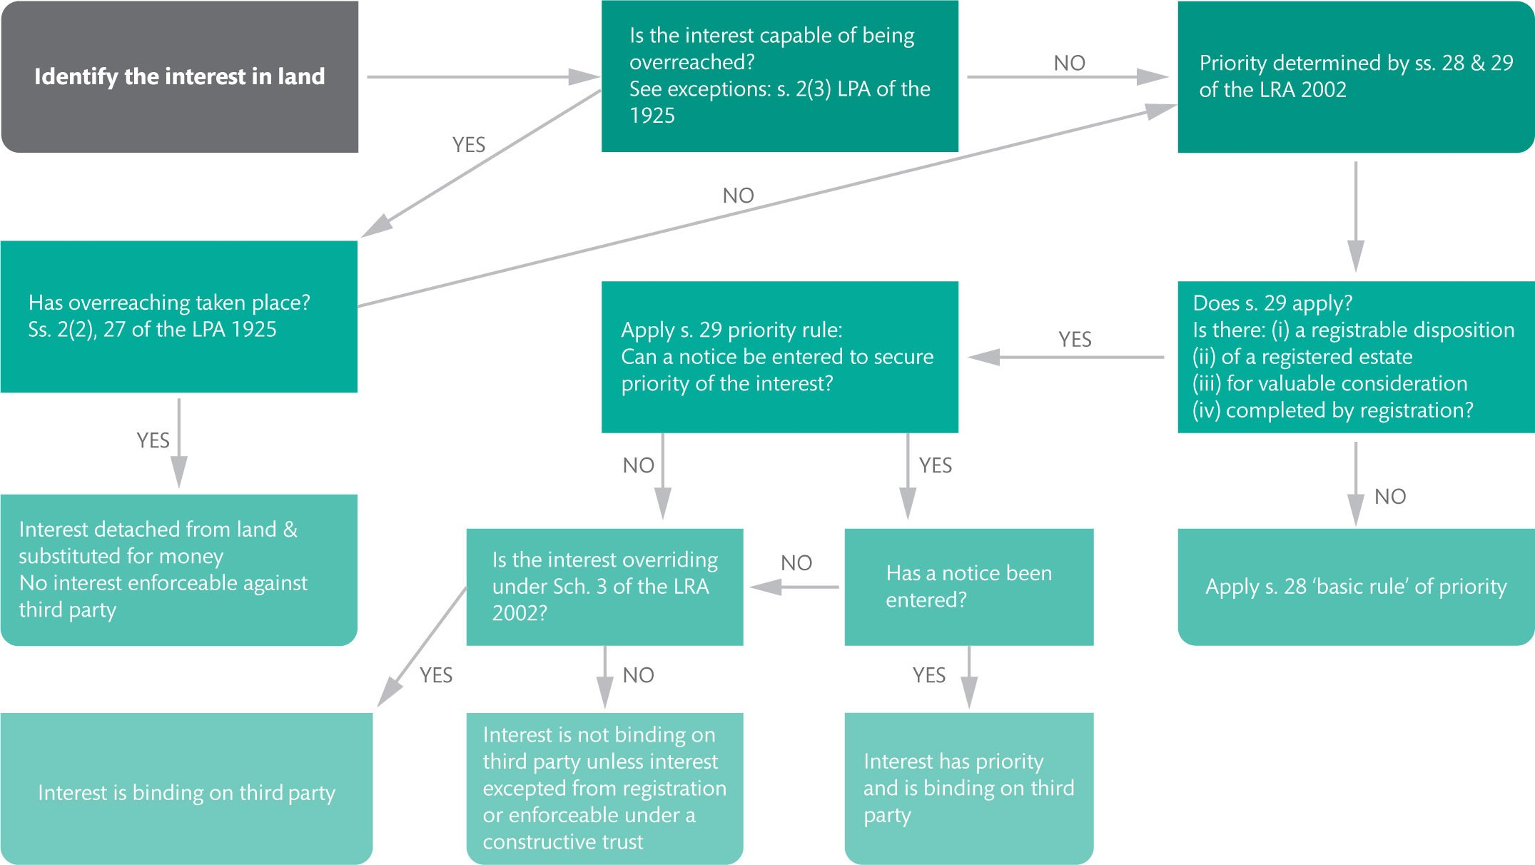
Figure 2.10 Bringing it all together: determining priority in registered land

Slide 13
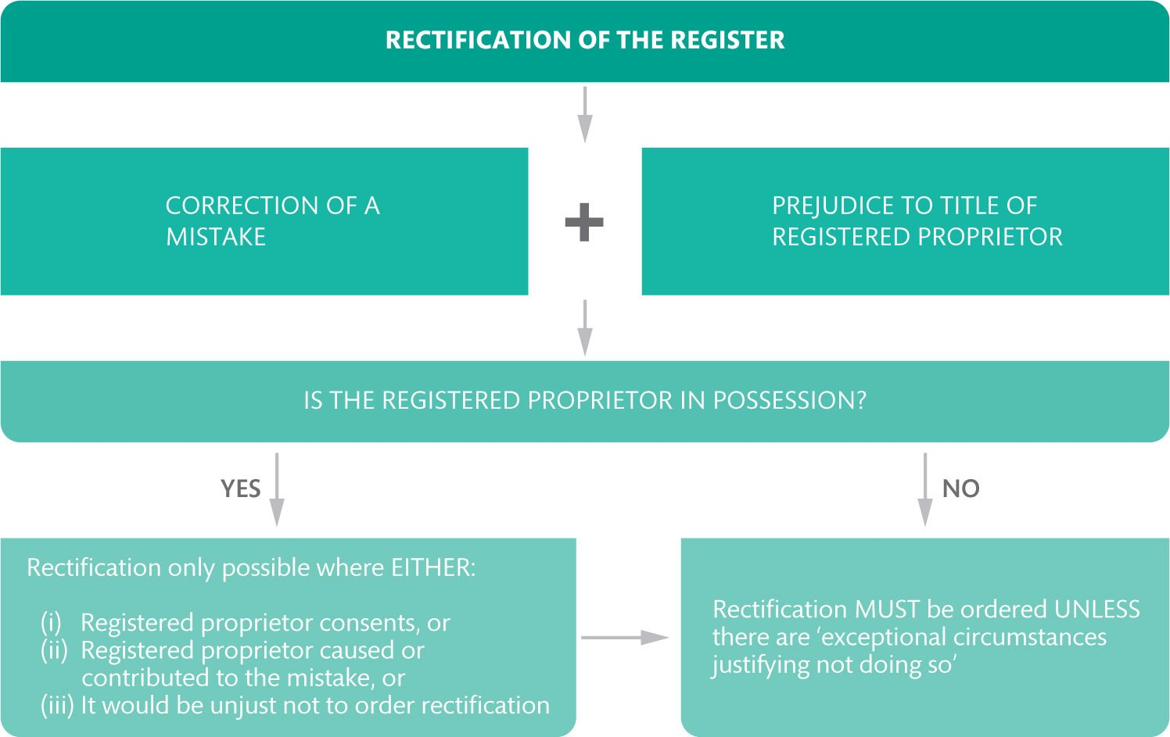
Figure 2.11 When rectification will be ordered under Sch. 4

Slide 14
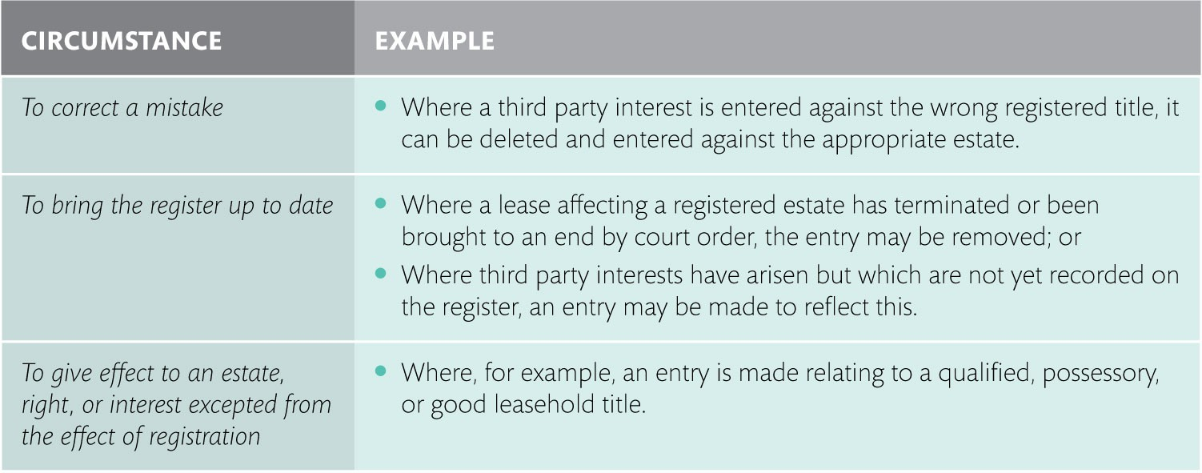
Table 2.1 Administrative alterations to the register

