Slide 1
Living Sociologically
Chapter 1: Introduction

Slide 2
Chapter 1 Lecture Outline
What is Sociology?
Level of Analysis
Thinking Relationally: The Paired Concepts
Why Sociology?

Slide 3
Chapter 1 Learning Goals
Defining the sociological imagination
Understanding different levels of analysis
Recognizing sociology as a “science”
Finding sociology outside of academia

Slide 4
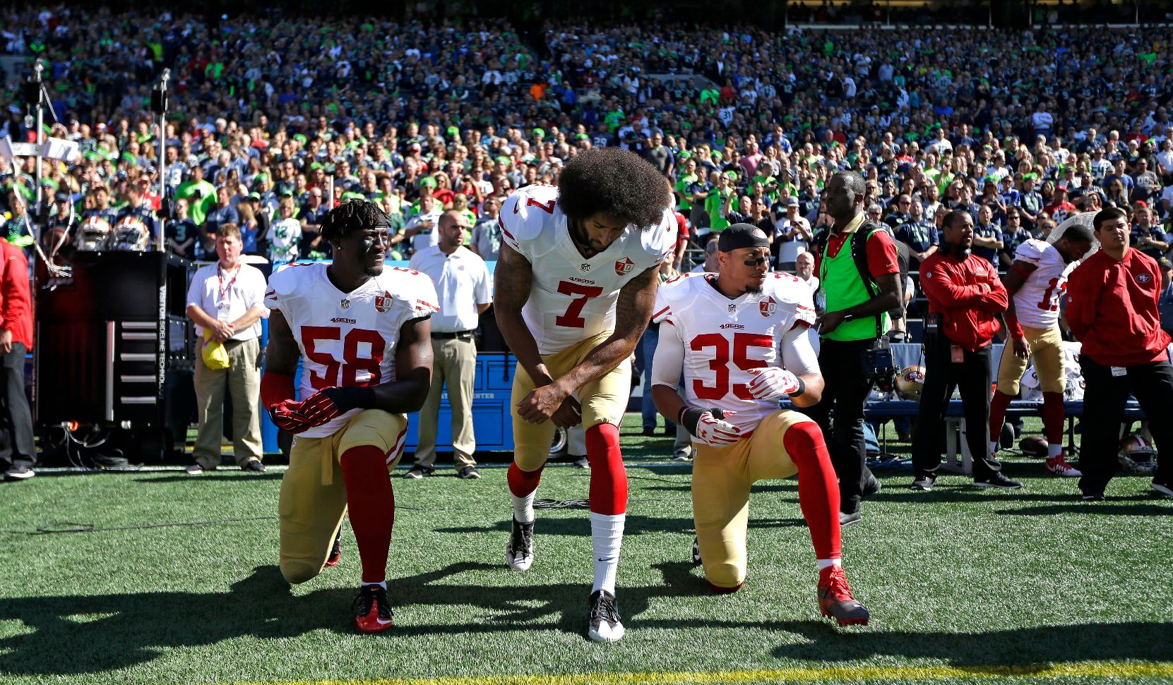
Chapter 1 Living Sociologically
Protest?
Disrespect?
Both?
Neither?
What can a sociological perspective suggest?

Slide 5
Chapter 1 What is Sociology?
Studies the relationship between individuals and society
Concerned with “social facts,” “social actions,” and “social relationships”

Slide 6
Chapter 1 A Sociological View
The ‘Sociological Imagination’ (C. Wright Mills)
Personal troubles are often connected to social issues
Notes:
“The sociological imagination,” Mills (1959: 6) wrote, “enables us to grasp history and biography and the relation between the two in society.”

Slide 7
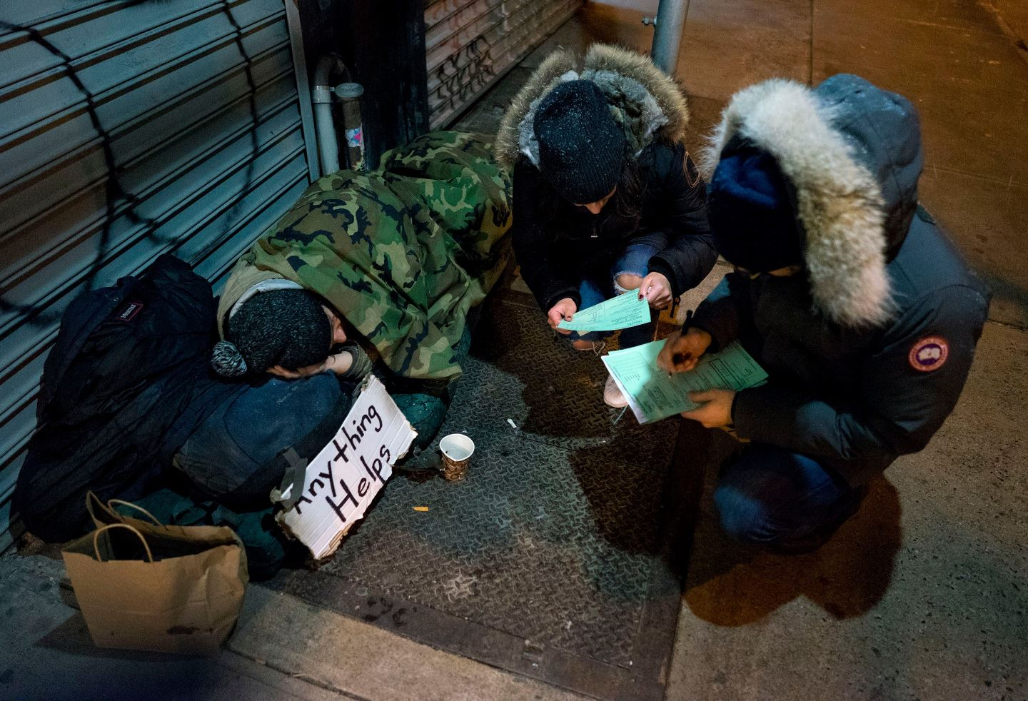
Chapter 1 A Sociological Purpose
Understanding the hopes, desires, and worries of others to engender positive social contributions (Zygmunt Bauman)

Slide 8
Chapter 1 A Sociological “Martial Art”
Sociology is a way to “make sense” of a complex world (Pierre Bourdieu)

Slide 9
Chapter 1 Primary Focus of Sociology
Social facts
A level of reality, external to individuals, that influences their lives (Durkheim 1895)
Social actions
How do people share meaning and act together (Weber, Baehr, and Wells 2002)
Social relationships
Individual lives are patterned but we also make choices (Small and Vincent 1894)

Slide 10
Chapter 1 The Discipline of Sociology
Sociology explores the world though systematic and scientific research
For success, sociology must
get the facts right
figure out how to get the facts right

Slide 11
Chapter 1 Sociology and Everyday Knowledge
Sociological knowledge is different from “common sense”
Serves as an antidote to confirmation bias
Strives to understand how social things are related to one another
Ultimate aim is improving a science of society

Slide 12
Chapter 1 Levels of Analysis
What is the “scale” of research?
Microsociology
Macrosociology
Institutional perspectives

Slide 13
Chapter 1 Levels of Analysis – Micro
Microsociology
Everyday interpersonal and small group interactions
Interested in how people act in specific situations

Slide 14
Chapter 1 Levels of Analysis – Macro
Macrosociology
Explores how large-scale historical trends and structural patterns influence social life
Choices matter, but so does the context we make them in

Slide 15
Chapter 1 Levels of Analysis – Institutional
Institutional perspective
Rules and strategies for people in given social situations
Institutions refer to
coordinated activities within a social domain (e.g. religion, family, education)
organizations adhering to the logic of the social domain

Slide 16
Chapter 1 Thinking Relationally
Sociology emphasizes focusing on relationships between social forces
Five sets of paired concepts
Solidary and conflict
Power and resistance
Inequality and privilege
Global and local
Structure and contingency

Slide 17
Chapter 1 Paired Concepts 1
Solidarity
A sense of belonging and connection to a particular social group
Creates an “us”
Conflict
Disagreement, opposition, and separation between groups
Creates a “them”

Slide 18
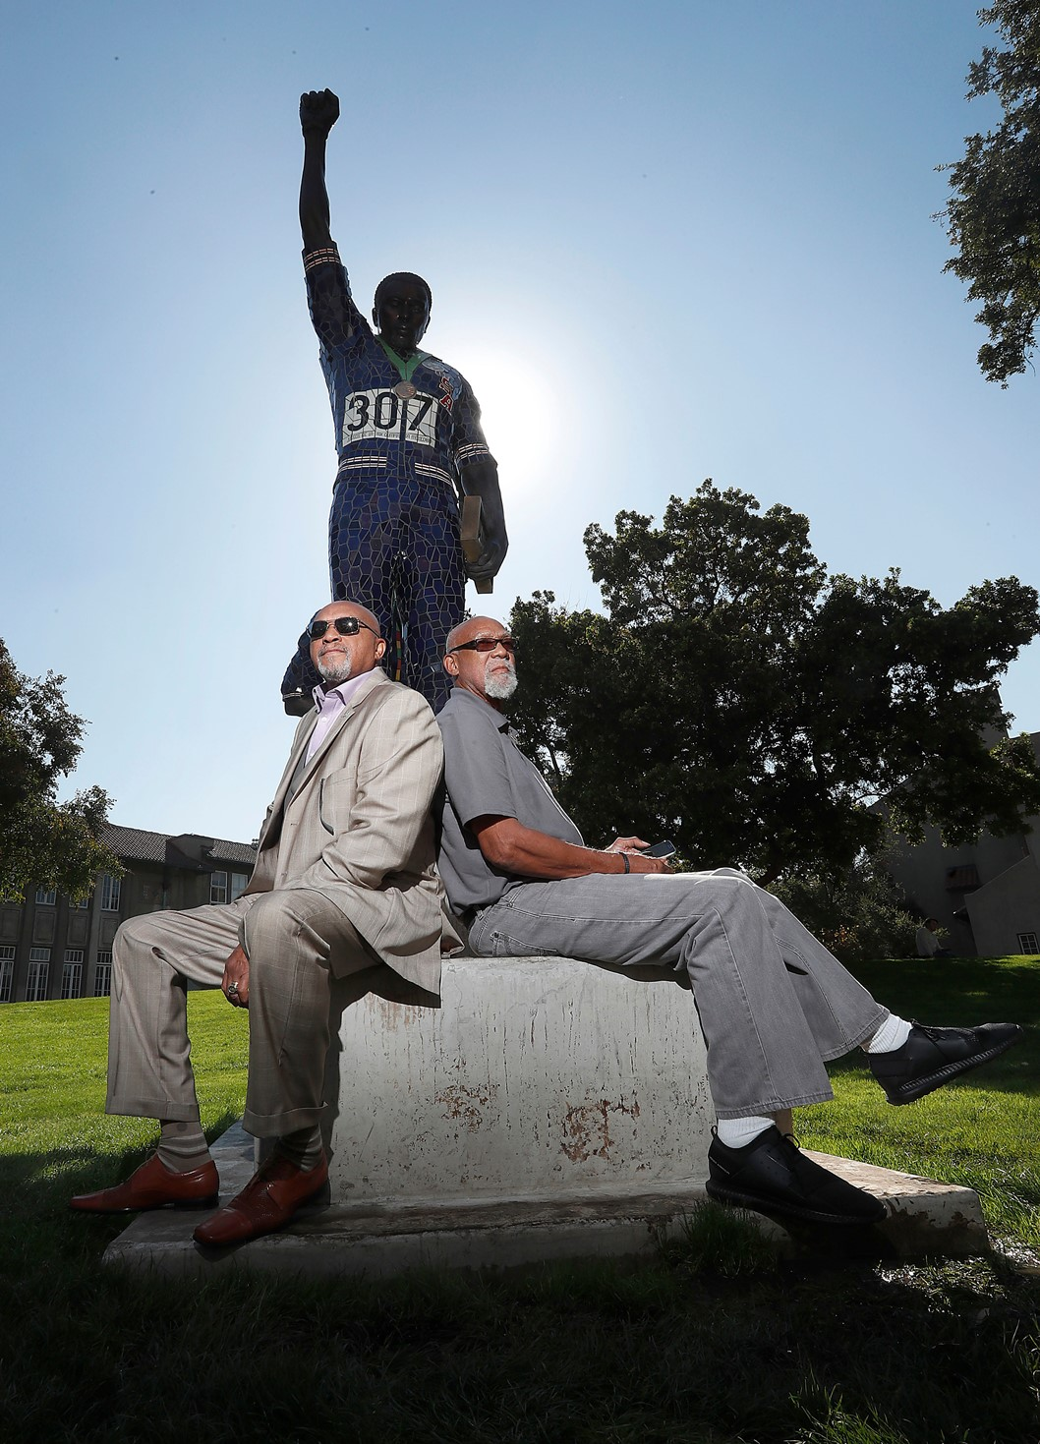
Chapter 1 Paired Concepts 2
Power
Influencing the conduct of others directly or indirectly
Resistance
Opposition to the exercise of power

Slide 19
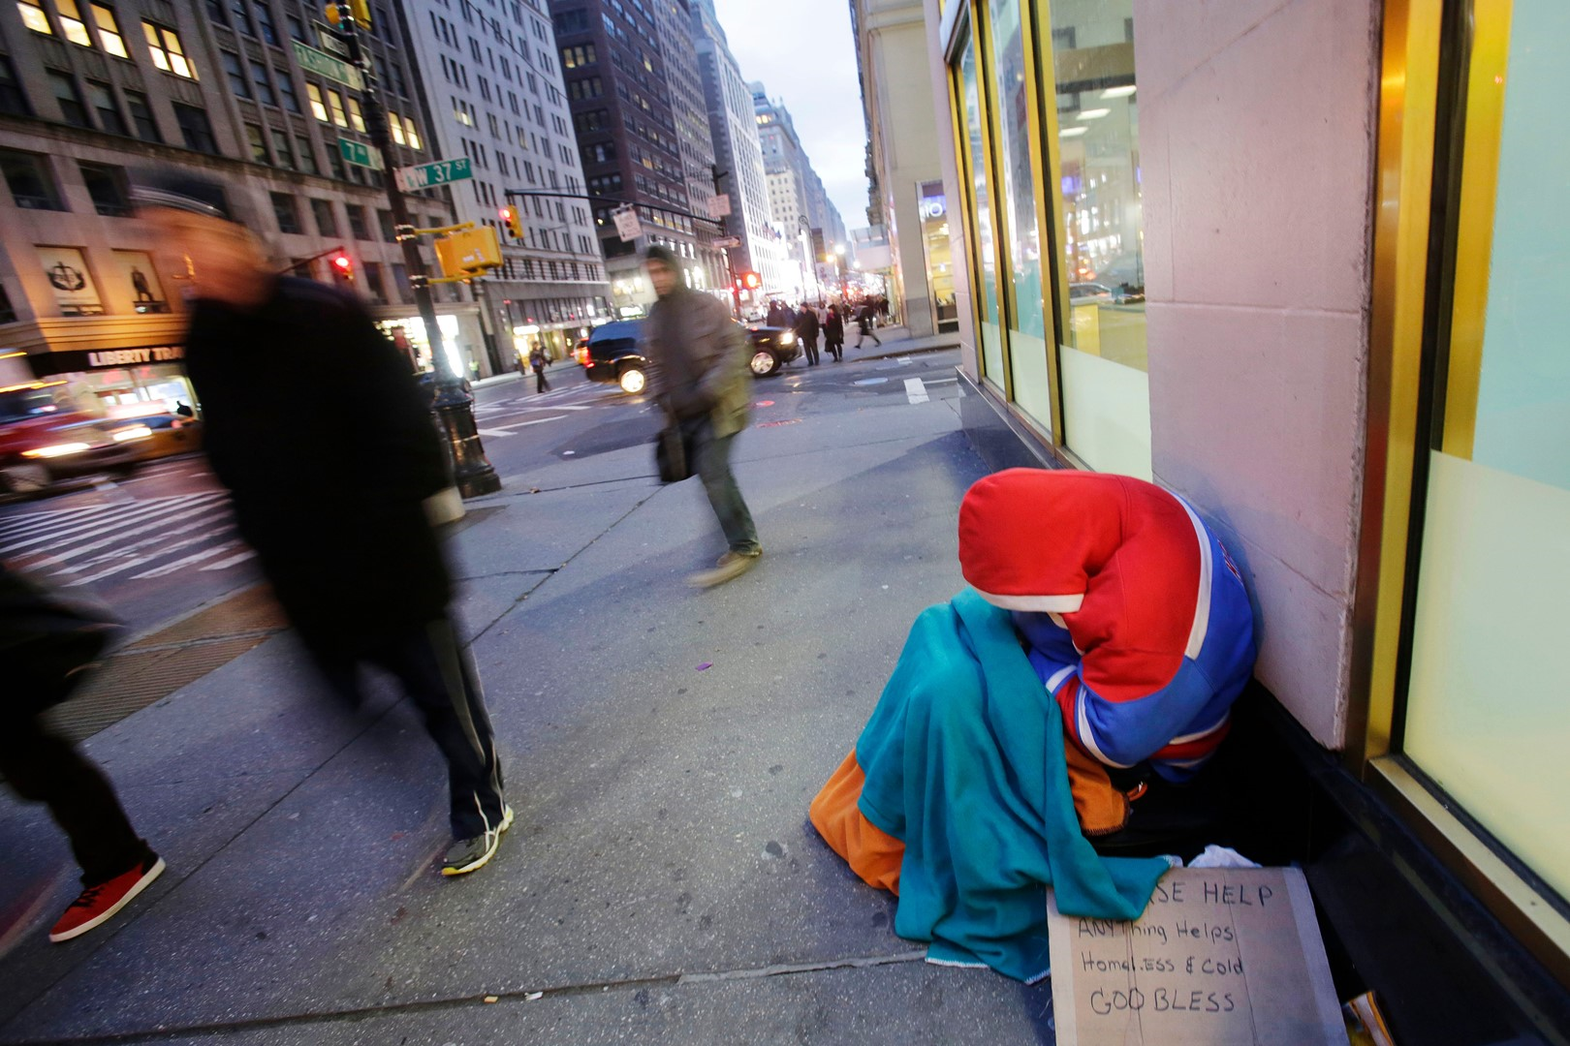
Chapter 1 Paired Concepts 3
Inequality
Uneven distributions of social resources
Privilege
Greater resources possessed by some compared to others

Slide 20
Chapter 1 Paired Concepts 4
Global
Interconnection of social life on the planet
Local
Specific settings of everyday life

Slide 21
Chapter 1 Paired Concepts 5
Structure
The seen and unseen regular, organized patterns of social life
Contingency
Openness in social life produced by human choices and actions

Slide 22
Chapter 1 Why Sociology? – Literacy Skills
Key concepts learned can be identified in real life
Helps develop ability to analyze data and information

Slide 23
Chapter 1 Why Sociology? – Sociology’s Promise
Aspires to inform but also act for freedom and human justice
Not meant to tell people what to think, but allows for clarification of thought
Helps us see the world from the perspective of someone other than ourselves

Slide 24
Review of Learning Objectives
What is the “sociological imagination”?
What are levels of analysis, and how are they generally classified?
What features make sociology a “science”?
Where can we find sociology outside of academia, and why?

Slide 25
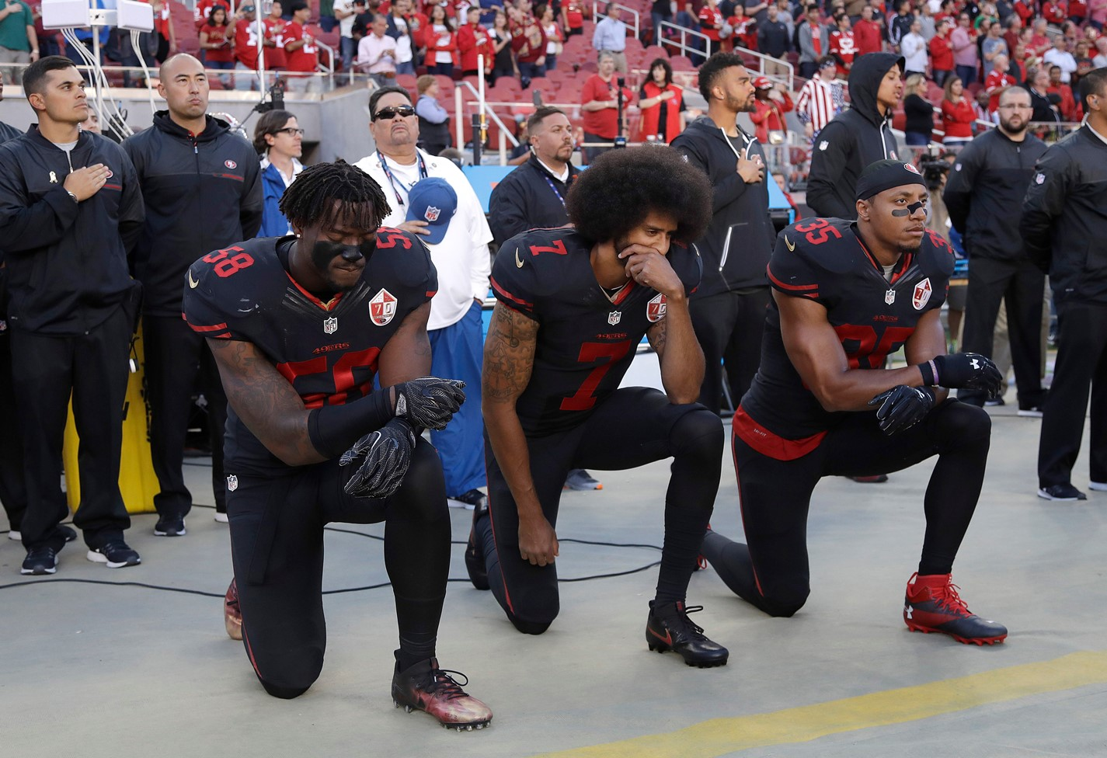
Chapter 1 “Old” Questions – “New” Tools
How might a sociologist understand the events related to Colin Kaepernick?
How might these be different from “common sense” understandings?

Slide 26
What’s Next?
Notes:
(instructor could add a preview of next class / unit / section)
(instructor could take opportunity for course administrative reminders – e.g. assignment due dates, up coming exams, etc.)

