Slide 1
CHAPTER 1
Crime and Justice

Slide 2
Learning Objectives
This lecture should help you
Describe the different ways of defining and classifying crime
Describe the three components of the justice system
Describe the reasons why the number of people in the “criminal justice funnel” decreases before the harshest punishments are imposed
Describe five main goals of the criminal justice system
Explain the differences between the crime control model and the due process model
Explain why wrongful convictions damage the public’s confidence in the criminal justice system

Slide 3
Introduction
Most solutions to the problems of crime are simplistic (e.g., lock up offenders and throw away the key) but are these just and fair solutions?
Most people think of violent/serious crime when they think of criminal events.
Why is this so when these acts are relatively rare?

Slide 4
Introduction, cont’d
Is crime increasing?
Are there more victims of violence today than ever before?
How much of our news is coming from the US?
These questions and answers provided by the media lead to confusion not only about crime in Canada, but what we should be doing about it.

Slide 5
Introduction, cont’d
Antisocial behaviour: Conduct that can be disruptive and reduce our quality of life, but might not be considered a criminal act.
Most Canadian’s experience this.
E.g., noisy people loitering in groups or groups or individuals who are drunk, rude or rowdy in public

Slide 6
Introduction, cont’d
How people experience crime is subjective.
We need to look beyond the harm of a physical injury and consider the range of emotional and behavioural impacts on an individual (e.g., survivors of assaults may live in fear and this may impact how they act with others in their lives).

Slide 7
Crime and Law
Acts that are considered to be crimes in Canada are defined by the Criminal Code.
Informal social control: The actions of individuals, such as their praise or disapproval that make people conform to the law and other social norms.
Norms: Standards of acceptable behavior that are based on tradition, customs, and values.

Slide 8
Crime and Law, cont’d
The Bedford decision
In December 2013, the Supreme Court of Canada ruled that existing prostitution laws were not constitutional.
The Conservative government was given one year to come up with new legislation that would make sex work safer in Canada.
Bill C-36 was created.
Controversy surrounds this new bill as it may not have increased the safety of sex workers.
Challenges to this bill in the future are inevitable.

Slide 9
Public (Criminal) and Private Law
Public law: A type of law addressing matters that affect society (such as responding to a person who commits a criminal act)
Private law/civil law: Legal Matters that relate to the relationships between individuals or businesses that involve contracts

Slide 10
The Criminal Code of Canada
The Criminal Code is a federal statute that was first enacted in 1892.
Acts that are considered to be crimes in Canada are defined by the Criminal Code.
These acts range from homicide to water skiing after dark (and lists the consequences for violating these acts).
Decisions about what acts are defined as crimes are the end result of political and legal decisions.
There is not always agreement on what acts should be labelled as crimes and this debate has raged for centuries.

Slide 11
Federal, Provincial, and Municipal Legislation
The federal government, provinces, territories, and municipalities have the authority to regulate our behaviours through legislation, but their authority is limited.
The powers that different levels of government have to enact laws and manage the criminal justice system are set out in the Constitution Act, 1867.
The federal government has the exclusive authority to enact legislation regarding criminal law and procedure.

Slide 12
Classifying Crime
Malum in se: An act that is universally considered by the public as being evil or harmful to society
E.g., homicide
Malum prohibitum: An act that is defined as illegal or wrong by a government, but is not considered wrong in itself
E.g., speeding on a highway

Slide 13
Classifying Crime, cont’d
Summary offences: Crimes that carry a less serious punishment in which judges can impose a jail sentence of up to six months and/or a maximum fine of $2,000 on an offender.
Indictable offences: Serious offences, such as homicide, where the defendants must appear in court and cases are heard before federally appointed judges.
Dual offences: Offences that can be prosecuted as either summary offences or indictable offences.

Slide 14
The Structure of the Criminal Justice System
All three components are separate but interrelated:
Police
Courts
Corrections

Slide 15
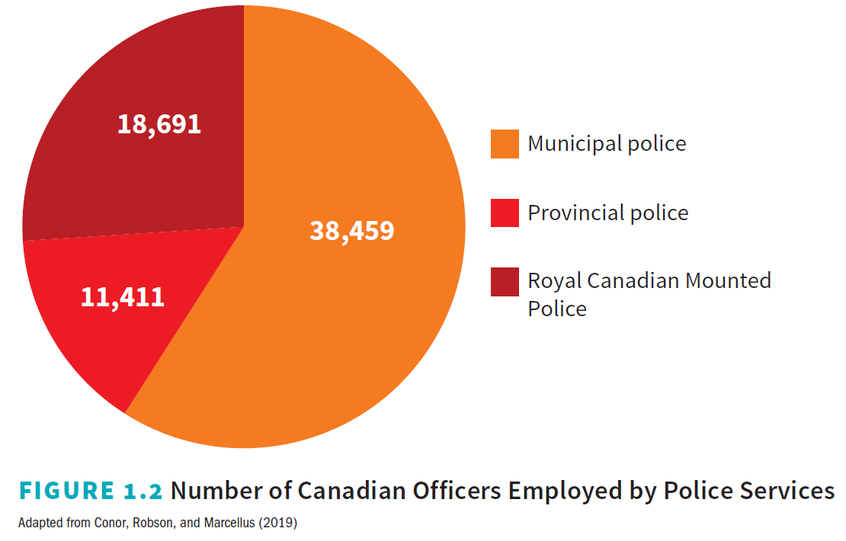
Police
Police are the most visible component of the justice system as they are the officials we are most likely to encounter.

Slide 16
Police, cont’d
Policing is a provincial responsibility.
Most Canadian cities are policed by municipal police services, whereas most rural communities and small towns are served by provincial police services or the RCMP.

Slide 17
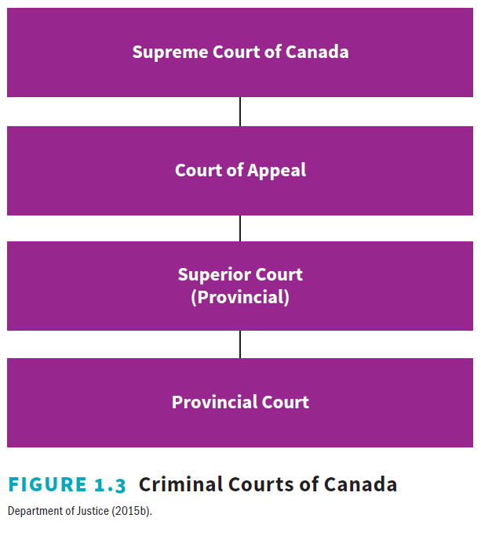
Courts
Canadian courts are based on English common-law systems.
There are four levels of courts in Canada.
Most cases related to criminal justice are heard in provincial or territorial courts.

Slide 18
Courts, cont’d
Every province has courts that hears appeals of decisions made by lower courts.
Parties who do not agree with the decisions of the appellate courts can appeal to the Supreme Court of Canada.

Slide 19
Corrections
On any given day, there are about 40,000 adults and over 800 youths incarcerated in federal and provincial/territorial correctional facilities.
104,000 adults and over 7,000 youths are serving sentences in the community.
CSC has 17 community correctional centres that allow inmates to enter the community in a structured and gradual manner.

Slide 20
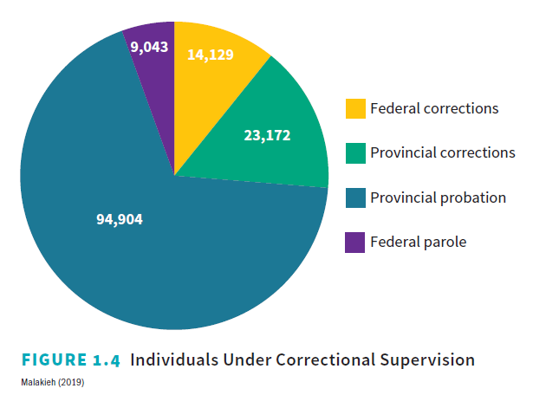
Corrections, cont’d
There are about three adult offenders serving a community sentence for every inmate in custody.

Slide 21
Common Elements in the Criminal Justice System
Cole, Smith and DeJong (2018) identify common elements in the CJS:
Discretion
Filtering
Sequencing

Slide 22
Discretion
Discretion is present in all components of the CJS.
The ability to use discretion enables workers in the CJS to operate in a more effective an efficient manner.
E.g., a police officer can caution or warn a shoplifter and then release him or her, or the officer can arrest the suspect and take him or her into custody. A prosecutor then decides whether to proceed with the charge and take the matter to court or whether to drop the matter.

Slide 23
Filtering
The concept of a funnel has been used to describe the movement of offenders through the CJS.
At every point in the system, individuals are filtered out.
In some cases, police are aware of an offence but they use their discretion to deal with an offence.
Of suspects who are arrested, some plead guilty.
Of those found guilty, only a small percentage are incarcerated and most of them serve their sentences in provincial correctional facilities.

Slide 24
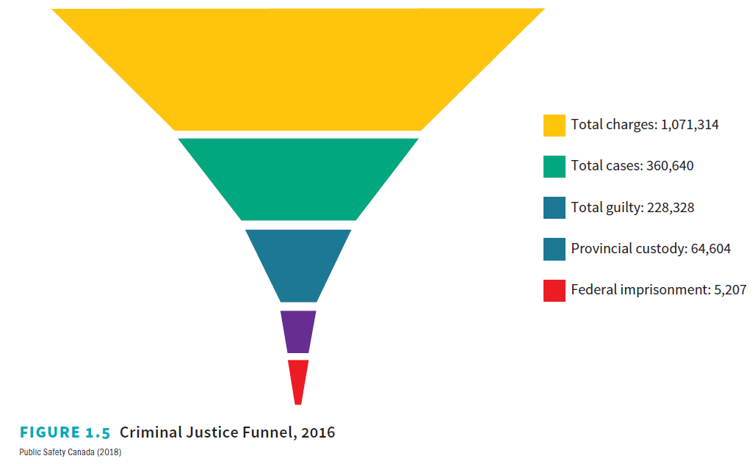
Filtering, cont’d

Slide 25
Sequencing
Canada’s system of justice is based on the principle that an accused person is innocent until found guilty beyond a reasonable doubt.
Sequencing: The treatment of persons involved in the justice system follows a set pattern that is dictated by law and policy.
E.g., the Justice system does not punish individuals before they are convicted.

Slide 26
Goals of the Criminal Justice System
Five main goals of the CJS:
Preventing crime
Protecting the public
Supporting victims of crime, their families, and witnesses
Holding people responsible for crimes they have committed
Helping offenders return to the community and become law abiding members of the community
How these goals are achieved or which one of them should be of first priority is contentious.

Slide 27
Preventing Crime
It is better to prevent a crime than to respond the offences that have already occurred.
Traditional crime prevention focuses on punishment and deterrence.
Crime is a predictable outcome of poverty, addictions, and breakdowns in the health educational and social service programs.

Slide 28
Protecting the Public
Police have the most visible role, but prosecutors help by focusing their efforts on the greatest threats to society.
Increase in non-police enforcement (e.g., security personnel)

Slide 29
Supporting the Victims of Crime, Their Families, and Witnesses
In the past, victims of crime often received shoddy treatment by justice system officials.
Often times, after a police officer took their statement, the victims were often dismissed or forgotten.
Victims rights were extended with the Canadian Victims Bill of Rights that came into effect 23 July 2015.

Slide 30
Holding Offenders Accountable
Canadians often express mixed feelings when it comes to holding individuals accountable (e.g., we will give a break to a young offender but we want violent offenders punished harshly).
Surveys suggest that most Canadians are not satisfied with the way that justice is administered (although most of us do not have any real knowledge about what actually happens in courts or in the sentencing of offenders).

Slide 31
Holding Offenders Accountable, cont’d
The death penalty was last used in 1962.
Two-thirds of Canadians polled by Angus Reid wanted capital punishment reinstated.
Why does the public want to bring back
the death penalty?

Slide 32
Helping Prisoners Return to the Community
Few prisoners will serve their entire sentence behind bars and most will receive some sort of early release.
Short sentences make it difficult to provide meaningful rehabilitative opportunities.
Once released, many ex-prisoners return to the same conditions from which they came:
Poverty
Substance abuse
Few job opportunities

Slide 33
Crime Control Model
Crime control model: Based on the philosophy that it is more important to protect society than the rights of any individual.
Supporters of the crime control model believe that people working within the justice system will act in a professional and lawful manner to carry out those goals.

Slide 34
Due Process Model
Due process model: Based on the philosophy that the justice system needs to protect the rights of a defendant.
Sometimes, police and prosecutors make mistakes that result in injustices such as wrongful convictions and the innocent need to be protected.
It is better to let ten guilty individuals walk free
than to imprison an innocent person.

Slide 35
Summary
Several important points were made in this chapter:
The main goals of the criminal justice system
The three components that make up the justice system
Packer’s (1968) classification of justice systems
Crime control model
Due process model

