Slide 1
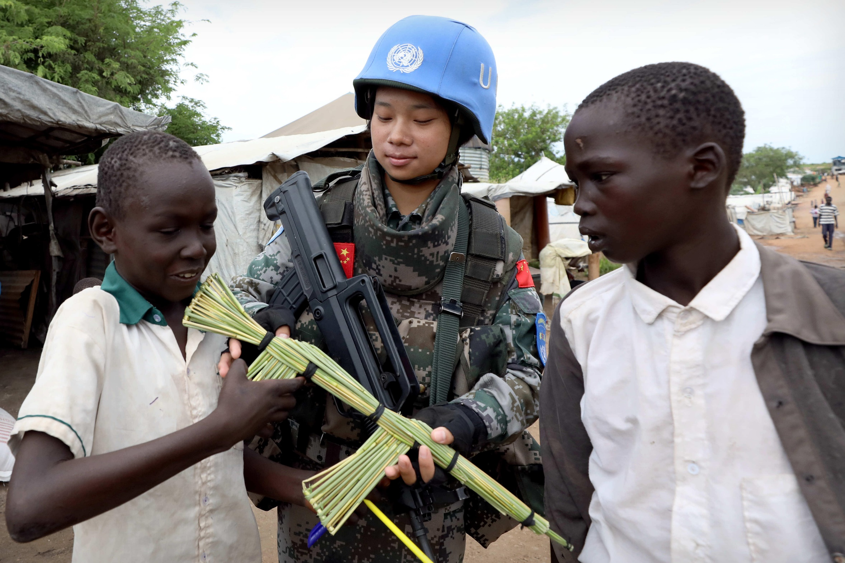
Chapter 6 International Organization: The Evolving Quest for Global Governance
Notes:
1

Slide 2
Chapter 6 International Organization: The Evolving Quest for Global Governance
Overview of IGOS
Global IGOS: Focus on the United Nations
Regional IGOS

Slide 3
Chapter 6 Learning Objectives
6.1 Discuss the various theoretical perspectives
6.2 Identify the United Nations as a global international organization
6.3 Debates related to its founding principles, structure, leadership, and operations/activities
6.4 Evaluate the relative success of international organizations

Slide 4
Overviews of IGOS 1 of 16
Many different types of IGOs
Multipurpose IGOs (UN, EU, OAS) a wide range of issues
Specialized IGOs (OPEC)
IGOs are all physical entities with organizational structures
Contentious relationship between states and IGOs

Slide 5
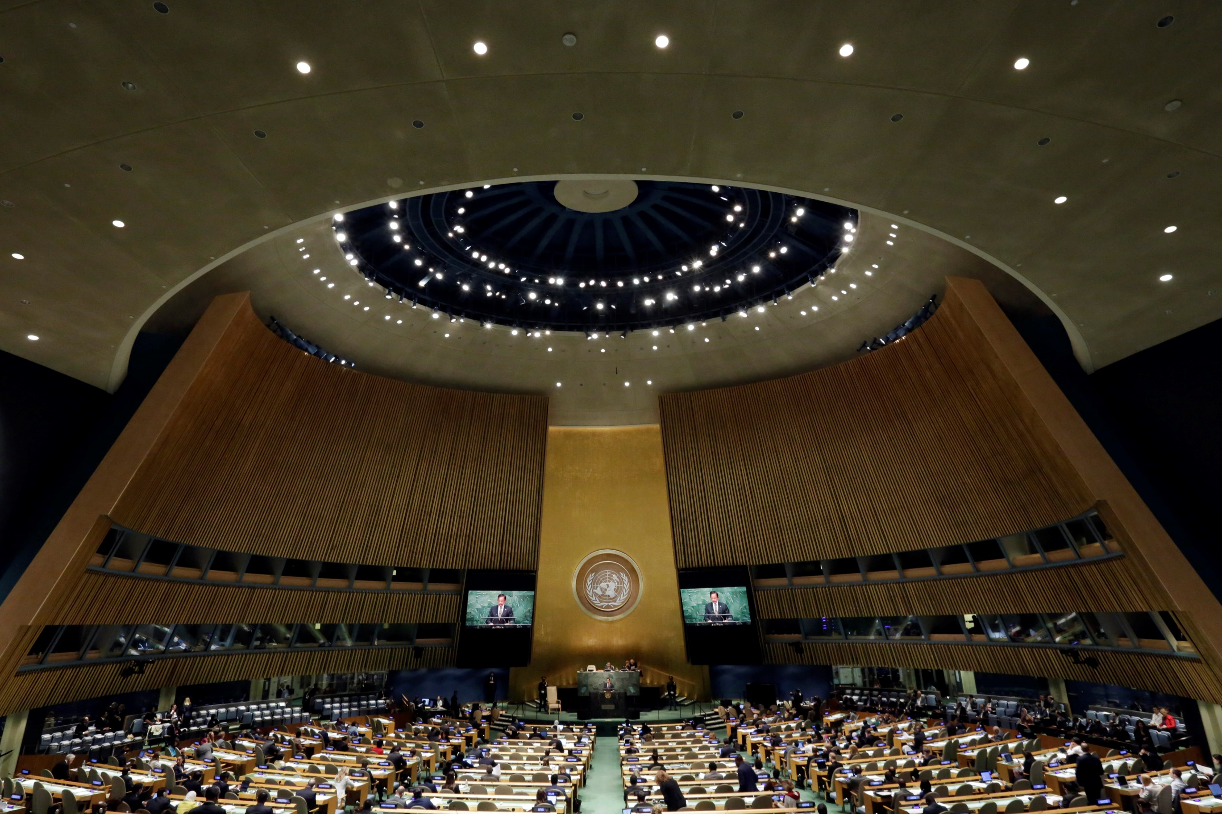
Overviews of IGOS 2 of 16

Slide 6
Overviews of IGOS 3 of 16
Why States Organize as Collectives
The existence of IGOs is not a modern phenomenon
Greek city-states established the Delian League in 478 BCE
IGOs as a means of promoting peace.

Slide 7
Overviews of IGOS 4 of 16
Why States Organize as Collectives
The formation of the EU not only to promote peace but also to foster prosperity
To create regional unity
Cooperation is strongly embedded in liberalism, particularly neoliberal institutionalism.

Slide 8
Overviews of IGOS 5 of 16
Institutionalism
Strand of liberal theory
Focus on the normative frameworks of international institutions
Creates complex interdependence that fosters cooperation

Slide 9
Overviews of IGOS 6 of 16
Functionalism
Arise from the fundamental needs of people and states
Needs are driven from the bottom up
Universal Postal Union developed in 1846

Slide 10
Overviews of IGOS 7 of 16
Functionalism
Arise from the fundamental needs of people and states
Needs are driven from the bottom up
Universal Postal Union developed in 1846

Slide 11
Overviews of IGOS 8 of 16
Functionalism
Arise from the fundamental needs of people and states
Needs are driven from the bottom up
Universal Postal Union developed in 1846

Slide 12
Overviews of IGOS 9 of 16
Neofunctionalism
Practical and incremental change
Spill-over effects
Skeptical about the functionalist
A major focus on public good
Montreal Protocol
Notes:
Public goods are those commodities that are “fully joint and nonexcludable” – that is, that (1) “consumption by one party does not reduce the amount available for consumption by another,” and (2) “once a public good or bad is made available to one party, no other party can be barred from consuming

Slide 13
Overviews of IGOS 10 of 16
Realist Responses
Realists remain skeptical
IGOs are marginal actors; lack enforcement powers
Realists see IGOs as convenient tools
States can override IGOs, as the United States did in 2003

Slide 14
Overviews of IGOS 11 of 16
Trends in IGO Formation
Primarily a modern phenomenon
Central Commission for the Navigation of the Rhine (1815)
Six IGOs were established during the 1800s

Slide 15
Overviews of IGOS 12 of 16
Trends in IGO Formation

Slide 16
Overviews of IGOS 13 of 16
Hague Convention
The first IGO dedicated to curbing, even preventing, warfare
Increased international contact.
Increased interdependence
The expansion of transnational problems
The failure of the current state-centered system
The efforts of small states to gain strength

Slide 17
Overviews of IGOS 14 of 16
How IGOs Function
Arena for Interaction
Provides a space for members
Small states use this avenue
It is sometimes politically easier to take action if an IGO has authorized it.
Helps promote the resolution of disputes without violence

Slide 18
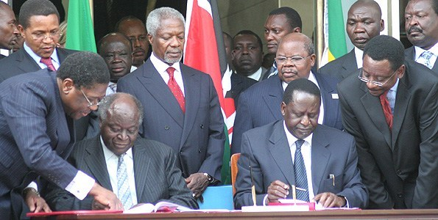
Overviews of IGOS 15 of 16
How IGOs Function
Facilitator for Cooperation
Notes:
Specific points of cooperation create complex forms of interdependence (international regimes)
Secretary-General Kofi Annan observed correctly that the UN’s “member-states face a wide range of new and unprecedented threats and challenges.
African leaders

Slide 19
Overviews of IGOS 16 of 16
How IGOs Function
Independent Political Actor
IGOs often function as agents of states
Role of independent international actors
Work through IGO secretariats
IGOs have a strong measure of autonomy

Slide 20
Global IGOS: Focus on the United Nations 1 of 8
IGO Membership: Procedures and Challenges
The UN has 193 members
The security council 15 seats and 5 permeant
General Membership Issues
Political controversy (e.g. Palestine)
Russia inherited the USSR’s veto power
Nationalist China (Taiwan)
Notes:
3. General Membership Issues:
a) The UN has near universal membership
b) Standards for admitting new members to the UN are a point of occasional political controversy (e.g. Palestine)
c) The Security Council must approve - nine votes out of fifteen and no veto from any of its five permanent members in order for Palestine to a full fledge member
d) Russia inherited the USSR’s permanent seat and veto on the Security
e) Nationalist China (Taiwan) was, in effect, ejected from the UN when the “China seat” was transferred to mainland China council.
f) Membership in an IGO Substructure
g) Controversy over Membership on the UN Security Council

Slide 21
Global IGOS: Focus on the United Nations 2 of 8
Voting Formulas and Debates
Majority voting is the most common formula
A variation to majority voting is supermajority
Weighted voting allocates unequal voting power on the basis of a formula.
Unanimity voting requires unanimous consent

Slide 22
Global IGOS: Focus on the United Nations 3of 8
Leadership
The UN Secretariat employs about 55,000
UN Secretary-General (SG) is the chief executive
Highly and complex political position
Two constituencies: The Secretariat and the member states
Standards for admitting new members

Slide 23
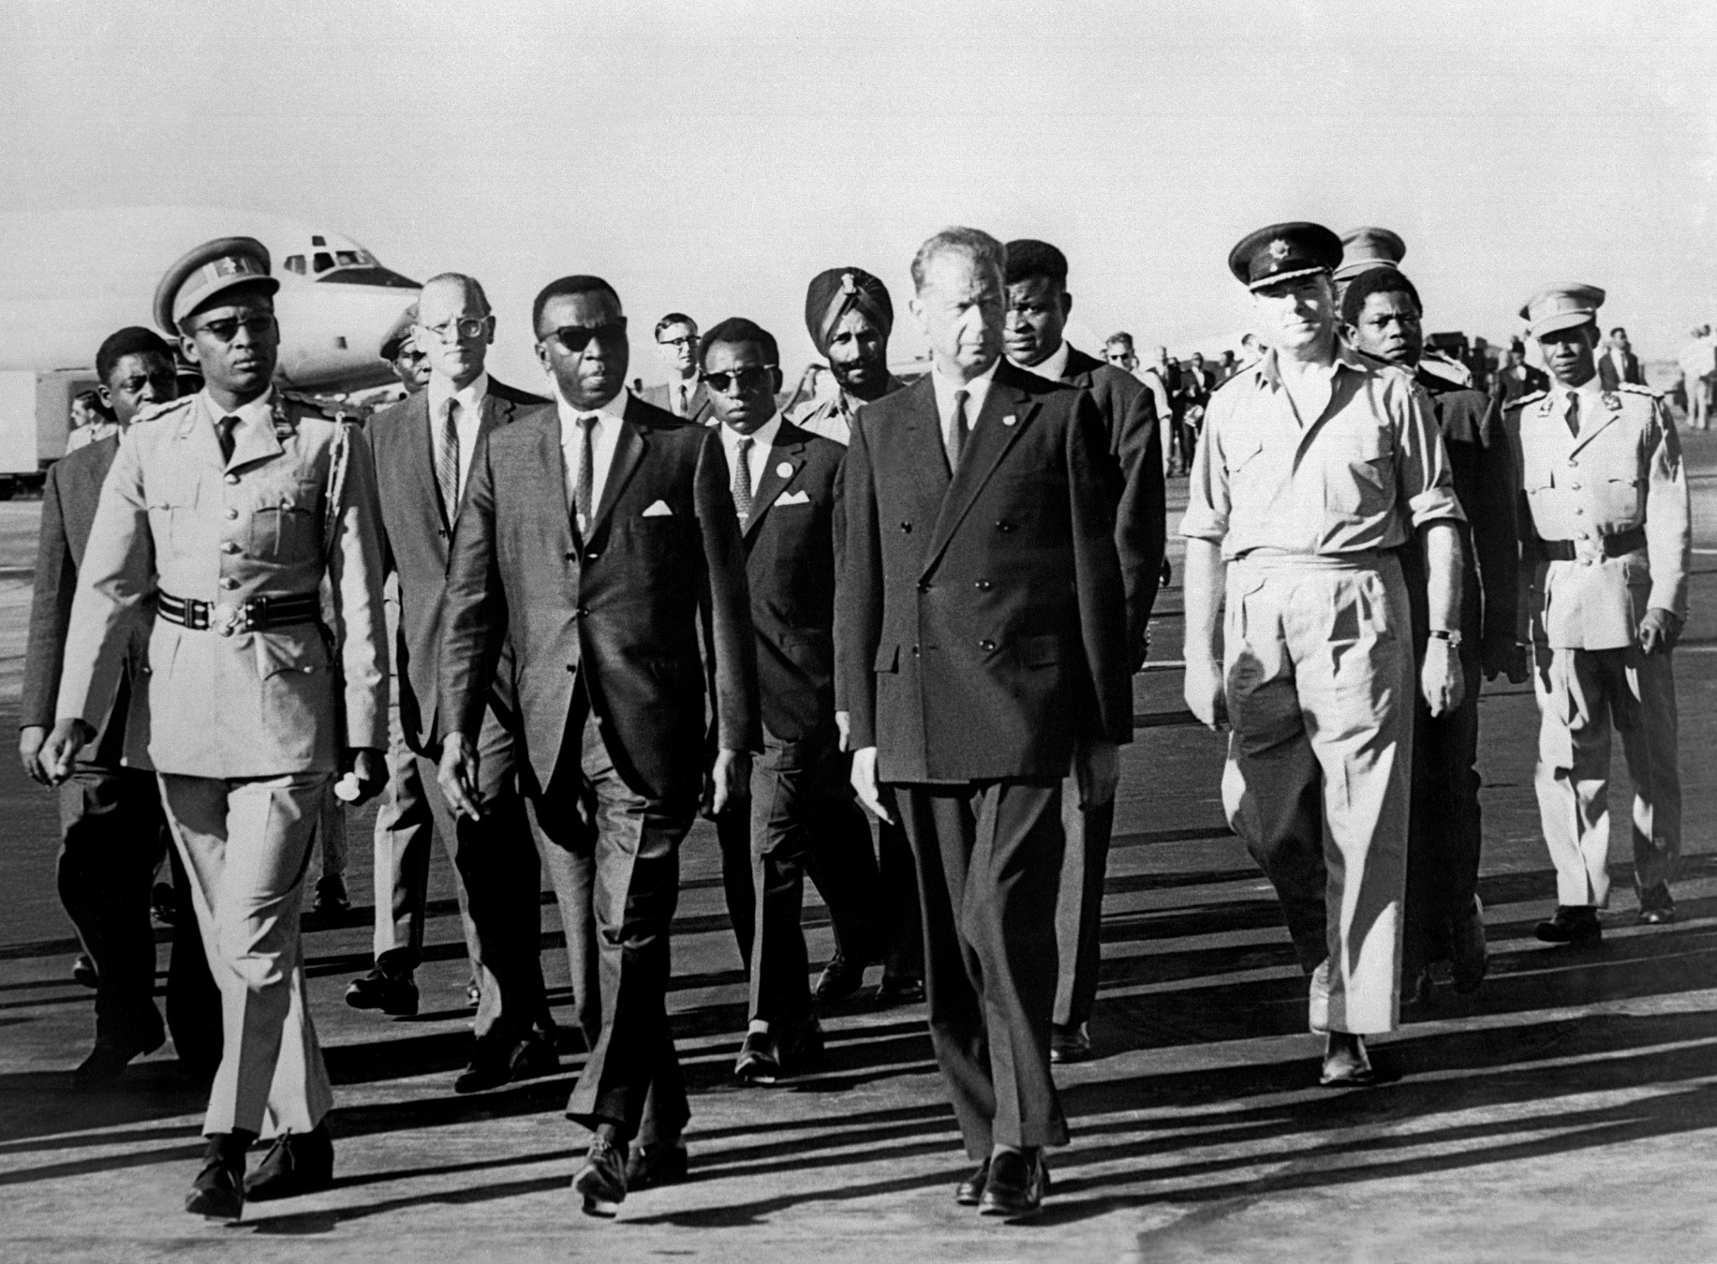
Global IGOS: Focus on the United Nations 4 of 8
Leadership

Slide 24
Global IGOS: Focus on the United Nations 5 of 8
Administration and Finance
The SG desires to balance dominant powers and its staff and other vulnerable constituencies.
2018, the gender: 61% men and 39% women.
Criticism has been the size and effectiveness Issues of funding

Slide 25
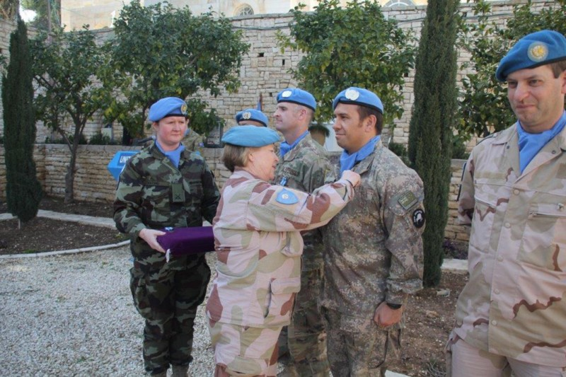
Global IGOS: Focus on the United Nations 6 of 8
Administration and Finance

Slide 26
Global IGOS: Focus on the United Nations 7of 8
Activities and Behaviors
Peace and Security Goals
Promoting arms control and disarmament
Peacekeeping is the best-known way that the UN
Declaration of Human Rights
Trusteeship Council

Slide 27
Global IGOS: Focus on the United Nations 8 of 8
Activities and Behaviors

Slide 28
Regional IGOS
B. The Association of Southeast Asian Nations (ASEAN)
Increase in the number of Regional IGOs
Community of West African States (ECOWAS)
Success with (MDGs) more work is needed
The European Union

Slide 29
Chapter 6 Review of Learning Objectives
6.1 Discuss the various theoretical perspectives
6.2 Identify the United Nations as a global international organization
6.3 Debates related to its founding principles, structure, leadership, and operations/activities
6.4 Evaluate the relative success of international organizations

