Slide 1
CHAPTER 11. HEALTH SOCIAL WORK WITH OLDER ADULTS IN MEDICAL CONTEXTS: DEMENTIA
Human Behavior for Social Work Practice
Power Point format & design by: Bailey Jader, University of Minnesota
Photo Credit: Pixabay

Slide 2
Objectives
Underscore how biological, psychological & social factors interact w/cultural & historical contexts to influence physical health in later adulthood
Understand unique role health social workers play in supporting people w/ Alzheimer’s disease
Demonstrate value of social work directly linked to health clinics, hospitals & community public health
Photo Credit: Unsplash
Notes:
The major learning objectives for this chapter are:
underscore how biological, psychological, and social factors interact within specific cultural and historical contexts to influence physical health in later adulthood.
Understand the unique role health social workers play in supporting individuals with Alzheimer’s disease and their families.
Demonstrate the value of social work directly linked to health clinics, hospitals, and community public health.

Slide 3
Older Adults
Older adults = 65yrs-death
New trend for people to work past 65yrs
Elderly people worldwide projected to increase in coming decades
Aging population burdened w/ more illness
Increasing lifespan brings challenges; financing & managing retirement more difficult
Photo Credit: Unsplash
Notes:
Older adults are comprised of individuals aged approximately 65 years until death.
However, because of improved medical care, diet, and living/work conditions in the Western world the point where “older adulthood starts is moving beyond the age of 65.
There is a new trend for people to work past the age of 65.
The number of elderly people worldwide is projected to increase in coming decades.
An aging population generally will be burdened with more illness.
Moreover, because of increasing lifespan the challenges of financing and managing retirement is becoming more difficult.
At the same time, fewer young workers will be available to assist the elderly or pay taxes.

Slide 4
Older Adults
As life expectancy increases, more individuals w/disabilities & chronic illness
Dementia = cognitive impairment sufficient to disrupt everyday activities
Most common form = Alzheimer’s
Aging = period of life where developmental changes create new avenues for growth/rewards & hazards/limitations
Healthy aging + developmental process w/ same potential for new self-knowledge, relationships, spirituality & achievements
Photo Credit: Unsplash
Notes:
As life expectancy increases, more individuals will live for extended periods with disabilities and chronic illness.
Dementia is characterized by cognitive impairment sufficient to disrupt everyday activities.
The most common form of dementia is Alzheimer's disease.
Aging is another period of life in which developmental change create new avenues for growth and rewards, as well as hazards and limitations.
Healthy aging is a developmental process and has the same potential for new self-knowledge, relationships, spirituality and achievements.

Slide 5
Older Adults
80% Americans 65+ have one+ chronic medical disorder; 50% suffer 2+ serious long-term illnesses
Social workers must become stronger advocates for older adults securing/protecting retirement income, disability benefits & health insurance
Older adults in communities of color experience more health problems accessing medical services
Most receive lower wages over lifetime = less retirement income
Photo Credit: Unsplash
Notes:
Eighty percent of Americans 65 and older have at least one chronic medical disorder, and 50% suffer from two or more serious long-term illnesses.
Obesity, dietary choices, and reduced exercise contribute to the onset of diabetes in adulthood.
Social workers must become stronger advocates for older adults in securing and protecting retirement income, disability benefits, and health insurance for low-income people.
Older adults in our communities of color generally experience more health problems and more difficulties accessing medical services.
Additionally, they most often receive lower wages over their life time, and therefore, have less retirement income.

Slide 6
Health Social Work w/ Older Adults
Social workers encounter aging adults in health-care settings: hospitals, assisted-living facilities & nursing homes
Health social work (or medical social work):
Sub-specialization focuses on impact of disease/disability on all ages
Health social workers act as:
Translators of medical info to patients/families
Providers of psychosocial information about patients/families to physicians
Photo Credit: Pixabay
Notes:
Social workers encounter many aging adults in health-care settings such as hospitals, assisted-living facilities, and nursing homes.
Health social work (or medical social work) is
a sub-specialization that focuses on the impact of disease and disability on individuals of all ages, their families, and communities.
Health social workers act as:
Translators of medical information to patients and their families; and
Providers of psychosocial information about patients and their families to physicians.

Slide 7
Health Social Work w/ Older Adults
Health social workers:
Understand patient’s physical condition & role in family/community affected by person’s health
Address social problems, facilitate & extend medical treatment
Help patients/families cope with & adapt to changes
Connect patients to appropriate services
Create/maintain safety net when people don’t qualify for needed services
Photo Credit: Pixabay
Notes:
Health social workers:
understand the patient’s physical condition and role within a family and community that is affected by that person’s health.
address social problems arising directly out of medical treatment to facilitate and extend medical treatment.
help patients and families cope with and adapt to changes brought about by illness, medical treatment, and disability.
connect patients to appropriate services and
create or maintain a safety net for those who do not qualify for needed services.

Slide 8
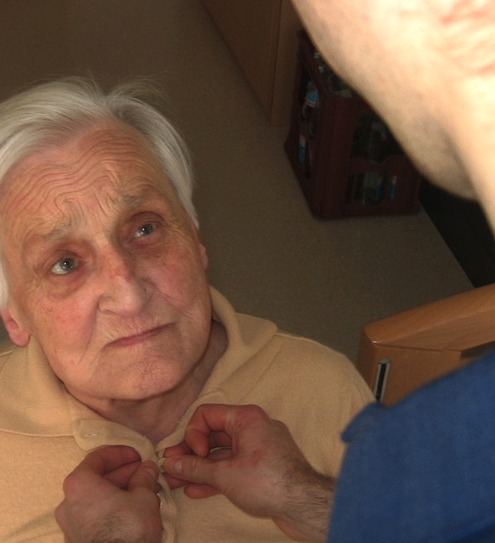
Health Social Work w/ Older Adults
Work in settings w/ transdisciplinary professionals
Share holistic approach to promoting health/wellness; includes how individuals, families, communities adjust to illness/medical treatment, & help define social health-care needs
Work to alert patients & families of health state, limitations, community services
Client's decision to accept/refuse services
Photo Credit: Pixabay
Notes:
Health social workers work in various settings with transdisciplinary teams of professionals.
Settings include
hospitals,
outpatient primary-care settings,
home health care,
long-term care facilities,
public health departments,
community health-care clinics,
school-based health clinics,
associations focused on specific illnesses.
Health social workers share a holistic approach to promoting health and wellness, which includes:
how individuals, families and communities adjust to illness and medical treatment, and help define what social health-care needs must be addressed.
Health social workers work to alert patients and their families of their health state, limitations, and available community services.
However, it ultimately is the decision of the client to accept or refuse services.

Slide 9
Overview of Development in Later Adulthood
Erikson describes final stage of psychosocial development as crisis of identity vs. despair; occurring 65+yrs.
Some feel at peace & absence of regret/recrimination
Others feel they’ve wasted opportunities & regret
Part of role to help 65+ accept past without feeling pain & find peace in daily life
Photo Credit: Unsplash
Notes:
Erikson describes a final stage of psychosocial development as the crisis of identity versus despair, typically occurring after the age of 65.
A Self-review may result in feeling at peace with oneself, and an absence of regret or recrimination.
For others the review may also result in feelings of wasted opportunities and regret.
Part of the social work role is to help aging individuals accept the past without feeling mental pain and continue to find peace in their daily life.

Slide 10
Overview of Development in Later Adulthood
Erikson considered psychosocial themes as less sequentially constrained by chronological periods than conventionally connoted by term “stage”
Life experiences may result in re-balancing of Erikson’s psychosocial themes across lifespan
Some believe later adulthood divided into periods:
“Young-old” (65-74yrs.)
“Middle-old” (75-85yrs.)
“Old-old” (85+yrs.)
Photo Credit: Pixabay
Notes:
In his later writing, Erikson considered various psychosocial themes as less sequentially constrained by chronological periods than conventionally connoted by the term “stage.”
Individual life experiences may result in a re-balancing or re-working of any of Erikson’s eight psychosocial themes across the lifespan.
Some scholars believe that later adulthood should be divided into periods:
“Young-old” ages 65 to 74
“Middle-old” ages 75 to 85
“Old-old” ages 85 and older

Slide 11
Overview of Development in Later Adulthood
“Young-old” (65 -74yrs.)
May be active w/ employment, community, families & friends
Begin to experience chronic illness & women outliving spouses
“Middle-old” (75-85yrs.)
Live more constricted lives & experience more physical impairments
Have more chronic diseases
Experience stress from loss of spouses, relatives & friends
Some enjoy mastered skills & meaningful family/peer relationships
Photo Credit: Pixabay
Notes:
“Young-old” ages 65 to 74:
May be active within employment, community and with families and friends;
Begin to experience chronic illness, and the phenomenon of women outliving their spouse emerges.
“Middle-old” ages 75 to 85:
Typically live more constricted lives and experience more physical impairments;
Have more chronic diseases;
Experience stress due to loss of spouses, relatives, and friends.
However, some find this is the age where they can enjoy having mastered skills and built meaningful family and peer relationships.

Slide 12
Overview of Development in Later Adulthood
“Old-old” (85+):
Most likely to be dependent & frail
Experience more disabilities/chronic illness
High probability person out-lived most relatives/friends
Functional age = ability to perform activities of daily living (ADLs).
ADLs = cooking, dressing, bathing; require cognitive & physical well-being
ADLs determine whether 85+ can continue to live in own homes
Photo Credit: Pixabay
Notes:
“Old-old” ages 85 and older:
Most likely to be dependent and frail;
Experience more disabilities and chronic illness.
Additionally, there is a high probability that the person has out-lived most relatives and friends.
Therefore, social workers can help the person overcome loneliness, and the fears of being alone.
Functional age refers to one’s ability to perform activities of daily living (ADLs).
ADLs include cooking, dressing, and bathing.
These skills require cognitive and physical well-being.
ADLs typically determine whether older adults can continue to live in their own homes, as most prefer

Slide 13
Overview of Development in Later Adulthood
Functional assessments include:
Attention to strengths
Emotional control
Problem-solving skills
Memory
Mobility
Social network
Economic stability
Physical & mental health
Social workers; consider older adults’ functional age to avoid making decisions from stereotypical perspective of aging
Photo Credit: Pixabay
Notes:
Functional assessment of older adults include
attention to strengths,
emotional control,
problem-solving skills,
memory,
mobility,
social network,
economic stability, and
physical and mental health.
Social workers need to consider older adults’ functional age to avoid making decisions from a stereotypical perspective of aging.

Slide 14
Overview of Development in Later Adulthood
Cultural context impacts aging.
Some contexts, elderly = wise; others, = burden
Changing demographics impact older adults differently:
Countries predicted to have larger youth populations face different issues than countries w/decreasing youth
Photo Credit: Pixabay
Notes:
Cultural context also impacts aging.
In some cultural contexts the elderly are revered as wise.
In others a burden on their families.
Changing demographics in different countries will impact older adults differently:
Countries that are predicted to have larger youth populations in the coming decades (e.g. Angola and Afghanistan), will face very different issues than
countries with decreasing youth and increasing aging populations (e.g. Japan and Sweden).

Slide 15
Overview of Development in Later Adulthood
International policy must address future conflicts over resources & migration as countries shift demographics over next decades
Policies protecting & vulnerable populations as natural resources decrease will need to be developed
Photo Credit: Pixabay
Notes:
International policy will have to address future conflicts over resources and migration as countries shift their demographics over the next few decades.
Policies protecting the aging and other vulnerable populations as natural resources decrease (such as water) will need to be developed.
Social work can play a vital role in alerting the macrosystem of the need for policies that protect the aging and others from decreasing natural resources.

Slide 16
Biological Factors: Physical Aging, Death & Dying
By age 30, bones reached max growth & process of deterioration started
Internal organs lose approx 1% function ability/year
Ongoing erosion increases risk for debilitating/life-threatening diseases
Good prevention efforts enhance quality of life in later adulthood
In U.S., aging more difficult than necessary; illness prevention not emphasized until 40-60yrs.
Final stage of physical development = death
Photo Credit: Pixabay
Notes:
By the age of 30, bones have reached their maximum growth, and the process of slow deterioration toward brittleness has started.
Internal body organs lose their ability to function by approximately 1% per year.
This slow, ongoing erosion increases risk for debilitating and life-threatening diseases such as diabetes, heart disease, and arthritis.
Good prevention efforts can enhance the quality of life in later adulthood.
For many in the United States, aging is more difficult than necessary because illness prevention is not emphasized until people are between 40 and 60 years of age.
Prevention for major physical disorders needs to begin no later than the age of 30 in many cases.
The final stage of physical development is death.
Eventually, the dying person becomes unresponsive, and breathing stops.
The legal and ethical requirements of determining death can be complicated.

Slide 17
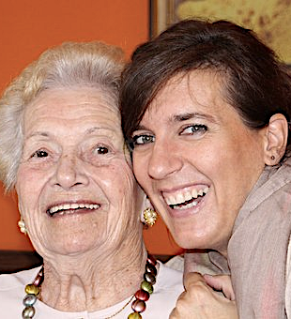
Psychological & Social Factors: Vital Involvement, Coming to Terms w/ Death
Health social workers identify aspects of life meaningful to individual, strengths & assets & considers individual/environmental deficits
Goal = support person to engage aspects of life they draw meaning & satisfaction
Individuals, families & friends must respond to mortality & loss
Elisabeth Kübler-Ross (1969) psychological aspects of dying; denial, anger, bargaining, depression & acceptance
Photo Credit: Pixabay
Notes:
Health social workers identify aspects of life that are meaningful to the individual, their strengths and assets, and considers individual and environmental deficits.
The goal is to support the person in remaining engaged in those aspects of life from which they draw meaning and satisfaction, for as long as possible.
Individuals, their families, and friends must eventually respond to mortality and loss.
Elisabeth Kübler-Ross (1969) describes the psychological aspects of dying as:
Denial
Anger
Bargaining
Depression
Acceptance

Slide 18
Psychological & Social Factors: Vital Involvement, Coming to Terms w/ Death
Stages occur in any order, repeat & some don’t experience all stages
Stages may be more prominent at various phases in life cycle
Social workers support clients facing life’s end or grieving families & friends
Can be challenging; helpful to reflect on own beliefs about death/dying & relate to clients
Photo Credit: Pixabay
Notes:
These stages can occur in any order, can be repeated numerous times, and some people never experience all the stages.
Certain stages may be more prominent at various phases in the life cycle
As an example, acceptance may be more difficult to achieve when death occurs at a younger age.
Social workers support clients who are facing life’s end, or their grieving families and friends.
This can be challenging, and it is helpful to reflect upon how our own beliefs about death and dying relate to those of our clients.
Interpersonal communication skills are an asset in having these conversations.

Slide 19
Sociocultural-Historical Context: Caring for the Elderly & Dying
Western society puts responsibility for adapting on aging person
Social work assessments help us understand negative perceptions, motivation problems, & reduced activity stem from environmental, not psychological or neurological deficits
Physiological changes w/age come into conflict w/cultural priorities & values
Photo Credit: Pixabay
Notes:
Western society generally places responsibility for adapting on the aging person.
Notice how public opinion and professional assessments focus on the aging individual’s physical health and psychological adjustment
Social work assessments can help professional teams, families, clients, and communities understand that negative perceptions, motivation problems, and reduced activity may stem more from environmental than from psychological or neurological deficits.
Physiological changes occurring with age can come into conflict with cultural priorities and values.
Society, as an example, may more value youthful appearance, energy, and productivity over wisdom and experience.

Slide 20
Sociocultural-Historical Context: Caring for the Elderly & Dying
Care of elderly/dying people depersonalized
Before 1940, families in U.S. cared for older adults at home
Today, 80% of deaths in U.S. in hospitals, nursing homes, institutions
Professionals also play role in depersonalization of death
After person dies, medical, police & emergency-care providers stop referring to deceased by name
Photo Credit: Unsplash
Notes:
Care of many elderly and dying people has become depersonalized.
Before 1940, families in the United States generally cared for older adults at home.
Today, 80% of all deaths in the United States take place in hospitals, nursing homes, or other institutions.
Professionals also play a role in the depersonalization of death.
Almost immediately after a person dies, medical, police, emergency-care providers, and others stop referring to the deceased by name.

Slide 21
Global Perspective on Death & Dying
Leading causes of death for older people in industrialized world shifted from infectious diseases to chronic/degenerative physical/mental disorders
Developing nations, probability life ended because of acute, treatable illness higher
Photo Credit: Unsplash
Notes:
The leading causes of death for older people living in the industrialized world have shifted from infectious diseases to chronic and degenerative physical and mental disorders.
For people in developing nations, the probability that life will be ended because of an acute, but treatable, illness is great.

Slide 22
Dementia: Developmental, Ecological-systems Analysis
Brain changes occur w/ aging & impact:
Cognitive functioning
Information-processing speed
Motor accuracy
Flexibility
Memory
Verbal fluency
Dementia = umbrella term, covers disorders resulting in loss of intellectual functions
Common diagnoses = Alzheimer’s, vascular, Huntington’s & AIDS dementia
Photo Credit: Unsplash
Notes:
Brain changes occur with aging.
These neurobiological changes impact:
cognitive functioning,
information-processing speed
motor accuracy,
flexibility,
memory, and
verbal fluency.
Dementia, an umbrella term that covers a set of disorders that result in a progressive loss of intellectual functions.
Diminished intellectual abilities include short-term memory, judgment, and language.
Common diagnoses include Alzheimer’s, vascular, Huntington’s, and AIDS dementia.

Slide 23
Dementia: Developmental, Ecological-systems Analysis
Many conditions result in confusion & cognitive problems
Symptoms of confusion/cognition resolved w/ proper medical care
Acute/chronic pain, hypothyroidism, malnutrition & medication side effects common & reversible causes of impaired cognition
Alzheimer’s = most common type of dementia & major cause of disability in older adults
Social work & medical services needed for approx. 14 million North Americans living w/Alzheimer’s disease predicted in 2050
Photo Credit: Pixabay
Notes:
Many medical conditions can result in confusion and cognitive problems.
Many symptoms of confusion and cognition can be resolved with proper medical care.
Acute or chronic pain, hypothyroidism, malnutrition, and medication side effects are common and reversible causes of impaired cognition.
Alzheimer’s disease is the most common type of dementia and a major cause of disability in older adults.
Social work and medical services will be needed for approximately 14 million North Americans living with Alzheimer’s disease predicted in 2050.

Slide 24
Biological Factors of Alzheimer’s Disease
Neurofibrillary tangles = bundles of collapsed & twisted neural structures
Amyloid plaques = deposits of material from dead neurons, destroys surrounding neurons & communication networks
Low levels of neurotransmitters necessary for communication between neurons also occurs in Alzheimer’s
Brain changes rob clients of memory, problem-solving skills, insight & control of moods
Photo Credit: Pixabay
Notes:
Neurofibrillary tangles are bundles of collapsed and twisted neural structures.
Amyloid plaques are deposits of material from dead neurons that destroy surrounding neurons and their communication networks.
Low levels of neurotransmitters necessary for communication between neurons is also occurs in Alzheimer’s disease.
These brain changes progressively rob clients of memory, problem-solving skills, insight, control of moods, and, life itself.

Slide 25
Psychological Factors of Alzheimer’s Disease
Alzheimer’s disease advances in three behavioral stages; each stage marked by increase in symptom severity & new problems: early, middle & late-stage
Symptoms of Alzheimer’s:
Anomia: difficulties in naming known people & objects
Palilalia: repeating own words
Echolalia: repeating words spoken by someone else
Mutism: inability to speak
Myoclonus: sudden & uncontrolled contraction of muscles
Photo Credit: Pixabay
Notes:
Alzheimer’s disease advances in three behavioral stages, with each new stage marked by an increase in symptom severity and new problems
Early-stage
Middle-stage
Late-stage
Symptoms of Alzheimer’s include:
Anomia: difficulties in naming known people and objects
Palilalia: repeating one’s own words
Echolalia: repeating words spoken by someone else
Mutism: inability to speak
Myoclonus: sudden and uncontrolled contraction of muscles

Slide 26
Social & Cultural Factors of Alzheimer’s Disease
Caring for older adults w/ Alzheimer’s requires substantial time in caregiving tasks
Caring for loved one w/Alzheimer’s = stressful
Many caregivers & family find support & info through Alzheimer’s Association:
Provides info about disease progression, symptoms & interventions
Connects families to help lines, home care, adult day care, assisted living, skilled nursing facilities, elder-care lawyers & transportation
Photo Credit: Pixabay
Notes:
Caring for older adults with Alzheimer’s disease requires substantial time in caregiving tasks.
Even with health education and support, caring for a loved one with Alzheimer’s disease is stressful.
Many caregivers and family members have found support and information through the Alzheimer’s Association, which provides:
information regarding the disease progression, symptoms, and interventions.
The Association also help connect families to help lines, home care, adult day care, assisted living, skilled nursing facilities, elder-care lawyers, and transportation.

Slide 27
Intervention for Alzheimer’s
Treatment for Alzheimer’s requires:
Specific medical interventions & supervision
Behavioral management & control of symptoms
Prevention of additional physical/emotional problems
Family support
Newer medications successful at slowing rate of cognitive decline
Currently no treatments to reverse/cure Alzheimer’s
In late stage, cognitive disabilities force patients into assisted living/nursing homes
Photo Credit: Pixabay
Notes:
Treatment for Alzheimer’s disease requires:
(1) specific medical interventions and supervision;
(2) behavioral management and control of symptoms;
(3) prevention of additional physical and emotional problems; and
(4) family support
Newer medications are successful in slowing the rate of cognitive decline.
However, there are currently no treatments to reverse or cure the brain pathology of Alzheimer’s disease.
In the late stage, cognitive disabilities force many patients into assisted living and nursing home facilities.

Slide 28
Intervention for Alzheimer’s
Control of dangerous behaviors caused by Alzheimer’s requires:
Appropriate use of medications
Humane behavior modification
Cognitive training
Social support
Environmental manipulations
Photo Credit: Unsplash
Notes:
The control of dangerous behaviors sometimes caused by Alzheimer’s disease requires:
Appropriate use of medications;
Humane behavior modification;
Cognitive training;
Social support; and
Environmental manipulations

Slide 29
Intervention for Alzheimer’s
Goals of health social work w/Alzheimer’s include:
Helping clients maintain personal control, self-empowerment & dignity
Screen/assess hidden & obvious signs of physical/mental neglect, physical/sexual assault & financial theft
Aiding family in locating facilities that provide humane care
Developing individual home treatment plans
Photo Credit: Unsplash
Notes:
Goals of health social work with Alzheimer’s disease include:
help clients maintain as much personal control, self-empowerment, and dignity as possible;
screen and assess hidden and obvious signs of physical and mental neglect, physical and sexual assault, and financial theft;
aiding the family in locating facilities that provide humane care,
developing individual home treatment plans,
case managing evidence-based medical and social interventions;
providing specialized behavioral and cognitive interventions to the client;
helping the family resolve feelings of anger, guilt, and grief;
helping families remain focused on the realities of Alzheimer’s disease and not being misled by false hopes.

Slide 30
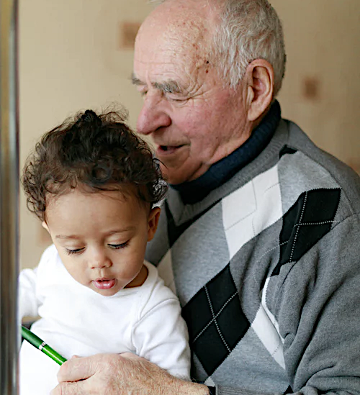
Intervention for Alzheimer’s
Goals of health social work w/Alzheimer’s include:
Case managing evidence-based medical & social interventions
Providing specialized behavioral/cognitive interventions
Helping family resolve feelings of anger, guilt & grief
Helping families remain focused on realities of Alzheimer’s; not being misled by false hopes
Photo Credit: Unsplash
Notes:
Goals of health social work with Alzheimer’s disease include:
case managing evidence-based medical and social interventions;
providing specialized behavioral and cognitive interventions to the client;
helping the family resolve feelings of anger, guilt, and grief;
helping families remain focused on the realities of Alzheimer’s disease and not being misled by false hopes.

Slide 31
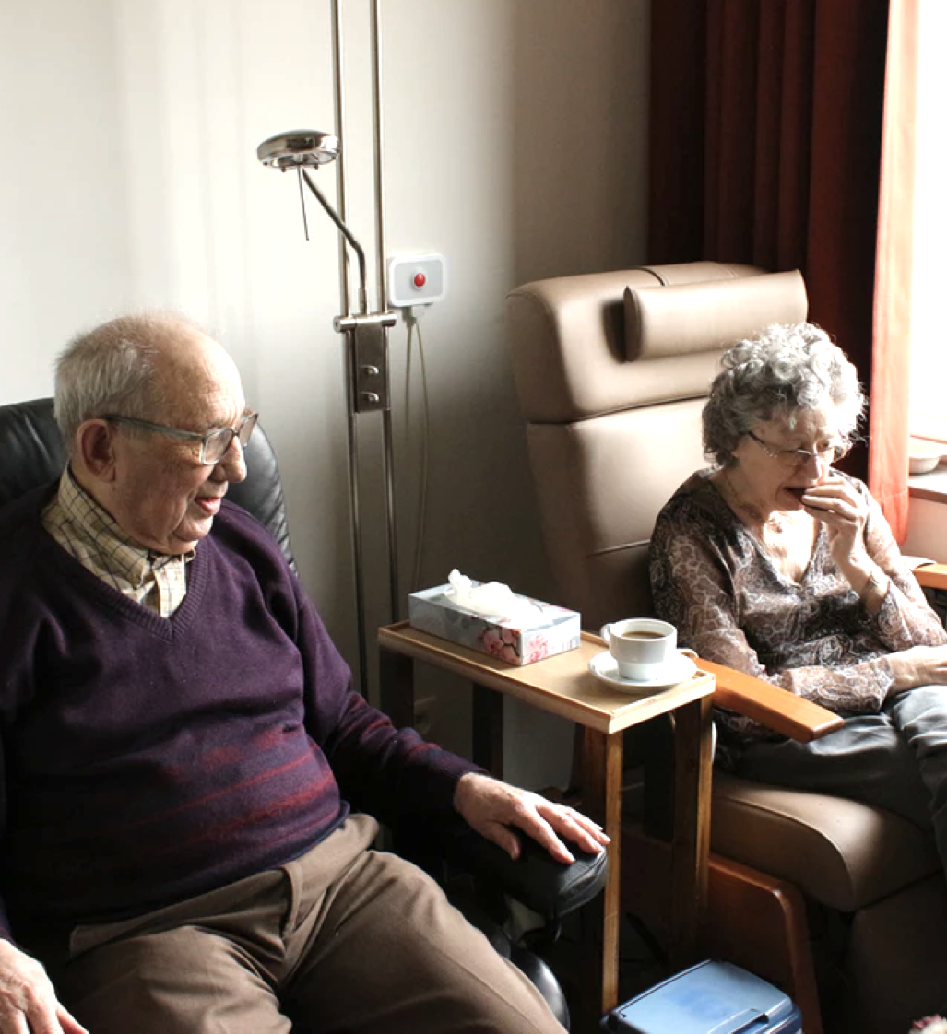
Summary
Later adulthood = developmental period, may be characterized by sense of fulfillment, meaningful relationships & continued curiosity about world
Also period where all individuals experience significant loss & death
Health social workers can function as part of transdisciplinary team of health-care professionals to provide support, specific cognitive/behavioral interventions & education for individuals & families suffering from Alzheimer’s
Photo Credit: Unsplash
Notes:
Later adulthood is a developmental period that may be characterized by a sense of fulfillment, meaningful relationships, and continued curiosity about the world.
It is also a period in which all individuals eventually will experience significant loss and death.
Health social workers can function as part of a transdisciplinary team of health-care professionals to provide support, specific cognitive and behavioral interventions, and education for individuals and families suffering from Alzheimer’s disease.

