Slide 1
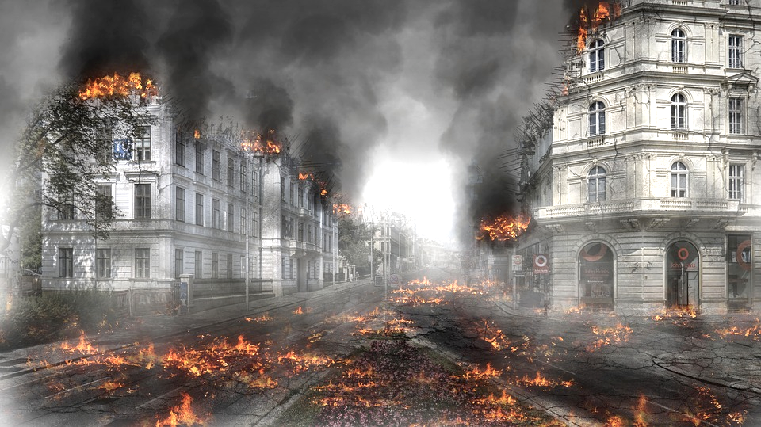
CHAPTER 15. TERRORISM & MASS MURDER: IMPACTS ACROSS THE LIFESPAN & AROUND THE GLOBE
Human Behavior for Social Work Practice
Power Point format & design by: Bailey Jader, University of Minnesota
Photo Credit: Pixabay

Slide 2
Objectives
Recognize people facing new challenges as result of terrorism & mass murder worldwide
Understand consequences of terrorism & mass murder for both victims & perpetrators
Discuss school shootings as example of mass murder
Understand how people become drawn into violent actions & impact it has on human behavior & development across lifespan
Photo Credit: Pixabay
Notes:
The major learning objectives for this chapter:
Recognize that people are facing new challenges as a result of terrorism and mass murder worldwide.
Understand the consequences of terrorism and mass murder for both victims and perpetrators.
Discuss school shootings as an example of mass murder.
Understand how individuals become drawn into violent actions, and the impact it has on human behavior and development across the lifespan.

Slide 3
Social Work with Terrorism & Mass Murder
Terrorism & mass murder affect people around world from infancy through later adulthood
Social workers must consider impact of violence on human behavior & development
Photo Credit: Pixabay
Notes:
Terrorism and mass murder affect people around the world from infancy through later adulthood.
Social workers need to consider the impact of such violence on human behavior and development.

Slide 4
What is Terrorism?
Each nation defines concept consistent w/ own national interest
Political leaders don’t want classification that links to international law & limits ability to support groups perceives as serving national interests
Nations avoid definitions for fear military & covert actions qualify as terrorism
Photo Credit: Pixabay
Notes:
Each nation defines the concept in a manner consistent with their national interest.
Political leaders do not want a classification that links to international law and limits their ability to support groups they perceive as serving their national interests.
Nations avoid definitions out of fear that their military and covert actions will qualify as terrorism.

Slide 5
What is Terrorism?
Author’s definition provided below informed by UN, UK & US policy definitions:
Terrorism: use of violence/threats by people w/ minimal political power to intimidate governments & civilians to achieve goals of political, social, religious or other beliefs
Terrorists’ aim to cause government instability, replace cultural leaders & re-build society according to own ideologies
Photo Credit: Canadian Inquirer
Notes:
The author’s definition of terrorism, provided below, is informed by the UN, UK and US policy definitions:
Terrorism is the use of violence or threats of violence by individuals with minimal political power to intimidate governments and their civilians to achieve the goals of their political, social, religious or other belief systems.
Terrorists’ grand aim is to cause government instability, replace cultural leaders, and re-build society according to their own ideologies.

Slide 6
What is Terrorism?
Violent attacks used to create fear, create chaos & recruit
Fear triggers citizen participation in spontaneous group actions
Terrorism associated w/ international organizations (Al-Qaeda & Islamic State of Iraq &Syria (ISIS))
Domestic groups also commit terrorism:
Oklahoma Federal building bombing committed by former U.S. military personnel
August 2019 El Paso Texas Walmart attack committed by person w/ “white nationalist” racists beliefs
Photo Credit: Pixabay
Notes:
Violent attacks are used to:
Create fear
Generate unruliness or civilian chaos
Recruit new individuals
Fear can trigger citizen participation in spontaneous chaotic group actions.
We often associate terrorism with international organizations such as Al-Qaeda and the Islamic State of Iraq and Syria (ISIS).
Keep in mind, however, that domestic groups also commit to terrorism.
The bombing of the Oklahoma Federal building (the second deadliest terrorist attack in the U.S.) was committed by U.S. citizens who were former military personnel.
The August 2019 El Paso Texas Walmart attack was an act of terrorism committed by a person who acknowledged “white nationalist” racists beliefs.

Slide 7
Where Does Terrorism Occur?
Global Terrorism Index (GTI) ranks countries based on terrorist activity within each nation
2017, U.S. had fewer terrorist attacks than 19 of 50 countries
Canada & Mexico < top 50 countries most targeted by terrorists
2018, Europe experienced 142 failed, prevented or completed terrorist attacks
6 credited to Islamic State & radicalized Muslim groups
136 attacks by nationalist & separatist extremists, religious leftist & right-wing extremists
Photo Credit: Wikipedia
Notes:
The Global Terrorism Index (GTI) annually ranks countries according to the amount of terrorist activity within each nation.
According to the GTI, in 2017 the United States had fewer terrorist attacks than 19 out of 50 countries.
Canada and Mexico did not make the top 50 countries most targeted by terrorists.
In 2018, Europe experienced 142 failed, prevented or completed terrorist attacks.
6 attacks were credited to the Islamic State or other radicalized Muslim groups.
136 attacks were carried out by nationalist and separatist extremists, along with religious, leftist and right-wing extremists.

Slide 8
Where Does Terrorism Occur?
GTI reports most terrorist attacks in 2017 occurred in Iraq
Worldwide, modest decrease in terrorist attacks
Possibly due to policies/practices associated w/ “war on terror”
Social workers advocate & join w/ groups who experienced social injustice as result of negative consequences of war on terror
Photo Credit: Pixabay
Notes:
GTI reports that most terrorist attacks in 2017 occurred in Iraq.
23% of all terrorist deaths worldwide occurred in Iraq.
16% of all terrorist deaths worldwide occurred in Nigeria and Somalia.
Worldwide, there has been a modest decrease in terrorist attacks.
This is perhaps a result of the policies and practices associated with the “war on terror.”
Social workers advocate and join with groups who have experienced social injustice as a result of some unintended negative consequences of the war on terror.
In particular, innocent and non-violent Muslim citizens around the world have been attacked, scapegoated, and accused of being terrorists or providing them with emotional and financial aid.

Slide 9
How Are People Drawn Into Terrorism?
No single combination of factors to explain how people drawn into terrorism
No single recruitment method for steering person to becoming terrorist
Factors not sufficient to explain terrorist’s development include:
Innate genetics/unchangeable neurological characteristics
Criminality, sociopathy & psychopathy
Mental health disorders
Personality
Exposure to religious radicalism
Experiences of poverty
Photo Credit: Unsplash
Notes:
There is no single or known combination of factors that explain how individuals are drawn into terrorism.
Similarly, there is no single recruitment method for steering a person into becoming a terrorist.
A recruit into a terrorist cell can come from any walk of life, social class or economic status.
Factors that are not sufficient to explain a terrorist’s development include:
Innate genetics or unchangeable neurological characteristics
Criminality, sociopathy, and psychopathy
Terrorists are typically motivated by perceived societal injustices and identify as ‘freedom fighters’.
Mental health disorders
Severe mental disorders decrease capabilities and make following instructions and group activities difficult
Personality
The goal of a terrorist recruiter is to train a person to suppress flexibility and perceive and respond to the world with limited and prescribed traits.
Exposure to religious radicalism
By adolescence, most individuals understand the impact of moral decisions and ethical guidelines, and are influenced by multiple forces other than religion.
Experiences of poverty
Financial and educational marginalization play only a secondary role in the process of becoming a terrorist.
The 9/11 attackers serve as an example.
They were educated, middle-class citizens of a wealthy country.

Slide 10
How Are People Drawn Into Terrorism?
Radicalization requires multiple life influences & combination of factors that may include, but not exclusive to:
Poverty
Political corruption
Manipulation by charismatic leaders
Life-stage
Internet use
Photo Credit: Pixabay
Notes:
Radicalization requires multiple life influences and a combination of factors that may include, but are not exclusive to:
Poverty
Terrorist leaders can create labels of marginalized poor as “righteous” and the rich as “evil”.
Terrorist groups may also offer monetary rewards and welfare benefits.
Political corruption
The misuse of power or draining of the country’s resources by national or foreign governments.
Manipulation by charismatic leaders
Motivated reasoning is a process utilized by terrorist organizations that
narrows thinking and
guides individuals to form and maintain false beliefs regardless of the logic of opposing information.
Life-stage
Adolescents and young adults may join a terrorist organization for the promise of action, excitement, and adventure.
Risk-taking behaviors with a shared terrorist mission may offer a sense of self-identity.
Internet use
provide a powerful tool for recruitment across physical boundaries.

Slide 11
How Are People Drawn Into Terrorism?
Most terrorists = ordinary people:
Receptive to propaganda
Learn new ways of thinking
Find membership in terrorist organization socially rewarding & uplifting
Photo Credit: youtube.com
Notes:
Most terrorists are ordinary people who:
become receptive to propaganda;
learn new ways of thinking; and
find membership in the terrorist organization socially rewarding and uplifting.

Slide 12
What is Mass Murder?
Mass murder: killing 4+ people in single location by 1+ people without “cooling off” period
Not all mass murders committed by terrorist organizations
Lone wolf: Person w/ no connection to organized terrorist groups; independently & violently strikes public, government, schools, other orgs.
Work alone, seeking revenge/retribution for perceived injuries/inequities
Photo Credit: Pixabay
Notes:
Mass murder refers to killing of four of more people, typically occurring in a single location by one or more people and without a “cooling off” period.
Not all mass murders are committed by terrorist organizations.
What has become know as “Lone wolves” are often involved in school and work place mass murder or terrorist attack.
A lone wolf refers to an individual with no connection to organized terrorist groups who independently and violently strikes the public, government, schools or other organizations.
They work alone and are generally seeking revenge or retribution for perceived injuries or inequities rather than making a political statement.

Slide 13
What is Mass Murder?
Lone wolves receives indirect help from:
Internet info on how to murder
Positive feedback from internet chat rooms & posting manifestos
Lack of gun control laws
Availability of legal & illegal weapons
Lack of mental health & substance rehabilitation assistance
Unaware, poorly informed, inattentive public
Photo Credit: Pixabay
Notes:
While lone wolves have no direct help in committing a crime, they seldom murder without indirect help.
The lone wolf receives indirect help from:
internet information concerning how to murder;
positive feed back from internet chat rooms and posting of manifestoes;
lack of gun control laws
availability of legal and illegal weapons
Lack of availability of mental health and substance rehabilitation assistance
An unaware, poorly informed, and inattentive public

Slide 14
What is Mass Murder?
Mental illness rarely associated w/development of terrorists; less clear on role w/ lone wolves
Lone wolves typically live in isolation, have little friends/support, suffer from depression, bipolar illness, personality disorders, schizophrenia or paranoia
Keep in mind:
People w/mental disorders seldom violent
Person w/mental illness may commit terrorism w/out mental disorder explaining criminal act
Photo Credit: Unsplash
Notes:
Mental illness is rarely associated with the development of terrorists.
However, its role in violence committed by lone wolves is less clear.
Lone wolves typically:
live an isolated life;
have few friends or support systems; and
often suffer from disorders like depression, bipolar illness, personality disorders, schizophrenia, or paranoia.
We need to keep in mind when thinking about terrorist and mental illness:
People with mental disorders are seldom violent;
mentally ill people are more likely to be violent to themselves than others;
A person with mental illness may commit terrorism without the mental disorder explaining any or part of the criminal act.

Slide 15
Understanding School Shootings
School shootings take/disrupt lives of children, staff, families & communities
1970-2018; 1300 gun violations occurred across U.S. elementary, middle & high schools
50% school shootings demonstrated pre-attack process of:
Gathering equipment & weapons
Internet communications suggesting violence
Target surveillance
Written plans or manifesto
Visualizations or role play rehearsals
Photo Credit: Unsplash
Notes:
School shootings take or disrupt the lives of numerous children, staff, families and communities.
1300 gun violations occurred across the United States’ elementary, middle, and high schools between 1970 and 2018.
96 of these incidents occurred in 2018 alone.
At least 50% of the school shootings demonstrated a pre-attack process of:
gathering equipment and weapons;
internet communications that suggest or hint at a desire for violence;
target surveillance;
written plans or manifesto;
visualizations or role play rehearsals of the planned terrorist attack.

Slide 16
Understanding School Shootings
Interaction between environmental & neurobiological factors shape thoughts & twist into cognitively rehearsed plan/lethal action
Internet & U.S. gun culture = variables that influence school or workplace violence
Internet:
Provides avenue for immediate feedback & support
Immediately validates beliefs individuals deserve planned attack
Desensitizes people to physical/emotional pain of others
Photo Credit: Unsplash
Notes:
Interaction between environmental and neurobiological factors shape angry obsessional thoughts that twist into a cognitively rehearsed plan and lethal action.
Two specific variables that influence school or workplace violence are:
(1) The Internet
(2) America’s gun culture
The Internet
provides an avenue for immediate feedback and support for anger, biases and violence;
provides immediate validation for a belief that individuals deserve the planned attack; and
desensitizes individuals to the physical and emotional pain of others.

Slide 17
Understanding School Shootings
In U.S.:
120.5 guns/100 people; 34.5/100 people in Canada
Policies emphasize rights of citizens to carry/conceal weapons
30% Americans own guns; 11% live in household w/ firearm
Guns = environmental factor, interacts w/:
Media violence
Internet validation for emotional anger
Obsessive thoughts justifying violent retribution
Untreated mental disorders
Photo Credit: Unsplash
Notes:
In the United States:
there are 120.5 guns per 100 people compared to 34.5 per 100 people in Canada;
policies emphasize the rights of citizens to carry and conceal weapons; and
30% of Americans own guns and another 11% live in a household that has a firearm.
Guns can be identified as an environmental factor that interacts with:
media violence;
internet validation for emotional anger;
obsessive thoughts justifying violent retribution; and
untreated mental disorders.

Slide 18
Understanding School Shootings
Roles of social workers:
Understand development of people who commit mass killings
Help keep communities/individuals safe
Understand humanity of violent perpetrators
Easy to understand social work plays role in protecting clients from violence & healing
Harder to accept social work ethics call us to:
Abhor terrorist’s violent behavior
Attempt to change violent behavior
See innate worth in terrorist
Believe terrorist worthy of compassion
Photo Credit: Unsplash
Notes:
The roles of social workers are to:
Understand the development of people who commit mass killings;
Help keep communities and individuals safe;
Understand the humanity of violent perpetrators.
It becomes easy to dehumanize violent perpetrators.
However, failing to see the terrorist as a human being offers no help to the victims, prevents communication with the terrorist, and provides propaganda for terrorist organizations.
It is easy to understand that social work plays a role in protecting clients from violence and helping victims heal.
It is harder to accept that social work ethics also call for us to”
abhor the terrorist’s violent behavior,
attempt to change violent behavior,
see innate worth in the violent terrorist,
care about the terrorist who in-spite of terrible behaviors is worthy of compassion.

Slide 19
Terrorism & Mass Killings Affect Development Across the Life Span
No way to predict who will have long term developmental & mental health problems after terrorist attack
Acute stress morph into increased long-term trauma, post traumatic stress, depression & other disorders
Survivors search for explanations, some focus on unanswerable question of why targeted
Inability to accept unsolvable increases anxiety & changes course development
Photo Credit: Unsplash
Notes:
There is no way to predict who will have long term developmental and mental health problems after facing a terrorist attack.
For some survivors, acute stress will morph into increased long-term trauma, post traumatic stress, depression and other disorders.
Survivors often search for explanations, and some will focus on the unanswerable question of why they were targeted.
An inability to accept the unsolvable can increase anxiety and change the course of one’s development.

Slide 20
Terrorism & Mass Killings Affect Development Across the Life Span
Taylor (2015) illustrates how terrorist attack can stimulate/reinforce increased anxiety:
Unexpected violence stimulates brain’s amygdala & hippocampus; creates frightening memories
After memory established, person attempts to understand event
When questions unanswered, difficult for survivor to accept reassuring statements from authorities & counselors
Emotional fears transition to flash memory
Anxious responses occur automatically, become part of person's behavioral & psychological responses
Photo Credit: Unsplash
Notes:
Taylor (2015) offers a model that illustrates how a terrorist attack can stimulate and reinforce increased anxiety:
(1) The unexpected violence immediately stimulates the brain’s amygdala and hippocampus to create frightening memories.
(2) After the memory is established, the person attempts to understand the event.
(3) When basic questions remain unanswered, it is difficult for the survivor to accept reassuring statements from authorities and counselors.
(4) Emotional fears transition into a flash memory that may randomly occur or be triggered by environmental cues
(5) Anxious responses occur automatically and become part of the person's behavioral repertoire and psychological responses.

Slide 21
Terrorism & Mass Killings Affect Development Across the Life Span
Traumatic attacks affects development differently
Infants & young children:
Fear/distress manifest as hyper-arousal, physical freezing, dissociation
Trauma disrupts brain’s normal fear control functions & alter expected neurodevelopment
Attachment relations affected by trauma
Photo Credit: Unsplash
Notes:
Traumatic attacks affects development differently across:
Infants and young children
Children
Adolescents and young adults
For infants and young children:
fear and distress may manifest as hyper-arousal, physical freezing, or even dissociation;
trauma disrupts the brain’s normal fear control functions and may alter the expected neurodevelopment.
attachment relations may be affected by trauma;

Slide 22
Terrorism & Mass Killings Affect Development Across the Life Span
Infants & young children:
Challenges increase when parents experience anxiety/depression
w/ depressed parents, higher probability for developing:
On-going attachment problems
Negative mental representations of parents & self
Mental health troubles in later life
Photo Credit: Understood.org
Notes:
Infants & young children:
such challenges are increased when parents also are experiencing anxiety or depression.
with depressed parents, they have a higher probability for developing:
(1) on-going attachment problems;
(2) negative mental representations of parents and self; and
(3) mental health troubles in later life

Slide 23
Terrorism & Mass Killings Affect Development Across the Life Span
Children:
Have increased anxiety & psychosocial problems long after attack
Experience stress, intense & unrealistic fears
Find it difficult to separate from parents, worry about safety of family members & refuse to participate in activities
Experience loss of emotional & behavioral control
Regress
Experience sleep disturbances, appetite changes & academic problems
Photo Credit: Pixabay
Notes:
Children may:
have increased anxiety and psychosocial problems long after the attack.
experience stress, or intense and unrealistic fears.
find it difficult to separate from parents, worry about the safety of family members, and refuse to participate in activities.
experience a loss of emotional and behavioral control.
regress (e.g. bowel and bladder accidents)
experience sleep disturbances, appetite changes, and academic problems.

Slide 24
Terrorism & Mass Killings Affect Development Across the Life Span
Adolescents respond similar to adults:
Demonstrate fear of death & obsess over safety
Lose impulse control
Participate in delinquent behavior
Photo Credit: Pixabay
Notes:
Adolescents respond similar to adults and may:
demonstrate a fear of death and obsess about safety.
lose impulse control.
participate in delinquent behavior.

Slide 25
Terrorism & Mass Killings Affect Development Across the Life Span
Research reports more life stressors & psychological symptoms reported for those who:
Had more exposure to violent attacks
Are female
Are vulnerable to developing mental disorders
Multiple terrorist events increase mental & physical health care treatment expenditures
Pressure placed on health & social resources from increased:
Disability claims
Medication costs
Homelessness
Inpatient hospital care
Photo Credit: Pixabay
Notes:
Research reports that more life stressors and psychological symptoms are reported for those who:
had more exposure and closer proximity to violent attacks.
are female.
are vulnerable to developing mental disorders.
Multiple terrorist events also significantly increase mental and physical health care treatment expenditures.
Pressure is placed on health and social resources from increased:
disability claims;
medication costs;
homelessness; and
inpatient hospital care.

Slide 26
Responding to Threats
In case of shooting, University of British Columba (2018) recommends:
Run: escape from area
Hide: lock & block entryways, remain quiet
Fight: attack immediately & mobilize others
Photo Credit Wall Street Journal
Notes:
One needs knowledge of how to respond to protect one’s self, coworkers and clients.
In the case of a shooting, the University of British Columba (2018) recommends:
Run: escape from the area
Hide: lock and block entryways, remain quiet
Fight: attack immediately and mobilize others

Slide 27
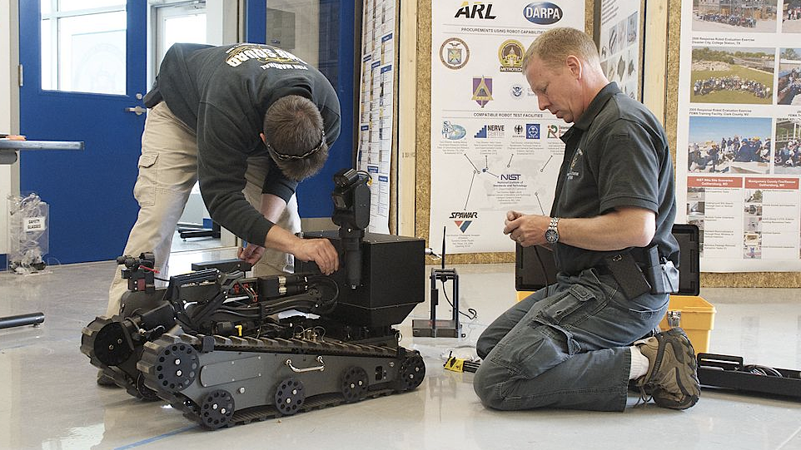
Responding to Threats
Bomb threats often phoned into agencies, businesses & schools
When receiving phone threat, get as much info from person as possible:
How much time to evacuate
Where bomb is located
Type of bomb
Why bomb was placed
Try to talk long enough to estimate caller’s age, gender, accent, knowledge of building
Photo Credit: Wikimedia
Notes:
Bomb threats often are phoned into agencies, businesses, and schools.
Upon receiving phone threat, attempt to get as much information from the person as possible:
how much time to evacuate,
where the bomb is located,
type of bomb,
why the bomb was placed,
Try to talk long enough to estimate the caller’s age, gender, accent, knowledge of the building.

Slide 28
Summary
Terrorism & mass murders create harmful ripple effect across individuals, economy & government
Short-term acute stress reactions include nightmares, anxiety responses, reduced pleasure responses & restricted activities
Some people modify life attempting to limit exposure to future attacks
Social workers must have skills for addressing initial crisis by terrorist attack & responding to long-term consequences
Photo Credit: Pixabay
Notes:
Terrorism and mass murders can create a harmful ripple effect across individuals, the economy, and government.
Short-term acute stress reactions include nightmares, anxiety responses, reduced pleasure responses, and restricted activities.
Some individuals modify their life attempting to limit exposure to future attacks.
Overly restricting one’s activities and socialization can negatively impact a person’s development and well-being.
Social workers must have skills for addressing the initial crisis generated by a terrorist attack and responding to an attacks long-term consequences.

