Slide 1
CHAPTER 3. The Brain: A Developmental Ecological Perspective
Human Behavior for Social Work Practice
Power Point format & design by: Bailey Jader, University of Minnesota
Photo Credit: Gerd Altmann

Slide 2
Objectives
Help social workers:
Understand basic neuroscience
Provide biopsychosocial education to clients suffering from health, developmental & mental disorders
Use/understand basic neuroscience concepts when participating as members of treatment teams
Photo Credit: Gerd Altmann
Notes:
Help social workers:
understand basic neuroscience,
provide biopsychosocial education to clients suffering from health, developmental, and mental disorders,
use and understand basic neuroscience concepts when participating as members of treatment teams.

Slide 3
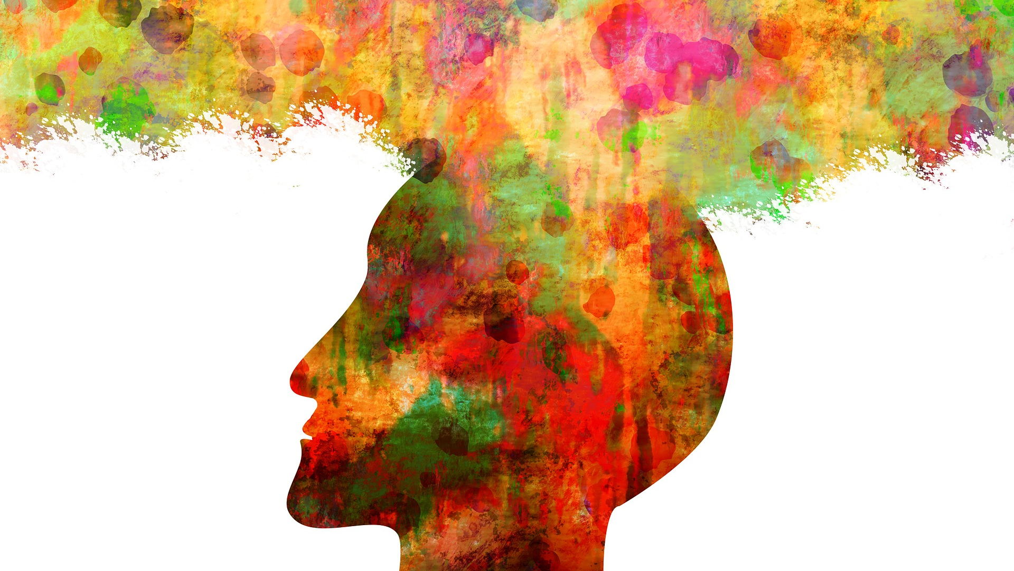
Developmental Systems Theory
Brain embedded within body of active person participating in sociocultural context; not isolated information processing device
Developmental cognitive neuroscience concerned with how brain develops, organizes into neuro-systems, plays key role in mental-thinking life
Photo Credit: Gerd Altmann
Notes:
The brain is embedded within the body of an active person participating within a wider sociocultural context. It is not an isolated information processing device.
Developmental cognitive neuroscience is concerned with how the brain:
develops,
organizes into neuro-systems, and
plays a key role in our mental-thinking life.

Slide 4
Developmental Systems Theory
Development occurs through co-action of genes & environment in complex levels of biological organization
Brain development exemplifies complex transactions of biological, physical, social & cultural contexts from earliest development
Photo Credit: Josh Riemer
Notes:
Development occurs through the co-action of genes and environment in increasingly complex levels of biological organization.
Brain development exemplifies the complex transactions of biological, physical, social, and cultural contexts from our earliest development.

Slide 5
Historical Overview: The Brain & Mental Illness
Beliefs about brain emerged from scientific findings, existential, religious/political concerns, periods of enlightenment & scientific inquiry
Hippocrates believed mental disorders resulted from disease & head injuries. Described schizophrenia as brain disorder that has some similarities with dementia
Middle Ages; mental illness viewed from religious perspective. Seen as possessed by demons or punished for sins
Photo Credit: Wikimedia
Notes:
Throughout history, beliefs about the brain have emerged from scientific findings, existential, religious, and even political concerns.
From the earliest of times, there have also been periods of enlightenment and scientific inquiry.
Hippocrates, the Greek medical doctor and teacher, believed that mental disorders resulted from disease and head injuries. He described what we now call schizophrenia as a brain disorder that has some similarities with dementia.
Throughout the Middle Ages, mental illness was mostly viewed from a religious perspective. The mentally ill were seen either as possessed by demons or as being punished for their sins.

Slide 6
Historical Overview: The Brain & Mental Illness
Banishment, exorcism, confinement, torture & death prescribed treatments
In 1800s, attention focused on science & brain studies flourished
Emil Kraepelin conducted research/taught schizophrenia, bipolar disorders, & dementia were disorders of brain & those suffering deserved humane, professional treatment
Early 1900s, psychoanalytic theory emerges, framed mental illness as internal emotional conflict
Photo Credit: Wikimedia
Notes:
Banishment, exorcism, confinement, and sometimes torture and death were often the prescribed treatments.
In the 1800s, attention was focused on science, and brain studies flourished.
For example, Emil Kraepelin, a German psychiatrist, conducted research and taught that schizophrenia, bipolar disorders, and dementia were disorders of the brain and that those suffering from them deserved humane, professional treatment.
The early 1900s ushered in psychoanalytic theory, which framed mental illness as an internal emotional conflict rather than as a disease of the brain.

Slide 7
Historical Overview: The Brain & Mental Illness
Sigmund Freud built sweeping theory for explaining mental illness, based on Western philosophy & limited clinical observations
Modern neuroscience moved focus of mental disorders back to brain
Psychoanalytic theory & religious beliefs continue to stigmatize mental illness
Photo Credit: Wikimedia
Notes:
Sigmund Freud built a sweeping theory for explaining mental illness, based on Western philosophy and limited clinical observations.
While modern neuroscience has again moved the focus of mental disorders back to the brain, aspects of psychoanalytic theory and some religious beliefs continue to stigmatize those living with mental illness and their families.

Slide 8
Outline of Human Brain Anatomy
Human brain & spinal cord comprise central nervous system (CNS)
Brain protected by skull & cushioned in cerebrospinal fluid. Also physiologically isolated from bloodstream by blood-brain barrier
CNS damage can occur at multiple levels:
Blunt trauma
Neurodegenerative disorders (e.g., Parkinson, Alzheimer’s)
Infections (e.g., syphilis, HIV)
Tumors
Autoimmune diseases
Interrupted blood supply
Photo Credit: Wikimedia
Notes:
The human brain and the spinal cord comprise the central nervous system (CNS).
The brain is protected by the skull and cushioned in cerebrospinal fluid. It also is physiologically isolated from the bloodstream by the blood-brain barrier.
CNS damage can occur at multiple levels.
Examples of events that damage CNS includes
blunt trauma,
neurodegenerative disorders (e.g., Parkinson, Alzheimer),
infections (e.g., syphilis, HIV),
tumors,
autoimmune diseases, and
interrupted blood supply.

Slide 9
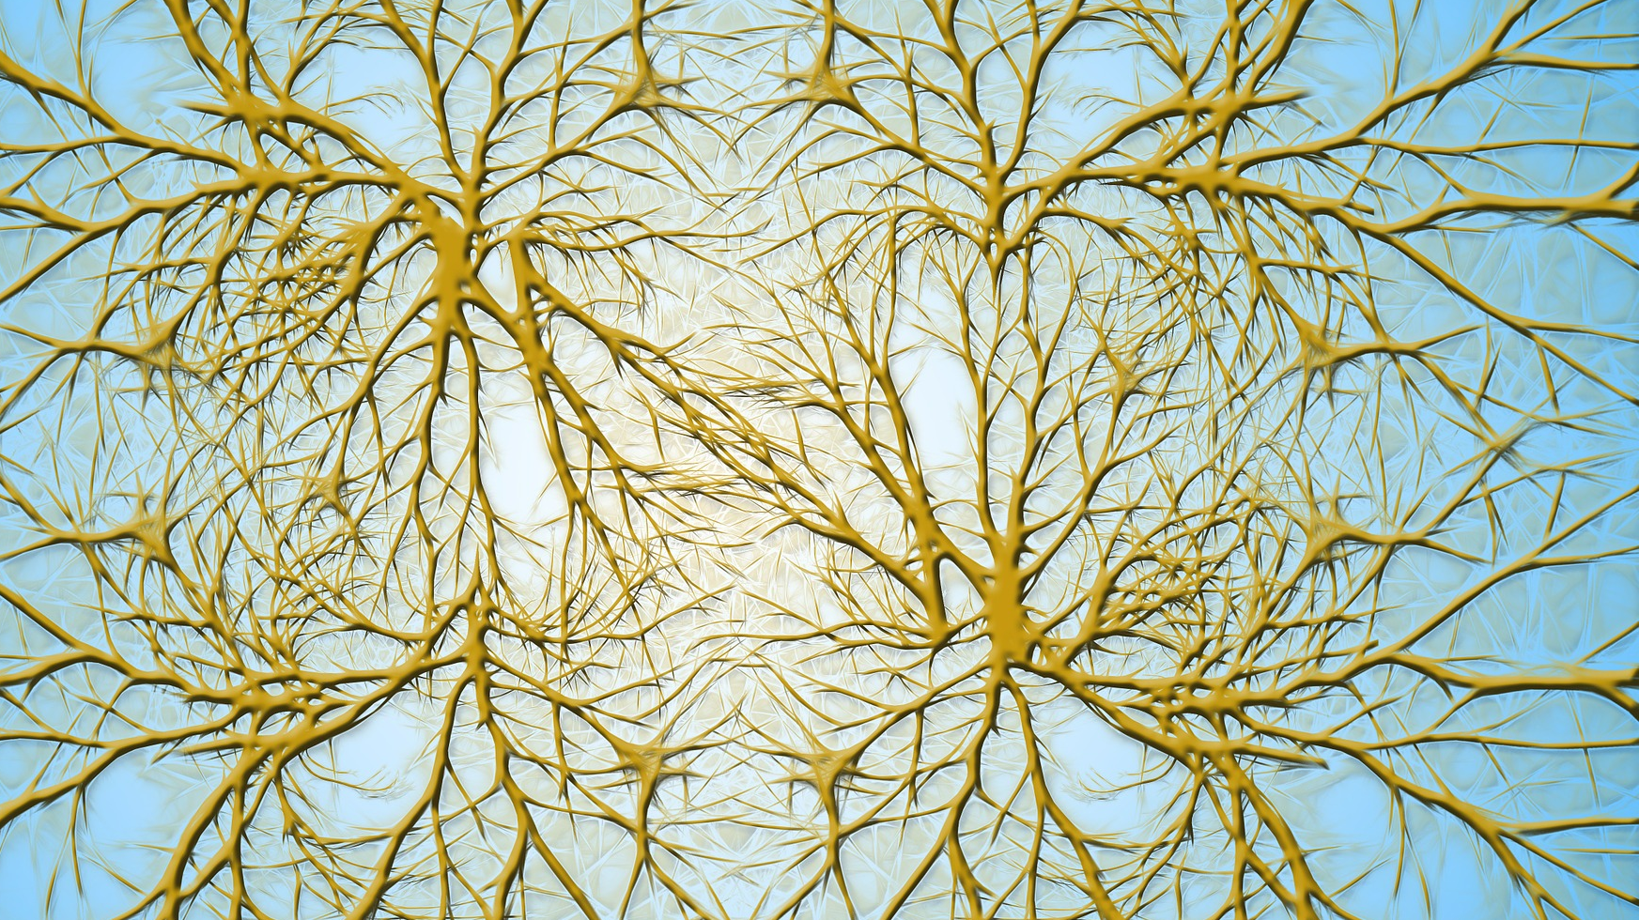
Outline of Human Brain Anatomy
Neurons: Brain cells that receive, process & transmit information
Synapses: Connections between neurons that extend into complex molecular networks
Neuronal axon: elongated fiber that projects from body of neuron & splits into smaller branches & twigs
Some axons run +/- meter from spine to toes
Photo Credit: Gerd Altmann
Notes:
Neurons
brain cells that receive, process, and transmit information. Neurons transmit signals across synapses using neurotransmitters and related molecules and electrical impulses.
Synapses
connections between neurons that extend into complex molecular networks.
A single neuron can have several hundred thousand synapses, but as a rule it only has one axon.
The neuronal axon is an elongated fiber that projects from the body of the neuron and splits into smaller branches and twigs.
Some axons can run about a meter from the spine to the toes.

Slide 10
Outline of Human Brain Anatomy
Glial cells & capillaries provide metabolic support & protection for neurons in complex fashion
Myelination: process where specific glial cells wrap around & electrically insulate longer axons
When bundled, form “white matter” tracts connecting remote brain areas
Corpus callosum in humans connects two cerebral hemispheres with 20 million axons
Human brain organized as forebrain & brainstem
Complex structures interconnected & always interacting
Photo Credit: Wikimedia
Notes:
Glial cells and capillaries provide metabolic support and protection for neurons in a complex fashion.
Myelination is a process where specific glial cells wrap around and electrically insulate longer axons.
When bundled together form “white matter” tracts connecting remote brain areas.
The corpus callosum in humans connects the two cerebral hemispheres with some 20 million axons.
The human brain is organized as the forebrain (includes cerebrum and hypothalamus) and the brainstem (includes the cerebellum).
These complex structures are interconnected and always interacting.

Slide 11
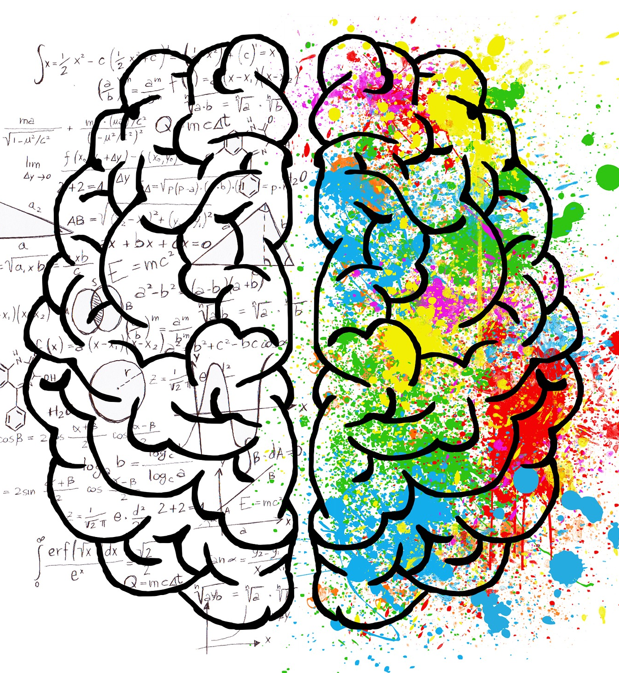
Outline of Human Brain Anatomy
Cerebrum largest part of brain & divided into two hemispheres
Right hemisphere controls movements & processes sensory signals from left side of body
Left hemisphere interacts with right side of body
Cerebrum involved in all voluntary actions:
Language
Social cognition
Emotion regulation
Rational thought
Motor learning
Memory
Photo Credit: Elisa Riva
Notes:
The cerebrum is the largest part of the human brain and is divided into two closely connected and roughly symmetrical hemispheres.
The right hemisphere mostly controls movements and processes sensory signals from the left side of the body. Likewise, the left hemisphere interacts with the right side of the body.
The cerebrum is involved in all voluntary actions:
language,
social cognition,
emotion regulation,
rational thought,
motor learning,
memory and much more.

Slide 12
Outline of Human Brain Anatomy
Brainstem is posterior & controls/involved in important bodily functions
Also regulates respiration, eye movement & facial expressions & sensory systems for smell/taste, hearing, balance & facial touch
Cerebellum involved in movement & contributes to coordination, posture, motor learning & fine movements
Region has evolved & expanded to play major role in language & higher cognition
Photo Credit: Pixababy
Notes:
The brainstem is posterior and controls or is involved in many important bodily functions, including:
heart rate,
learning and reward,
consciousness,
breathing,
sleeping, and
pain.
It also regulates respiration, eye movement and facial expressions, and sensory systems for smell and taste, hearing, balance, and facial touch.
The cerebellum is involved in movement and contributes to coordination, posture, motor learning and fine movements.
This region has evolved and expanded to play a major role in language and higher cognition.

Slide 13
The Cerebral Cortex in Brief
Cerebral cortex = outer layer of cerebrum & plays key role in basic functions that contribute to sense of:
Self
Consciousness
Memory
Thought
Language
Perception
Emotion
Social relationships
Notes:
The cerebral cortex is the outer layer of the cerebrum and plays a key role in many of the basic functions that contribute to our sense of:
self,
consciousness,
memory,
thought,
language,
perception,
emotion, and
social relationships

Slide 14
The Cerebral Cortex in Brief
Cerebral cortex can be divided into frontal, temporal, parietal & occipital lobes
Frontal lobes in humans evolved to dominate cerebral hemispheres
Components work together in:
High-level reasoning
Controlling attention
Planning complex movements
Emotion regulation
Social cognition
Some core aspects of memory
Notes:
The cerebral cortex can be divided into the
frontal,
temporal,
parietal, and
occipital lobes.
The frontal lobes in humans have evolved to dominate the cerebral hemispheres.
The components work closely together in
high-level reasoning,
controlling attention,
planning complex movements,
emotion regulation,
social cognition, and
some core aspects of memory.

Slide 15
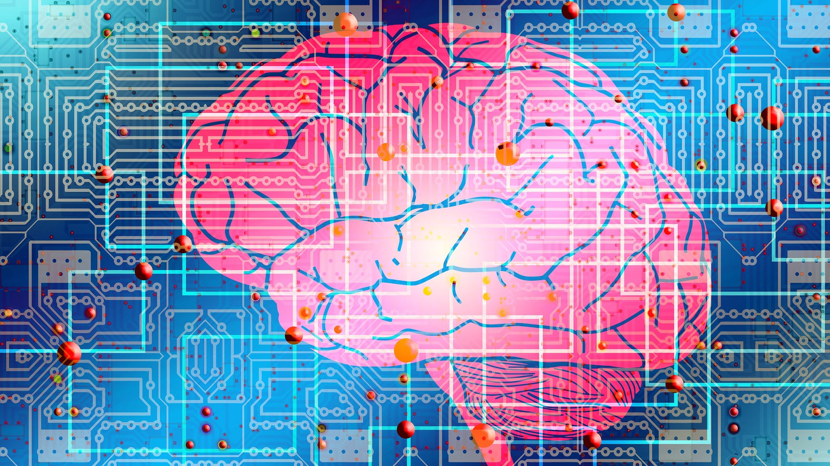
The Cerebral Cortex in Brief
Temporal lobes contain complex group of structures that process:
Auditory information
Language perception (usually on left side)
Learning & memory
Regulation of emotion
Temporal lobes connected to deeper structures in limbic system, including:
Amygdala - involved in producing/controlling fear & anxiety
Hippocampus - involved in forming short-term memories, spatial cognition & context evaluation
Photo Credit: Gerd Altmann
Notes:
The temporal lobes contain a complex group of structures that process
auditory information,
language perception (usually on the left side),
learning and memory, and
regulation of emotion.
The temporal lobes are connected to deeper structures in the limbic system, including the
amygdala, which is involved in producing and controlling fear and anxiety, and the
hippocampus, which is involved in forming short-term memories, spatial cognition, and context evaluation.

Slide 16
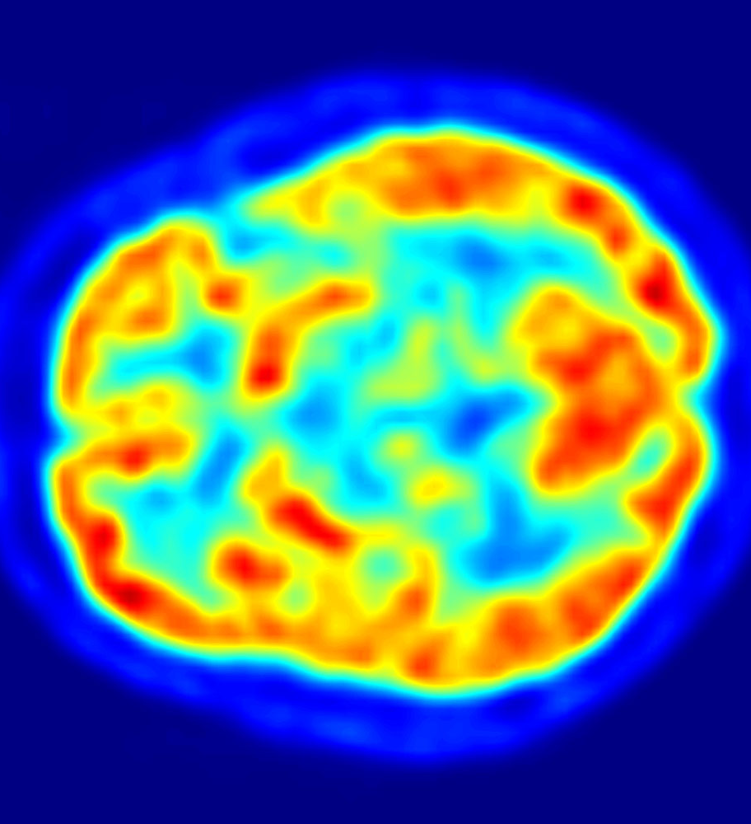
The Cerebral Cortex in Brief
Parietal lobes located behind frontal lobes & above temporal lobes
Components process:
Spatial orientation & perception
Integrating visual information & spatial cognition
Sense of touch
Occipital lobes sit toward back of the brain
Primarily responsible for vision & visual associations
Damage to parietal lobes can cause agnosia & apraxia

Slide 17
Brain Development
Genetically programmed sequence of cell division, differentiation, migration & death
Starts at embryogenesis & continues throughout life span
Rapid brain growth occurs in early childhood
Prefrontal cortex continues to develop through adolescence
Adolescent brain perfects abstract thinking
Photo Credit: Gerd Altmann
Notes:
Brain development is largely a genetically programmed sequence of cell division, differentiation, migration, and death.
Brain development starts at the earliest stages of embryogenesis and continues throughout the life span.
Rapid brain growth occurs in early childhood.
The prefrontal cortex continues to develop through adolescence.
Therefore social workers need to be concerned and closely assess indications of mental disorders, substance use, head injury, and delays in social development.
Additionally, the adolescent brain perfects abstract thinking.

Slide 18
Genetic Control Of Number Of Neurons
First trimester of gestation; brain forms
3-4 wks. of gestation; neural tube forms central nervous system
End of first trimester; neurons proliferate in neural tube
Apoptosis: embryonic brain overproduces neurons followed by approx. 50% of them dying
Helps brain get cells in appropriate places
Process of neuron overproduction & pruning back observed in different brain regions (0-4 yrs)
Photo Credit: Wikimedia
Notes:
During the first trimester of gestation, the brain is formed in an intricate, genetically programmed choreography.
Within three to four weeks of gestation, the neural tube that will form the central nervous system develops.
At the end of the first trimester and start of the second trimester,
neurons proliferate in the neural tube,
causing it to bend and thicken in a characteristic sequence.
In a programmed sequence, the embryonic brain goes on to overproduce neurons followed by approximately 50% of them dying off.
This is a normal, species-specific process called apoptosis.
The apoptosis process helps the brain get the correct number of cells in their appropriate places.
This process of neuron overproduction and pruning back is observed in different brain regions from the first trimester to four years.

Slide 19
Genetic Control of the Location of Neurons
Neurons form in clusters & sequentially migrate to specific locations
Migration guided by molecular markers & glial cells
Brain’s cortex (six layers) develops at different time & requires 6 separate neuronal migrations
Neurons must move through existing layers of cortex to reach target
At correct location, neurons aggregate/align with other neurons in area & form nervous system structures
If migration process disrupted, future development can be altered
Photo Credit: Pixababy
Notes:
Part of the choreography of brain development is that neurons form in clusters and then sequentially migrate to specific locations.
This migration is guided by complicated molecular markers and glial cells.
The brain’s cortex consists of six layers: each layer develops at a different time and requires six separate neuronal migrations.
Many neurons must move through already existing layers of cortex to reach their target.
After reaching the correct location, the neurons aggregate, or align themselves with other neurons in the area, and form nervous system structures.
If the migration process is disrupted, future development can be altered.

Slide 20
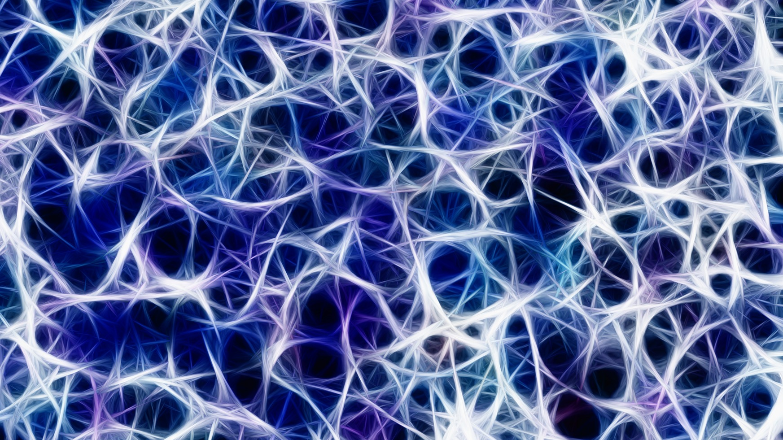
Brain Plasticity
Plasticity: brain changes over time from social, educational & treatment experiences
Function of brain tissue can be shaped according to type of ecological & biological input
Central question in early brain development:
To what extent do environments & experience play a role in developing brain & behavior
More research needed to clarify:
Which environments particularly helpful/toxic?
How much experience needed within environment to change brain?
Are there critical age periods where environments stimulate pos. or neg. brain development?
Photo Credit: Gerd Altmann
Notes:
Shaping brain networks through experience implies a degree of plasticity in cortical tissue
Plasticity refers to brain changes over time from social, educational, and treatment experiences.
The function of brain tissue can be shaped to some degree according to the type of ecological and biological input it receives, particularly in early life.
A central question in early brain development - -
To what extent do environments and experience play a role in developing the brain and behavior.
We need more research that clarifies:
Which environments are particularly helpful and which are toxic for brain development
How much experience is needed within an environment to change the brain
Are there critical age periods where certain environments stimulate positive or negative brain development

Slide 21
Brain Plasticity
Complex social & cognitive experiences result in improved social skills & greater control over stress responses
Brain changes resulting from experience distributed over neural systems, involve enlargement of brain, formation of new neurons & synapses
Development of mammalian brain shaped by environment & experience
Social workers complete assessments as clients evolve
Experience-expectant developmental processes develop as interaction of innate neural wiring with experiences present in human environment
Photo Credit: Gordon Johnson
Notes:
We do know that:
Complex social and cognitive experiences result in improved social skills and greater control over stress responses.
Brain changes resulting from experience are distributed over
several neural systems
involve a gross enlargement of the brain, and
formation of new neurons (brain cells) and synapses (connections between neurons).
The development of the mammalian brain appears to be shaped by environment and experience throughout the life span, but particularly in early life.
Therefore, social workers need to complete new assessments as clients evolve across the life span.
Experience-expectant developmental processes develop as an interaction of innate neural wiring with experiences that are universally present in any human environment.
For example, typically developing infants in all cultures experience social interactions.
Children who experience severe social deprivation may have permanent impairments to their social and language development

Slide 22
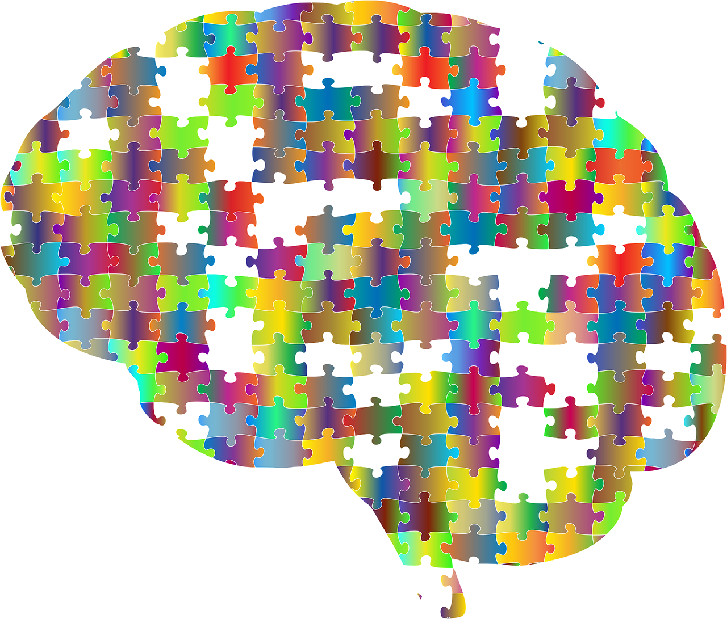
Brain Plasticity: Learning Disorders
Learning disorders illustrate plasticity & its limits
15% of reading problems in North America from poor schooling, mental retardation, or other problems; 85% from biologically based learning disorder
Brains w/ learning disorders < integrated neural structures in left hemisphere
People w/ reading disorders demonstrate difficulty w/phoneme awareness, language-processing skills, speech perception, vocabulary & phonological representation
Genetics or experience don’t dictate outcome of learning disorders
Experience focused on left hemispheric exercises/learning, brain develops new pathways
Photo Credit: Pixababy
Notes:
Learning disorders illustrate both plasticity and its limits.
15% of reading problems in North America stem from poor schooling, mental retardation, or other problems.
The remaining 85% result from a biologically based learning disorder.
Brains of individuals with learning disorders generally have less integrated neural structures in the left hemisphere.
People with reading disorders often demonstrate difficulty with phoneme awareness, language-processing skills, speech perception, vocabulary, and phonological representation.
Neither genetics nor experience completely dictates the outcome of a learning disorder.
Through experience focused on left hemispheric exercises and learning, the brain may develop new pathways.
With continued educational practice and increased engagement of the left hemisphere, reading mastery often increases.

Slide 23
Studying the Brain: Neuroimaging Methods
Computerized axial tomography (CAT scan)
Positron-emission tomography (PET)
Magnetic resonance imaging (MRI) and functional MRI (fMRI)
Electroencephalogram (EEG)
Photo Credit: Gerd Altmann

Slide 24
Studying the Brain: Cat Scans
Shape & size of brain areas measured using computerized axial tomography (CAT scan)
Created by computer; turns multiple X-ray images into high-contrast 3-dimensional pictures
Provide sharper resolution of soft tissue than routine X-rays
CAT scans allow view of tiny changes in grey & white matter in living patients, including characteristics of:
Strokes
Brain trauma
Tumors
Dementia
Developmental disorders
Photo Credit: Wikimedia
Notes:
The shape and size of brain areas are measured using computerized axial tomography (CAT scan).
A CAT scan (also called a CT scan) is created by a computer that turns multiple X-ray images of a selected body area into high-contrast 3-dimensional pictures.
CAT scans provide much sharper resolution of soft tissue than routine X-rays.
CAT scans allow one to view tiny changes in grey and white matter in living patients, including characteristics of
strokes,
brain trauma,
tumors,
dementia,
developmental disorders.

Slide 25
Studying the Brain: PET Scans
Positron-emission tomography (PET) shows metabolically active areas of brain when person is resting or performing tasks
Accomplished by measuring amount of oxygen & glucose metabolized throughout brain
Requires person to be exposed to low dose of radioactive substance
Gamma rays emitted & detected by sensors & computers construct 3-dimensional image of brain function
Photo Credit: Wikimedia
Notes:
Positron-emission tomography (PET) allows one to observe which areas of the brain are metabolically active when a person is resting or performing a specific task.
This is accomplished by measuring the amount of oxygen and glucose metabolized throughout the brain.
The PET scan requires the person to be exposed temporarily to a low dose of radioactive substance.
As the chemical enters the brain, gamma rays are emitted and detected by sensors and computers construct a 3-dimensional image of brain function.

Slide 26
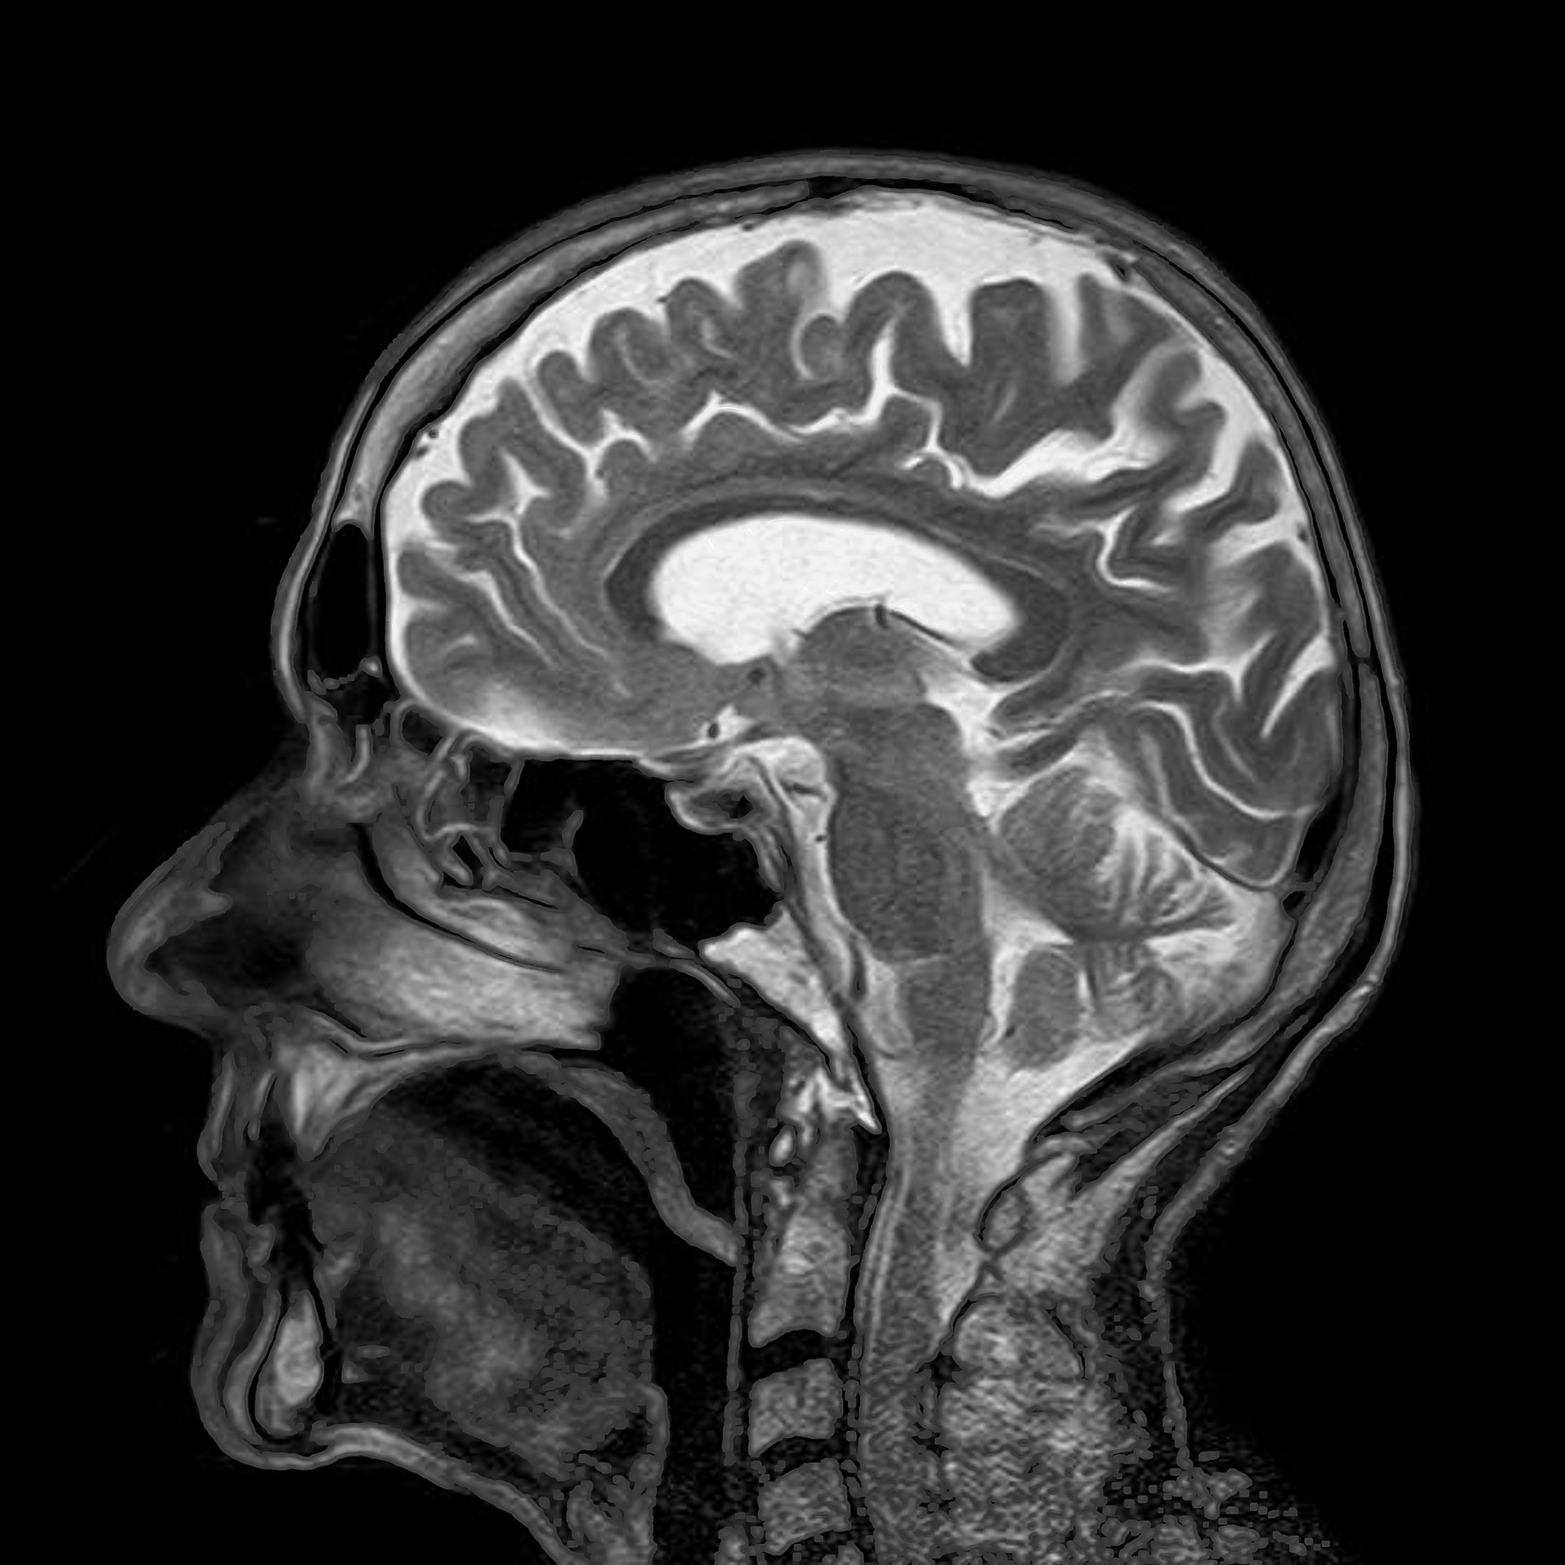
STUDYING THE BRAIN: MRIs
Magnetic resonance imaging (MRI) and functional MRI (fMRI) capture detailed pictures of brain anatomy & functioning without harmful radiation
Strong electromagnet rapidly flips magnetic field back & forth, causing hydrogen atoms in water & fat molecules to line up together & relax in unison by emitting small radio signals
Sensitive equipment detects signals & collates them to assemble 3-dimensional image
Photo Credit: Toubibe
Notes:
Magnetic resonance imaging (MRI) and functional MRI (fMRI) capture detailed pictures of brain anatomy and functioning without any harmful radiation
An extremely strong electromagnet rapidly flips its magnetic field back and forth, causing hydrogen atoms in water and fat molecules to line up together and then relax in unison by emitting small radio signals.
Sensitive equipment detects those signals and collates them to assemble a 3-dimensional image.

Slide 27
Studying The Brain: EEG
Electroencephalogram (EEG) measures & graphs brain’s electrical activities
Normally functioning brain produces set pattern of recordable brain waves
Electrical impulses emitted from brain picked up from sensors placed on head
Often used for assessing, diagnosing, & monitoring seizures & sleep disorders
Photo Credit: Wikimedia
Notes:
The electroencephalogram (EEG) measures and graphs the brain’s electrical activities.
A normally functioning brain produces a set pattern of recordable brain waves.
The electrical impulses emitted from the brain are picked up from sensors placed on the head and fed into a computer.
The EEG is often used for assessing, diagnosing, and monitoring seizures and sleep disorders.

Slide 28
Studying the Brain: Limitations of Neuroimaging
Findings based on group data
Medical-imaging studies = expensive & seldom answer mental health diagnostic/treatment questions
Medical insurance may not cover cost of MRI, fMRI, or CAT scan to rule out/verify mental disorder.
Photo Credit: Wikimedia
Notes:
Findings from neuroimaging research are based on group data, and may not represent any one person.
Medical-imaging studies are expensive and seldom answer mental health diagnostic or treatment questions.
In most cases, medical insurance will not cover the cost of an MRI, fMRI, or CAT scan to rule out or verify a mental disorder. Therefore, until imaging becomes a proven assessment process for mental health, little or no benefit will be gained from an expensive brain scan.

Slide 29
Studying the Brain: Considerations of Neuroimaging
Used to rule out disorders; Alzheimer’s disease & multiple sclerosis
Clients can develop neurological disorders & have active mental health problems over time
When symptoms/indicators signal neurological problem beyond known mental disorder, medical consultation immediately needed
Photo Credit: Wikimedia
Notes:
Brain scanning is also used to rule out disorders such as Alzheimer’s disease and multiple sclerosis.
We must always keep in mind that clients across the life span can develop neurological disorders and also have an active mental health problem.
Whenever symptoms or any indicator signals a possible neurological problem beyond the known mental disorder, a medical consultation is immediately needed.

Slide 30
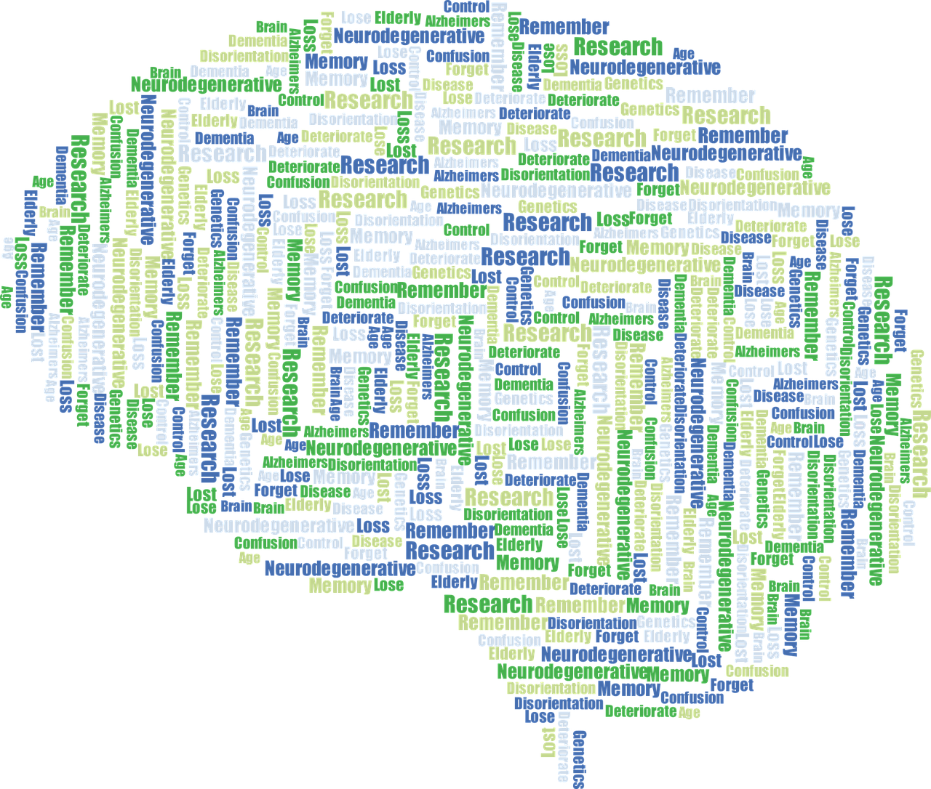
Studying the Brain: Neuropsychological Testing
Assessment of brain functions that indirectly offers info about structural & functional integrity of client’s brain
Tests can be scored to provide global estimates of pathology, or can be used to localize structural problems
Testing can be helpful to clinicians when combined with brain imaging, clinical history & other tests
Photo Credit: Wikimedia
Notes:
Neuropsychological testing is an assessment of brain functions that indirectly yields information about the structural and functional integrity of the client’s brain.
Neuropsychological tests can be scored to provide global estimates of pathology (e.g., the severity of dementia) or
they can be used to localize structural problems (e.g., executive function deficits indicating prefrontal pathology).
Neuropsychological testing can be enormously helpful to clinicians especially when combined with brain imaging, clinical history, and other tests.

Slide 31
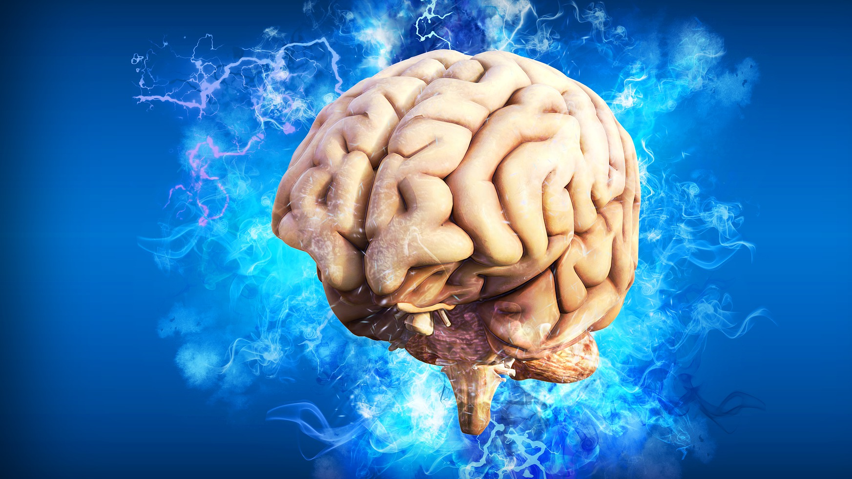
Studying the Brain: Neuropsychological Testing
Evaluation performed by licensed psychologist through interview & tests
Many tests in published literature, intended to measure specific cognitive & behavioral issues in clinical populations
Important to ensure neuropsychological instrument has been psychometrically studied for reliability & validity with culture, race & gender of client being assessed
Photo Credit: Pete Linforth
Notes:
Neuropsychological evaluation is often performed by a licensed psychologist through an interview and the administration of tests.
The tests used to be pencil and paper type tests, but recently they are more often done on computers.
There are many psychological tests in the published literature, intended to measure specific cognitive and behavioral issues in numerous clinical populations.
It is important to ensure that the neuropsychological instrument has been psychometrically studied for reliability and validity with the culture, race, and gender of the client being assessed.

Slide 32
Studying the Brain: Examples of Neuropsychological Tests
Montreal Cognitive Assessment (MoCA)
Mini Mental Status Exam (MMSE)
Clock-Drawing Test
Cambridge Neuropsychological Test Automated Battery (CANTAB)
Used to assess effects of traumatic head injury, dementia, stroke, or other neurological diseases
Notes:
The Montreal Cognitive Assessment (MoCA), the Mini Mental Status Exam (MMSE), and Clock-Drawing Test are often used by clinicians for screening
Cambridge Neuropsychological Test Automated Battery (CANTAB) is a computerized measure of general learning, visual memory, working memory, executive function, attention, reaction time and response inhibition.
It is often used to assess the effects of traumatic head injury, dementia, stroke, or other neurological diseases

Slide 33
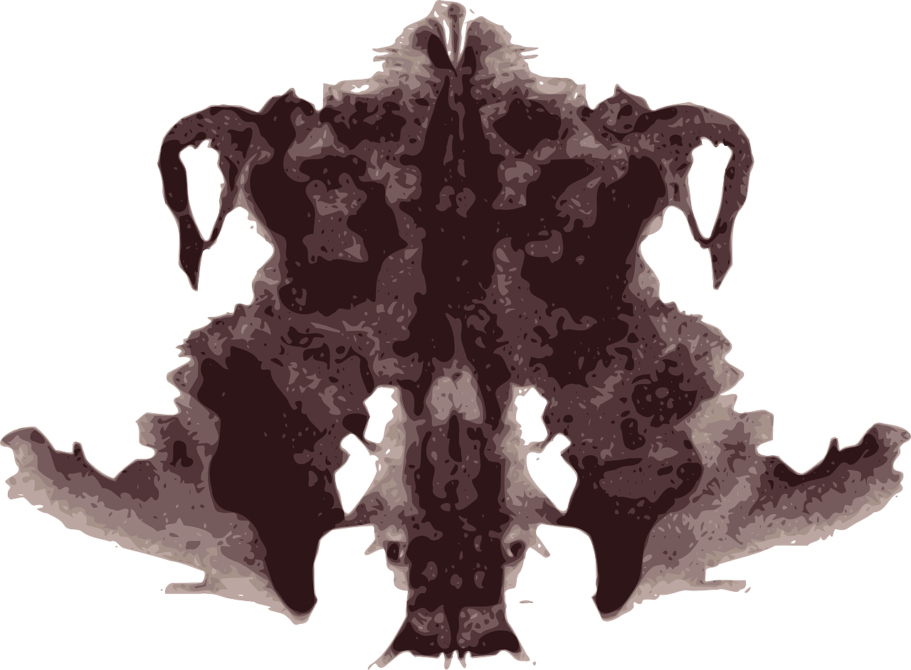
Studying the Brain: Examples of Neuropsychological Tests
Wechsler Intelligence Scale for Children (WISC) measures full-scale intelligence
Rorschach Inkblot Test & Thematic Apperception Test (TAT)
Studies found assessments have little or no reliability/validity
Notes:
For children, the Wechsler Intelligence Scale for Children (WISC) measures full-scale intelligence
The instrument has specific subtests for verbal skills, spatial reasoning, working memory, and fluid reasoning.
The Rorschach Inkblot Test and Thematic Apperception Test (TAT) are described as projective tests, in that subjects impose hidden emotions or internal conflicts onto ambiguous inkblots or pictures.
Numerous studies have found that these and other projective assessment instruments have little or no reliability or validity.

Slide 34
Summary
Biological brain & mystical mind intrinsically bound together
Way of understanding mind is consider it the reality we trained our brain to produce
Without countless interactions among brain functioning, memory, & sociocultural context, there is no mind
To help clients understand neurological testing, learning, & brain disorders, and contribute to multidisciplinary teams serving individuals suffering from mental illnesses, contemporary social workers require basic understanding of brain, & how it relates to concept of the mind
Photo Credit: Okan Caliskan
Notes:
The biological brain and the mystical mind are intrinsically bound together.
One way of understanding the mind is to consider it the reality we have trained our brain to produce.
Without the countless interactions among brain functioning, memory, and the sociocultural context, there is no mind
To help clients understand neurological testing, learning, and brain disorders, and to contribute to multidisciplinary teams serving individuals suffering from mental illnesses, contemporary social workers require a basic understanding of the brain, and how it relates to that elusive concept of the mind.

