Slide 1
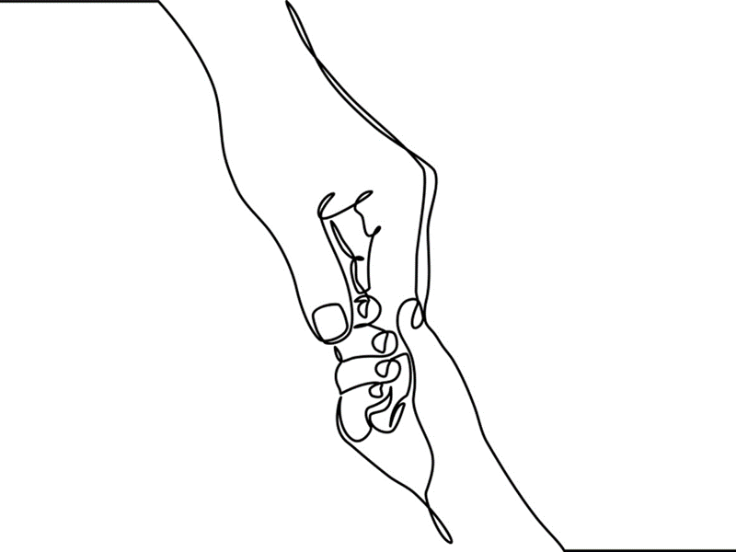
Chapter 13: Children of the World

Slide 2
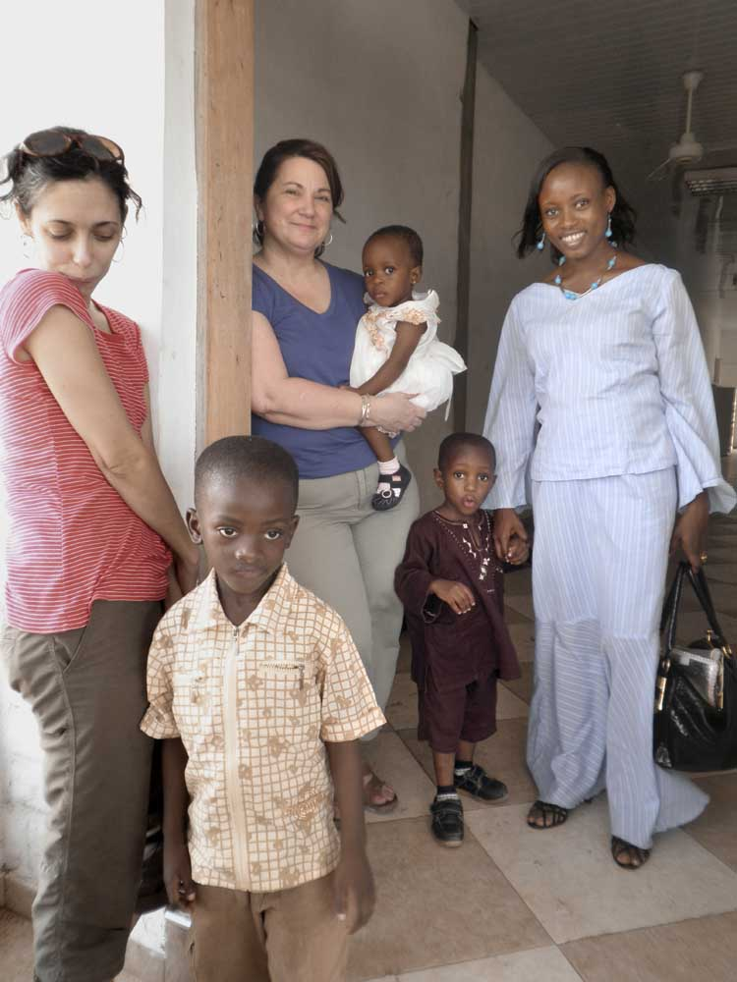
“Meeting of the minds and feelings.”
Boyd Webb, 2001
Notes:
Relational connections are most effective when workers are both culturally prepared and open to learning from and with child clients and families about their unique and collective experiences.
In the next 50 years ethnic-minority children under the age of 18 will become the majority in the United States and Canada.
Building relationships with children and families from unfamiliar cultures is complicated due to language and communication barriers and also a result of different perceptions of health and helpers, problems and solutions.
Workers should take care not to accept a “single story” or embrace a stereotype about any culture or cultural group recognizing that within any set of values and customs there are similarities and variations.
Photo: Courtesy of Shelley Cohen Konrad

Slide 3
The UN Convention on the Rights of the Children affirms the right of all children to their cultural identities and protection from all forms of discrimination and oppression.
Children of the World
Notes:
Cultural identity is informed by knowledge, lore, and customs that are passed on in families and communities through stories, child rearing practices, and rituals.
Culture shapes behaviors, communication patterns, and worldviews and is expressed through formal and informal laws, music and the arts.
Ethnicity and race intersect with culture; ethnicity and common experiences.
Race is viewed as both a biological descriptor that characterizes people who share similar skin color and also as a social construction that predicts privilege and belonging within any given society.
McIntosh’s (1990) seminal article on white privilege elucidates how race rather than other factors such as class, ethnicity, gender, and faith is targeted for discrimination. Race is an important aspect of identity in childhood as children are aware of skin color and make comparisons between their own and that of others.
Recently, as political and social trends in North America have shifted, citizenship status has significantly affected child and family identities.
Photos: Far Left -- Courtesy of Shelley Cohen Konrad; Upper Left -- www.public-domain-image.com; Middle Top – commons.wikimedia.org; Lower Middle – www.flickr.com; Upper Right – www.flickr.com; Lower Right – Courtesy of Shelley Cohen Konrad; Far Right – commons.wikimedia. Org.
Top Right Photo Courtesy of Shelley Cohen Konrad; Top Left Photo Right Middle Photo by Trevor Cole on Unsplash; Top Right Photo www.flickr.com; Bottom Left Photo by Muhammadtaha Ibrahim on Unsplash; Bottom Right Photo by Sharon Christina Rørvik on Unsplash.

Slide 4
HOW DO I KNOW WHO I AM?
RACE
ETHNICITY
LANGUAGE
EDUCATION
CLASS
CUSTOMS
FAITH
CULTURE
Notes:
Culturally-informed workers continuously reflect upon their personal assumptions, experiences, and identities.
Cultural humility emphasizes the importance of self-reflection and examining world views, where knowledge comes from, and attending to their collective influence.
Factors such as race, ethnicity, language, education, class, customs, faith, culture, and beliefs shape our estimations of people from diverse nations, religions, practices, and cultures.
Previous relationships and experiences color how we approach people and whether or not we feel safe to do so.
Although one may believe themselves to be free of prejudice, it is important to recognize that no one is free from bias. Recognizing bias is a first step in becoming culturally aware.

Slide 5
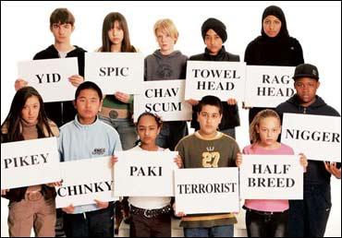
BIAS
Notes:
Everyone has thoughts, opinions, assumptions, and biases. Recognizing and acknowledging them is a professional obligation that helps to avoid the pitfalls of unintended discrimination.
Ask learners to respond to this slide. What feelings and thoughts does it evoke? In what ways does it speak to the need to have personal and professional standards for cultural awareness and anti-discrimination standards?
Many professional organizations have broadened their definition of cultural competence: National Association of Social Workers (NASW) defines cultural diversity as the “sociocultural experiences of people of different genders, social classes, religious and spiritual beliefs, sexual orientations, ages, and physical and mental abilities” in their professional standards document.
The American Counseling Association’s Code of Ethics as well as the American Psychological Association’s Ethical Principles of Psychologists urge practitioners to “be aware enough not to engage in unfair, discriminatory, and harassing or demeaning behaviors” and “maintain evidence-based knowledge about the groups with whom we work.”
Best practice dictates respecting rather than challenging difference, finding commonalities, and addressing discrimination, oppression and inequities.
Photo: www.flickr.com.

Slide 6
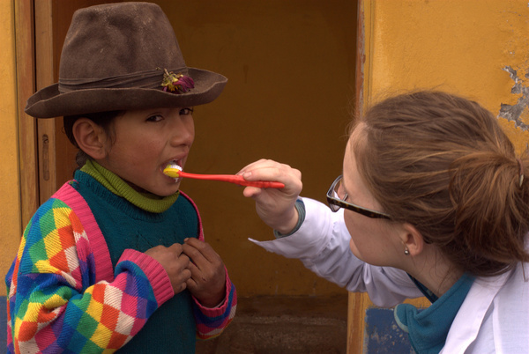
Learning With and From
Notes:
The first tenet of culturally-informed practice in child-centered relational work is willingness to learn directly from child clients and families about their unique and collective experiences.
This standpoint conforms to values of social inclusion, self-determination, diversity, and human dignity while simultaneously appreciating that cultural identities are constantly evolving and changing.
Cultural humility guides us to be simultaneously aware that as we attempt to understand others’ perspectives they too are trying to understand ours; relationships are always bidirectional.
Culturally-informed knowledge reduces practice errors and avoids misinterpretations that may lead to disrespectful and unsafe practice choices.
Application of culturally-informed principles recognizes inequities and disparities that exist for different racial and ethnic groups.
Photo Courtesy of University of New England

Slide 7
Ethical Quandaries
Cultural Belief
Parental Right
Health Perspective
Child Abuse
Child Best Interest
Autism
Mental Illness
Notes:
Practicing from a standpoint of cultural-humility prepares but does not prevent workers from encountering vexing ethical dilemmas.
Value dilemmas and ethical issues arise when working with families whose child rearing practices and health perspectives do not conform to dominant social norms and institutional policies.
Seeking culturally informed consultation aids workers to avoid stereotyping or unfairly judging cultural practices.
When ethical dilemmas or conflicts surface, workers must weigh and balance how treatment suggestions are made and to whom, and also to what extent they should advocate for treatment protocols or social service interventions that defy a family’s beliefs and customs (e. g. mandated reporting).
Child-centered practice methods that cross cultural borders include story-telling, expressive modalities, and mutual aid and support groups.

Slide 8
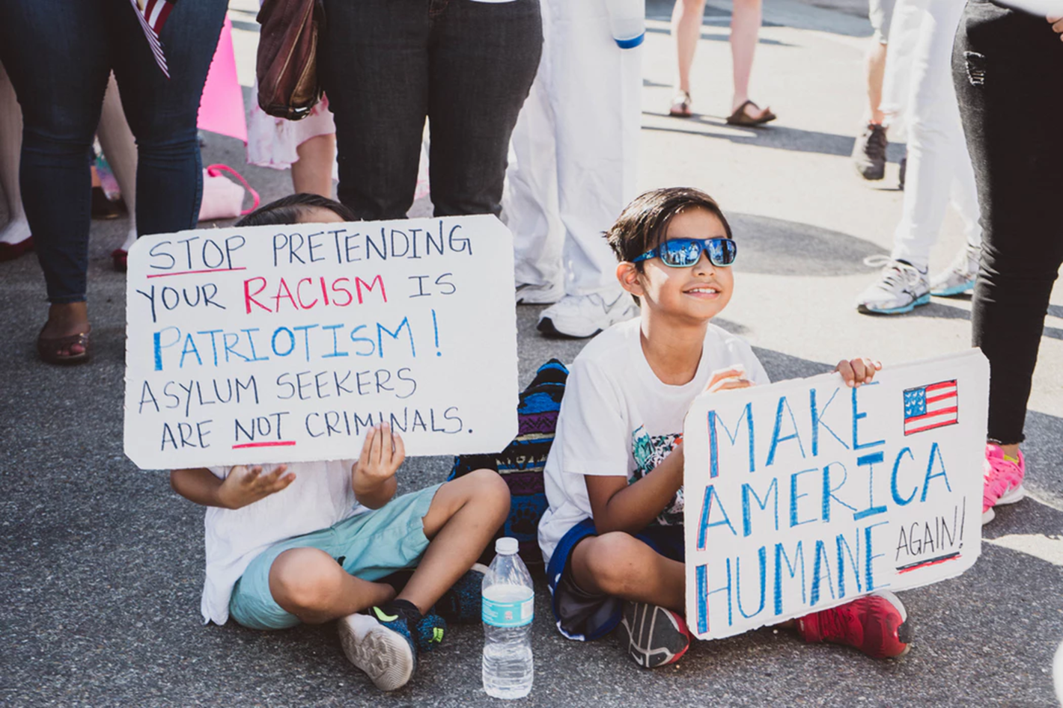
Notes:
According to the Pew Research Center (2015), the last 50 years has seen an exponential increase of immigrants and their descendants coming to the U. S.
The sheer number of migrants flowing into North America has challenged public perceptions, surfaced deep-seated prejudices, and brought about calls to restrict immigration and limit opportunities for citizenship and sanctuary.
Given the evolving and sometimes volatile political environment, it is not surprising that immigrant and refugee parents experience heightened worry about their children’s well-being and that children may exhibit adverse effects from encounters with individual and institutional discrimination.
Photo by Samantha Sophia on Unsplash

Slide 9
Notes:
Each child’s immigration journey is unique even for those who come from the same country or who practice the same faith.
Immigrant and refugee children and families may come from war-torn countries and most have experienced traumatic experiences and losses.
Some child immigrants and refugees arrive in the U. S. and Canada with their families while those considered more vulnerable come on their own as unaccompanied minors who resettle with foster families or previously relocated family members.
Approximately 1.7 children living in the U. S. are undocumented. An estimated 5 million children who are citizens of the United States have at least one undocumented parent.
Regardless of circumstances children who immigrate to the U. S. and Canada face many challenges not the least of which are adapting to an unfamiliar culture, learning a new language, accommodating to new social norms and peer group rules, and assimilating into foreign school systems.
Photo: www.flickr.com.

Slide 10
Stresses and Strains
Separation from family & Community
Loss of loved ones
Symptoms
Post-traumatic stress
Depression
Protective Factors
Strong faith
Capacity to manage uncertainty
Witness to Violence
Forced migration
Long-term food & shelter insecurity
Threats & discrimination
Relocation
Anxiety
Aggression & behavioral symptoms
Hope
Emotion-focused coping strategies
Suppression of difficult feelings
Focus on what one can control
Notes:
Separation from and/or loss of one or both parents or family members is correlated with high PTSD scores in refugee children and particularly unaccompanied minors.
Cumulative and interacting stressors including forced migration, prolonged periods of hunger, discrimination, and traumatic displacement simultaneously interact with developmental stressors that children and youth are experiencing.
Studies suggest gender differences in mental health symptomatology. Girls more commonly experience symptoms of depression and internalizing behaviors whereas boys tend to express their distress by way of behavioral symptoms, most notably aggression.
Emotion-focused coping strategies, strong faith, and suppression of difficult feelings help some children manage their stress and adapt to ongoing and post-traumatic life-changing circumstances.
Capacity to embrace uncertainty and focus on what one can control are protective factors noted in refugee children.
Left Photo www.flickr.com; Middle Photo: www.flickr.com; Right Photo by Loren Joseph on Unsplash.

Slide 11
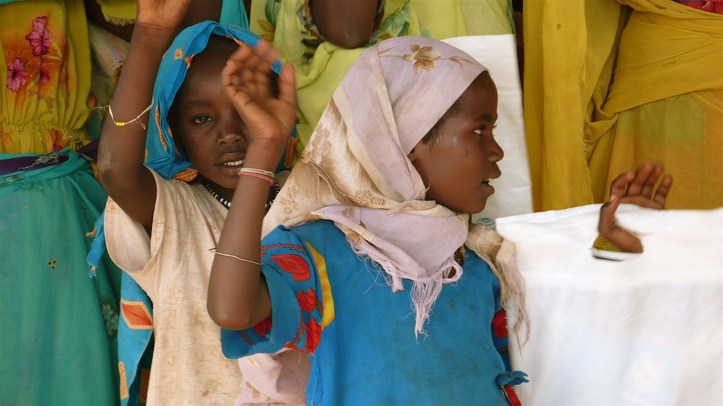
Found Hope
Notes:
A significant number of refugee youth exhibit positive social adjustment and resiliency despite the many stressors they have faced.
Factors contributing to children’s resilience and found hope include collectivity and peer support; emotion-focused coping strategies and suppression of difficult feelings in order to move forward.
Strong faith is seen as adaptational in the aftermath of trauma fostering children’s gratitude in having survived.
Capacity to embrace uncertainty and focus on what one can control was another protective factor noted in refugee children.
Peer support is another protective factor identified in refugee children especially those who have been separated from their parents.
Photo: www.flickr.com.

Slide 12
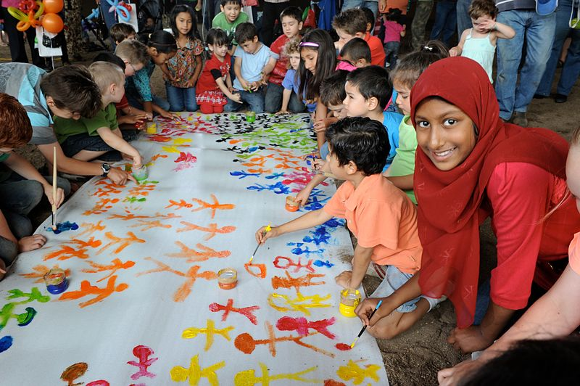
Hope for the Future
Notes:
Relocation to the U. S. and Canada begins with parents’ great hopes for their children’s futures.
Children of immigrant parents are one of the fastest growing demographics in the United States and Canada.
Children’s well-being is linked to how well or how poorly their parents adjust. If parents have difficulties settling into their new environment it is likely that the children will, too
Parents face tremendous hurdles in adapting to in their new communities not the least of which are dealing with language barriers, economic disadvantage, changed social status, and unfamiliar cultural and social norms.
Families feel the sting of intolerance caused by heated controversies in U. S. immigration policies.
Some families become more cohesive as a consequence of the migration struggles they have shared. Strong faith helps many parents make meaning and transcend adversity.
Photo: commons.wikimedia.org.

Slide 13
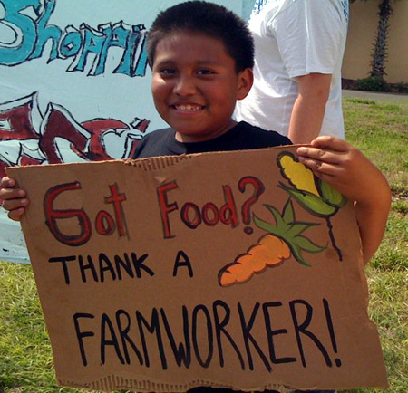
The Forgotten
Notes:
Migrant or seasonal workers are defined as transient, temporary workers whose employment and residence is of limited duration. There are an estimated 3 to 5 million migrant laborers working in America at any given time.
Temporary living situations and undocumented status make it difficult to track the whereabouts of these parents, children, and families and nearly impossible to enforce laws designed to protect their safety and welfare.
According to the U. S. Department of Labor children of migrant workers under the age of 16 are not allowed to be in work situations considered dangerous. However the National Farm Worker Ministry reports that children as young as 6 have been observed working in hazardous conditions.
Children and migrant worker families face tremendous economic and health disparities as well as continuous injustices perpetrated by a thorough lack of understanding of the exigencies of their lives.
To counteract discrimination those working with migrant children and families must be open and express desire to learn about their culture.
Photo: www.flickr.com.

Slide 14
Notes:
Cultural responsiveness means that workers not judge child-rearing based on their own or solely Western practices.
Raising children is informed by culture and custom and by family history and custom.
Below are some child-rearing traditions seen across cultural groups:
Extended family members and other caring adults may help raise children in African-American families.
Chinese, Hmong, and Muslim parenting cultures promote obligation to family over the needs of the individual; children are taught to respect and defer to elders.
In contemporary sectors of urban North America, childrearing is child-focused; many parents afford youngsters significant say in decision-making.
Children are the responsibility of the community responsibility for many First Nation tribes (See Oscar’s Story Chapter 4).
Photos: Top three -- www.flickr.com; Left bottom photo by www.flickr.com; Bottom Middle Photo by TREGG MATHIS on Unsplash; Bottom Right: Photo by Nathan Anderson on Unsplash.

Slide 15
Hmong Heart
Notes:
Mrs. Ly’s Story (modified from Chapter 13, pp. 320-321): Mrs. Ly was called in to speak about her son Liko, age 3, with a mental health counselor at Headstart. Liko’s teachers were concerned about bouts of inconsolability, dreaminess, and withdrawal. They agreed amongst themselves that he needed medical and psychiatric assessments to evaluate for such conditions as autism, a seizure disorder or cognitive delays.
Although Mrs. Ly appreciated and respected the teachers’ concerns, she had already consulted her Shaman who associated Liko’s symptoms with ancestral failings. He suggested that the family seek support from community elders to retrieve Liko’s soul. The family was also prescribed medicinal teas and tinctures for healing. Mrs. Ly had naturally consulted with her mother and grandmother, both insisting that she engage in spiritual rituals before taking Liko to see Western healers.
The Headstart counselor questioned whether or not she should report Mrs. Ly to child protective services for medical negligence. Instead she consulted with a cultural broker from whom she learned that Mrs. Ly was following traditional customs of care. Working with the cultural broker and Mrs. Ly eventually led to a compromise and Liko was seen by a Hmong psychologist who helped with evaluation and service planning.
Suggested reference: Fadiman, A. (1997). The Spirit Catches You and You Fall Down: A Hmong Child, Her American Doctors, and the Collision of Two Cultures. New York: Farrar, Strauss and Giroux.
Photo: darkfallenangel1999.deviantart.com.

Slide 16
Conversation Starters
Describe what it means to have cultural humility.
Discuss the importance of reflective practice when working with children and families from different cultures. Share an example from your work or personal experience.
Write a one-pager describing your family’s culture. How does cultural identity influence your work with children and their family systems.
What ethical quandaries are raised in Mrs. Ly’s story? How might you address them?
In small groups or dyads, explore how relational principles inform cross-cultural practice.
Using examples from your readings, experiences, and other sources, discuss the power of hope.

