Slide 1
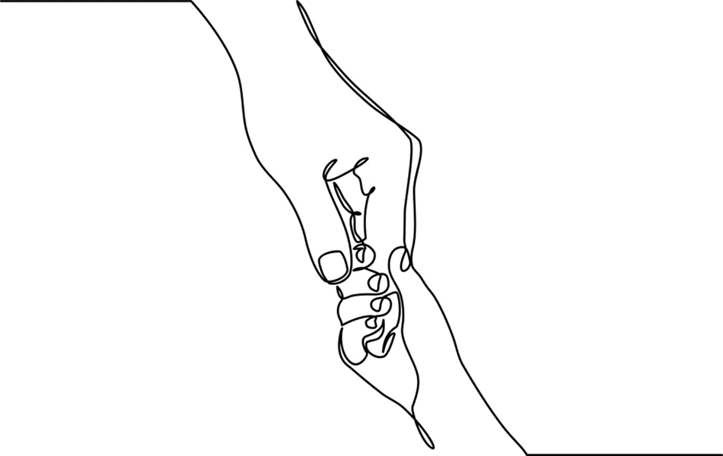
Chapter 12:The Impact of Violence on Children

Slide 2
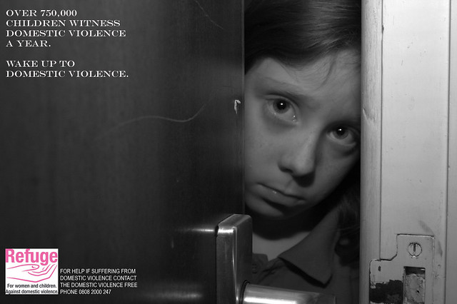
Notes:
Children’s exposure to violence is a significant public health concern.
Photo: www.flickr.com

Slide 3

Intimate Partner Violence (IPV)
Notes:
Intimate Partner Violence, also known as domestic violence, occurs between current and former spouses/, dating couples; or adults in former relationships; among heterosexual or same-sex couples. IPV occurs across social class, race, ethnicities, religions, genders, geographic settings, parenting relationships and age groups.
IPV ranges in frequency and severity; it can be physical, emotional, financial, sexual or a combination of other controlling and battering behaviors.
Although men may be the target in violent relationships, the majority of those impacted by IPV are women.
IPV is often associated with a cycle of violence - described as having three stages: the tension building stage; the violent episode; and the honeymoon stage.
IPV influences how children understand relationships and has long term impacts on social learning, actions, and behaviors.
Photo: www.flickr.com.

Slide 4
Exposure to Violence
WITNESSING
DIRECT INVOLVEMENT
AFTERMATH
Notes:
Children’s IPV exposure includes watching or hearing violent acts, being directly involved or trying to break up the abuse, and experiencing the aftermath of the event
Even within the same household, children make differing meaning of their experiences; some accept violence as an aspect of family life; others wonder what they did to cause it and how they can prevent it.
Photos: Large Circle: www.flickr.com; Top Circle: Chantalpresentsonc913.blogspot.com; Middle Circle: Drhalloncall.com; Bottom Circle: www.stopvaw.org

Slide 5

Bella’s Dilemma
Notes:
Bella’s Story (Modified from Chapter 12, pp. 281-282): Bella, now in her 30’s, has vivid flashbacks of her mother’s blackened eyes, broken bones and hidden bruises. Typically the day after beatings her mother would minimize their impact and chastise Bella for even mentioning them. “Your father works hard,” she’d say. “I overreacted and he had every right to get angry at me.”
Bella’s father never spoke of the violence and neither did her brother Leon, two years her junior. Even worse her parents did nothing to stop Leon when he began to beat on her. Bella sought help only once. She was 12 when she approached her Priest about the violence. He called her parents who dismissed the complaints. From that point on he avoided Bella on Sundays when her family came to worship.
Bella’s high school guidance counselor became aware of her plight from friends. Bella had learned to deal with the craziness by denying herself food, skipping school, and shoplifting. The thrill she got from risky behaviors helped her forget the fear from the night before. This coping method worked for Bella until the day she passed out on the soccer field. The guidance counselor directly asked Bella about family violence. Bella briefly contemplated her options. She couldn’t bear to be dismissed again. In the end Bella opted to keep silent; the guidance counselor just couldn’t be trusted.
Photo: www.flickr.com.

Slide 6
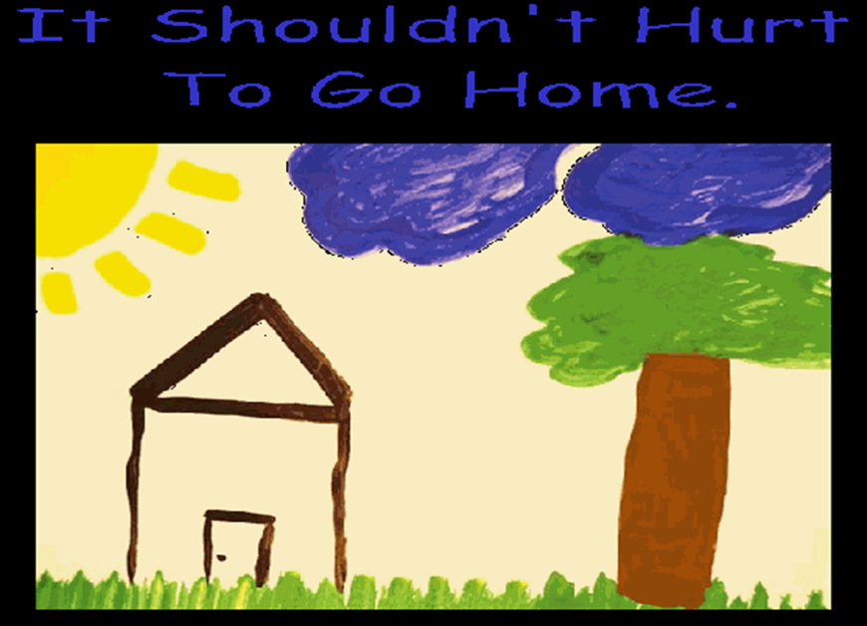
Notes:
Mothers experience two million injuries from intimate partner violence each year (CDC, 2008) and many of these assaults are witnessed by child witnesses.
Some children lived in chronically violent homes; others witness episodic attacks; there are those that leave violent homes living temporarily in shelters only to return to violence; and others leave permanently and relocate immediately after the first serious incident of violence occurred
Image: www.annapolis.gov

Slide 7
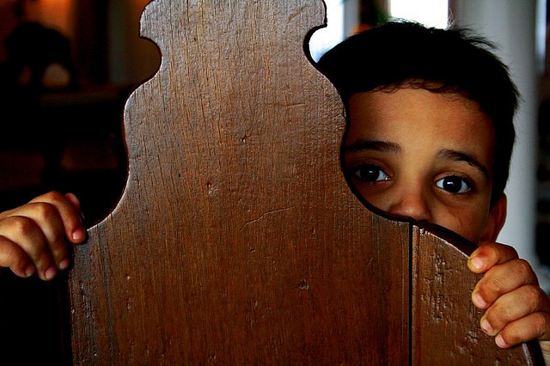
“Do you want to know how I feel about it? It gets me all confused and muddled up.” (8-year-old boy)
Notes:
Children are present in 81% of households where IPV has occurred.
Eighty to 90% of children are well aware of the violence that takes place in their homes even when parents believe them to be asleep or occupied.
Infants and toddlers exposed to violence may exhibit excessive irritability, sleep and eating disturbances; inconsolability, separation anxieties, and developmental and social delays.
As children mature they become increasingly cognizant of the harm family violence imposes but at the same time they remain confused, anxious, afraid and uncertain.
Some youngsters become skilled at making excuses for not inviting friends over and maintaining an illusion of normal
Adolescents are significantly affected by family violence; some experience behaviors consistent posttraumatic stress disorders, antisocial behaviors and/or conduct disorders.
Photo: www.flickr.com.

Slide 8
FAMILY VIOLENCE
DEPRESSION
ANXIETY
AGGRESSION
HYPERVIGILENCE
INATTENTION
Notes:
Whether as bystanders or participants, children and youth are at risk for a range of short and long-term emotional, relational and behavioral difficulties.
IPV is a form of toxic stress and is considered an adverse early experience that if unaddressed, will affect people throughout their lives.
Symptoms such as aggressive and antisocial behaviors as well as anxiety and depression are seen in children exposed to family and community violence.
Behaviors associated with posttraumatic stress such as hypervigilance, reactivity, and inattentiveness are observed in children living in violent homes and neighborhoods.
Along with recognizable psychiatric and behavioral symptoms children experience grief in connection to the losses brought about by family and community violence.
Photo: www.flickr.com.

Slide 9
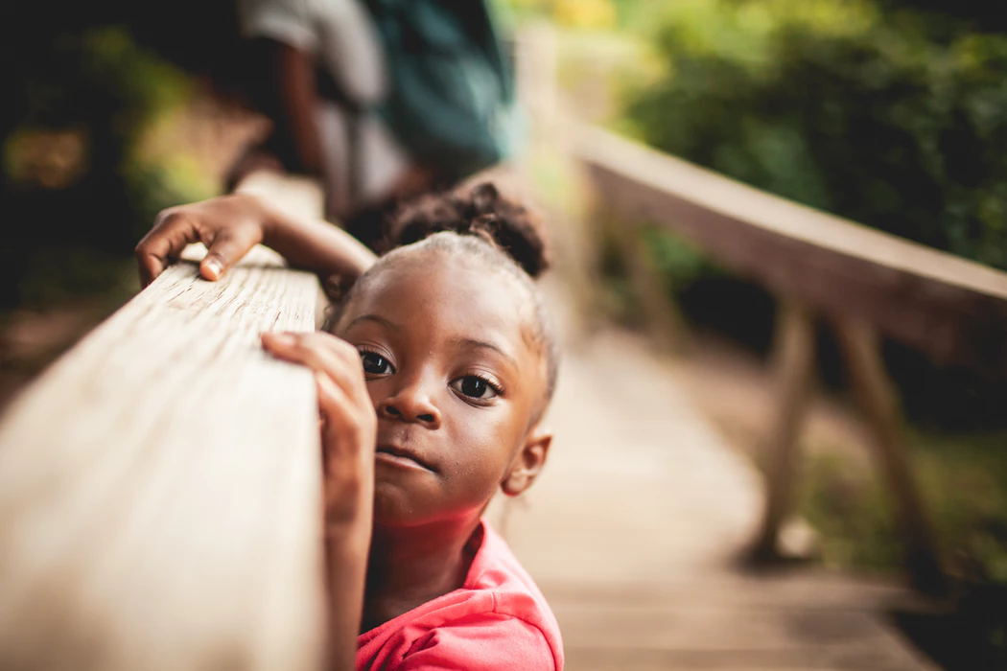
Diannah’s Story
Notes:
Effects of family violence are often missed by workers and other child-centered professionals, camouflaged by behaviors that mimic those common to psychiatric problems or psychosocial conditions. Diannah’s story offers a cautionary tale of why it’s important for workers to ask about family violence routinely in their assessments and to persist when they believe it may be present in children’s lives.
Given the known life-affecting risks of family violence it is essential that child-centered workers routinely and repeatedly ask questions about its prevalence; an open approach assures children that the worker is willing to have a conversation should violence be part of their lives. Although some children will maintain silence others will see these questions as opportunities to safely disclose their experiences.
Diannah’s Story (Modified from Chapter 12, pp. 283-285): Diannah Stone, an African-American 9-year-old was referred to the school social worker because of seemingly complicated grief following the sudden death of her beloved grandmother. Nana Mills took care of Diannah and her sister, Francie, 7 after their mother died. Diannah’s father and grandmother were known in their community as kind and gentle people. They were active in the Abyssinian Church. Mr. Stone was seen as an exceptional parent after the unexpected loss of their mother. Soon after Nana Mills’ death, Mr. Stone and the girls moved in with his girlfriend Bonnie, and her two boys, ages 10 and 13.
During a parent-teacher conference teachers shared with Mr. Stone that Diannah’s grades were declining and that she seemed preoccupied. Mr. Stone was greatly concerned and immediately agreed to have Diannah see the school’s social worker.
During the intake process the social worker observed that Diannah displayed noticeable reactions to questions about family violence. When asked about these, Diannah responded by saying she was sad. When asked why, she shrugged her shoulders and her eyes went blank. However the social worker noted that Diannah’s artwork was rife with violent images. Over the weeks, the social worker slowly and patiently inquired into Diannah’s experiences. She let Diannah know that she could tolerate whatever feelings and thoughts she decided to share. Eventually Diannah revealed that her father’s new girlfriend beat him up. “He doesn’t want anyone to know,” Diannah said. She also told the worker that she witnessed the girlfriend hitting and screaming at her boys. They in turn, took their frustration out on Diannah and Francie. “Nothing we can’t handle,” she reported to the social worker.
With Diannah’s consent the social worker brought Mr. Stone into a session. He acknowledged the family violence but didn’t realize the repercussions it was having on Diannah. “I thought she was still grieving for her grandmother and mother,” he said. “I didn’t even think about how Bonnie’s actions were hurting the girls.” It took a while but Diannah’s father finally asked his girlfriend to leave. Additionally both he and the social worker reported the boys’ abuse to CPS.
Photo by Zach Lucero on Unsplash.

Slide 10
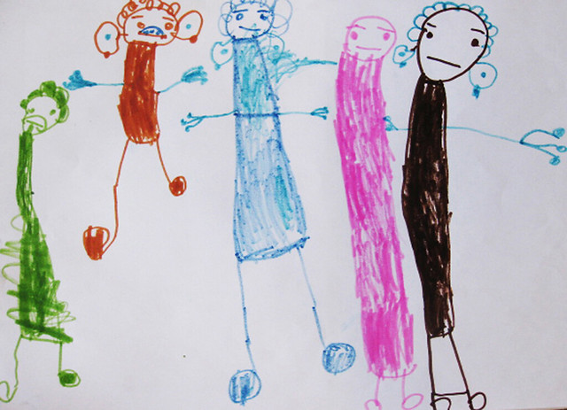
The Ultimate Dilemma
Notes:
Although leaving an abusive partner seems logical, victims see it very differently. More often than not they are physically, economically and/or psychologically compromised and unable to leave their circumstances.
Parents who stay in abusive relationships are harshly judged; victims recognize however that there are significant risks in leaving and believe they are acting in their children’s best interests.
Offenders are skilled in psychological control and instill fear and helplessness in their partners systematically destroying their confidence and self-efficacy.
Offenders will purposely manipulate children or directly threaten their welfare to control their partners’ behaviors.
IPV victims living with violent partners face the ultimate dilemma: they want to keep their children safe yet they also want to keep their families together.
Photo: www.flickr.com.

Slide 11

Protective Factors¹
Help children reestablish a sense of order, routine, and trust
Provide age-appropriate explanations for the violent events
Assure children that violence is not their fault
Respond honestly to children’s fears and anxieties
Notes:
Protective factors for children in violent homes include accessible and ongoing relationships with at least one if not more caring adults and availability of safe and protective resources, for example family violence shelters.
Personality characteristics and resources that aid children’s resilience are intelligence, self-worth, self-efficacy, good health; positive social relationships; faith-based beliefs and resources, strong regulatory skills and socioeconomic stability.
Positive outcomes take place when children are permitted to speak of their experiences without fear of judgment or retribution.
Children describe hope as a healing factor, for example children who were eventually able to leave violent households expressed joy in the possibilities for their futures.
Parents can help their children counteract the effects of violence by providing structure, clarity, and assuring children that violence and abuse are never their fault.
¹ Groves (2002).
Photo: commons.wikimedia.org.

Slide 12
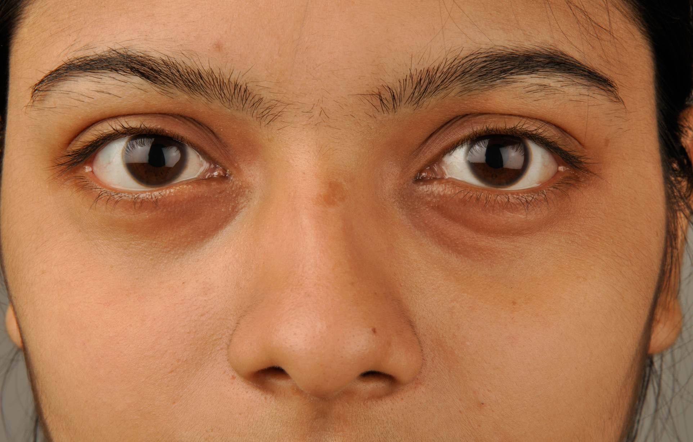
Children’s Perspectives
Notes:
Few studies have investigated interpersonal violence directly from the perspectives of child witnesses.
Although adults certainly lend vital perspectives, they cannot accurately speak for children.
The capacity to make meaning of IPV is variable; some children find comfort and healing in telling their stories; some fear being ignored, dismissed, or not believed; still others fear reprisals should they reveal their family’s violent secrets.
When able to speak of violence, youngsters’ primary goal is to find safety for themselves and their family.
Coping strategies also vary: Many youngsters avoid thinking about the violence altogether by immersing themselves in activities, blanking out to screens, or dissociating from their feelings. Others seek comfort from friends and pets.
Perhaps the most powerful lesson learned directly from children is that they need to be taken seriously by significant adults in their lives. They want to be heard and not forgotten.
Photo: commons.wikimedia.org.

Slide 13

Children of murder victims are the “forgotten victims” of homicide.
Notes:
Thousands of children in North America are affected by IPV homicide and family murder.
Murder is both unexpected and violent; when it occurs child survivors experience both grief and symptoms resembling those of post-traumatic stress.
Children are subjected to psychological distress as a result of criminal justice proceedings, public media coverage, and family changes that take place after the death of a family member.
Photo: kateannexterrasochi.deviantart.com.

Slide 14
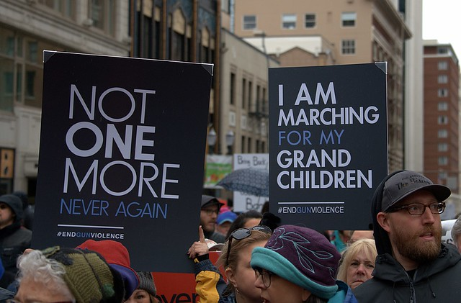
Community Violence
Notes:
Increasing attention has been focused on children’s exposure to community violence vis à vis violent street crime, bullying, school shootings and other public displays of aggression.
Some approximate that community violence occurs with more frequency in low income urban communities; others observe that rates of school place violence are increasing in middle and upper income suburban and rural areas.
Exposure to community violence affects children’s overall well-being; depressive symptoms, hypervigilance, anxiety, and relational difficulties are related behaviors.
Older children may be terrified of neighborhood violence; some may feel pressure to join in the violence to protect themselves and their families.
Family factors can exacerbate or mediate children’s coping; family resilience, structure and support help children manage while vulnerable families are often negatively affected by neighborhood violence.
Community-based interventions are most effective however most neighborhoods lack resources to adequately address the material, mental health, and protection needs of children and families trying to cope with the effects of violence.
Boyd-Franklin and Franklin (2000) suggest that violence towards African-American male children in America profoundly affects their lives as well as those of their families and neighborhoods.
Image: Courtesy of Shelley Cohen Konrad.
Image: Courtesy of Shelley Cohen Konrad.

Slide 15
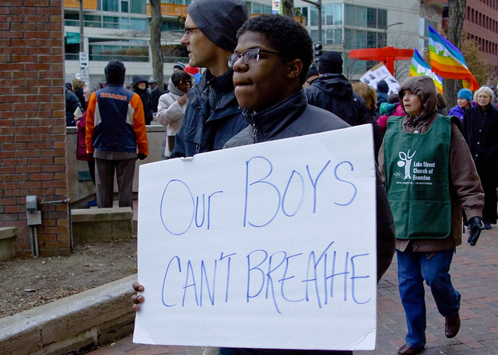
Notes:
African- Americans male children in urban, low income communities are more often exposed to violence than any other population demographic (Jones Thomas, A., Carey, D., Prewitt, K., Edna Romero, E. et al (2012).
As of 2019, homicide is the leading cause of death among African American youth ages 15 to 24
The impact of community violence on African American families is powerfully felt.
Parents are protective of their children and particularly their boys.
Parents counsel their male children to avoid confrontations of any sort and to respond deferentially when confronted by persons in authority.
Photo: www.flickr.com

Slide 16
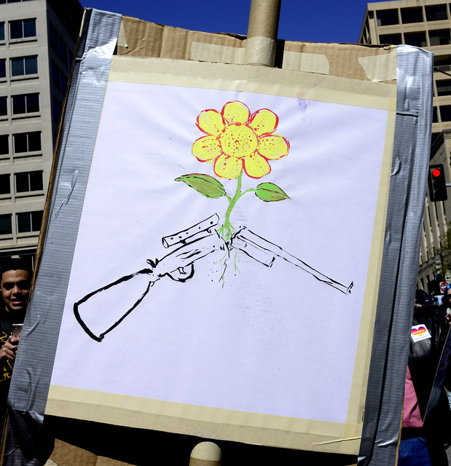
Gun Violence
Notes:
Over the last two decades (1999-2019) more than 150,000 students attending at least 170 primary or secondary schools in the U. S. have experienced violence as a consequence of a school shooting (Strauss, 2018).
Youth are seriously concerned about gun violence, and some have used anti-gun advocacy to address their fears and hopes for the future.
The social and emotional effects of actual and potential gun violence are immediate and long-lasting, destabilizing children’s sense of the world as a safe place.
Existential outcomes are manifested in feelings of futurelessness and by a fears that they will not reach adulthood. Children who are exposed to community violence, directly or indirectly, express higher levels of trauma symptomatology.
Photo: www.flickr.com

Slide 17
Virtual Violence
Notes:
Unlike any previous time in history, children witness and become victims of violence through virtual and passive medium such as television, computers and smart phones.
Studies suggest that the effects of media violence are real and strong when children are continually exposed to violence as entertainment.
Two-thirds of children ages 6-months to six years are tuned into screen for at least 2-hours a day; older children spend on average 4-6 hours tuned into screen-based media.
Watching violent TV and video games may promote aggression in children with histories of behavioral problems and cause others to become apathetic towards the effects of violence.
Social networks (e. g. Facebook, Twitter), emails and texting via cell phones are now common forums for stalking, bullying and other forms of emotional, verbal, and psychological abuse.
The American Academy of Pediatrics recommends that children under 2 watch no media at all while those over 2 be restricted to two hours or less watching age-appropriate media programming.
Photo: First Circle: Pixabay; Second Circle: commons.wikimedia.org; Third Circle: www.flickr.com; Final Circle: heartnsoulfriend.deviantart.com

Slide 18

Signs of Child Trafficking
• Irregular school attendance
• Frequent absences
• Incidences of running away
• Signs of physical trauma
• Mention of frequent travel to other cities
• Lack of travel documents and/or little control over personal schedule
• Substance use disorder
• Poor hygiene and dress
• Rote answers to personal questions
• A boyfriend or girlfriend who is much older
• Attempts to hide injuries or tattoos
• Hyperarousal including irritability and overreaction
• Inattention, avoidance of relationships and shyness
Notes:
Child trafficking occurs when children are “recruited, transported, transferred, harbored or received for the purpose of exploitation” (UNICEF, 2018).
The actual number of trafficking cases is difficult to identify because trafficked individuals are reluctant to be identified due to fear of reprisal and shame; some are too young or immature to even describe their experience (Greenbaum, 2017).
Early trauma and ongoing adversity make youngsters vulnerable to traffickers who initially promise a better life. Such promises from are quickly replaced by violence, abuse, and fear.
Children are most vulnerable to human trafficking when they are separated from their families and communities (Smolenski & Interman, 2017).
Child-centered workers should be aware of the signs and symptoms that might indicate a child or adolescent is being trafficked; trauma-informed training in human trafficking is recommended for frontline child-centered workers across sectors including schools, child welfare, social service, the juvenile justice system, law enforcement, and others who touch the lives of vulnerable and disenfranchised children and youth.
Photo by Carolina Pimenta on Unsplash.

Slide 19
Conversation Starters
Discuss relational, community, and cultural factors that influence IPV and other forms of violence.
What are inherent dilemmas when working with children and parents experiencing IPV and family violence? How can you balance the needs of children with those of the adults?
Children who witness violence often remain silent. How do you explain this phenomenon and what can help break the silence?
Both Bella and Diannah experienced violence in their family systems. Compare their stories with attention to gender, race, socioeconomic, and cultural factors.

