Slide 1
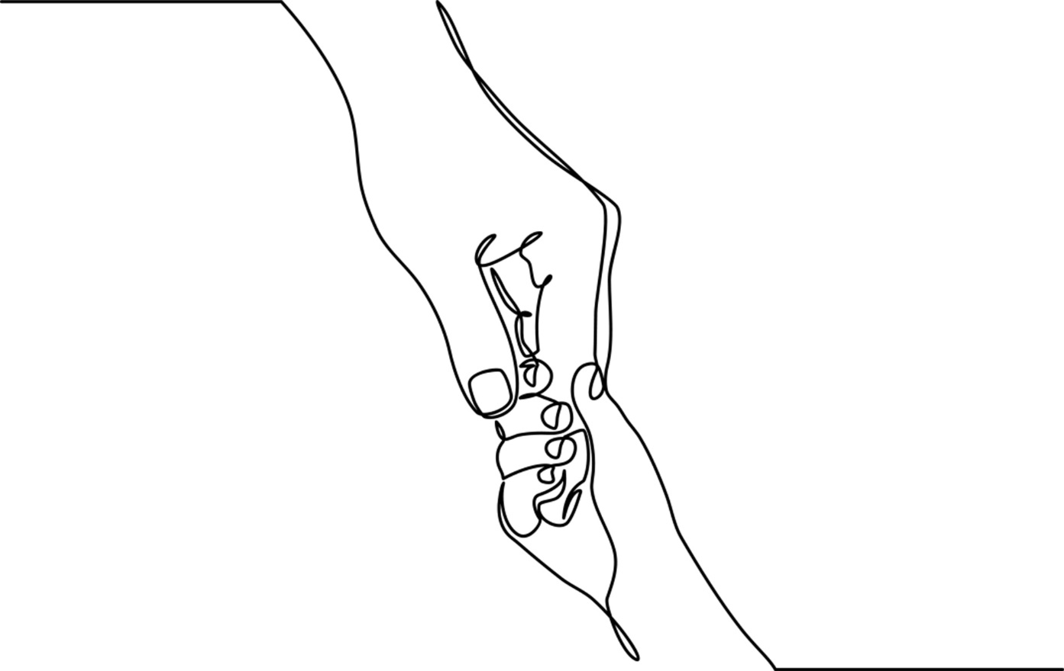
Chapter 11: Death and Grief in Childhood

Slide 2
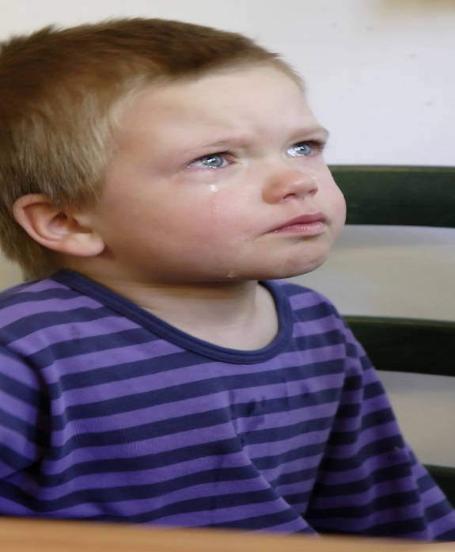
“When you die you can float through walls and doors and stuff you can’t do now. “
Jack Simon, age 5
Notes:
Children process death in ways that fit their understanding of the world.
The death of a loved or known person is an unforeseen yet not uncommon experience for children and youth.
Although children make sense of death in ways different from those of adults their grief is no less real.
Children are also passive witnesses to death in the media. Rather than prepare children however, frequent media exposure may in fact heighten their fears of death and the potential loss of loved ones.
Photo: commons.wikimedia.org.

Slide 3
Children’s Perspectives on Death
Cannot verbalize feelings of grief
Feel impact of grieving caregivers
Fear losing control over their emotions
Don’t want to appear different from peers
Accept the reality of death
Grief is felt and experienced
Aware that death is universal
Increased separation & anxiety issues
INFANTS & TODDLERS
SCHOOL-AGED
YOUNG TEENS
ADOLESCENTS
Notes:
Children’s age, developmental levels, and relationship to the deceased affect understanding and responses to death. For most children, the permanency of death is not fully appreciated until ages 6-8.
As with divorce and other separations infants and very young children suffer distress related to distractions of their grieving caregivers. First encounters with meaningful loss often occur when a family pet dies.
Maturing cognitive capacities and increasing social/emotional awareness enhance school-aged children’s (7 to 11) appreciation for the universality of death and its irreversibility.
Children of all ages tend to assume that death is a reality for the old and infirm. During the school years children comprehend that everyone will die.
Talking about or expressing grief is sometimes suppressed in teens because they do not wish to stand out.
Being available and open to the variable ways youth express their losses opens the door to helping them transition from grieving to healing.
Photos: Far Left – www.flicker.com; Second Left — www.flickr.com; Second Right -- commons.wikimedia.org; Far Right – www.flickr.com.

Slide 4
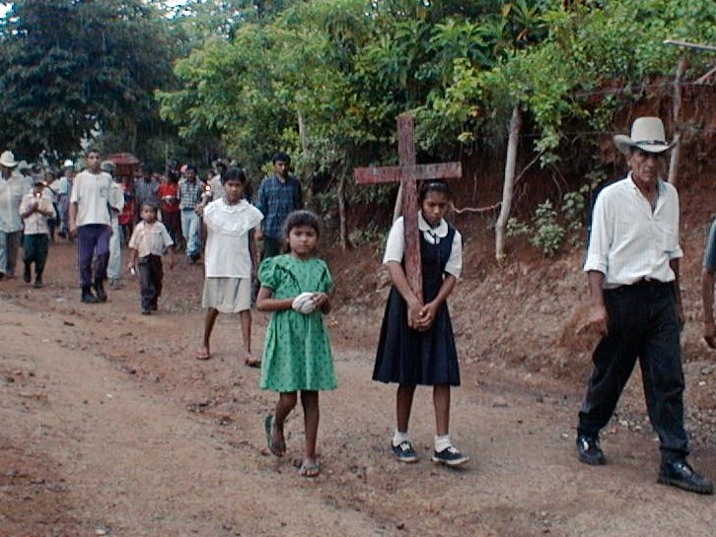
Parental Death
Notes:
Approximately 2.5 million or 3.5% of children under 18-years of age in the United States will lose a parent to death each year.
The death of a parent is considered a highly stressful life-changing event for people of every age but it is especially felt by dependent children.
In developing countries and underserved regions, the rate of early parental death is significantly higher due to accelerated rates of AIDS, insect and water borne infectious disease, and maternal death in childbirth
For young children a parent’s death is devastating because of the interdependency of their relationships and the need for reliable, secure attachments that allow them to advance and grow.
Children of all ages experience elements of anxiety related to worries about who will care for them and how their daily life will be affected without their parent.
Capacity of the surviving parent to support children after a death is critical to healthy grieving and healing. Helpful as well is knowing that other familiar adults and community members are there to provide support and care to the family.
Photo: commons.wikimedia.org.

Slide 5
Children and teens who are grieving the death of a brother or sister are often forgotten survivors.”
(MADD Victim Services, 2011)
Notes:
Emotional turmoil derails children and families as they seek to find meaning after a sibling dies.
Families reconfigure roles within a family structure now missing a vital family member.
Grief researchers agree that when parents are able to maintain their parental functions, it serves as a source of strength for their children as they work through grief.
Children’s reactions to sibling loss are seen as influenced by multiple variables including age and development; how well parental functions are maintained after the death of a sibling; by how close the siblings were with one another and whether sibling rivalry was a factor in the relationship.
Sibling loss affects children in a variety of ways: some are at risk for emotional and behavioral difficulties; there are those that exhibit heightened vulnerability as well as greater concerns about their own mortality; some express heightened maturity and empathy for others .
Photo: www.flickr.com.

Slide 6
Harry’s Story
Notes:
Davies (2005)¹ identified four common responses to sibling grief (see above). Harry’s story shows how these responses are played out.
Harry felt extremely guilty for having survived the car accident that took the life of his older brother, Axel. Before the accident, Harry admitted that sometimes he wished Axel would just disappear so that he could have the limelight of his parents’ love. It was six months after the funeral when Harry’s mother first noticed he wasn’t himself. It took another three months before teachers sat down with Harry’s parents and told them that he cried at school every day over “nothing.”
In retrospect, the adults in Harry’s life felt terrible for having missed the signs of his deepening depression. As for Harry, he didn’t blame them. He had tried his best to remain as invisible as possible. He didn’t want to worsen his parents’ sadness nor did he wish to distract attention away from Axel. Being ignored seemed to be minimal punishment for what he really felt; he didn’t deserve to be alive.
When children acknowledge that they hurt inside practitioners can offer a range of approaches to express and externalize their hurt. In Harry’s case a worker might ask him what hurt looks and feels like. He could then illustrate, act out, or tell a story about his hurt, helping the worker better understand his experience.
Children who do not understand may be conveying two separate but related messages; they may need more information to fill in the gaps about their sibling’s death; and they may be expressing an existential lack of understanding as in why did this happen to my sibling and our family. Harry’s worker might therefore convene a family meeting during which time they fill him in on age appropriate details so that he could develop a coherent story about Axel’s death; this could be followed by identifying that which they could control – for example ways in which they could honor Axel’s memory and gain power over the helplessness they feel.
Children who feel they no longer belong describe feelings of being overwhelmed or displaced. Harry already felt lesser than his brother in life; Axel’s death made him feel more isolated within the family. Narrative family therapy could help Harry reframe his identity within the family, know that he is enough, and also put a name to the survivor guilt he feels.
Photo: www.childhealing.com

Slide 7
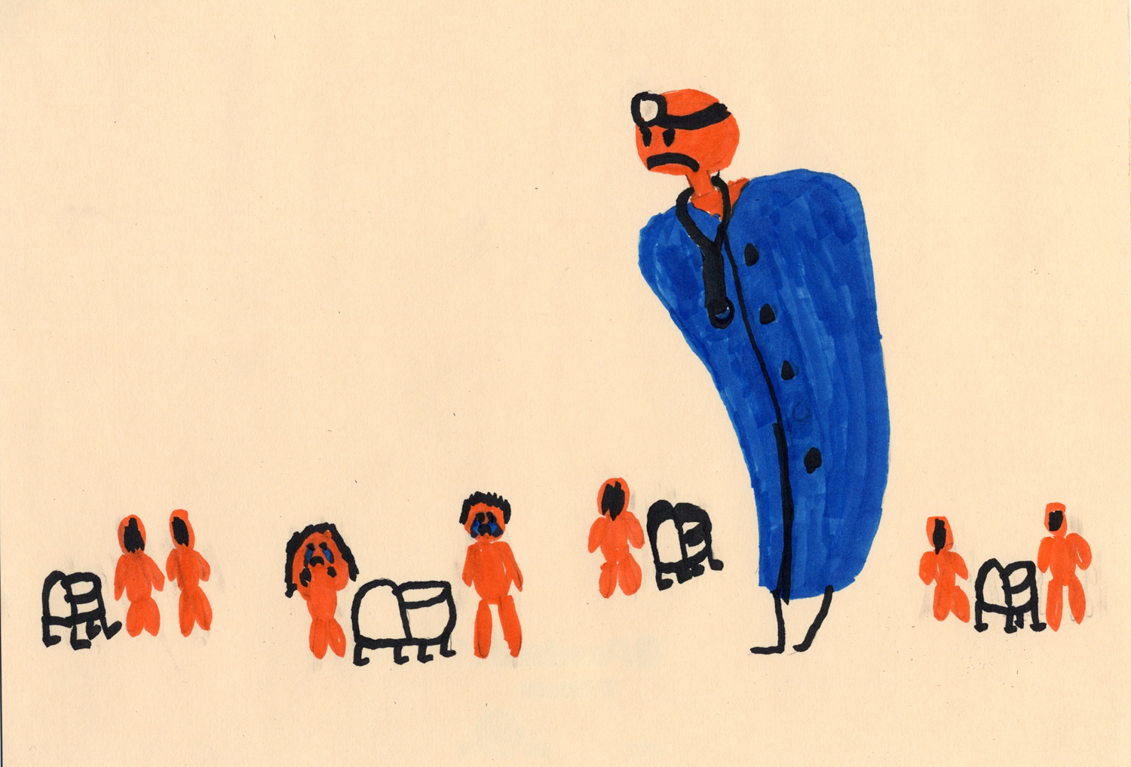
Notes:
The death of a child is one of life’s saddest and most stressful events. It defies the natural order of things.
Despite advances in medical technology and trauma medicine, approximately 55,000 children ages 0-19 in the U. S. die each year from medically-related illness and disability.
Children are born with incurable degenerative conditions that technology cannot cure. Children acquire life-limiting illnesses and disabilities that will lead to their untimely death; and children die in accidents that no amount of adult supervision can prevent.
In western cultures, child death is rarely talked about and some describe a “conspiracy of silence” that surrounds acknowledging that children die despite everyone’s best efforts.
Parents who know they children’s lives will be limited experience feelings of loss and grief beginning at the time of diagnosis.
The majority of parents navigate the grief process without assistance from a professional counselor or therapist; grief is a normative process that parents manage in different ways.
Some grieving parents however, seek the support of someone outside the family so as not to further burden family members and/or friends who may also be mourning.
Art courtesy of Shelley Cohen Konrad.

Slide 8
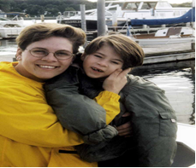
Living while Dying
Notes:
Seriously ill and dying children sometimes go to great lengths to protect their parents from grief and sadness, having witnessed their family’s pain and knowing that there was little they could do about it.
Children may become exhausted by curative treatments. Weighing and balancing quality of life with hopes for maintaining a child’s life as long as possible is a common end-of-life dilemma.
The concept of living while dying applies to these children and their families.
Photo: Courtesy of Theresa Gaetjens in memory of Michaela.

Slide 9
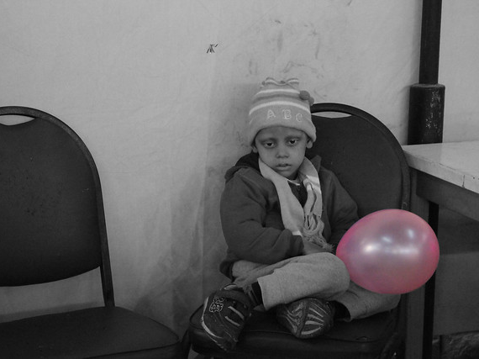
Talking with Children about Dying
Notes:
Talking with children about their own death is a considerable challenge and conversations must be adapted to the child’s developmental understanding of what it means to die
2. Some children express their inner knowledge of death through art, play and other expressive modalities.
Children living with serious and terminal illnesses frequently acquire a maturity that transcends their years. People who get to know these children observe that they intuitively grasp when they are close to death.
Although children become progressively aware of diminishing options not all will want to talk about or express their feelings about dying.
Supportive adults must take care not to impose or pressure children to speak of death if they prefer to focus instead on other things.
Children process dying in different ways; some choose to focus on other things; some are curious and ask questions about the death process and the afterlife.
Children cope best when they know what’s going on and are given developmentally informed, clear, and honest information.
Being candid about difficult news, rather than frightening children actually eases suffering; when left uninformed, young children create their own stories and youth fill in the gaps using information found on the Internet, either of which can lead to unnecessary anxiety.
Photo: www.flickr.com.

Slide 10
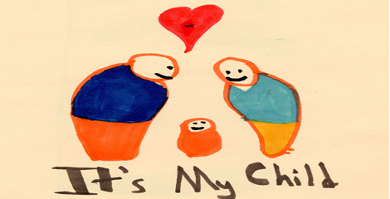
The “now” is paramount” to dying children.
Notes:
The present is all that matters for seriously ill children. The future holds no promise so quality of life in the present is essential. Parents are thus faced with urgent incentives to make each day as good as possible, while at the same time remaining emotionally available and authentic.
Relinquishing hope for the future (cure) and living in the now (quality of life) is understandably difficult for parents given the often overwhelming everyday caregiving burdens they must manage while at the same time coping with powerful and difficult feelings. It is also difficult for children who must endure many difficult and often painful treatments.
Even with these powerful emotions, many parents report benefiting from the lessons they learned from their fragile children.
Artwork: Courtesy of Shelley Cohen Konrad.

Slide 11
What Parents Need
“Thank you for showing us that you care. It helps to know that you care about what’s important to us – that it’s not just a matter of efficiency, it’s that you’re dealing with real people.
It goes a long way knowing that someone is there for us emotionally and mentally and being able to do that doesn’t mean you waste your time. There’s business to be done. But just to say how are you today? How’s it going? Something very simple was meaningful to us.”
Notes:
Every family makes meaning of a child’s death in different ways; some experience continuing bonds integrating the child into rituals practiced by the family; those with beliefs in the afterlife may look forward to reunion; some consider the death of a child the end of a chapter in their family life; others never fully recover from the loss.
Many parents want to talk about their deceased children to those willing to listen.
It is often the case that friends and extended family refrain from asking parents about their children’s deaths afraid that they will cause undue suffering.
Workers and other helping professionals take the time to listen to parents’ stories without judgment and without being overwhelmed by them.
Workers can help parents determine what is and isn’t within their control and offer information that helps them manage concrete tasks making seemingly unmanageable situations easier to bear.
Image: www.flickr.com – text aggregate of parents’ comments.

Slide 12
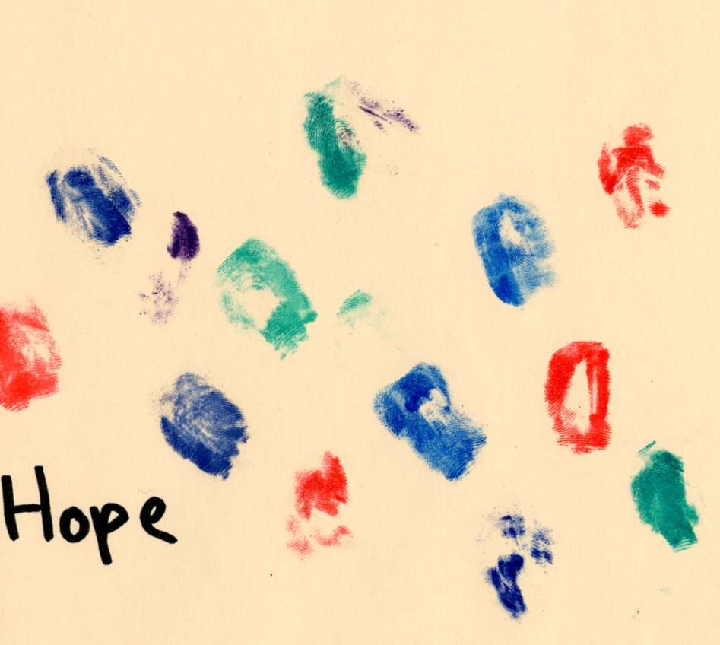
Remember Me
Notes:
Children old enough to communicate want to be remembered. Their fingerprints leave a legacy of hope.
Dying children create scrapbooks, blogs, or videos as tangible mementoes of their lives.
Older children and adolescents additionally wonder about life’s meaning and question what they might find in the life hereafter. Some have religious convictions that earmark their journeys while others may be comforted by the thought of reunion with lost family members, pets and friends.
Image: Courtesy of Shelley Cohen Konrad.

Slide 13
Margaret’s Parents
Notes:
Margaret’s parents made the decision to end curative and life-sustaining treatments at her request when she was approximately twelve-years-old. Diagnosed as a toddler with cystic fibrosis, a chronic, debilitating lung disease, Margaret’s health progressively declined until she could no longer breath on her own. A number of circumstances made her a poor candidate for lung transplant.
From the start Margaret’s parents rigorously followed medical protocols and investigated alternative treatments. Over time however they observed that rather than benefiting from increasingly intrusive treatments, Margaret became weaker, not better.
In her last year of life Margaret let her family know that she was all done with treatments and prepared to move on to a peaceful death. It took every ounce of her parents’ strength and humanity to acquiesce to her wishes. According to her father, “We had to decide whether life alone was worth it for our daughter and we decided that no, it wasn’t. She needed to have a quality of life no matter how brief it was going to be and no matter how emotionally painful it felt to us.” After Margaret’s death her grateful mother told me that she died peacefully with her family around her.
Photo: www.flickr.com.

Slide 14
Conversation Starters
This chapter presents very difficult topics and hard conversations. Discuss your thoughts and feelings about relational practice with children and their families at times of grief, loss, and death.
Identify end-of-life and parenting concepts illustrated in Margaret’s end-of-life circumstances. Describe her parents’ coping choices. What role did Margaret play in decision making?
How does Margaret’s story represent relational practice principles?

