Slide 1
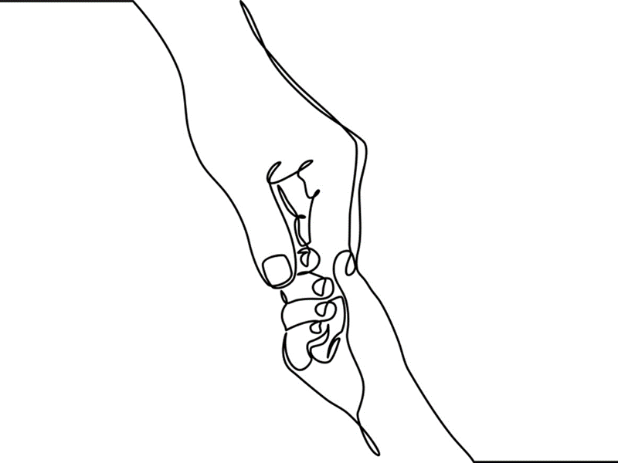
Chapter 10: Family Disruption and Ambiguous Losses

Slide 2
Wounds of the Heart
Death
Separation
Divorce
Ambiguous Losses
\
Notes:
Relational separations and transitional life events are part of the ever-changing landscape of childhood.
Child-centered workers and other helping professionals must be prepared to help children respond to expected, unexpected and ambiguous losses that occur in childhood.
Expected losses and transitions include for example, the arrival of a new sibling, moving on to middle school, and relocating to a new neighborhood. Most children navigate these changes well; most need adults to help them facilitate and structure transitions.
The death of a loved or cared for person is an unforeseen yet common loss experienced by children. (Chapter 11 will focus on children and death.)
Separations from parents are instigated by situations such as divorce, military deployment, incarceration and hospitalization.
Losses are experienced by children when parents, family members or caregivers are physically present yet emotionally and relationally inaccessible. Pauline Boss identified these experiences as ‘ambiguous losses.’
Photos: www.flickr.com

Slide 3

Divorce & Parental Separation
Notes:
Every year, approximately 40 to 50 per cent of all first marriages end in divorce leaving an estimated one million children under the age of 18 newly affected. The divorce rate for second marriages is even higher, 60% - 70% for the U. S. and Canada respectively.
The term divorce refers to the legal dissolution of a marriage while parenting partner separation is used to describe the formal split-up of non-legally-married parenting partners.
Common factors found to affect children before, during and post-divorce include: chronic parental conflict, financial strains and changes in economic status; re-partnering of one or both parents and/or introduction of same-sex partners; transitions into stepfamily life, and parental/family relocation.
Child characteristics seen as contributing to adaptation include: age at time of divorce (see Chapter 10, pp. 228-231); cognitive and maturational levels; temperament and available social resources; history of trauma/abuse and extent of previous losses.
Photo: www.ehow.com

Slide 4
Infancy
Focus on attachment and low conflict
Preschool/Young School-aged
Explain separation in age-appropriate language and assuring that it is not their fault
Older School-aged
Concerned about social image. May be embarrassed by family changes.
Adolescence
May appear unaffected, but feel things deeply
Notes:
When parents divorce during children’s earliest years, attachments and family ties are destabilized. Attention to securing infants’ bonds with both parents must continue regardless of the adults’ decision to end their relationship.
Explaining family changes to younger children should be well planned, rehearsed, and delivered using age-appropriate language. Assuring children that the divorce is not their fault is a cornerstone of parent-child communication.
Older school-aged children (9-12 years old) deeply feel the changes and losses of parental separation. It’s at this age that children become more socially astute and for some, divorce/separation is an embarrassment.
More than their younger counterparts adolescents possess sufficient cognitive maturity to understand the reasons that precipitate parental divorce and separation. They may act as though they are unaffected or may assume adult roles. It’s important to ask adolescents about family separation because despite their reticence to express feelings, they are deeply affected by the changes.
Photos by www.flickr.com

Slide 5
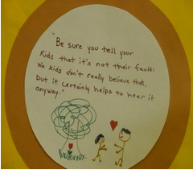
Notes:
Enduring parental conflict is the single most deleterious factor affecting children’s post-divorce adaptation.
Chronic conflict is especially toxic when children are witness to or placed in the middle of their parents’ battlegrounds.
Unrelenting parental conflict results in a range of adjustment and behavioral problems, which may evolve into serious relational problems as children transition to adulthood.
Children may decide to choose one parent over the other in order to reduce ongoing tensions and deflect emotional damages.
Parental alienation syndrome (PAS) is a term used by mental health and legal professionals to describe situations when children experience loyalty conflicts to such an extreme that they refuse to be in the presence of one or the other parent.
Parents, new partners, and extended family must keep children out of the middle of their conflicts to ensure their children’s short and long-term emotional, relational and social well-being.
Image: Courtesy of Kids First, Photo by Shelley Cohen Konrad

Slide 6
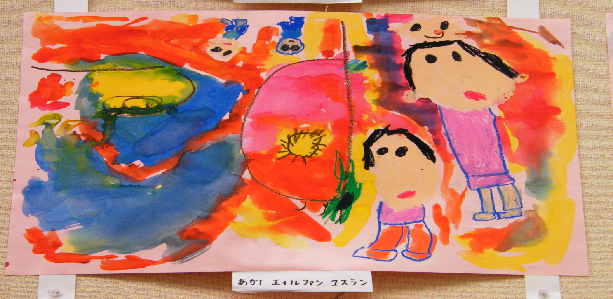
New Relationships & Stepfamilies
Notes:
New relationships are powerful reminders that parents will never be reunited – a common fantasy that divorced children share.
In the majority of instances post-divorce families manage to establish “good enough” co-parenting structures that support their children’s growth and development.
It is not unusual for children’s earlier feelings of loss to reemerge when new parent-adult relationships form and step-siblings appear.
Artwork: www.flickr.com.

Slide 7
Models of Postseparation Parenting
Co-parenting
Parallel Parenting
Sole Parenting
Notes:
1, Children do best when their parents resume stable parenting routines.
2. Co-parenting arrangements assume that parents have capacity to collaborate and maintain a child-centered perspective including ongoing communication that focuses on the immediate physical, material, relational, emotional, educational, spiritual and social needs of children.
Parallel Parenting is a strategy recommended for parents who are unable to maintain cordial, post-divorce communication and are at risk of potentially exposing children to relational conflicts. Parents, often through the courts or mediation, establish specified responsibilities for their children to avoid areas that might have otherwise required negotiation. A parallel parenting plan is made when there is no known risk of abuse to children or to either of the parents.
Sole Parental Custody, a relatively rare arrangement, is legally enacted when one parent is determined to be abusive or sufficiently negligent or has abandoned responsibilities to shared children.
Step parenting takes place when parents remarry or establish new ongoing partnerships with someone who may eventually be responsible for the children’s care.
Photos top right, left and bottom at www.flickr.com; middle top by Andrew Seaman on Unsplash.

Slide 8

Interviewing Children in Cases of Parental Dissolution¹
Provide an appropriate environment with minimal distractions
Prepare children for the interview and its purpose
Create a nonjudgmental atmosphere in which all views are heard
Establish rapport through non-suggestive means
Use developmentally and age appropriate language
Collectively establish ground rules, structure and shared expectations
Use open-ended questions and invite children to use their own words
Do not ask children & youth where or with whom they want to live
Avoid introducing bias or reinforcement of one perspective over the other
Let children & youth know that they do not make the final decision
Notes:
Specific skills and attitudes are necessary for interviewing children of divorce to determine their views while at the same time protecting their best interests.
1Modified from Saywitz, Camparo, & Romanoff, 2010, pp. 549-556. Recommendations apply to children and youth of all ages.
Photo by Laura Fuhrman on Unsplash

Slide 9

Having a voice does not mean making final decisions; but it does mean serious consideration is given to the views of children.
Notes:
1. The best interest of the child standard is used by most courts in the United States “to determine a wide range of issues related to the well-being of children after divorce and parental separation.
2. Canadian child best interest standards recognize that children want a say in legal matters that affect their lives.
3. There is substantive disagreement between knowledgeable and child-focused scholars about the role children should play in legal proceedings; some assert that children are expert witnesses to their own experiences and as such are instrumental to informing successful residency and custodial arrangements; others argue that children are at substantial risk when asked to make decisions affecting their relationships with parents.
Photo: kill3r4ev3r.deviantart.com.

Slide 10

Ambiguous Loss
Notes:
Ambiguous loss refers to two types of losses that often go unrecognized: those that take place when a family member is physically present yet psychologically unavailable; and those that take place when a family member is physically absent yet psychologically alive.
Over the years the concept of ambiguous loss has broadened to include other types of uncertain changes many of which are considered unresolvable, or at the very least, hard to define and thereby difficult to manage, for example in substance abusing families, or when a formerly reliable parent becomes incapacitated due to illness or disability and is no longer readily accessible or present.
Grief related to ambiguous loss is also felt by children whose military parents are deployed, sometimes multiple times, and also by those that lose parents for extended periods due to incarceration, hospitalization or other forms of long-term separation.
Foster children may grieve the non-death losses of parents, siblings, and other loved ones, losses which often go unrecognized and unacknowledged.
Photo at www.flickr.com

Slide 11
Dealing with Ambiguous Loss¹
FIND MEANING
TEMPER MASTERY
RECONSTRUCT IDENTITY
NORMALIZE AMBIVALENCE
REVISE ATTACHMENT
DISCOVER HOPE
Notes:
Boss’ (2006) framework guides children to address what they can and cannot control; encourages the development of positive coping strategies that externalize blame; and assists children in adapting to expected and unanticipated separations.
Healthy adaptation is accomplished when children can miss their loved one yet stay emotionally connected to available and caring adults.
¹ Boss, P. (2006). Loss, Trauma, and Resilience: Therapeutic Work with Ambiguous Loss. New York: W. W. Norton.

Slide 12
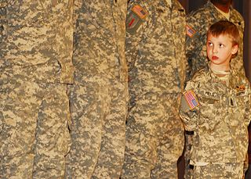
Parental Deployment
Notes:
Children in military families may experience uncertainty and anticipation of loss interwoven into all aspects of everyday life.
Feelings of uncertainty arise when children and youth wonder about whether and if their parent’s will be deployed. It continues following deployment and is often exacerbated by unexpected changes in return dates and unanticipated redeployments.
Active duty military and veterans return from active combat changed in some way; with physical injury; post-traumatic stress or by having witnessed death and environmental destruction.
Parental absence due to deployment in and of itself creates shifts in family structure, routines, and tasks.
Perceptions and appraisals of deployed parents’ military roles also make a difference; when children believe that parents are fighting for a good cause it’s easier to feel pride and accept their absence.
Proximity to others who share common experiences, values and strains provide children and non-deployed parents with support.
Veterans and National Guard and Reservist (NGR) families live in civilian or non-military communities and sometimes feel isolated from the kinds of supports and services they need.
Photo: commons.wikimedia.org.

Slide 13
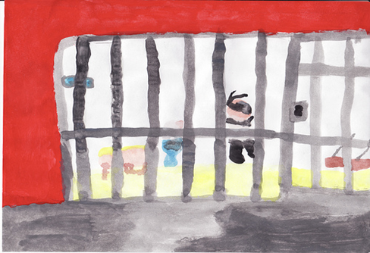
Parental Incarceration
Notes:
An estimated 1.5 - 2 million minor children in America have incarcerated parents during some point in their formative years; up to 10 million youth at any given time have mothers and fathers involved to some extent with the criminal justice system.
Unlike children of military parents who receive sympathy for their plight, children of incarcerated parents remain secretive due to anticipated stigma, blame, or social disapproval when others learn of their parents’ crimes.
Children with incarcerated parents may exhibit insecurities and disruptions in their attachment patterns making it difficult for them to establish trusting relationships with other available, caring adults.
Family insecurities are common for children and youth with incarcerated parents; children frequently lose contact not only with their incarcerated parents but also with other significant adults due to crises and relocations.
Attempts to stay connected to the incarcerated parent are difficult; visitation restrictions and protocols prove undermining and even traumatizing, especially for young children.
To work effectively with this population helping professionals must gain respect for the complexity of these children’s lives and also for the resilience which gets them through each day.
Photo at: www.schoolsz.com.

Slide 14

Chronic Health Conditions
Notes:
Children whose parents live with cognitive disabilities, life-affecting physical illness, and chronic mental illness may experience ambiguous loss because their parent is physically present but relationally and psychologically unavailable.
Young children, whose loved ones experience fragile health may experience insecurities and anxieties about their own survival and that of their well parents and/or siblings.
Children and youth whose parents struggle with less apparent or invisible chronic conditions such as mental illnesses or addictions feel ashamed and tend to isolate from others because they fear exposing themselves to criticism, shame and judgment.
Some children take on caregiving roles that require skills and responsibilities well beyond their appropriate age or maturational levels.
Although young caregivers are often seen at greater risk for problems than comparably aged children of healthy functioning parents, there are those who upon later reflection have found benefit from their experiences.
Image: pixabay.com.

Slide 15

Foster Care
“My loss was more lack of self-preservation and self-worth. I feel as if this could only happen to someone no one cares about” Kanisha, 2018
Notes:
In 1989 Sau-Fong Siu and Patricia Turner Hogan identified common themes seen in the experiences of children in the child welfare system. Amongst them was loss, grief and mourning.
Such ambiguous losses are sometimes painfully felt by youngsters in foster care but are not well articulated, recognized, or moreover believed and can surface feelings of loneliness and despair; confusion and hopelessness.
Although foster children may have many well-intended positive adults in their lives, for some, the wished-for parent can never be replaced leaving a void in their ability to fully establish a coherent identity.
Multiple moves and transitions may also result in a loss of community or sense of belonging.
Photo by Olayinka Babalola on Unsplash.

Slide 16

Substance Use Disorders
Notes:
According to the Substance Abuse and Mental Health Services Administration (SAMHSA), in 2017, 8.5 million American adults suffered from both a mental health disorder and a substance use disorder, or co-occurring disorders; approximately 38% of adults battled an illicit drug use disorder; and nearly 74% of adults with substance use disorder associated with an alcohol use (National Survey on Drug Use and Health (NSDUH), 2017); https://www.samhsa.gov/data/report/2017-nsduh-annual-national-report.
About 1 in 8 children (8.7 million) aged 17 or younger live in households with at least one parent who had a past year substance use disorder (NSDUH), 2017) and an estimated 1 in 35 children (2.1 million) live in households with at least one parent who had a past year illicit drug use disorder (NSDUH), 2017).
Nonmedical use of prescription medications such as Vicodin and Oxycontin is an escalating public health concern affecting parents and children as young as twelve (NSDUH, 2017).
Children and youth living with parents, siblings, and other family members struggling with substance use disorders experience insecurity, uncertainty, love, and distress. Although their family members are physically present they are inconsistently available.
Youth may experience ambiguous losses in conjunction with family substance use disorders as well as an overwhelming sense of responsibility for the family’s welfare.
Photo at www.flickr.com.

Slide 17

Phil’s Secret Life
Poundstone
Notes:
Phil’s Secret Life: Phillip’s girlfriend Tess is sure she is the only one who knows about his secret life. They’d been dating for 3-months when she insisted on meeting his mother. Phillip avoided her request but she gave him an ultimatum – if she wasn’t good enough to meet his mother then their relationship was over. In hindsight Tess wishes she hadn’t put Phil in this position.
On the outside his house looked like any other on a street; a little rundown but neat with a tiny grass patch and a few flowers along the fence. Inside though it was packed tight with boxes and garbage bags. It smelled of cat pee and the TV was on a shopping channel with no sound.
Mrs. Poundstone, Phil’s mom greeted Tess warmly but there was something off about her smile. Later he told her that his mother suffered from bipolar disorder and was not taking her medications. Until he could get her to take them again packages of stuff would show up at their house for weeks on end. Tess thinks she loves Phil but she isn’t sure she wants to be with someone who has so many problems.
Phillip is accustomed to living a dual existence. He’s been quietly caring for his mom since he was 8 after his dad left with his younger brother. They support themselves with his mother’s social security checks and occasional child support sent by his father. Phil has also been working at Walmart four nights a week since he turned 14. He’s now 17 and concerned about what will happen to his mother when he goes to college.
Photo: www.flickr.com.

Slide 18
Conversation Starters
Identify instances of ambiguous loss using personal or professional experiences or those in the media or arts.
How might relational practice address ambiguous loss?
In what ways does Phil’s secret life conform to concepts of ambiguous loss in childhood? How would you apply concepts from slide 11 to his situation?
How would evidence from ACE (Chapter 2) and Attachment (Chapter 3) research inform your working relationship with Phil?
What barriers and ethical dilemmas might be present in working with Phil and his family?

