Slide 1
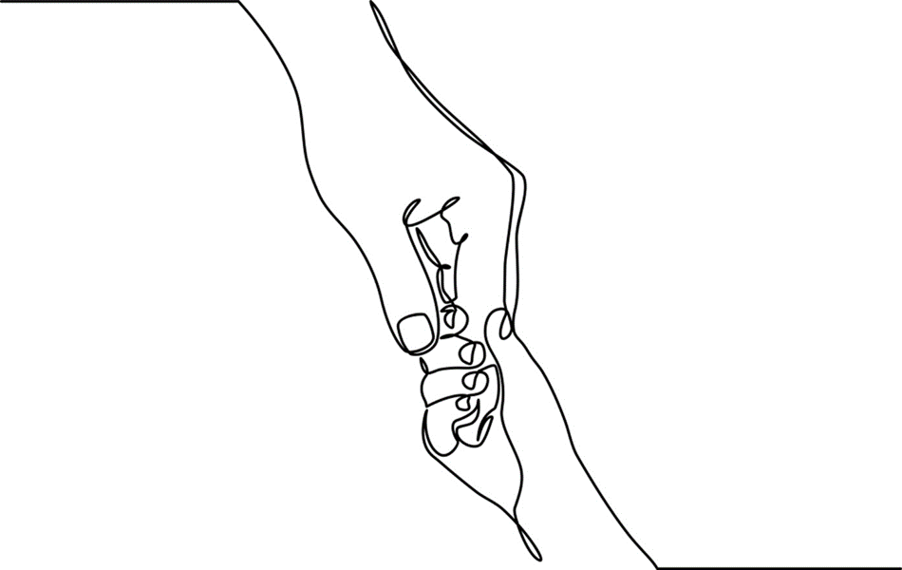
Chapter 8: Working with Adolescents

Slide 2

No Longer Children
Notes:
1. Adolescence is characterized by both subtle and intense personal transformation.
2. Throughout adolescence youth are viewed as in flux as they gradually relinquish their childhood and take on tasks and expectations of adulthood.
3. Adolescents juggle the drive for autonomy with desire for connection and identification with adult role models and peers.
4. Despite popular stereotypes, most adolescents maintain positive and respectful connections with their families, cultures, and communities.
Photo: www.flickr.com.
www.flickr.com

Slide 3

Adolescence signifies a transitional stage of life characterized by both subtle and intense personal transformation.
Notes:
Adolescence is a time of accelerated growth made even more complex because of interacting cognitive, physiological, relational and psychological changes.
Teens are vulnerable to a range of challenges yet one should not assume that their struggles will necessarily lead to behavioral or mental health problems.
Some adolescents come to the attention of mental health practitioners and other child-centered professionals due to depression, suicidality, troubles with body image, substance misuse and problems in social functioning.
Photo: www.flickr.com.

Slide 4
Adolescence is best characterized by uneven and rapid growth in multiple developmental domains.
PHYSICAL
SEXUALITY
PUBERTY
PSYCHOSOCIAL
AUTONOMY
FRIENDSHIPS
IDENTITY
COGNITION
RISK TAKING
Notes:
Puberty is the term used for the physical changes that occur in adolescence. In particular puberty signals maturation of secondary sexual characteristics and emerging awareness of sexual feelings and urges.
Like all areas of development young people’s physical maturation is variable; differences in physiologic growth may influence emotional, relational and social development.
Youth experience discoveries around sexuality, sexual identity and gender orientation during adolescence.
At the same time that adolescents are contending with changing bodies they are simultaneously experiencing rapidly expanding, cognitive growth; increasing capacity for abstract thinking and enhanced capacity for empathy.
Parallel to surges in physical maturity is the adolescent’s developing sense of personal identity.
Adolescents are discovering what aspects of themselves are both unique from and similar to those of their families and peers.

Slide 5

Adolescent identity includes assessing how one measures up against others.
Notes:
Adolescents continually evaluate where they fit in or belong in relation to friends, families, and increasingly, to media images. When youngsters compare themselves unfavorably to idealized standards. their self-appraisal and self-worth are diminished.
Disorders of eating and body image emerge for all genders during the teen years.
Adolescents receive constant feedback about their identity and image by way of real and virtual communication. Bullying is a serious concern of youth, parents, families, educators, and other responsible and caring adults.
Photo: Commons.wikimedia.org.

Slide 6

LGBTQ Youth
Notes:
Youth who identify as heterosexual and gender conforming typically have fewer familial and social struggles than those who identify as gay, lesbian, and bisexual, transgender, third gender or questioning (GLBTQ).
Although North American and European cultures are generally becoming more tolerant of sexual and gender diversity, LGBTQ youth still face significant social and relational marginalization in schools and within the greater peer group culture.
LGBTQ adolescents also fight for acceptance within their families and for some, these relational struggles can lead to mental health concerns, the most extreme of which is suicidality.
To open the door for engagement around sexual orientation and gender identity, workers should ask about to preferred pronouns and include a universal question about sexual orientation and gender identity in their intake process.
Photo by Sharon McCutcheon on Unsplash

Slide 7

Notes:
Approximately 10-20% of youth across cultures report frequent episodes of peer victimization.
Peer victimization, or bullying, is a significant risk factor for mental health problems during puberty.
Bullying has negative consequences for both the victim and the aggressor.
Youth who are bullied, are repeatedly subjected to physical, verbal, and social taunts; children who bully characteristically struggle with low self-worth and perceived rejection.
Cyberbullying, defined “as repetitive, aggressive, intentional behavior carried out by an individual or group using electronic means against victims who cannot easily defend themselves” (Gámez-Guadix and Gini (2016) p. 81) has become a significant public health problem affecting youth across ages, social status, class, and races.
heartnsoulfriend.deviantart.com

Slide 8

Scott’s Story
Eating disorders (ED) are the third most common chronic disorder diagnosed among adolescents in Western countries
Notes:
Scott’s Story (Modified from Chapter 8 pp. 184-185): Scott, 30, recalled how as a teen he would exercise compulsively to stay fit. He toyed with steroids and at one point became so thin that he was hospitalized. “I had something to prove” recalled Scott. “My father was absent and my mom clearly favored my brother the athlete.” According to Scott he felt invisible and out of control most of his childhood. “I was so self-conscious and got teased at school. My Mom told me to fight back but it wasn’t in my nature.” Scott found his talent in wrestling. This lead to preoccupation with body fat and body image. “I thought being thin would get me the attention I deserved. It was a way to keep focus on what I could control” he said. “But it flipped on me and I found myself in a vicious cycle.” Scott was in and out of treatment programs for anorexia throughout his late adolescence and early adulthood. “I’m still learning how to take care of myself” he says.
Now a father himself, Scott recognizes that his choices were unwise and he’s grateful for having survived. “I still struggle with eating and weight even now” says Scott. “I just hope my kid won’t have to struggle like I did.”
Photo: commons.wikimedia.org.

Slide 9
Mental Health Problems
Self Harm
Depression & Anxiety
Disorders of Eating
Antisocial Behaviors
Substance Use Disorders
Traumatic Stress
Notes:
Depression is the most prevalent mental health concern for adolescents in America. Depression ranges from mild to severe and is characterized by mood impairment and loss of interest and enjoyment in life’s activities.
Early intervention with depressed adolescents is critical; first to relieve their immediate suffering and second, to curb their use of alcohol, illicit drugs, or self-harming gestures that run the risk of becoming unhealthy lifelong coping devices.
Many adolescents experience intermittent episodes of anxiety however there are those whose anxiety severely impedes daily functioning. Anxiety affects concentration and attentiveness impeding academic and performance functioning; misuse of alcohol and other drugs may occur when adolescents are self-medicating for the effects of anxiety, depression and/or panic.
Youth with behavioral disorders are perhaps the least understood of any group dealing with mental illness, trauma and loss. Youngsters with poor impulse control need equal portions of firm limits and guidance from adults.
Youth 15-19 years of age are among the highest risk groups for suicidal behaviors. Depression, isolation, and bullying contribute to youth suicidal ideation and self-injury as do social forces such as oppression, discrimination and social inequities, particularly for GLBTQ and other marginalized youth.
Photo: Left: commons.wikimedia.org; Top: www.flickr.com; Bottom Right: Luaxan.deviantart.com; Right: flickr.com; Boy with cigarette: by Amritanshu Sikdar on Unsplash; Girl near lockers: www.kataliniclawfirm.com

Slide 10

Substance Use Disorders
Notes:
By12th grade, an estimated 70% of students have consumed alcohol and taken an illegal drug.
Factors that influence adolescent substance use include wanting to fit in with peers who are using; availability of alcohol and drugs within the home, neighborhood, school, and community; and family/home-based stressors such as interpersonal violence, abuse, trauma, chronic family conflict, and individual or family member substance use and/or mental illness.
“The immature brain, already struggling with balancing impulse and self-control, is more likely to take drugs again without adequately considering the consequences. If the experience is repeated, the brain reinforces the neural links between pleasure and drug-taking, making the association stronger and stronger (NIDA, 2014).
Photo by Warren Wong on Unsplash

Slide 11

Notes:
Youth suicide is a serious and growing public health concern.
Youth suicide is a serious and growing public health concern. Suicidal ideation, suicide attempts, and suicide are significant and growing adolescent health risks.
According to the CDC, in 2016, suicide was the second leading cause of death among individuals between the ages of 10 and 34.
Given the vulnerability of youth, early detection and intervention are critical prevention strategies.
Wikipedia Commons: from Colora Maryland, United States

Slide 12


Limits, Listening, Presence, and Love
Notes:
Given the transitional uncertainties of adolescence, it is not unexpected that even competent parents wrestle with constantly shifting needs of their maturing children.
Experts agree that successful parent/adolescent relationships require continuous rebalancing of limits, love and tolerance for the unique characteristics of youth.
Qualities intrinsic to these relationships include flexibility, acceptance of difference, and open, responsive communication.
Although young people need room to experiment with their growing skills they perhaps more than ever before need clear, consistent and appropriate guidance and structure from their parents.
Photo: www.flickr.com.

Slide 13

Identifying with and belonging to a community is invaluable to adolescent development and mastery.
Notes:
When youth feel connected, confident, and heard they are able to fully choose and engage in positive activities, including learning.
Travis and Leech (2013) note that meaningful community connections are critical for African American youth because they are strengths-based and veer away from negativity, stereotyping, and problem-saturated perspectives.
When participating in treatment, having a voice increases the likelihood that adolescents will experience therapeutic success.
Collaborating with youth to develop interventions suited to their needs and desires promotes positive and enduring behavioral change.
Working with the adolescent’s family systems further ensures that recommendations are relevant, reinforced, and growth is sustained.
Photo: Photo by Yingchou Han on Unsplash

Slide 14



Resilience
Notes:
In the last two decades resiliency research has demonstrated that adversity, though a formidable barrier to healthy adaptation, does not inevitably lead to poor adjustment.
Relational connection appears to mediate the impact of early and ongoing hardship, and though not a panacea, helps adolescents access their inherent potential to function successfully in a difficult world.
“A large segment of adolescents demonstrates healthy development by building upon personal and environmental strengths, even when burdened by factors that increase the risk of negative outcomes” (Travis & Leech, 2013, p. 93).
Belonging within community helps youth access their resilience enhancing connection to something greater than oneself, which in turn, enhances positivity, builds confidence, and reduces isolation and loneliness.
The reliable presence of at least one “caring,” “confiding,” and/or “good enough” relationship with a caring adult is another key factor contributing to youth resilience.
Top left Photo: www.flickr.com: Bottom left: Photo by Niko Lienata on Unsplash; Photo of skyping: www.flickr.com

Slide 15
What Adolescents Value
Attention
Availability
Trust
Empathy
Respect
Virtue
Notes:
1. Qualities that adolescents appreciate in caring adults include those cited in the slide above (Laursen & Birmingham, 2003) and behaviors such as responsivity, mutual communication, respectful understanding, and reliability (Spencer, Jordan & Sazama, 2004).
2. Adolescents report that disingenuous and/or punitive relationships disincentivize their willingness to engage in building alliances of any sort with adults.
Photo: www.flickr.com.

Slide 16
Youth in Therapy
Notes:
Successful therapeutic outcomes are more likely when services are tailored for youth and family driven; guided by their cultures, perspectives, worldviews, and preferences.
When participating in treatment, having a voice increases the likelihood that adolescents will experience therapeutic success.
Collaborating with youth to develop interventions suited to their needs and desires promotes positive and enduring behavioral change.
Working with the adolescent’s family systems further ensures that recommendations are relevant, reinforced, and growth is sustained.
Equally important to youth is the perception that adults can relate to their experiences and are not wholly exempt from poor judgment or error.
Photos: Large Circle: Alexandre Debiève on Unsplash; Top Small Circle: Humphrey Muleba on Unsplash ; Middle Small Circle: www.flickr.come; Bottom Small Circle: www.flickr.com.

Slide 17
Conversation Starters
Recall a time in your adolescence when you encountered roadblocks. What factors fostered your success?
Describe the impacts of mental health and substance use disorders on adolescents.
Discuss the importance of belonging and relational connection. Offer examples of community activities or expressive opportunities that engage youth.
Reflect upon Scott’s story. Identify developmental, relational, gender, and other factors that influenced his well-being and recovery.

