Slide 1
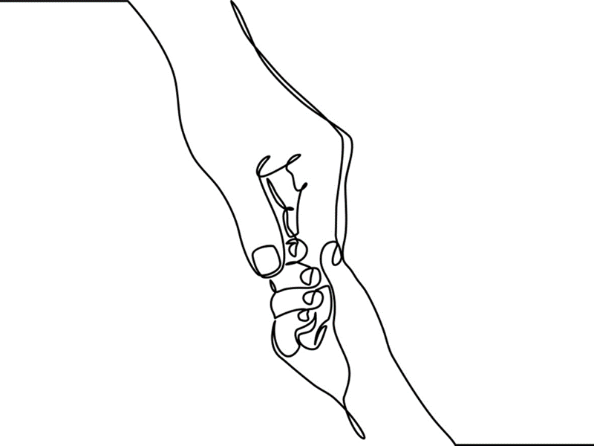
Chapter 7: Play & Expressive Therapies

Slide 2

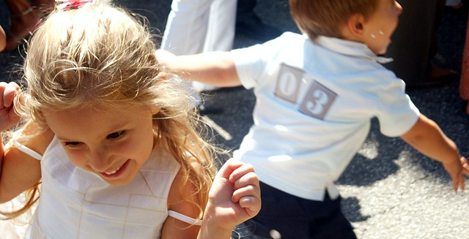
Play
Play is “a universal and inalienable right of childhood.” (CRC, 1983)
Notes:
Though games, rituals, and toys may vary children’s play is universal and transcends differences across cultures, nations, genders, and faith communities.
Play is critically important to early development. Evidence suggests that play activities advance the cognitive, emotional and physical development of children.
Play opens opportunities for workers to participate and observe children’s worlds. Child-worker relationships develop and grow through play and collaborative engagement.
Photo: www.flickr.com

Slide 3
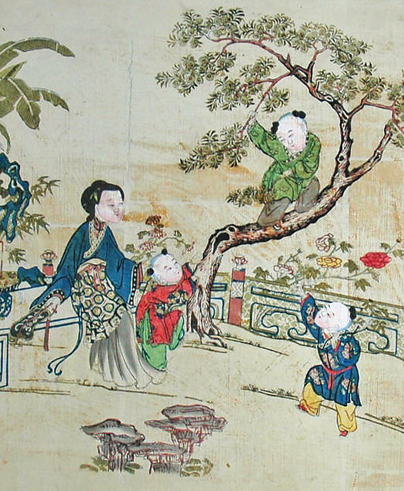
If play is children’s work then playfulness is an essential skill for those who work with children.
Notes:
From the moment relationships begin child-centered practitioners should inform parents, that play is used as a therapeutic tool in their children’s treatment.
Explicit acknowledgement avoids the common but false impression that children “do nothing but play” during their counseling or therapy sessions.
The use of play in therapy is a skill, one that will be further discussed throughout this chapter.
Image: Children at Play in a Garden,19th century China – Metropolitan Museum of Art

Slide 4


“The technique worked out for the adult must be largely altered for children. A child is psychologically different from an adult.”
(Sigmund Freud on Anna Freud’s work with children cited in Donaldson, 1996)
Notes:
Anna Freud (1895-1982) and the lesser known child psychoanalyst, Hermine Hug-Hellmuth, introduced the use of play into child psychoanalysis. They observed that children occupied in play activities were more likely to talk about their thoughts and concerns. Both also saw play as a means to relationally connect with children during the therapy session.
Melanie Klein (1882-1960) utilized play for assessment purposes, observing, interpreting and then integrating her findings into therapeutic recommendations.
Virginia Axline (1911-1988), probably the best known early play analyst, expanded the work of her child-centered mentors. In her work with children Axline offered children opportunities “to “play out” their feelings and problems in much the same way as adults in therapy “talk out” their difficulties.
Photo: commons.wikimedia.org

Slide 5
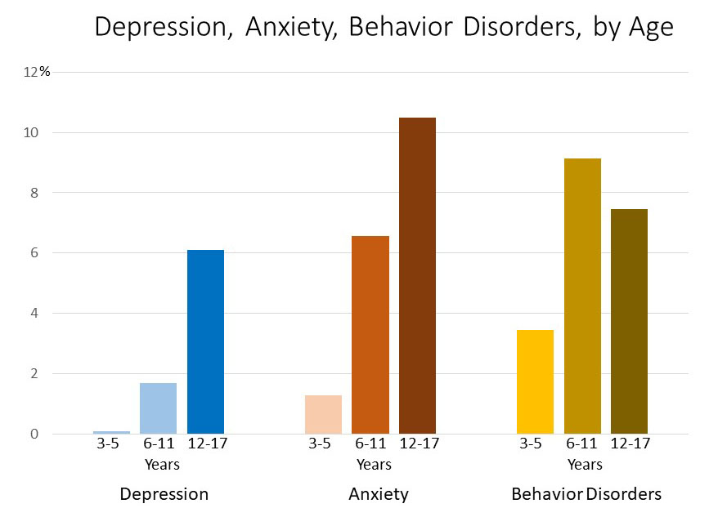
Engaging children in therapeutic work is important given the increasing numbers of children in the United States and Canada identified with childhood mental health disorders.
Notes:
Childhood behavioral health disorders are defined as uncharacteristic behaviors and/or significant changes in typical patterns of managing behavior, learning, emotions, and difficulty negotiating the normal rigors of daily life.
Common childhood diagnoses include: traumatic stress and attention deficit disorders; anxiety, depression; aggressive and other behavioral disorders.
In the early 21st century emotional and behavioral difficulties of children are among the leading health concerns of parents.
In Canada one in five children and youth are identified with mental health conditions of enough severity to affect overall functioning and warrant interventions.
In the U. S. approximately 50% of the children psychiatrically diagnosed were prescribed medication yet only 5% received directed therapeutic intervention.
Health and human services experts suggest: 1. Access to child-centered treatments be increased and 2. Studies explore and validate non-medication modalities for treating childhood mental illness.
Graph: Division of Human Development and Disability, National Center on Birth Defects and Developmental Disabilities, Centers for Disease Control and Prevention, April 2019

Slide 6
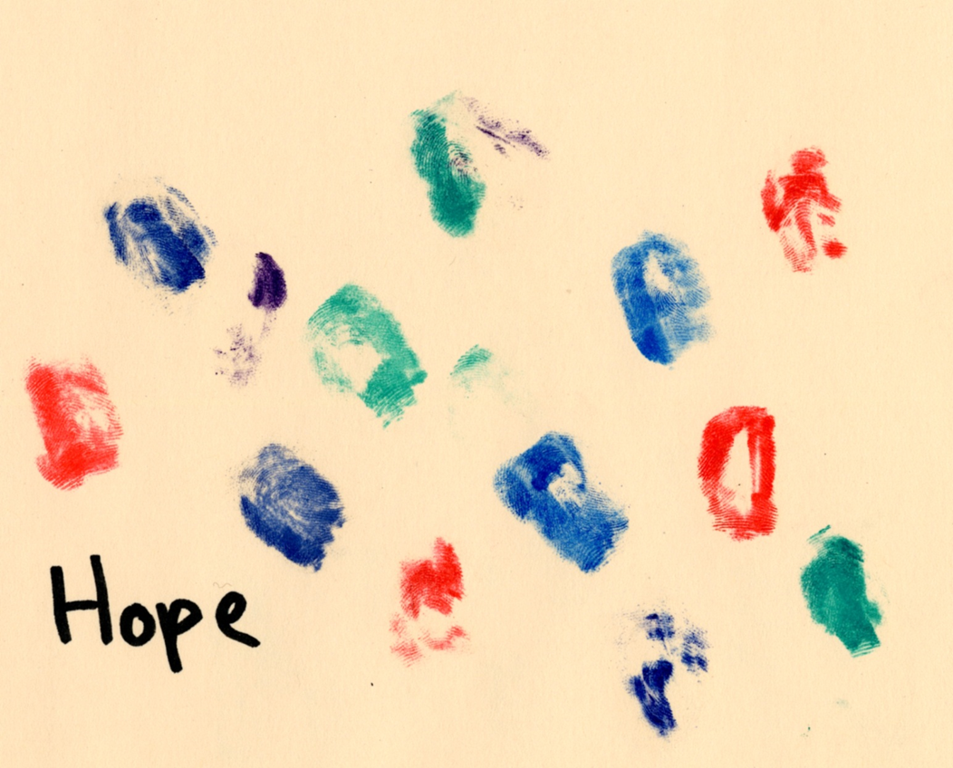
Play and the use of expressive arts in child-centered therapy are evidence-based, non-medication methodologies that are global in their benefits, utility, and applications.
Notes:
Play therapy’s utility is based on the premise that children are best understood from a developmental perspective (Wilson & Ryan, 2005).
Bratton, Ray, Edwards, & Landreth’s (2009) comprehensive meta-analysis found that child-centered play therapies create optimal and empowering conditions for children to engage in their growth and healing.
Studies with children find that two factors, a positive relationship with a caring adult and a sense of control over the therapeutic process, contributes to successful play therapy outcomes (Carroll, 2002).
Image: Courtesy of Shelley Cohen Konrad

Slide 7
Genuine Interest
Unconditional Acceptance
Safe Relational Space
Responsivity
Resilience & Agents of Change
Conversation & Guidance
Safe Boundaries
Comfort with Evolving, Uncertain Process
Notes:
Virginia Axline (1947) outlined eight guiding principles of play therapy that have endured over time. These include:
1. Genuine interest in the child expressed in the context of a caring relationship
2. Unconditional acceptance even when the child’s behaviors are considered unacceptable
3. Maintenance of a safe relational space that supports exploration and expression
4. Affective and cognitive responsiveness to the child’s thoughts and feelings
5. Recognition that children are resilient and active change agents
6. Commitment to an individualized process that is both directed and non-directed.
7. Collaboration on rules for safety however workers are responsible for maintaining limits and structure.
8. Comfort with uncertainty knowing that therapeutic work with children is an evolving process
Photo: Ben White on Unsplash

Slide 8
Play Therapy Approaches
Non-directive
Child Directed
Focus on Child’s spontaneous play
Workers as Participant-Observers
Focus on Targeted Issues of Concern
Cognitive-Behavioral
Worker Directed
Directive
Focus on Core Thoughts & Behavioral Change
Sensorimotor
Youth-Worker Collaboration
Focus on Regulation Skills
Notes:
The goal of non-directive play therapy is to increase understanding of the underlying conflicts that contribute to children’s problems. Children choose from selected play, art, or other activities and workers observe and reflect upon the play
Directive play therapy is an active and goal-oriented method that helps children release emotions and tensions brought about by negative and/or traumatic experiences. Workers are participant-observers who facilitate play in a meaningful ways.
Cognitive-behavioral play approaches are based on the belief that changes in thinking lead to changes in feelings and behaviors. Once core beliefs are identified, workers and children develop strategies that will reduce or ameliorate problematic experiences (e. g. anxiety; fears).
Sensorimotor approaches focus on helping children gain control of their physical, cognitive, and emotional regulatory responses. This approach is effectively used with children and youth who have experienced trauma, interfamilial violence, and attachment failures and those who are predisposed to attentional difficulties and neurologic or developmental problems affecting self-management capacities.

Slide 9
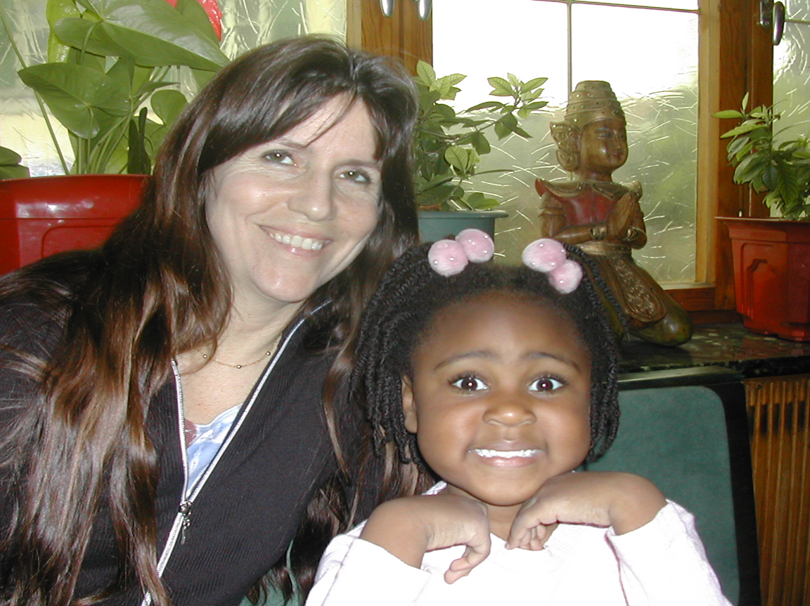
The application of multiple approaches must be systematic, rigorous, never random, and supported by a strong child-worker alliance.
Notes:
Different approaches applied to a child’s therapy can result in equivalently successful treatment outcomes when child-worker-family alliances are good and when child clients are motivated.
In the course of a child’s treatment, several different therapeutic methods, when applied thoughtfully and strategically, can achieve better outcomes than adherence to a single approach.
However, the application of multiple approaches must be systematic, rigorous, and never random.
Photo: www.flickr.com

Slide 10

Lydia’s Story
Notes:
Lydia’s story provides an example of an integrated, play-based child-centered therapeutic approach:
Case Narrative (Modified from Chapter 7, pp. 155-159): Born in Vietnam, Lydia was adopted by the Taylors, a white, middle-class family, when she was 16-months old. She was soon joined by an adoptive sister, Liah, just one-month her junior. The pediatrician noted that Lydia was malnourished and x-rays further revealed previously broken bones. Despite her early disadvantages Lydia, though shy, quickly met developmental milestones. By age ten, she was deemed a gifted student and expressed advanced musical talent. Her talents and intellectual precocity however, served as a smokescreen for underlying anxieties and fears. Lydia spent much of her free time at home with her mother and avoided her father and sister altogether.
When Lydia was 9 Mrs. Taylor was diagnosed with progressive relapsing multiple sclerosis (MS) and she was hospitalized seven times in the first year of her diagnosis. Liah and Mr. Taylor rose to the occasion, but Lydia’s functionality declined. She was afraid to leave the house, her sleep was fitful, and she stopped playing the violin. The Taylors decided to seek therapy for Lydia.
I was immediately impressed by Lydia’s poise and charm. In our early alliance-building sessions I employed non-directive play therapy techniques. Lydia selected the activity, which was most often artwork. More often than not I would do an activity alongside her; Lydia would ask me about my drawings and sculptures, which opened the door for me to ask about hers. Non-directive play allowed me to be both an observer and participant in Lydia’s therapy process. I became familiar with themes and patterns in her play and also came to know the qualities and characteristics that made her uniquely Lydia. As Lydia gained comfort in our relationship, I decided to approach her about doing a structured directed play therapy art exercise to relieve her anxiety. Her assignment was to draw her worries. She took to this task with an intensity I had not yet observed in her play.
Her first drawing was a self-portrait, which filled a large (14 x 16) sheet of white paper. Surrounding the portrait were words and phrases indicative of her worries such as “mom is too sick,” “no one likes me,” and “afraid to be alone.”
Lydia’s artwork and expressive activities provided language we then used to give voice to her worries and concerns. I asked her what it felt like “to be afraid and alone.” Lydia responded saying how afraid she was that MS would cause her to lose her adoptive mother. She had never been told what had happened to her biological mother.
Following this powerful exchange Lydia built a heart out of red clay. She showed me the heart and then took the clay tool and cut it in half. She looked at me and said, “People who love me go away – it breaks my heart.”
An underlying principle of Cognitive-behavioral play therapy is to concentrate attention and efforts on things that are within a person’s control and to find acceptance for things that are not. There was no doubt that Lydia’s worries were valid yet she needed skills to manage life’s realities including her mother’s increasing debility.
Together Lydia and I developed a three-step treatment plan: The first step was designed to lower the volume of Lydia’s negative internal messages and fearful thoughts by using self-talk. Lydia chose to work on the core assumptive belief that she was unworthy of a mother’s love. Lydia made a pack of laminated cards, each with an affirming message that combated this powerful negative messages (e. g. I am loveable). This method worked well because she had immediate access to alternative ways of thinking when she needed them.
The second step was for Lydia to name and then externalize her worries, a method used in narrative therapies. Lydia named her negative and fearful core beliefs “gloomy thoughts” and she identified ways in which she could lessen their impact (e. g. listen to music, draw a picture of them, talk to someone rather than keep them inside).
The third step of the plan was for Lydia to spend time with people other than her mother. This was the hardest step yet.
Gradually Lydia made positive connections with peers and older mentors. At the same time she became closer with Liah and they discovered that they both loved to cook. This in turn helped out at home by lessening some of the day-to-day pressures on Mrs. Taylor and both girls managed to feel empowered.
About 9 months into the work Lydia unexpectedly decided to end therapy. The precipitous ending illustrates that in real life practice one does not typically have the luxury of meeting all desired goals. In retrospect I chose to believe that Lydia’s choice was indicative of a successful outcome.
www.flickr.com.

Slide 11

Jemina’s Story
Reliable relational presence coupled with effective social service delivery advances children’s growth and healing.
Notes:
Relationally based play therapy models have been criticized for their inapplicability to work with vulnerable and/or marginalized children.
Conversely some argue that a relational connection is precisely what disenfranchised children need to support growth.
See chapter 2 to review neuroscience concepts regarding attachment, the brain, and the influence of relational connection on regulation and relational capacities.
Jemina’s Story: I met Jemina, a 13-year-old, white youngster while working in a residential treatment program. I was assigned to be her play therapist. Jemina grew up in an isolated, rural area where she lived with her brother, uncle and two younger male cousins, all fishermen in a large one-room cabin. Jemina’s mother died when she was nine. Before coming into residence, Jemina left home only to attend school. She had no known friends and few social skills. According to case records, Jemina’s intellectual abilities were thought to be delayed but she had never completed formal testing. In knowing her I never questioned that she was deeply intelligent.
Jemina was initially mistrustful. For the first three months she refused to make eye contact or sit down in my presence. We made connection only when I brought her to the campus store to buy small needed items such as shampoo. Jemina seemed enchanted by these purchases. In conversations with her caseworker I learned that she had little contact with women since her mother’s death. Her dad, though caring, was not nurturing. These weekly shopping trips became our relational ritual.
At thirteen Jemina was four inches taller than me and physically strong. So when she began to run from me it was difficult to catch her let alone bring her back against her will. However Jemina always paused and waited for me to catch up with her. I quickly realized that this pattern was not about leaving, it was about joining. Jemina ran because she wanted to be assured that I would run after her.
Our rituals to some degree fulfilled Jemina’s need for tangible (buying small items at the campus store) as well as affective (running and joining rituals) evidence of caring. It took time, but the presence of a reliable relationship slowly helped Jemina transform her beliefs about relational trust and worthiness. She became stronger, more connected, and though still equivocal, she came to appreciate that people cared for her.
Photo: commons.wikimedia.org.

Slide 12

  GUIDELINES FOR ENDINGS
    Common understanding that relationship will end
    Opportunities for child-worker-family feedback
    Share what child family & worker have learned from one another
    Name expected feelings (e.g. sad, anger, readiness)
    Plan for anticipated, expected responses .
    Identify methods to maintain positive change
    Develop a plan should problems resurface
    Support investment and transitions to new relationships
    Modified from Walsh, 2007, pp. 41-59
Notes:
Unlike those with family and friends, therapeutic relationships with children are meant to end.
Workers should anticipate and plan for therapeutic endings to ensure that children understand why the relationship is coming to a close and to help them feel some control over the ending process.
When endings are positive they foster smooth transitions that highlight what children and families have accomplished. For children who have experienced hurtful and multiple relational losses, positive therapeutic endings are especially healing.
When endings are unplanned or precipitous, children may believe that they have done something to cause the relationship to end or they may lose trust in the relational process altogether.

Slide 13
ENDINGS
Common understanding that relationship will end
Opportunities for child-worker-family feedback
What have child & worker learned from one another
Name expected feelings (e.g. sad, anger, readiness)
Plan for anticipated, expected responses
Identify methods to maintain positive change
Develop a plan should problems resurface
Support transitions to new relationships
Notes:
1. Unlike those with family and friends, therapeutic relationships with children are meant to end.
2. Workers should anticipate and plan for therapeutic endings to ensure that children understand why the relationship is coming to a close and to help them feel some control over the ending process.
3. When endings are positive they foster smooth transitions that highlight what children and families have accomplished. For children who have experienced hurtful and multiple relational losses, positive therapeutic endings are especially healing.
4. When endings are unplanned or precipitous, children may believe that they have done something to cause the relationship to end or they may lose trust in the relational process altogether.
Image: Courtesy of Shelley Cohen Konrad

Slide 14
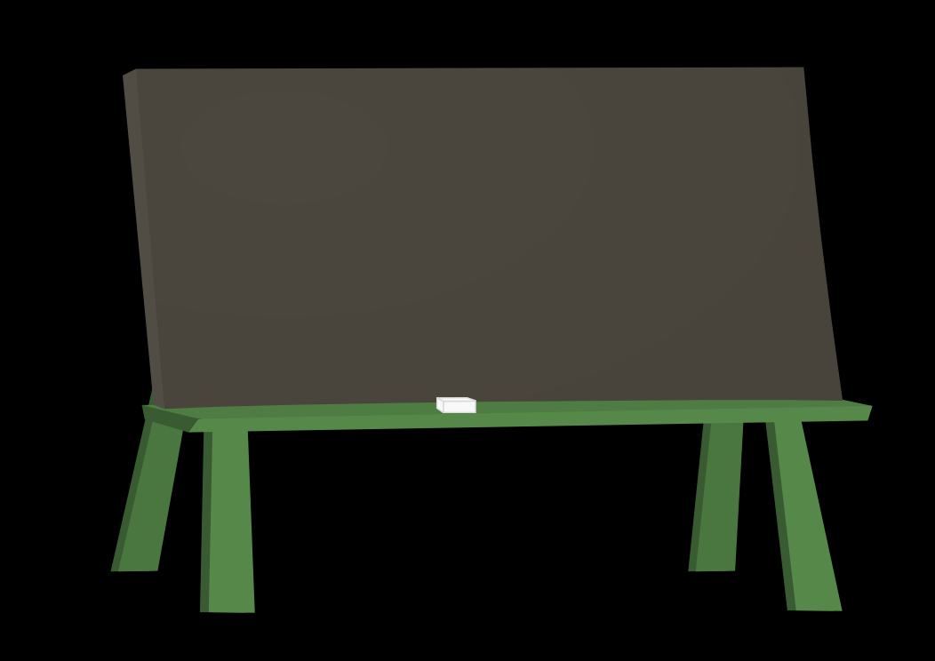
A well-constructed play space promotes children’s autonomy and problem-solving.
Play room Rules
Use inside voice
Respect toys and materials
Help clean up
Do not hurt with words or hands
No bullying!
Notes:
The playroom should have enough toys, games, and art materials to stimulate play activities but not so many that children are overwhelmed.
The therapeutic environment, like secure relational attachments, allows children to try out behaviors, fail, and then try again within the confines of acceptance.
Playroom rules are established in the very first session. Rules apply to how play materials are used as well as to how people are expected to treat one another.

Slide 15
Tools of the Trade
Board Games
Imaginative Play
Puppets
Video Game
Artwork
Storytelling
Notes:
Board games provide opportunities for adults and children to share playful and sometimes competitive experience and at times are used for assessment purposes.
Dolls, play houses and puppets allow children to “play out” their experiences and concerns.
Books, blogs, scrapbooks and oral storytelling make life histories tangible and are especially powerful for children who experienced early relational disruptions and losses.
Children express difficult feelings and take risks in their paintings, drawings, sculptures, and comics. The process of doing art reinforces children’s mastery and sense of control over their emotions and impulses.
When used for therapeutic purposes, youth respond well to technology and video games designed to help with self-regulation, attentional difficulties, and impulsivity.
Photo: Game – www.flickr.com; Imaginative play – commons.wikimedia.org; Puppets – www.flickr.com; Video game: commons.wikimedia.org; artwork - posiedon12.deviantart.com; www.flickr.com

Slide 16
Conversation Starters
Discuss your thoughts, feelings, and ideas about using play and expressive methods in work with children.
In what ways was play used to engage Jemina and Lydia in their therapeutic relationships?
How were guiding principles for play therapy evident in each case narrative?
Given concepts presented in Chapter 6, how might you engage Lydia’s family in her treatment process?
What are your thoughts about Jemina’s and Lydia’s therapeutic relationships ended?

