Slide 1
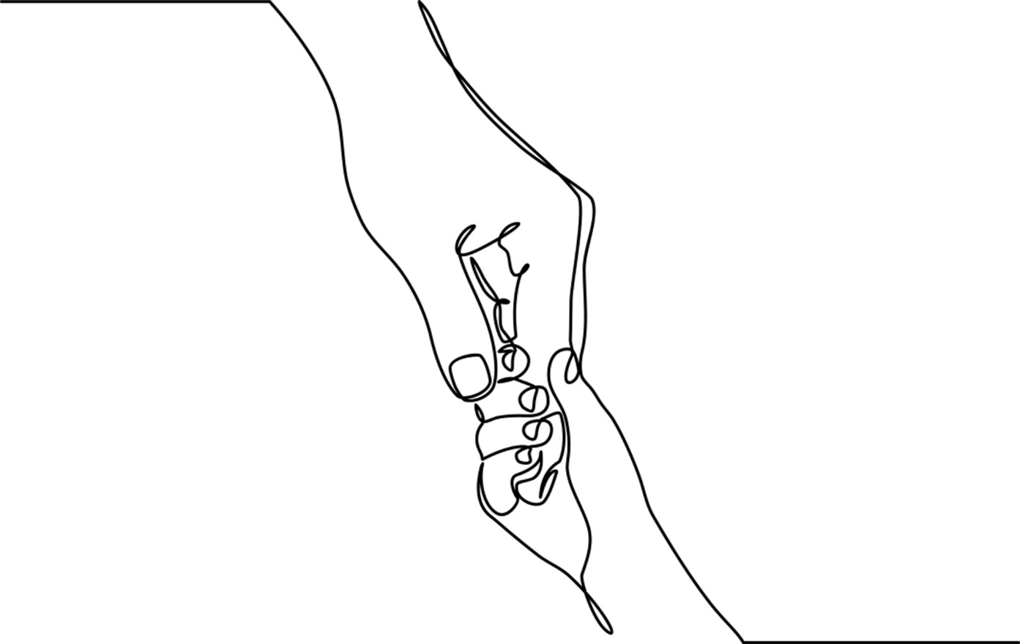
Chapter 5: Therapeutic Conversations with Children

Slide 2

Trust forms over time, when children can “be sure of you”
“Piglet sidled up to Pooh from behind. “Pooh, he whispered.
“Yes Piglet?” “Nothing,” said Piglet, taking Pooh’s paw, “I just wanted to be sure of you.”
A. A. Milne
Notes:
Many of the children we meet in practice have experienced significant single or cumulative adverse experiences; some have been targets or witnesses to violence, violation, and high conflict; others may never have experienced being wanted or loved.
Miller & Sparks (2007) found that if child clients and parents do not experience a positive connection within the first few sessions they will end treatment.
Environments of trust exist within relationships and can be established within a range of settings (e. g. office, home, school).
2. Skills and attitudes essential to establishing safe environments include: 1. Set the stage for all feelings to be heard, tolerated and expressed; 2. Describe and establish limits that assures children their behaviors and feelings can be managed; 3. Be honest within a context of caring; 4. Believe in children’s capacity to self-heal.

Slide 3
Qualities of Child-centered Conversations
Actions
Attention to Children’s Interests
Express Genuine Curiosity
Never Dismiss feelings
Invite active communication
Validation
Attitude
Patience
Flexibility
Humor
Playfulness
Tolerance
Notes:
1. Actions that promote effective child-centered communication include: being attentive to subjects that interest the child; conveying genuine curiosity about their expressed thoughts and feelings; never being dismissive of their opinions, fears or worries; and inviting them to engage in an interactive exchange of ideas.
2. Attitudes that set a positive relational tone include: patience, flexibility, humor, tolerance for ambiguity and playfulness.
3. Equally important is validation, which involves an active process of letting children know that what they feel is real, credible and deserving of respectful consideration.
4. With younger children, child-centered communication requires knowledge and skills for entering their real and imagined worlds.

Slide 4


First encounters should be positive and hopeful with the singular goal of children returning for a second conversation.
Notes:
First conversations have far-reaching effects.
Ideally parents collaborate with workers to prepare their children for therapeutic conversations.
Preparation: Consideration of child’s age and development; setting; previous experiences with helpers/workers; and circumstances that initiated the referral.
Language should be age and culturally appropriate.
Allow time for child to transition into room/setting.
Worker should provide simple, clarifying introduction and follow the child’s lead.
Learn what child knows about why she/he is talking with you. Expand upon role worker will play and how child-client and worker can work together.
Photos: Upper left: Photo by Caleb Woods on Unsplash; Lower right: Photo by Camille Minouflet on Unsplash

Slide 5

Confidentiality is an ethic of social work practice. Child-centered workers must inform and remind younger children that they regularly speak with their parents and caregivers.
Notes:
Workers are obligated to explain and clarify the boundaries of confidentiality when working with children.
It is always best to do this early in the relationship-building process as well as with all parties at the same time to reach agreement about what and what not will be considered within the realm of confidential communication.
With young children it is helpful for parents, guardians, and caregivers to know that pertinent information will always be shared with them and that they are welcome to ask questions or seek advice whenever necessary.
Parents/caregivers should additionally be informed that children will want to keep aspects of their therapeutic conversations private.
With young children workers should let them know that they regularly speak with parents/caregivers. Most children are unconcerned, but some might want to know what the worker will share and ask for input into the process.
Image: Flickr

Slide 6
Society for Adolescent Medicine (SAM)
“Individual adolescents vary in their levels of psychosocial maturity and economic independence, as well as in their behaviors and family situations. Therefore, it is inappropriate to apply a single moral prescription in all cases.
The protection of confidentiality in adolescent health care should be grounded in the moral principle
of respect for autonomy, but must recognize that in specific circumstances it may be permissible or even necessary to breach confidentiality to further other important moral principles, such as beneficence or nonmalificence.”
Notes:
Confidentiality with adolescents is more complex than with younger children.
In some states there are health care laws that permit minors (ages 14 and older) to give consent for their own health and mental health care, meaning that they’re entitled to the same confidentiality rights as adults.
Variability of these laws however demands that confidentiality agreements be individualized and explicitly agreed upon with each adolescent client.
Workers should discuss the parameters of confidentiality with adolescent clients and their parents/guardians making sure that all parties understand and agree to the terms.
When working with adolescents worker discretion is used in conjunction with consulting professional ethical guidelines when decisions are made to disclose otherwise confidential information.

Slide 7

Sadie
Notes:
Sadie’s Story: Sadie’s adoptive parents referred the shy 15-year-old for counseling because she seemed depressed and lonely. Their two biological children were honor students and athletes. Sadie was bothered by the fact that she simply could not keep pace with their accomplishments.
During a session Sadie reported to the worker that she had a new group of friends, mostly boys, who she met on the internet. Shortly thereafter her style of dress and make-up changed drastically and her parents reported that Sadie’s behaviors were uncharacteristically challenging. One evening the worker received an emergency call from the parents frantic that Sadie had run away. She returned home safely but refused to talk to any of her family members about where she’d been or what had happened.
Sadie eventually opened up to the worker, disclosing that she was meeting these boys in remote locations without informing anyone of her whereabouts. The worker discussed the danger Sadie was putting herself in. Initially Sadie minimized her concerns stating that the boys “were really nice people.” She was defensive and challenged the worker to trust in her judgment.
However the worker could not take this chance and although she wished to honor Sadie’s right to privacy perceptions, the worker’s first obligation was to protect her from harm. The worker reminded Sadie that they agreed from the beginning that confidentiality could be breached if Sadie put herself in harm’s way. When the time came to speak with her parents Sadie, though reluctant, confided to her parents about meeting the boys. The process of disclosure proved revelatory for all involved. Sadie was able to see that these youth were not her friends and that indeed she had put herself in physical and emotional jeopardy. Sadie’s parents didn’t dismiss her perspective and were receptive to her feelings. Family counseling was suggested to promote further conversation and solidify family connections.
Photo: www.flickr.com

Slide 8
Identify:
Barriers
Assumptions
Recognize:
Child Development Factors
Parent Expertise
Use :
Child-centered Language & Communication
Descriptive Reports
Preparation for First Conversations
Notes:
Reflect upon what the barriers might be in getting to know each child and family; recognize the assumptions, knowledge, beliefs and values that could potentially influence the encounter.
Become acquainted with pertinent child development literature or consult a supervisor about what one might expect from an interview with children of any age, race, culture, and circumstance.
Enter into child-centered conversations with curiosity; be playful; ask for clarification, making sure what the child says is understood and respected. (See slide #4 – qualities for child-centered conversations).
Listen to parents and let them know they’ve been heard. Present information clearly and respectfully, checking in to see if information has been received and understood. Be prepared for anger and other difficult feelings to arise.
Use descriptive, non-judgmental language in reports. It is not unusual reports to focus on problems rather than strengths. The zeal to identify and/or remediate problems however should not exclude reporting evidence that highlights what is going right. It’s the worker’s responsibility to provide accurate and holistic information because recommendations made based on the findings can and do lead to dire and irreparable consequences for children and families.
Photo: Children playing: By DFID - UK Department for International Development - Circles of care, CC BY 2.0, https://commons.wikimedia.org/w/index.php?curid=26240006 – commons.wikimedia.org; Blocks – Photo by Susan Holt Simpson on Unsplash; Young boy – Photo by Joseph Gonzalez on Unsplash

Slide 9

Difficult Conversations
Notes:
Hard conversations arise when difficult or life-changing events occur in families and/or communities.
The desire to shield children from unfairness, suffering and sorrow is understandable and not uncommon. However, in the long run avoiding difficult conversations can backfire or cause more harm than good.
Although children respond differently than adults, they nonetheless feel the impact of trauma and tragedy in their lives.
Workers and families set the tone for difficult conversations to take place. Children need permission, support, and patience to voice their innermost feelings.
Relational practice encourages workers to stay current with evidence-based research to determine services that meet children’s and families facing traumatic, transitional, and/or tragic circumstances.
Image: Photo by Kat J on Unsplash

Slide 10
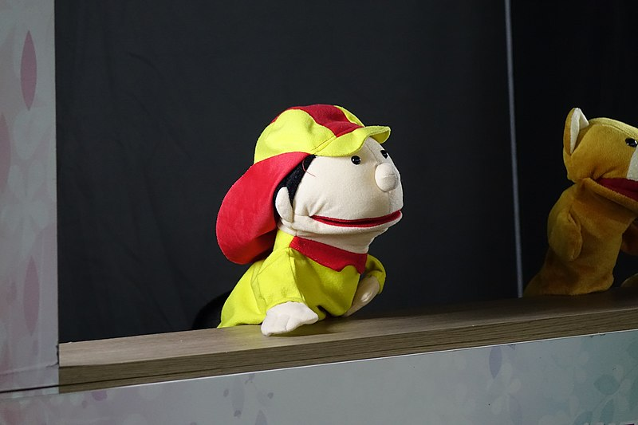

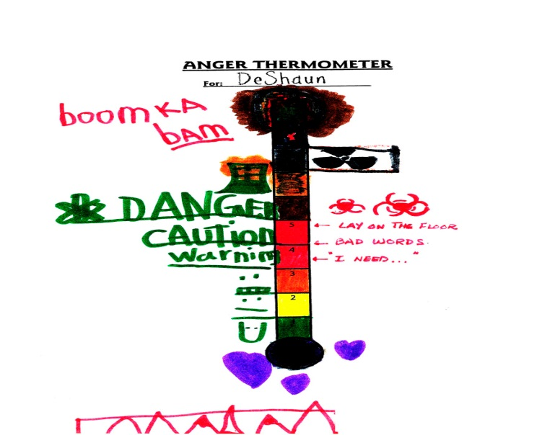

Non-verbal Communication
Notes:
Children’s behaviors, actions, and expressive gestures frequently speak louder than words.
Children may communicate through sensory, behavioral or ritualized modes; some children pass wind when anxious; others act up or disruptively seek attention; others clear their throats or pull at their hair when stressed.
The use of symbols and metaphors is a natural means of communication and engagement with children.
Children also express inner thoughts, unspoken feelings, and relational dynamics through art, storytelling, and play (See Chapter 7 for a more detailed discussion of play therapies).
Photo: Puppets – By Kwangmo - Own work, CC0, https://commons.wikimedia.org/w/index.php?curid=45473120; Teen Art by Gaara of the Desert at Deviantart.com; Child art courtesy of Shelley Cohen Konrad; Child with guitar: Photo by kychan on Unsplash

Slide 11
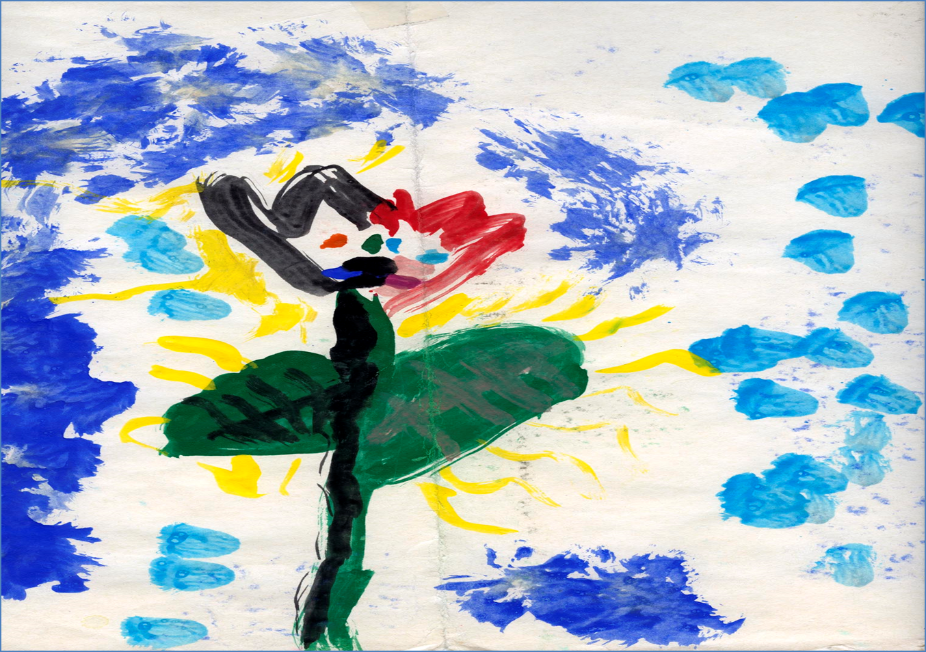
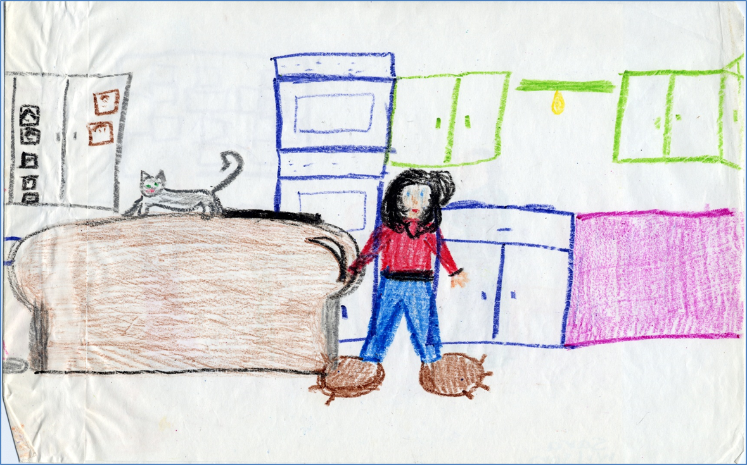
Art as Communication
Notes:
Engaging children in art and other expressive modalities is an invaluable communicative tool (See Chapter 7 for more detailed discussion of art in play therapy).
Through art and storytelling, children of all ages reveal inner thoughts, unspoken feelings, and relational dynamics that may be inaccessible or hard to articulate.

Slide 12


Reflective Practice
Notes:
Reflective practice asks us to stay in touch with our thoughts, feelings and reactions.
When working with children it is likely that workers will experience emotional and experiential fallout as a consequence of their unresolved or remembered childhood experiences. Children’s abuse or abandonment may conjure up workers’ memories of their own abuse or other traumas or losses.
If feelings and reactions remain unacknowledged, workers may avoid asking children questions that contain answers they don’t wish to hear; they may minimize or seek quick fixes for highly complicated problems.
Finally there are times when we simply don’t like the children we work with or find their behaviors difficult or distressing.
Reflexive practice asks us to stay in touch with our thoughts, feelings, and reactions to children knowing that conversations often reveal discomforting information evoke difficult feelings.
Time set aside for self-reflection, self-care, and supervision is a critical aspect of effective relational practice.
Photos: Silhouettes – Gerd Altmann at Pixabay; Stones at www.flickr.com

Slide 13
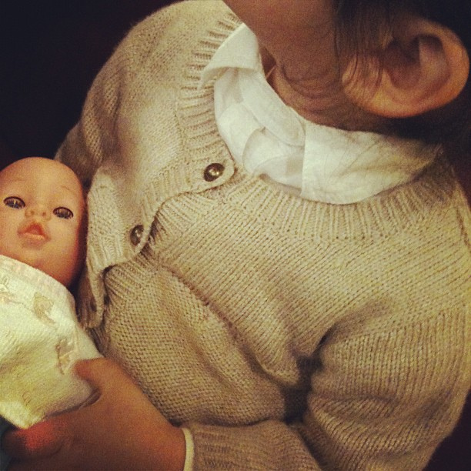
Kahlila Johnson, Age 4
Notes:
Kahlila Conversation (A more detailed version can be found on pages 101-106). Linda Frost, a 25-year-old Caucasian woman she sat looking at Kahlila Johnson’s file. She had very little experience with children except for occasional babysitting in high school and now she was about to meet 4-year-old Kahlila in her role as caseworker. To prepare, Linda read every detail of the case file. According to the notes, the Johnson family recently moved from another state. The family lived in an apartment complex in a low income neighborhood. Mrs. Johnson worked as an administrative assistant.
The meeting was held in response to four anonymous complaints about lack of child supervision made to child protective services over the last few months. Child Protective Services required that a caseworker visit with the family to assess the situation.
The doorbell was answered by Mrs. Johnson, a 35-year-old tall, heavy-set African-American woman. Linda indicated that she was from CPS and showed Mrs. Johnson her identification. Mrs. Johnson welcomed Linda into her apartment. Linda noted that the house had a lived in quality with lots of family photos displayed on the walls and table tops.
Linda informed Mrs. Johnson about the CPS reports. Mrs. Johnson sat back in her chair, smiled, and sighed. She stated in a firm but not unfriendly way that there were very few young families still living in the housing complex. There were even fewer families of color. Most of her neighbors were white, elderly women. According to Mrs. Johnson, “They have shown no interest in getting to know me or my family.”
Linda noticed Kahlila standing in the doorway. She was taller and slighter than Linda had expected. Her light brown hair formed a wild, curly mane around her face. “Well hello there” Linda said. Kahlila slowly retreated back into her bedroom. Kahlila looked up from the doll she had been playing with and smiled. Linda looked around noting lots of toys, stuffed animals and a white-veneered bed and dresser. “Is that your favorite doll?” she asked. Kahlila nodded. “What’s her name?” Kahlila shrugged.
Just as Linda began to panic, Kahlila asked: “What’s your name?” “I’m Linda and I came to visit with you and your Mom.” “She’s not my mom,” Kahlila quickly retorted. Linda was taken aback. She didn’t recall reading anything about Mrs. Johnson being a foster or adoptive parent. “Well then, who is she?” Linda asked. “She’s my mama.” Linda was slightly annoyed by Kahlila’s correction but she was determined to seem positive.
Linda proceeded, “So, does your mama work a lot?” she asked. Kahlila answered, “She’s always at work. I hate when she works. And Gustav is really mean to me.” Linda found it difficult to understand Kahlila’s speech and wondered if she might have an accent or perhaps speech impairment.
Linda went on to explore Kahlila’s comments. “Is your Mama away from the house a long time? Who takes care of you?” Kahlila shrugged again and then suddenly turned to Linda and asked, “Do you want to hold Tatiana?” She held her doll out to Linda. Linda politely declined her offer. Kahlila turned away looking mildly offended. Linda moderated her tone using her best child-friendly voice. “It’s really important for me to know who takes care of you when Mama’s not home. Little children need to be cared for. Is it Gustav?” Kahlila retorted, “No. He’s always watching TV.” Linda quickly responded, “Then who takes care of you when Mama’s at work?” “Gustav!” Kahlila shouted impatiently.
Linda tried again. “What time your Mama comes home at night from work?” “How should I know?” Kahlila responded. “Maybe midnight, but I can’t tell time.” Linda left the room and proceeded to the kitchen where she found Mrs. Johnson. Mrs. Johnson asked if Kahlila had behaved and Linda said she did. She then asked Mrs. Johnson what time she typically came home from work. “Around 5,” she answered. “Why?” “I just need a time line,” Linda replied. They set an appointment for Linda to meet with Gustav the following week and Linda politely said her good-byes.
Photo: www.flickr.com

Slide 14

Case Note
Child and Family Services Office
Division of the Department of Health & Human Services
To Whom it May Concern:
Re: Kahlila Johnson
DOB: 2-05-2007
I met with Kahlila Johnson, age 4, and her mother Mrs. Monica Johnson in their home on 32 Stuyvesant Way. Gustav Stone, 13, Mrs. Johnson’s son from a previous relationship, was not available to be interviewed. The Johnson apartment was small, clean but cluttered. Mrs. Johnson was friendly and did not interfere with the visitation and child interview. The interview took place in the child’s bedroom. Kahlila had little to say. She avoided most questions and used her
Notes:
Full Case Note: I met with Kahlila Johnson, age 4, and her mother Mrs. Monica Johnson in their home on 32 Stuyvesant Way. Gustav Stone, 13, Mrs. Johnson’s son from a previous relationship, was not available to be interviewed. The Johnson apartment was small, clean but cluttered. Mrs. Johnson was friendly and did not interfere with the visitation and child interview. The interview took place in the child’s bedroom. Kahlila had little to say. She avoided most questions and used her doll to deflect communication. Kahlila’s speech and language skills were somewhat impaired thus making it difficult at times to determine her communications.
While Kahlila did not respond directly to questioning about her mother’s supervision she did state: “She’s always at work. I hate when she works. And Gustav is really mean to me. He makes me shut off the lights and I’m scared of the dark” The child refused to elaborate further leaving this caseworker with concerns about the kind of supervision Kahlila does receive when her mother works. Further, there is a discrepancy between Mrs. Johnson’s and Kahlila’s reports about when the mother comes home from work. Kahlila believes that her mother comes home at “midnight” while Mrs. Johnson insists she’s home by 5 pm. A meeting with Gustav is scheduled for, January 19, 2011.
Suggested activity: Ask students to write up a case note based on a paper case, video, or simulation.

Slide 15
Conversation Starters
Identify qualities of communication that contributed to the worker’s first meeting with Kahlila and Mrs. Johnson. Offer critique on ways the worker might have improved communication.
What worker-related factors influenced this first session outcome? What are your suggestions for preparing for a first-time meeting?
Sadie’s case presents an ethical dilemma surrounding disclosure of confidential information. Would you have made the same decisions?
Art exercise: Using either Sadie’s or Kahlila’s case vignette, draw or write a reflective response. Indicate whose perspective you’re representing – the worker’s, the client’s, or your own.

