Slide 1
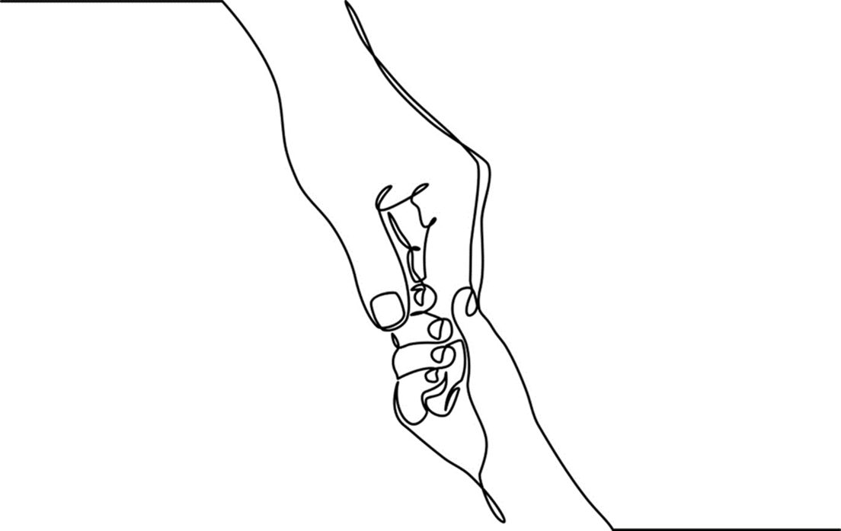
Chapter 4: Child-Centered Assessment

Slide 2
A process, not a fact-finding mission
Struggles
Context
Resources
Growth
Strengths
Notes:
Child-centered assessment is a process, not a fact-finding mission.
The goal of assessment is to get to know each child; to see their uniqueness, appreciate the exigencies of their circumstances – the contexts of their lives; identify their strengths and resources and to work with all of these to relieve discord and suffering.
Assessment builds a framework for understanding a child’s world; the factors that contribute to problems and resilience.
Data gathered for assessment is complicated and at times, contradictory. Workers should use information as a springboard for asking questions and learning from the child, family and related systems.
Because children are in a steady process of growth, assessment ideas & intuitions evolve and change over time.
Suggested activity: Divide class into small groups (4-6 student maximum). Select a vignette from the case study portfolio or one of your own. Have student groups use the process model to develop a case theory about the child (10-15 minutes). As each group reports out, note emerging themes. How do they align with the process model? How are they different? Do students focus on strengths or do they move to a problem-only assessment.
Photo: www.flickr.com

Slide 3
CASE THEORY
ASSESSMENT
FORMULATION
DATA GATHERING
RECOMMENDATIONS
INTERVENTIONS
EVALUATION
REVISIONS
Notes:
Workers gather data from multiple sources, for example parents, children, and caregivers, teachers, providing a diversity of perspectives. Data is used to help evaluators make sense of complex and dynamic information.
Data is used to formulate ideas and develop hypotheses about the child’s strengths, coping strategies, resources, and presenting problems.
A case theory (working hypothesis) represents a synthesis of information gathered including input from the child. Recommendations and interventions are developed in response to a working case theory.
Interventions are continuously evaluated and updated to meet the needs of the evolving child.
Photo: www.flickr

Slide 4
CHILD-CENTERED
ASSESSMENT
Outside sources
Specialized interviewing
Child’s perspective
Ongoing self-reflection
Child/Adult Balance
Notes:
Child-centered assessments are distinctive from those conducted with adults in a number of ways:
Data gathered for child assessment is primarily obtained from outside sources, not from the child client. Relational practitioners make sure that the child’s views are integrated into the assessment process.
Evaluators may not recall what it was like to be a child and thus may not understand their views, behaviors, and emotions.
Specialized knowledge and skills are needed to effectively interview children.
It is difficult for adults to appreciably recall the feelings and perceptions of childhood. It takes skill and intentionality to see the world through children’s eyes; to value their fears, honor their perceptions, and never dismiss their realities.
Children’s perspectives should be balanced with with those of their parents and caregivers.
Self-reflection is essential to separate one’s own experiences of being a child from those of children being assessed.
Photo: www.flickr.com

Slide 5
Psychological
Temperament
Personality
Signigicant Events
Gender Identiy
Resilience
Relational
Attachments
Trauma/Adversity
Family Dynamics
Family Violence
Peers
Cultural & Spiritual
Faith
Customs
Historical Trauma
Values
Citizen Status
Biological
Health
Speech
Motor Skills
Language
Cognition
Social
Stigma
Discrimination
Friendships
Identity
Socioeconomics
Resources
Notes:
Data gathered for child-centered assessment illuminate biological, relational, social, cultural & spiritual, and psychological domains of a child’s live. In combination they provide individual and contextual information that helps formulate a case theory. The domains are not meant to be exclusive; factors outside of these domains may be foundational to assessment and formulation.
Parent, caregivers, and those who engage the child in his/her natural environment contribute to data in each of these domains.
Photo: www.flickr.com

Slide 6
Biological Factors
Physical Health
Developmental Growth
Language/Cognition
Motor Skills
Prenatal Care
Notes:
Biological data include relevant information about the overall health and wellness of the child; developmental factors and milestones, including those related to speech, motor skills, language, and intellectual growth.
The achievement of developmental milestones is sequential however it is influenced by circumstances, culture, and context resulting in variations in when they are achieved (See Generalized Child Development, pages 67-68).
Pre-natal, birth, and perinatal factors including parents’ early responses to their children are relevant to child-centered assessment.
Photo: www.flickr.com

Slide 7
Psychological Factors
Temperament
Relational Fit
Life Experiences
Gender Identity/Sexuality
Resilience
Mental Health
Notes:
The psychological domain explores personality, temperament, sexuality, gender, and other factors that contribute to identity formation and a sense of self.
Significant life events and early adversity impact the growing child’s developmental pathway and brain architecture (See Chapter 2).
Background history on the child’s adaptation, resilience, and coping style is included in this domain as is mental health history and experience in the mental health system.
Relational assessments recognize the dynamic interaction of a child’s strengths, challenges, capacities, and vulnerabilities.
Social, economic, and environmental factors intersect with all other aspects of psychological growth and development.
Photo: www.flickr.com
Photos: Upper left & right: www.flickr.com; Bottom left & right courtesy of Shelley Cohen Konrad

Slide 8

Edward’s Story
Notes:
Edward’s Story: Edward, age 12, was reluctant to discuss his attraction to boys with the new social worker. A veteran of psychotherapy since the age of six, he was astute at detecting adults’ discomfort and judgments. None of his previous therapists made mention of sexual orientation or gender identity so Edward simply kept quiet about these matters. His four previous evaluations (all of which he’d read) contained an array of diagnostic speculations about why this bright; good-looking, athletic, seemingly healthy young man did not live up to his potential or thrive.
When asked about sexual orientation and gender identity, Edward refused to answer. When his parents were asked, they were insulted; their son was “all man” his father reported. However once a safe-enough relationship was established, Edward came back to the issue of sexual orientation on his own. He asked if it was “normal” for him to like boys “in that way”. The initial assessment questions about sexual development had left the door open for him to be candid.
Image: Photo by Augustin de Montesquiou on Unsplash

Slide 9
Social Factors
Discrimination
Stigma
Social Identity
Socioeconomic/
Community Resources
Peer Relationships
Friendships
Life Securities
Notes:
The social component of assessment investigates individual, family, and community-based aspects of the child’s social world.
Social engagement is influenced by the child’s age as well as by her/his developmental capabilities.
A child’s social experiences shape how they both see themselves as well as how they are seen.
Discrimination including racism, sexism, heterosexism, body shame, stigma associated with poverty and other forms of social oppression, affect how children perceive themselves. Regardless of its source, any form of marginalization or bullying impacts a child’s social well-being regardless of age.
Material insecurity and its effects including hunger and homelessness are powerfully felt by children. They feel stigmatized by those with greater economic means, privilege and access and their circumstances often deprive them of participating in social and peer-related activities. In combination, children in low economic circumstances may feel like outsiders in school and other places where they should feel safe and thrive.
Photo: www.flickr.com

Slide 10
Relational Factors
Attachment
Connection
Family & Peer
Support Systems
Family Violence
Disconnection
Notes:
Relational connection is a hallmark of health; positive ties with at least one adult help children to thrive and garner resilience.
As noted in Chapter 3, strong ties between infants and caregivers lead to secure attachments; insufficient or disrupted ties can result in insecure attachments that can impede a child’s growth across developmental domains.
Child maltreatment and violence of any kind erodes relationships between parents, adults, and children and leading to disconnection and relational mistrust.
People including those outside of the biological/original family, can form meaningful ties with children. Foster parents, siblings, kin, coaches, counselors, and teachers among others, can provide foundational support to children.
Relational practice emphasizes relationship between child and worker, and between worker and family, as a primary tool in healing.
Photos: www.flickr.com.

Slide 11

Notes:
Workers should be familiar with the descriptions, codes, and which diagnoses are reimbursable using the Diagnostic and Statistical Manual of Mental Disorders (DSM-5, 2013). Knowing this further helps workers understand formal diagnoses that may have already been applied in previous assessments to the child or the child’s family members.
A diagnosis is one tool used for understanding behavior and should never be used as a substitute for fully knowing a child or family member. A diagnosis is an hypothesis about why a person may be experiencing a range of symptoms or acting in a particular manner. Trauma-informed practice (Chapter 2) considers what has happened to a child rather than what is ‘wrong’ with them. Diagnoses should be considered within a trauma-informed context.
In some instances, a diagnosis may prove helpful to parents and children trying to make sense of diverse and complicated behaviors. Some families are relieved to learn that their child’s seemingly indescribable behaviors are attributed to a condition called autism or attention deficit hyperactivity disorder. Although no parent wants a child to live with a chronic health condition, being able to identify the condition and seek resources to manage it, oftentimes makes it more bearable.

Slide 12
Cultural & Spiritual Factors
Faith
Spirituality
Values
Customs
Traditions
Historical Trauma
Immigration
Citizen Status
Notes:
Cultural and spiritual factors influence the fabric of daily life for children and families.
Such factors include individual and family customs, personal beliefs and faith traditions; ties to family and community, and shared histories including historical trauma and immigration experience.
Although common threads run across diverse cultures, races, ethnicities, regions, nationalities, and religions, each child and family will be distinctive in the ways in which they weave these together.
Photo: Courtesy of Shelley Cohen Konrad.

Slide 13

PIECES OF THE PUZZLE
Notes:
Assessment data only provides a partial portrait of a child’s life.
To avoid common assessment errors, workers must consider data provided from all sources including the child and their carer.
Common Errors:
Gathering data to support a preferred diagnosis rather than considering all data received.
Ignoring data that disconfirms case theory; decontextualizing information received.
Seeking single causes for complex issues.
Making judgments based on only one source.
Photo: Courtesy of Shelley Cohen Konrad and Glenn Simpson

Slide 14

CAN YOU SEE THE WORLD THROUGH MY EYES?
Notes:
Children are experts in their own lives and like people of all ages, they deserve to be listened to, respected, and heard.
Information gleaned from children adds much to data provided from parents and others adults involved in the assessment process.
Evaluators must be versed in early childhood knowledge and possess skills for child-centered communication (See Chapter 5). Additionally they must respect and value how children make sense of the world.
Evaluators should do their best to create a conversational, and developmentally-sensitive environment in which the child can feel safe enough to share his or her story. Expressing sincere interest in the child’s perspective builds trust. Play and other activities help engage children in productive dialogue.
Photo: www.flickr.com

Slide 15
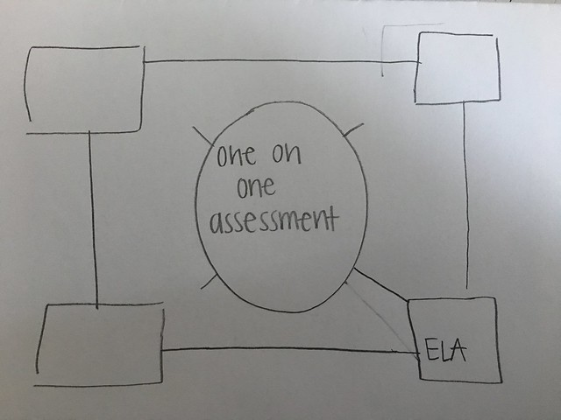




Notes:
The culmination of the assessment process is a written report read by those concerned with the child’s welfare.
Assessment documents are most constructive when they are descriptive and not categorizing.
The use of language should be thoughtful and considerate for the following reasons:
How it will be perceived by the child and affect his/her short and long-term identity
How it will be perceived and understood by the child’s caregivers
How recommendations will be translated by professionals
The longevity of reports through electronic recordkeeping.
4. Plain language should be used to ensure that the report can be read and understood by a range of parents and child-centered stakeholders. It’s usage avoids creating communication barriers and instills trust.
Photos: www.flickr.com

Slide 16
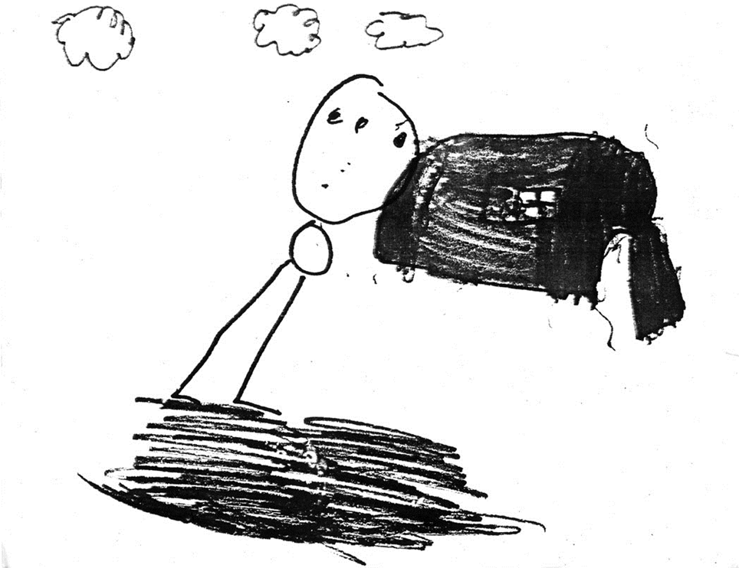
Oscar Dana-Winter
Notes:
Case study (See full details in Chapter 4, pp. pp. 81-91): Oscar Winters is a 7-year-old boy whose parentage is Native American (mother) and Caucasian (father). Oscar just returned to his mother’s home after living for 18 months with his aunt and cousins on the Reservation just south of the Canadian border. According to his mother, Nancy Dana, 32, she sends her children to be with relatives when she feels too stressed to parent. Oscar currently lives with his mother and sister, Mary, 13. The whereabouts of Oscar’s father, Edmund Winters, 62, are unknown. Edmund travels to find work and is often out of touch with his children.
Most of the time Oscar’s family lives in a one-bedroom, rental cottage in a coastal tourist town. Their cottage is heated by an old propane stove; Nancy is responsible for supplying the heating fuel. In the summer, the family moves north and lives in a tent. They return to the coastal community just before Labor Day so the children can stay in the same School Administrative District. According to the referral materials, Oscar has moved 16 times in his young life.
This referral was prompted by the school nurse. According to the referral notes, she is concerned about Oscar’s inconsistent toileting. She suggests that he suffers from encopresis, a condition that causes involuntary defecation. The school nurse reports that they keep a limited clothing supply in her office for children who wet or dirty their clothes. However, school policy requires that children who defecate be automatically sent home to be showered and changed. According to the nurse’s notes, Oscar’s mother does not have a reliable phone number. The school nurse states “I’m at a loss as to how to deal with Oscar’s soiling problem.”
Drawing courtesy of Shelley Cohen Konrad. This drawing was done by a seven-year-old boy whose life was much like Oscar’s. How do child drawings and other expressive modalities help with the child assessment process? What do we learn about this child from this drawing?

Slide 17
Conversation Starters
Write down your initial impressions of Oscar’s strengths, challenges, and needs.
Identify factors used to formulate a relational assessment. Discuss how factors such as language, cultural sensitivity, trauma-informed knowledge, resilience and attachment theories influence your understanding of child clients.
Is Oscar’s perspective represented in either case report? Discuss approaches you might use to gain understanding through his eyes.

