Slide 1
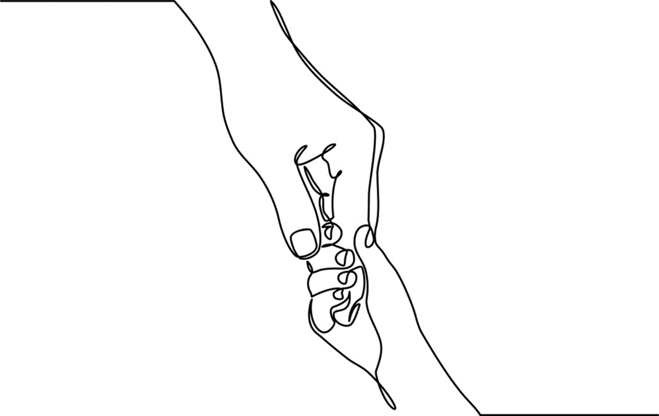
Chapter 2: Early Experiences Matter

Slide 2

Science is the evolving and systematic study of phenomenon that helps organize and evaluate what we know.
http://developingchild.harvard.edu/topics/science_of_early_childhood/
Notes:
Scientific study guarantees that knowledge is tested and retested so that breakthroughs are incorporated into new theories and everyday practices. It is constantly evolving, which explains why theories about human behavior and the social environment change over time. (Please see link to Center for the Developing Child).
Childhood researchers include neuroscientists, social workers and social work researchers, public health researchers, epidemiologists, behavioral scholars, and community action researchers and community-based participatory partners.
Common objective is to uncover factors and circumstances that contribute to family health and childhood well-being.
3. Science benefits and is used by families, educators, policy-makers, medical and behavioral practitioners, and legislators in a range of ways.
4. Science is used in everyday life to inform problem-solving and to explain complex human concerns.
Photo – Scholarship: photo by Neil Conway on Flickr

Slide 3
Critical Relational Theories
Infant Mental Health Research
From Neurons to Neighborhoods
Center for the Developing Child
Adverse Childhood Experiences
Trauma-informed Practice
Empowerment-based Positive Youth Development
Notes:
Early childhood science focuses on infants’ regulatory capacities; the development of relational ties known as attachment (this will be covered in chapter 3) and on social, economic, and familial resources that are necessary to help children reach optimal growth and development.
This chapter cites several pertinent and interrelated study areas: Infant mental health research; the neurons to neighborhoods study; ongoing studies at Harvard’s Center on the Developing Child; and the ongoing Adverse Childhood Experience or ACE research conducted by U. S. Centers for Disease Control and Prevention and Kaiser Permanente’s Health Appraisal Center.
Studies find that children’s regulatory capacities and relational competencies are influenced by their earliest relationships.
The growing child’s brain and neurological development are responsive to caregiver feedback.
Caregivers and parents are also influenced by the feedback they receive from their infants.
A trauma-informed culture is one that recognizes that adversity and trauma affect the lives of people from across socioeconomic strata; of all ages and from all races, genders, ethnicities, sexual orientation, and faiths. Trauma-informed practitioners, rather that asking, ‘what’s wrong’ inquire about ‘what’s happened to you’? This seemingly slight change has powerful effects.
Empowerment-based Positive Youth Development (EMPYD) (Travis & Leech, 2013), like TIC and health-centered approaches, focuses on client assets and community connection. EMPYD specifically addresses trauma and resilience in youth of color.

Slide 4
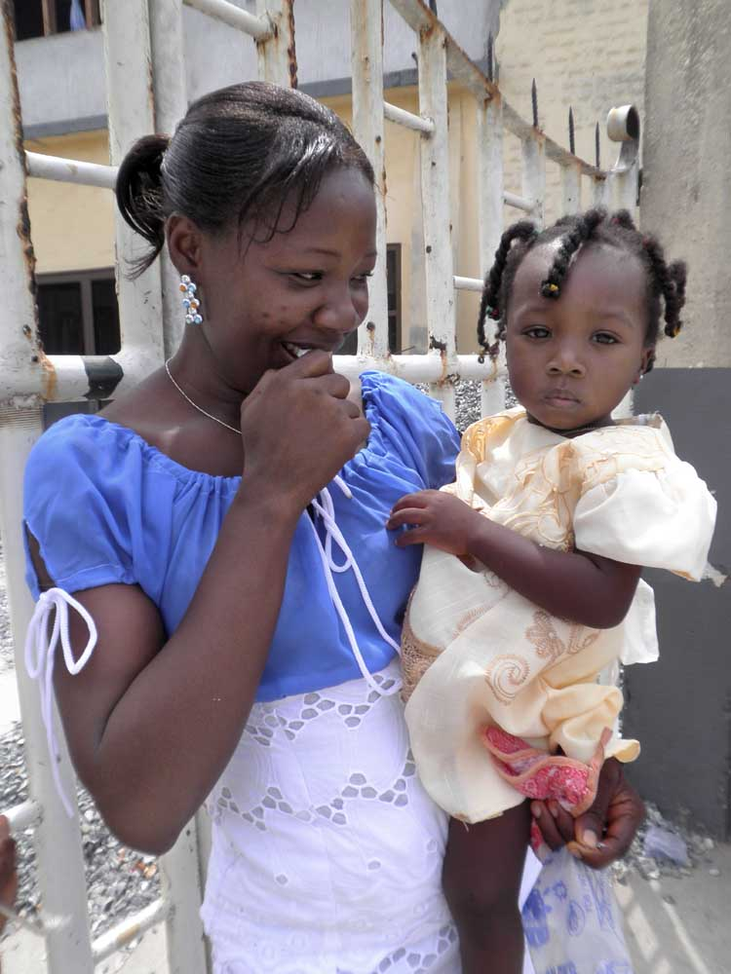
Infant mental health is the observation, study, and assessment of parent/caregiver/infant interactions, the history of parents’ earliest relationships, and the influence of attachment.
Notes:
Dr. Selma Fraiberg was an early infant researcher recognized as a founder of early maternal-infant relationship studies and to the development of the infant mental health (IMH) field.
IMH practitioners focus on relationships between infants and parents; between families and practitioners; and between family systems and communities.
Through methodical, direct observations these interdisciplinary practitioners learned about the importance of nurturing for both infants and parents.
Together they concluded that parents who feel secure and cared for are better equipped to nurture their infants.
Photo courtesy of Shelley Cohen Konrad

Slide 5
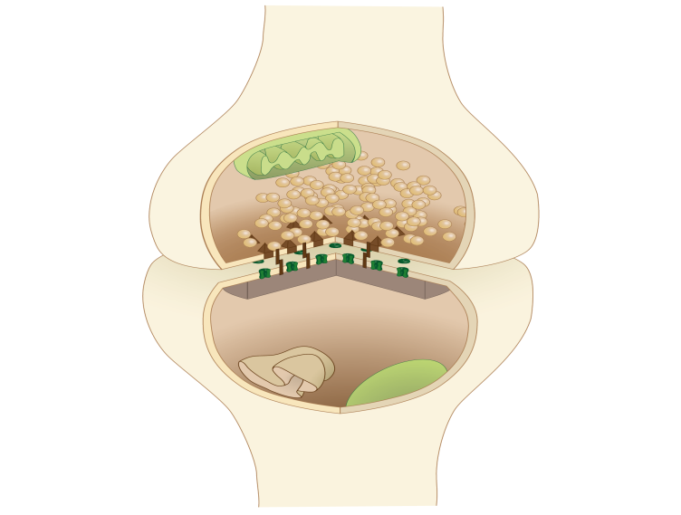

All children are born wired for feelings &
ready to learn
Shonkoff, J. & Phillips, D. (Eds.). (2000). From Neurons to Neighborhoods: The science of early childhood development.
Notes:
1. Neurons to Neighborhoods was the brainchild of the National Research Council and the Institute of Medicine (IOM).
2. Identified a need to reevaluate the needs of children 0-5 in the new millennium.
3. Findings concluded that because human development is a dynamic and interactional process, children’s earliest relationships and environments are central to their short and long term health and well being.
4. Relationships include those with central caregivers as well primary systems, e. g. child care, schools, social service institutions, and the broader society.
5. The NTN study found that human development is shaped by the interplay of vulnerabilities & resilience and open to risks and protective factors throughout development .
Images: Synapse: commons.wikimedia.com; girl with hula hoop: Photo by Patricia Prudente on Unsplash
6. In 2012 FNTN collaborators revisited their findings and concluded that they had formidable endurance (“Front Matter”, 2012). The 2012 report produced a rich appreciation for the importance of early relationships, brain health, and their relation to children and adult well-being.

Slide 6


Like children, parents need to be nurtured, cared for, and supported.
Notes:
Relationship: The nature versus nurture debate is scientifically obsolete. Genetic, relational, and environmental influences are intertwined and work together in dynamic ways over the course of development.
2. Children's early development depends on the health and well-being of their parents who, along with other regular caregivers, are the “active ingredients” of environmental influence during the early childhood period.
Photo: Courtesy of Justin Konrad

Slide 7

Social, economic, and environmental disadvantages impact children’s health and overall development.
Notes:
Striking developmental disparities associated with social and economic disadvantages are apparent well before kindergarten and are predictive of later academic performance.
Social, emotional, and regulatory impairments can seriously compromise early childhood development. Young children suffer sadness and dysregulation in response to trauma, loss, or personal rejection.
3. Many early childhood programs do not have the capacity to address child and family social and behavioral concerns.
4. The quality of child care and other children’s services including early education and child protection matters.
5. Environmental quality also matters. We know that health and living profiles of disadvantaged and impoverished neighborhoods are significantly worse than those in thriving communities.
6. There is a great need for policies and resources to target healthier communities, access to preventative medicine and the development of resources that enhance child and family wellness for underserved and vulnerable populations.
Photo: Photo by Gift Habeshaw on Unsplash

Slide 8
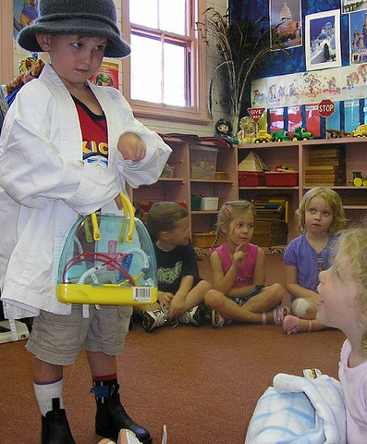
Quality early childhood programs yield a high return on investment for children, families, and communities.
www.developingchild.harvard.edu
Notes:
The Center on the Developing Child at Harvard University extends the work of the NTN study and is dedicated to the science of early childhood. CDC advances scientific evidence about the importance of early relationships and the effects of early experiences on children’s brain architecture.
Young children need positive relationships, rich learning opportunities, and safe environments.
Vulnerable children & families need intensive home support that is intergenerational and guided by knowledge of health inequities.
Early childhood programs should employ well-trained, relationally responsive, culturally-aware staff.
Programming for children must be rich, age-appropriate, and developmentally stimulating .
Policies that guide early childhood programs must be proven effective across biopsychosocial domains.
Photo: Jimee, Jackie, Tom, & Asha at flickr.

Slide 9
Adverse Childhood Experiences (ACE)
  Children experiencing early and ongoing adversity and disadvantage face risks to short and long term health and functioning.
ABUSE
NEGLECT
FAMILY SUBSTANCE ABUSE
FAMILY MENTAL ILLNESS
MULTIPLE LOSSES & SEPARATIONS
CHRONIC HEALTH CONDITIONS
POST TRAUMATIC STRESS DISORDER
CHRONIC MENTAL ILLNESS
Notes:
The U. S. Centers for Disease Control and Prevention and Kaiser Permanente’s Health Appraisal Center in San Diego, California, conduct ongoing research examining the impact of child abuse, family violence, and other detrimental life experiences on later, lifelong health outcomes.
ACE study findings suggest that there are predictable links between deprivation and trauma in early childhood and the advent of chronic illnesses and other life-affecting conditions in adulthood.
Limited access to health care, healthy, affordable food, and stable shelter adversely affect children’s quality of life.
Parents living in insecure environments are more likely to be distracted and distressed and therefore less able to meet the multi-faceted demands of their growing children.
Reference: Dong, M., Anda, R. F., Dube, S. R., Giles, W. H., & Felitti, V. J. (2003). The relationship of exposure to childhood sexual abuse to other forms of abuse, neglect, and household dysfunction during childhood. Child Abuse & Neglect, 27, (6), 625.

Slide 10
Stress Taxonomy
Acute
POSITIVE STRESS
TOLERABLE STRESS
Persistent
TOXIC STRESS
National Scientific Council on the Developing Child (2005)
Notes:
To better understand the intersection of stress and resilience, the National Scientific Council on the Developing Child developed a taxonomy that describes three categories of stressful life experiences. These include positive, tolerable, and toxic stress and their relative impact on developing children.
Positive stress: Occurs when children face acute events or tasks that are unfamiliar or anxiety-producing. For example, the first dentist visit. Mastering this acute stress experience increases the child’s self-worth and advances maturation & growth.
Tolerable stress Occurs when a child’s physiologic state is disrupted by life-altering events. For example, the death of a loved one, a period of homelessness, loss of family status. If stress is not mediated, it is more likely that the child will experience short and long term adverse effects than if stress is addressed with support and resources.
Toxic Stress is extreme, persistent, and uncontrollable adversity is at the root of chronic stress. For example, family violence, neglect, and parental mental illness (untreated) contribute to toxic stress. Over time toxic stress interferes with health brain development and incurs damage to other organ systems. When unaddressed, toxic stress leads to significant physical and mental health issues in adulthood.
National Scientific Council on the Developing Child. (2005). Excessive Stress Disrupts the Architecture of the Developing Brain: Working Paper #3. Available at: http://www.developingchild.net.

Slide 11

Trauma-informed Practice Principles
Safety
Trustworthiness and Transparency
Collaboration and Mutuality
Empowerment
Voice and Choice
Cultural, Historical, and
Gender Issues
Notes:
1. A trauma-informed culture is one that recognizes that adversity and trauma affect the lives of people from across socioeconomic strata; of all ages and from all races, genders, ethnicities, sexual orientation, and faiths. Trauma-informed practitioners, rather that asking, ‘what’s wrong’ inquire about ‘what’s happened to you’? This seemingly slight change has powerful effects.
2. Trauma-informed principles and practices have been well studied. Evidence-based trauma-informed care (TIC) recognizes that early adversity affects human functioning across the life course.
3. TIC reflects adherence to six (6) key principles rather than a prescribed set of practices or procedures. These principles are generalizable across settings, although terminology and application should be geared to the needs of the individual child and to the family culture and setting. (See slide).
Image: By Will Brown - Dandelion, CC BY 2.0, https://commons.wikimedia.org/w/index.php?curid=71398943

Slide 12
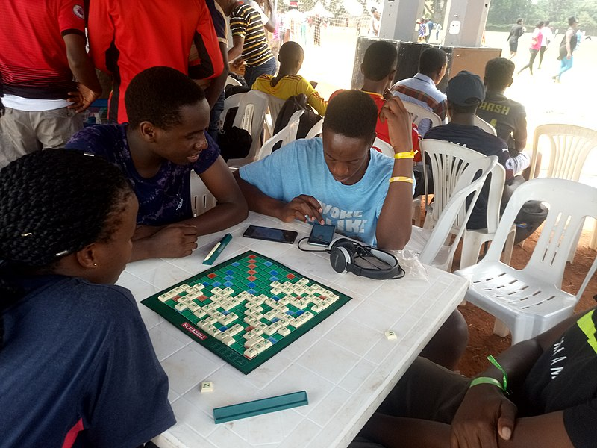
Empowerment-based Positive Youth Development (EMPYD) – 7 Cs
Connection
Caring
Confidence
Confidence
Character
Competence
Community
Citizenship
Notes:
Empowerment-based Positive Youth Development (EMPYD) (Travis & Leech, 2013), like TIC and health-centered approaches, focuses on client assets and community connection.
The 7 Cs of EMPYD are: connection, caring, confidence, character, and competence, (sense of) community, and citizenship, tenets similar to those found in the work of youth resiliency researchers described below. Questions for youth workers include – what should we be working towards for youth and what is our active role in this process? What does health development look like?
Photo: By Kamzes - Own work, CC BY-SA 4.0, https://commons.wikimedia.org/w/index.php?curid=76670837

Slide 13

Economic hardship imposes tremendous burdens on children and parents.
Notes:
Economic hardship imposes tremendous burdens on children and parents. This is true for those living in urban settings and in rural communities.
Financial disadvantage for all children and families is associated with tangible burdens, for example obtaining basic necessities of life such as housing, food, medications, and clothing. It is also linked to emotional and relational consequences brought about by cultural marginalization and social stigma.
3. Children experience societal and internalized stigma because of living in poor neighborhoods.
4. Friendships are important to poor children however poor children cannot keep up with their middle-class classmates due to lack of resources.
Photo from by M@rg, Creative Commons at flickr

Slide 14

60 Minutes: Children & Poverty
http://www.cbsnews.com/video/watch/?id=7389750n&tag=contentBody;storyMediaBox

Slide 15
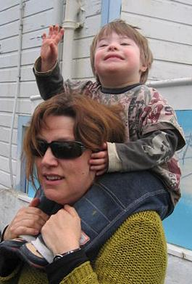
Costs of Childhood Chronic Illness or Disability
3x Costs
Well-being
Stress
Insurance
Understanding
Stigma
Notes:
Families raising children with medical and developmental disabilities incur 3x the costs of those raising non-disabled children.
Families report a higher level of stress and a lower level of well-being caused by economic and resource inequities, insurance failures, and society’s lack of understanding.
See Therese’s story in next slide.
Photo: Child piggyback2 from commons.wikimedia.org .

Slide 16
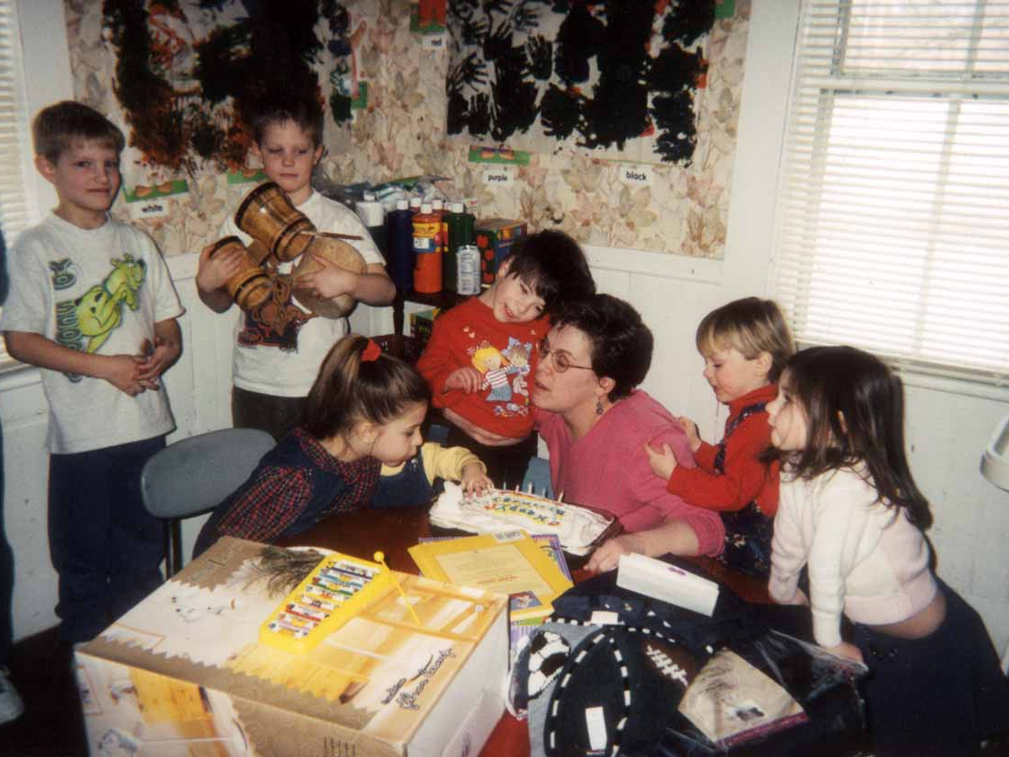
Therese & Magdalena
Notes:
Therese’s story: Therese’s story helps illustrate these points. Magdalena, her daughter, was born with Leigh syndrome, a degenerative illness that leads to early death. By the age of four, Magdalena’s symptoms included seizures, feeding and speech difficulties, heart problems, and muscle weakness. By age five she required medical technology assistance and 24-hour care for basic activities of daily living. Therese lovingly cared for her daughter as well as for her two younger children. In addition to home and childrearing responsibilities, she worked at a Laundromat three mornings a week to supplement her husband’s salary.
Therese would also tell you that being a parent to a child with a chronic health condition was hard work that few people outside of the disability world understood.
Therese’s story exemplifies many of the common dilemmas shared by families of children with disabilities and chronic illnesses. Unlike poor or low income families of healthy children, paid work is not the sole solution to the fiscal concerns faced by parents of children with chronic health conditions. Therese needed to be home to care for Magdalena. Although she received some home health service that was insurance reimbursable, it did not nearly cover the totality of her health care needs. Nor did Therese want others to care for her beautiful yet vulnerable daughter. Rather she wanted to have as much time as possible with Magdalena as she knew her life would be all too brief.
Therese aptly observed that few people recognize or seek to understand the experiences of parents whose children live with chronic medical conditions. Researchers report that family members, friends, and health professionals frequently misunderstand parents’ experiences or avoid them altogether. Like financially disadvantaged families, those caring for ill and disabled children are oftentimes judged as being somehow responsible for their plight. Parents are well aware that no one can truly know them unless they “walk in their shoes”.
Photo Courtesy of Theresa Gaetjens.

Slide 17

Family resilience is a dynamic process fostered by positive interaction and interrelationship with others.
Notes:
Resilient families support one another and find benefit in the shared experience of survival.
Families viewed as resilient are characterized by a combination of individual qualities including positive outlook, faith, communicative and problem-solving capacities, planned time together, and other functional capabilities that enable them to manage and deal with hard times.
Community-level factors that promote family resilience include involvement with and support from neighborhood and community networks, including faith-based institutions.
How families perceive their circumstances is additionally influential to adaptation. Optimism, humor, and confidence appear at the heart of dealing with adversity. Capacities to positively appraise difficult circumstances, find value in small successes, and cope with uncertainty helped families combat despair and hopelessness.

Slide 18
Conversation Starters
Provide examples of how scientific knowledge is applied in every day practice with children and families?
How does science promote relational practice principles?
What pitfalls or errors occur when workers do not stay current with childhood-related studies?
Why is it important for social service agencies and policy makers to stay abreast of early childhood scientific findings?
How does trauma-informed practice influence relationship-building with clients?
How do context and culture influence scientific inquiry and its applications? Why should science be culturally and trauma-informed?

