Slide 1
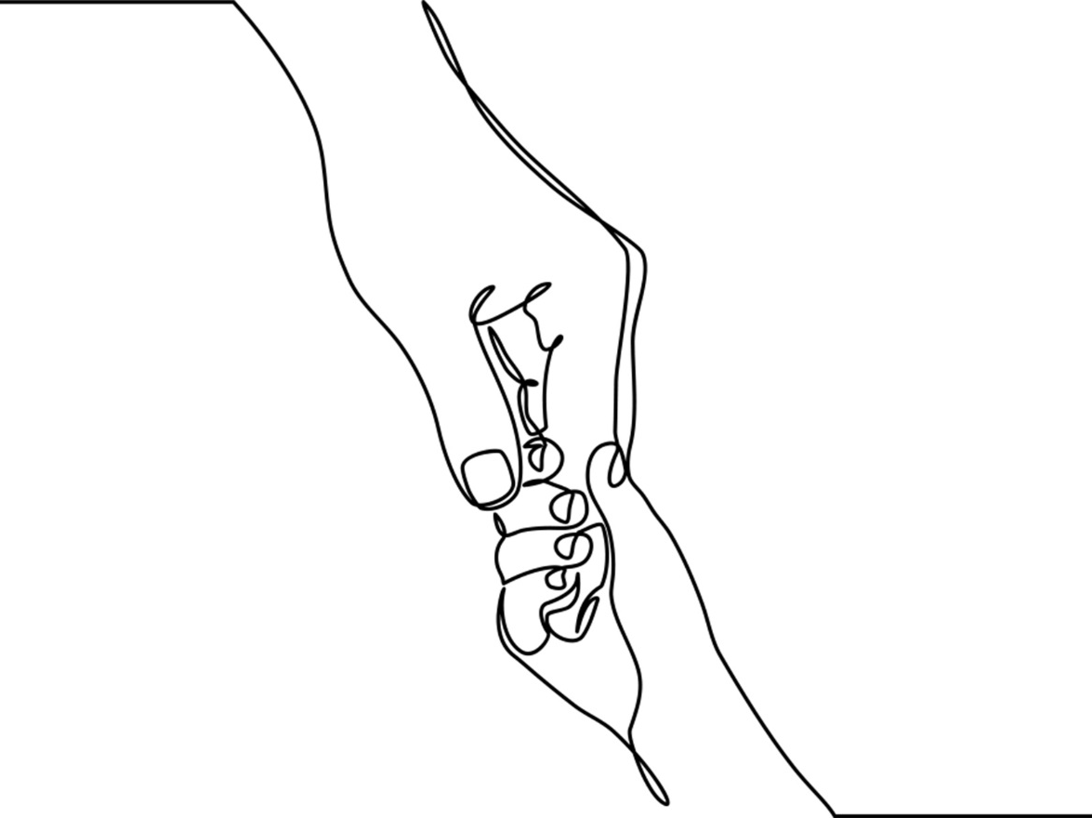
Chapter 1: Introduction to Relational Practice

Slide 2
Relational Practice: Key Concepts
Relationship
Reflexivity
Research
Notes:
Relational practice with children and families requires 3 key concepts and practices:
Relationship: Building relationships with children, their families, key stakeholders, and other professionals/practitioners involved in the child’s caring team
Research: Commitment to staying current with the science of childhood and evidence-guided practice innovations and findings; respecting the lived wisdom of clients and families; valuing one’s earned wisdom as a child-centered social worker or other mental health professional.
Reflexivity: Commitment to reflect upon one’s biases, assumptions, and influential experiences and knowledge.

Slide 3


Relationship
Human connections matter, especially those between children and primary caregivers and between families and communities.
Notes:
Workers acknowledge, value, and work with the key people in children’s lives. They understand the interdependence of children and caregivers and the reliance children have on those who provide key services.
Children’s relationships with adults are interdependent and complicated. Workers should not view the needs of one as separate from the other.
3. Relationship is a primary tool in all aspects of practice, no matter the theory or approach used.
Image By Mujeebcpy - Own work, CC BY-SA 4.0, https://commons.wikimedia.org/w/index.php?curid=76732099

Slide 4

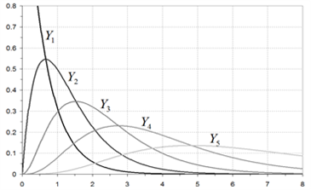
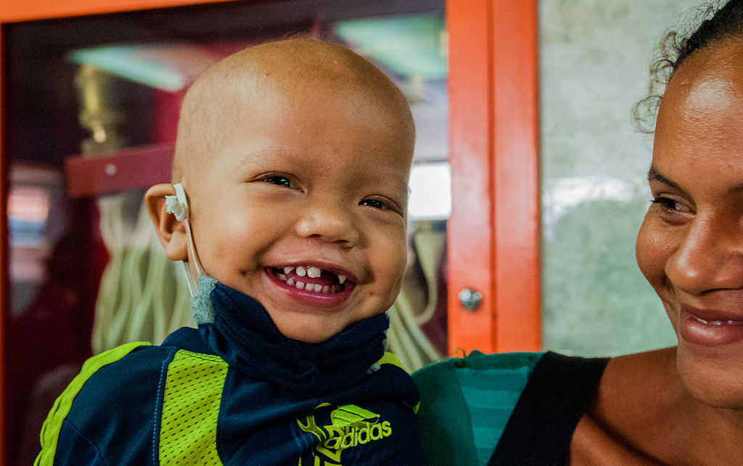
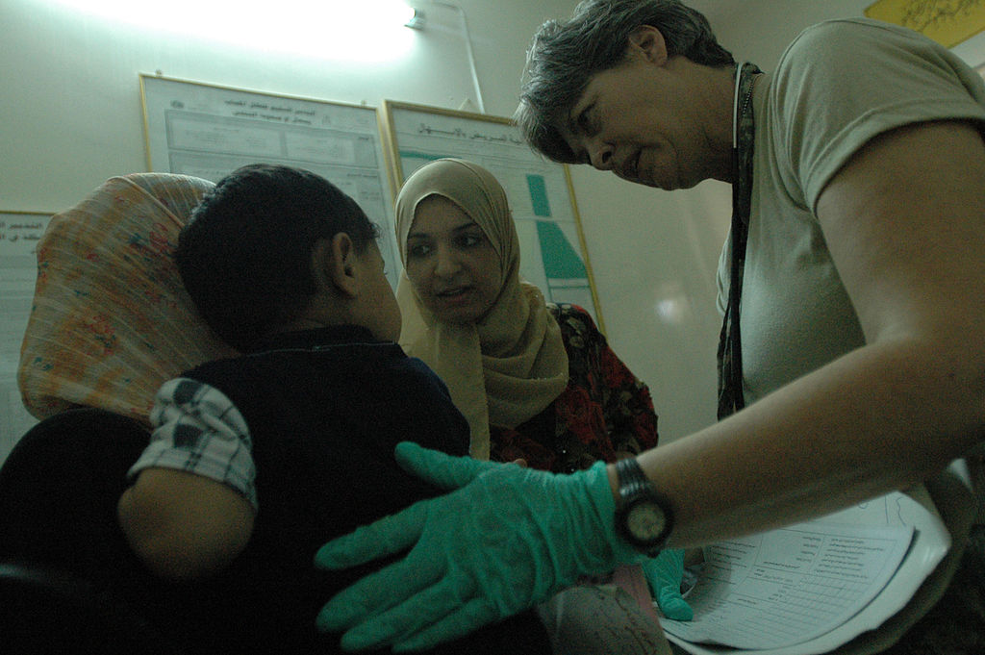
Research
Evidence-based
Interdisciplinary Scholarship & Traditions
Lived Wisdom
Practice Wisdom
Lived Wisdom
Practice Wisdom
Notes:
Relational Practice: Research is:
1. Grounded in diverse theories and scholarly traditions including social work, developmental psychology, medicine, nursing, occupational therapy and mental health counseling.
2. Informed by evidence-guided research and scientific discovery. The productive use of relationship is validated in neuroscience and social/behavioral research (see chapter 2).
3. Acknowledges clients’ lived wisdom and experience. Client’s expertise provides workers with best evidence about their lived experiences and perspectives.
4. Recognizes workers’ earned wisdom and practice-based evidence. Workers also gather evidence about human experience from interactions with clients who share common experiences. Such earned wisdom is useful but should not lead to premature assumptions about any given person.
Photo – Scholarship: photo by Neil Conway on Flickr; Evidence-Guided Research by commons.wikimedia.org; Lived wisdom By The Photographer - Own work, CC0, https://commons.wikimedia.org/w/index.php?curid=30152999; Practice Wisdom By Sgt. Armando Monroig - https://www.dvidshub.net/image/46808, Public Domain, https://commons.wikimedia.org/w/index.php?curid=39588555.

Slide 5
Reflexivity
Reflexive Practice
Curiosity & Openness
Examine knowledge
Shared Expertise
Awareness of Biases
Notes:
Reflexivity requires that workers continually reflect upon where the knowledge used for practice decisions comes from. It engages workers in identifying and analyzing the influence of their knowledge on practice choices and decisions.
Workers recognize that personal belief systems, cultural assumptions and values, and prior life experiences influence how knowledge is constructed. It promotes curiosity and willingness to learn with, from, and about our clients.
Characteristics of a reflexive worker include humility and openness to diverse perspectives and experiences, a non-judgmental approach to human experience and problem-solving and appreciation for the complementary knowledge shared by clients, workers, and systems.
Reflexive practice acknowledges that what we do not know is as important as what we do know.

Slide 6
Unifying Principles
Children are resilient and thrive if given opportunities
Children and Caregivers are Interdependent
The child-worker relationship is powerful
Notes:
These unifying principles are applied and illustrated throughout the text:
1. Children are resilient and thrive if given opportunities and resources.
2. Children are connected to and interdependent with their parents, caregivers and social environments.
3. The child-worker relationship is a powerful tool in the process of change and healing.

Slide 7
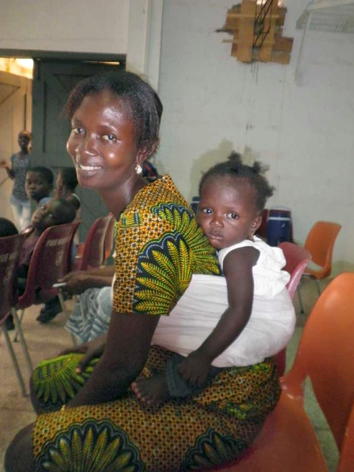

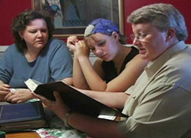
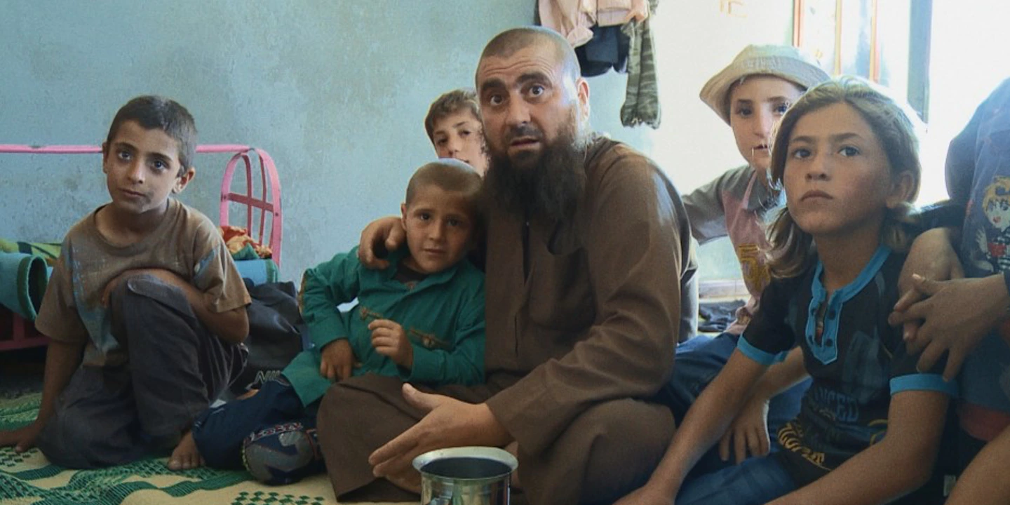
Every Family is Unique
Notes:
Complex and interacting factors influence child and family experience including those that contribute to problems in functioning within social, familial, and institutional environments.
Common influential factors reside in biological, psychological, relational, social, cultural, political, spiritual, and phenomenological (meaning-making) domains.
Reactions to life’s problems and circumstances are unique; responsive to factors cited above and to the meaning people make of their experiences.
Photo 1: Gerald Yuvallos' photostream on flickr; Photos 2 courtesy of Shelley Cohen Konrad; Photo 3 Getty; Photo 4 Courtesy of Kino Lorber Inc.

Slide 8
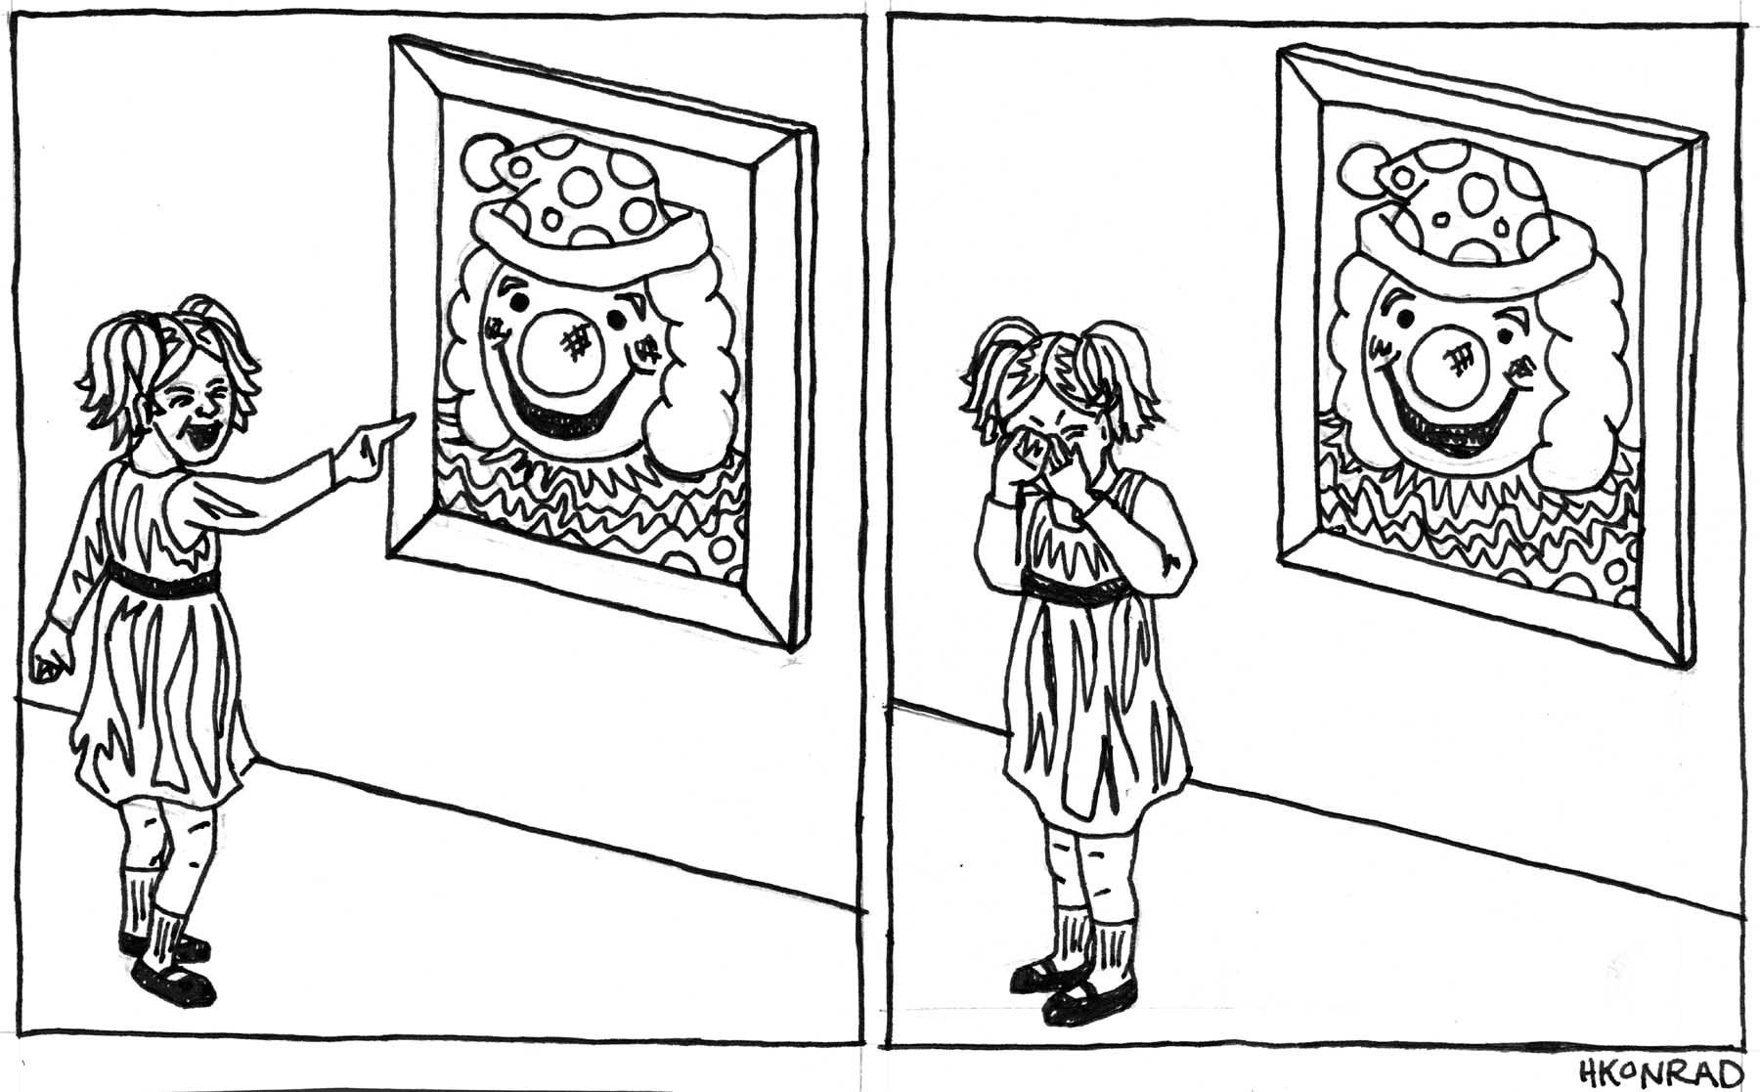
Children respond differently to common experiences
Notes:
The drawing above shows one child enjoying a clown painting while another is frightened by it. Drawing by HE Konrad.

Slide 9
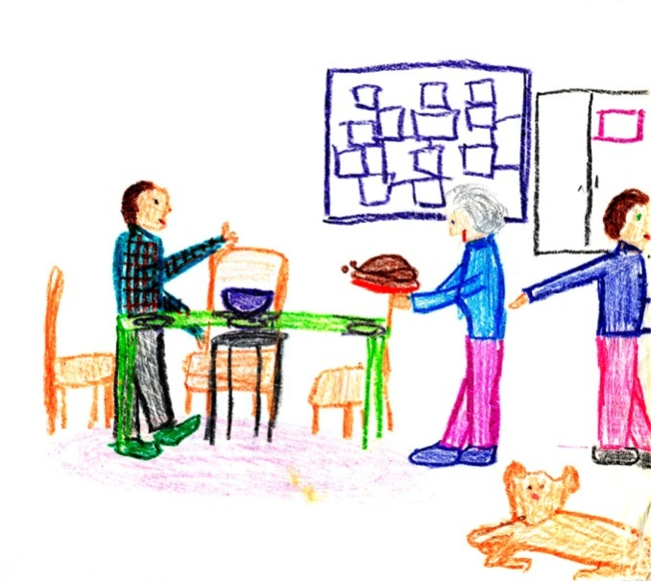
Distinctive families; Different resources, responses and supports
Notes:
While families may experience similar circumstances and events, differential resources, family supports, culture, and life views affect how they will respond and act. Getting to know each family’s strengths, capacities for resilience and vulnerabilities is central to providing effective service. Recognizing culture and its influence is also key to best practice.

Slide 10
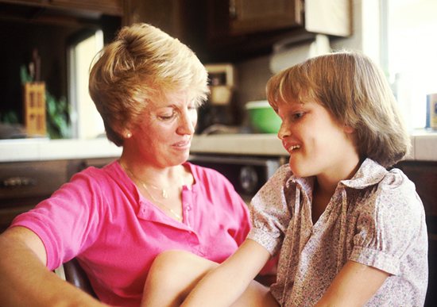
The Client/Worker Relationship
Dynamic
&
Interactive
Safe
&
Open
Engaged
&
Two-way
Transformative
Notes:
Guiding principles influence workers’ attitudes and the application of these attitudes to practice skills.
Child and family relational workers explicitly and respectfully invite clients and family into conversations aimed at building relationships and collectively finding solutions to problems.
Workers are responsible for establishing relationally safe environments where clients can be open, candid, and engaged in their own discovery.
Workers directly acknowledge that clients are the experts in their own experience. At the same time, they exhibit confidence that they have useful knowledge, experience, and resources to share.
Workers must be able to bear witness to clients’ experiences while not being overwhelmed by it. In the end, openness to children’s and family’s stories is transformative.
Photo: commons.wikimedia.org

Slide 11
Research/Inquiry
Investigate Clients’ Concerns
Lifelong Learners
CURIOUS
&
ENGAGED
Evidence-guided Practitioners
Notes:
Child- and family-centered relational practitioners commit to ongoing, life-long learning. Such learning entails staying current with contemporary scientific/empirical research, evidence-guided practices, and also on social/political/policy trends that affect human rights, physical health and mental health, and overall well-being.
From a micro/mezzo perspective, workers are willing to research questions and issues related to individual child clients and family-related situations.
Willing to go the extra mile to investigate clients’ concerns and systems’ needs.

Slide 12
Reflexivity
Reflection
Awareness
Reflexivity
Consultation
Notes:
Workers are actively self-reflective, aware of how their assumptions, values, knowledge, and experiences affect their practice choices.
Workers are willing to learn about, from, and with clients, parents, and relevant community member and resources.
Supervision and consultation are used to ensure that other perspectives are considered and biases are kept in check.

Slide 13

The Boy in the Waiting Room
Notes:
Case Narrative: Roger, an African-American child, sits in the waiting area of your practice setting. You notice that his clothes don’t fit and are well-worn. He seems frail and small for a four-year-old. While he sits his legs swing back and forth without stopping; he seems ready to be on the move. For the moment Roger is absorbed in a picture book. He is sitting with an older, Caucasian man and is pointing something out to him on the page. The man looks on but doesn’t respond. You know from the case record that Roger is in his third foster care placement. His mother died and his father relinquished custody. He now lives with Mrs. Doris Miller, a widow with older, married children. Mrs. Miller believes in strong limits and discipline. As an African-American parent, she has serious concerns about the fate of African-American boys left without supervision.
Roger has been diagnosed with Attention Deficit Hyperactivity Disorder. The Head Start teachers report that he is bright but easily derailed when changes occur in the classroom setting. They also note that he is highly sensitive to what people think of him.
Photo: mghardie.wordpress.com

Slide 14
Conversation Starters
What do you think you know about Roger? Mrs. Miller?
What further information do you need to develop a relational assessment?
What contextual factors should you consider?
How will your attitudes, values, and experiences influence the assessment process? How will you address these effects?
Who will you include on the assessment and planning team?
What factors and resources will improve the likelihood for a positive alliance with Roger and his family system?

