Slide 1

How to do Your Social Research Project Or Dissertation
by Tom Clark, Liam Foster and Alan Bryman

Slide 2
Chapter 7
Building Your Project
© Tom Clark, Liam Foster, and Alan Bryman, 2019

Slide 3
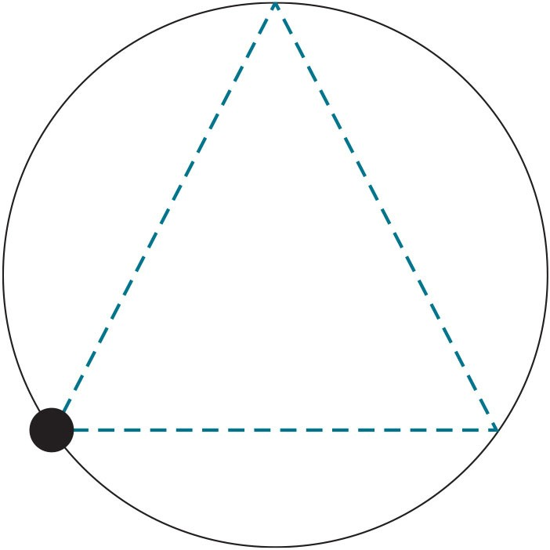
Figure 7.1 Triangulation

