Slide 1
Appendix B
TIME VALUE OF MONEY CALCULATIONS USING SPREADSHEETS AND CALCULATORS

Slide 2
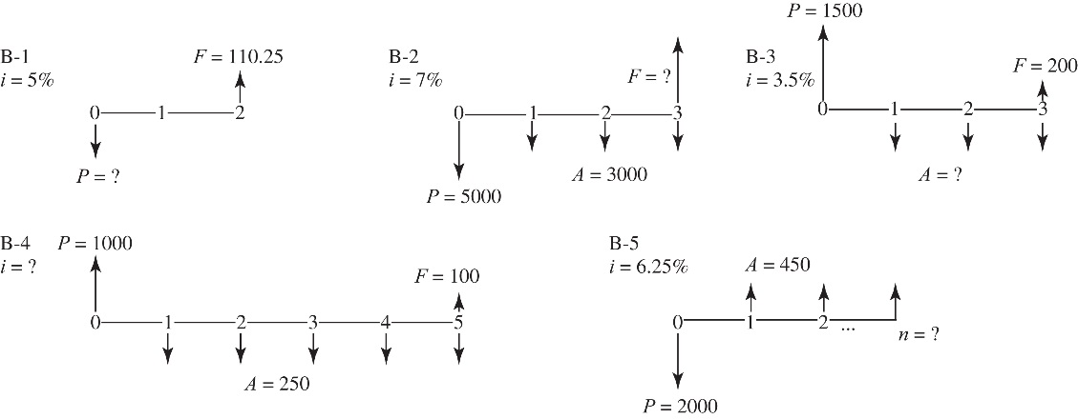

Slide 3


Slide 4
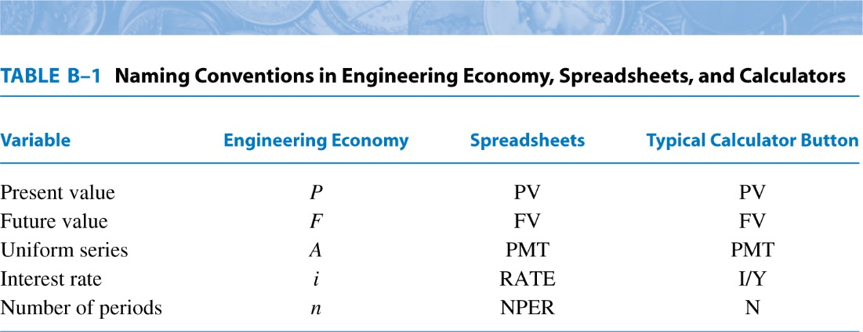

Slide 6
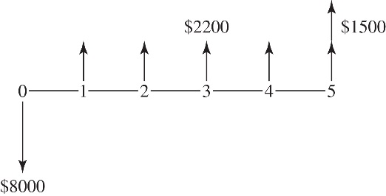

Slide 7


Slide 10
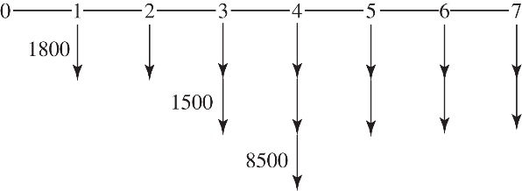

Slide 11


Slide 12


Slide 14


