Slide 1
Chapter 6
Real Econometrics
Second Edition
Michael A. Bailey

Slide 2


Slide 3
Case Study Photos
Chapter 6

Slide 4

Case Study 1

Slide 5
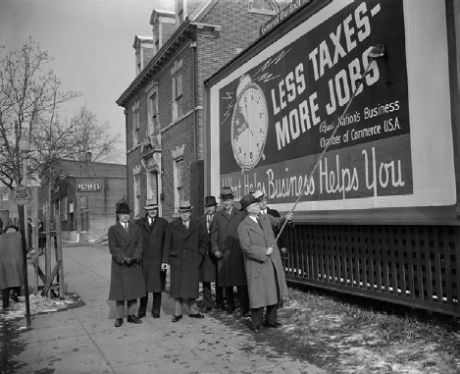
Case Study 2

Slide 6
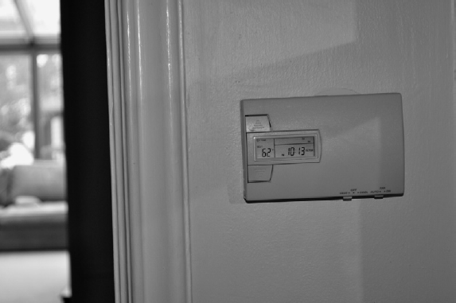
Case Study 3

Slide 7
Figures
Chapter 6

Slide 8
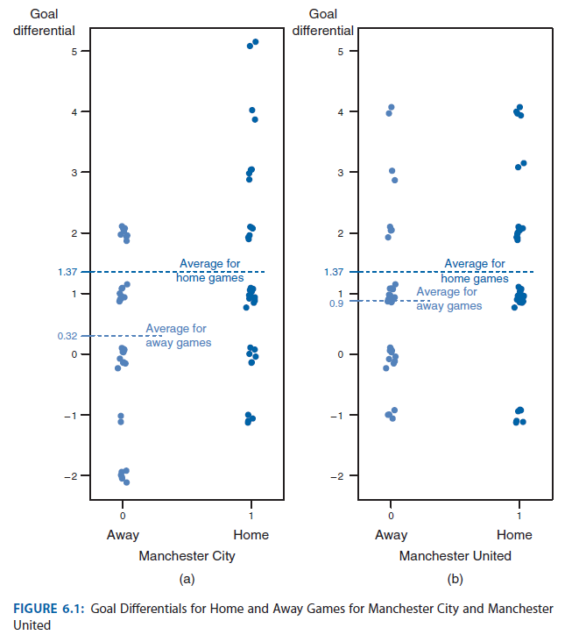
Figure 6.1

Slide 9
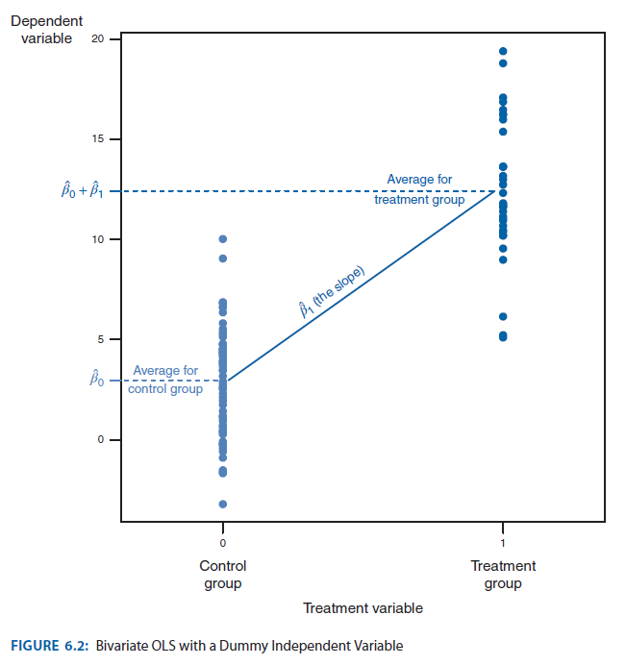
Figure 6.2

Slide 10
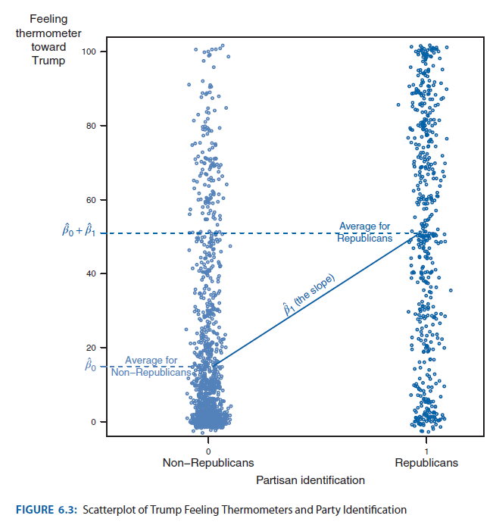
Figure 6.3

Slide 11
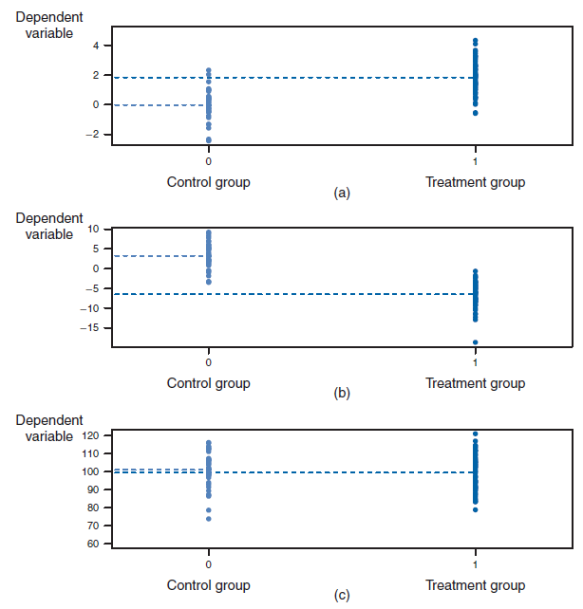
Figure 6.4

Slide 12
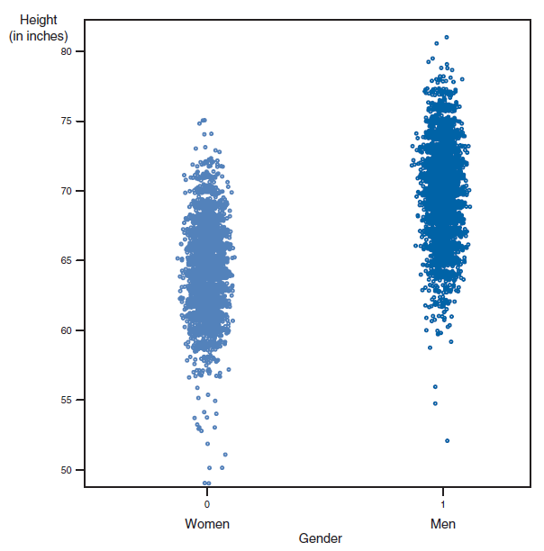
Figure 6.5

Slide 13
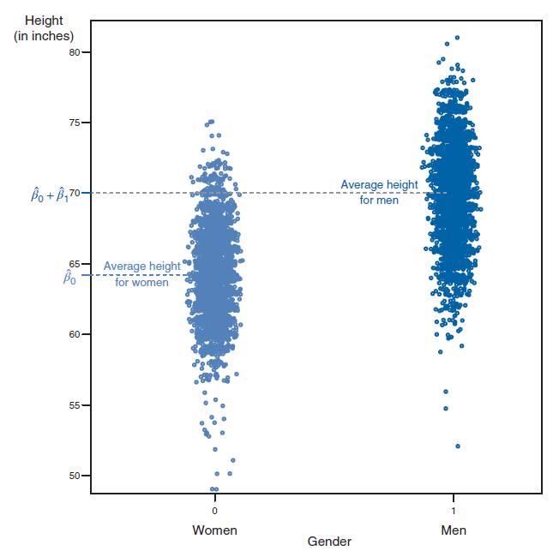
Figure 6.6

Slide 14
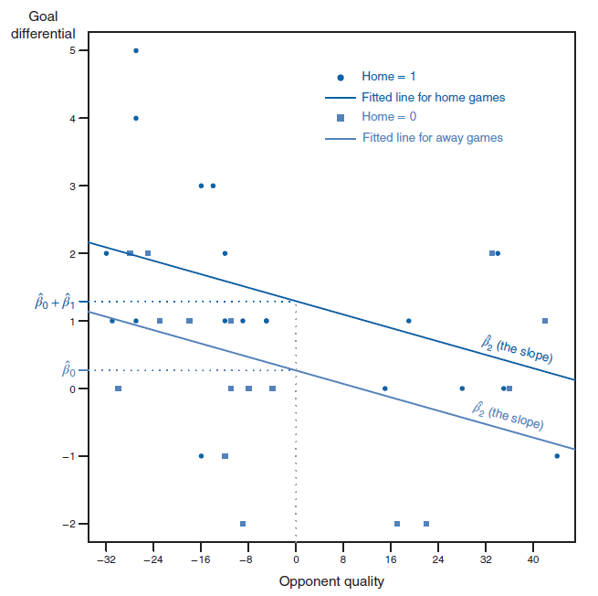
Figure 6.7

Slide 15
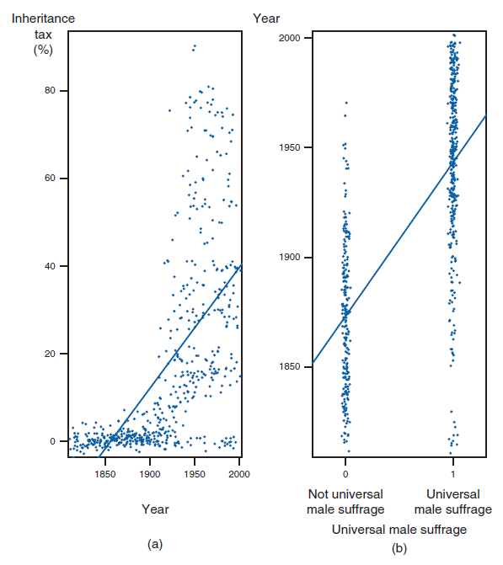
Figure 6.8

Slide 16
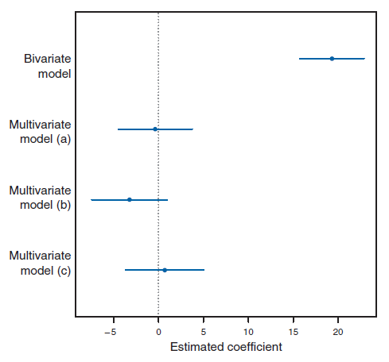
Figure 6.9

Slide 17
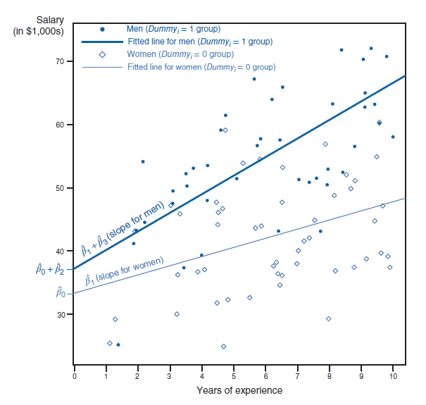
Figure 6.10

Slide 18
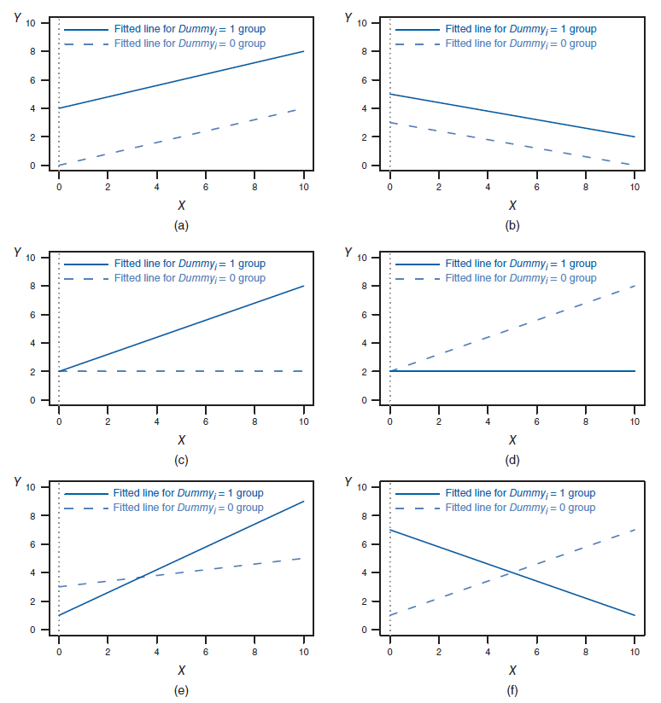
Figure 6.11

Slide 19
Figure 6.11

Slide 20
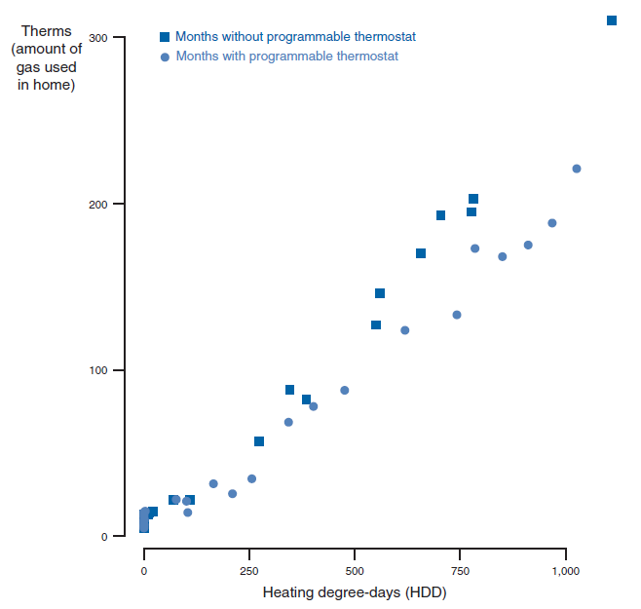
Figure 6.12

Slide 21
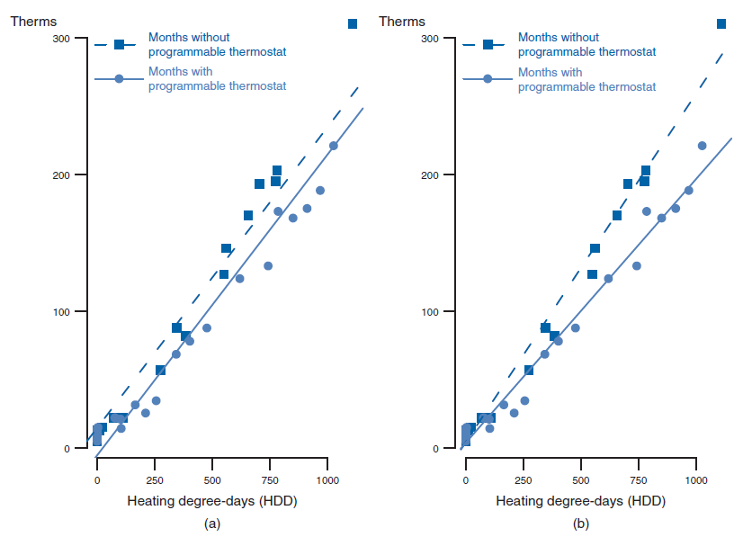
Figure 6.13

Slide 22
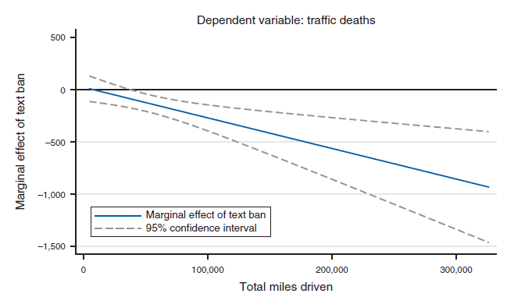
Figure 6.14

Slide 23
Tables
Chapter 6

Slide 24
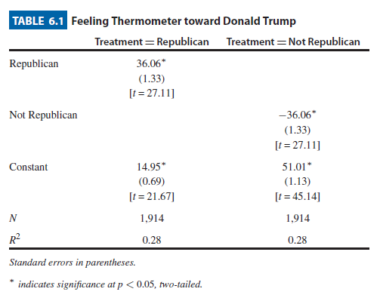
Table

Slide 25
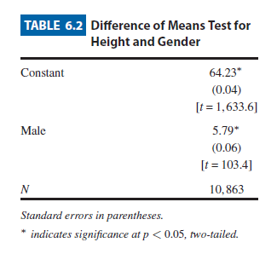
Table 6.2

Slide 26
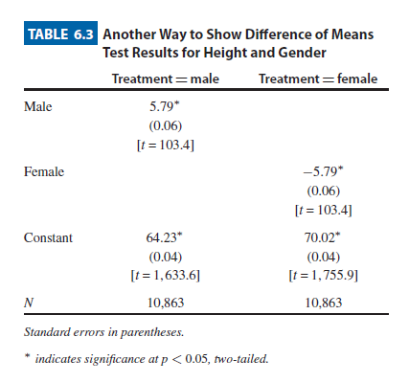
Table 6.3

Slide 27
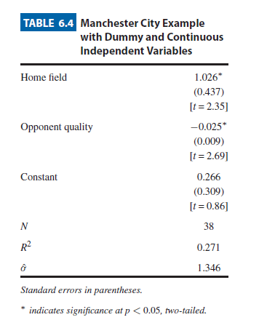
Table 6.4

Slide 28
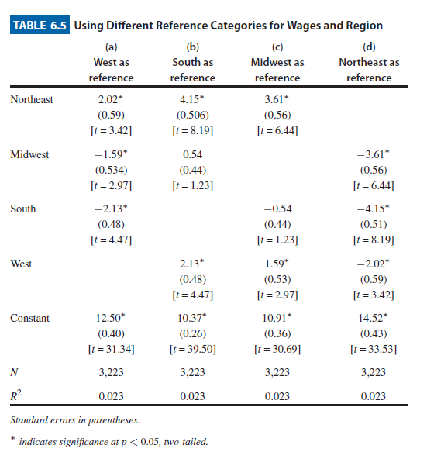
Table 6.5

Slide 29
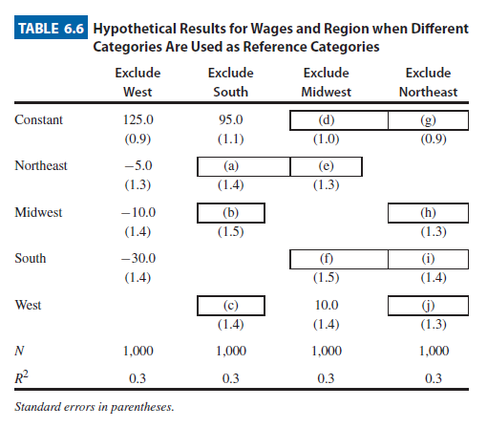
Table 6.6

Slide 30
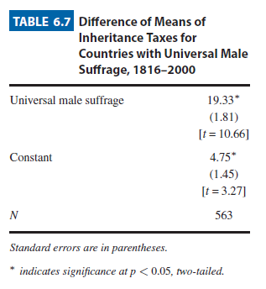
Table 6.7

Slide 31
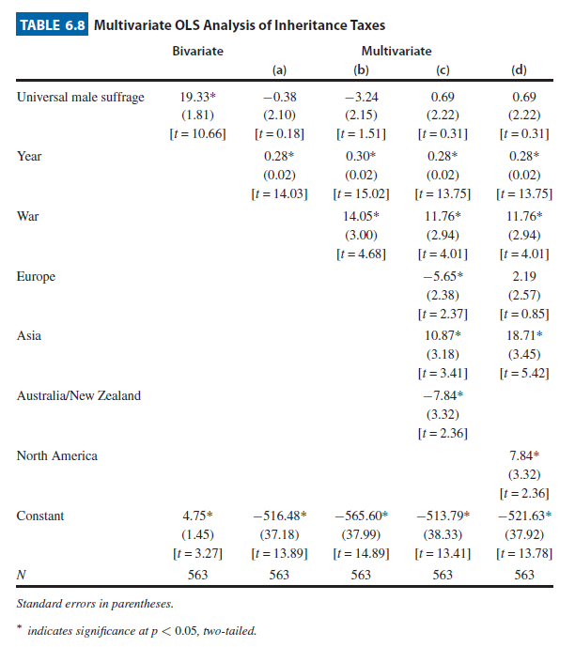
Table 6.8

Slide 32
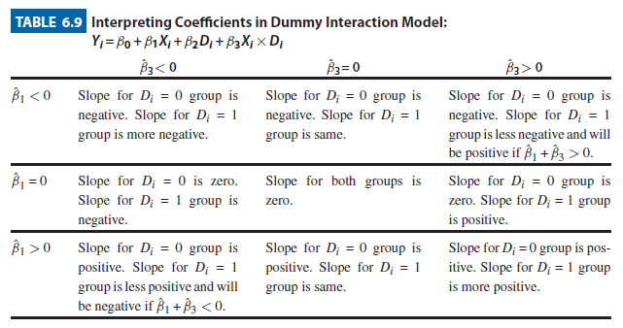
Table 6.9

Slide 33
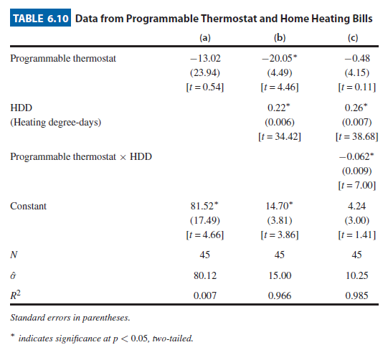
Table 6.10

Slide 34
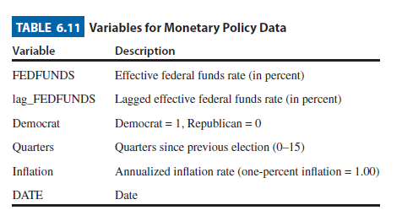
Table 6.11

Slide 35
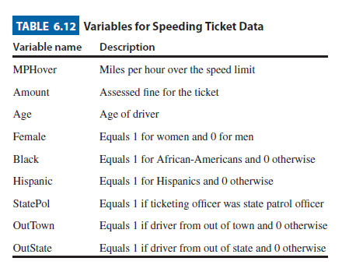
Table 6.12

