Slide 1
Chapter 14 Real Econometrics Second Edition Michael A. Bailey

Slide 3
Figures
Chapter 14

Slide 4
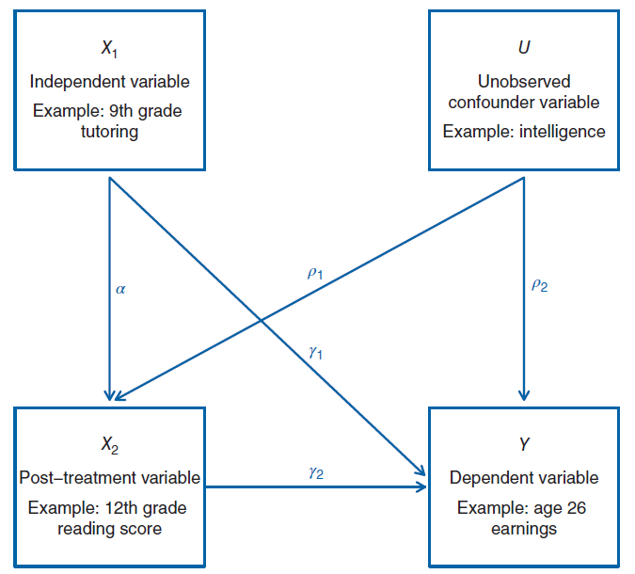
Figure 14.1

Slide 5
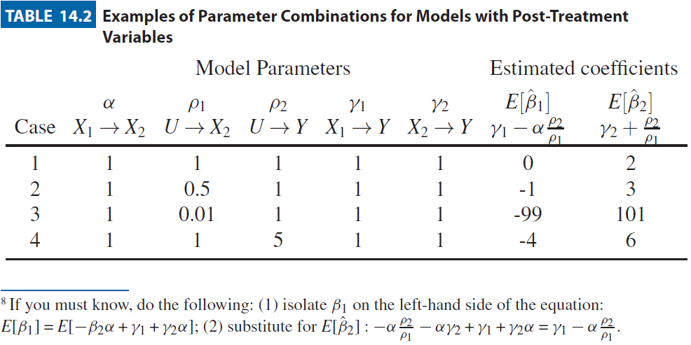
Figure 14.2

Slide 6
Tables
Chapter 14

Slide 7
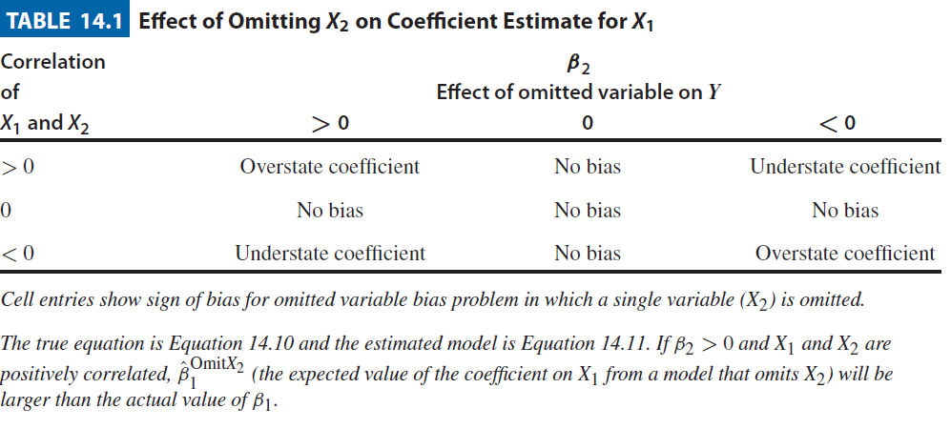
Table 14.1

Slide 8
Table 14.2

Slide 9
Table 14.3

