Slide 1
Chapter 1
Real Econometrics
Second Edition
Michael A. Bailey

Slide 2
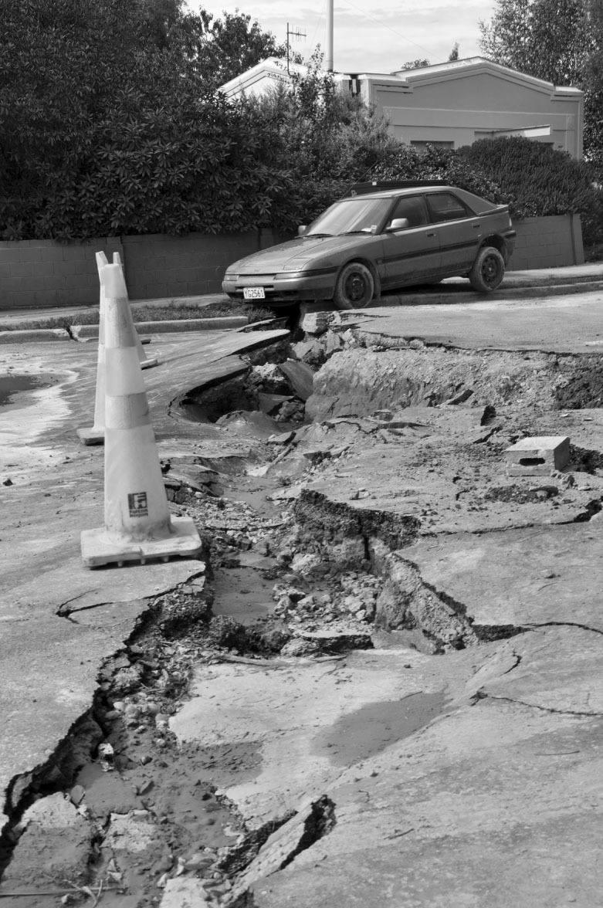

Slide 3
Case Study Photos
Chapter 1

Slide 4

Case Study 1

Slide 5

Case Study 2

Slide 6
Figures
Chapter 1

Slide 7
Figure 1.1

Slide 8
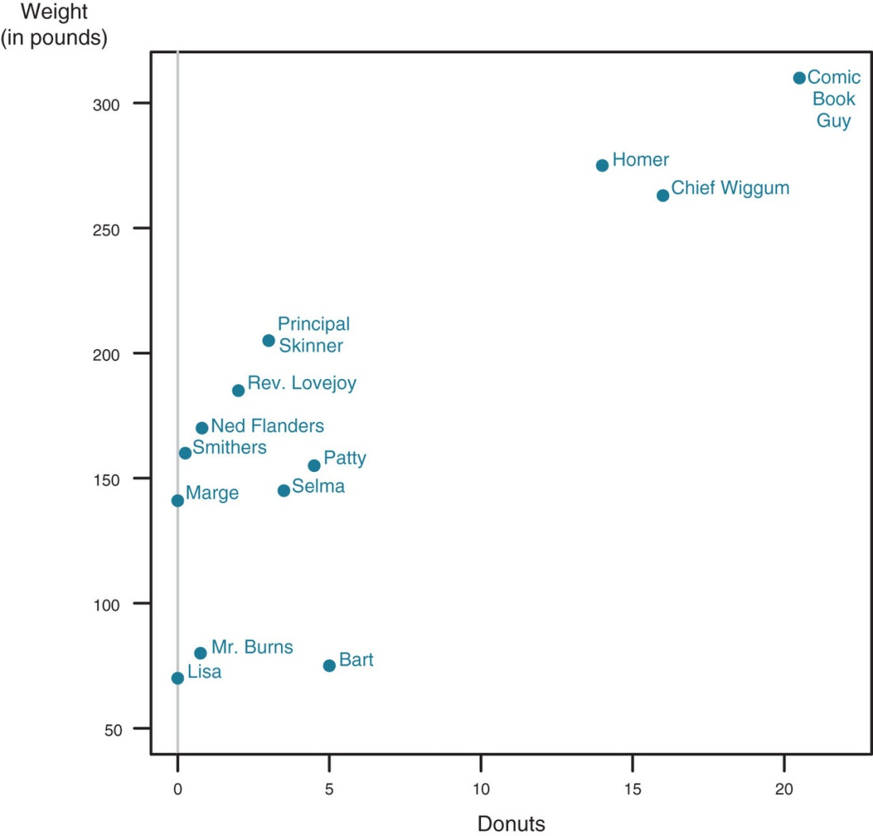
Figure 1.2

Slide 9
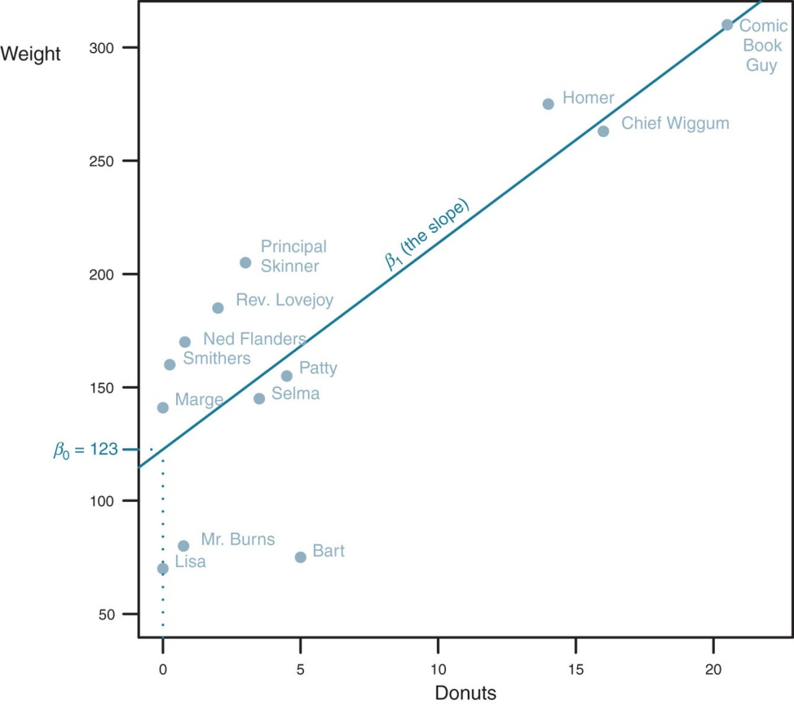
Figure 1.3

Slide 10
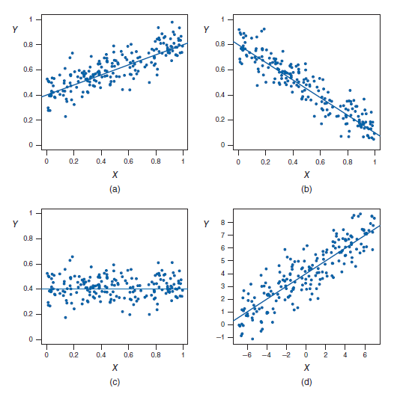
Figure 1.4

Slide 11
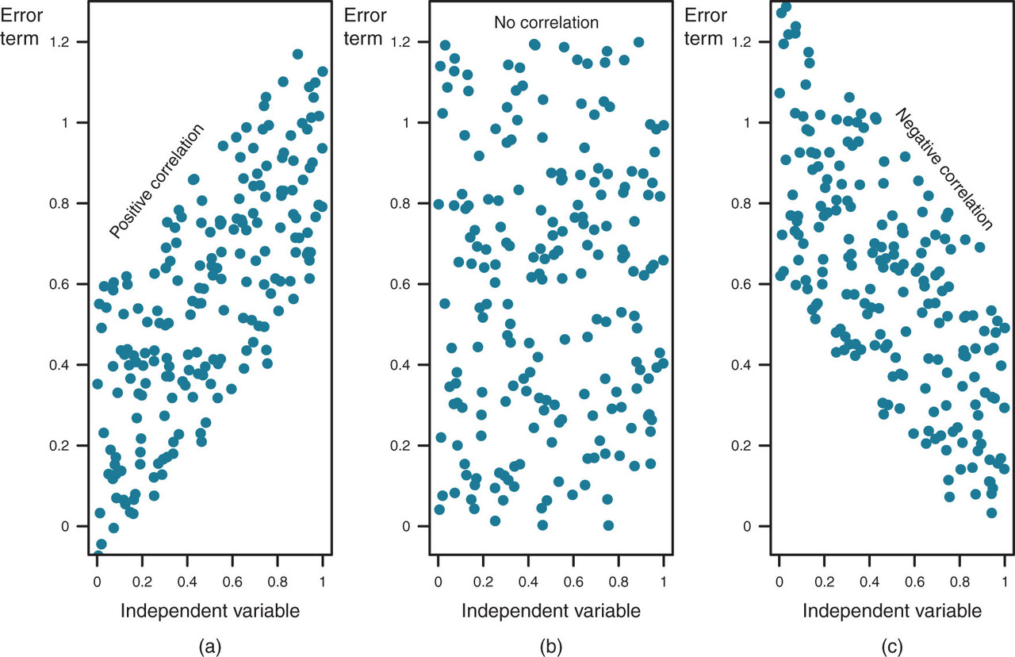
Figure 1.5

Slide 12
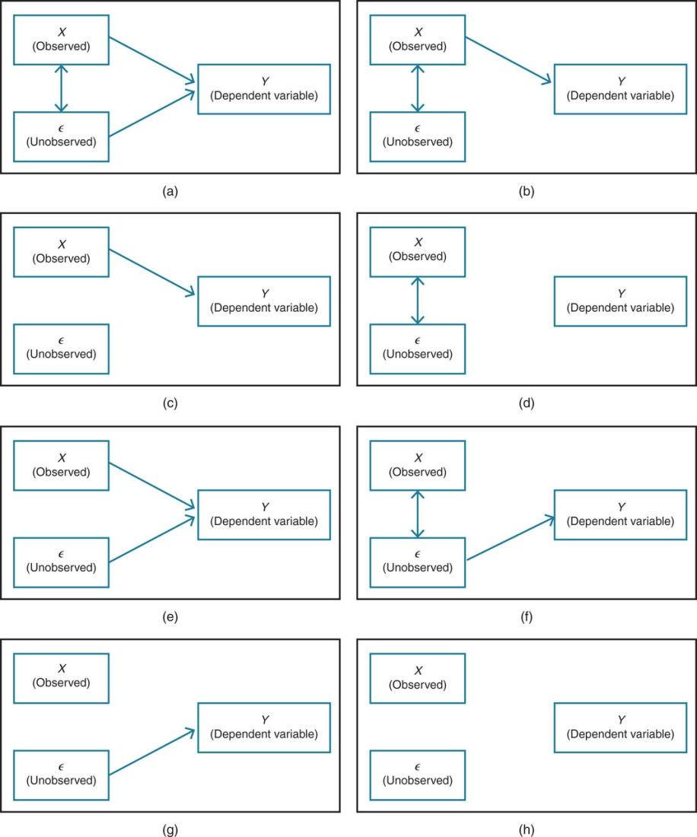
Figure 1.6

Slide 13
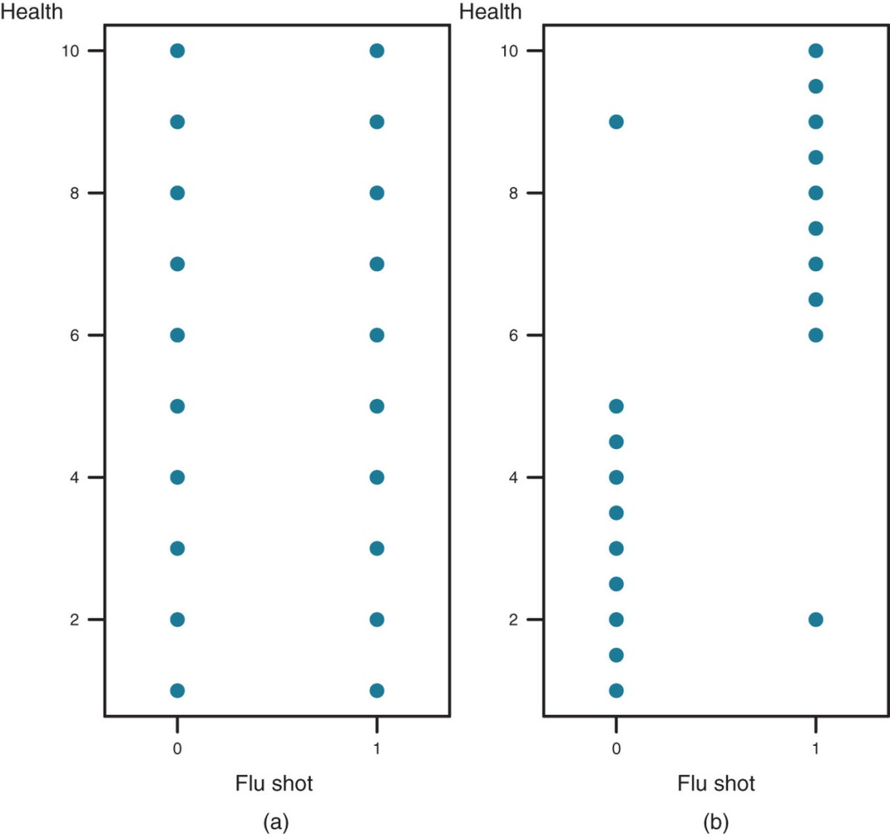
Figure 1.7

Slide 14
Tables
Chapter 1

Slide 15
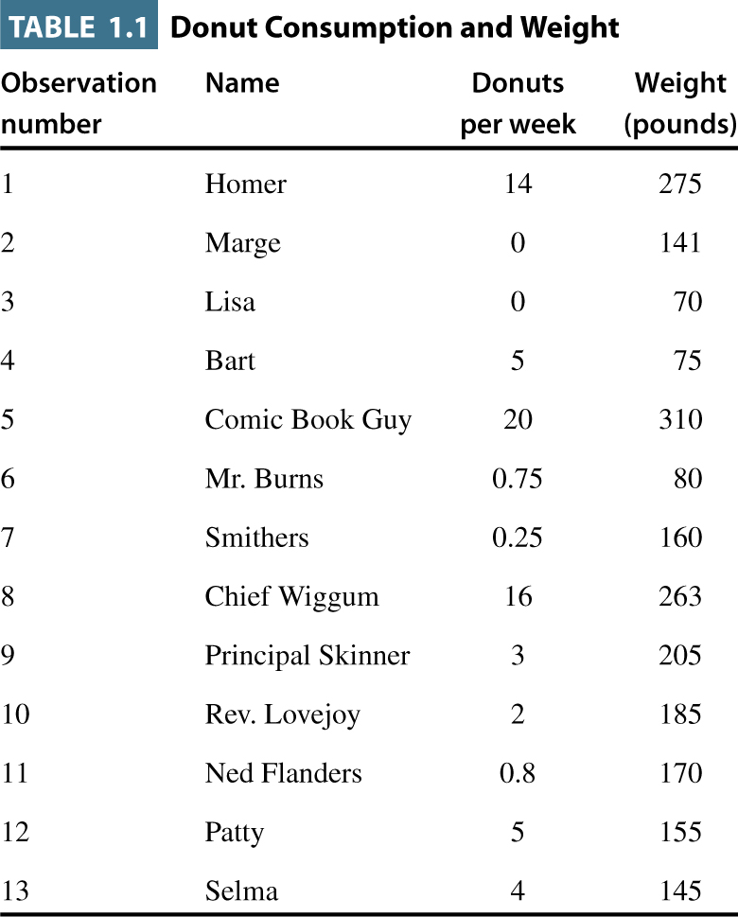
Table 1.1

