Slide 1
Vital Statistics Probability and Statistics for Economics and Business
William H. Sandholm
University of Wisconsin-Madison
Brett A. Saraniti
Northwestern University
Chapter 17
Inference from Small Samples

Slide 2
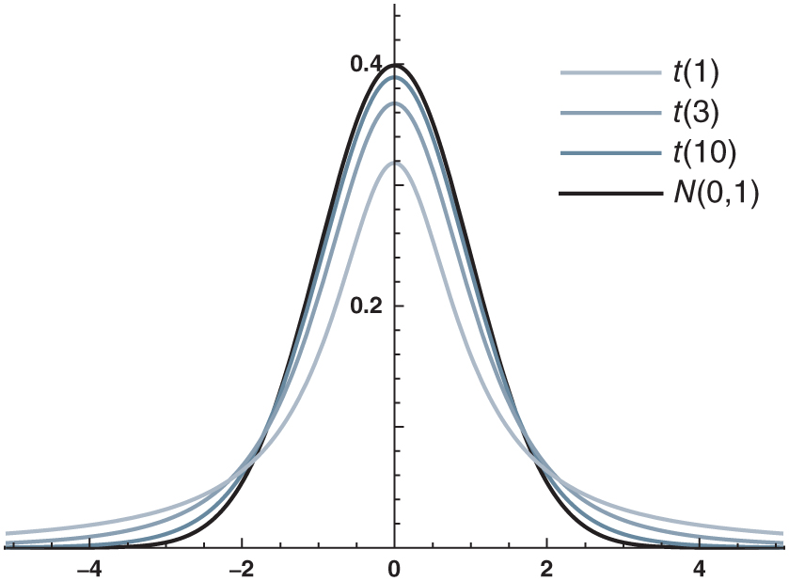
Figure 17.1: Some t(d) densities and the standard normal density.

Slide 3
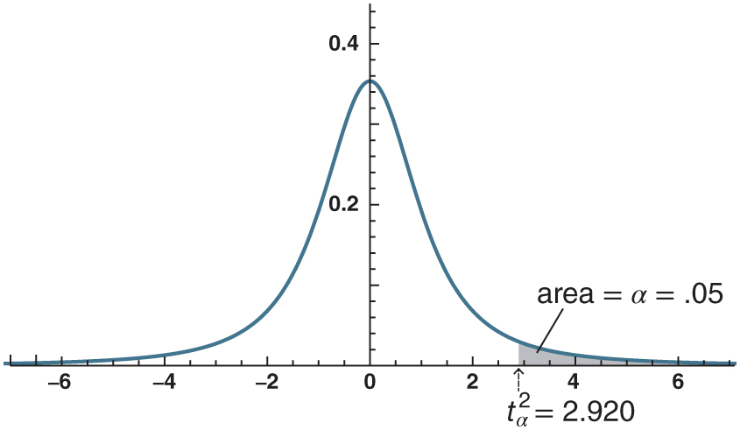
Figure 17.2: The definition of t-value.

Slide 4
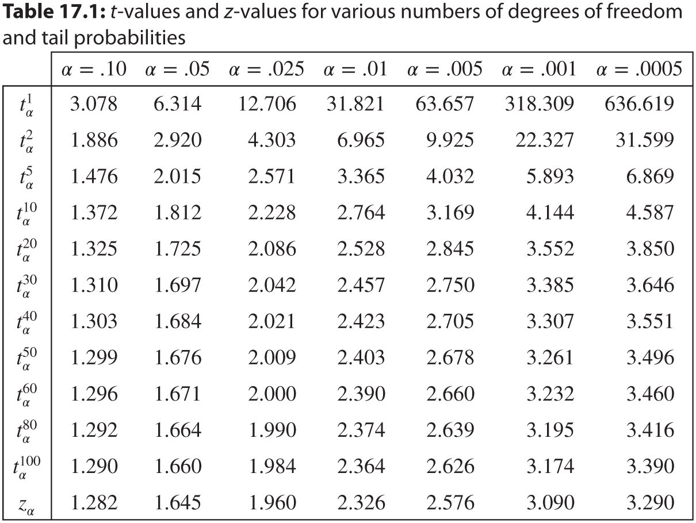
Table 17.1: t-values and z-values for various numbers of degrees of freedom and tail probabilities

Slide 5
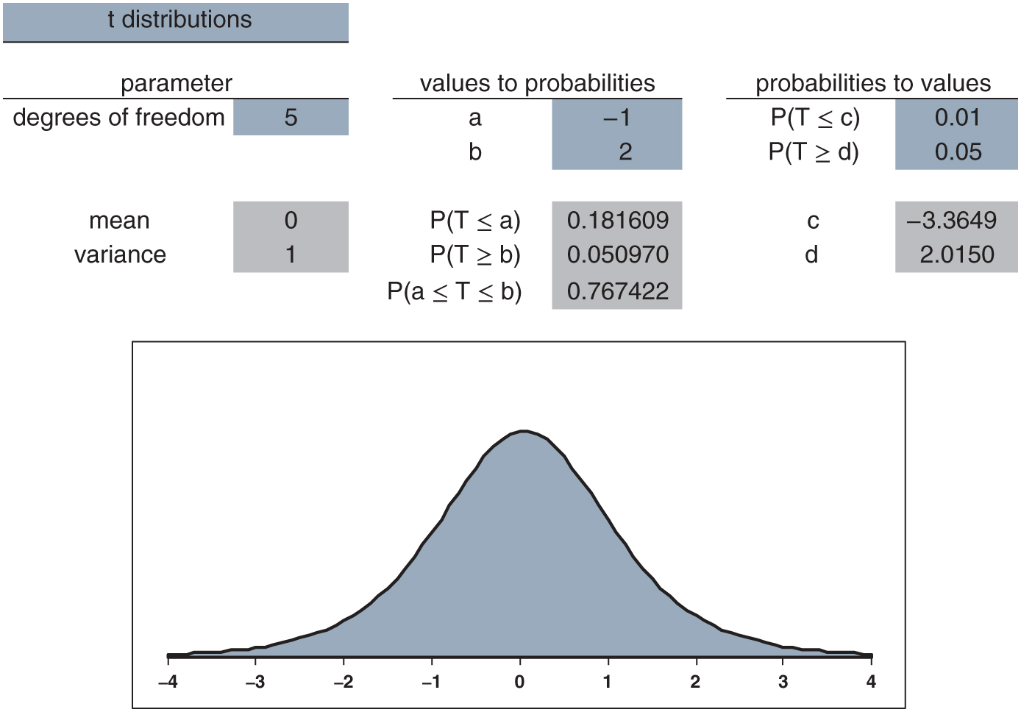
Figure 17.3: Using the distributions.xlsx workbook.

Slide 6
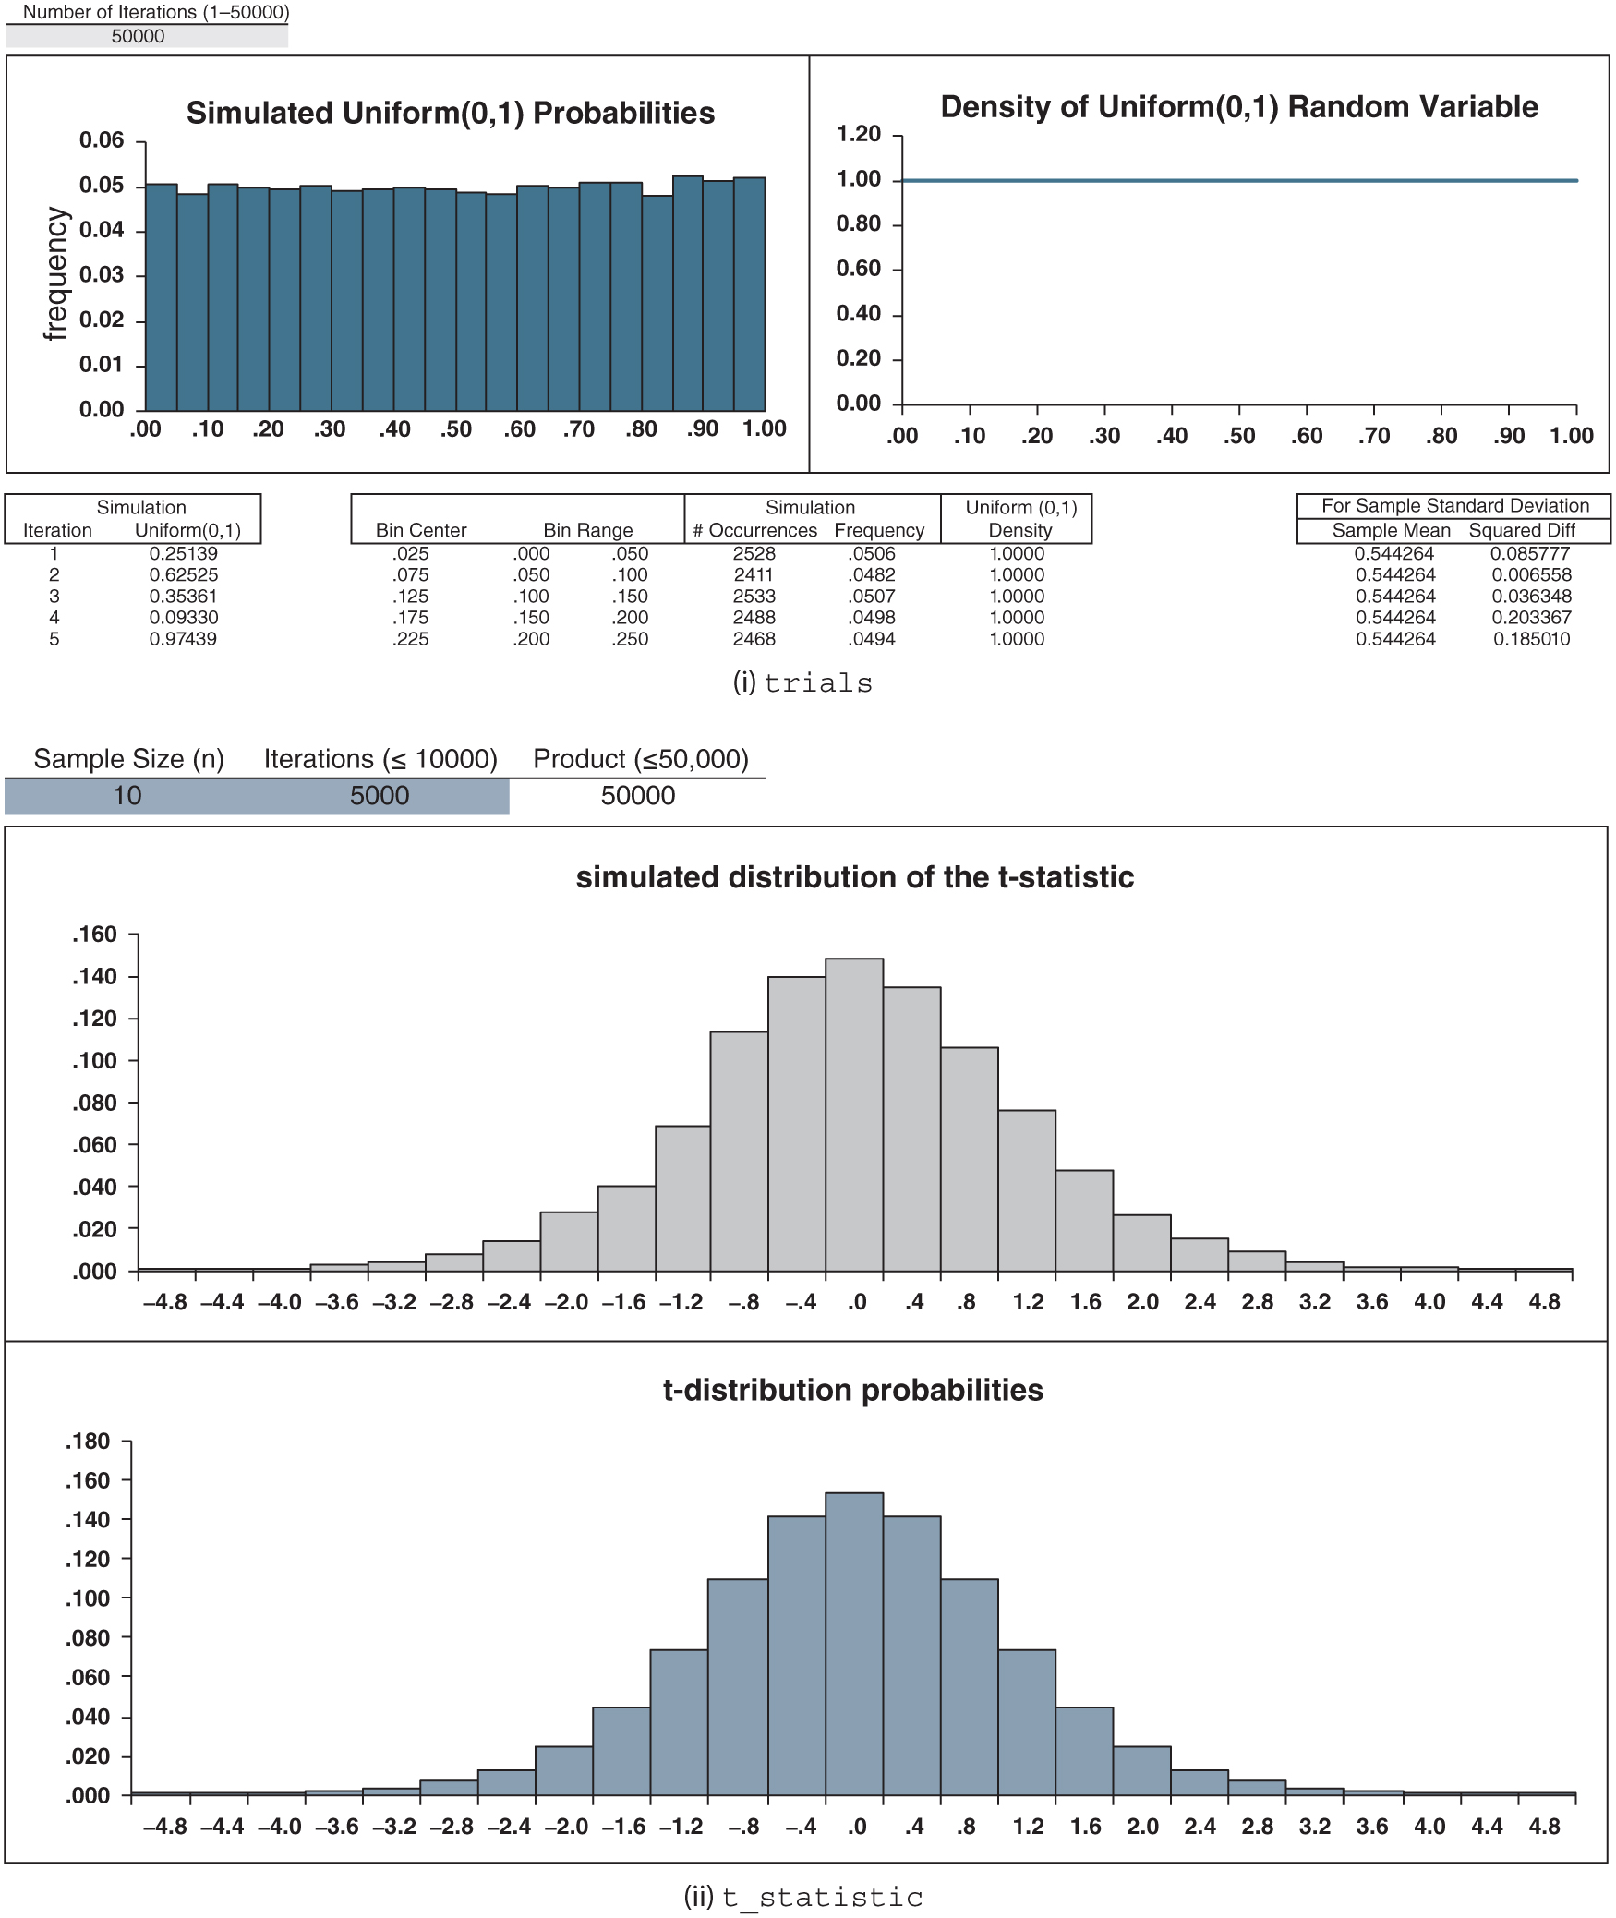
Figure 17.4: t_statistic_uniform.xlsx

Slide 7
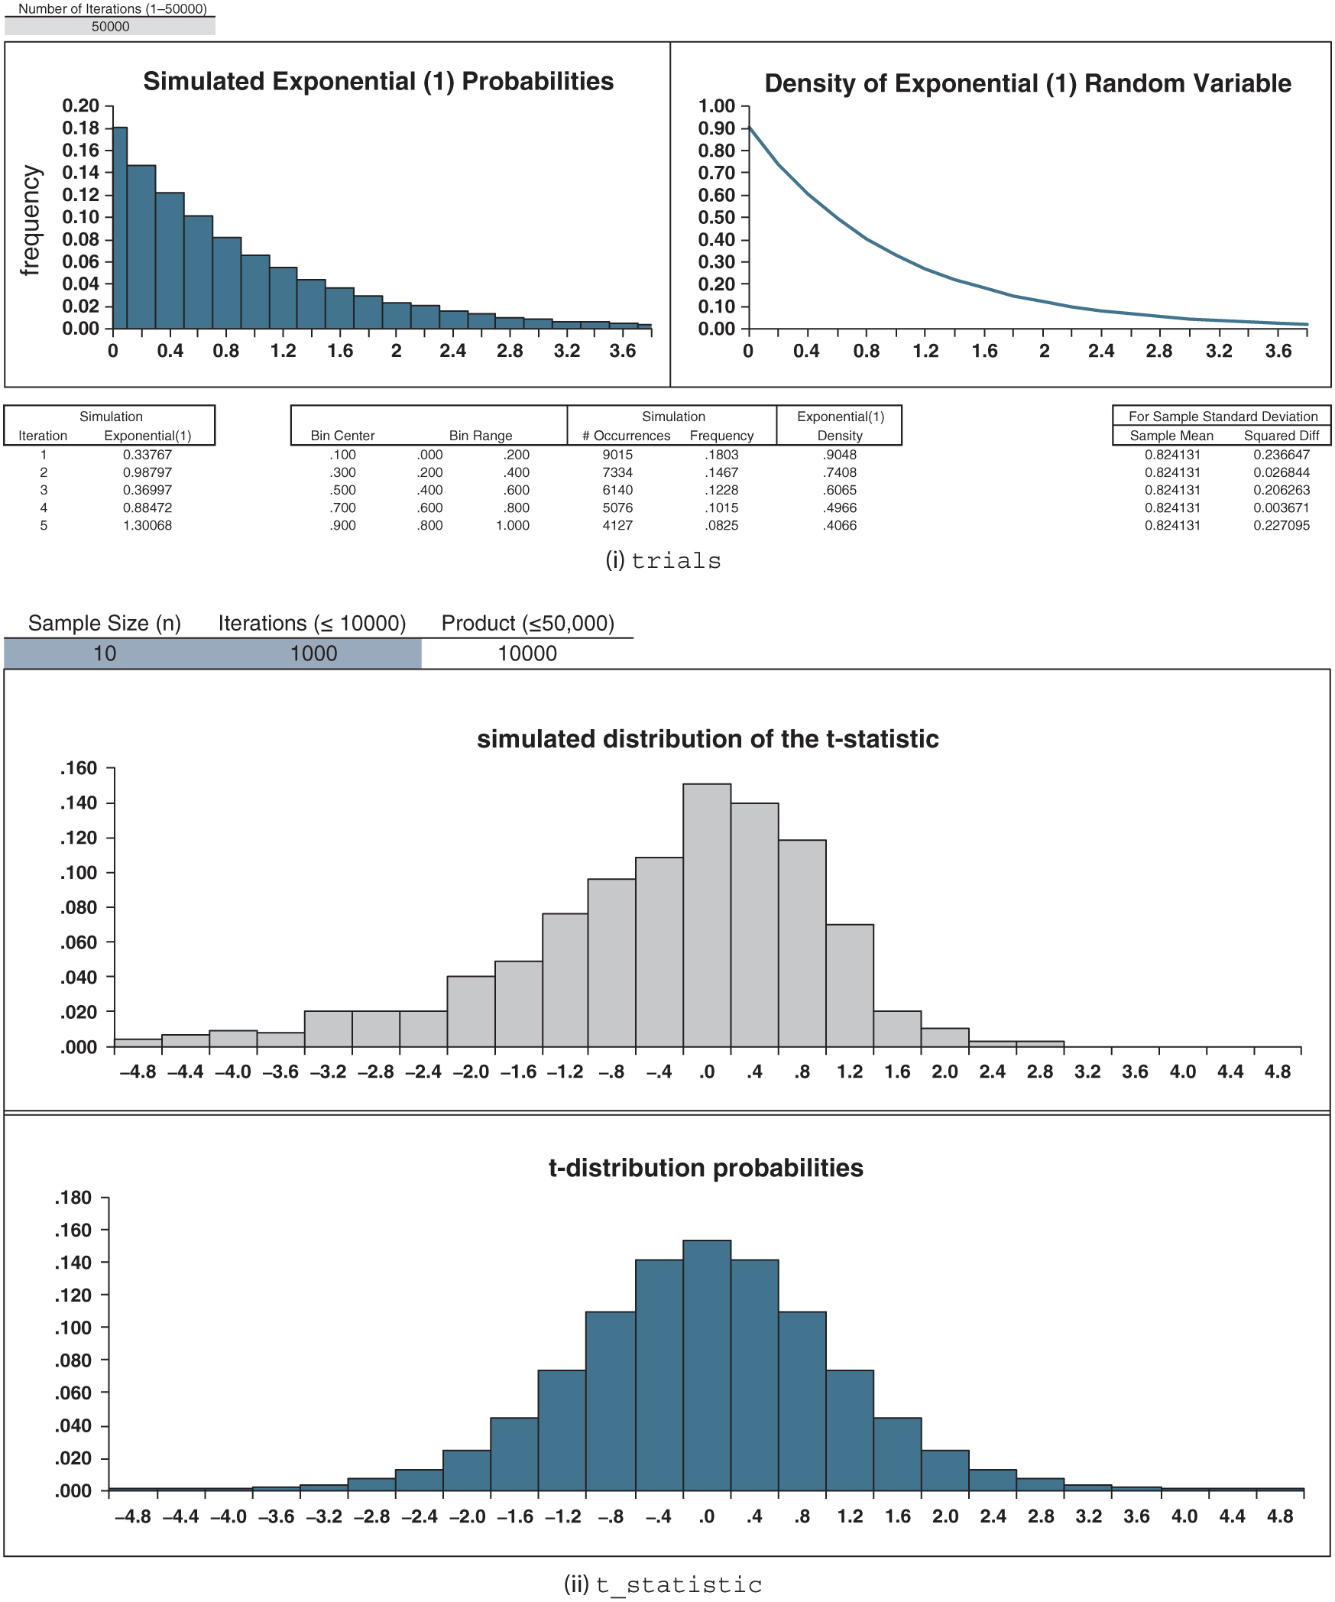
Figure 17.5: t_statistic_exponential.xlsx

Slide 8
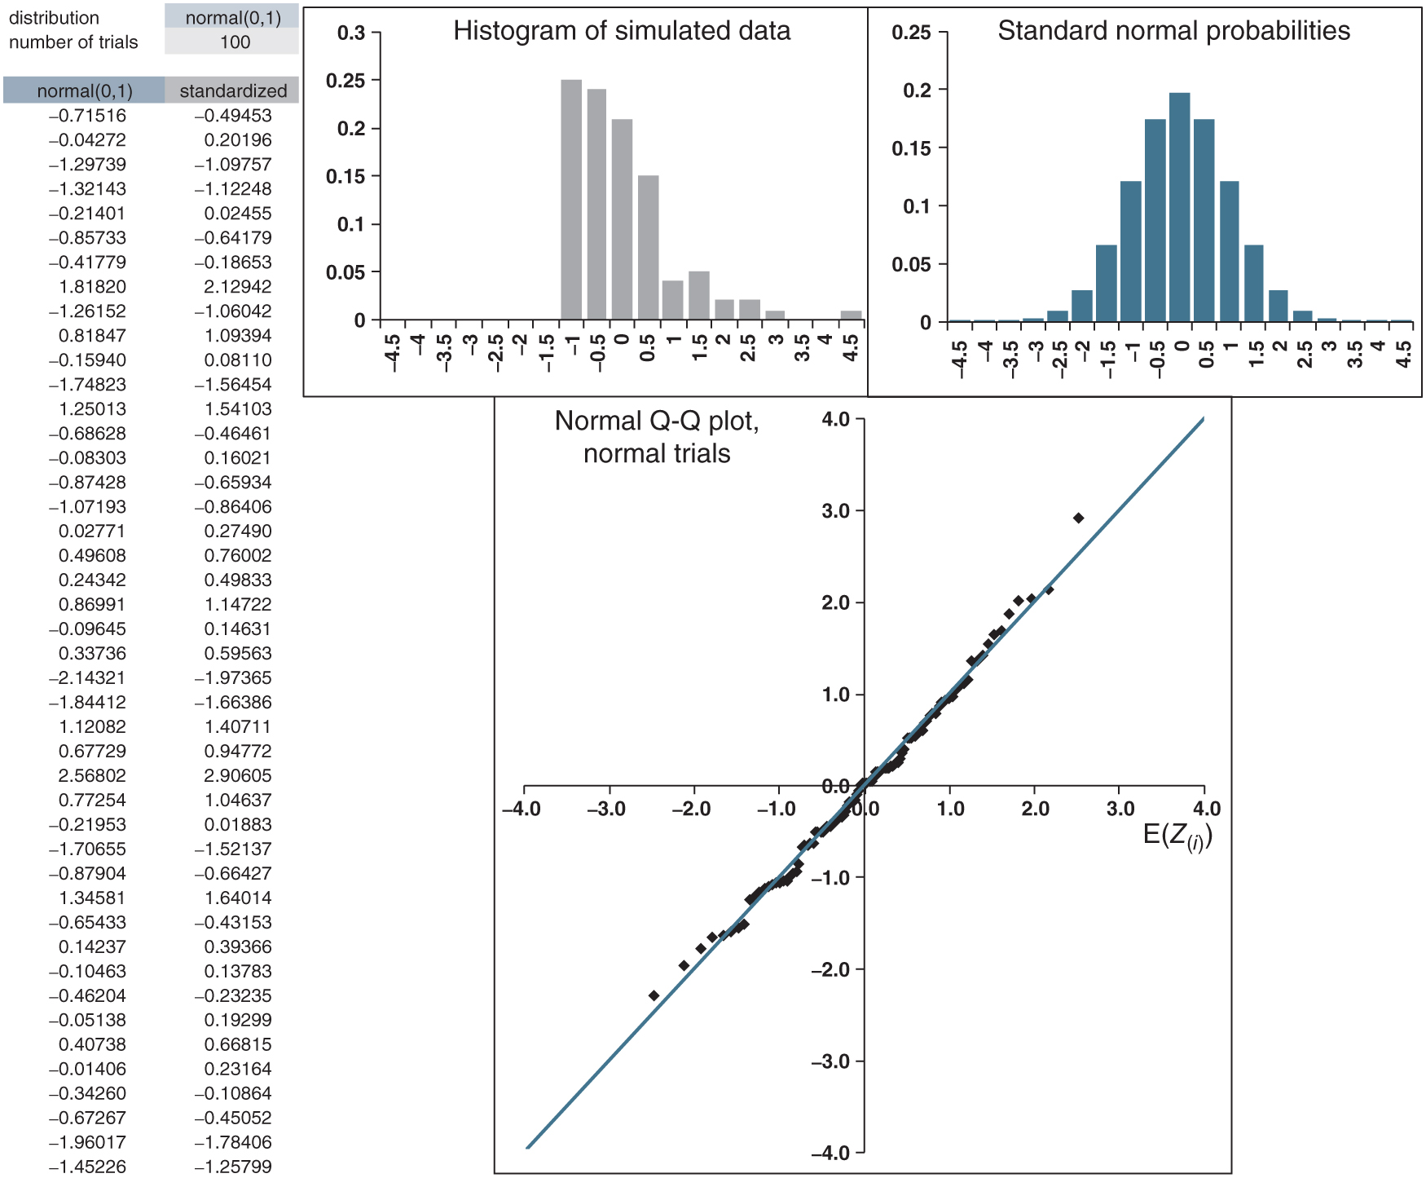
Figure 17.6: normal_QQ_plots.xlsx/normal

Slide 9
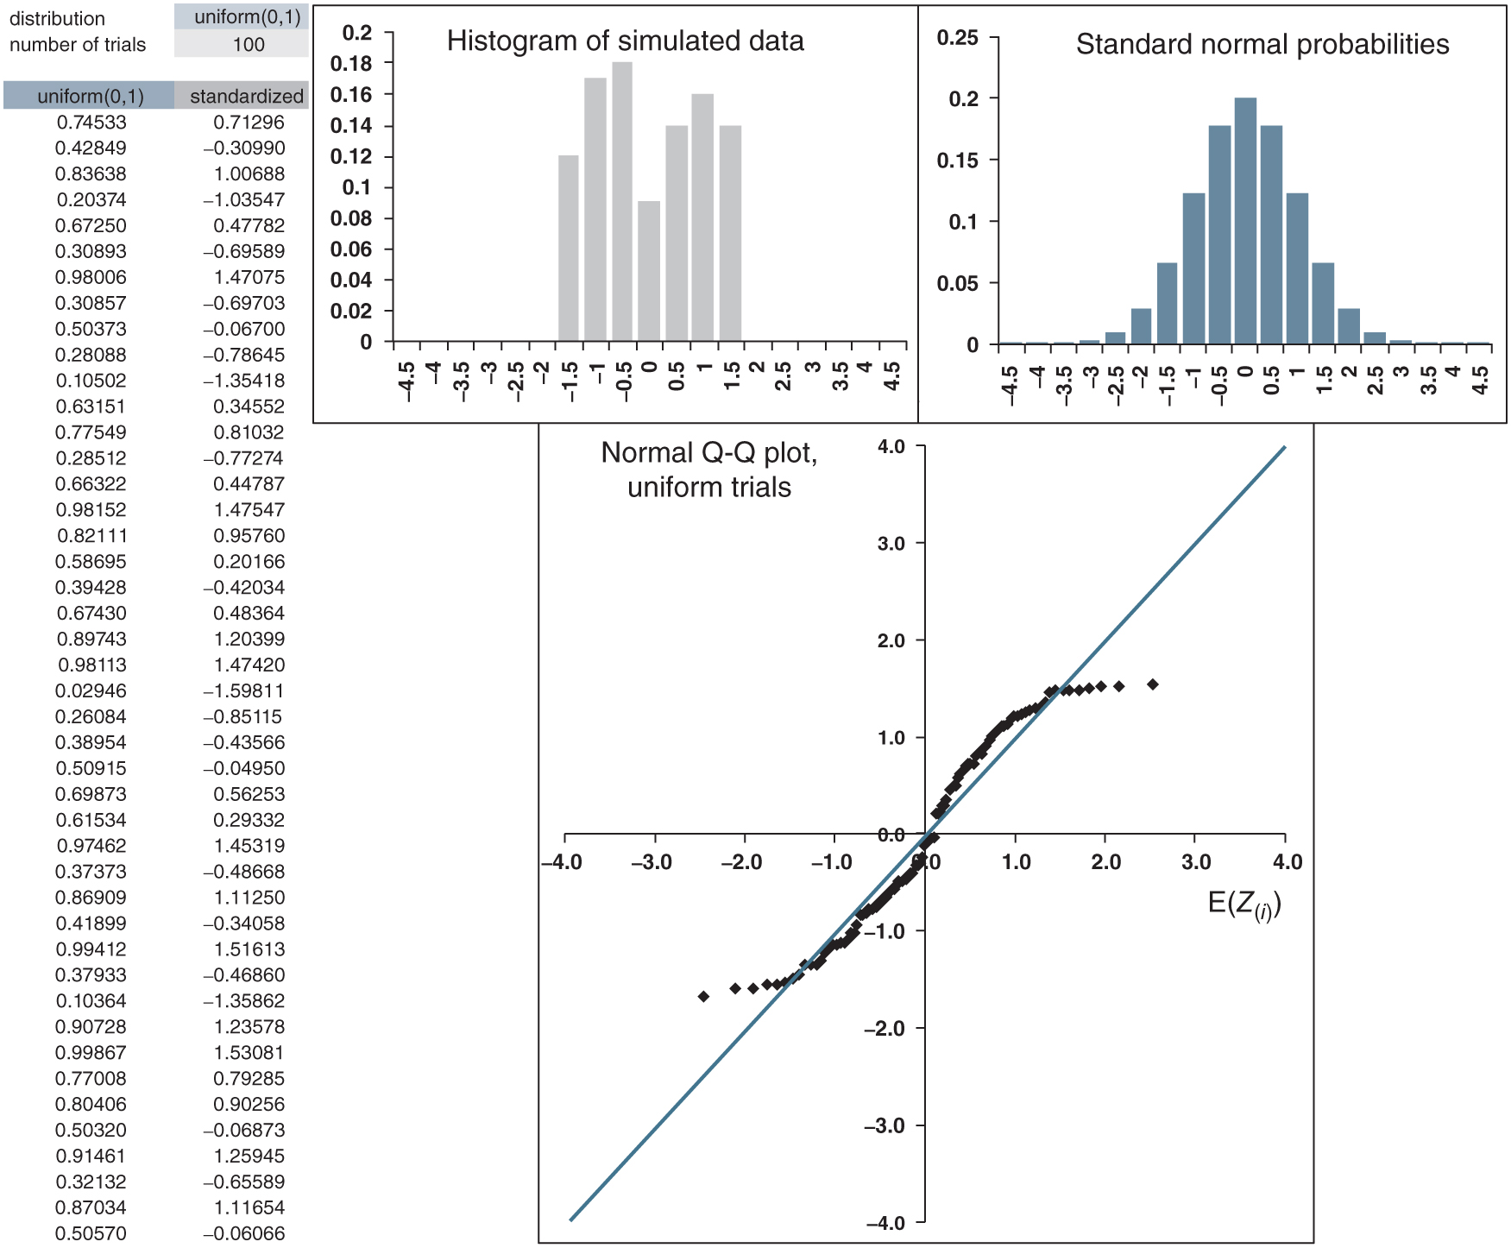
Figure 17.7: normal_QQ_plots.xlsx/uniform

Slide 10
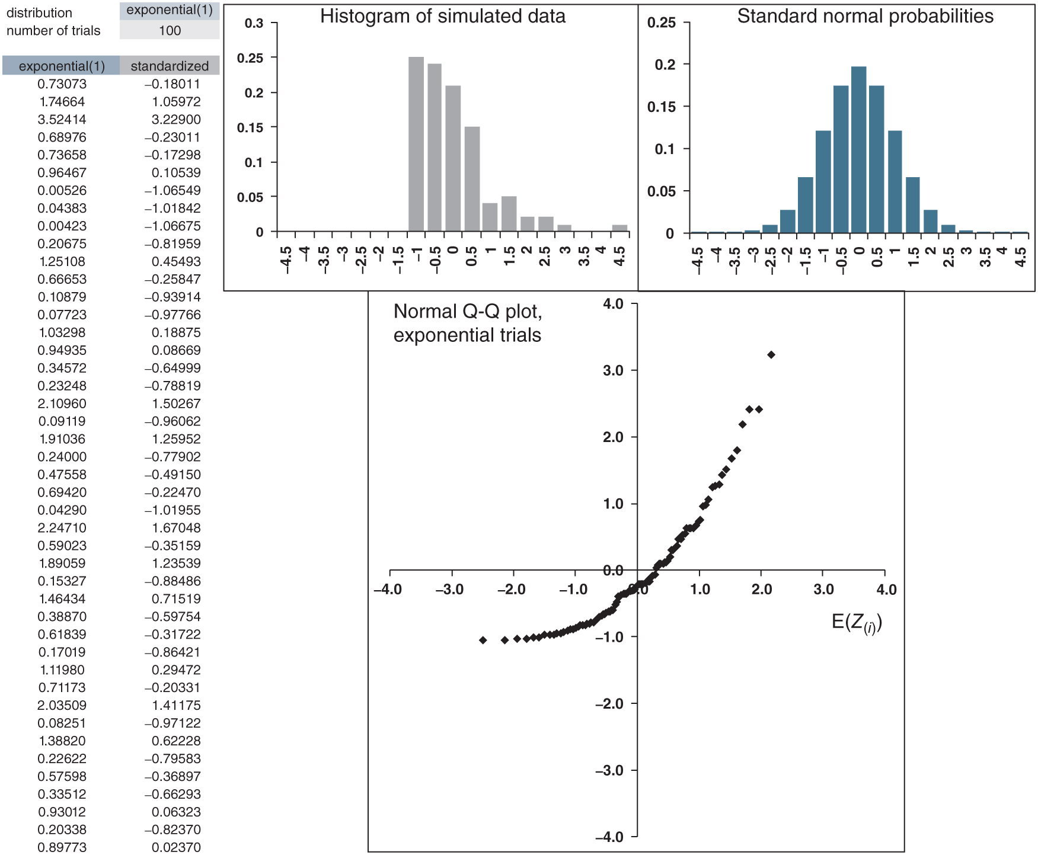
Figure 17.8: normal_QQ_plots.xlsx/exponential

