Slide 1
Vital Statistics Probability and Statistics for Economics and Business
William H. Sandholm
University of Wisconsin-Madison
Brett A. Saraniti
Northwestern University
Chapter 12
Descriptive Statistics

Slide 2
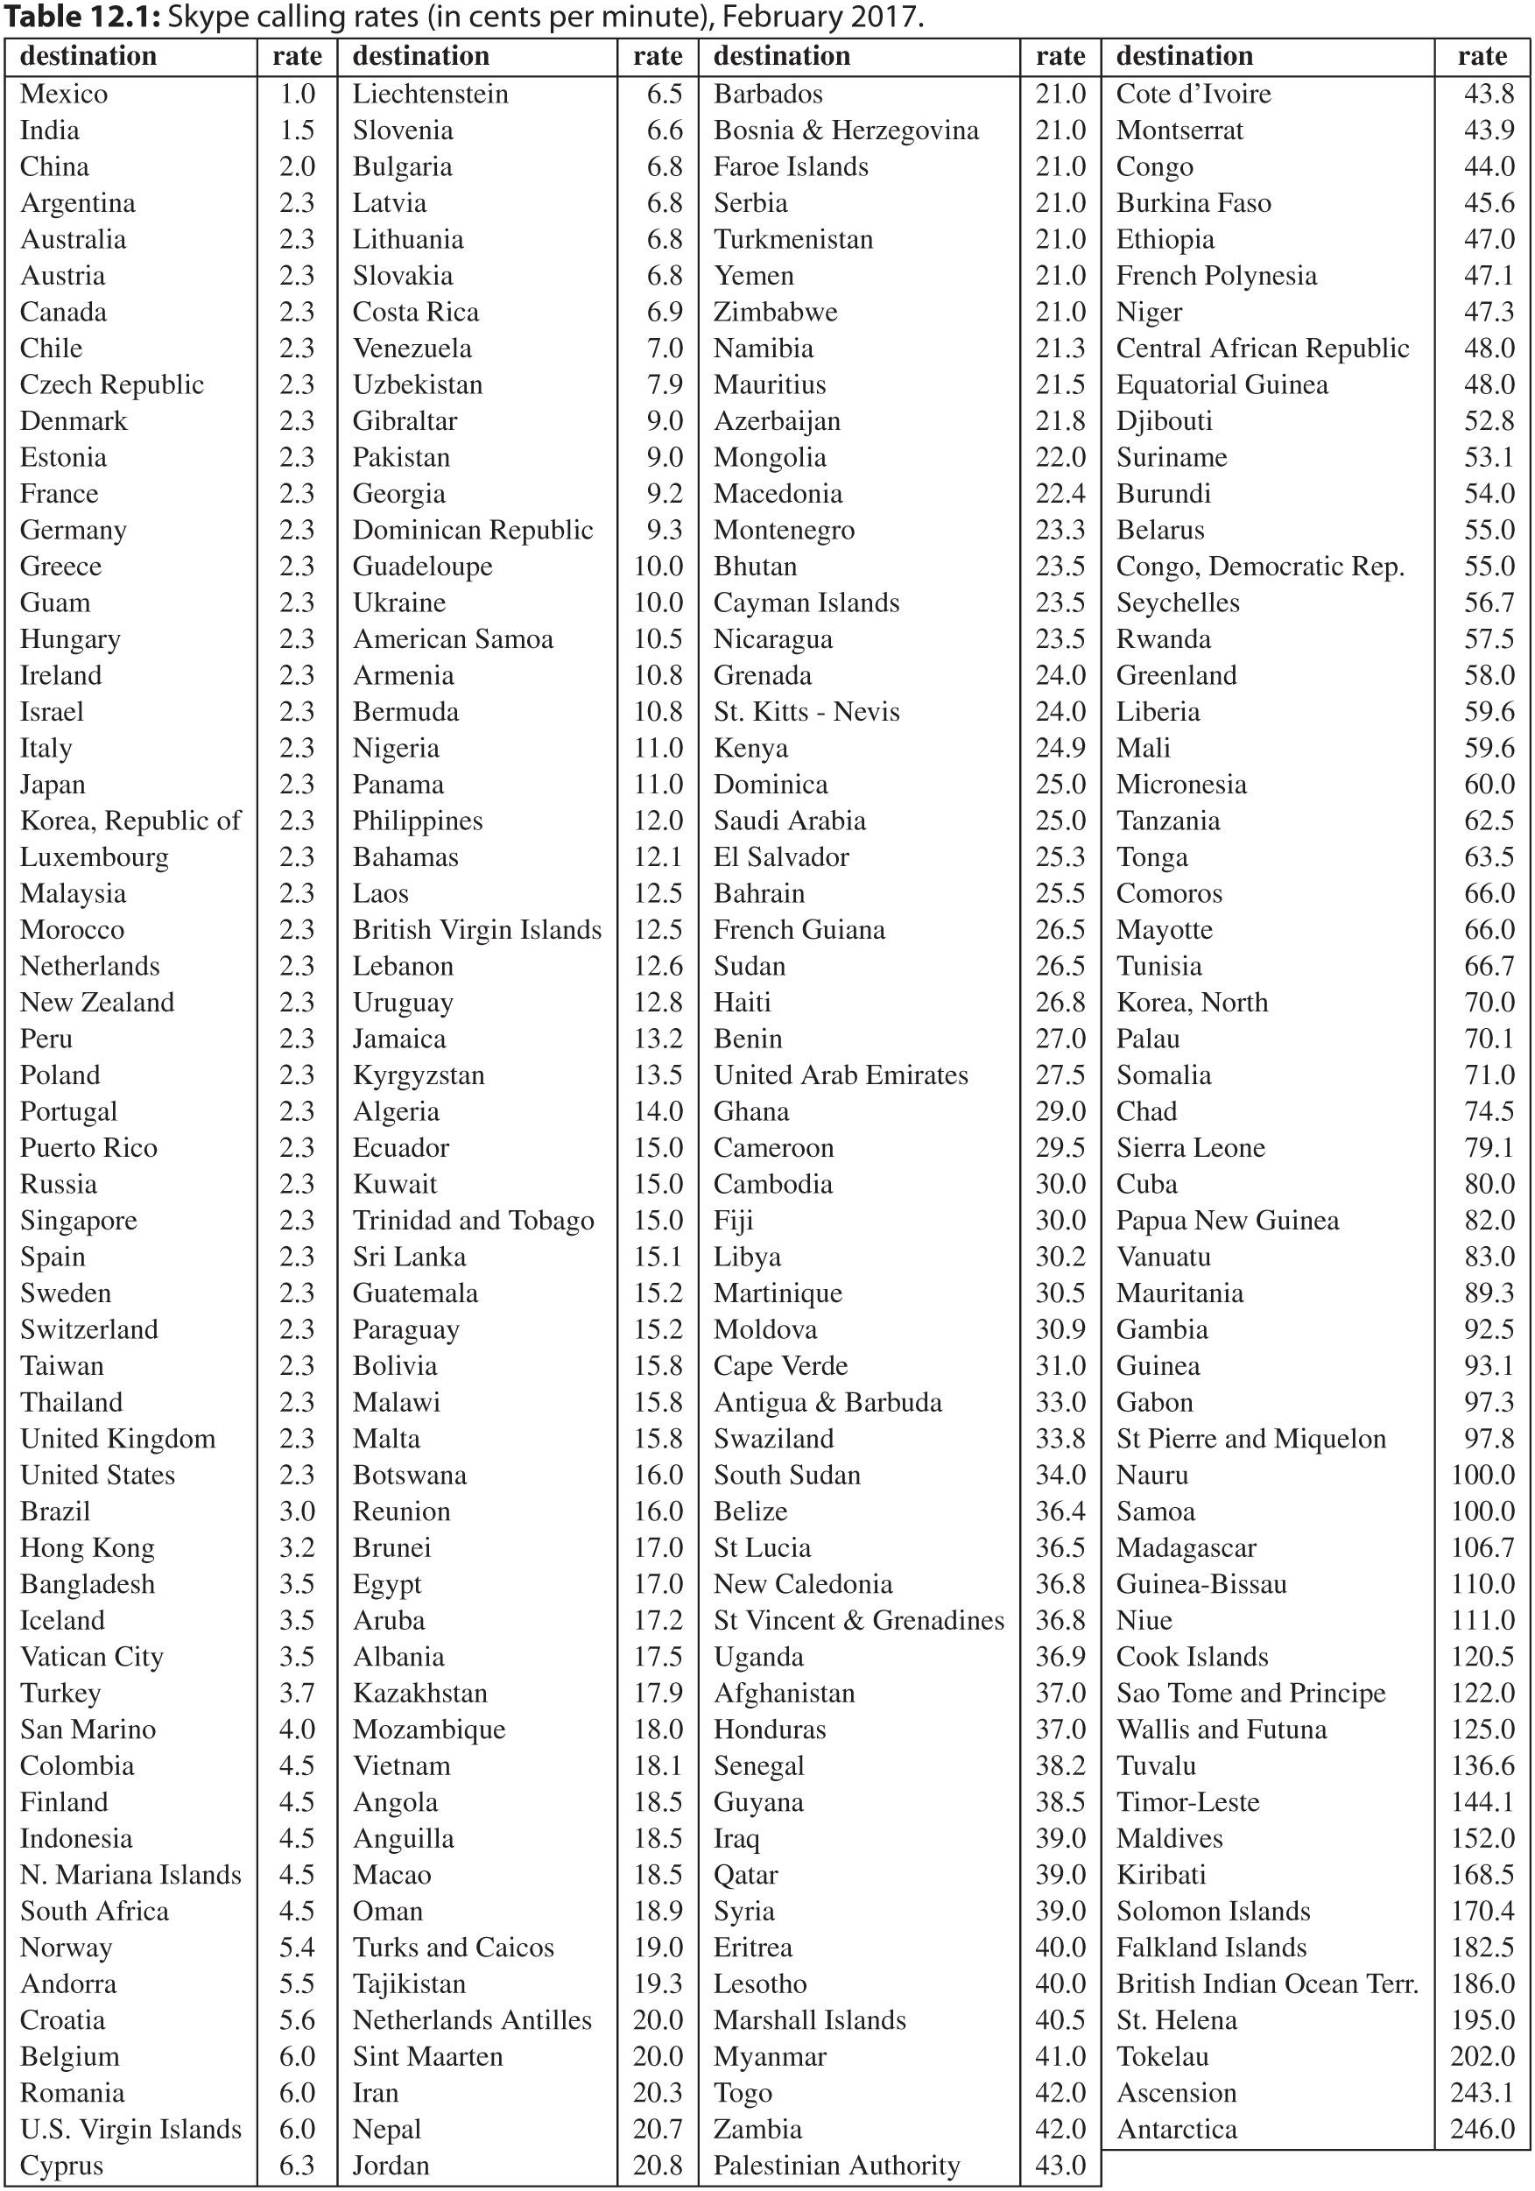
Table 12.1: Skype calling rates (in cents per minute), February 2017.

Slide 3
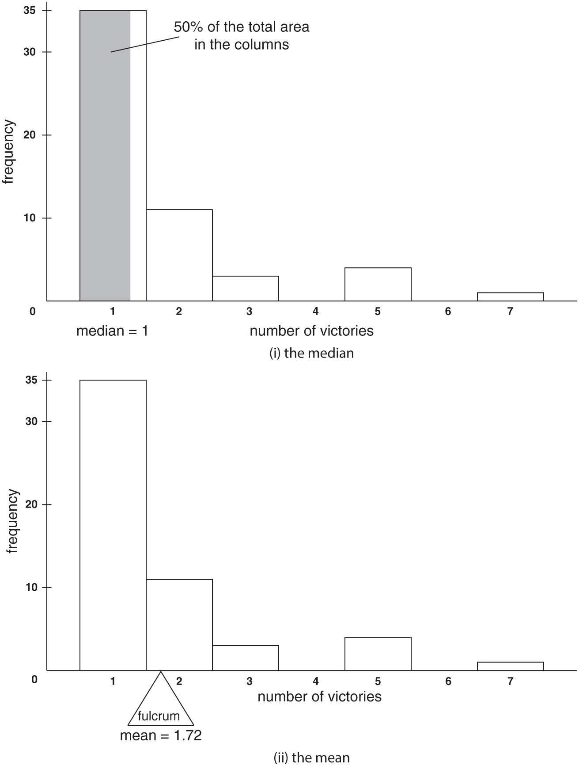
Figure 12.1: The median and mean in pictures.

Slide 4
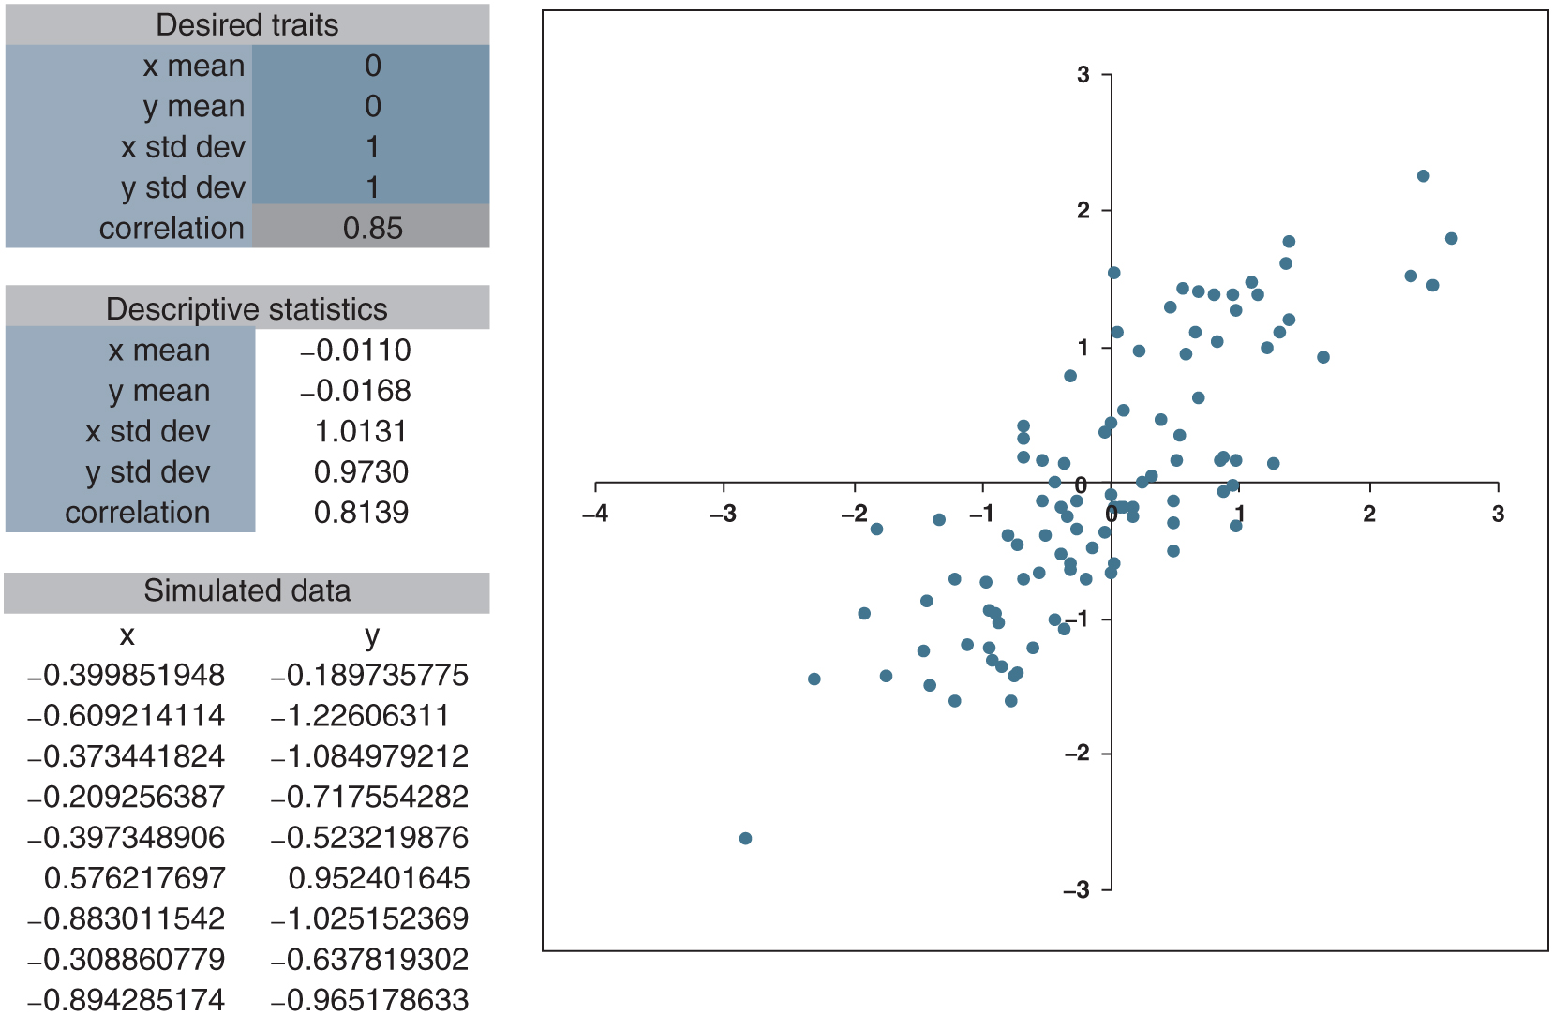
Figure 12.2: correlations.xlsx

Slide 5
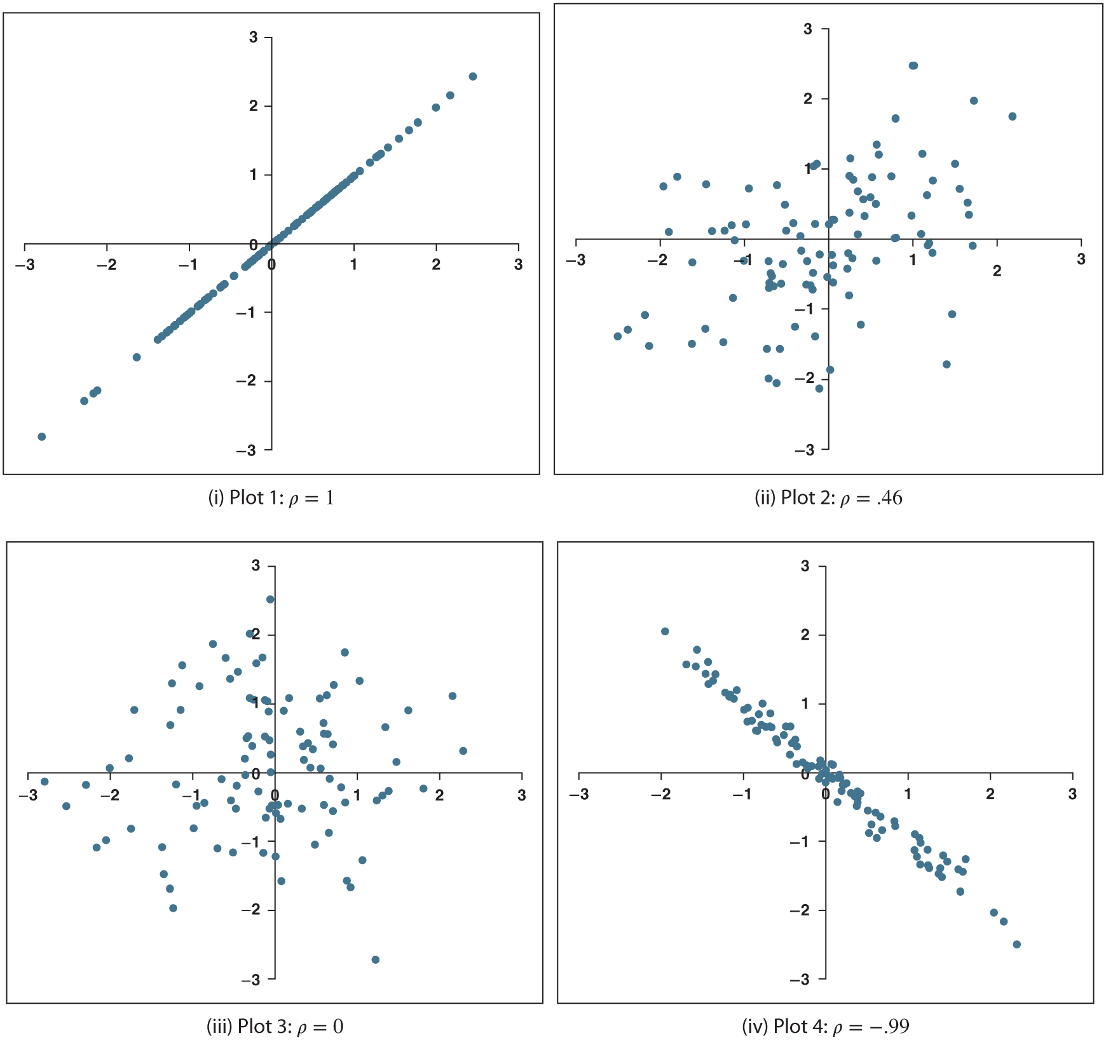
Figure 12.3: Examples of different levels of correlation.

Slide 6
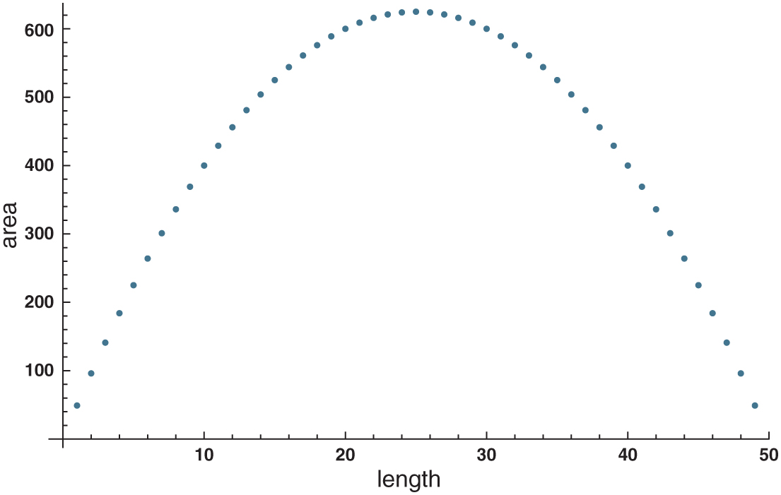
Figure 12.4: Zero correlation does not mean no relationship.

Slide 7
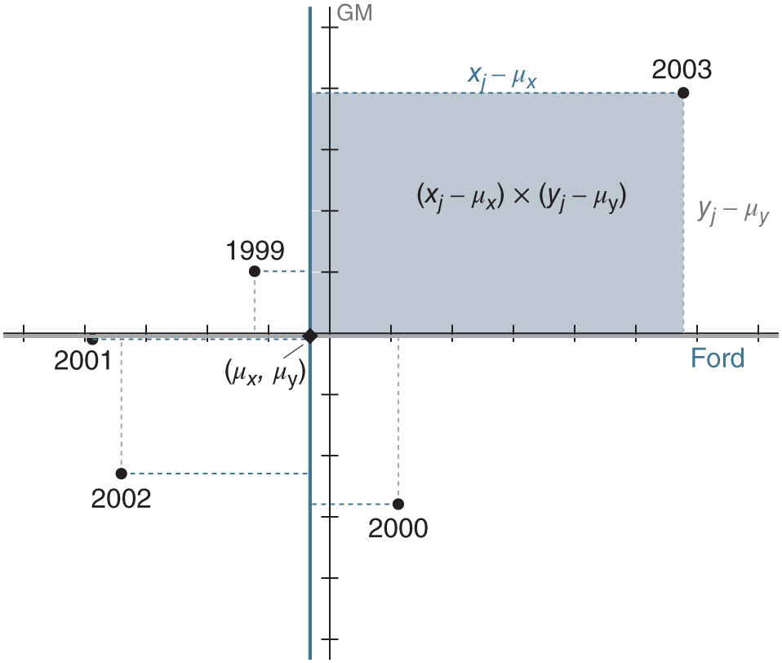
Figure 12.5: Computing covariances and correlations with pictures.

Slide 8
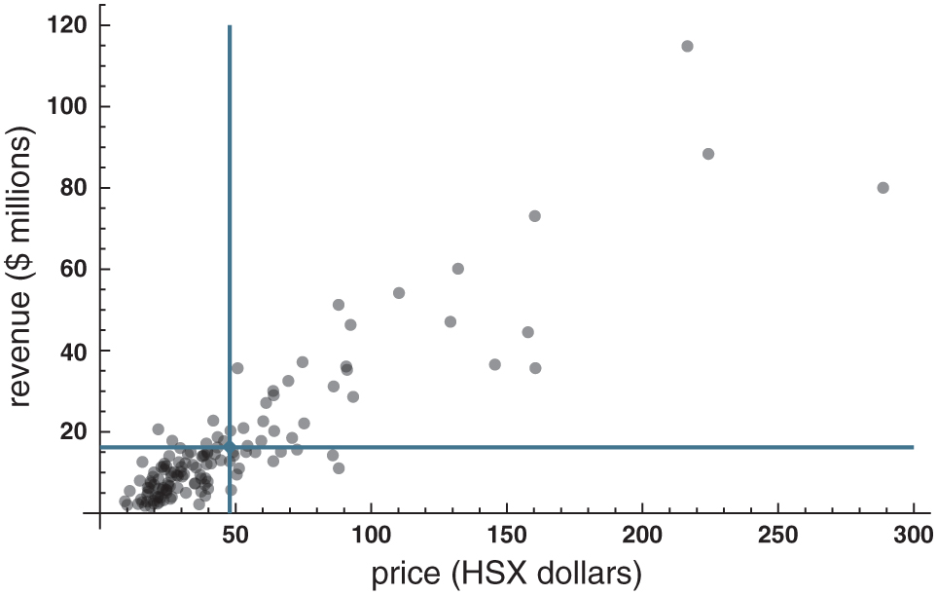
Figure 12.6: HSX: Scatterplot with lines at the means

