Slide 1
Vital Statistics Probability and Statistics for Economics and Business
William H. Sandholm
University of Wisconsin-Madison
Brett A. Saraniti
Northwestern University
Chapter 11
Data Graphics

Slide 2
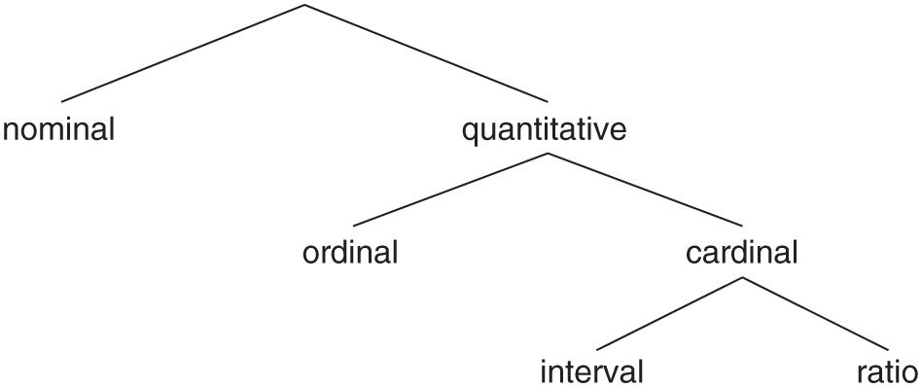
Figure 11.1: Types of variables.

Slide 3
Figure 11.2: Bar chart: The Big Mac Index.

Slide 4
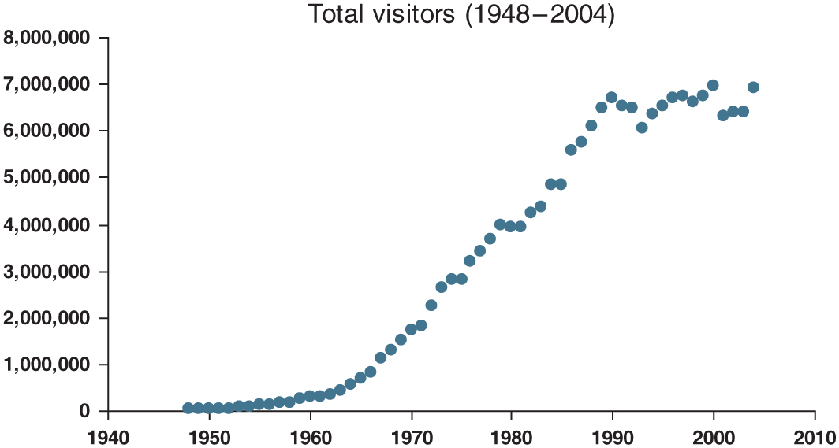
Figure 11.3: Dot plot: Time series data on Hawaiian tourist visits.

Slide 5
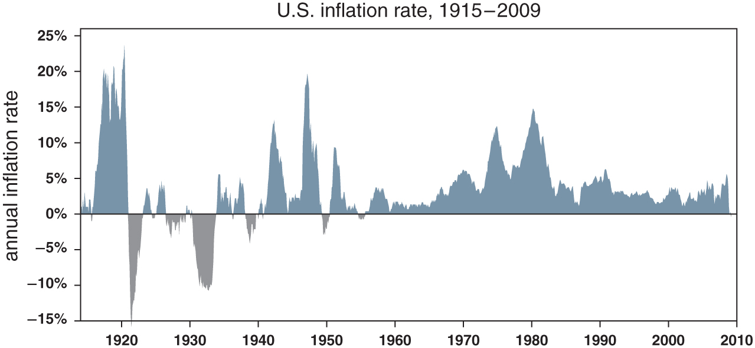
Figure 11.4: Line chart with shading: time series data on U.S. inflation.

Slide 6
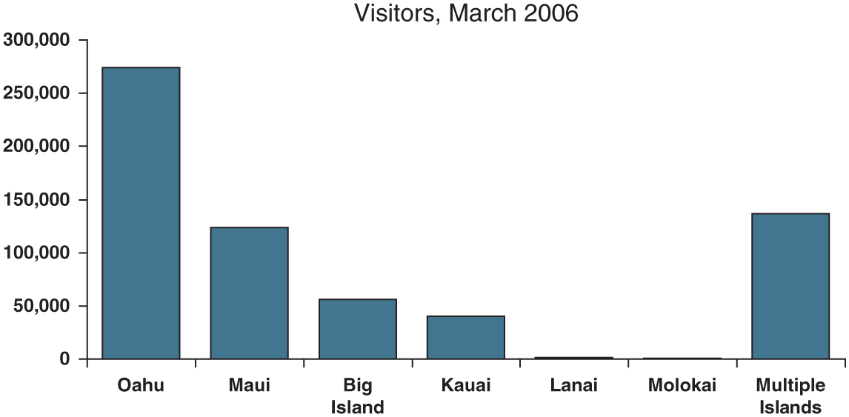
Figure 11.5: Bar chart: Frequencies of visits to Hawaiian islands.

Slide 7
Figure 11.6: Bar charts: Numbers of Tour de France victories.

Slide 8
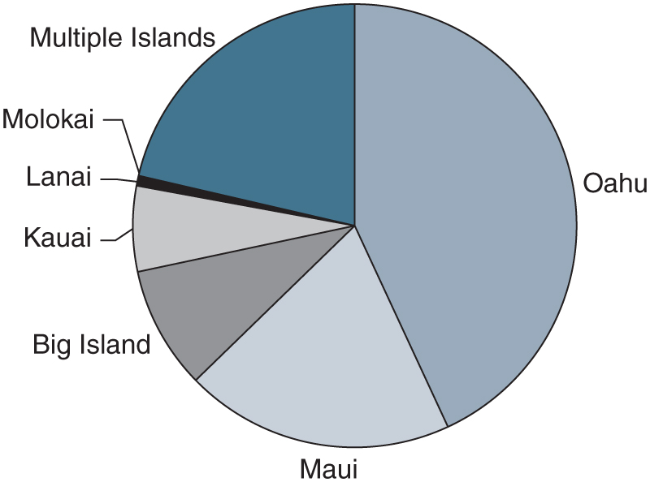
Figure 11.7: Pie chart: Relative frequencies of visits to Hawaiian islands, 2006.

Slide 9
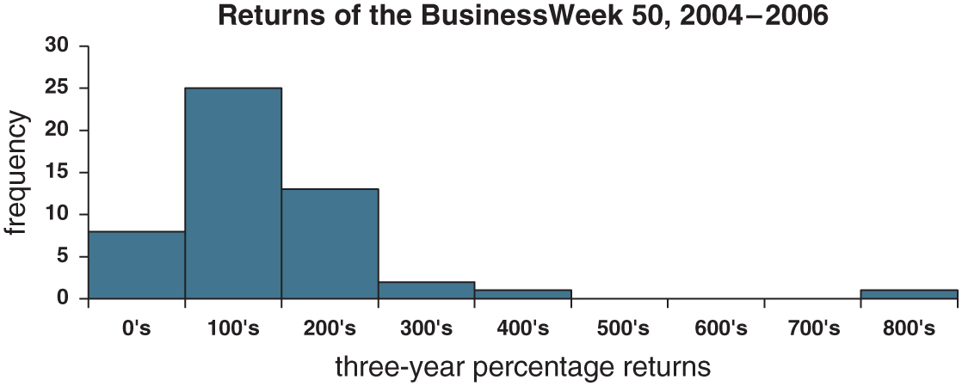
Figure 11.8: Histogram: Returns of the BusinessWeek 50.

Slide 10
Figure 11.9: Patterns in histogram data.

Slide 11
Figure 11.10: Histograms: Poor choices of numbers of bins.

Slide 12
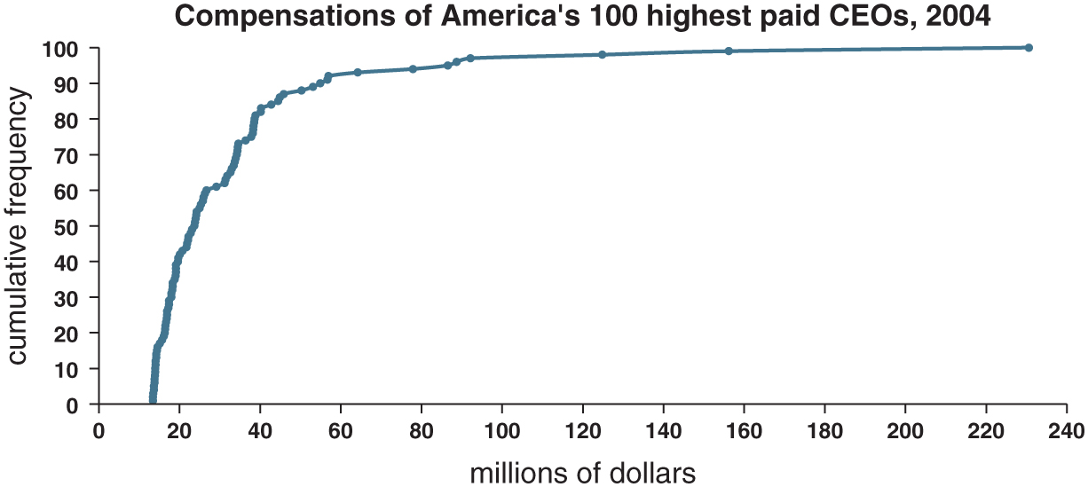
Figure 11.11: Ogive: CEO compensation.

Slide 13
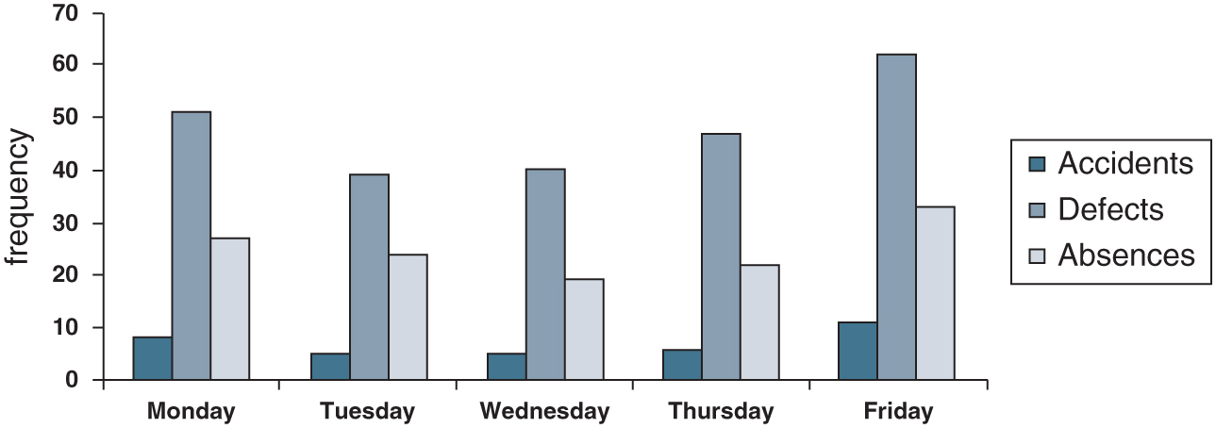
Figure 11.12: Bar chart: Factory incidents.

Slide 14
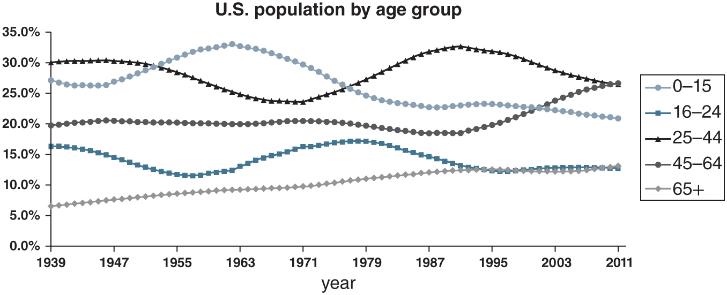
Figure 11.13: Dot plot: U.S. population by age group.

Slide 15
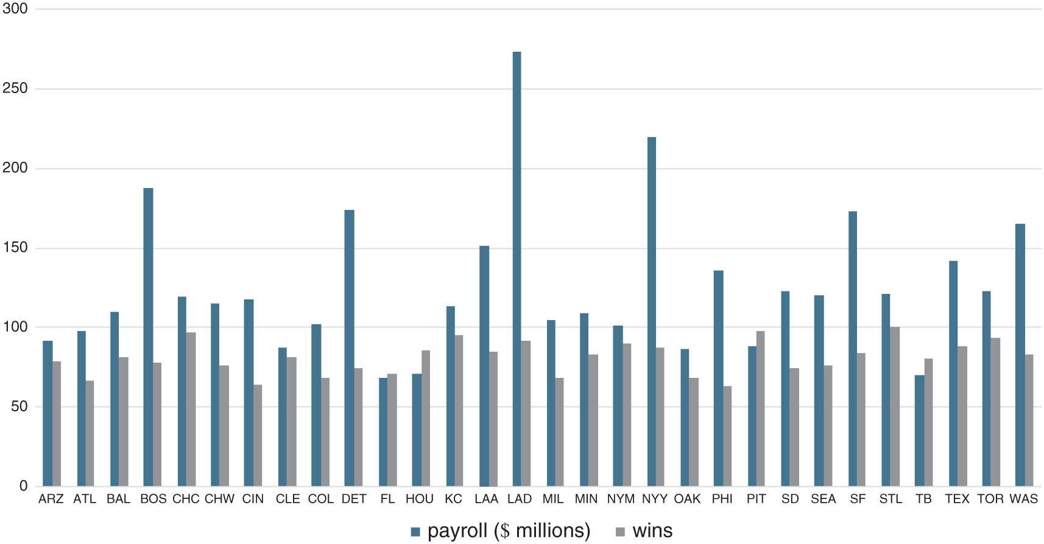
Figure 11.14: Bar chart: MLB payrolls and wins, 2015.

Slide 16
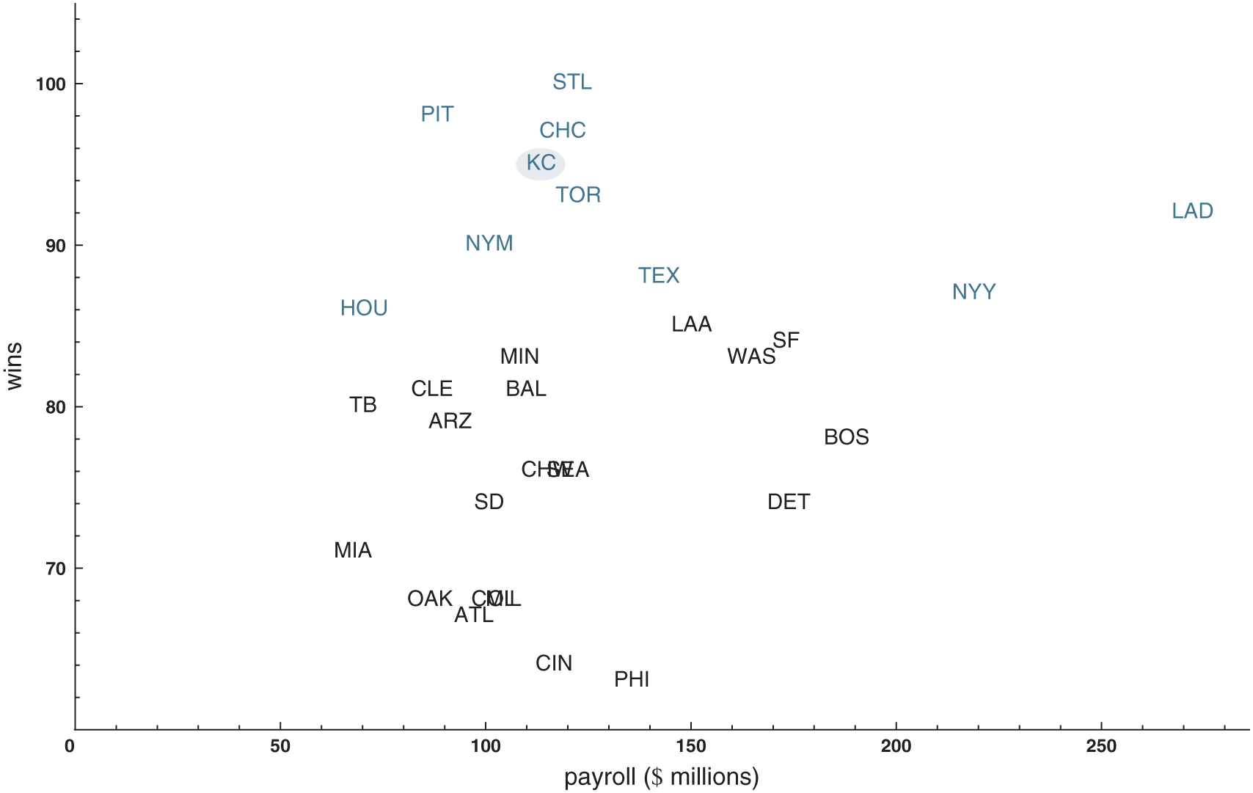
Figure 11.15: Scatterplot: MLB payrolls and wins, 2015. Abbreviated team locations are used as plot points. Playoff teams plotted in blue type; World Series champion plotted on a blue oval.

Slide 17
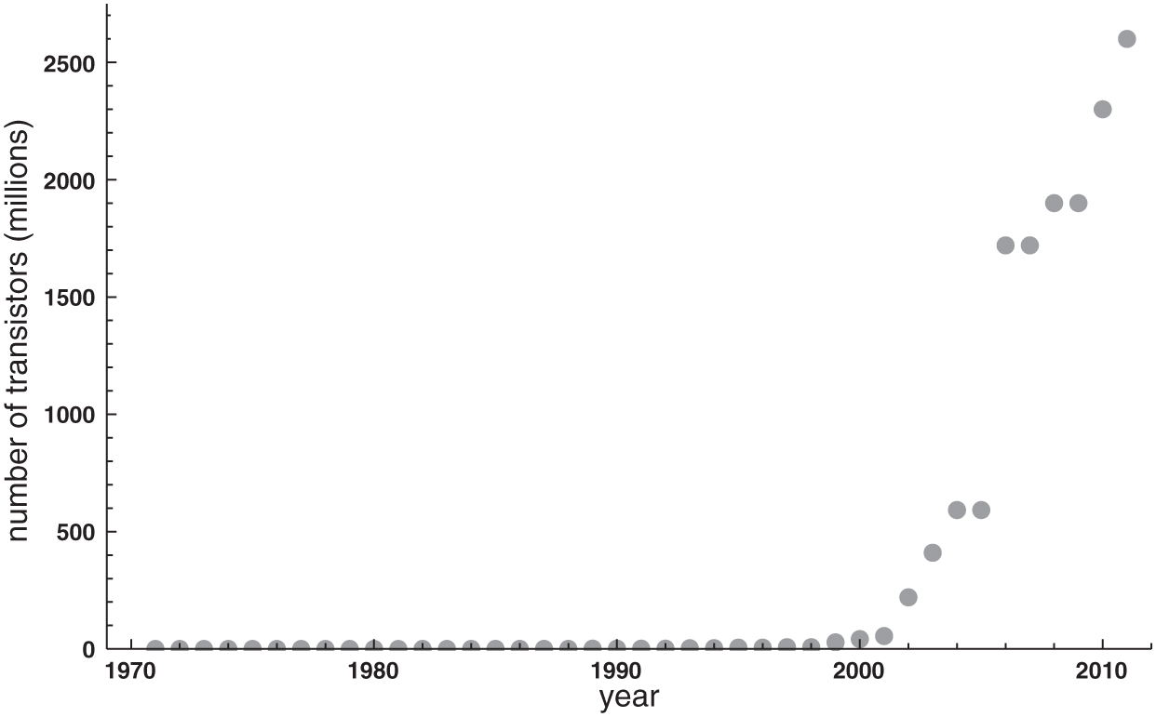
Figure 11.16: Highest transistor counts on Intel CPUs (using linear scale).

Slide 18
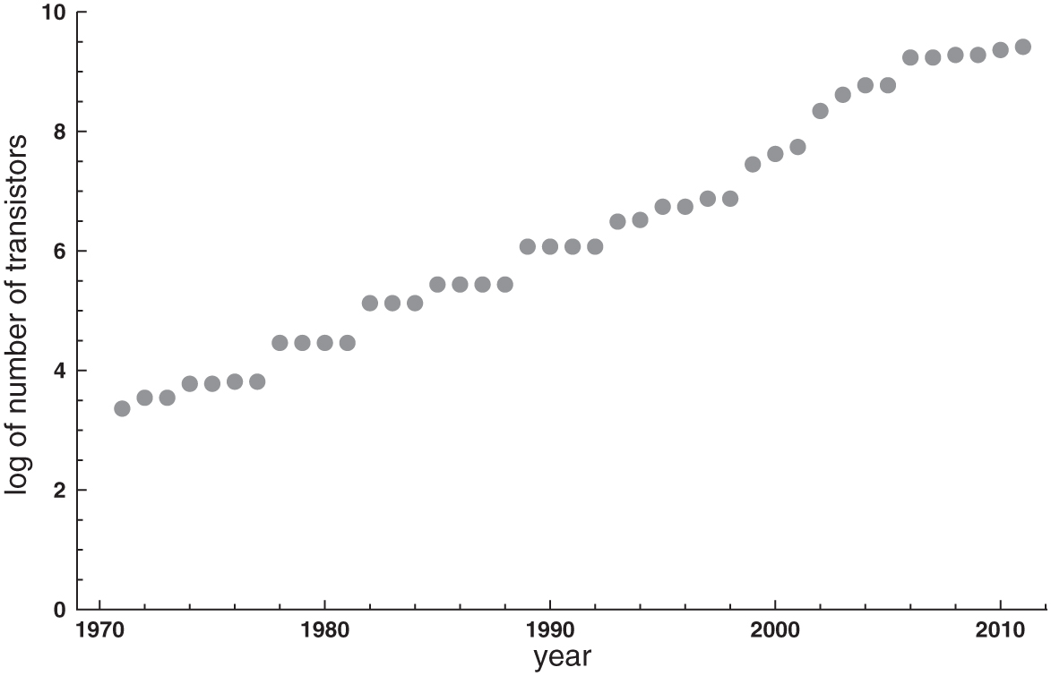
Figure 11.17: Highest transistor counts on Intel CPUs (using logarithmic transformation).

Slide 19
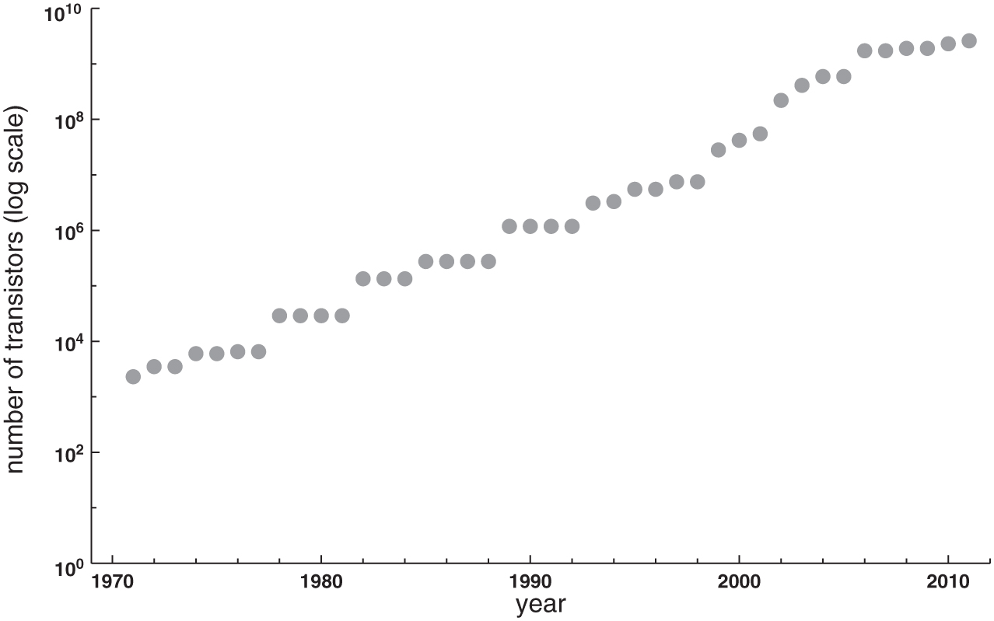
Figure 11.18: Highest transistor counts on Intel CPUs (using logarithmic scale).

Slide 20
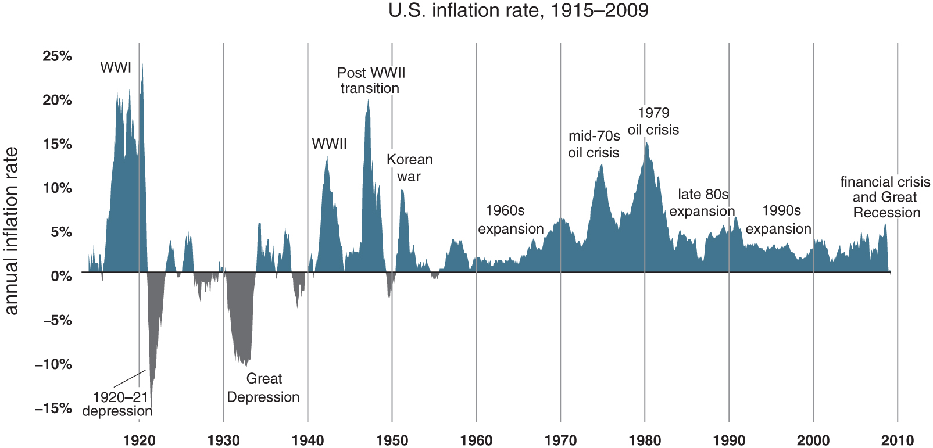
Figure 11.19: An annotated line chart: U.S. inflation, 1915–2009.

Slide 21
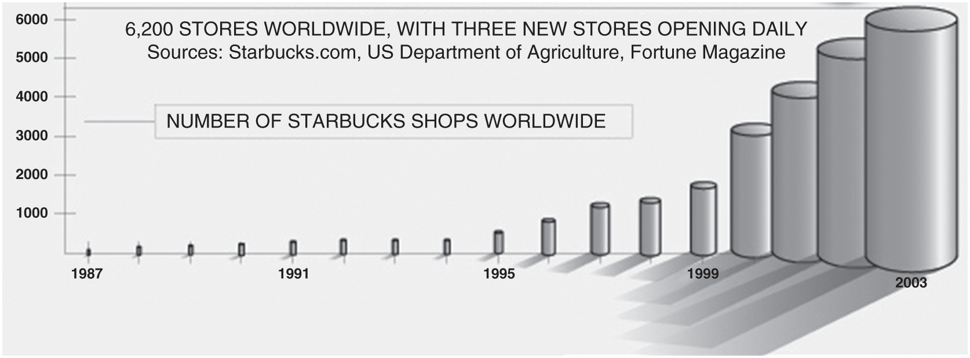
Figure 11.20: Number of Starbucks shops worldwide, 1987–2003.

