Slide 1
Vital Statistics Probability and Statistics for Economics and Business
William H. Sandholm
University of Wisconsin-Madison
Brett A. Saraniti
Northwestern University
Chapter 8
Poisson and Exponential Distributions

Slide 2
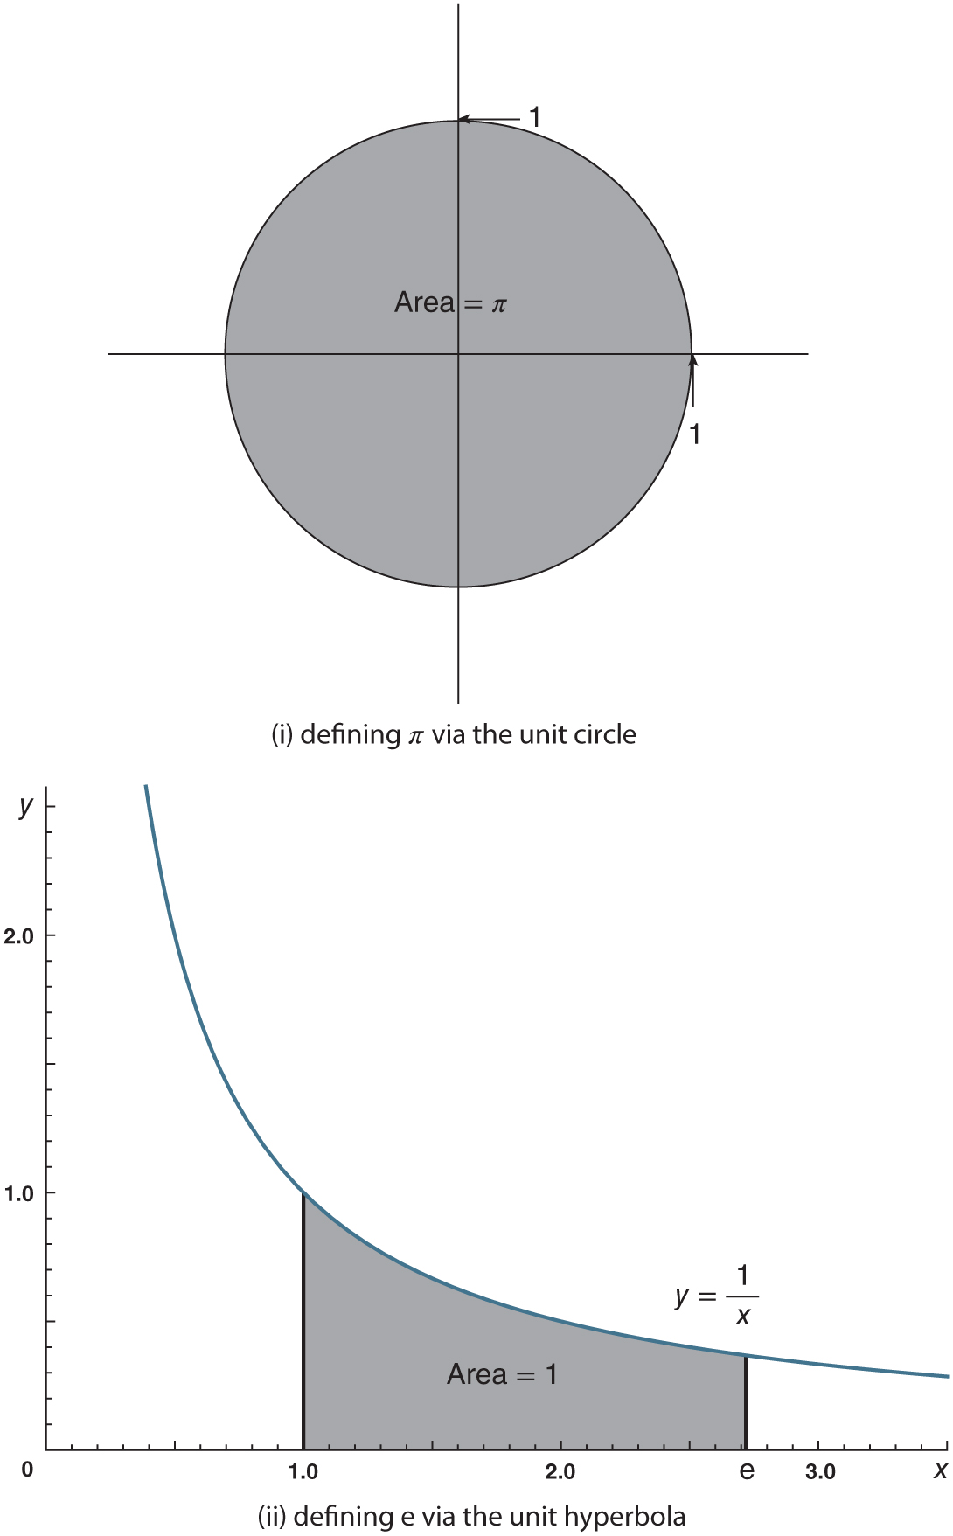
Figure 8.1: Geometric definitions of 𝜋 and e

Slide 3
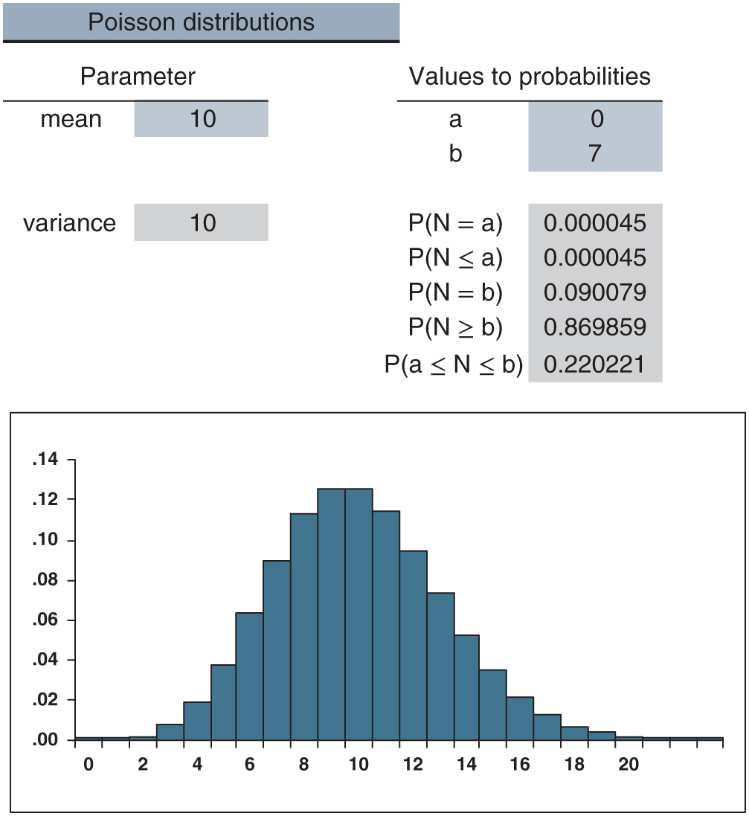
Figure 8.2: distributions.xlsx/Poisson

Slide 4
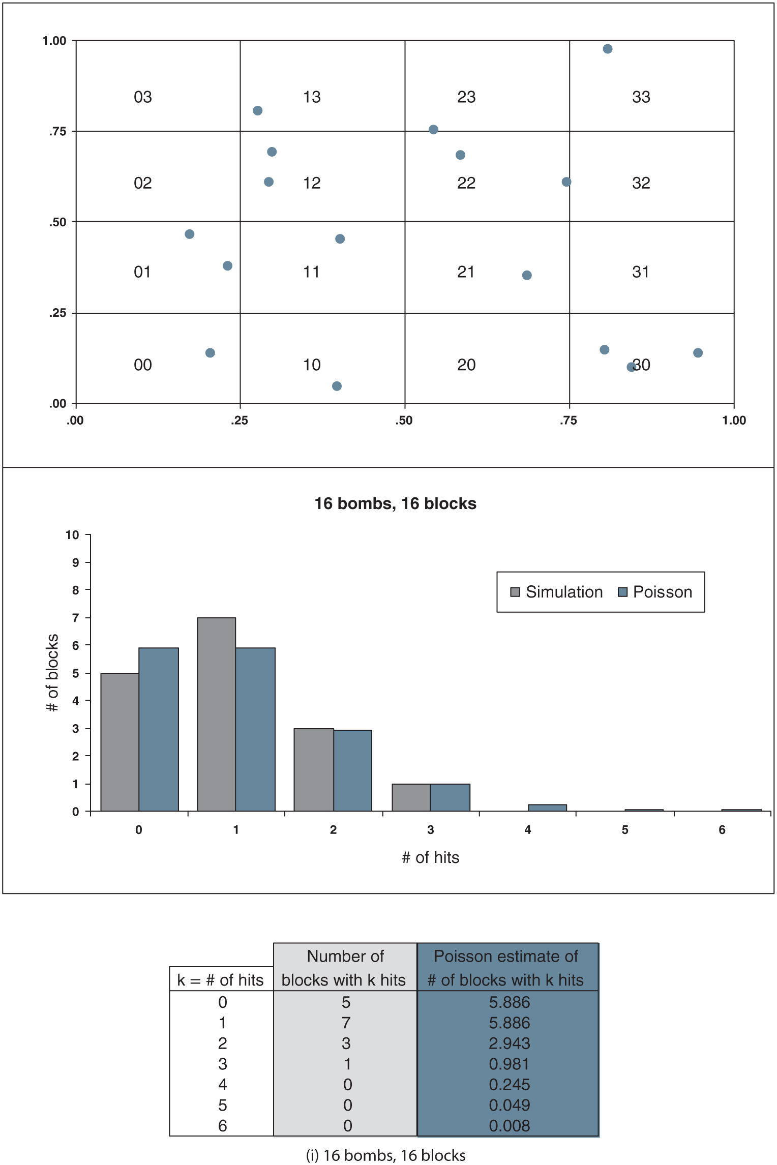
Figure 8.3: bombs.xlsx

Slide 5
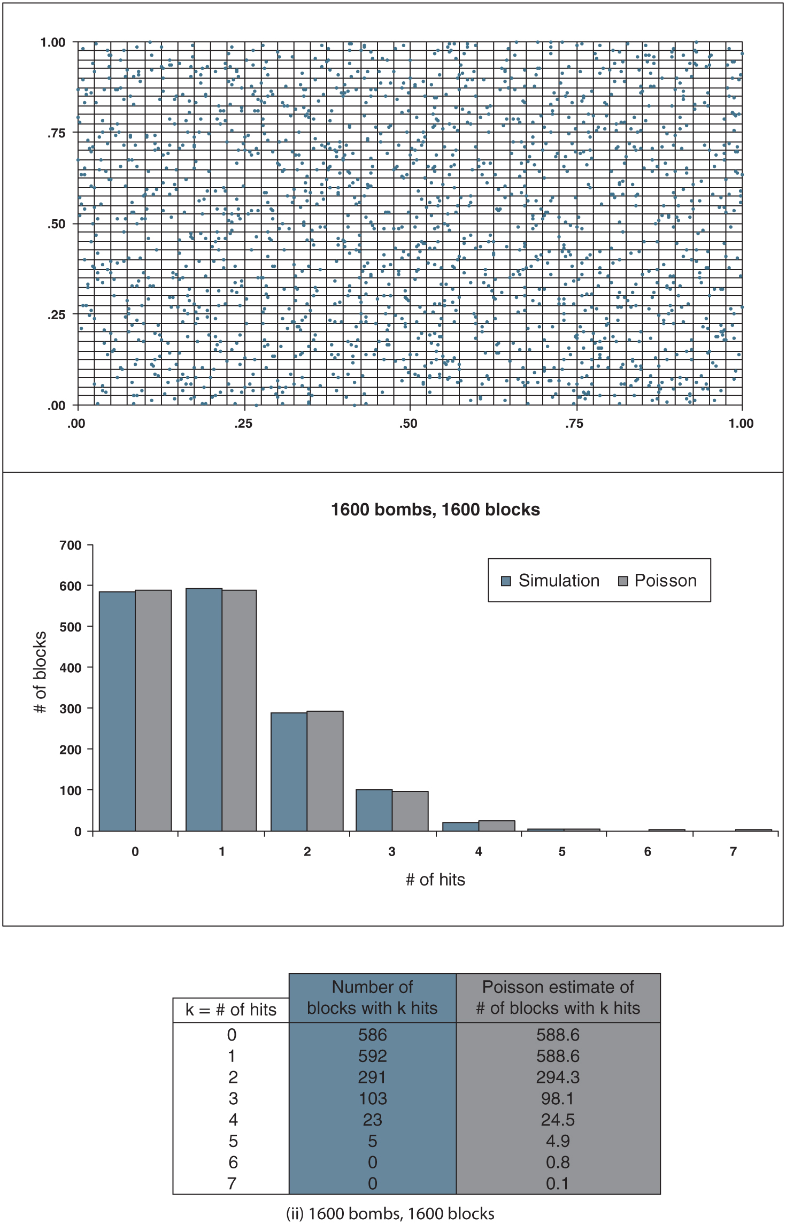
Figure 8.3: continued

Slide 6
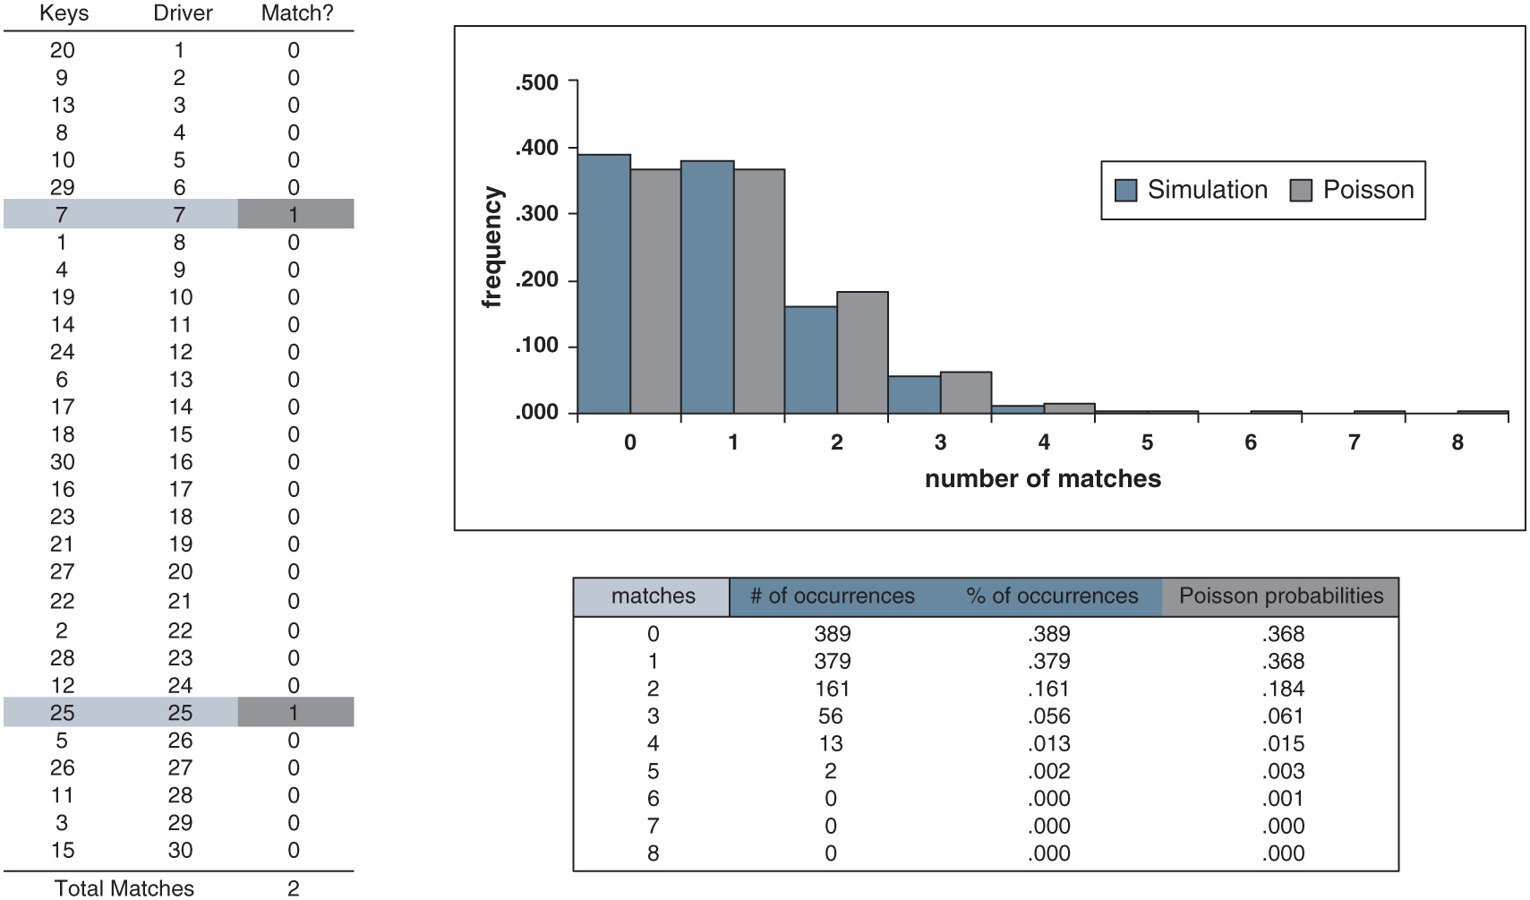
Figure 8.4: keys.xlsx

Slide 7
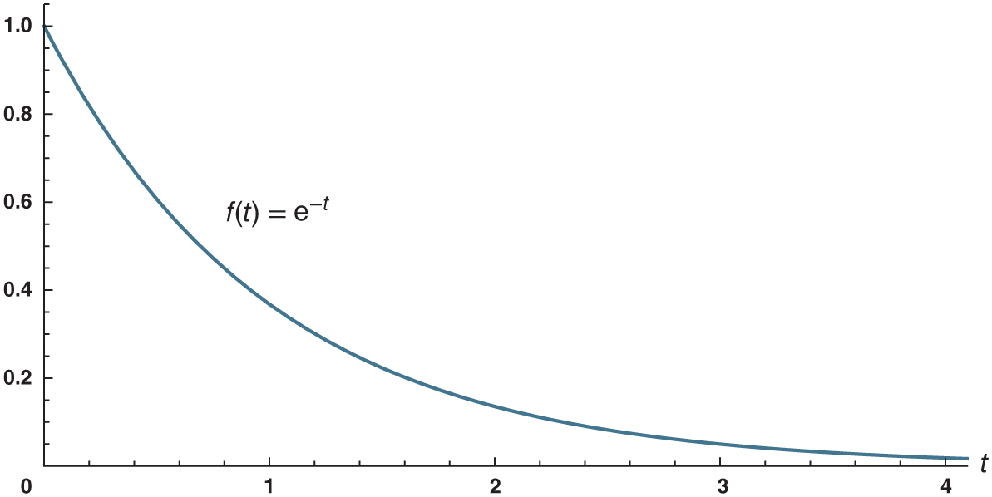
Figure 8.5: The exponential(1) density function.

Slide 8
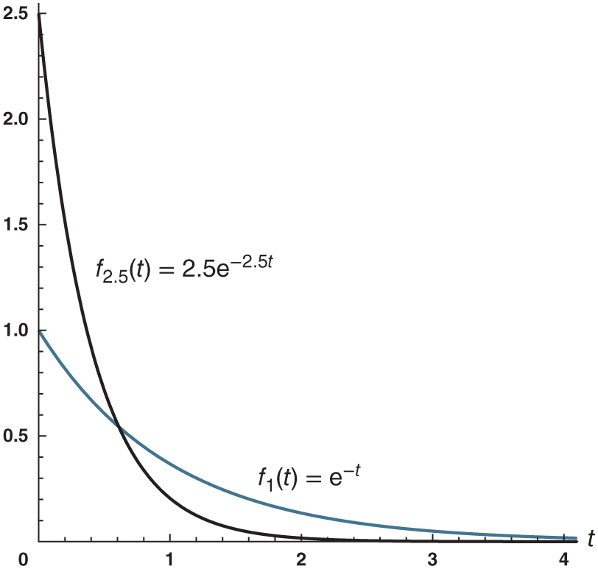
Figure 8.6: The exponential(2.5) and exponential(1) density functions.

Slide 9
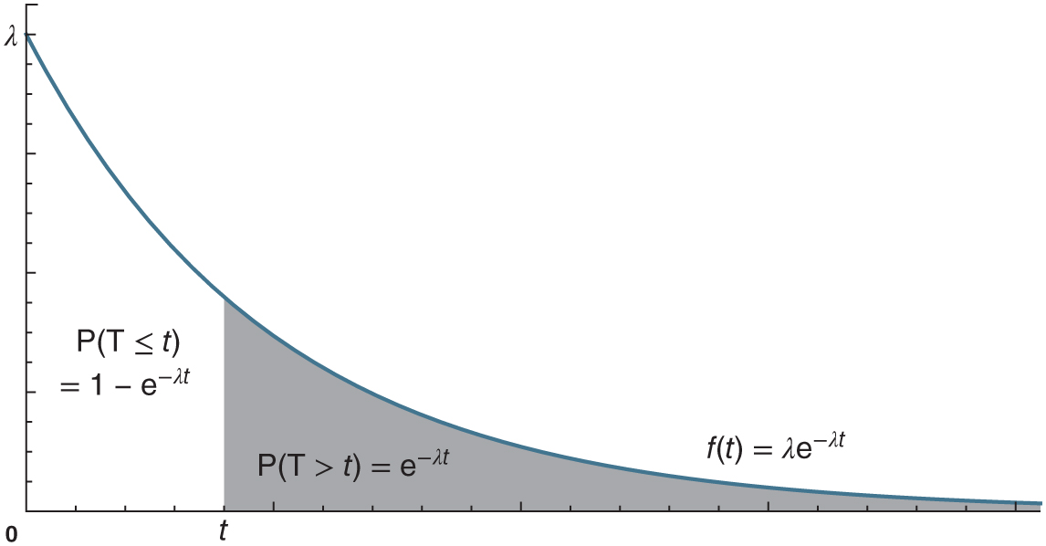
Figure 8.7: Exponential probabilities.

Slide 10
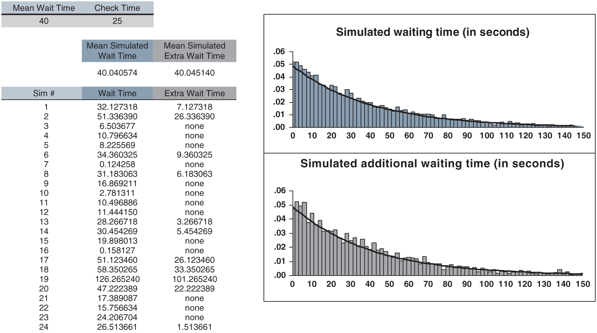
Figure 8.8: memorylessness.xlsx

Slide 11
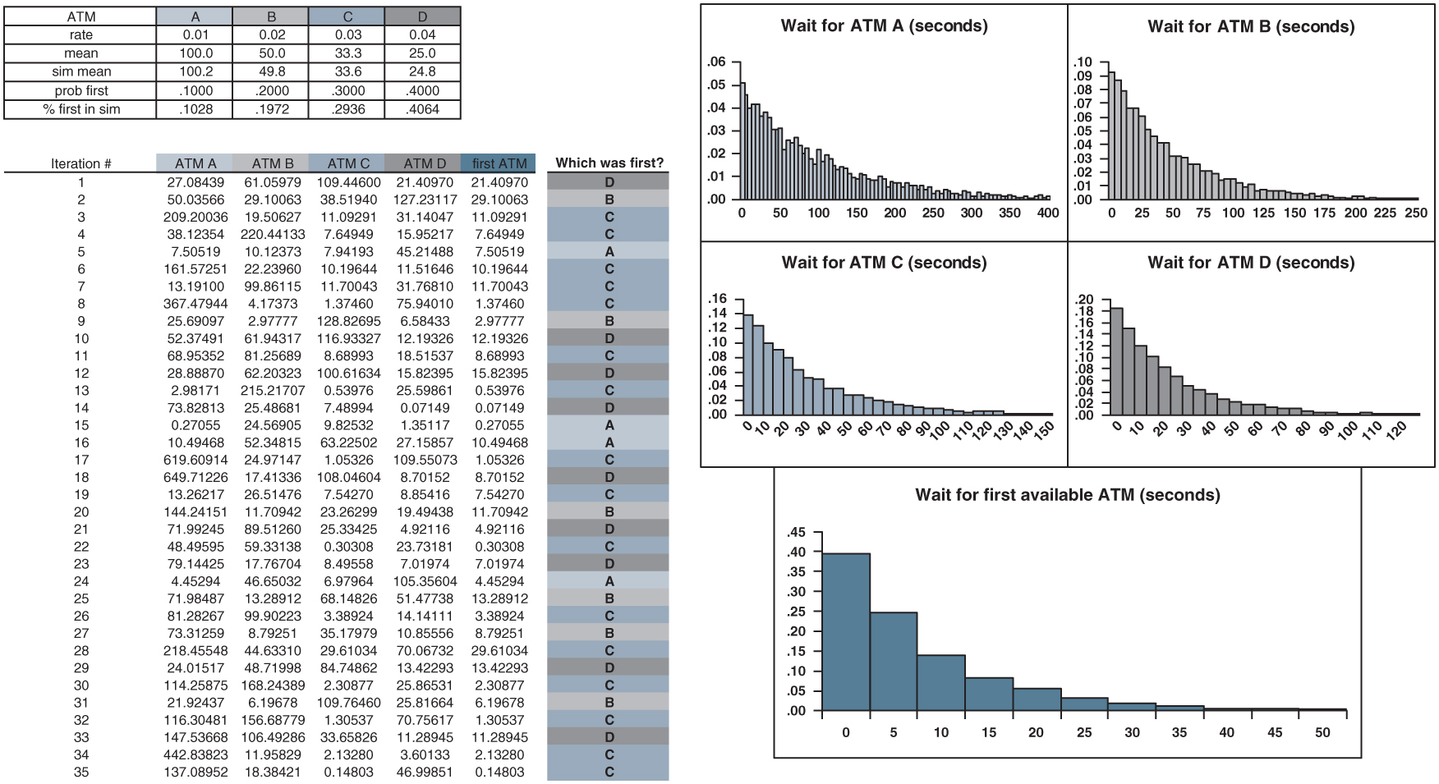
Figure 8.9: ATMs.xlsx

Slide 12
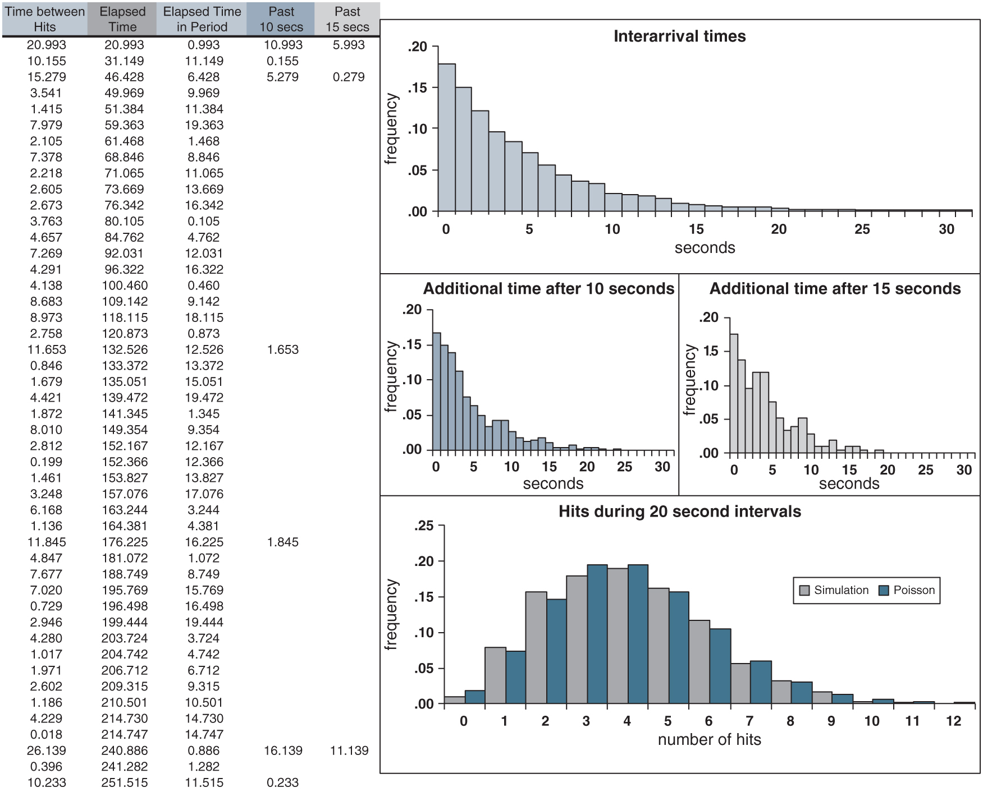
Figure 8.10: website.xlsx

