Slide 1
Vital Statistics Probability and Statistics for Economics and Business
William H. Sandholm
University of Wisconsin-Madison
Brett A. Saraniti
Northwestern University
Chapter 7
The Central Limit Theorem

Slide 2
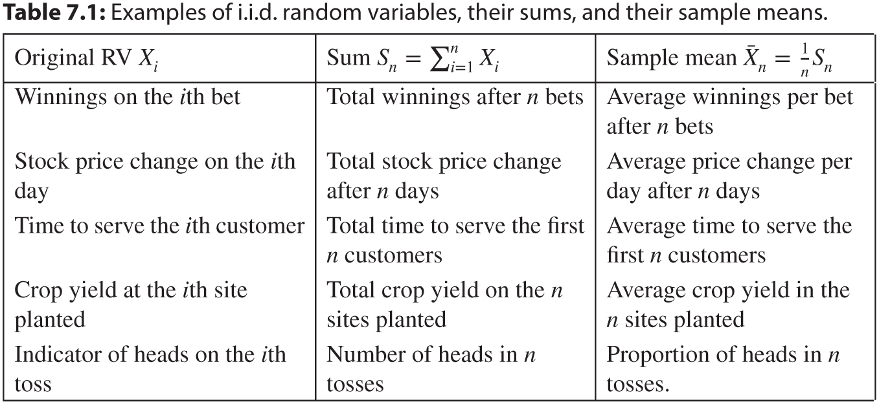
Table 7.1: Examples of i.i.d. random variables, their sums, and their sample means.

Slide 3
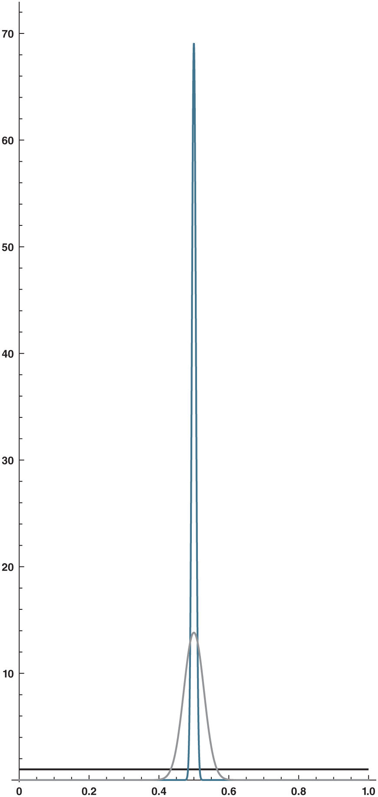
Figure 7.1: Density functions of the sample means of uniformly distributed trials. The black line is the density function of single uniform(0, 1) trial, the gray curve is the density function of ̄ X₁₀₀, and the blue curve is the density function of ̄ X₂₅₀₀.

Slide 4
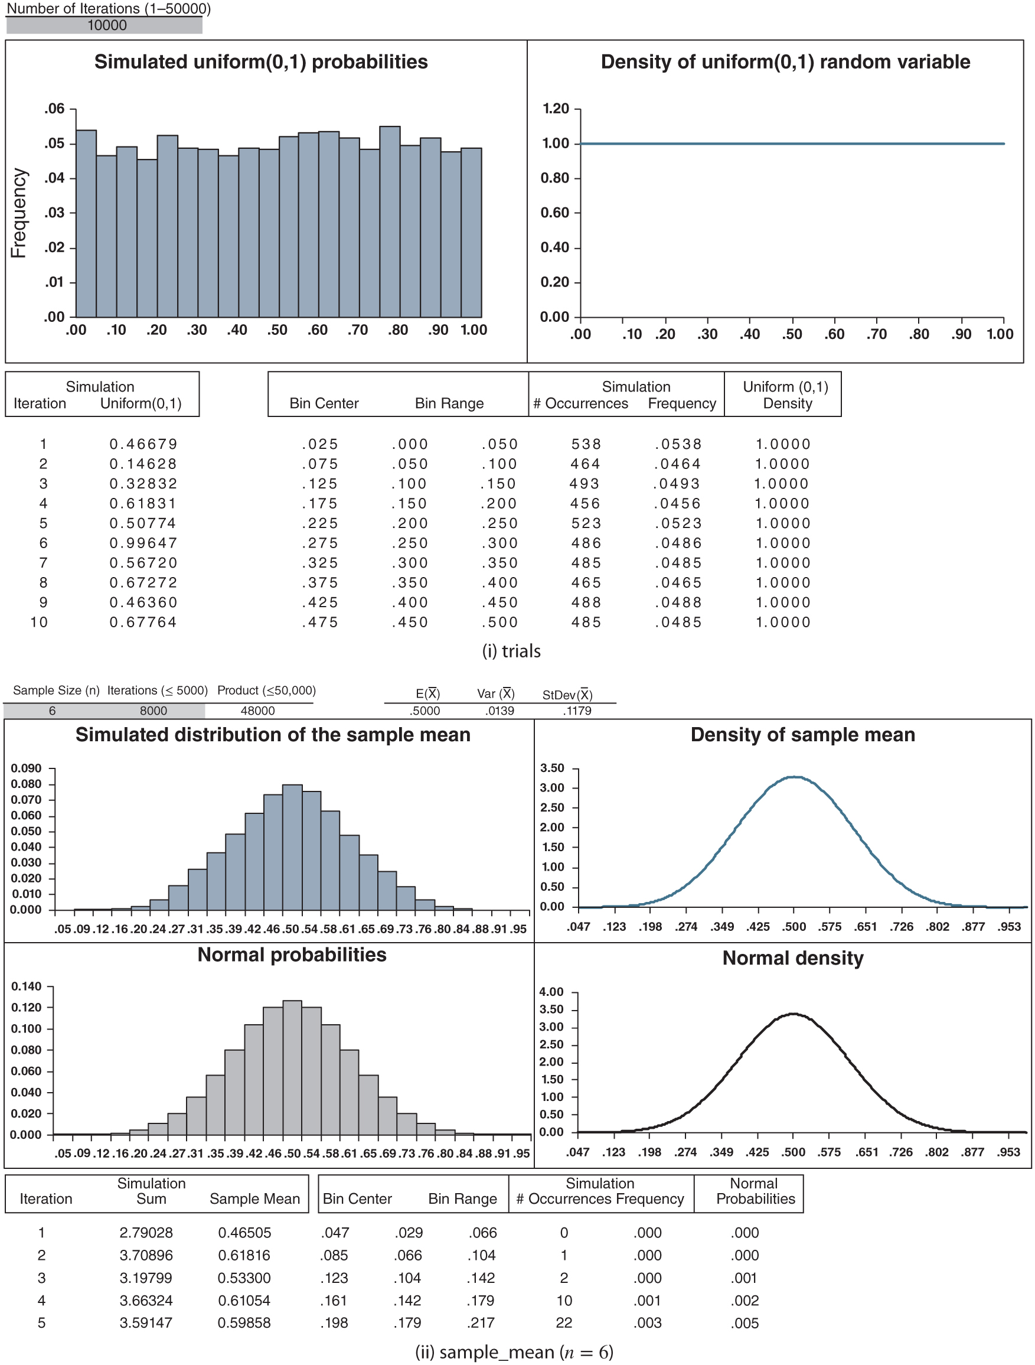
Figure 7.2: CLT_uniform.xlsx

Slide 5
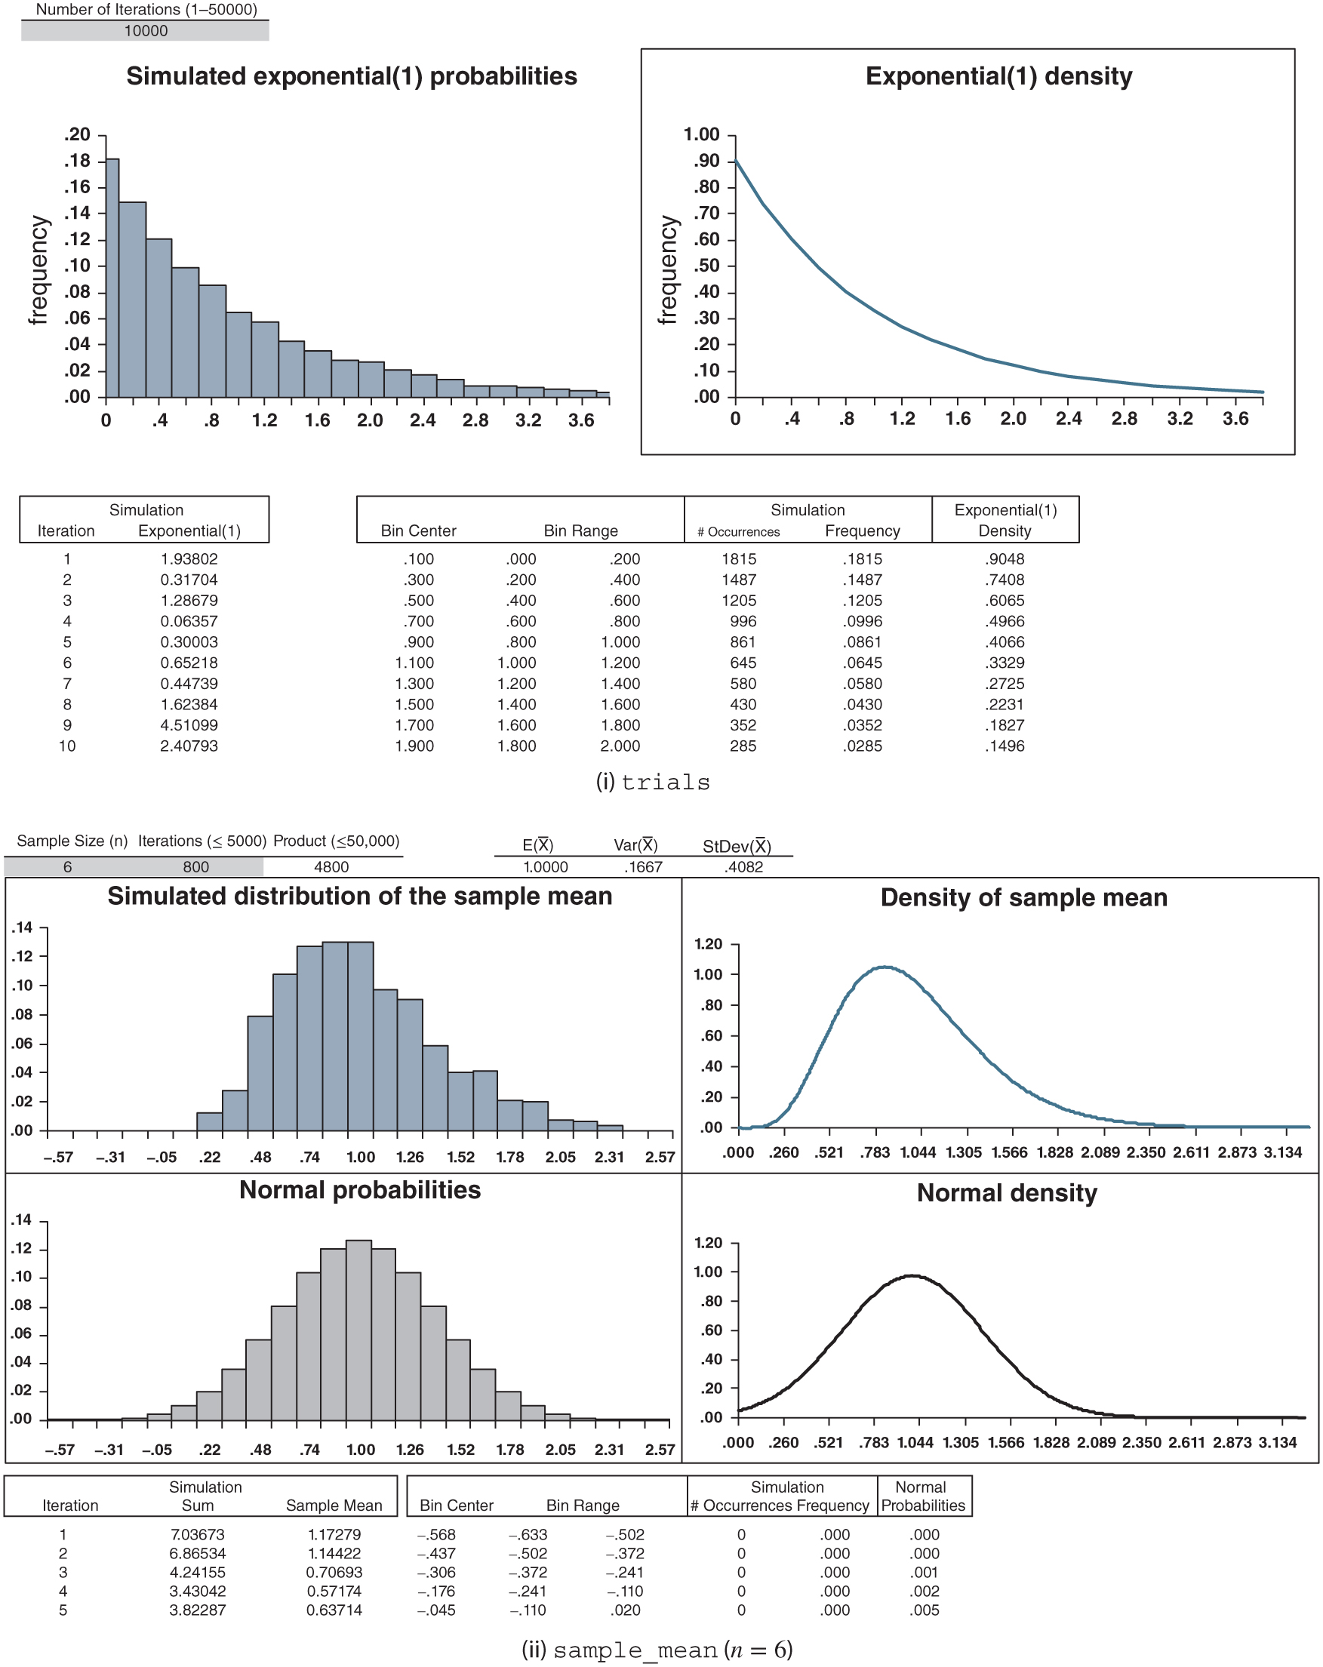
Figure 7.3: CLT_exponential.xlsx

Slide 6
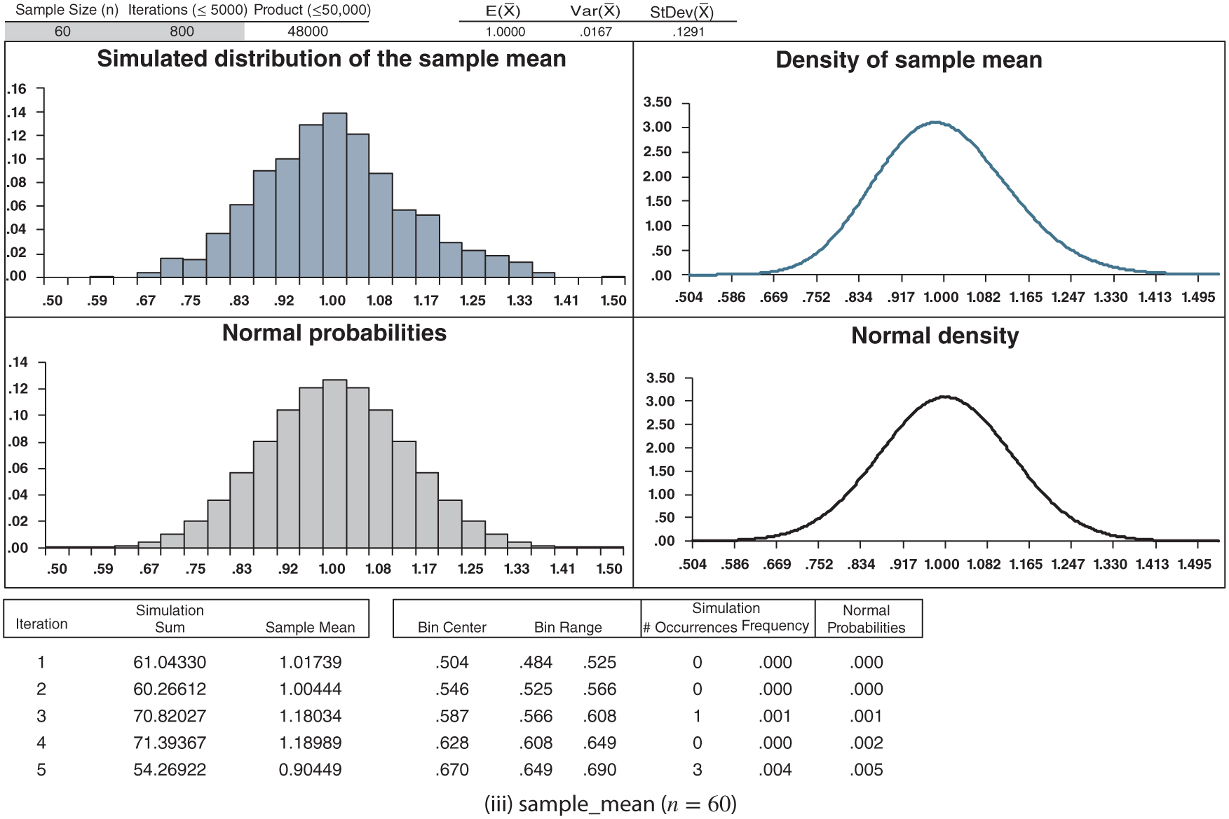
Figure 7.3: continued

Slide 7
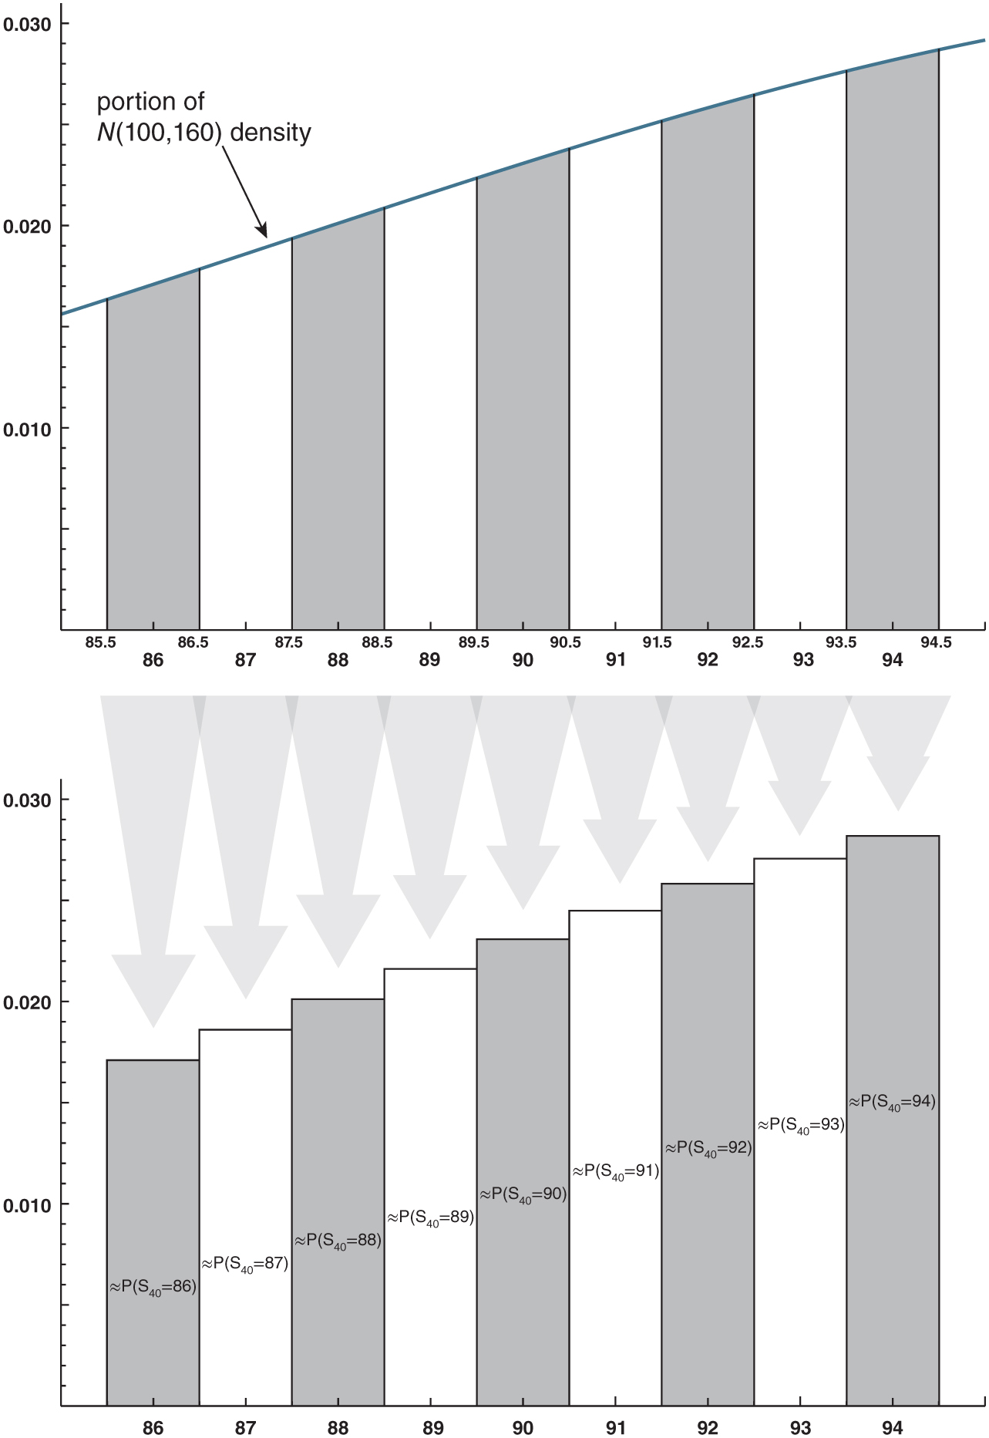
Figure 7.4: The continuity correction.

Slide 8
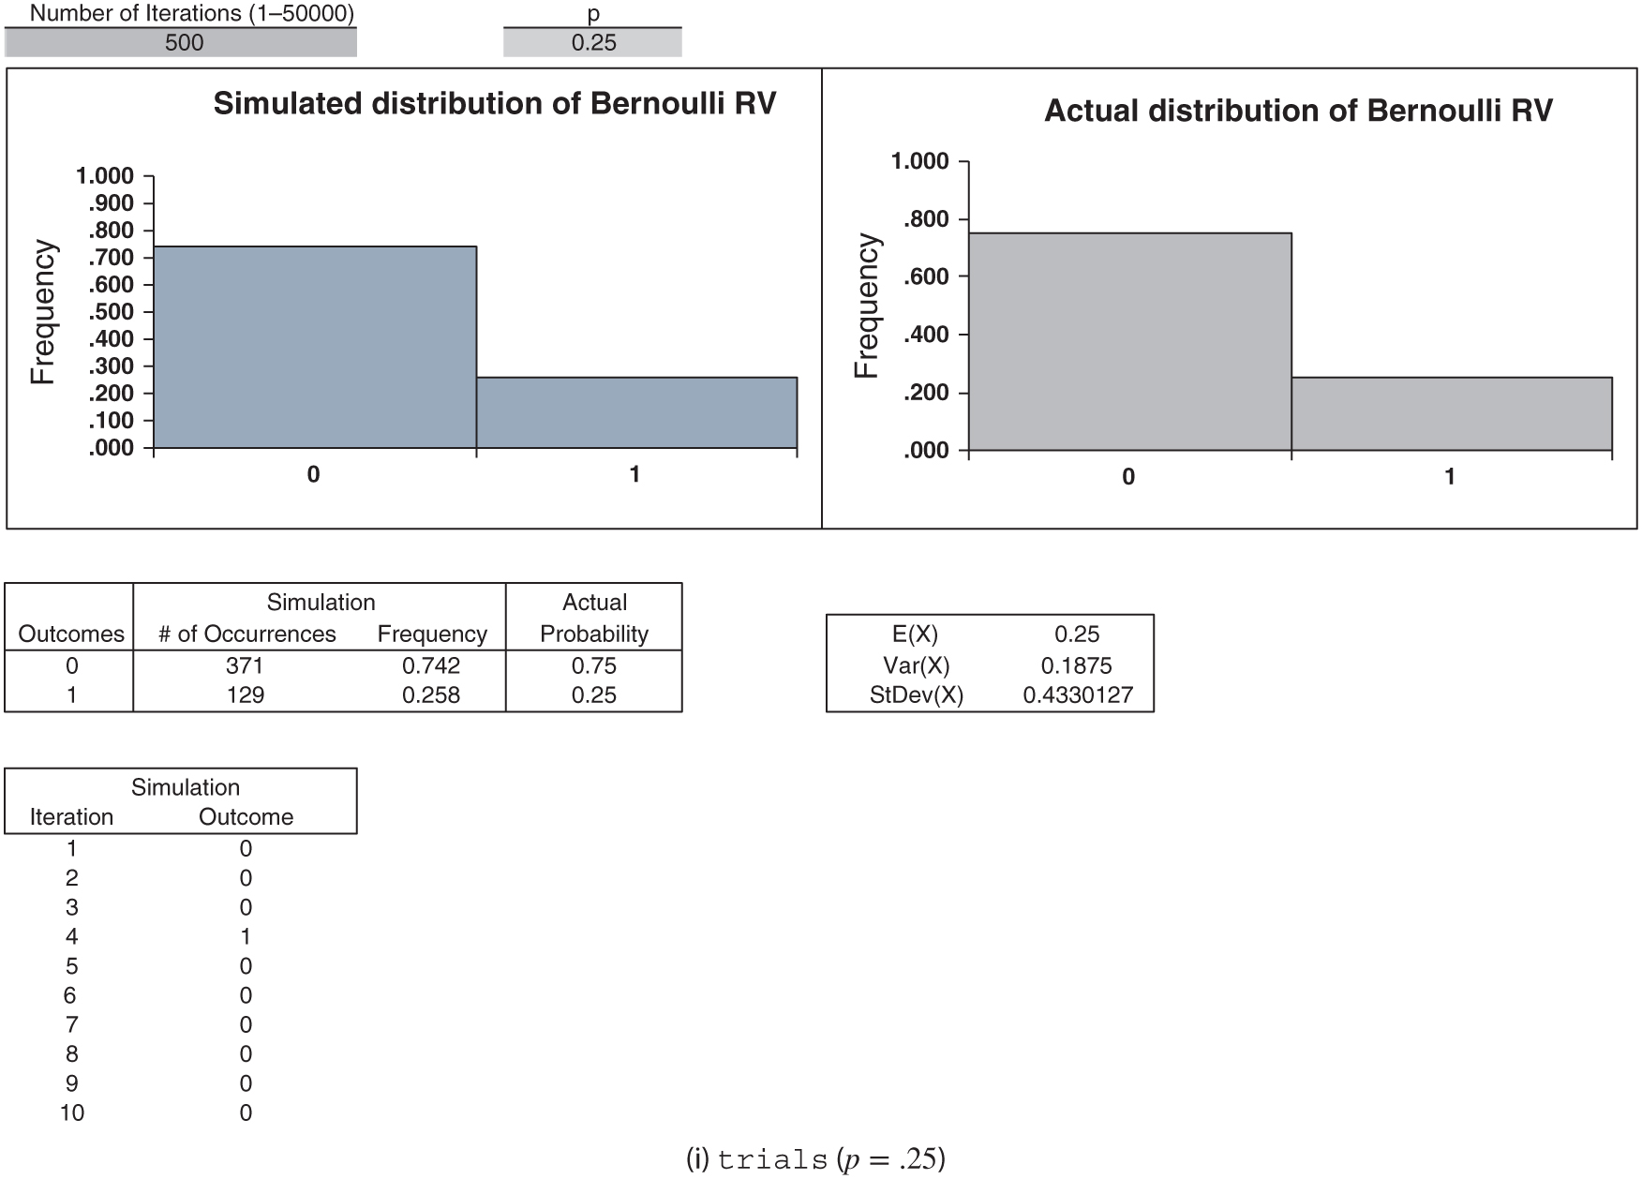
Figure 7.5: CLT_Bernoulli.xlsx

Slide 9
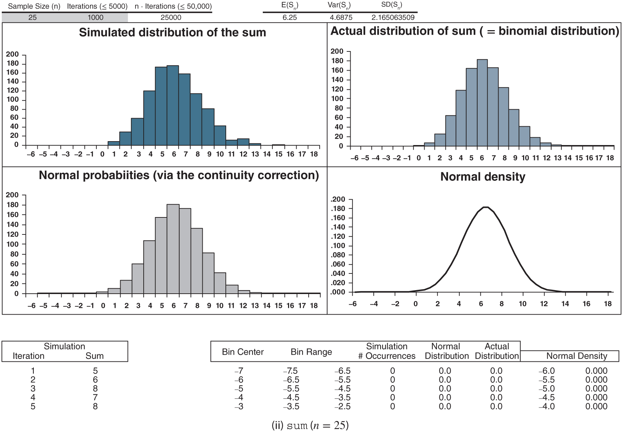
Figure 7.5: continued

Slide 10
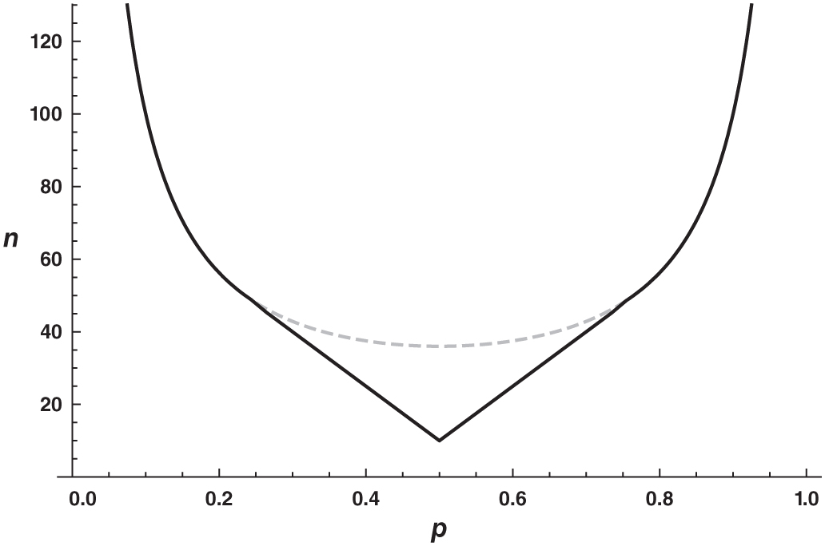
Figure 7.6: The V-neck: the number of trials n required for the normal approximation to the binomial distribution to be accurate as a function of the probability of success p. The black curve is condition (7.7). Replacing the middle section of the black curve with the gray dashed curve yields the simpler condition (7.8).

Slide 11
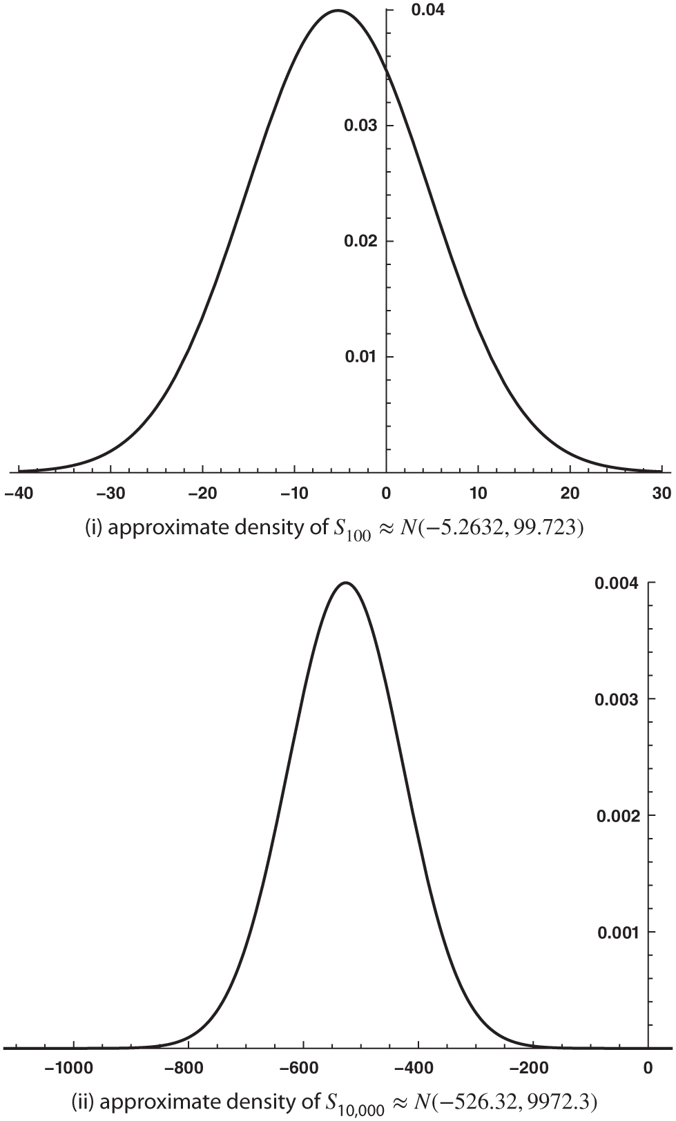
Figure 7.7: 100 and 10,000 one-dollar bets at roulette.

