Slide 1
Vital Statistics Probability and Statistics for Economics and Business
William H. Sandholm
University of Wisconsin-Madison
Brett A. Saraniti
Northwestern University
Chapter 6
Continuous Random Variables and Distributions

Slide 2
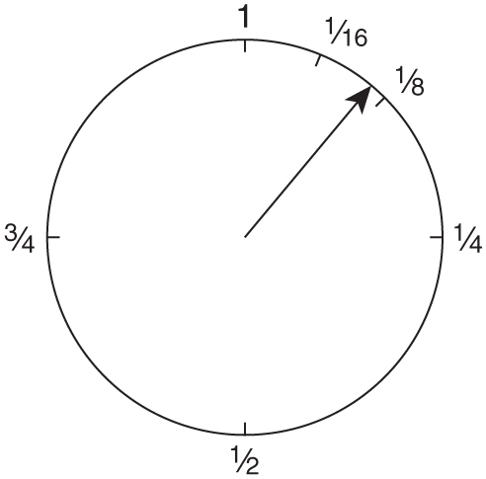
Figure 6.1: A fair spinner.

Slide 3
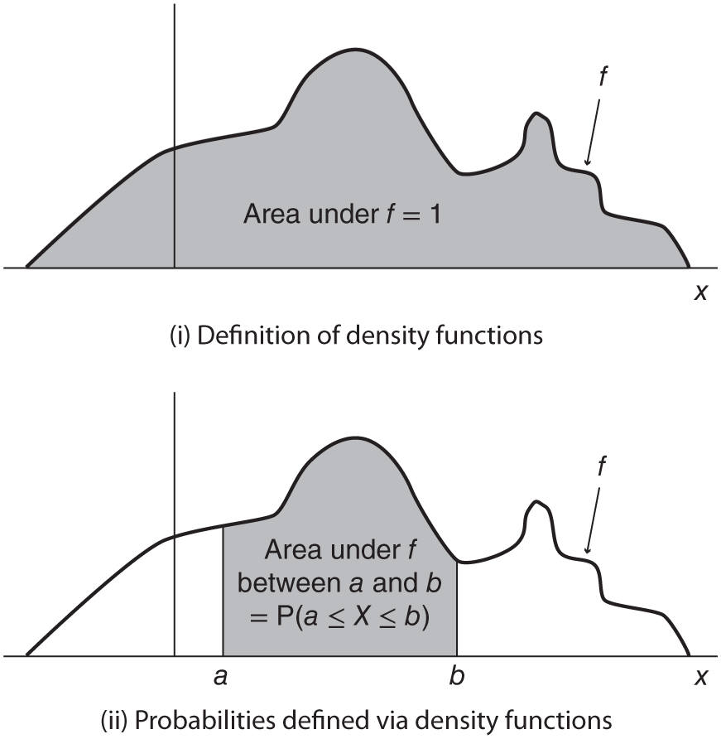
Figure 6.2: Density functions.

Slide 4
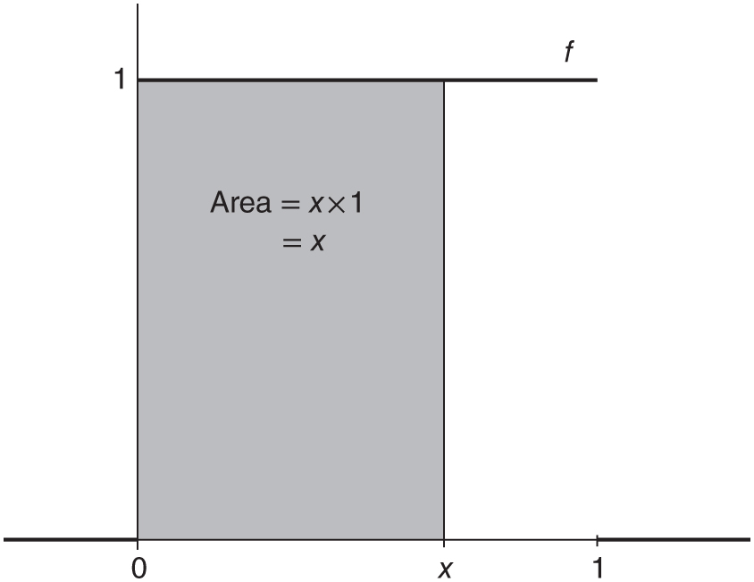
Figure 6.3: The density function for the fair spinner.

Slide 5
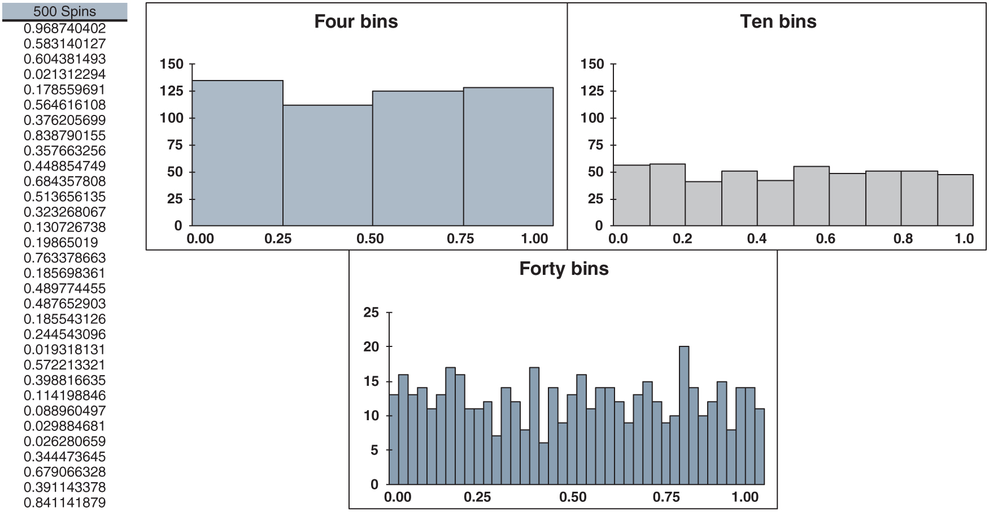
Figure 6.4: spinner.xlsx/500_spins

Slide 6
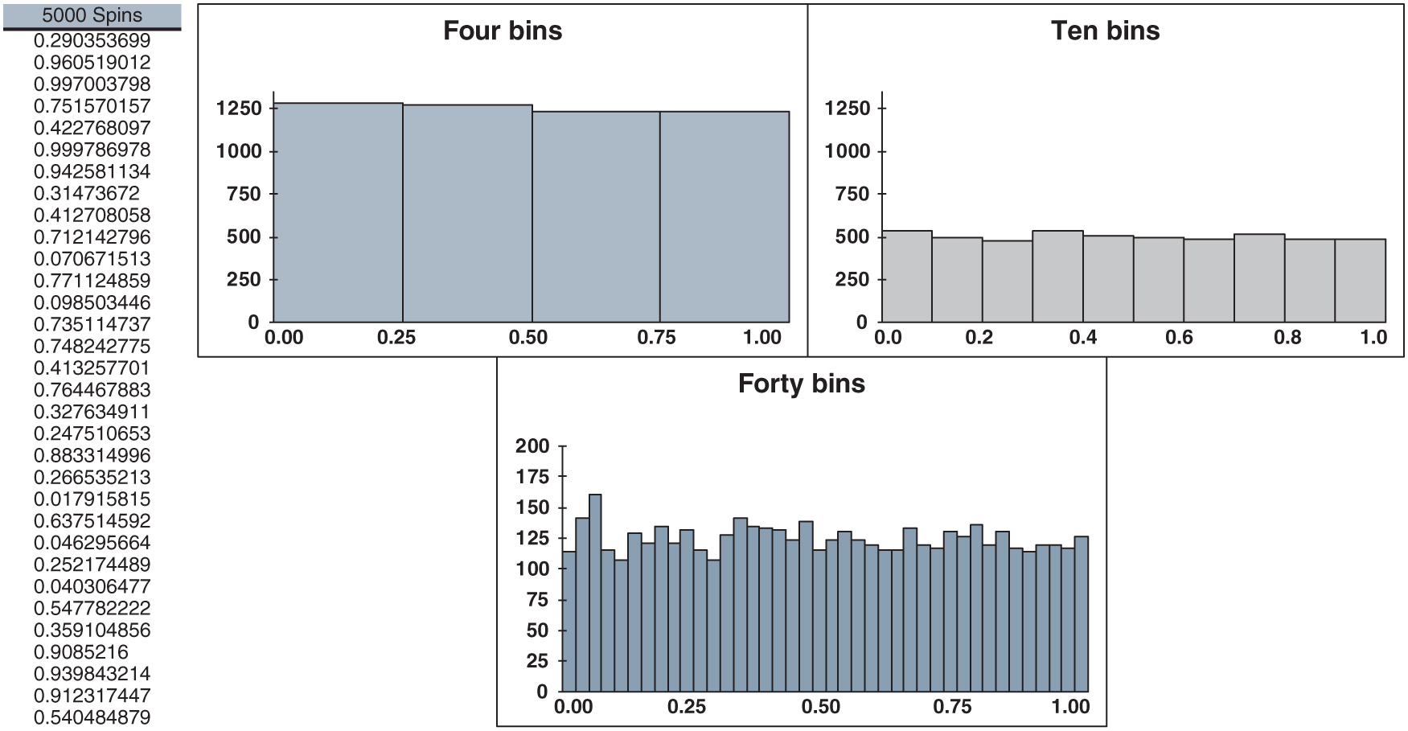
Figure 6.5: spinner.xlsx/5000_spins

Slide 7
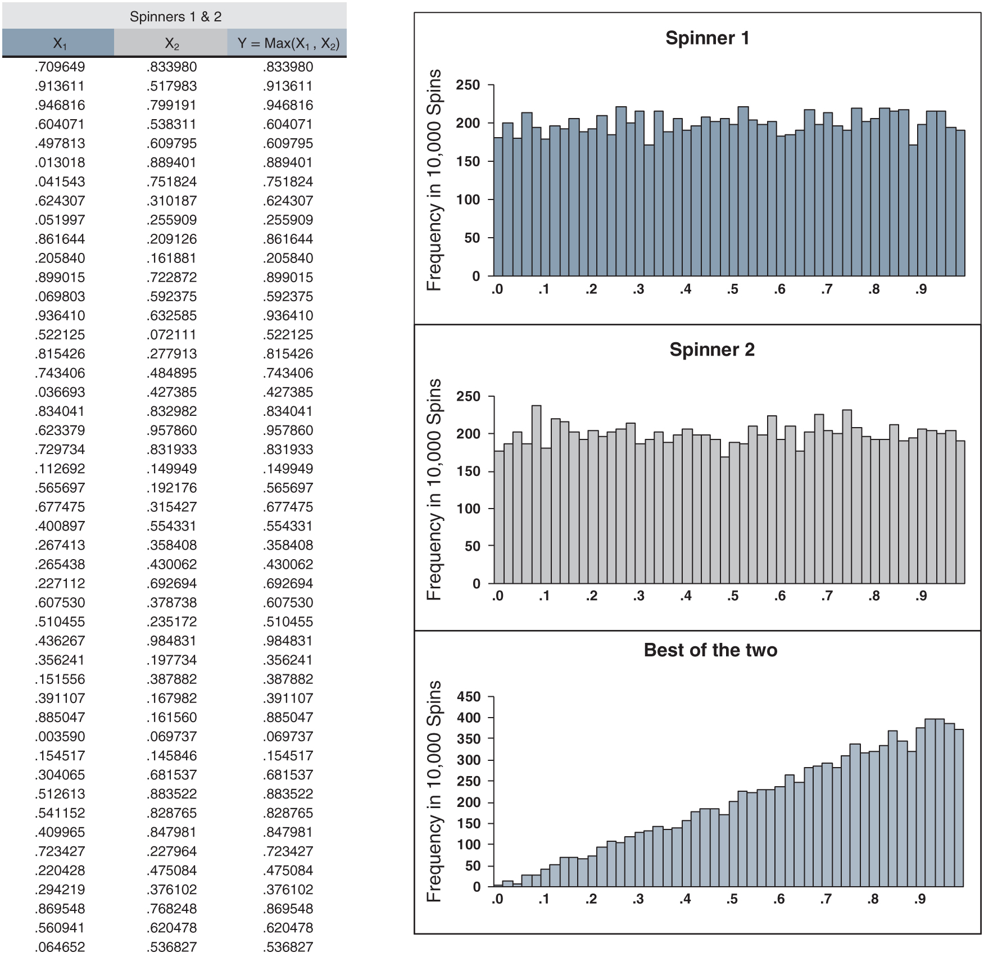
Figure 6.6: best_of_two.xlsx

Slide 8
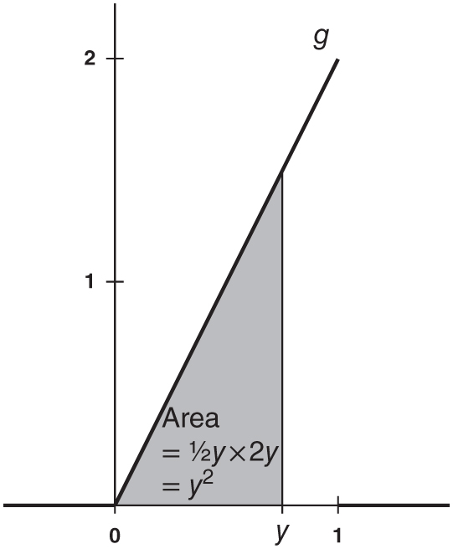
Figure 6.7: The density of the random variable Y.

Slide 9
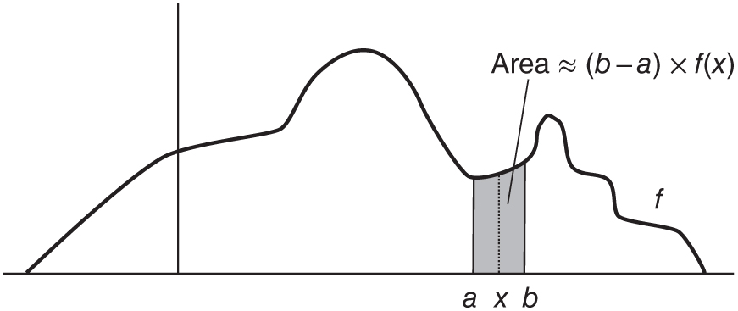
Figure 6.8: Interpreting f (x).

Slide 10
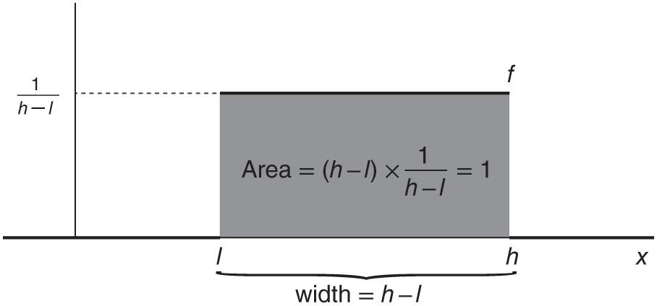
Figure 6.9: A uniform density.

Slide 11
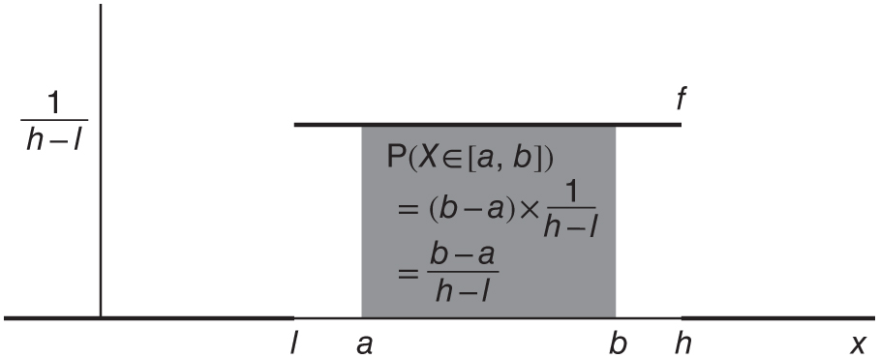
Figure 6.10: Uniform probabilities.

Slide 12
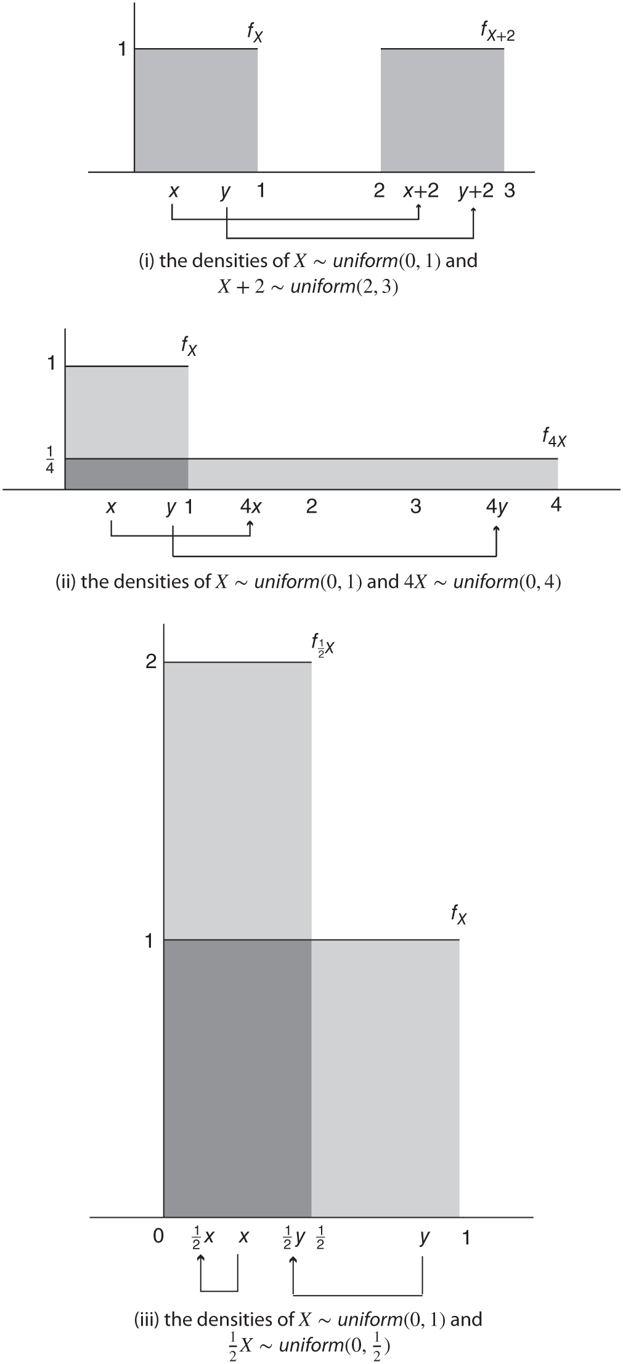
Figure 6.11: Shifting and scaling of uniform random variables.

Slide 13
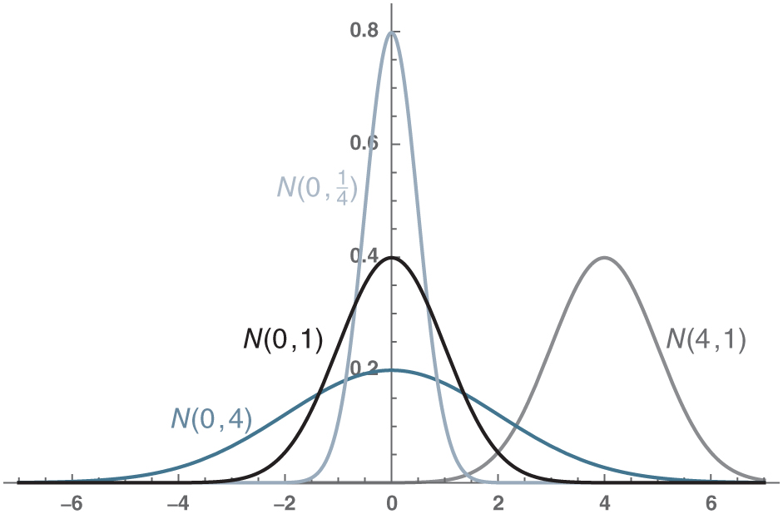
Figure 6.12: Some normal densities.

Slide 14
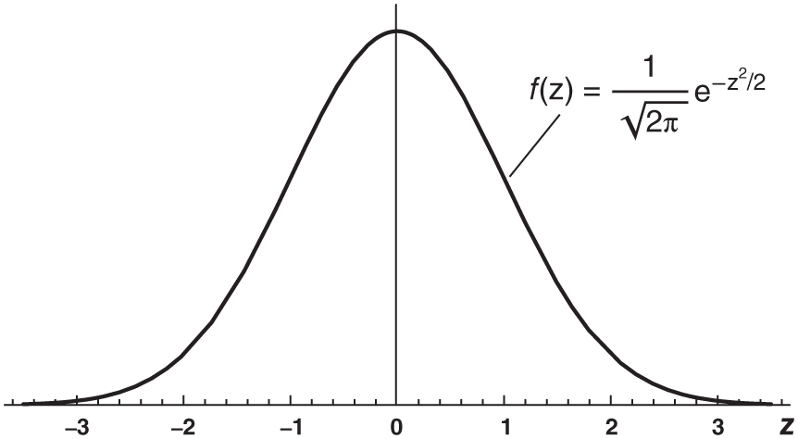
Figure 6.13: The standard normal density function.

Slide 15
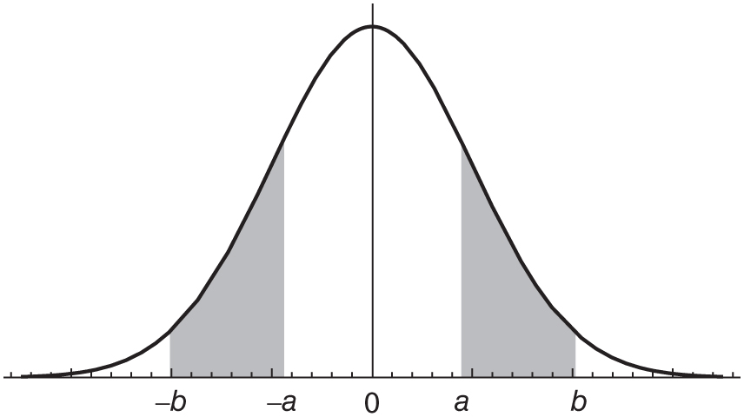
Figure 6.14: P(Z ∈ [−b,−a]) = P(Z ∈ [a, b])

Slide 16
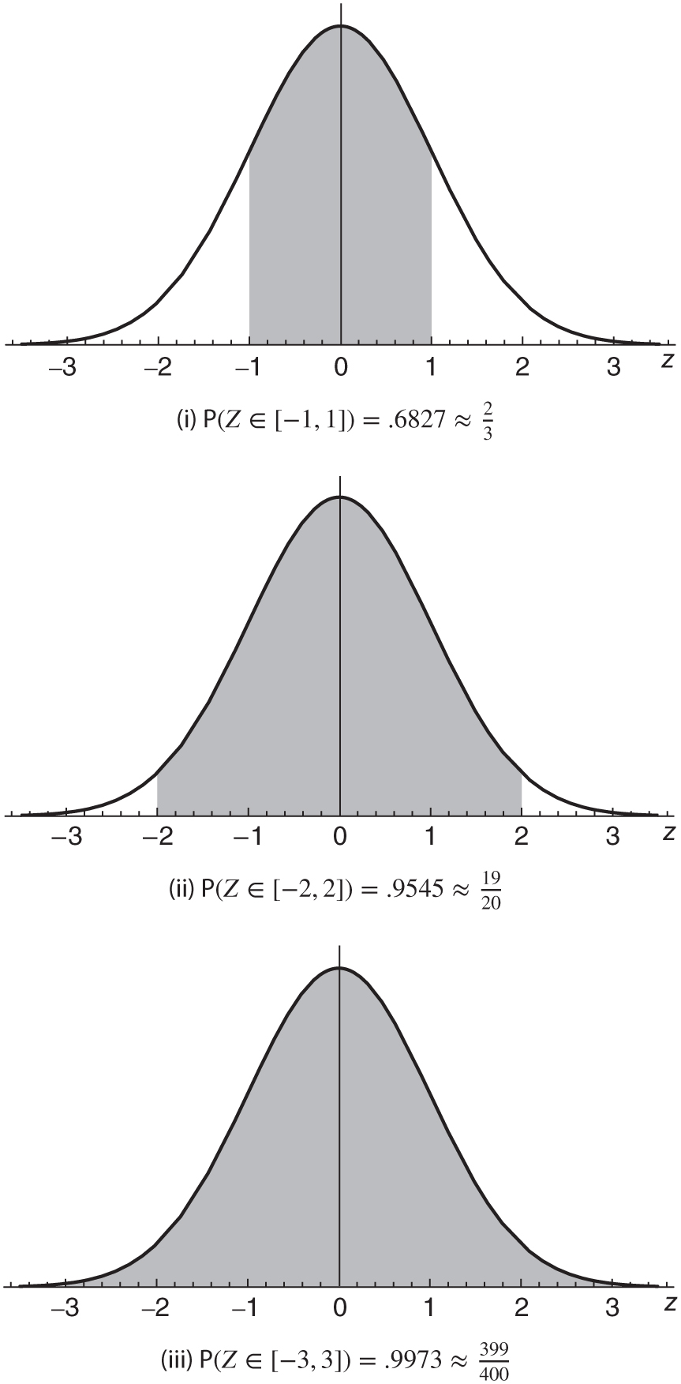
Figure 6.15: Some standard normal probabilities.

Slide 17
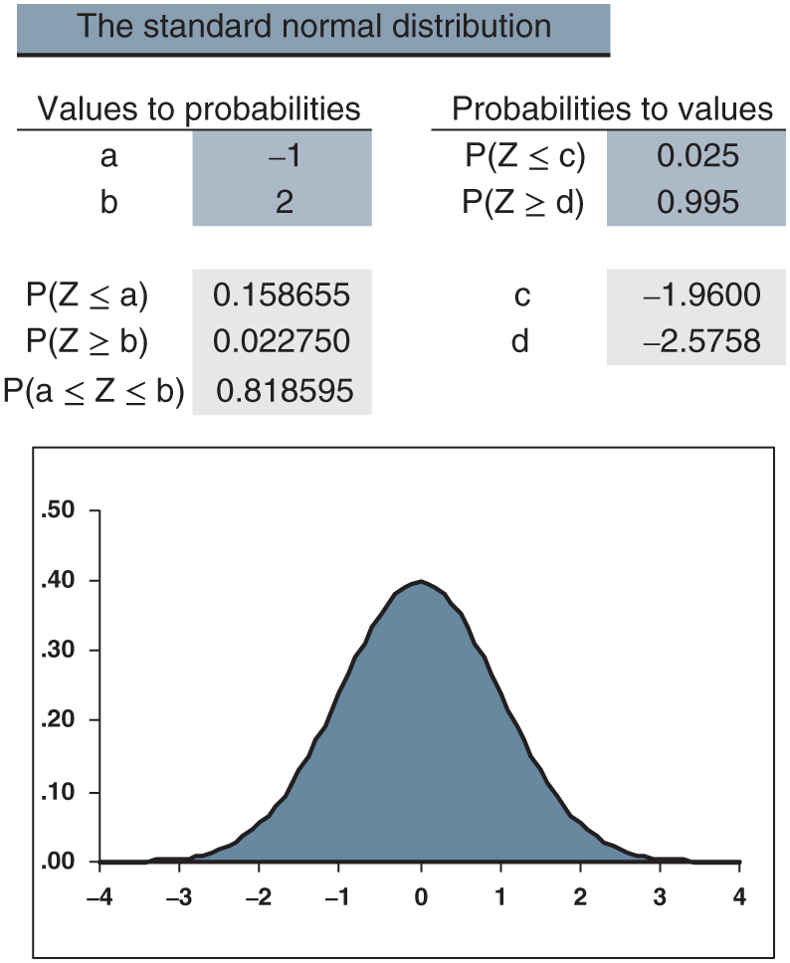
Figure 6.16: distributions.xlsx/standard_normal

Slide 18
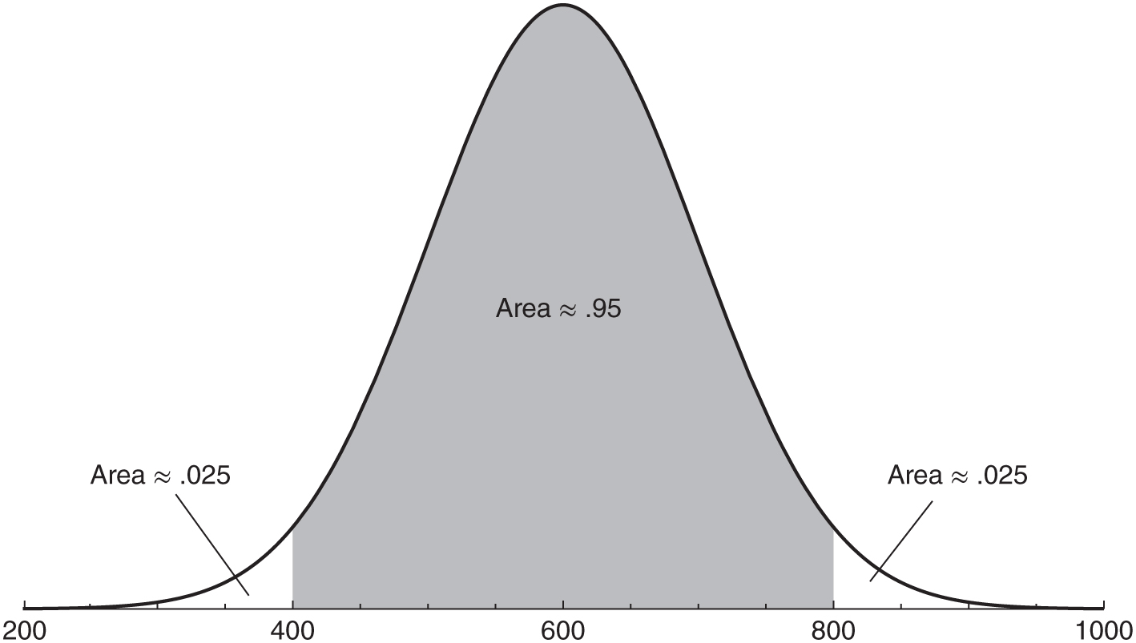
Figure 6.17: Some N(600, 10,000) probabilities.

Slide 19
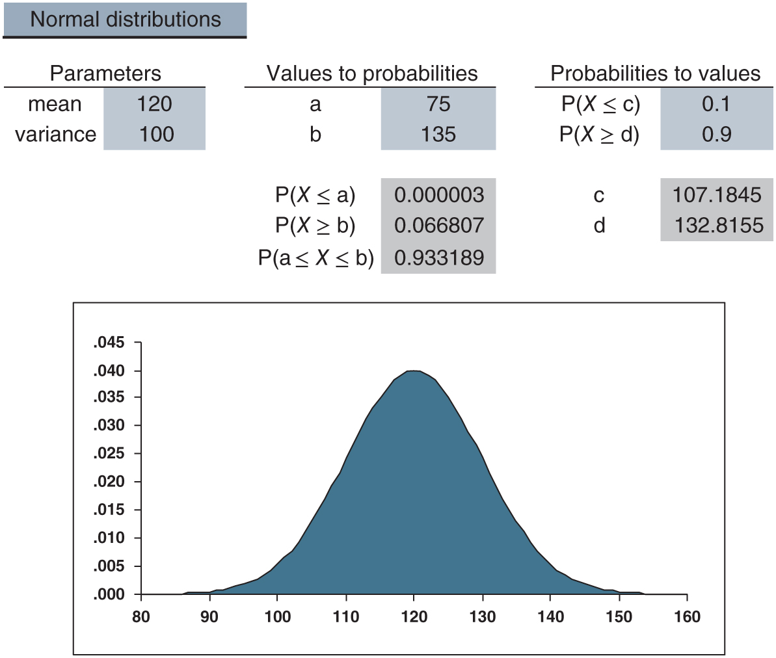
Figure 6.18: distributions.xlsx/normal

Slide 20
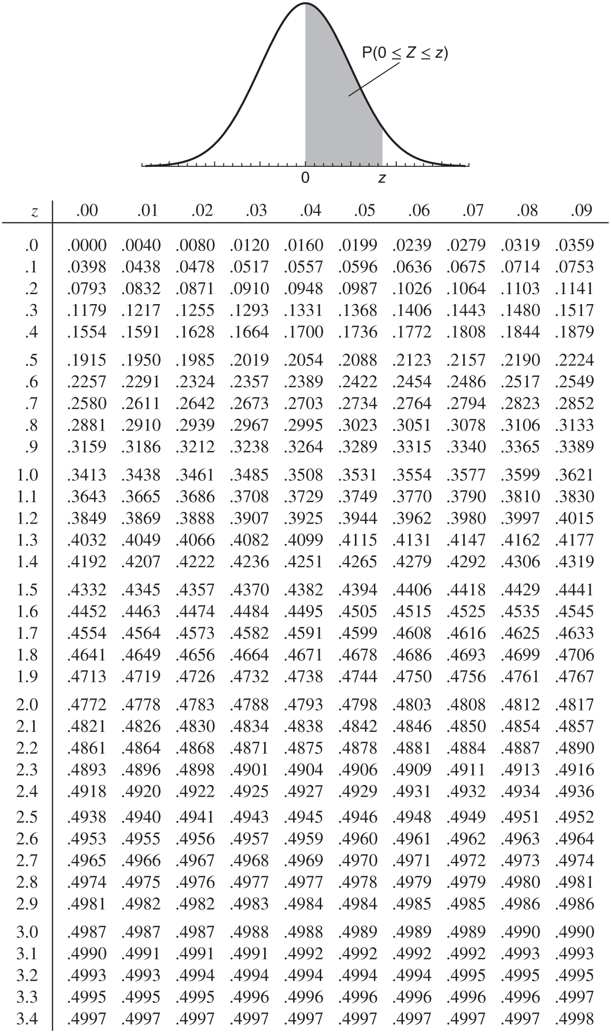
Table 6.1: The standard normal distribution table.

Slide 21
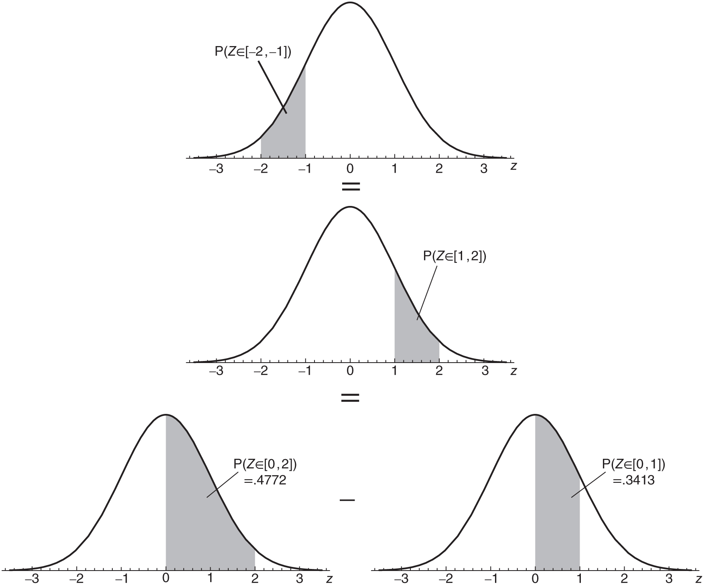
Figure 6.19: Calculating P(Z ∈ [−2,−1]).

Slide 22
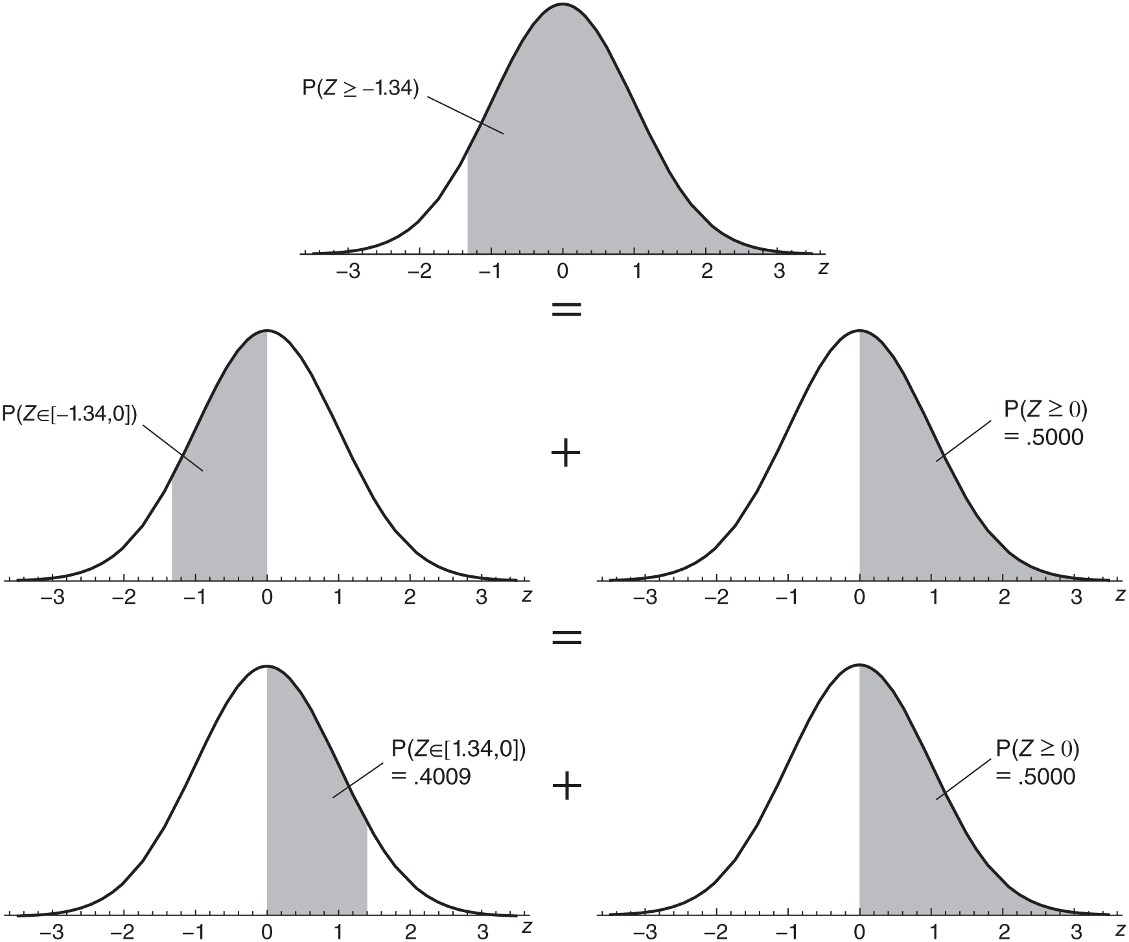
Figure 6.20: Calculating P(Z ≥ −1.34).

Slide 23
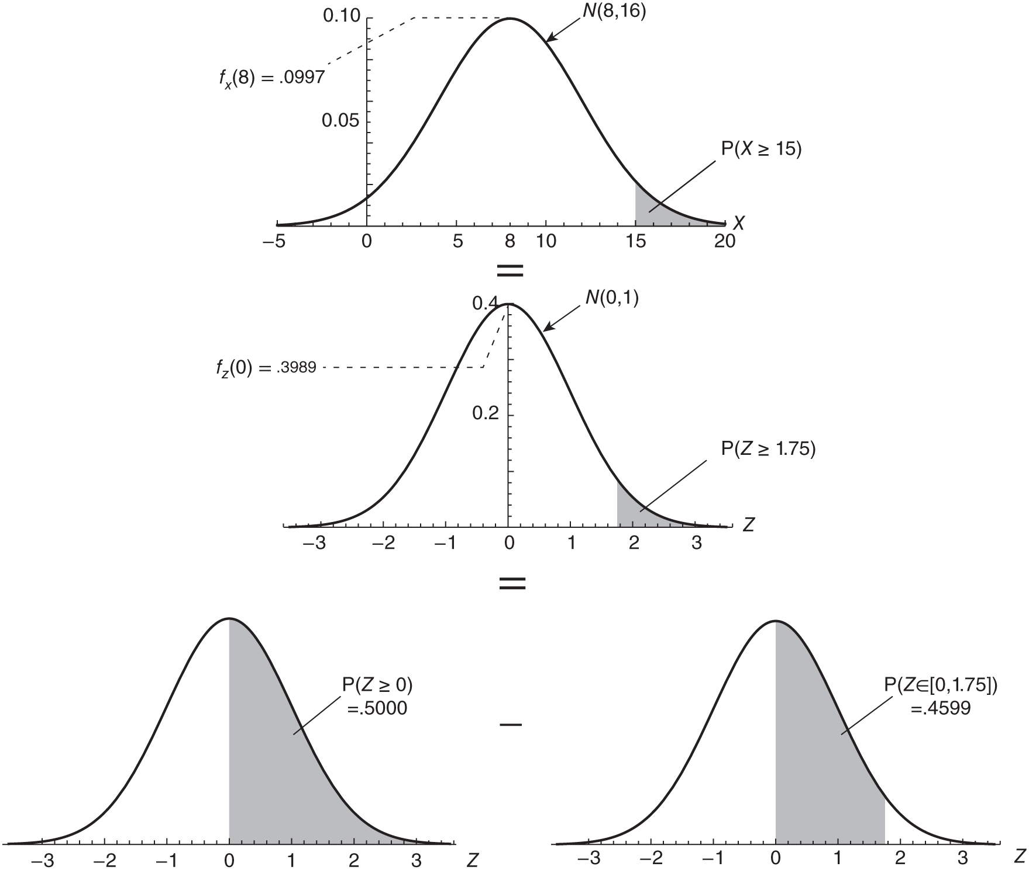
Figure 6.21: Calculating P(X ≥ 15) when X ∼ N(8, 16)

Slide 24
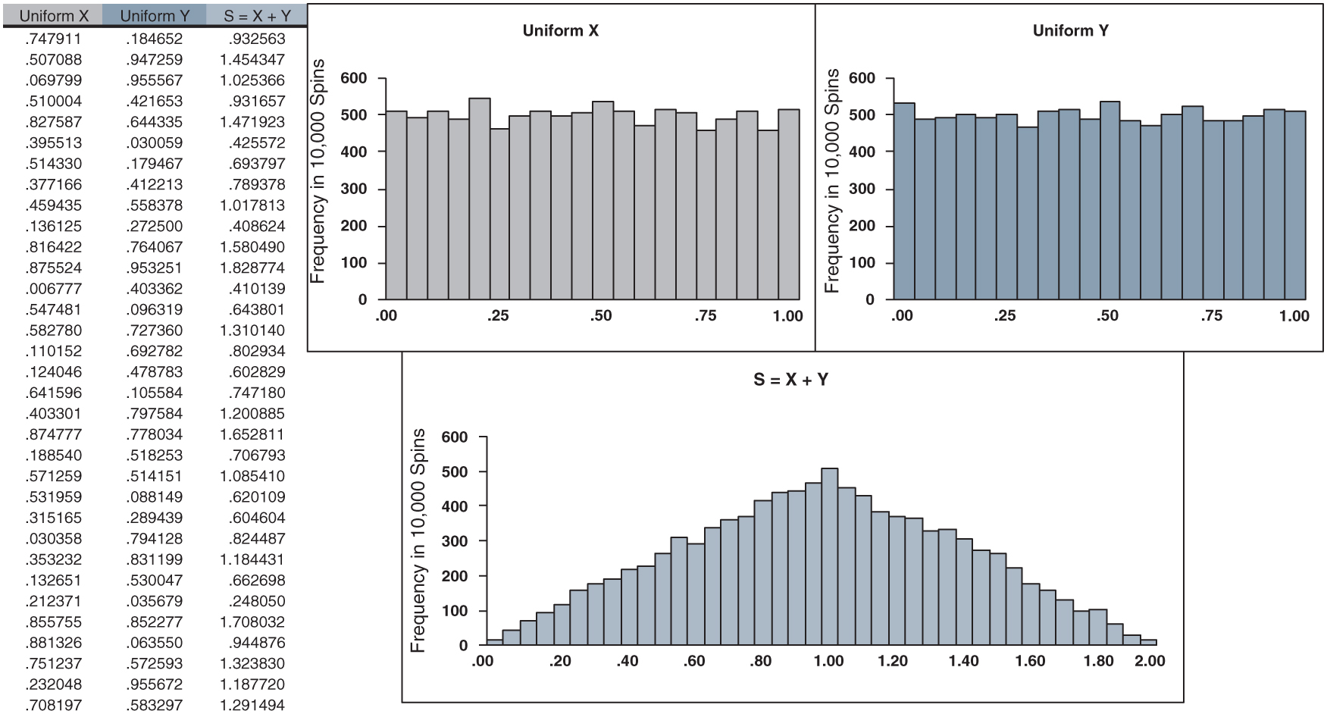
Figure 6.22: uniform_sum.xlsx

Slide 25
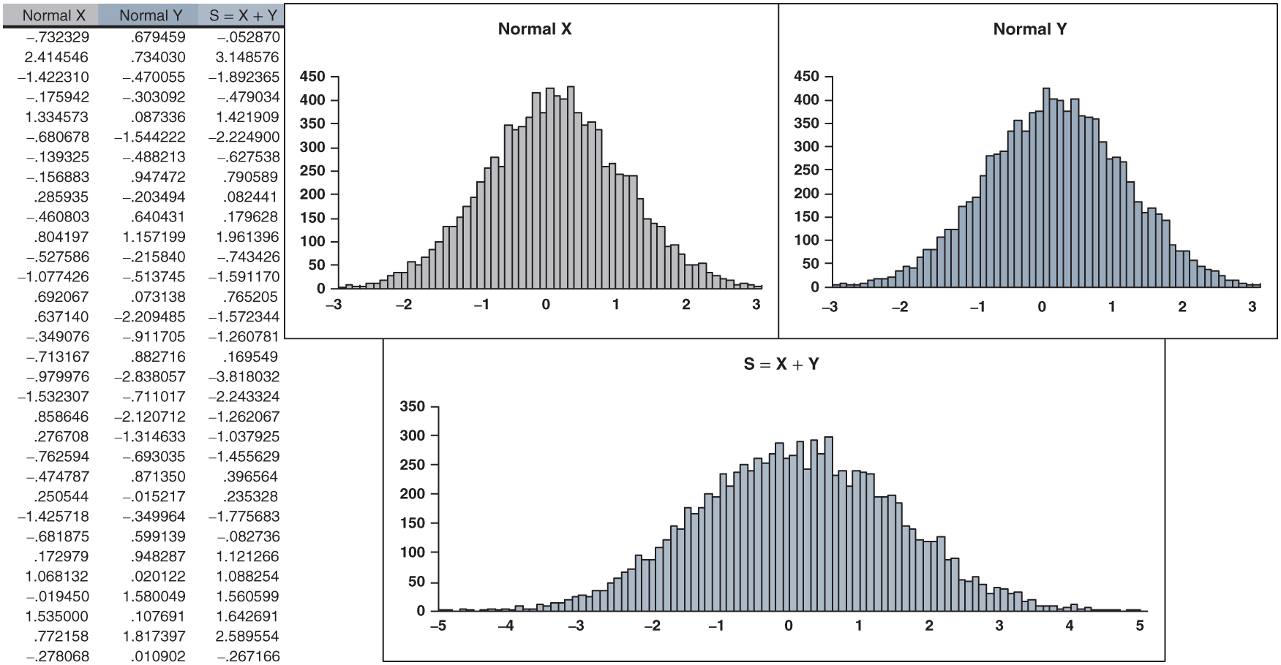
Figure 6.23: normal_sum.xlsx

Slide 26
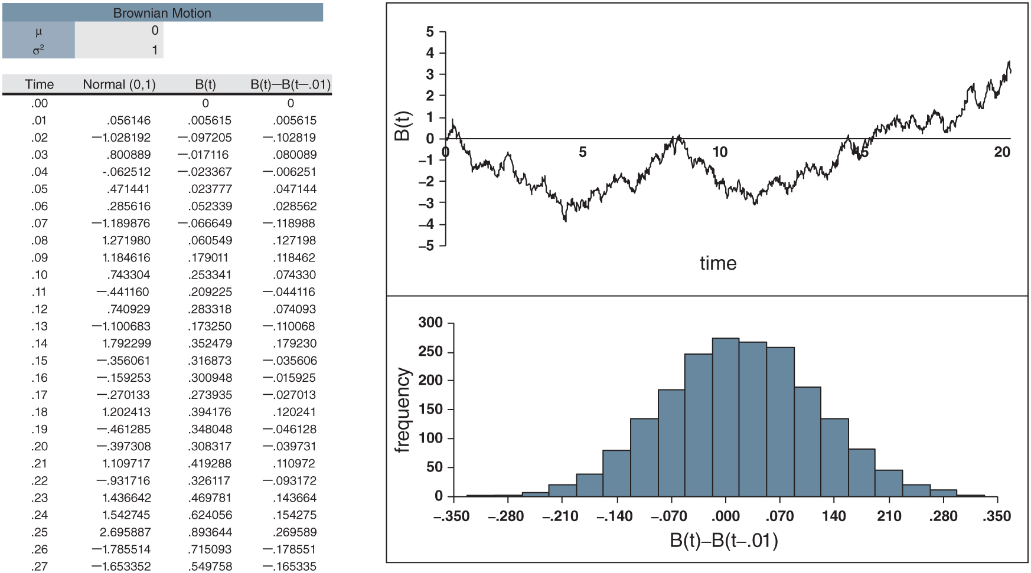
Figure 6.24: Brownian_motion.xlsx

Slide 27
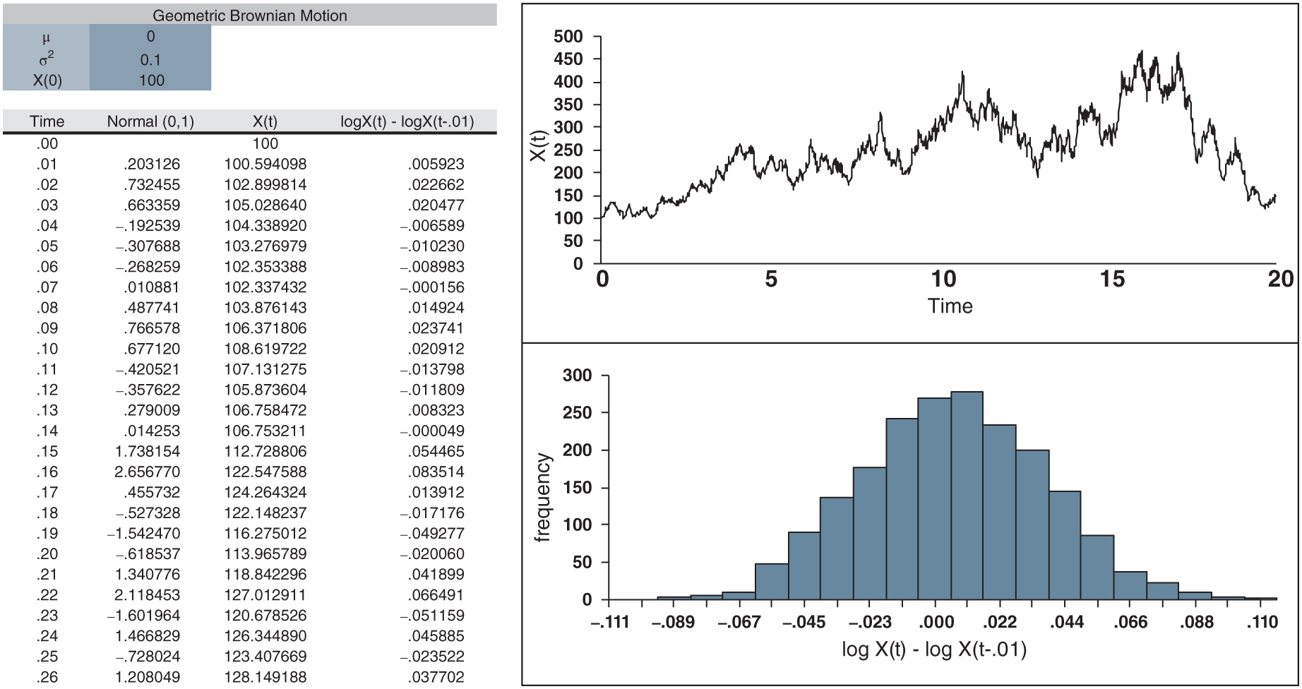
Figure 6.25: geometric_Brownian_motion.xlsx

