Slide 1
Vital Statistics Probability and Statistics for Economics and Business
William H. Sandholm
University of Wisconsin-Madison
Brett A. Saraniti
Northwestern University
Chapter 5
Bernoulli Trials Processes and Discrete Distributions

Slide 2
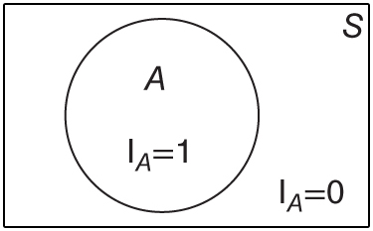
Figure 5.1: Probability diagram of an indicator random variable.

Slide 3
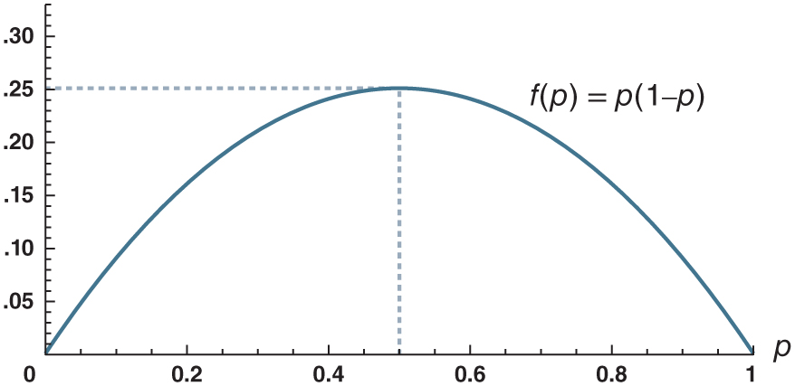
Figure 5.2: Means and variances of Bernoulli random variables.

Slide 4
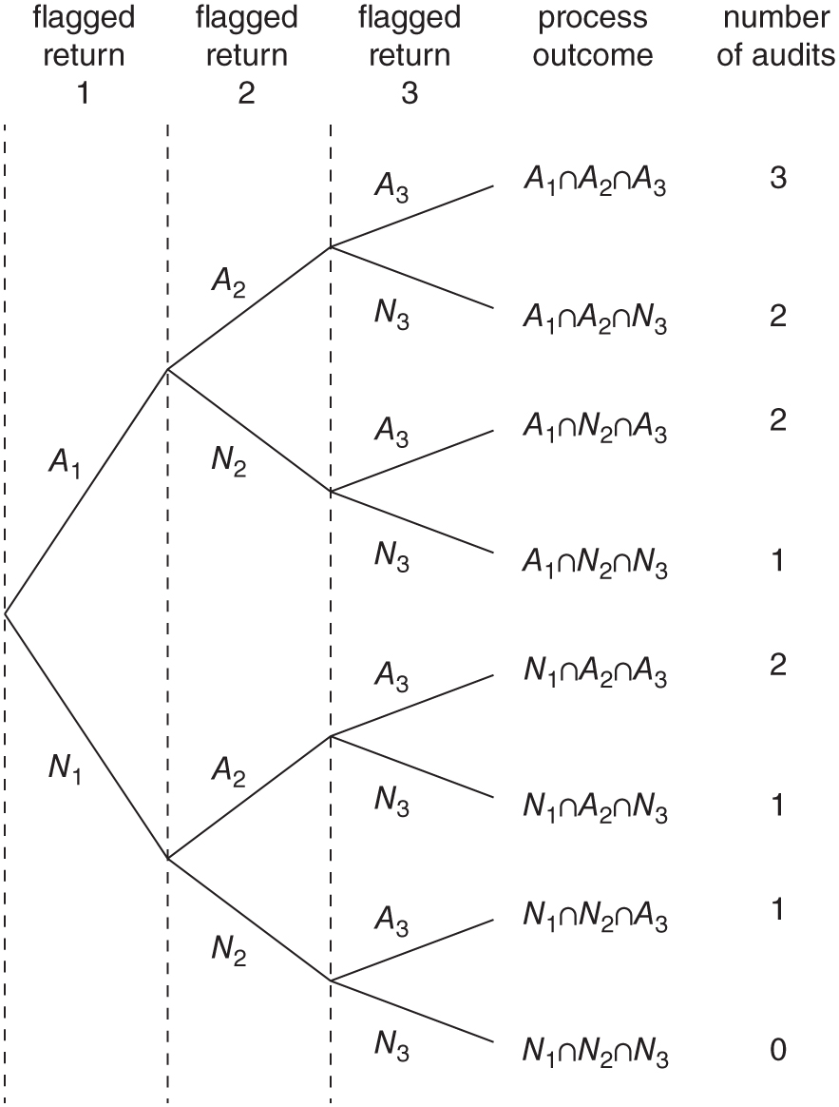
Figure 5.3: Tree diagram of a Bernoulli trials process.

Slide 5
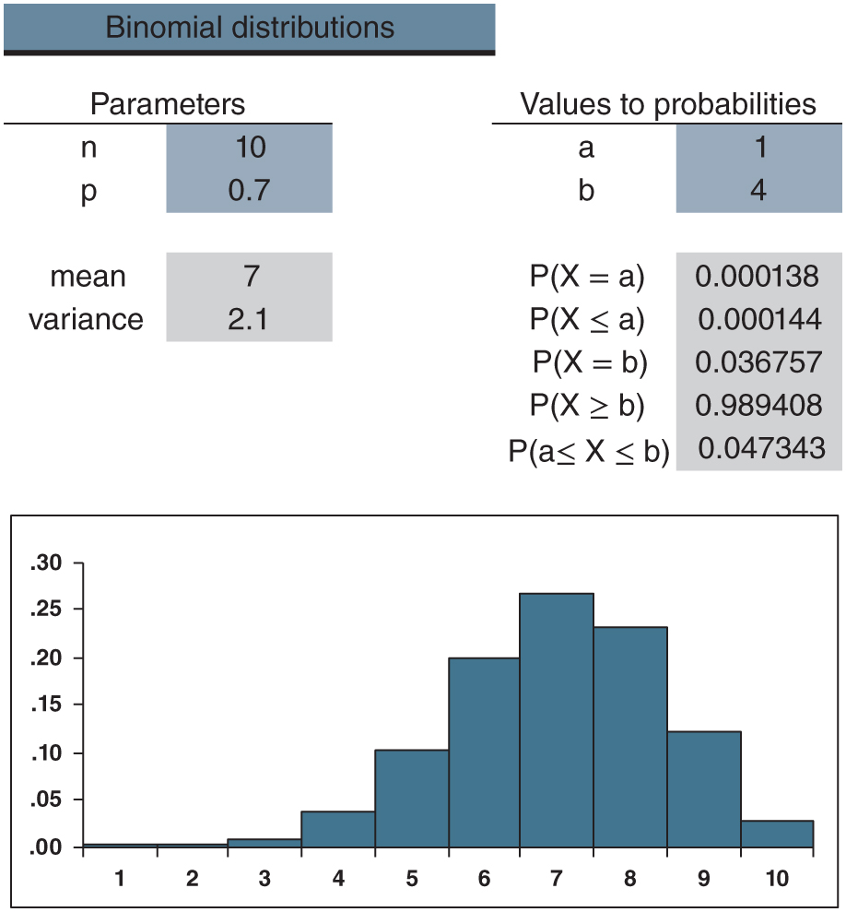
Figure 5.4: distributions.xlsx/binomial

Slide 6
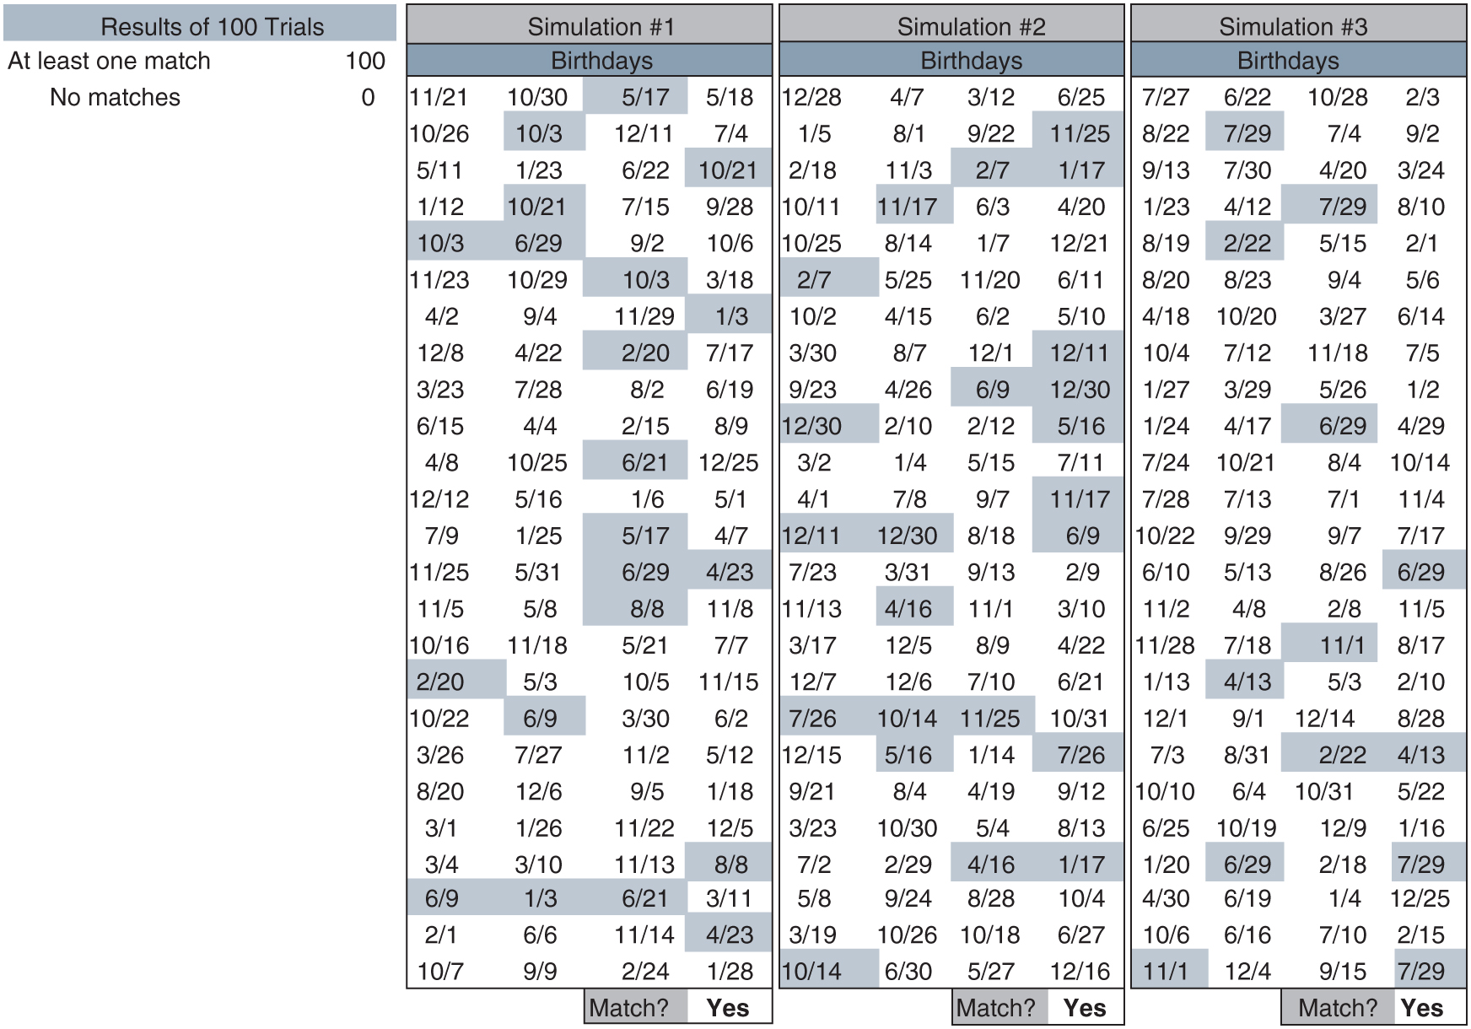
Figure 5.5: birthdays_100.xlsx

Slide 7
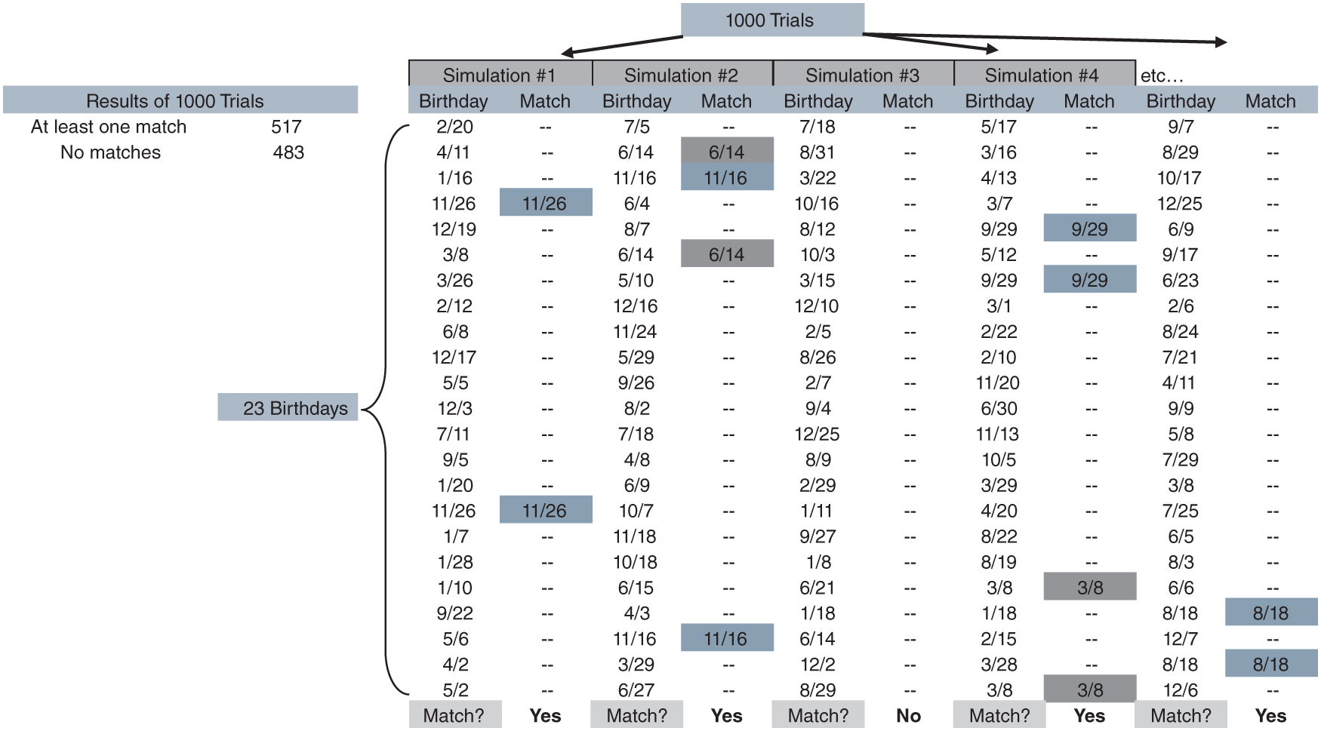
Figure 5.6: birthdays_23.xlsx

Slide 8
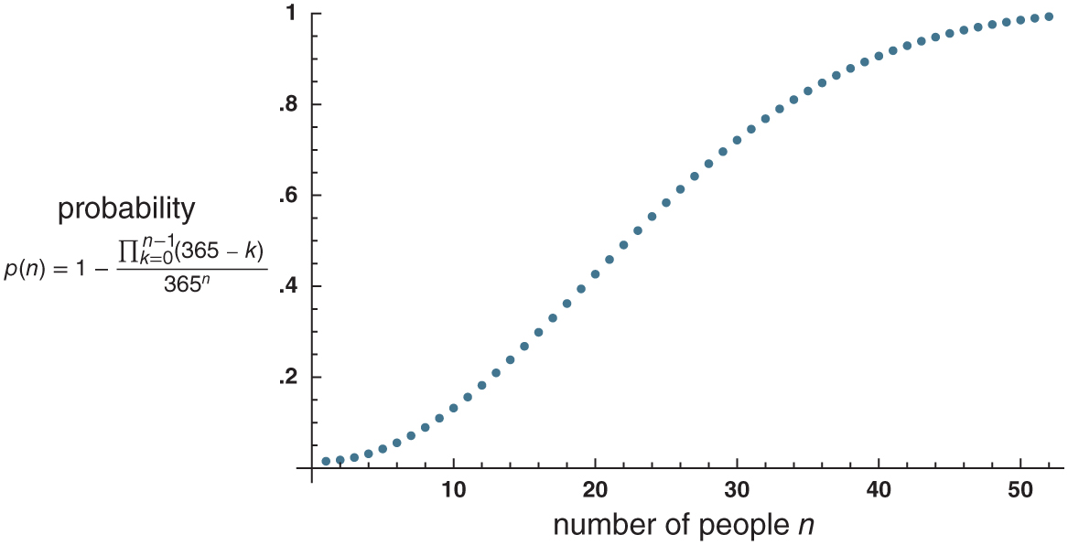
Figure 5.7: p(n) = the probability of a shared birthday in a group of n people.

