Slide 1
Vital Statistics Probability and Statistics for Economics and Business
William H. Sandholm
University of Wisconsin-Madison
Brett A. Saraniti
Northwestern University
Chapter 2
Probability Models

Slide 2
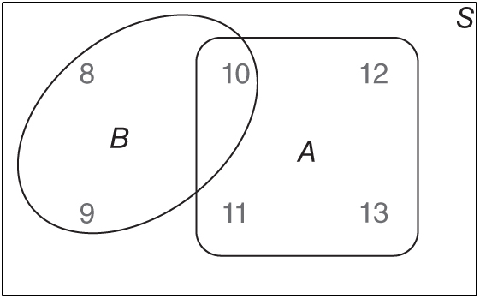
Figure 2.1: A Venn diagram.

Slide 3
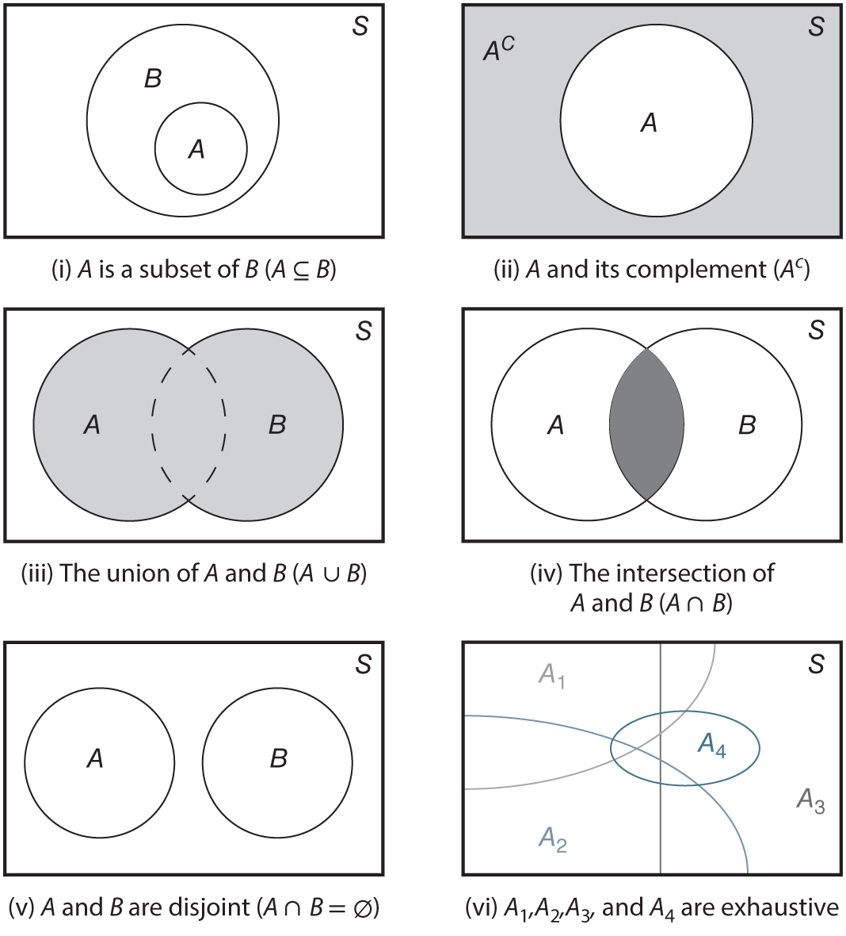
Figure 2.2: Basic definitions presented using Venn diagrams.

Slide 4
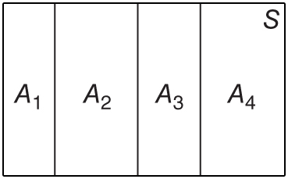
Figure 2.3: A partition of S.

Slide 5
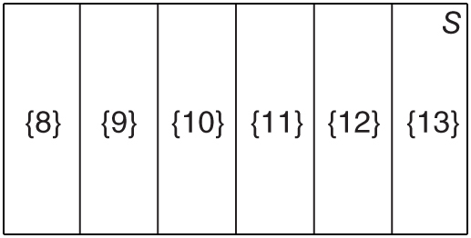
Figure 2.4: Probability diagram for the Neofuturists example.

Slide 6
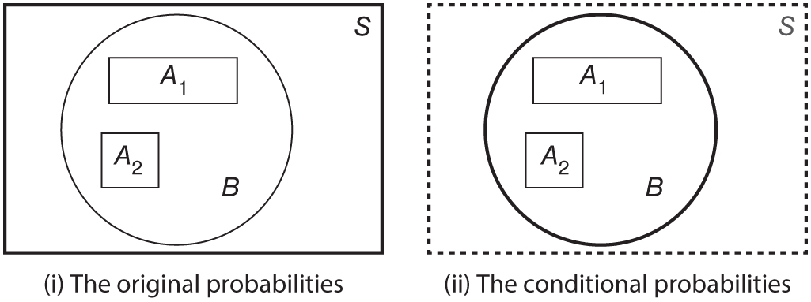
Figure 2.5: The conditional probability axioms.

Slide 7
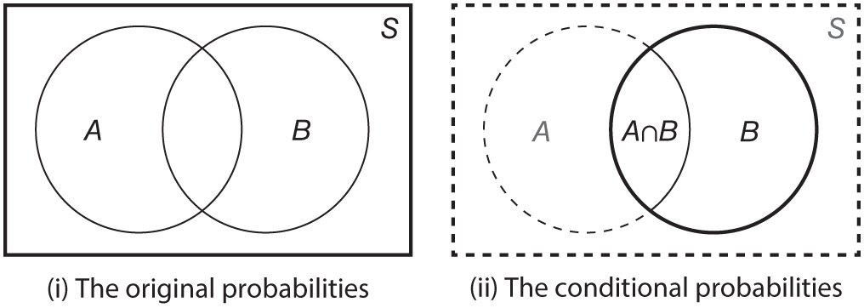
Figure 2.6: The conditional probability formula.

Slide 8
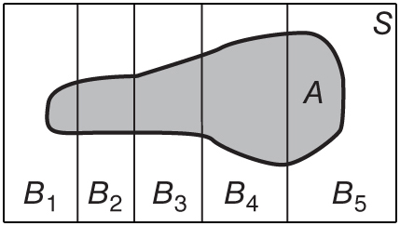
Figure 2.7: The total probability rule.

Slide 9
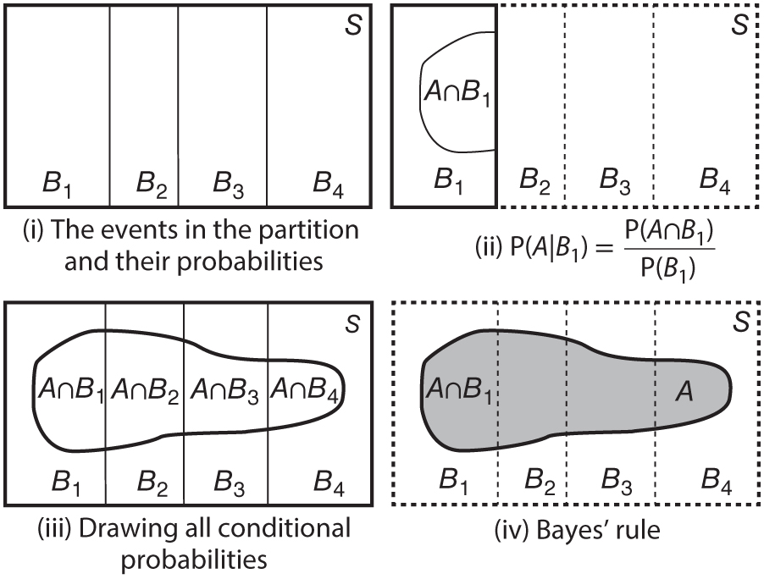
Figure 2.8: Bayes’ rule in pictures.

Slide 10
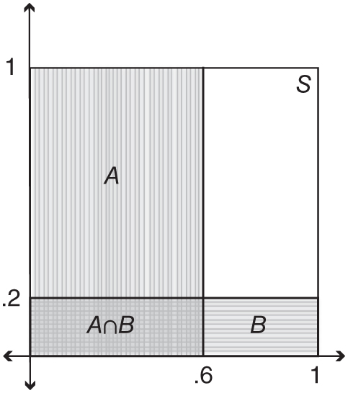
Figure 2.9: Independent events: P(A) = .6 × 1 = .6, P(B) = 1 × .2 = .2, P(A ∩ B) = .6 × .2 = .12.

Slide 11
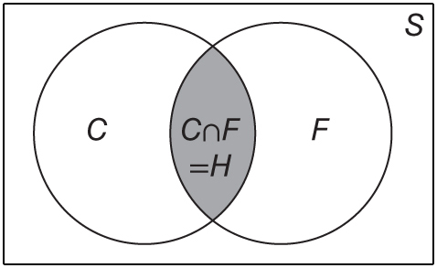
Figure 2.10: Probability diagram for the Linda problem.

Slide 12
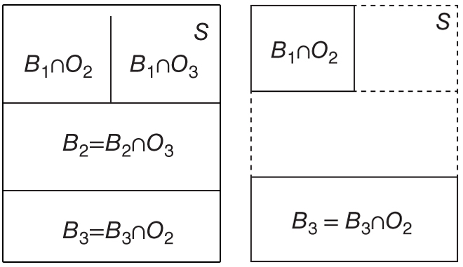
Figure 2.11: Probability diagrams for the Monty Hall problem.

