Slide 2
Chapter 13
Mental Illness

Slide 3

Outline
The challenge of classifying and treating mental illness
Schizophrenia
Depression
Anxiety disorders and other related disorders

Slide 4

Classifying and treating mental illness
Where do mental illnesses come from?
  The stars, the humors, the brain?
How do disruptions in neurons propagate to severe cognitive/behavioral dysfunction?

Slide 5
Classifying and treating mental illness
Once we agree that the brain is the source of the illness, how do you fix it?
Electroconvulsive therapy (ECT)
Drugs?
Surgery?

Slide 6
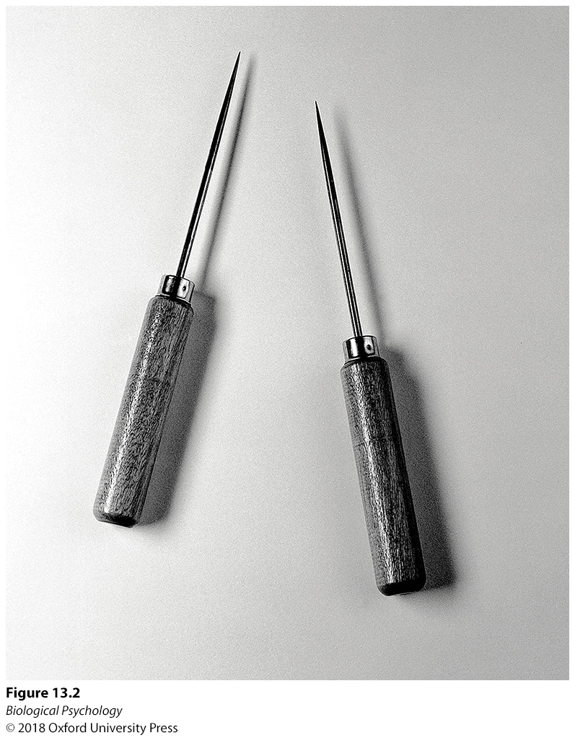
Classifying and treating mental illness
Nobel Prize
winning treatment
Notes:
Although the lobotomy treatment strategy led to the Nobel Prize, it is now known that the procedure lacked empirical support and, unfortunately, resulted in severe impairment in the patients who received the “treatment.” Shown here are a set of Watts–Freeman lobotomy instruments.

Slide 7
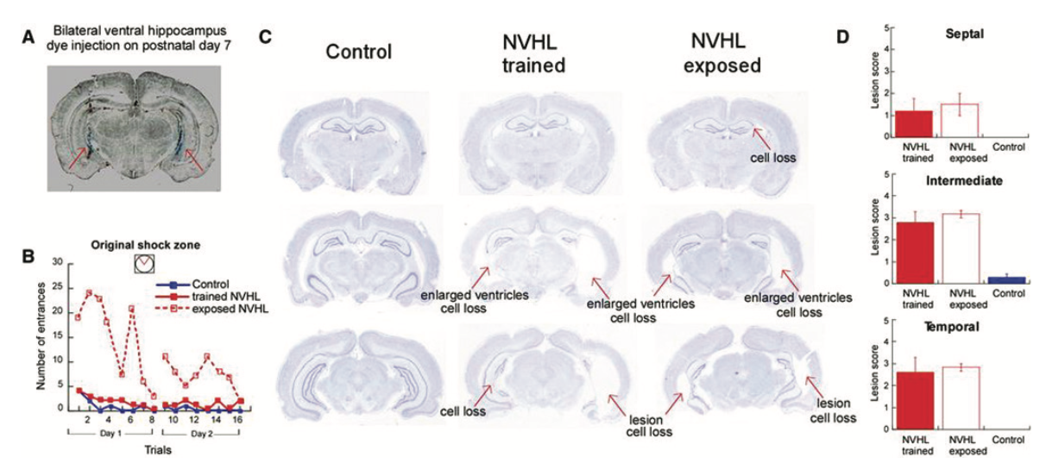
Classifying and treating mental illness
Notes:
At 12 years of age, Howard Dully was lobotomized by Dr. Walter Freeman at the request of his stepmother, who was concerned about his behavioral problems, including not cleaning his room or wanting to bathe.

Slide 8
Classifying and treating mental illness
Even today we can’t agree on how to classify mental illness
Current efforts: ICD-10, DSM-5
Problems
  Changing disorder criteria
  Elusive bio/behavioral markers
  Similar biological bases present different symptoms

Slide 9
Schizophrenia
1% prevalence
  Does this seem high or low?
Positive Symptoms
Negative Symptoms
Notes:
Positive symptoms: delusions, hallucinations
Negative symptoms: diminished emotions/thought processes

Slide 10
Schizophrenia
Potential Causes
Neurochemical
  Dopamine
  Acetylcholine
  Glutamate
Notes:
Positive symptoms: delusions, hallucinations
Negative symptoms: diminished emotions/thought processes

Slide 11
Schizophrenia
Potential Causes
Neurochemical
  Dopamine
  Acetylcholine
  Glutamate
Notes:
Positive symptoms: delusions, hallucinations
Negative symptoms: diminished emotions/thought processes

Slide 12
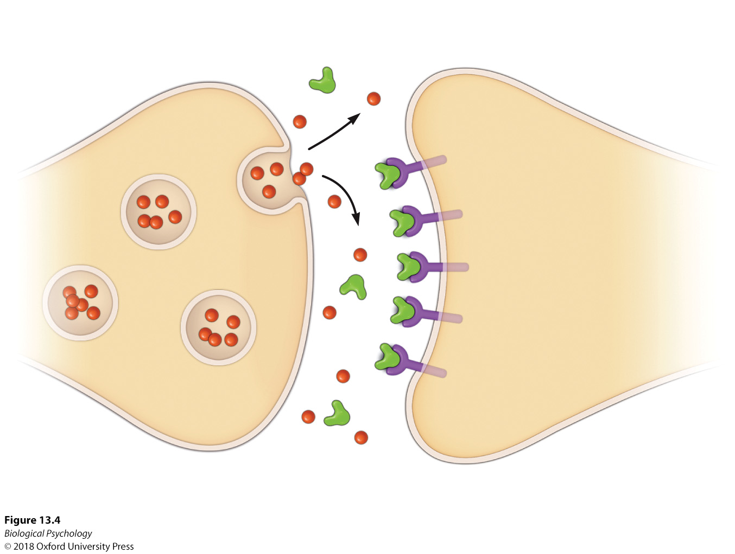
Schizophrenia
How does chlorpromazine work?
Notes:
Neuroleptic drugs such as chlorpromazine block dopamine D2 receptors.

Slide 13

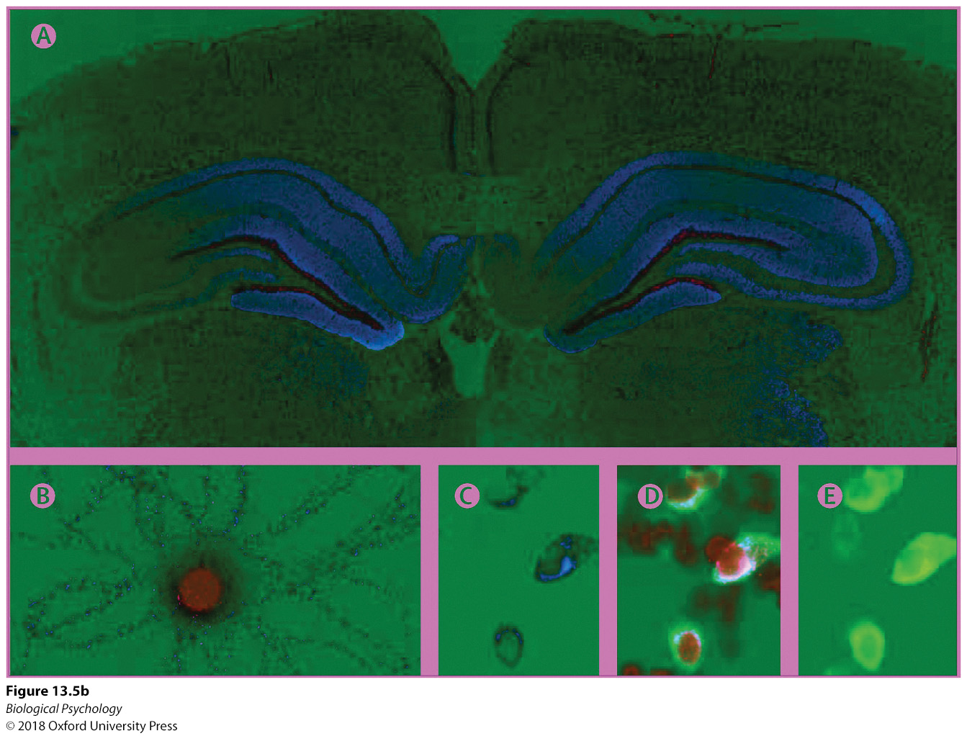
Schizophrenia
anti-NMDA receptor autoimmune encephalitis
Role of glutamate in schizophrenia-like symptoms
Notes:
(a) Susannah Cahalan exhibited characteristic symptoms of schizophrenia after developing anti-NMDA receptor autoimmune encephalitis. (b) When cerebrospinal fluid from patients with this disorder is applied to rat brains, antibodies for NMDA receptors occupy the hippocampus (shown in blue).

Slide 14
Schizophrenia: Anatomy
Smaller
Larger
Temporal lobes
Frontal lobes
Thalamus
More loss of gray matter during adolescence
Ventricles
Notes:
In identical twins disconcordant for schizophrenia, the twin with schizophrenia has larger ventricles.

Slide 15
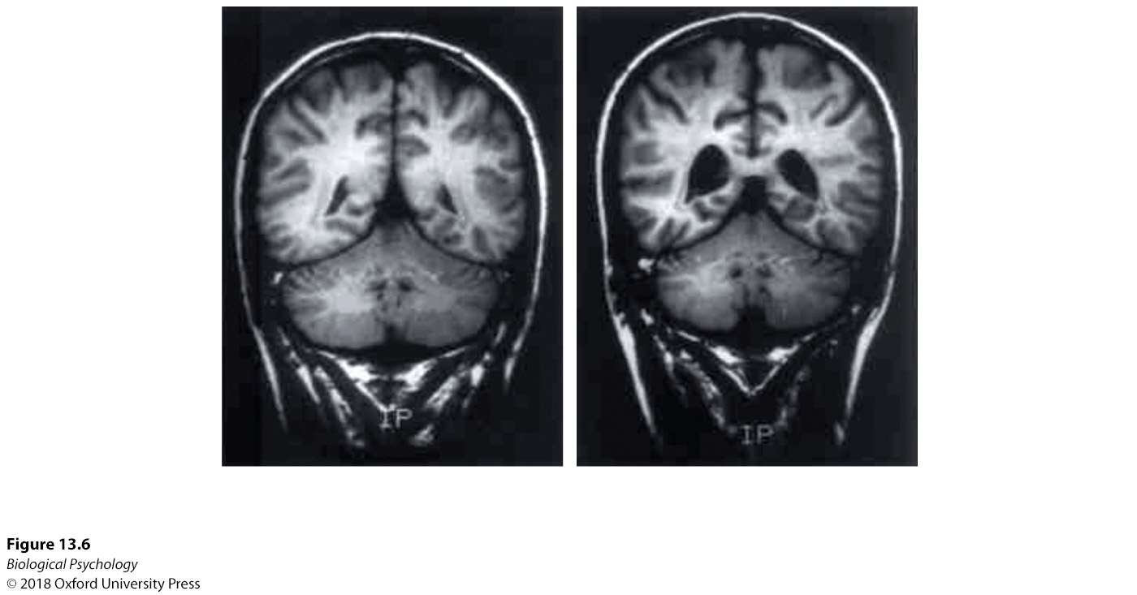
Schizophrenia: Anatomy
Notes:
In identical twins disconcordant for schizophrenia, the twin with schizophrenia has larger ventricles.

Slide 16
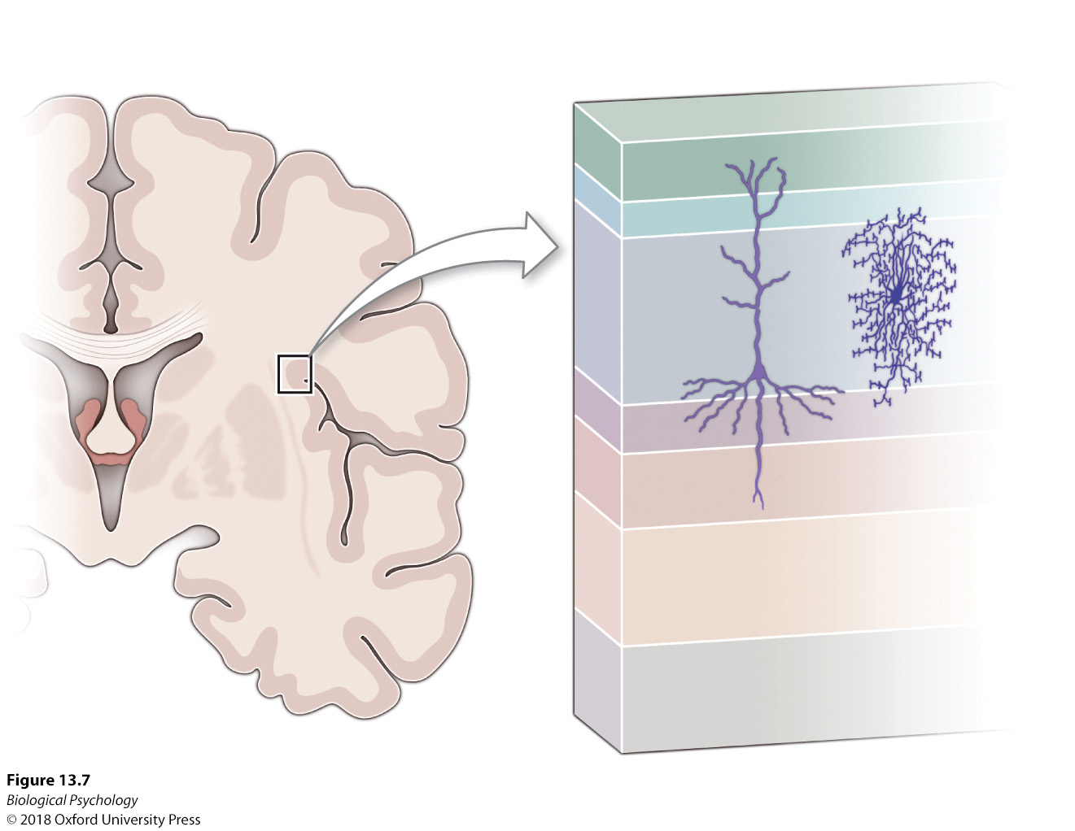
Schizophrenia: Anatomy
Notes:
When compared with healthy controls, individuals diagnosed with schizophrenia have altered receptors in the chandelier cells of the cortex. ese chandelier cells are thought to communicate with the cortical pyramidal cells.

Slide 17
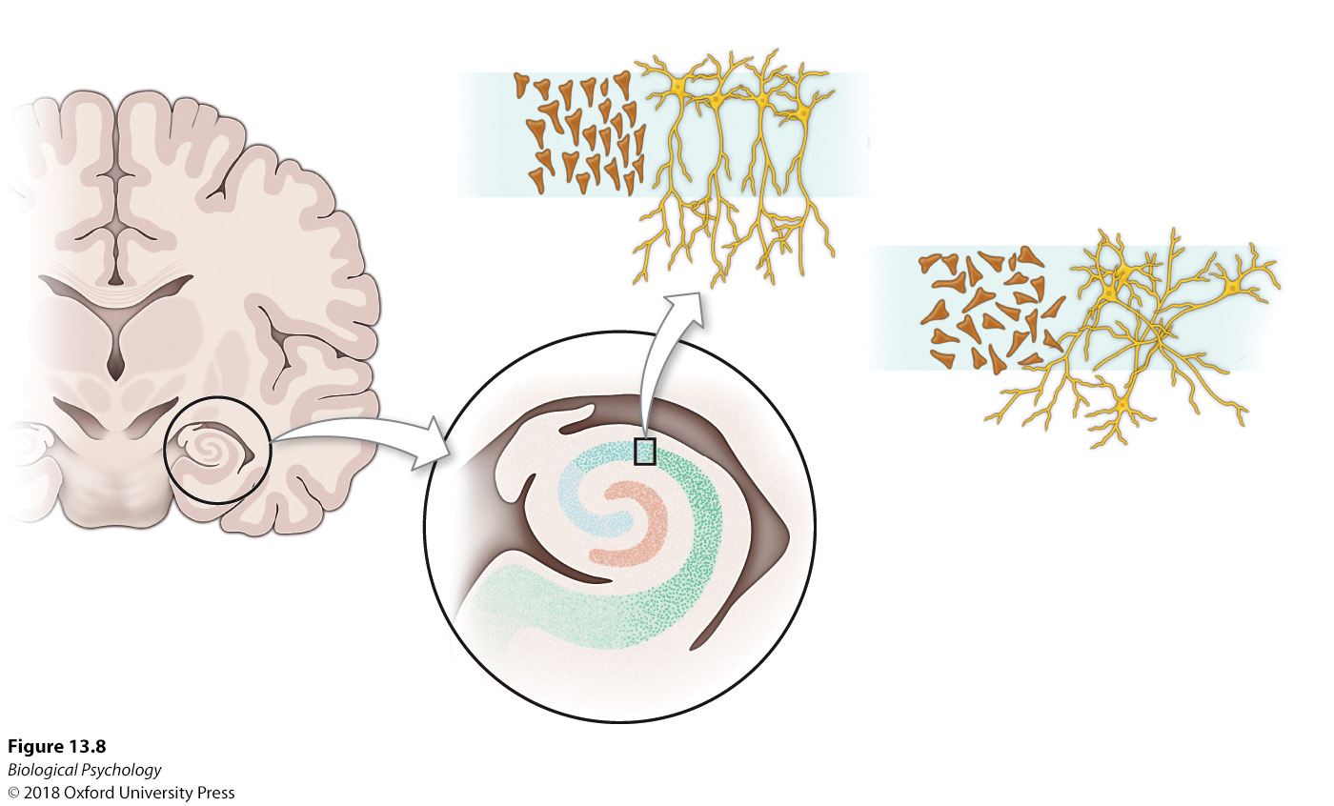
Schizophrenia: Anatomy
Notes:
In the hippocampus, pyramidal cells are characterized as being disorganized in comparison to the more organized alignment observed in healthy controls, a structural effect that likely affects neuronal processing in this brain structure.

Slide 18
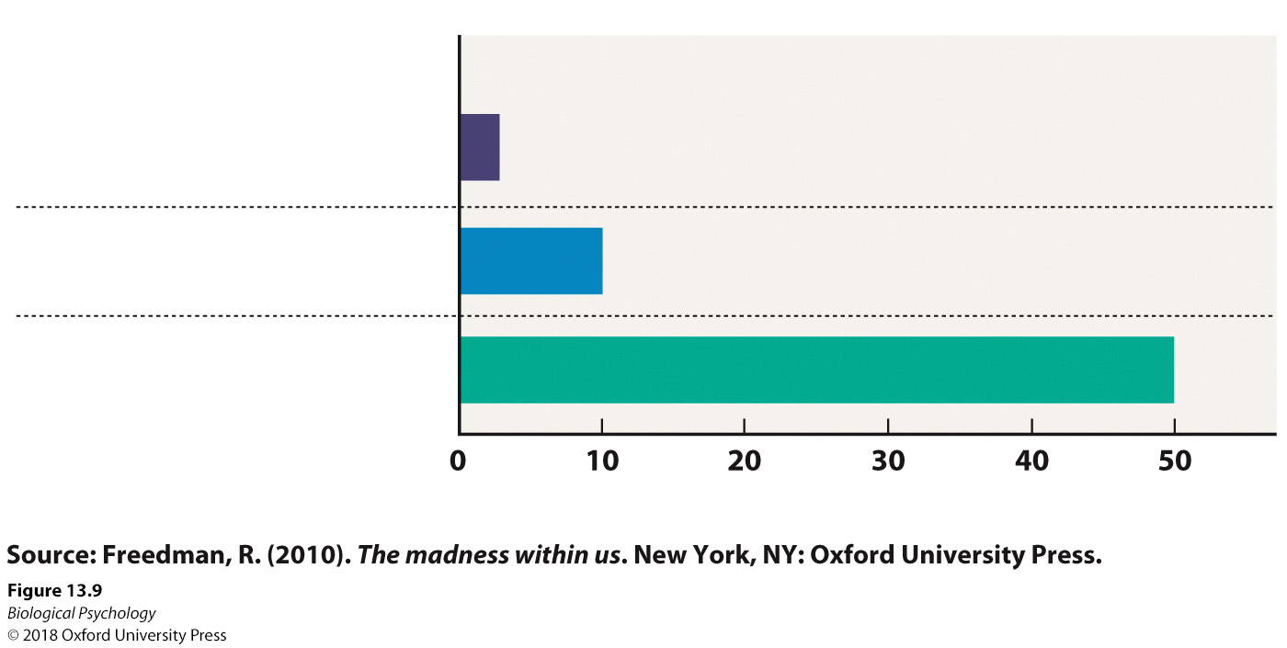
Schizophrenia: Genetics
Notes:
Because the highest concordance rate of schizophrenia is observed in identical twins and the lowest concordance rate in two individuals who are not related, a genetic component is acknowledged and is being investigated by researchers.

Slide 19
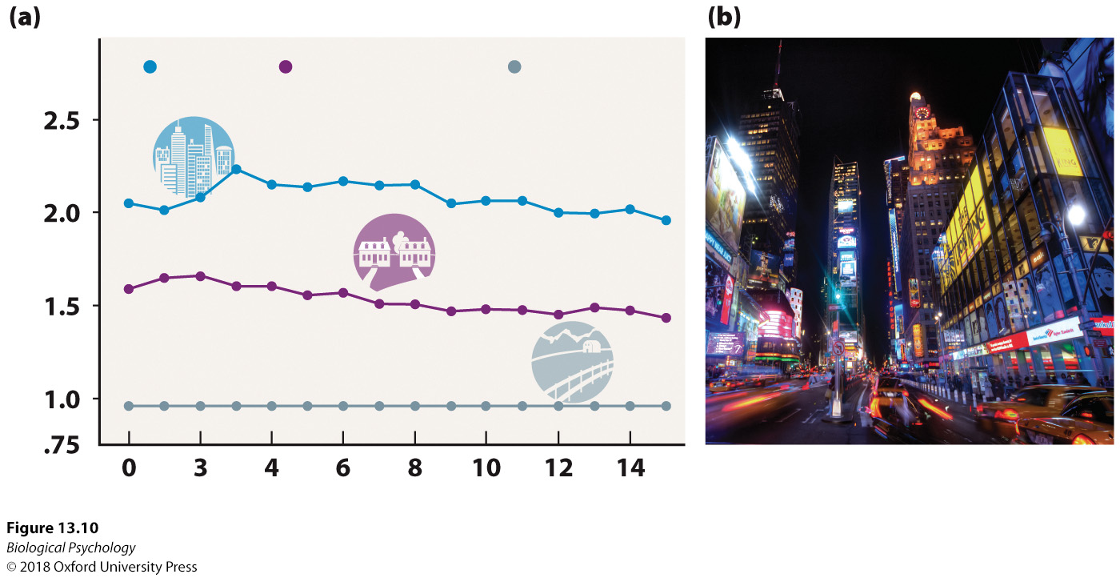
Schizophrenia: Environment
Notes:
When individuals lived in the more urban settings at any year during the first 15 years of their lives, this variable was associated with a higher risk of schizophrenia. Additional analyses indicated that individuals living in urban settings for the entire first 15 years had the highest rates of schizophrenia.

Slide 20
Schizophrenia: Environment
Should we move out of cities?
What is it about cities that might cause/trigger schizophrenia?
Notes:
When individuals lived in the more urban settings at any year during the first 15 years of their lives, this variable was associated with a higher risk of schizophrenia. Additional analyses indicated that individuals living in urban settings for the entire first 15 years had the highest rates of schizophrenia.

Slide 21
Schizophrenia: Treatment
Pharmacological treatment
Cognitive remediation
Compensatory therapy

Slide 22
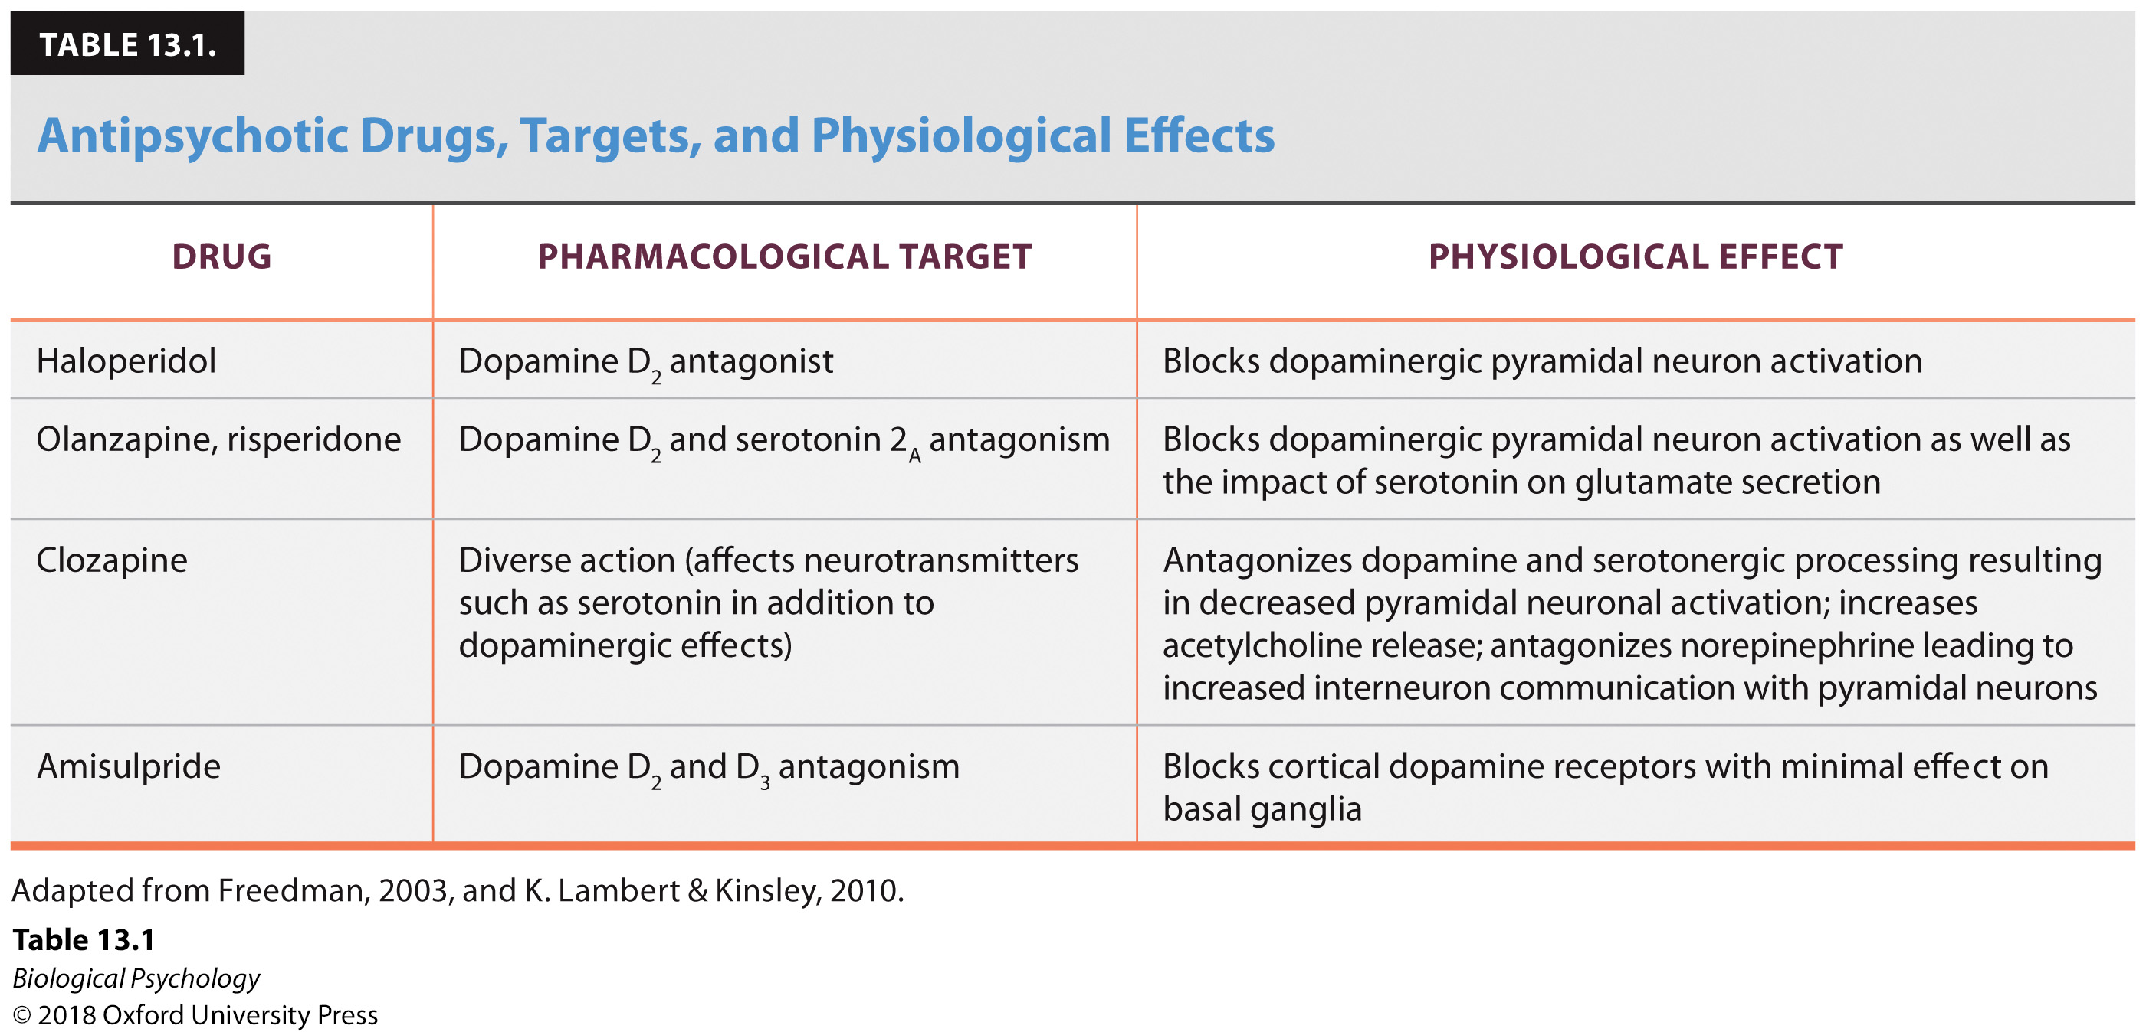
Schizophrenia: Treatment
Pharmacological treatment

Slide 23
Schizophrenia: Treatment
Cognitive remediation & Compensatory therapy
Early reports suggest effectiveness without the side effects

Slide 24
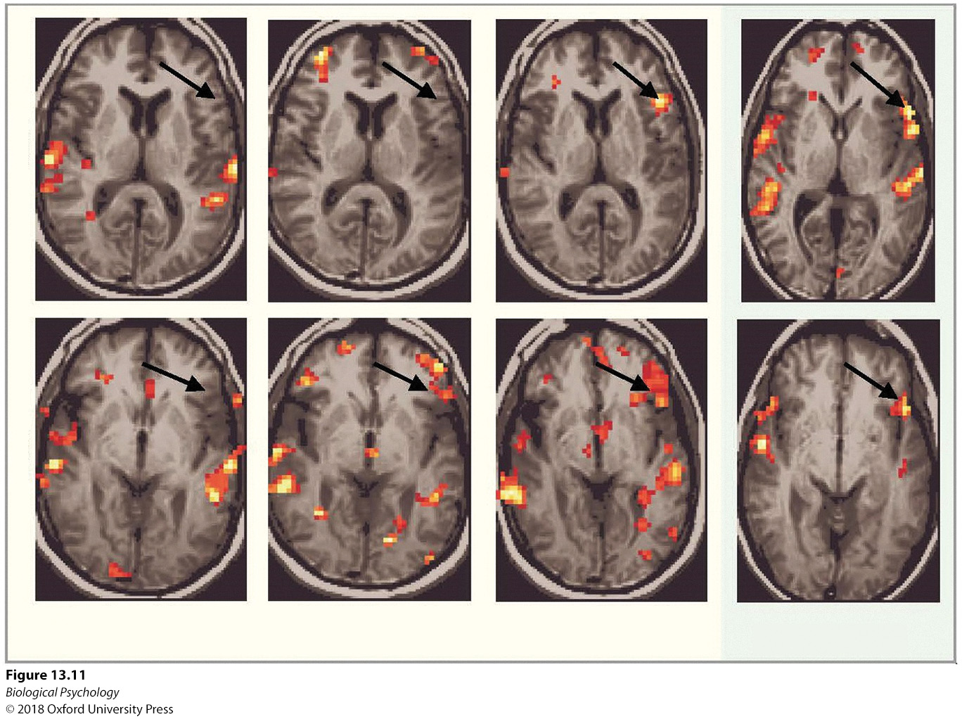
Schizophrenia: Treatment
Notes:
Following 10 and 15 weeks of cognitive training, this patient experienced increased activation in the le inferior frontal gyrus (slice 1) and le lateral orbital gyrus
(slice 2). Activation in these levels was closer to that of the healthy subject than observed prior to training.

Slide 25
Schizophrenia: Treatment
How can we study schizophrenia treatments in nonhumans?
  Develop a model for a specific symptom/neurochemical deficit
  Treat the deficit

Slide 26
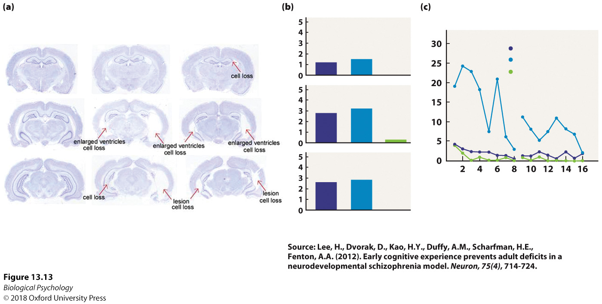
Schizophrenia: Treatment
Notes:
(a) Although the lesioned areas were similar in both trained and untrained groups, confirmed by (b) similar lesion size scores, (c) the trained animals performed similar to the non-lesioned controls in the cognitive task, with fewer entrances into a shock zone than the non-trained animals over the course of two days of trials.

Slide 27
Depression
17% lifetime prevalence
Neurochemical basis
  Monoamine hypothesis
  Dopamine hypothesis
  Molecular hypothesis
  Cortisol
  BDNF

Slide 28
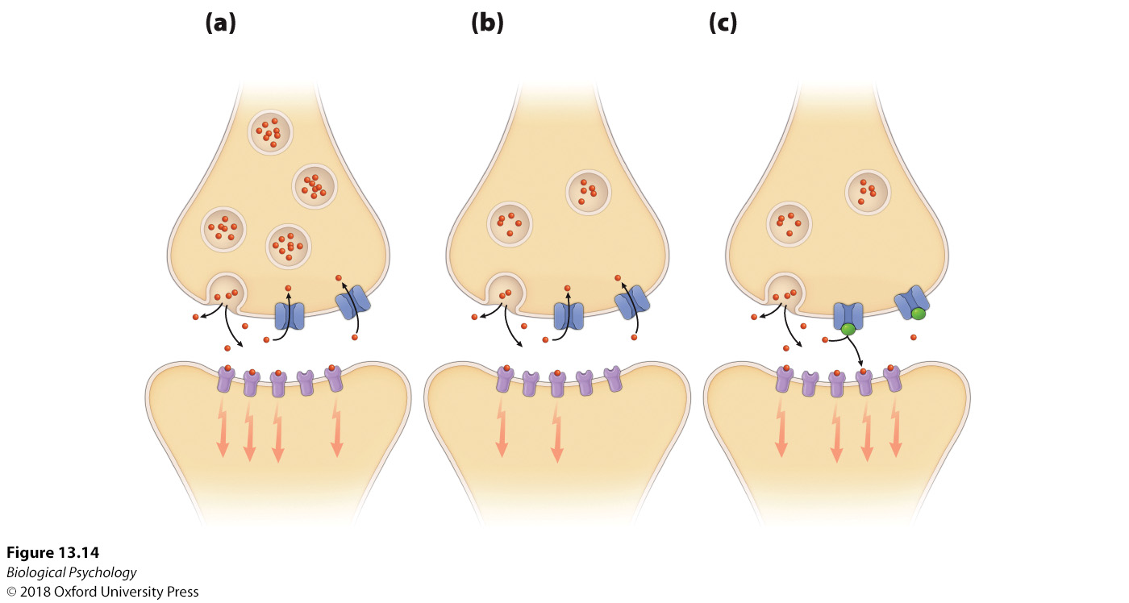
Depression: Monoamine hypothesis
Notes:
Imipramine blocks the reuptake of the monoamines, thereby keeping them in the synapse longer.

Slide 29
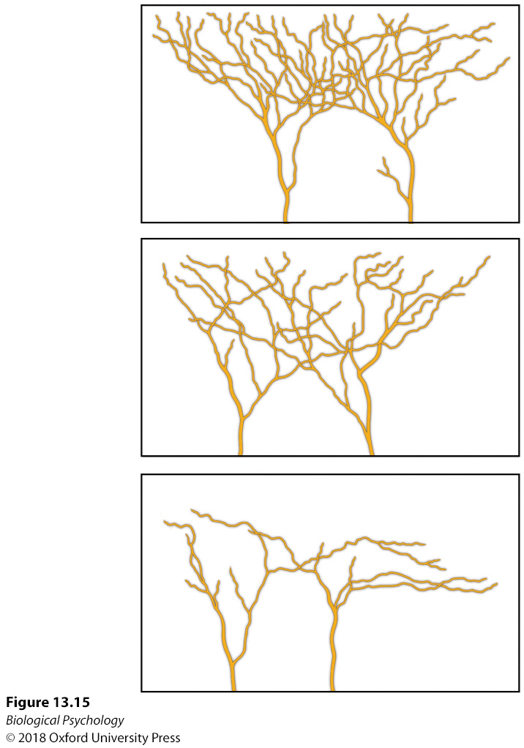
Depression: BDNF
Comparing dendritic branches in medial prefrontal cortex in mice with low BDNF
Notes:
In an investigation of the role of varying levels of BDNF on brain areas implicated in depression, mice with significantly reduced BDNF levels exhibited increased atrophy of the dendritic branches in the medial prefrontal cortex.

Slide 30
Depression: Anatomy
Symptoms suggest anatomical targets
Lank of motivation for pleasurable activities
  Nucleus accumbens
  Effort-based reward theory
Lack of concentration/cognitive difficulty
  PFC
Chronic stress
  Hippocampal volume/function

Slide 31
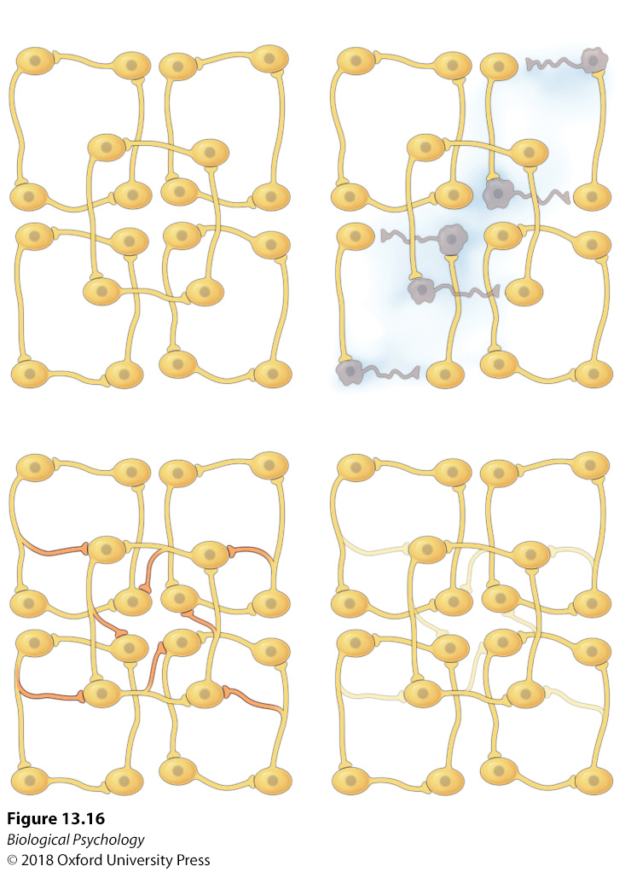
Depression: Network Hypothesis
Rather than a single “chemical imbalance” depression may result from a disorder of connectivity
Activity-dependent neuroplasticity
How do you measure network activity in humans?
Notes:
This theoretical model proposes that depression results from compromised neural networks, and the symptoms subside when the networks are recovered through effective treatments.

Slide 32
Depression: Treatment
ECT / rTMS
Pharmacotherapy
Cognitive and behavioral therapies
Emerging treatments

Slide 33
Depression: Treatment
ECT
  still used for patients that do not respond to other approaches
  Some short-term effectiveness
  Side effects include memory loss
rTMS
  Magnetic stimulation
  Less intense, fewer side effects
  Data is still coming in

Slide 34
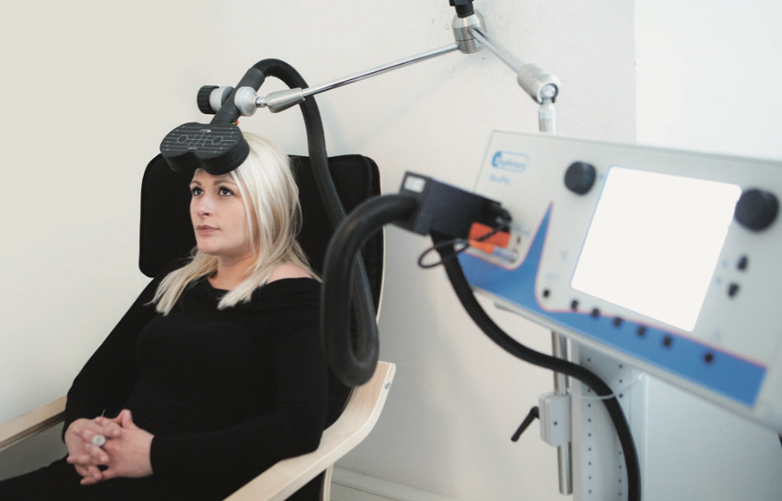
Depression: Treatment
Notes:
Treatment with rTMS involves positioning a very powerful electromagnet on the scalp that ultimately depolarizes underlying neurons.

Slide 35
Depression: Treatment
Pharmacotherapy
MAOIs
Tricyclics
SSRIs
Need better double-blind studies
  Prevalence of side effects may un-blind control vs. experimental group

Slide 36
Depression: Treatment
Cognitive
Behavioral
Focus on eliminating the destructive beliefs of the patient
Longer lasting effects
Combined drug/cognitive approaches are common
Focus on how the patient interacts with the external environment.
Patients learn contingency between behavior and positive outcomes (effort-based reward model)

Slide 37
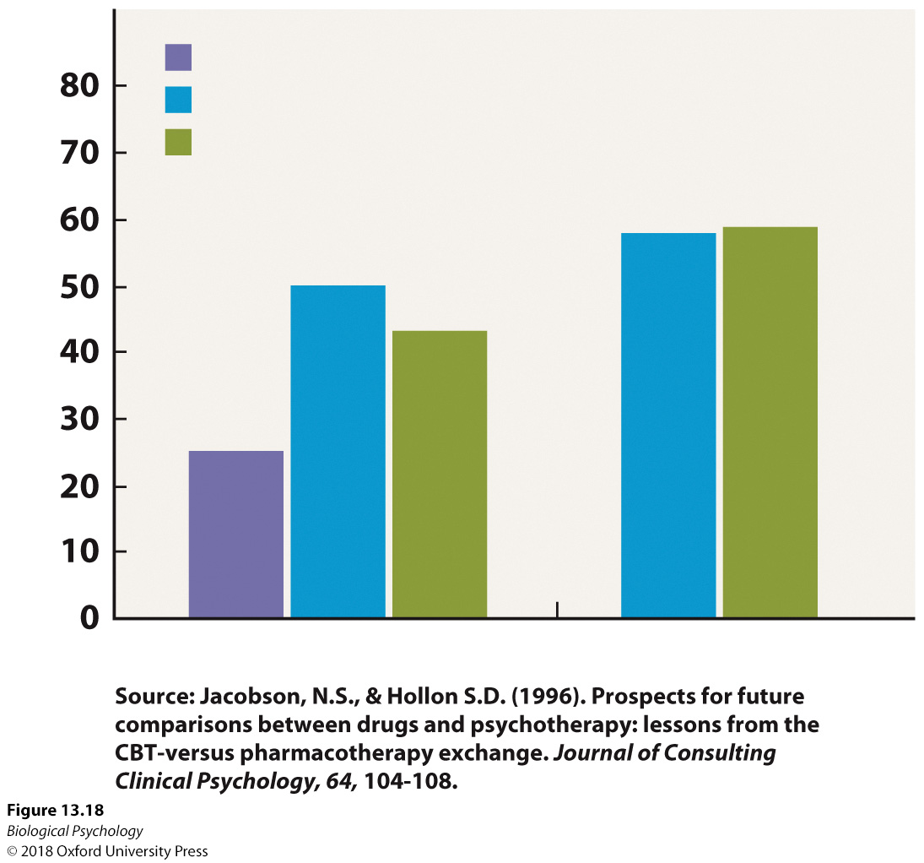
Depression: Treatment
Notes:
Efficacy rates of various depression therapies. At two time points, 8 weeks and 16 weeks, there is little difference between antidepressant and cognitive therapies.

Slide 38
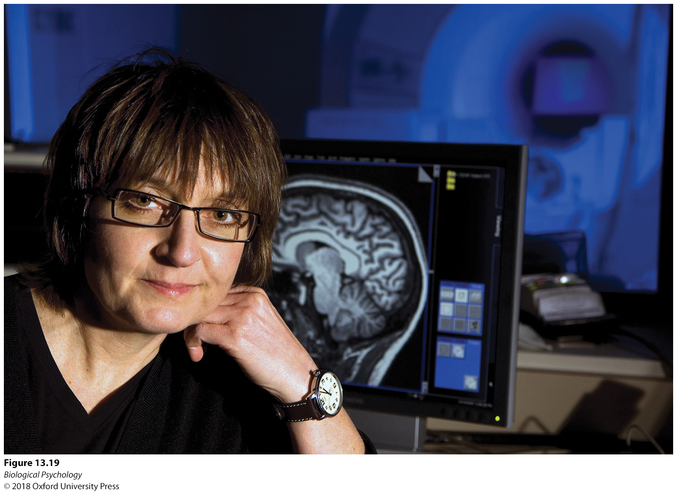
Depression: Treatment
Deep brain stimulation
Common Targets: subcallosal cingulate gyrus, lateral habenula
Notes:
Edi Guyton, after suffering from long-term depression, had electrodes implanted into the subcallosal cingulate to treat the depression symptoms

Slide 39
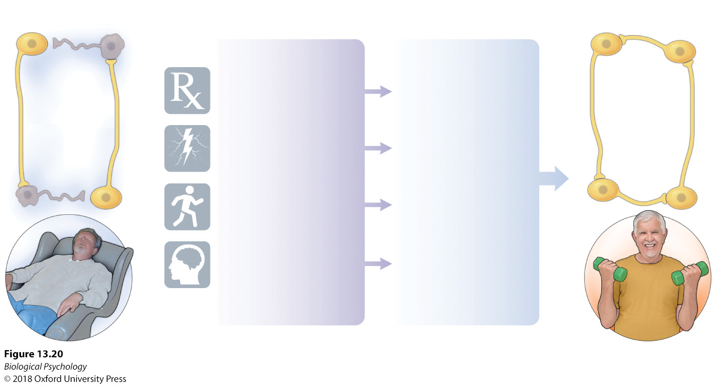
Depression: Treatment
Neural plasticity may underlie all treatment effects
Notes:
Several common treatment strategies impact neural plasticity that restores the neural networks for competent rather than impaired function

Slide 40
Bipolar Disorder
Lows of depression
Manic periods where those with this disorder often engage in dangerous/risky behaviors.
Treatment most often lithium
  Likely affects serotonin
  70-80% effective

Slide 41
Anxiety Disorders
Anxiety is a feature of life, but out of control anxiety can cause severe disruptions
State vs. trait anxiety

Slide 42
Anxiety Disorders: Causes
Often triggered by a stressful event
Amygdala and GABA system have been implicated
Chronic stress may damage stress response system
Measureable genetic component
  Don’t forget about individual differences

Slide 43
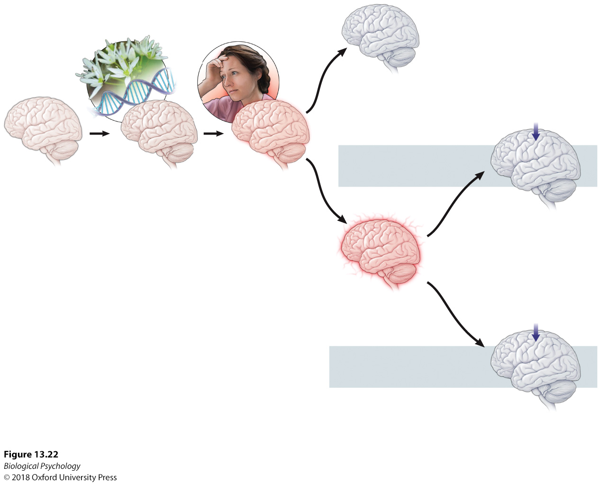
Anxiety Disorders: Causes
Notes:
Genetic predispositions, environmental factors, and anxiety disorders. Exposure to the same life stressors can result in different anxiety response outcomes in individuals with varying genetic predispositions and environmental histories.

Slide 44
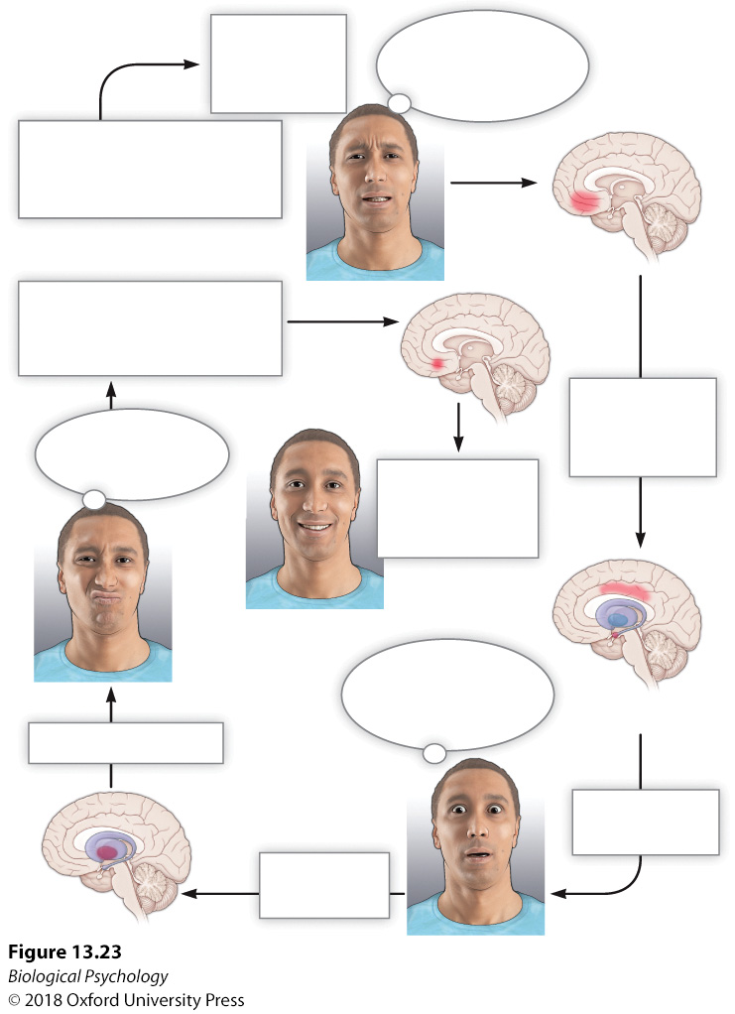
Anxiety Disorders: Causes
Notes:
Environmental contexts, such as leaving a car in the parking lot, can prompt sufficient uncertainty and anxiety to trigger obsessions characteristic of OCD. For example, as fear and worry are experienced, this may ultimately lead to a response resulting in reduced anxiety (e.g., going back to the parking lot to make sure the car is locked).

Slide 45
Anxiety Disorders: Treatments
SSRIs
  not fast acting
Surgery
  bilateral lesions to the lower medial OFC and the anterior cingulate bundle area
Behavioral approaches, e.g., exposure therapy for phobias

Slide 46
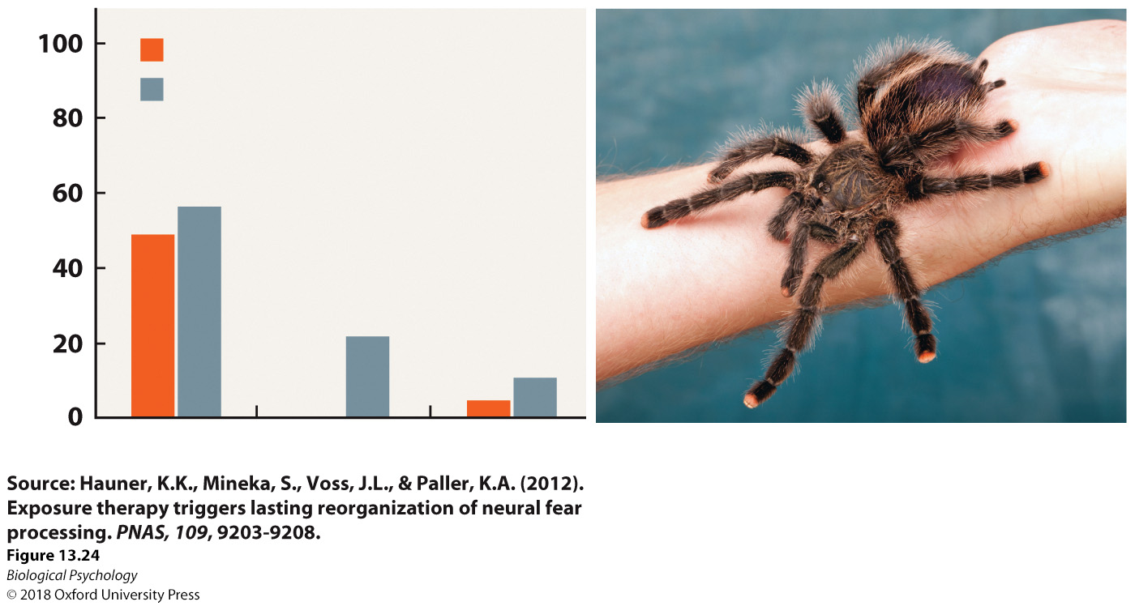
Anxiety Disorders: Treatments
Notes:
A two-hour exposure therapy session resulted in persistent decreases in self-reported phobia symptoms, self-reported fear beliefs, the ability to approach a live tarantula, and the fear associated with that fear.

Slide 47
Anxiety Disorders: Treatments
How do we get (un)learning to generalize to new contexts?
Are there any phobias for which exposure therapy might be impractical?
What about exposure in a virtual environment/video game context?

Slide 48
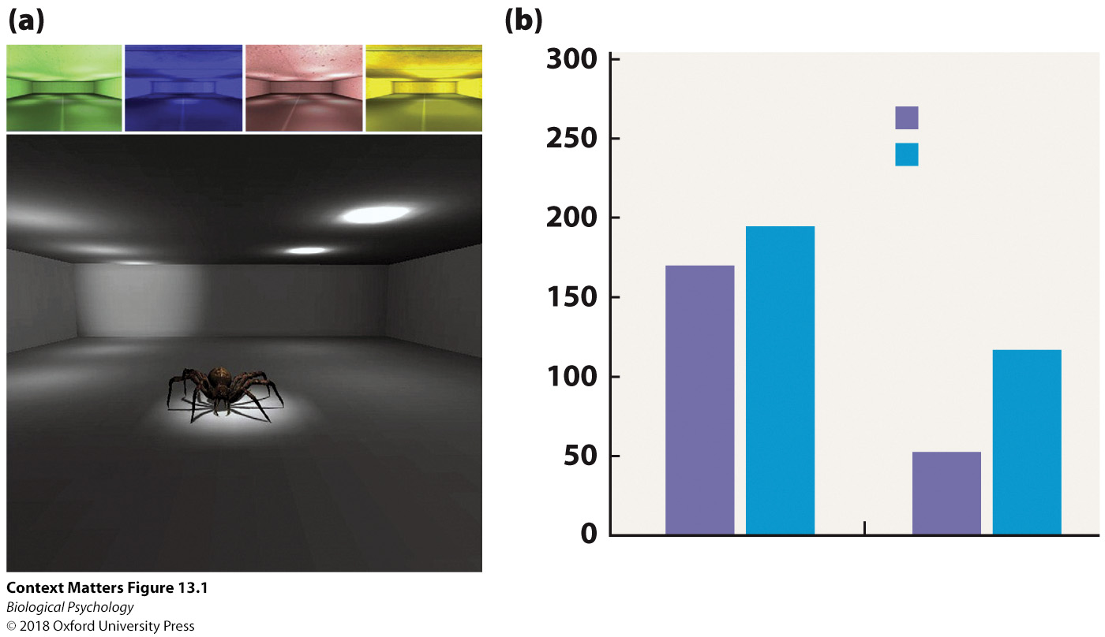
Anxiety Disorders: Treatments
Notes:
After multiple context exposure (MCE) therapy in which participants are exposed to spiders in various colored room contexts or the single context exposure therapy, (b) the participants in the MCE group were able to move a live spider in a box closer to them in the behavioral approach test.

Slide 49
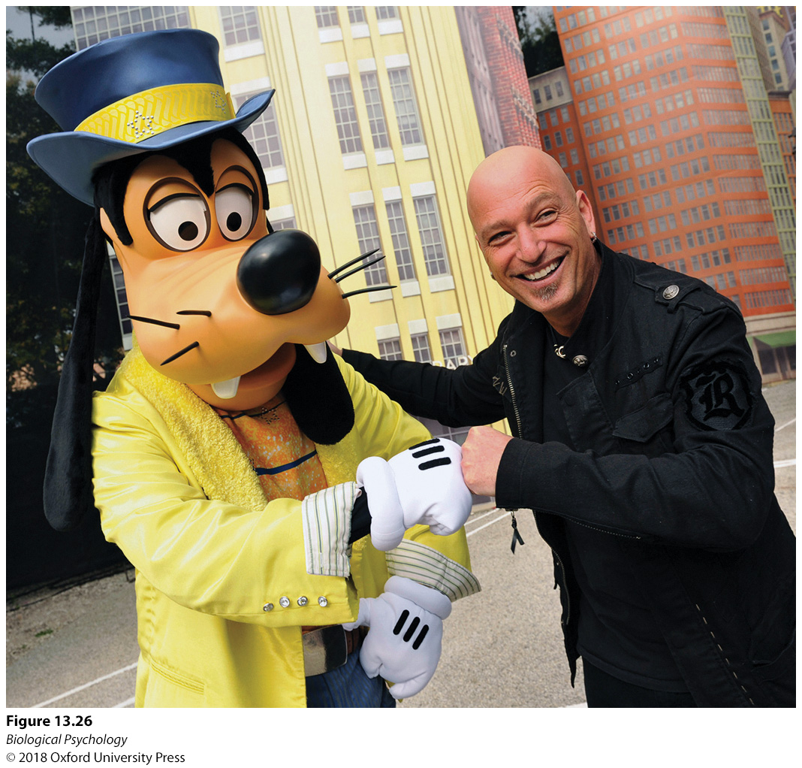
Anxiety Disorders
Anxieties can have adaptive value
Difficult to change behavior, when alternatives exist
  e.g., Avoiding shaking hands
How do we decide when a compulsive behavior should be modified?
Notes:
To avoid germ transmission and calm his anxiety, the comedian Howie Mandel greets others by tapping fists rather than shaking hands.

