Slide 2
Chapter 12
Learning, Memory, and Decision Making

Slide 3

Outline
Neurobiological foundations of learning and memory
Modifying memories
Attention as a gateway to learning and memory
Decision making

Slide 4

Neurobiological foundations of learning and memory
Behavioral Approaches
Cellular Mechanisms
Structural Neuroplasticity
Integrating Clinical and Laboratory Research
Notes:
(a) Pavlov used dogs to assess saliva production in response to varying stimuli; (b) his classic work pairing conditioned and unconditioned stimuli laid the groundwork for empirical investigations for learning.

Slide 5
Neurobiological foundations of learning and memory
Behavioral Approaches
Pavlov: Classical conditioning
Watson: Trial and error learning
Skinner: Operant conditioning
Notes:
(a) Pavlov used dogs to assess saliva production in response to varying stimuli; (b) his classic work pairing conditioned and unconditioned stimuli laid the groundwork for empirical investigations for learning.

Slide 6
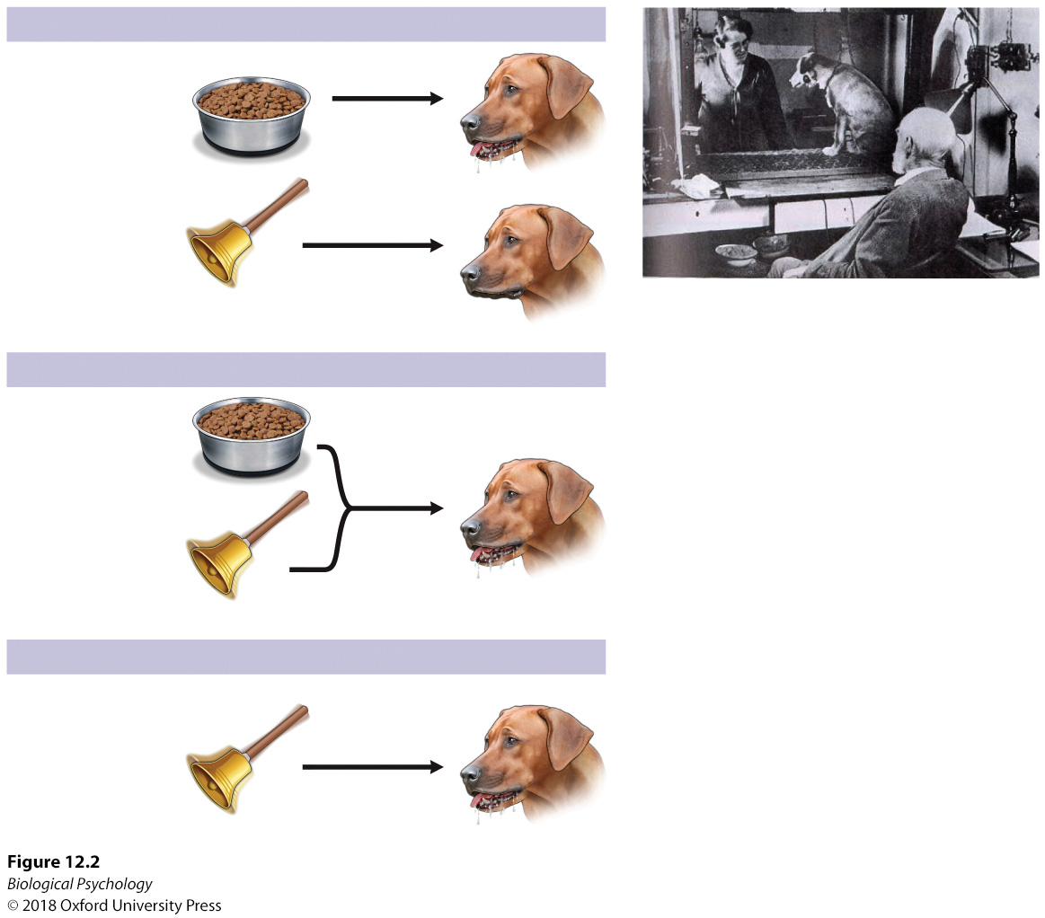
Neurobiological foundations of learning and memory
Classical conditioning
  US:UR
  NS+US:UR
  CS:CR
Notes:
(a) Pavlov used dogs to assess saliva production in response to varying stimuli; (b) his classic work pairing conditioned and unconditioned stimuli laid the groundwork for empirical investigations for learning.

Slide 7
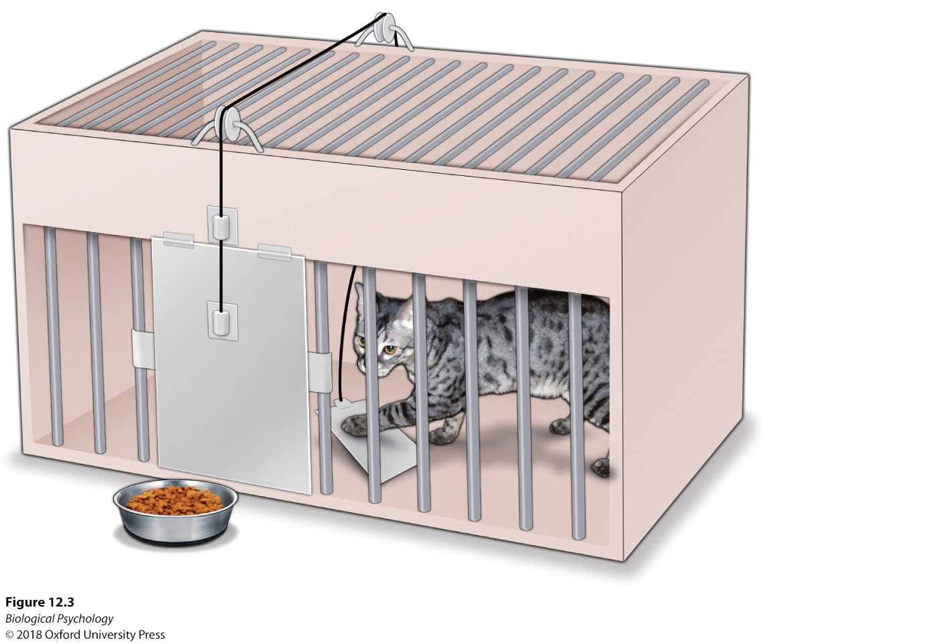
Neurobiological foundations of learning and memory
Law of Effect
How did Thorndike measure learning?
Notes:
Problem solving and puzzle boxes. Thorndike observed cats’ responses in puzzle boxes as they searched for ways to escape and approach the food. Once a response was observed to lead to the positive consequence of obtaining the desired food, that same response was repeated in future exposures to the puzzle box.

Slide 8
Neurobiological foundations of learning and memory
Operant Conditioning vs. Classical conditioning

Slide 9
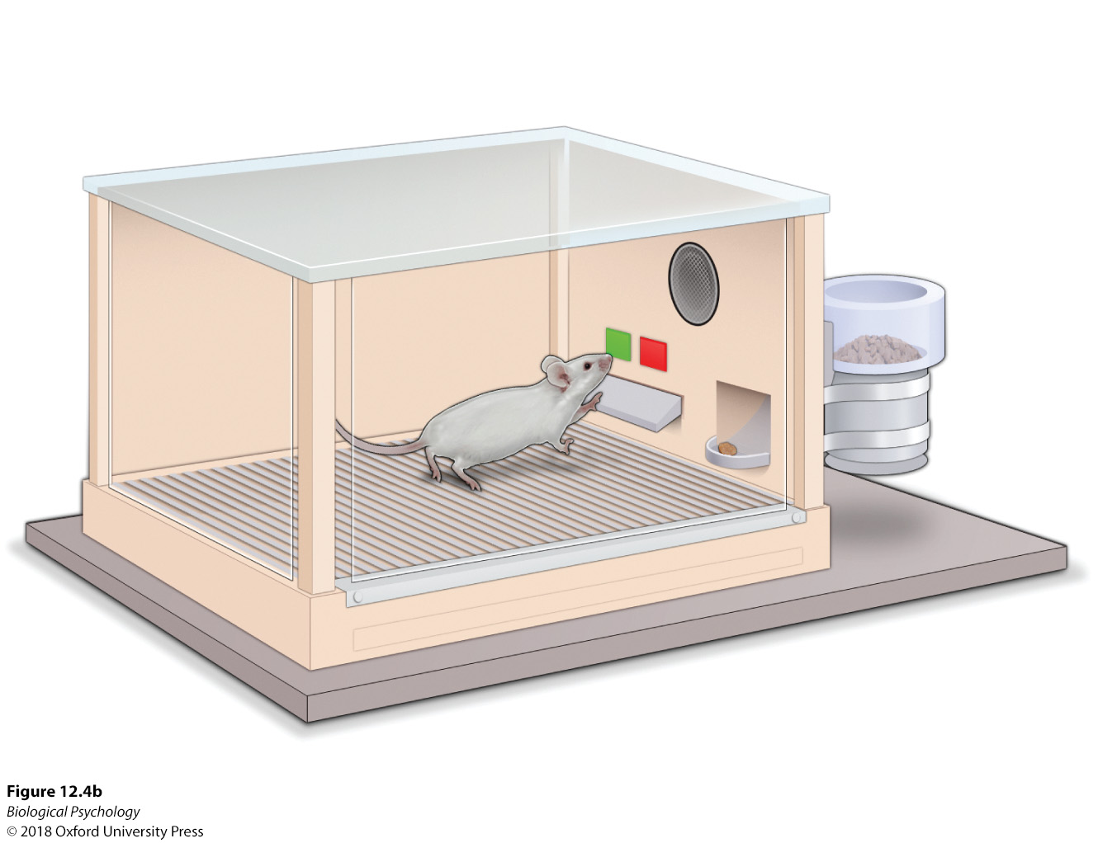
Neurobiological foundations of learning and memory
Skinner box
Notes:
Skinner developed operant chambers in which rats pressed levers to receive food pellets. The rats adjusted their responses to changing reinforcement schedules signaled with cues such as lights or sounds.

Slide 10
Neurobiological foundations of learning and memory
Role of contingency in behavior
Is there a danger in only measuring lever presses?

Slide 11
Neurobiological foundations of learning and memory
Cellular mechanisms
Hebbian learning: neurons the fire together, wire together
What happens chemically to allow a neuron to change its response to a stimulus?

Slide 12
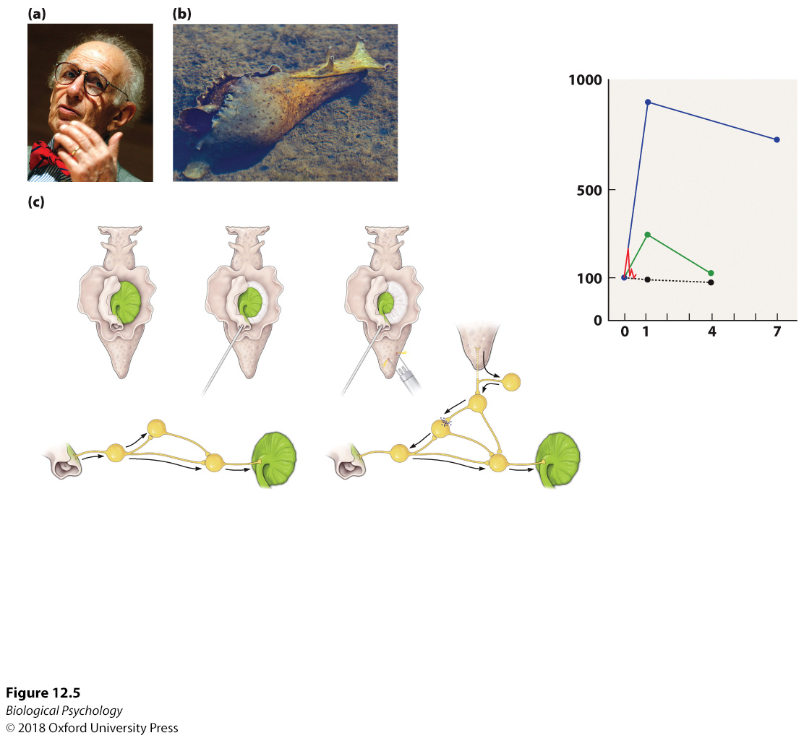
Neurobiological foundations of learning and memory
Sensitization and Habituation
Notes:
Eric Kandel used the aplysia as a model animal to investigate cellular responses in forms of associative learning such as sensitization and habituation.

Slide 13
Neurobiological foundations of learning and memory
Some cells help us learn specific kinds of information
  Place cells
  Grid cells
  Direction cells
Rats need to navigate from early on in development

Slide 14
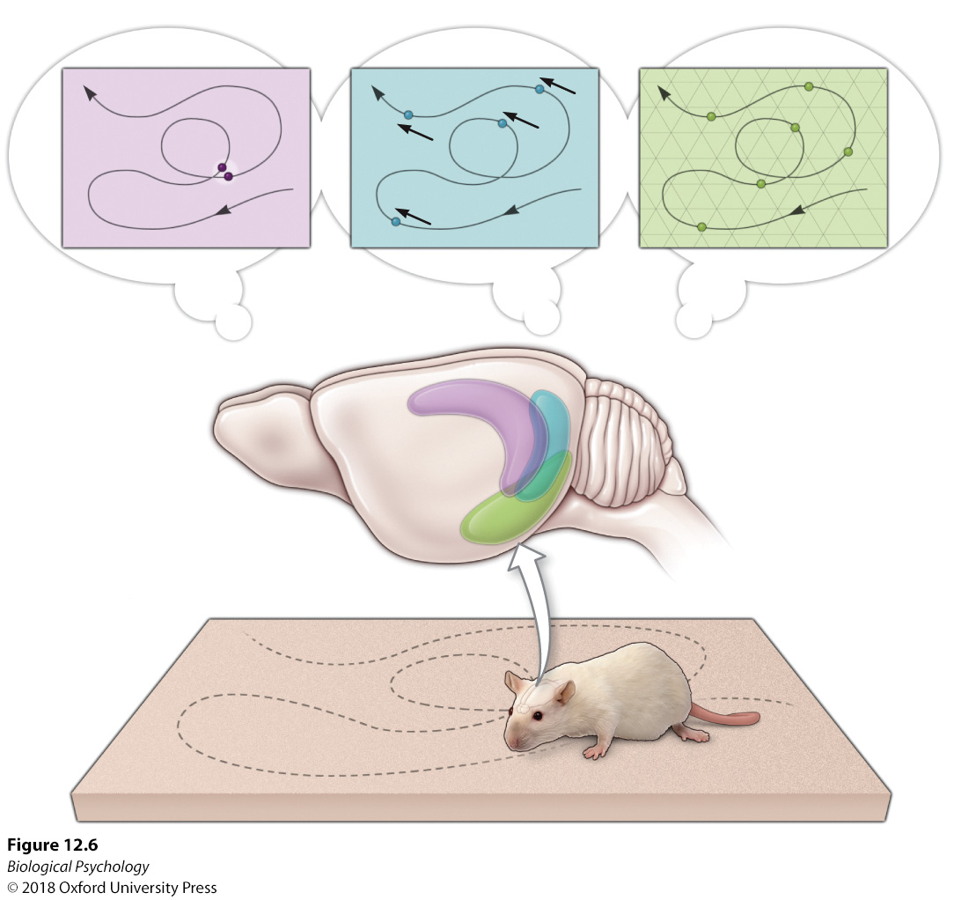
Neurobiological foundations of learning and memory
Notes:
Place cells and grid cells in the hippocampus and surrounding areas are important for the rat’s movement of body and head around its environment.

Slide 15
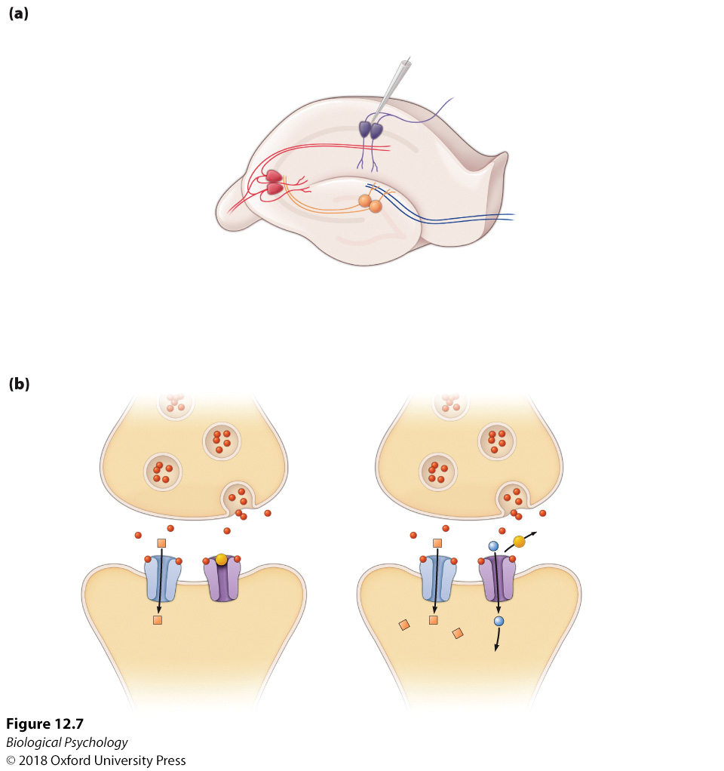
Neurobiological foundations of learning and memory
Long-term potentiation as a candidate for memory
Notes:
Microelectrodes are used to record postsynaptic potentials of the hippocampal neurons.
Postsynaptic glutamate receptors have been identified as key components of the LTP process.

Slide 16
Neurobiological foundations of learning and memory
What happens structurally during learning?
  Restructuring of dendrites
  Growing new neurons
Problems with always growing new neurons?
  Slow
  Space limitations
  Energy cost

Slide 17
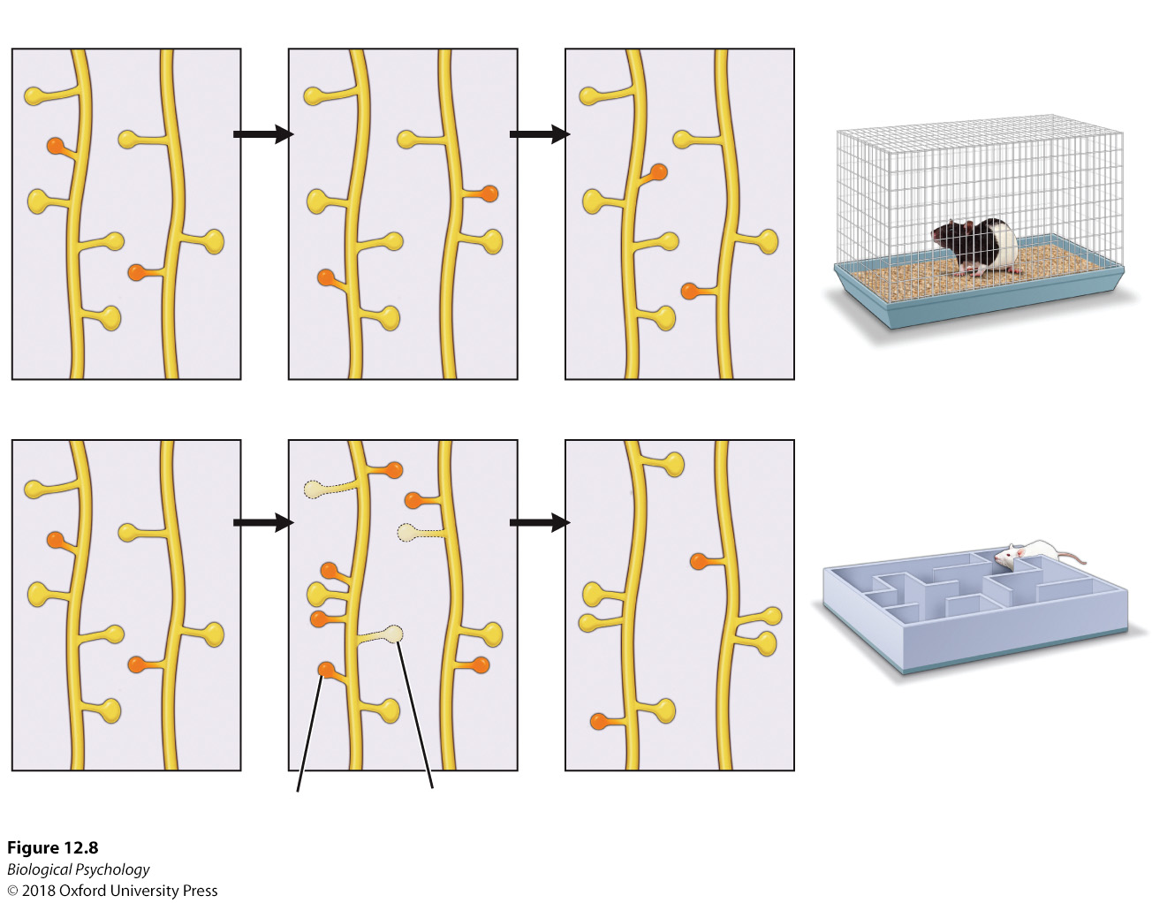
Neurobiological foundations of learning and memory
Notes:
Learning-induced spine restructuring. During behavioral learning, the structures of the dendritic spines are modified in ways that are thought to facilitate neural networks supporting the newly acquired learned behavioral responses.

Slide 18
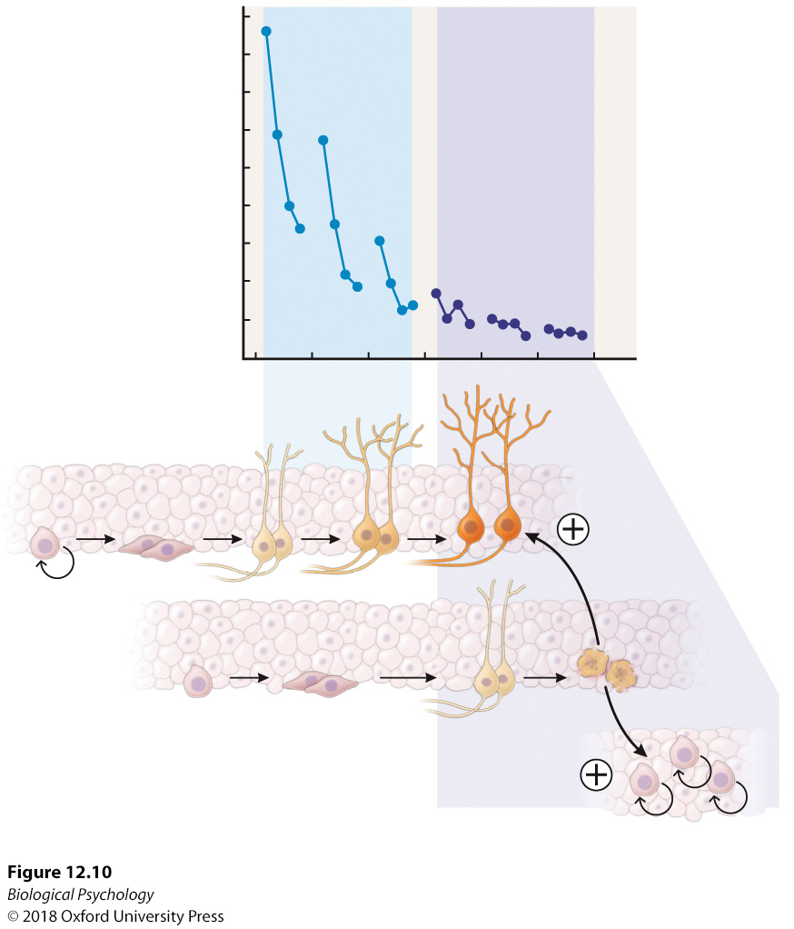
Neurobiological foundations of learning and memory
Notes:
New cells have increased rates of survival early in the learning process; however, once the task is mastered, the death rate of newborn neurons increases.

Slide 19
Neurobiological foundations of learning and memory
We can learn about brain function by studying patients with brain damage

Slide 20
Neurobiological foundations of learning and memory
HM
Bilateral MTL lesions
Anterograde amnesia
Procedural vs. declarative memory

Slide 21
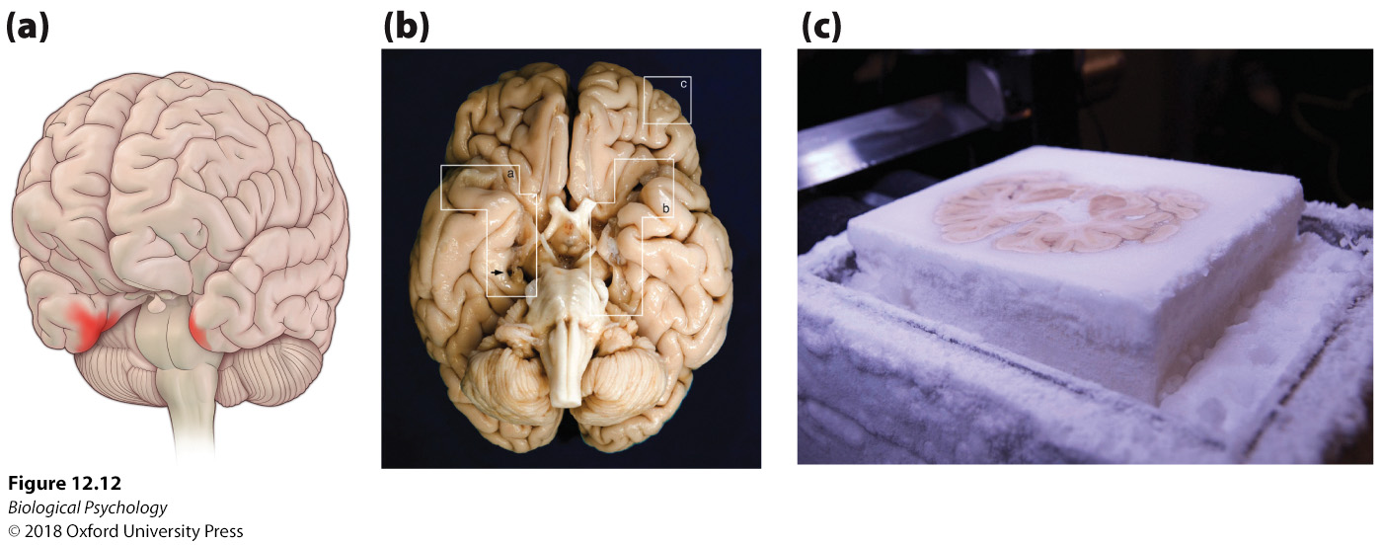
Neurobiological foundations of learning and memory
Notes:
(a) Brain imaging has confirmed bilateral hippocampal damage in H.M., which impaired his declarative memory while leaving his procedural memory less impaired. (b) The ventral surface of H.M.’s brain. (c) Following H.M.’s death, the neuroanatomist Jacopo Annese conducted the necessary histological analysis of the brain tissue; equipment was created to freeze and slice the whole brain into pieces that could then be studied under a microscope.

Slide 22
Neurobiological foundations of learning and memory
Memory engram
Theory of equipotentiality

Slide 23
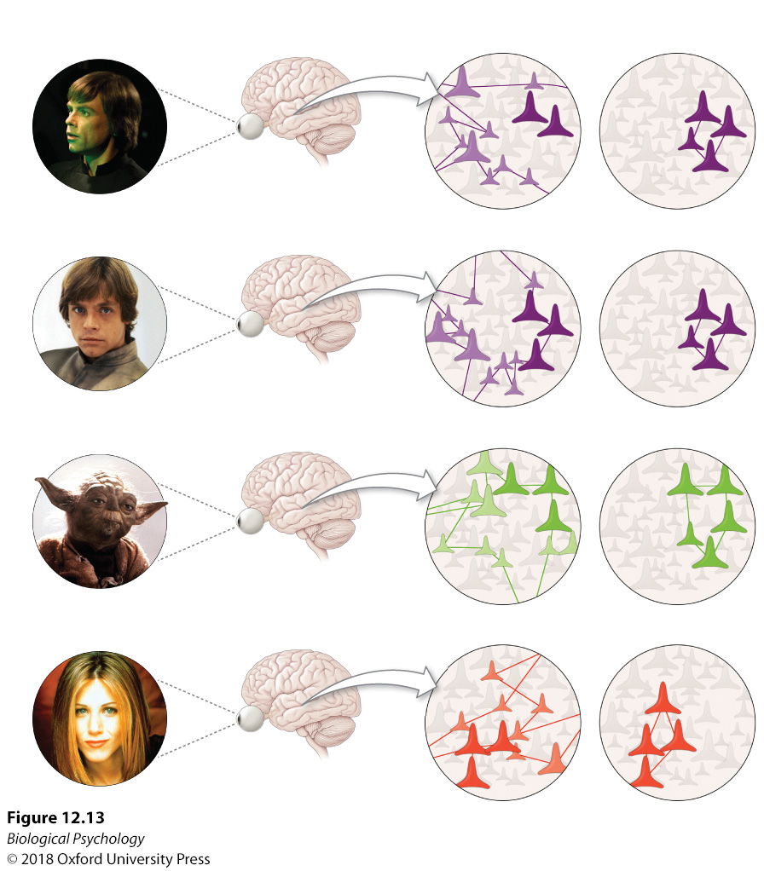
Neurobiological foundations of learning and memory
Notes:
Neural networks and memories. Although research suggests that memories are not represented or coded in a single cell, it is unclear whether memories are stored in networks characterized as sparse or more distributed across the brain.

Slide 24
Neurobiological foundations of learning and memory
To study memory in animals, we need procedures with well defined parameters
Different tasks allow study of different kinds of memory
Notes:
Delayed nonmatching-to-sample task. (a) When monkeys are assessed in this task that requires them to hold the information in memory before making the correct response, (b) those with lesions of the hippocampus and amygdala exhibit learning deficits.

Slide 25
Neurobiological foundations of learning and memory
Delayed (non)match to sample
Morris water maze
Radial arm maze
Eye-blink condition
Rodent obstacle courses
Notes:
Delayed nonmatching-to-sample task. (a) When monkeys are assessed in this task that requires them to hold the information in memory before making the correct response, (b) those with lesions of the hippocampus and amygdala exhibit learning deficits.

Slide 26
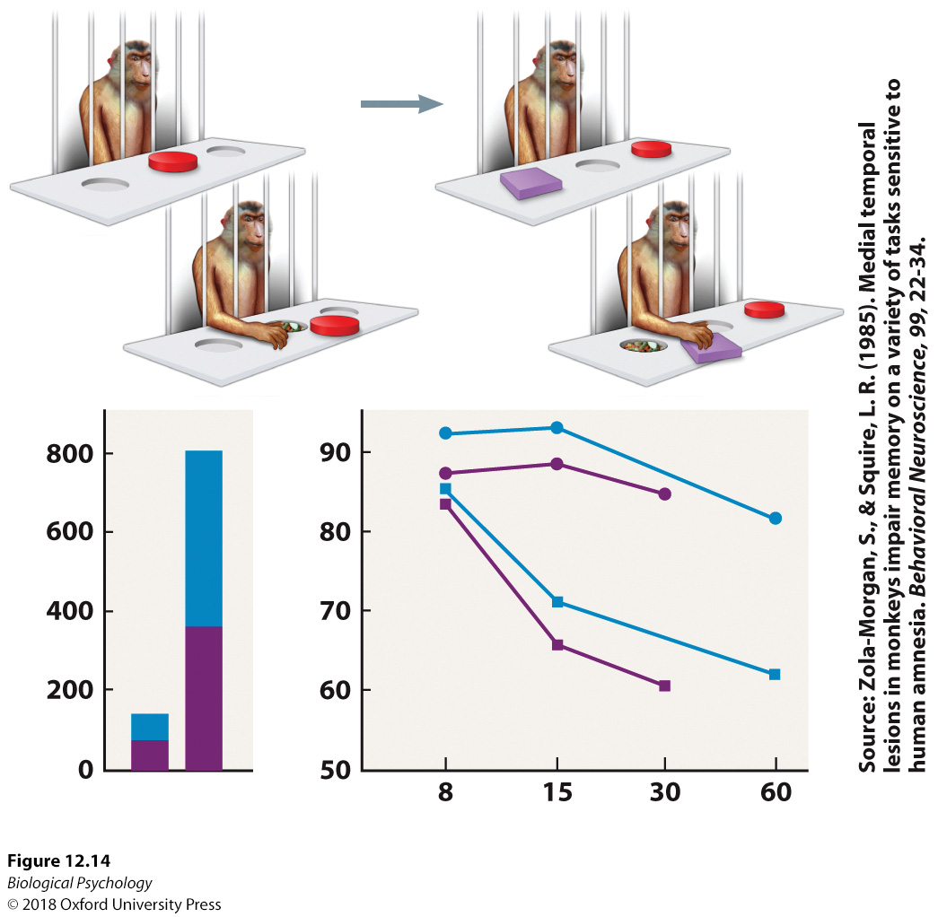
Neurobiological foundations of learning and memory
Notes:
Delayed nonmatching-to-sample task. (a) When monkeys are assessed in this task that requires them to hold the information in memory before making the correct response, (b) those with lesions of the hippocampus and amygdala exhibit learning deficits.

Slide 27
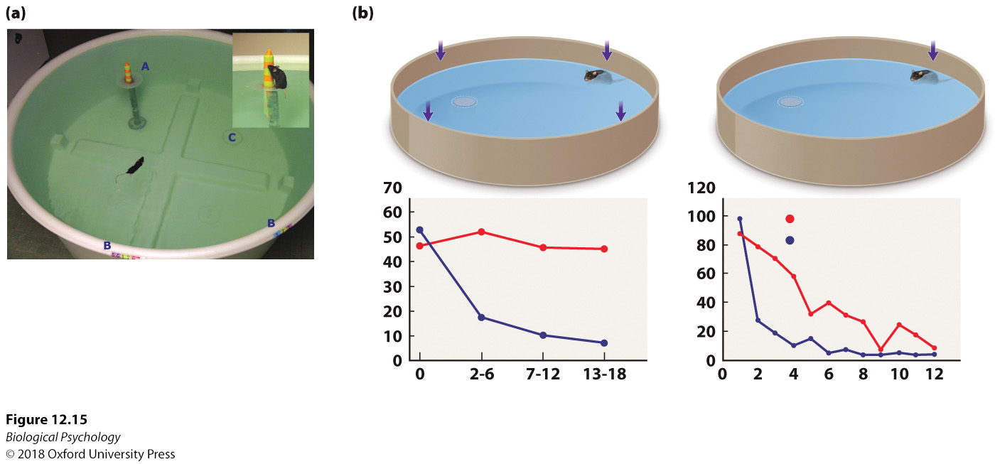
Neurobiological foundations of learning and memory
Notes:
When spatial ability is assessed in the Morris water maze, (b) animals with hippocampal damage perform poorly during training and testing.

Slide 28
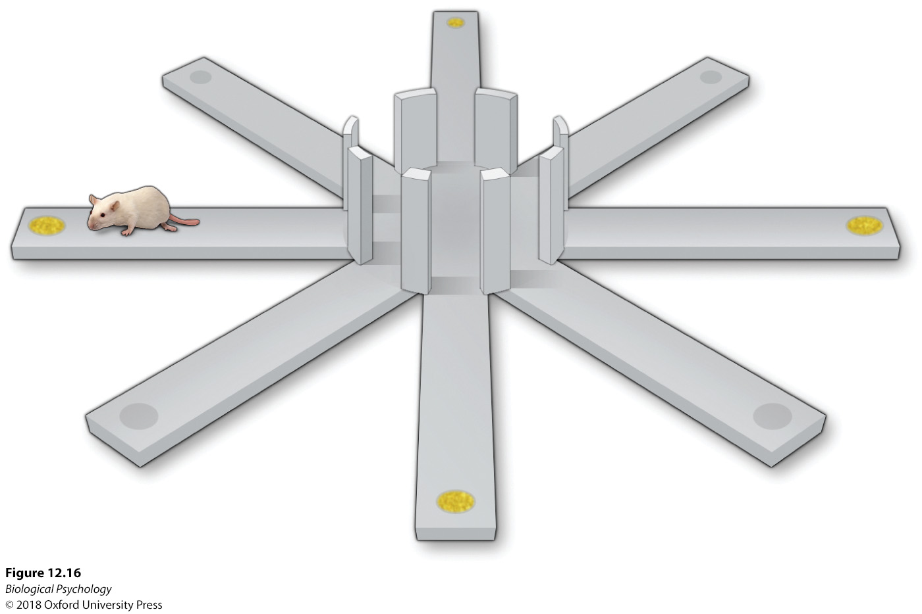
Neurobiological foundations of learning and memory
Notes:
Spatial memory is assessed in the radial arm maze in which animals are required to remember arms or alleys of the maze to avoid revisiting previously visited arms—a response recorded as an error.

Slide 29
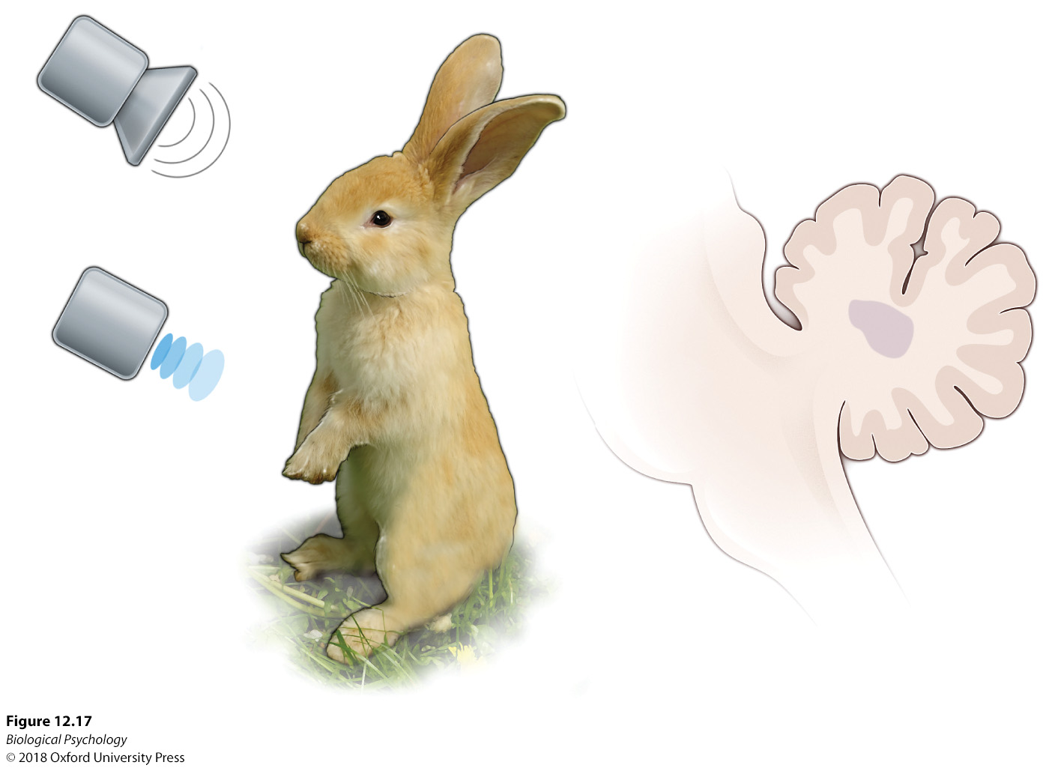
Neurobiological foundations of learning and memory
Notes:
The interpositus nucleus of the cerebellum is integrally involved in the rabbit conditioned eye-blink response. Following conditioning, both the conditioned stimulus (CS, tone) and the unconditioned stimulus (US, air puff) trigger the eye-blink response (either as an unconditioned response (UR) or as a conditioned response [CR]).

Slide 30
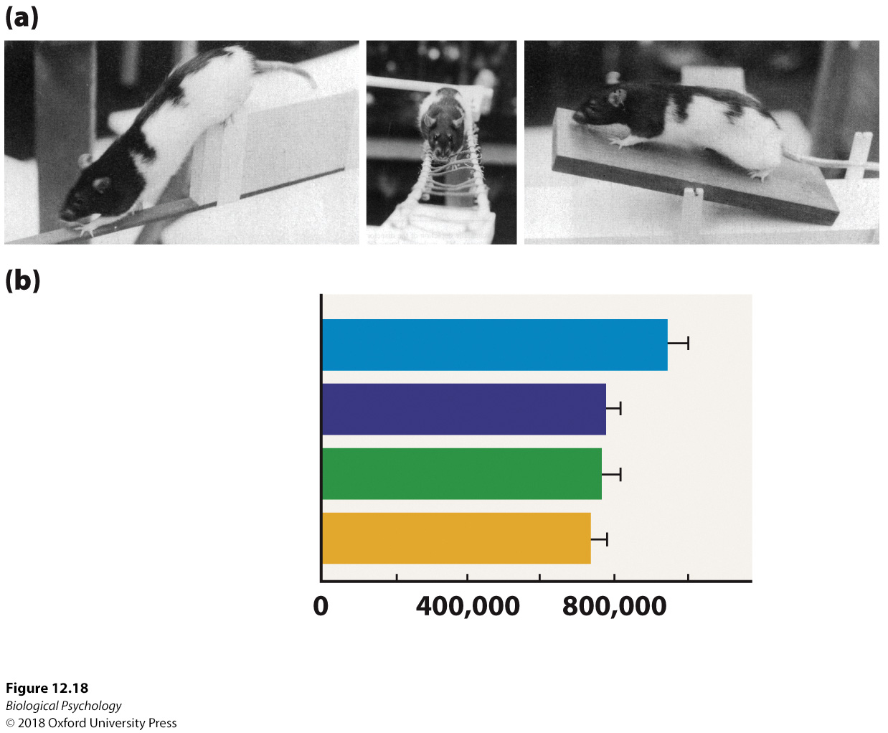
Neurobiological foundations of learning and memory
Notes:
Obstacle course training and neuroplasticity.
(a) When rats were exposed to physical training (AC) in challenging obstacle courses, (b) increased synapses were observed in the Purkinje cells when compared with those of nontrained animals.

Slide 31
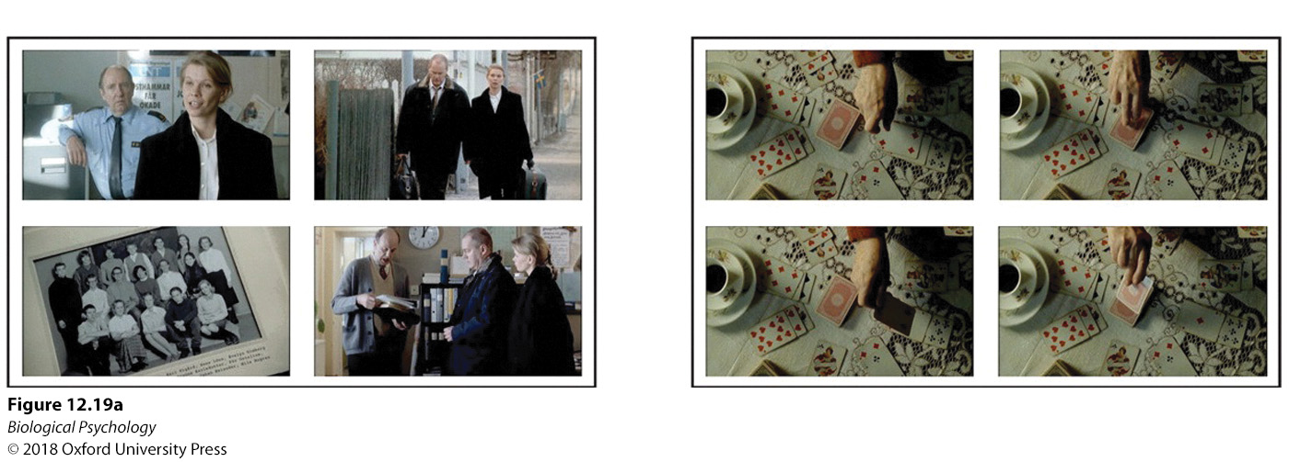
Neurobiological foundations of learning and memory
In humans, fMRI and PET can be used to find regions active while subjects perform different memory tasks
Drawbacks to fMRI vs. single cell recording?
Notes:
When participants were asked to (a) retrieve and organize pictures representing scenes from a movie in the order presented in the movie as opposed to inferring how the order of the pictures should appear, (b) more hippocampal activation was observed.

Slide 32
Neurobiological foundations of learning and memory
Systematizing memory
Structural organization
Functional organization
Process-based organization

Slide 33
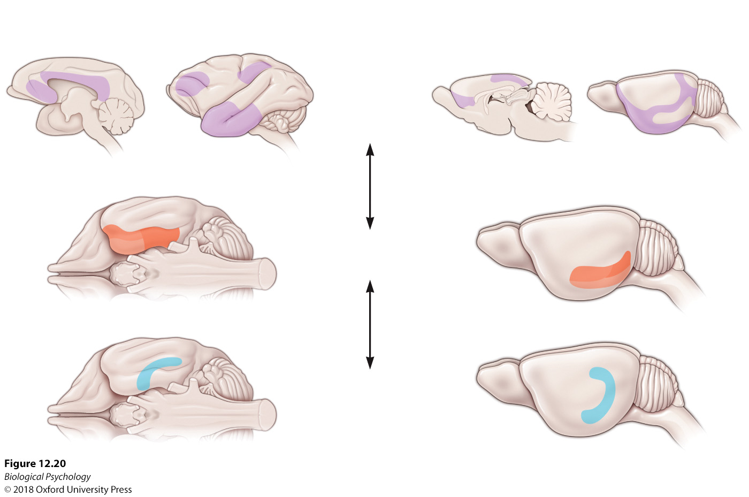
Neurobiological foundations of learning and memory
Cortical–hippocampal memory system
Notes:
Cortical–hippocampal memory system. In both rodents and primates, the hippocampus receives and sends information to the parahippocampal and neocortical association areas. The parahippocampal region can be considered a hub or convergence area for this memory input—distributing it to the appropriate hippocampal and neocortical areas.

Slide 34
Neurobiological foundations of learning and memory
Processing-based memory system
  Fast vs. slow encoding
  Single-item vs. associative encoding
  Flexible vs. rigid representation

Slide 35
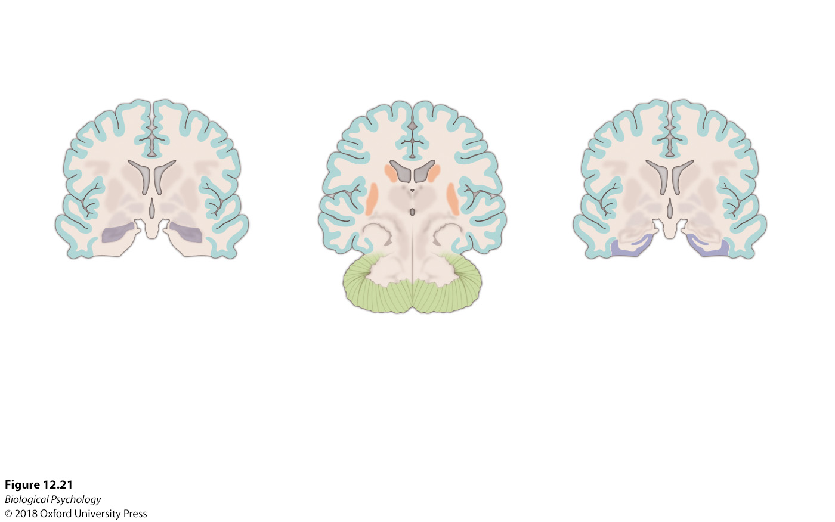
Neurobiological foundations of learning and memory
Notes:
This model distinguishes among three different types of memory systems: fast and flexible associations, slow and rigid associations, and fast processing of single-input units. Each proposed system is associated with specific brain areas.

Slide 36
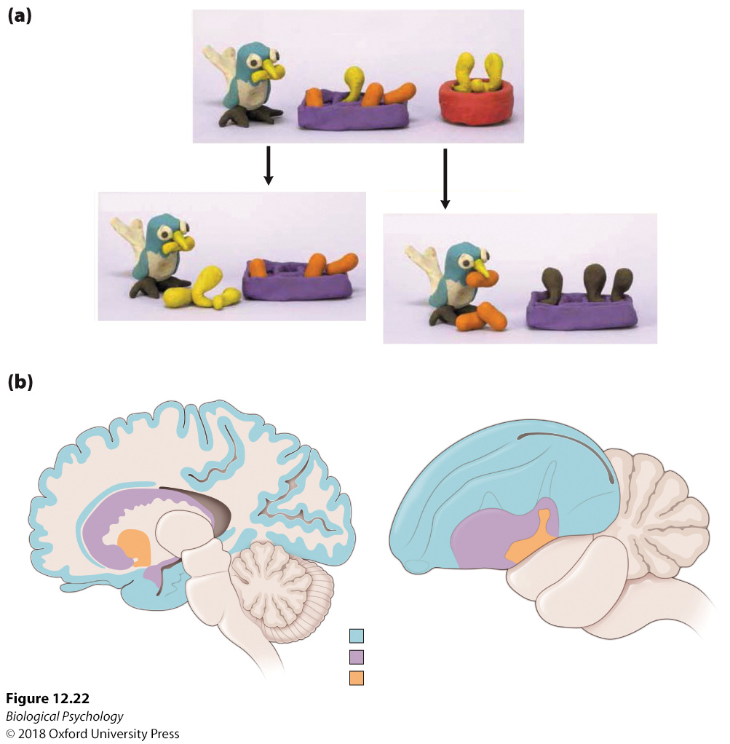
Neurobiological foundations of learning and memory
Hippocampus implicated in complex memory across species
Notes:
Similar to mammals, avian memory processing likely involves the avian version of the hippocampus

Slide 37
Modifying Memories
How reliable is memory under normal conditions?
What about stressful situations?
Key ideas
  Reconsolidation
  Post-retrieval lability
  Confabulation

Slide 38
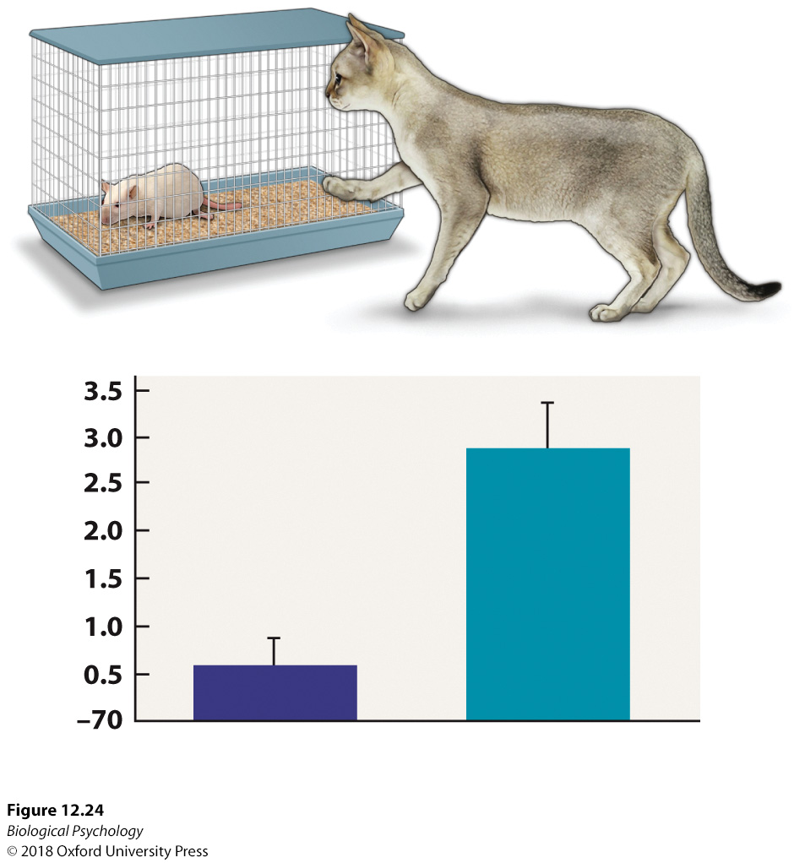
Modifying Memories
Notes:
(a) In this paradigm, rats are exposed to cats prior to being tested in a memory task. (b) Rats previously exposed to cats made more errors in the radial-arm maze than nonexposed rats.

Slide 39
Modifying Memories
Knowing that stress impairs memory, how can we help people who experience stress (all of us, at one point or another)?
What about severe acute stress, or chronic stress?

Slide 40
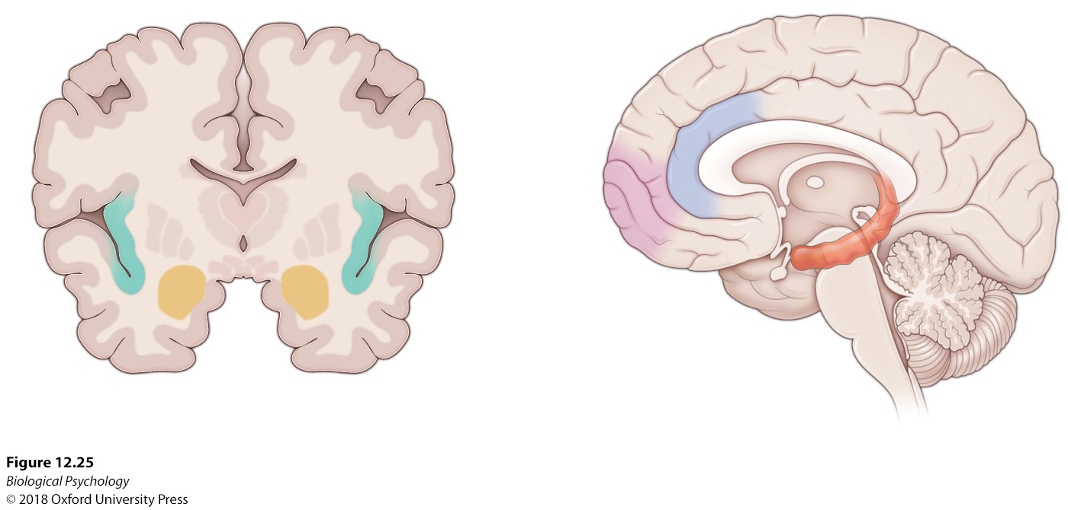
Modifying Memories
PTSD
Notes:
Imaging data reveal that PTSD is characterized by hyperactivation of the amygdala, insula, and cingulate cortex and diminished activity in the ventromedial prefrontal cortex. Both hyper- and hypoactivation have been observed in the hippocampus

Slide 41
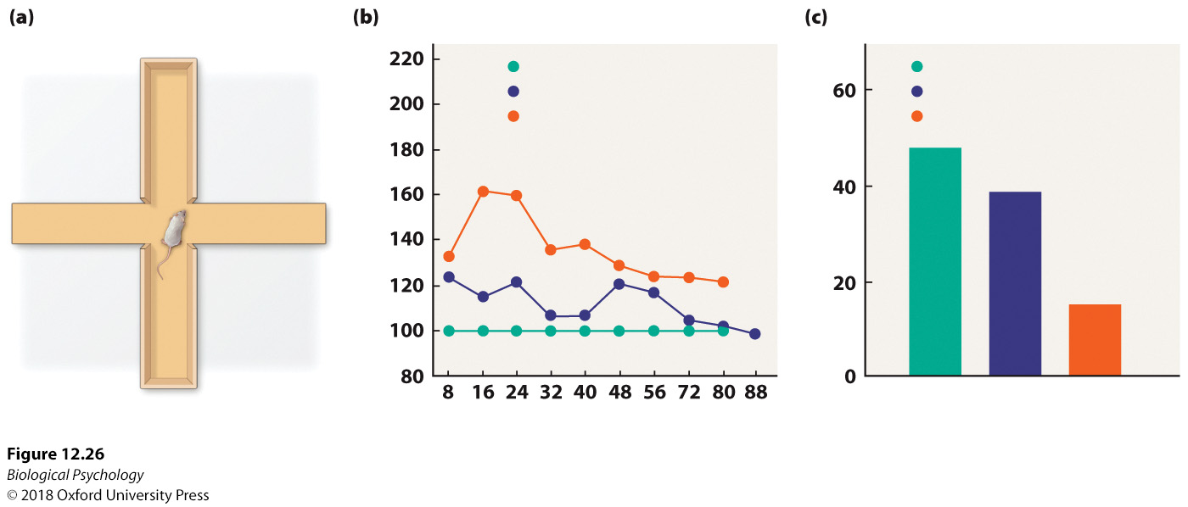
Modifying Memories
Effect of stress can be cumulative
Notes:
When rats were exposed to two hours of immobilization stress, (a) they exhibited more densely populated spines on neurons in the amygdala after 10 days as well as (b) persistent avoidance of the open arm in an elevated plus maze. these data reflect strong memories of the immobilization stress, with the effects building over time.

Slide 42
Modifying Memories
Are some people more susceptible to stress-impaired memory?
How would you test this idea?

Slide 43
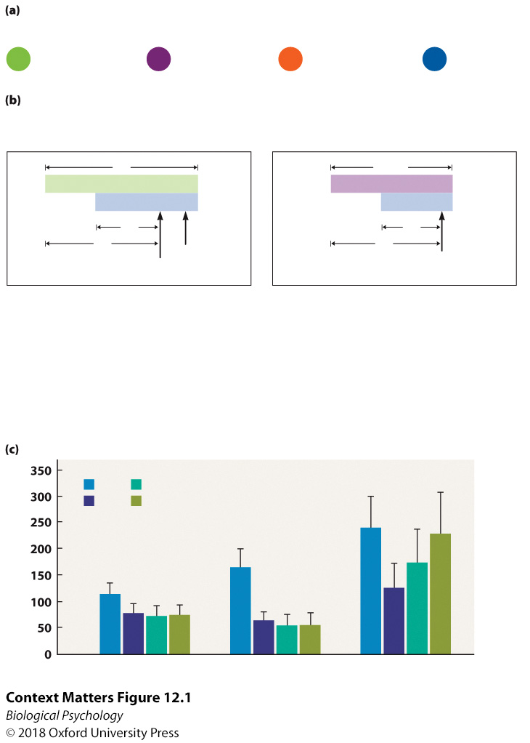
Modifying Memories
Notes:
Posttraumatic stress disorder (PTSD) effects on conditional discrimination. (a) After establishing light signals that predict or do not predict a threatening stimulus (air blast), (b) participants were exposed to a novel aversive noise stimulus alone and in the presence of the light cues that were associated with the air blast. (c) Participants in the high-symptom PTSD category were less likely to inhibit threat expectation in the presence of the safety signals than the control and low PTSD participants.

Slide 44
Attention as the gatekeeper
In order to remember, we must first attend
Inattentional blindness

Slide 45
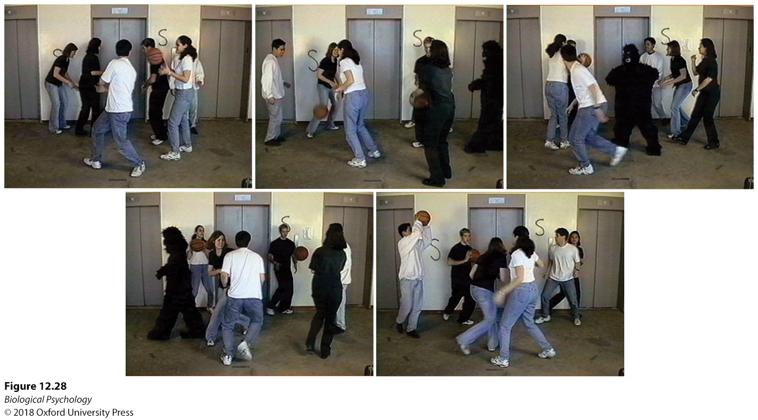
Attention as the gatekeeper
Notes:
Inattentional blindness. When study participants were asked to observe a video and focus on the number of times the ball was passed among the players, they failed to see the gorilla that walked across the room.

Slide 46
Attention as the gatekeeper
Parts of attending
  Alerting
  Orienting
  Executive attention

Slide 47
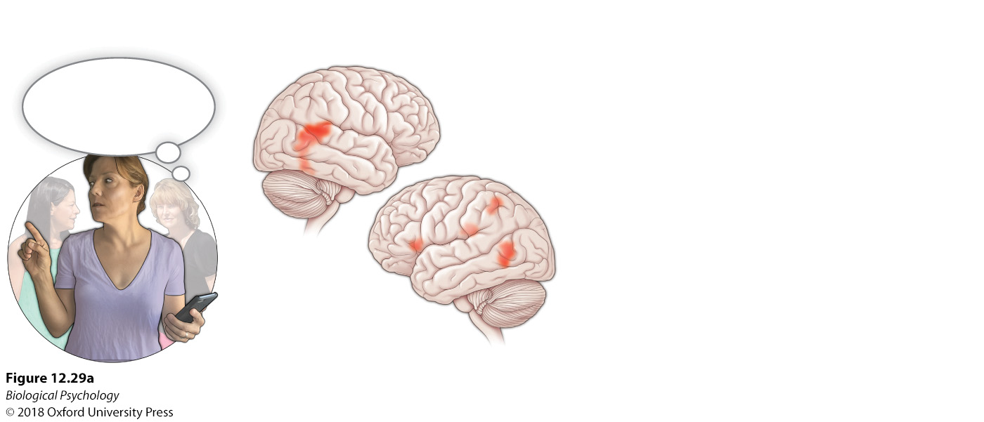
Attention as the gatekeeper
Notes:
Attentional modes in the brain. During the three aspects of attentional modes including alerting, orienting, and executive function, specific brain areas are engaged to facilitate these responses.

Slide 48
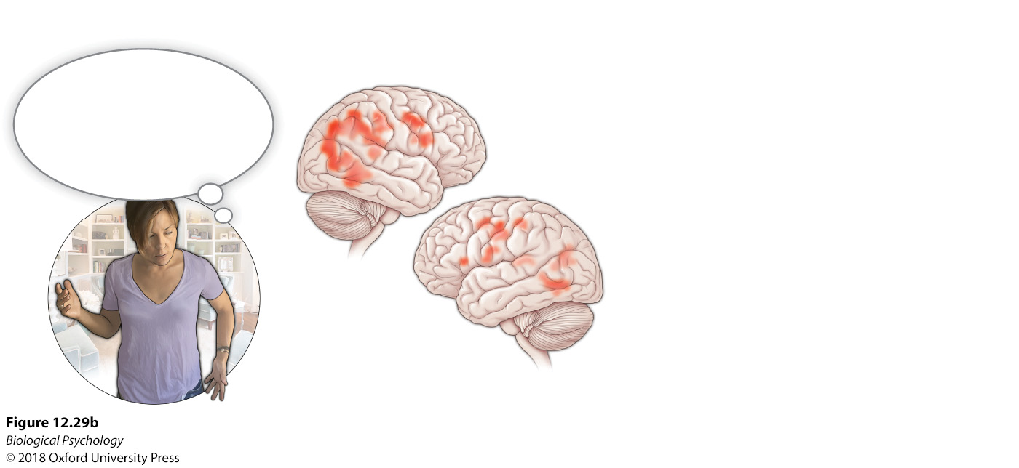
Attention as the gatekeeper
Notes:
Attentional modes in the brain. During the three aspects of attentional modes including alerting, orienting, and executive function, specific brain areas are engaged to facilitate these responses.

Slide 49
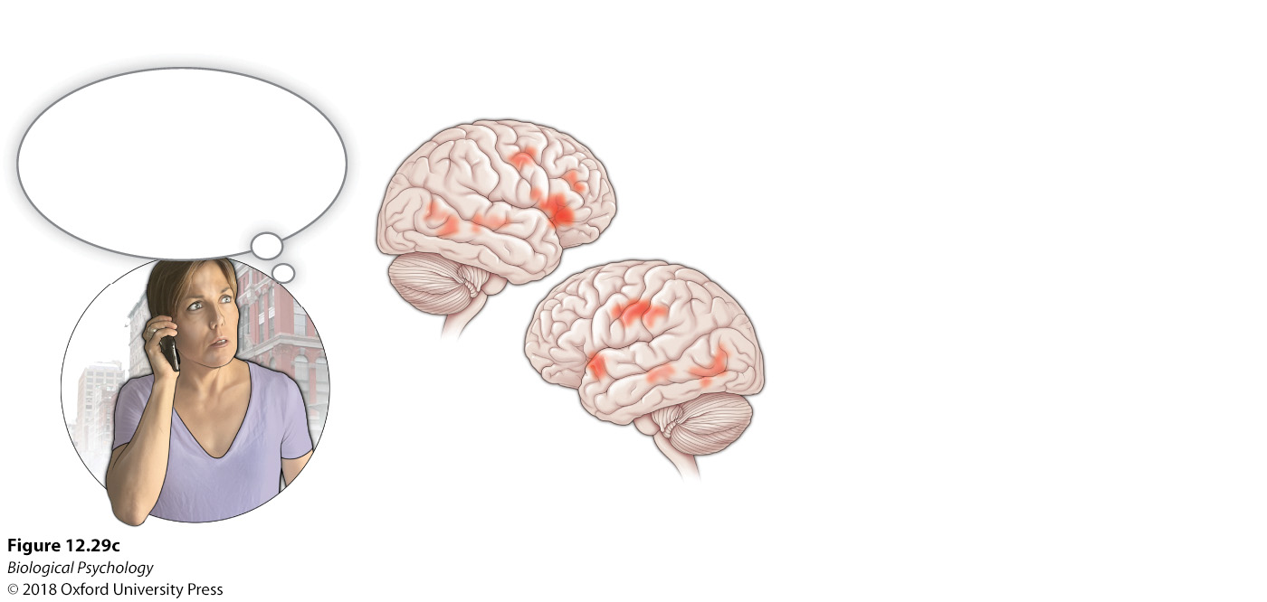
Attention as the gatekeeper
Notes:
Attentional modes in the brain. During the three aspects of attentional modes including alerting, orienting, and executive function, specific brain areas are engaged to facilitate these responses.

Slide 50
Attention as the gatekeeper
Because attention necessarily affects memory, what can we do about attention disorders
How do we decide when to give brain-altering drugs to children?

Slide 51
Decision making
Decisions require integrating current sensory information and memory
How many kinds of memory are required to verbally understand and correctly answer a simple arithmetic question?
To study decision making, we start with simple tasks

Slide 52
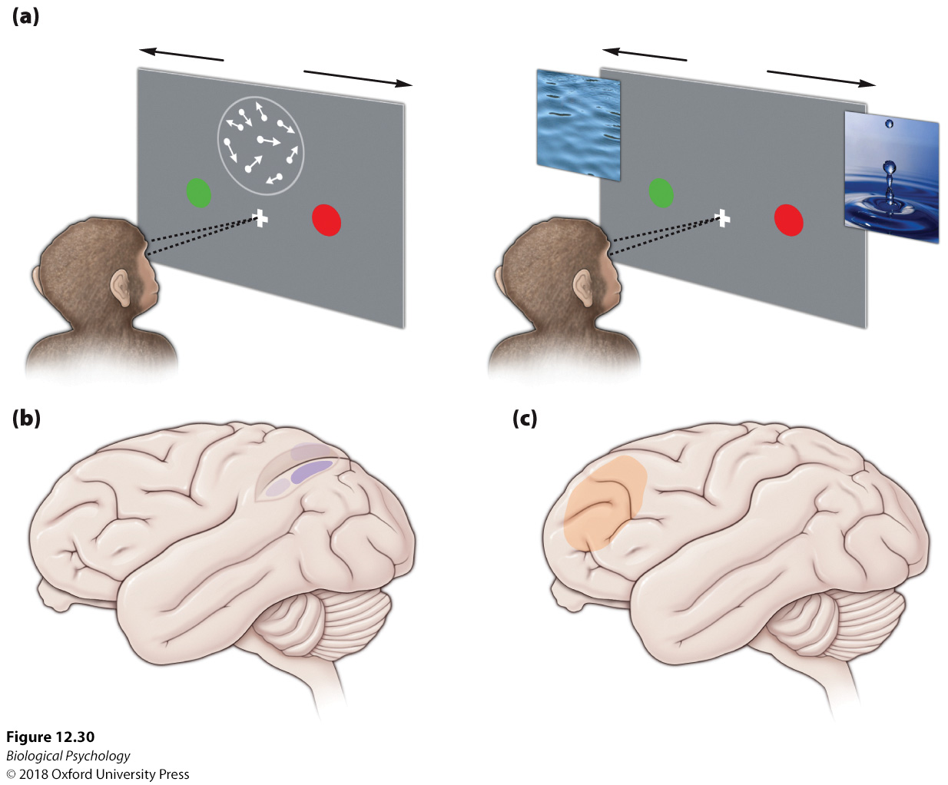
Decision making
Notes:
(a) When monkeys are exposed to a random dot decision-making task, as they make the decision to respond in a certain way, the (b) lateral intraparietal (LIP) area and (c) the dorsolateral prefrontal cortex (DLPFC) are activated.

Slide 53
Decision making
Appreciating uncertainty is a necessary part of (rational) decision making
Even a decision at a traffic light could be fraught with uncertainty

Slide 54
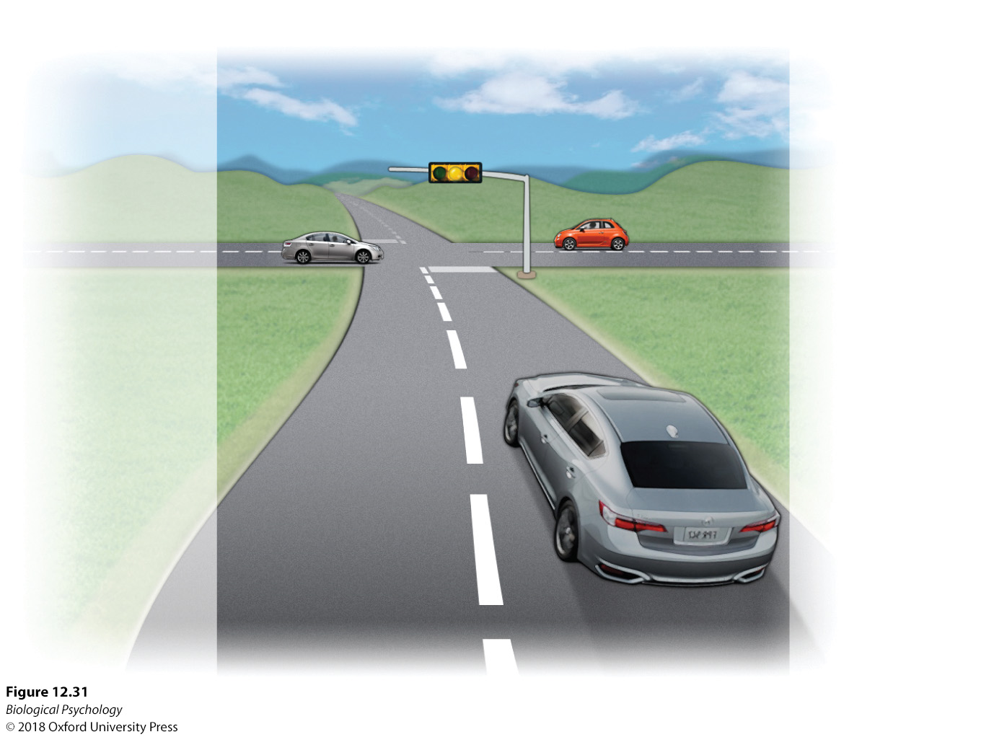
Decision making
Notes:
In everyday tasks such as driving, various categories of uncertainty are encountered including sensory, state, rule, and prediction uncertainty.

Slide 55
Decision making
We can not always learn a single stimulus-response rule
In everyday environments, the rules change from time to time

Slide 56
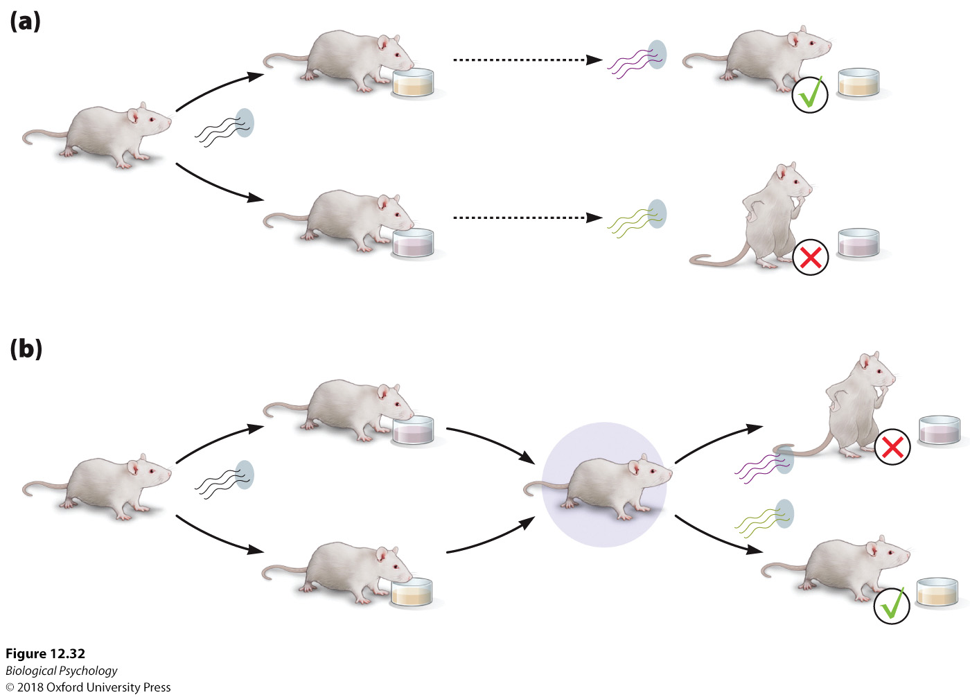
Decision making
Notes:
Orbitofrontal cortex and flexible behavior
When rats were trained in an odor discrimination task in which one odor predicted a desired sweet fluid and another odor predicted an aversive bitter fluid, animals with lesions were slow to inhibit the previous response– outcome association and adapt by changing their responses to avoid the bitter fluid.

