Slide 2
Chapter 11
Affiliative and Reproductive Strategies

Slide 3

Outline
Hormones and behavior
The neurobiology of relationships
Sexual behavior and characteristics
The neurobiology of parental behavior

Slide 4

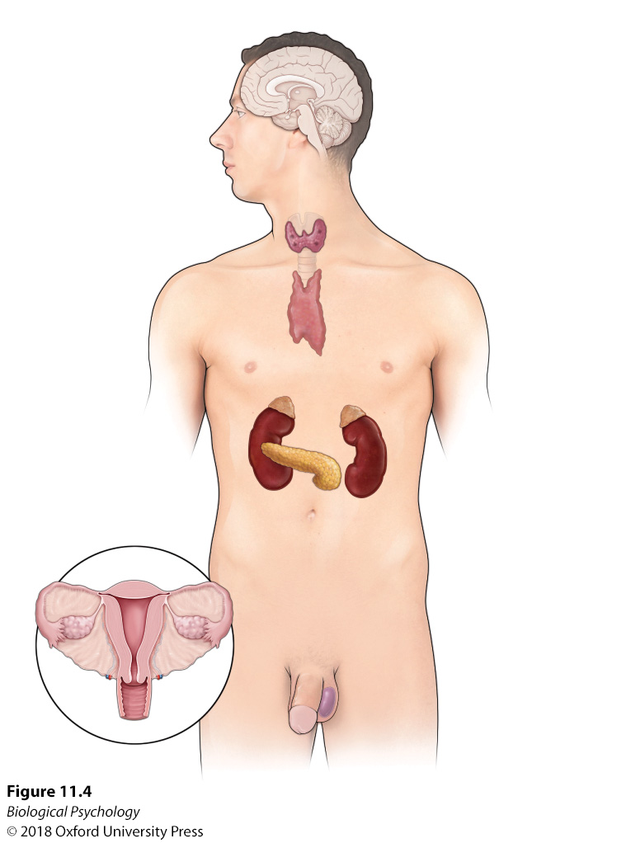
Hormones and behavior: Endocrine system
Notes:
The endocrine system consists of several endocrine glands located throughout the body.

Slide 5
Hormones and behavior
What is the role of hormones during development?
How could you test the role of specific hormones?

Slide 6
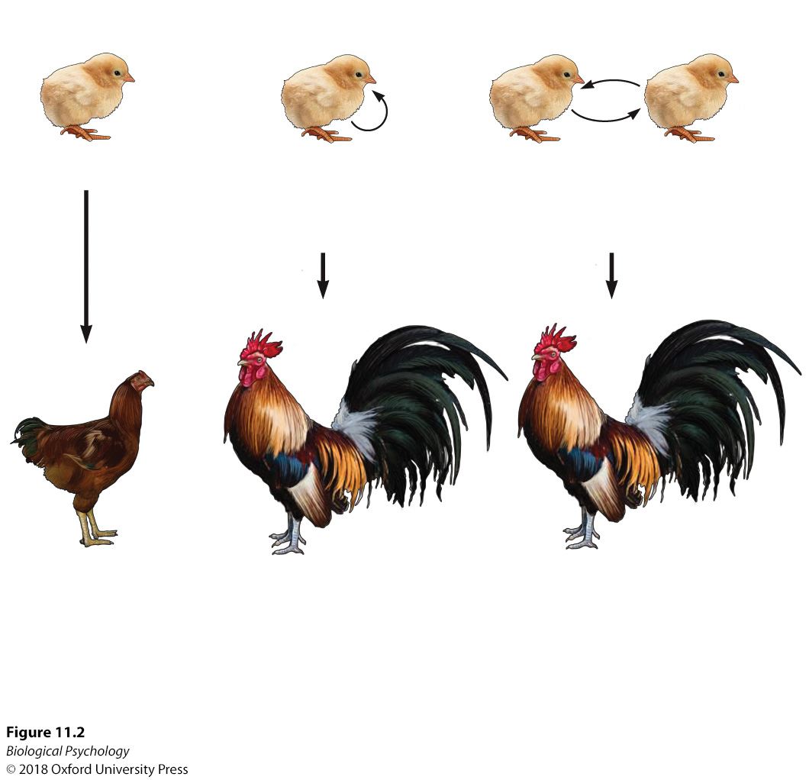
Hormones and behavior
Notes:
Early endocrinological investigations revealed that the removal of gonads impacted the sexual maturation of roosters; however, replacement of hormones via gonad replacement recovered typical sexual maturation in these animals.

Slide 7
Hormones and behavior
We classify hormones by their structure
  Steroid
  Amine
  Peptide
  Protein
Vasopressin and oxytocin are released by neurons

Slide 8
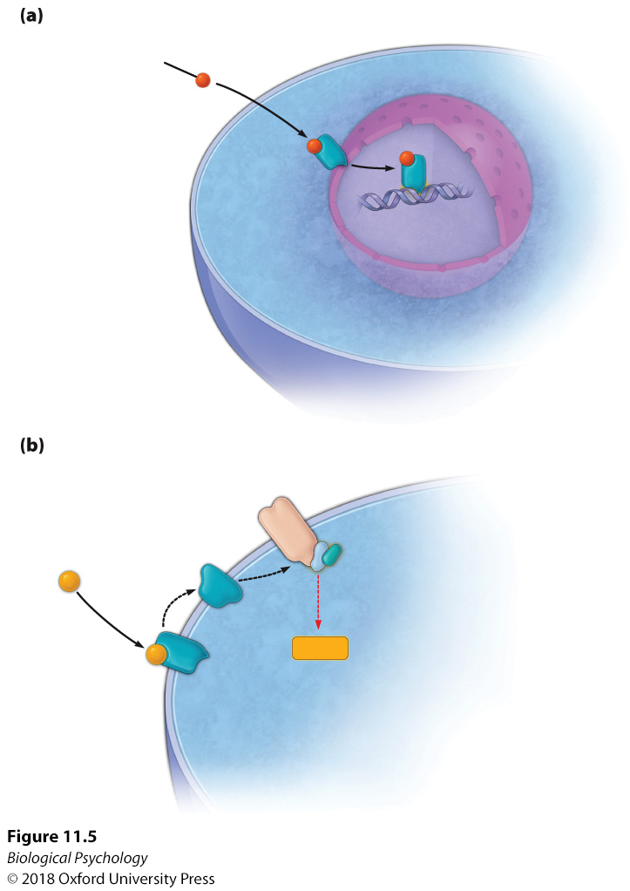
Hormones and behavior
How do hormones affect neurons?
Steroid hormones easily cross cell membranes
Other hormones require specific receptors
Notes:
Steroid hormones are able to travel across the cell membrane before attaching to a receptor protein to activate protein production by the nucleus. (b) However, nonsteroid hormones are dependent on the presence of receptors in the membrane that activate a G-protein and subsequent second messenger system to activate protein production.

Slide 9
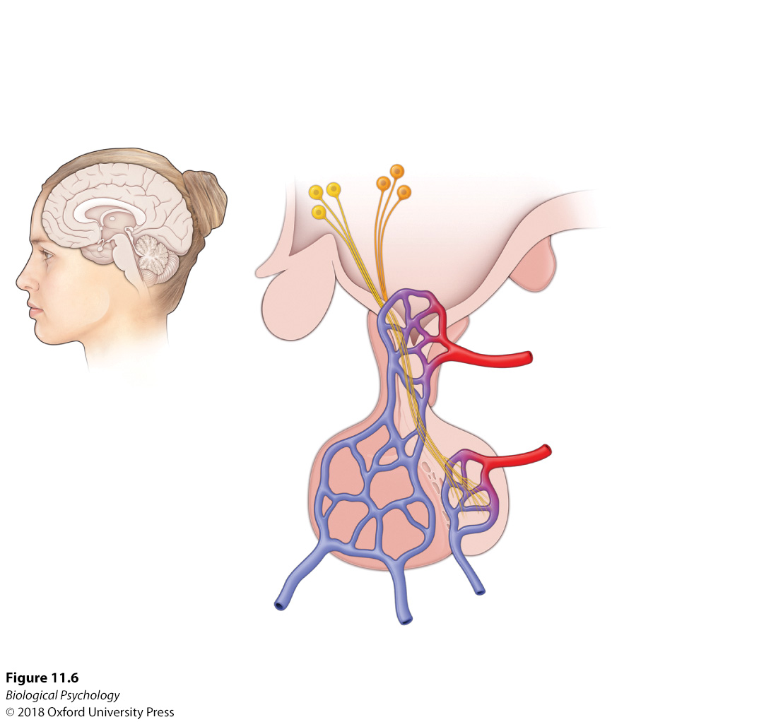
Hormones and behavior
Notes:
The hypothalamic-pituitary system. The hypothalamus influences the release of pituitary hormones in different ways. Specifically, hypothalamic releasing hormones travel through the pituitary blood vessels to stimulate the release of anterior pituitary hormones, whereas axons from the hypothalamus extend to the posterior pituitary, where they release the posterior pituitary hormones.

Slide 10
Hormones and behavior
Timing of hormone release impacts their effect
Prenatal delivery: brain organization
After maturation: brain activation

Slide 11
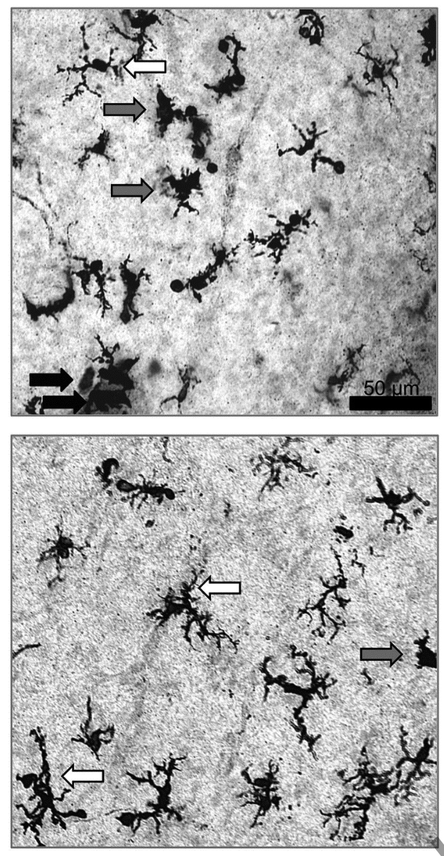
Hormones and behavior
Microglia, postnatal day 2
Notes:
Sex differences and microglia. On postnatal day 2, the glial cell morphology is different in male and female rat pups, with females having more of the elongated diffuse cells than males.

Slide 12
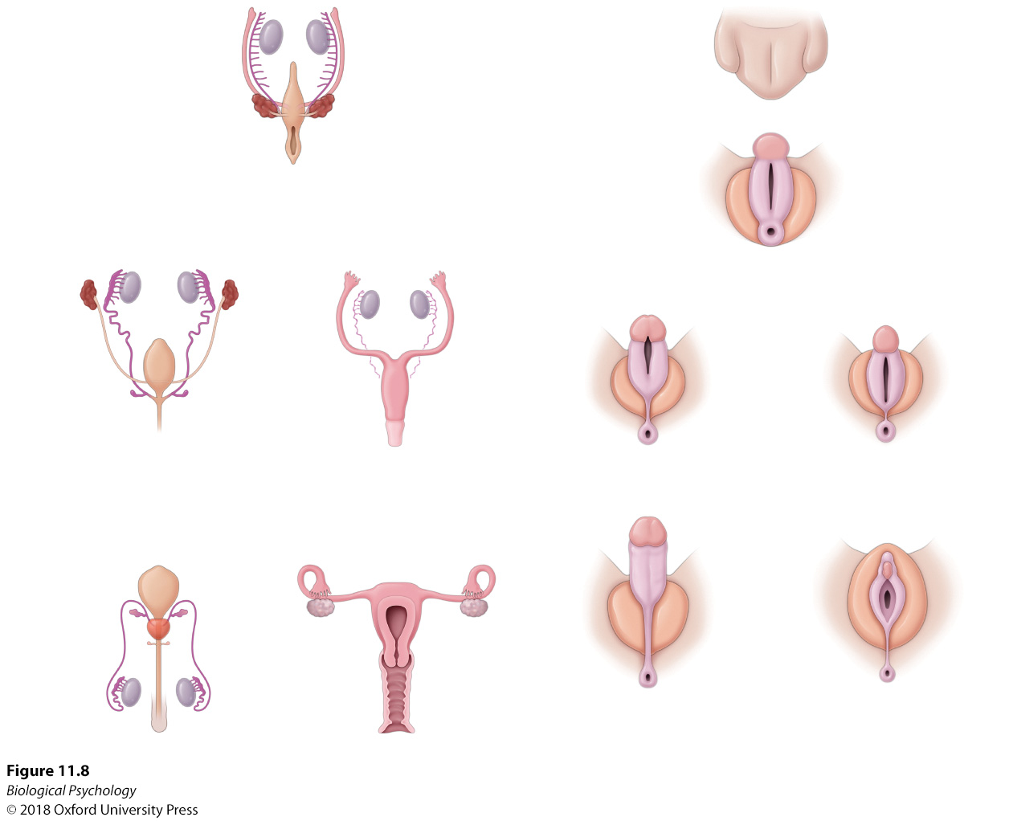
Hormones and behavior
Notes:
Sexual differentiation. Development and differentiation of reproductive organs and genitalia in males and females.

Slide 13
Hormones and behavior
What if things go wrong?
  Hormone replacement therapy
  Surgery

Slide 14
Neurobiology of relationships
Oxytocin and vasopressin
Difficult to study experimentally (genetic engineering)
Use “natural” experiments
  Animals with similar environments
  Different prevalence of oxytocin and vasopressin

Slide 15
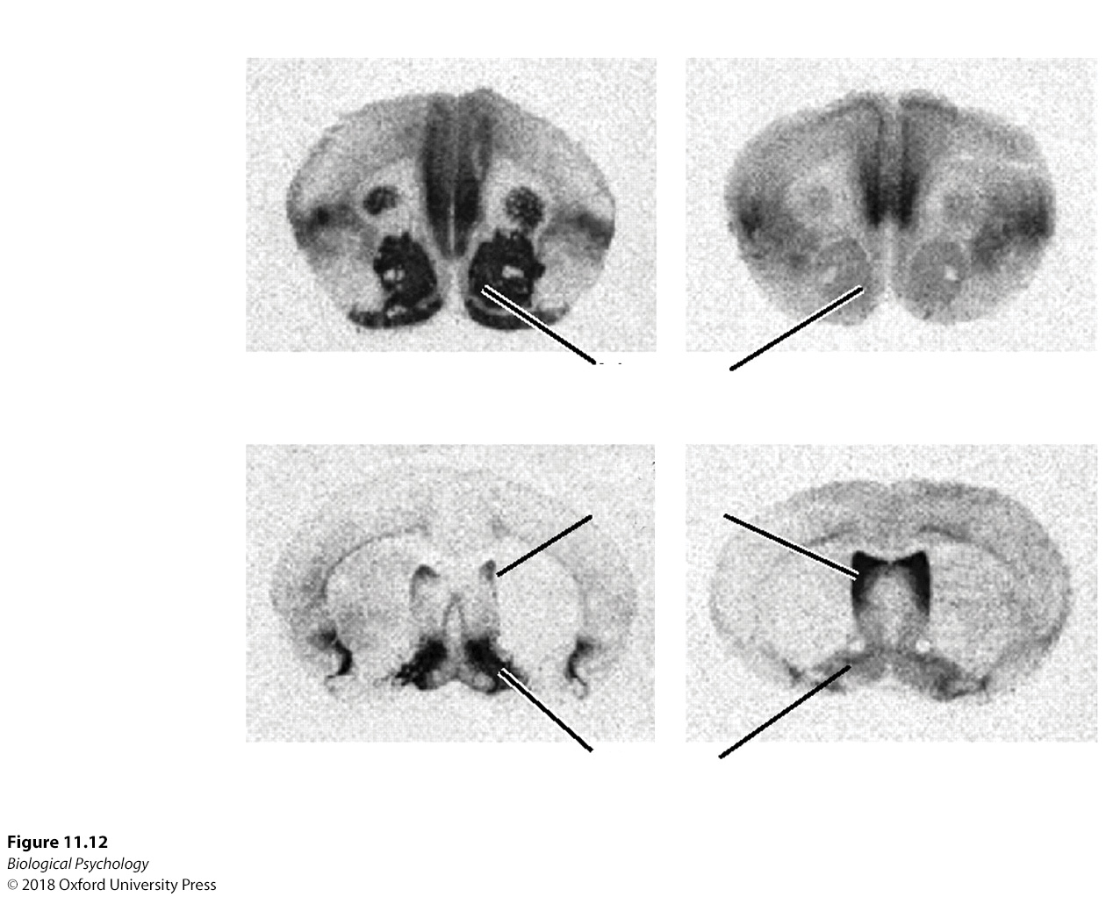
Neurobiology of relationships
Notes:
Social monogamy and social neuropeptides. Oxytocin and vasopressin receptors are distributed differently in the monogamous prairie vole and non-monogamous montane vole. The darkest areas depict higher densities of receptors.

Slide 16
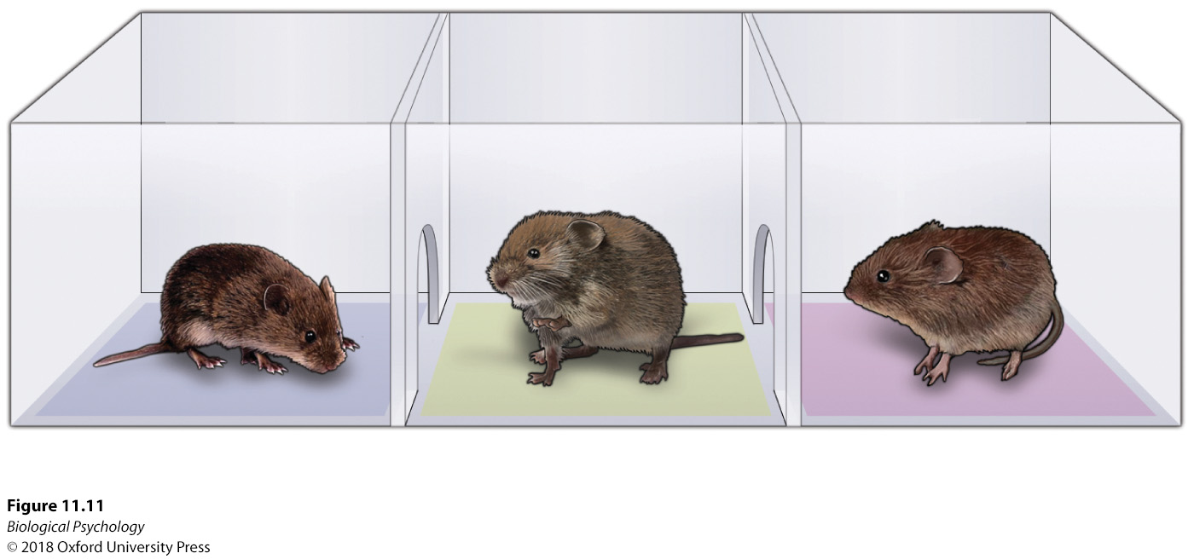
Neurobiology of relationships
Notes:
Pair-bonding. Following a sexual encounter, male voles were given the choice of spending time in proximity with the familiar female or an unfamiliar female; whereas prairie vole males spent more time with the familiar female exhibiting evidence of an established social bond, montane voles did not exhibit this preference.

Slide 17
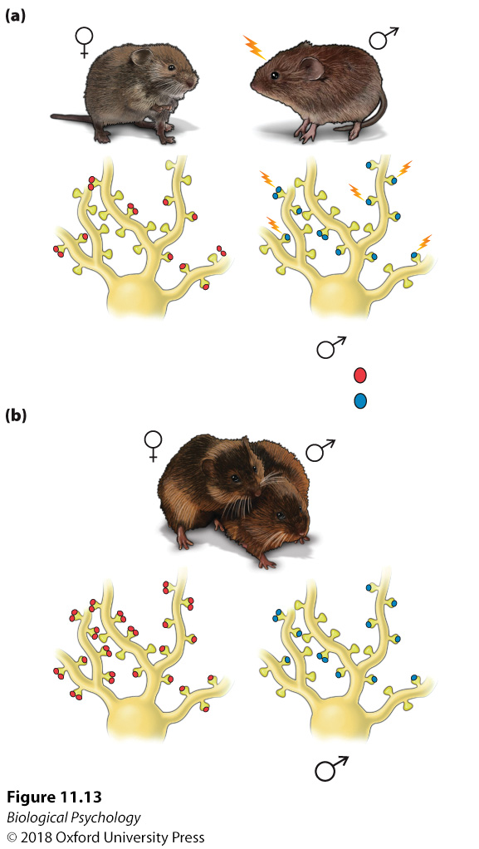
Neurobiology of relationships
Role of dopamine
Compare bachelors to bonded voles
Why nucleus accumbens?
Notes:
Dopamine and social bonding. (a) During an initial social contact, more D2 receptors are activated in the nucleus accumbens of the male vole, (b) whereas following social bonding, increased D1 receptors are apparent in the male nucleus accumbens.

Slide 18
Neurobiology of relationships: Trust
Prosocial behavior
Can we experimentally manipulate trust?

Slide 19
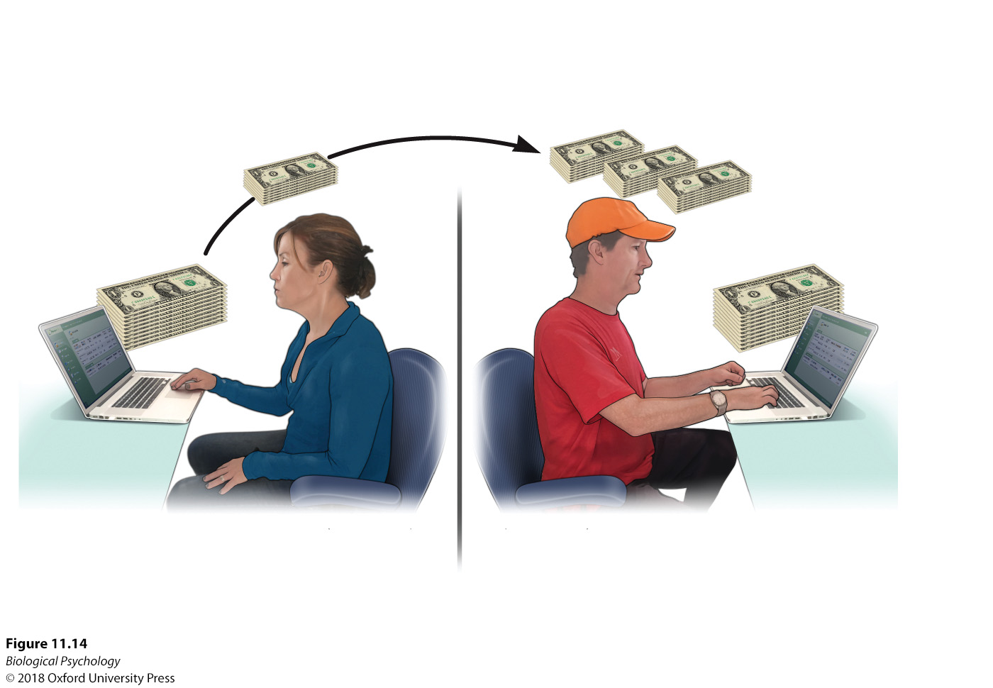
Neurobiology of relationships
Notes:
Oxytocin and trust.
Paul Zak’s research indicated that the administration of oxytocin nasal spray increased trustworthiness in the trust game.

Slide 20
Neurobiology of relationships
Should we be worried about mass oxytocin administration?
What are the ethics of developing and selling oxytocin?
Can doctors force “patients” to take a drug?

Slide 21

Neurobiology of relationships
Human-pet bonds
Notes:
Human–pet interactions. Social bonds between pets and humans alter oxytocin levels in a manner similar to that observed between humans with established social bonds.

Slide 22
Sexual behavior and characteristics
Changes in rodent sexual behavior are accompanied by reliable changes in hormones
Human females show a comparable hormonal cycle
Notes:
The estrous cycle.(a) e rodent estrous cycle occurs over a 4-day period. (b) The human menstrual cycle extends over a 28-day period. Although the durations differ, both species experience systematic fluctuations in estrogen, progesterone, luteinizing hormone, and follicle-stimulating hormone.

Slide 23
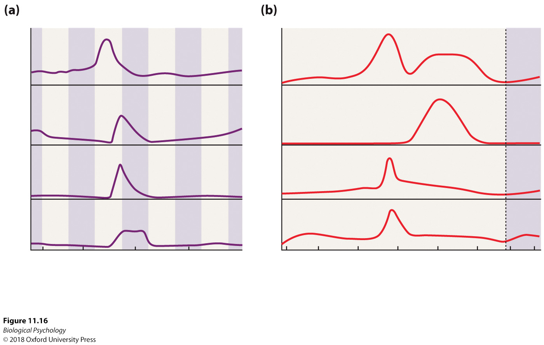
Sexual behavior and characteristics
Notes:
The estrous cycle.(a) The rodent estrous cycle occurs over a 4-day period. (b) The human menstrual cycle extends over a 28-day period. Although the durations differ, both species experience systematic fluctuations in estrogen, progesterone, luteinizing hormone, and follicle-stimulating hormone.

Slide 24
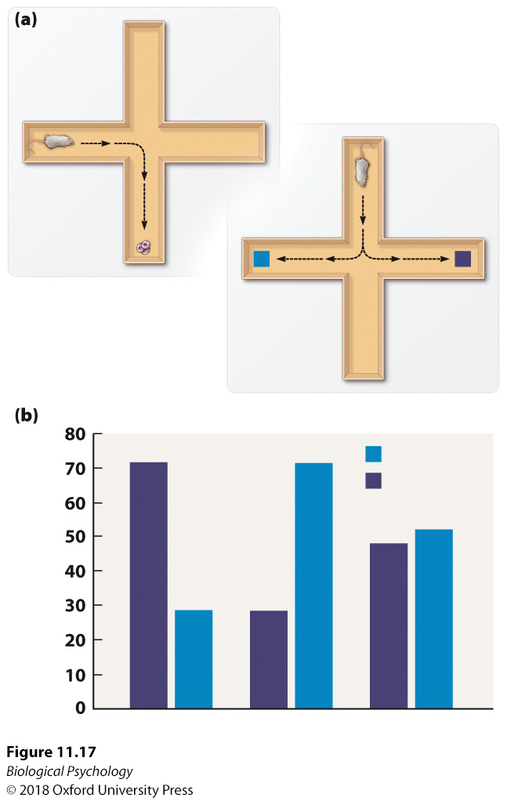
Sexual behavior and characteristics
Hormone levels affect behavior in rats
Do we need to worry about applying these results to humans?
What is the risk of exaggerating the impact of hormones on female decision making?
Notes:
Response strategies in female rats during estrus cycle stages. (a) After being trained to find food at a particular spot, rats were placed into the mirror image of the same maze. Sometimes they went to the spot where the food had been, and at other times, they followed the “directions” (e.g., turn right) that had led to the food in the training. (b) The response strategy changed depending on the stage of the estrus cycle.

Slide 25
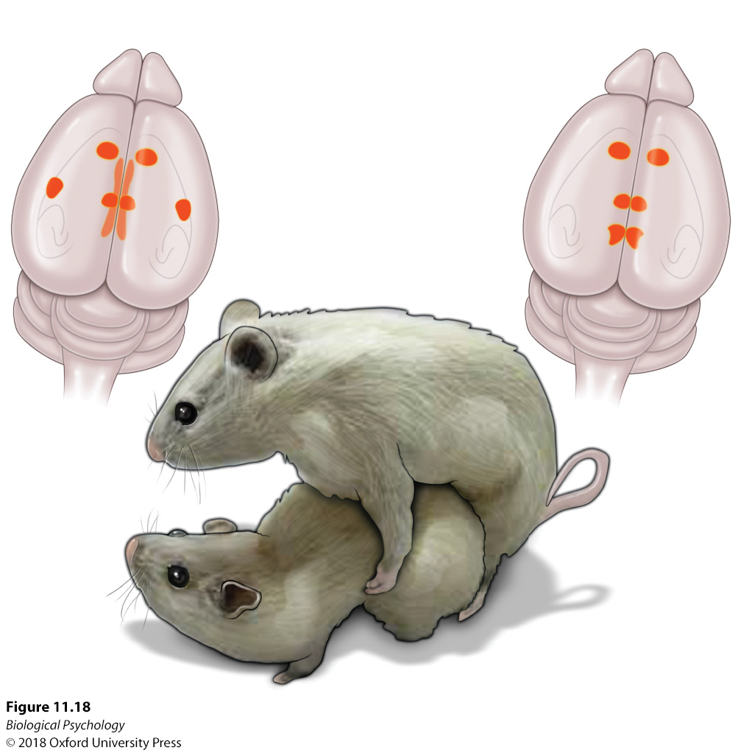
Sexual behavior and characteristics
Brain activation during copulation in rats
Notes:
During copulation, male and female brain activation patterns consist of both similar and different neural areas.

Slide 26
Sexual behavior and characteristics
Coolidge effect
Male vs. female mate selectivity
Notes:
During copulation, male and female brain activation patterns consist of both similar and different neural areas.

Slide 27
Sexual behavior and characteristics
Brain differences Male vs. female
Response to stress
Amygdala size
Amygdala laterality
Notes:
During copulation, male and female brain activation patterns consist of both similar and different neural areas.

Slide 28
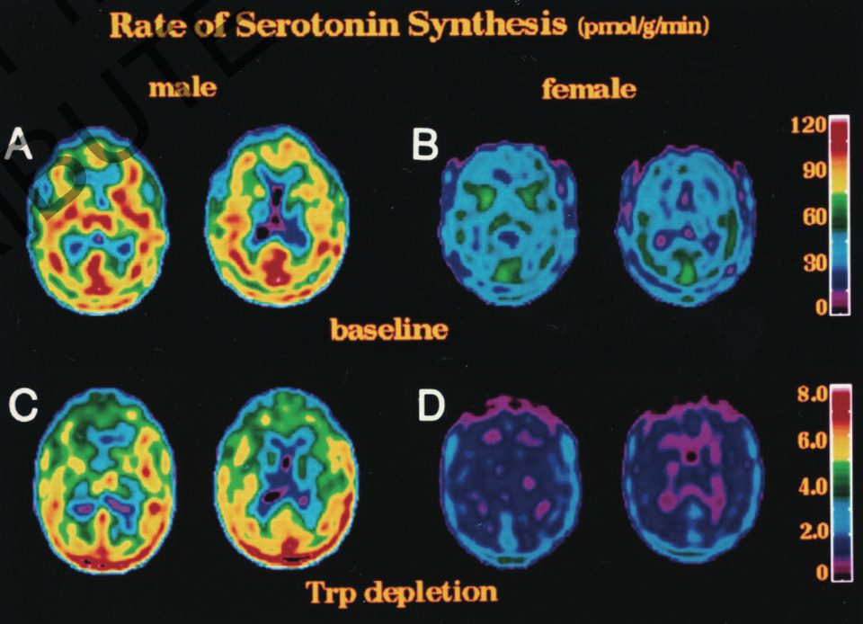
Sexual behavior and characteristics
Notes:
The bright colors in these positron emission tomography scans depict higher rates of serotonin synthesis in males than in females.

Slide 29
Sexual behavior and characteristics
Neurobiology of sexual orientation and transsexualism
Controversial both biologically and philosophically
Current work in humans is correlational
Animal models rely on modification of the prenatal environment
Notes:
The bright colors in these positron emission tomography scans depict higher rates of serotonin synthesis in males than in females.

Slide 30
Sexual behavior and characteristics
Role of serotonin in heterosexual interest
Individual differences in anatomy
individual differences in behavior
Notes:
The bright colors in these positron emission tomography scans depict higher rates of serotonin synthesis in males than in females.

Slide 31
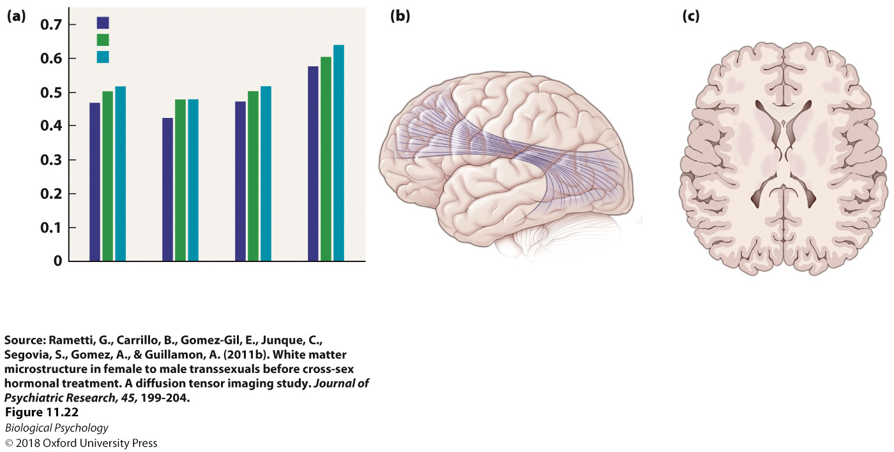
Sexual behavior and characteristics
Notes:
Brain involvement in transsexuals. (a) White matter structures in female-to-male transsexuals are more similar to those in heterosexual male brains than those in female brains in several brain areas, including the (b) superior longitudinal fasciculus, forceps minor, and corticospinal tract.

Slide 32
The neurobiology of parental behavior
The maternal brain
The paternal brain
Alloparenting
Notes:
Maternal behavior and foraging. (a) After being trained to locate food (top row), rats began from different starting positions (bottom row). Maternal rats consistently found the food faster than non-mothers did. (b) A mother rat grooms her pups.

Slide 33
The neurobiology of parental behavior
The maternal brain
Critical hormones
  Estrogen
  Progesterone
  Prolactin
  Oxytocin
  Endorphins
Don’t forget about individual differences

Slide 34
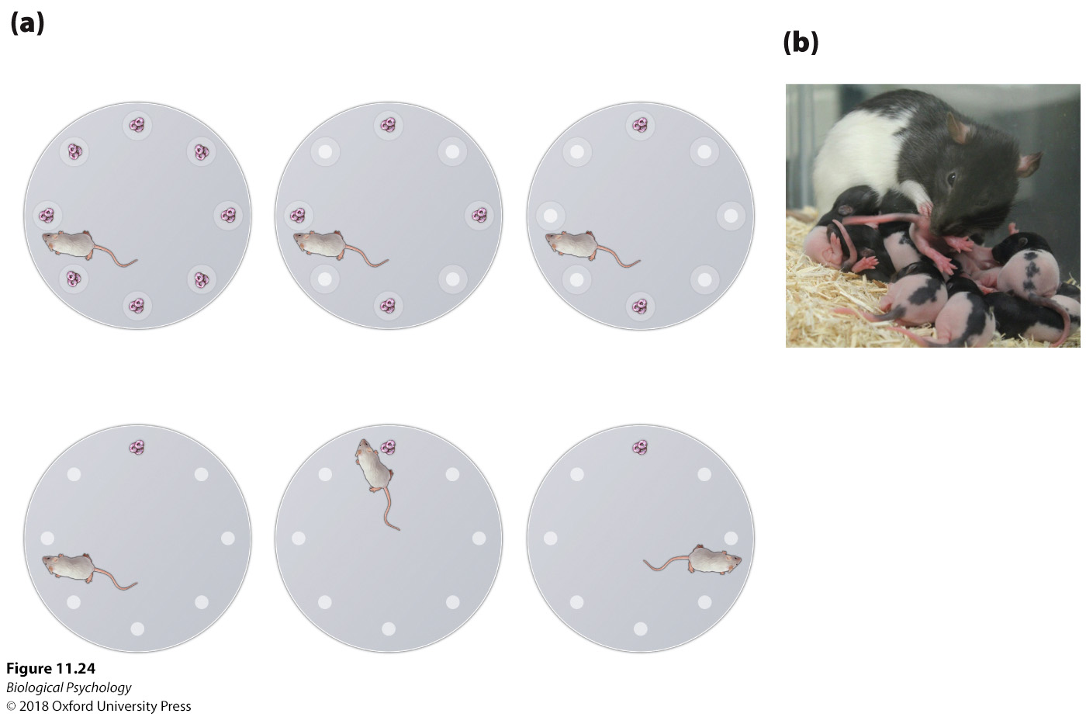
The neurobiology of parental behavior
Maternal brains are smarter brains?
Can we separate brain changes from effects of stress?
Notes:
Maternal behavior and foraging. (a) After being trained to locate food (top row), rats began from different starting positions (bottom row). Maternal rats consistently found the food faster than non-mothers did. (b) A mother rat grooms her pups.

Slide 35
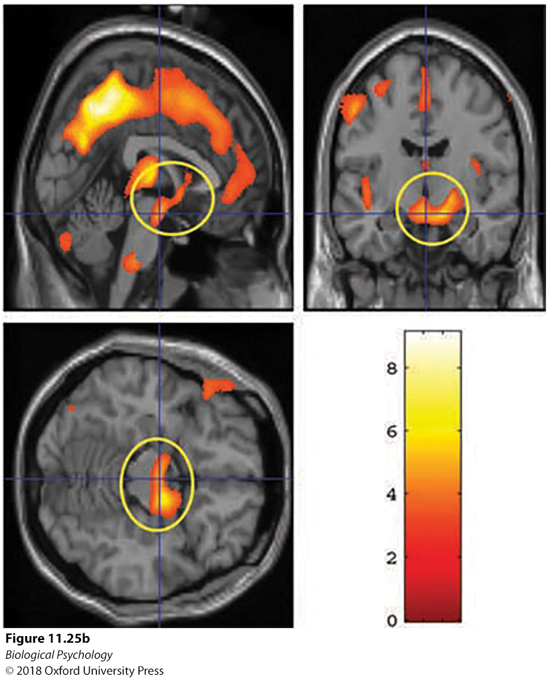
The neurobiology of parental behavior
Maternal brains are bigger brains?
Notes:
(a) Gray matter volume increased from two to four weeks to three to four months following delivery. (b) The mothers who reported a more positive perception of their babies at the earliest testing period experienced enhanced volume increases in several midbrain areas, including the hypothalamus, substantia nigra, and amygdala.

Slide 36
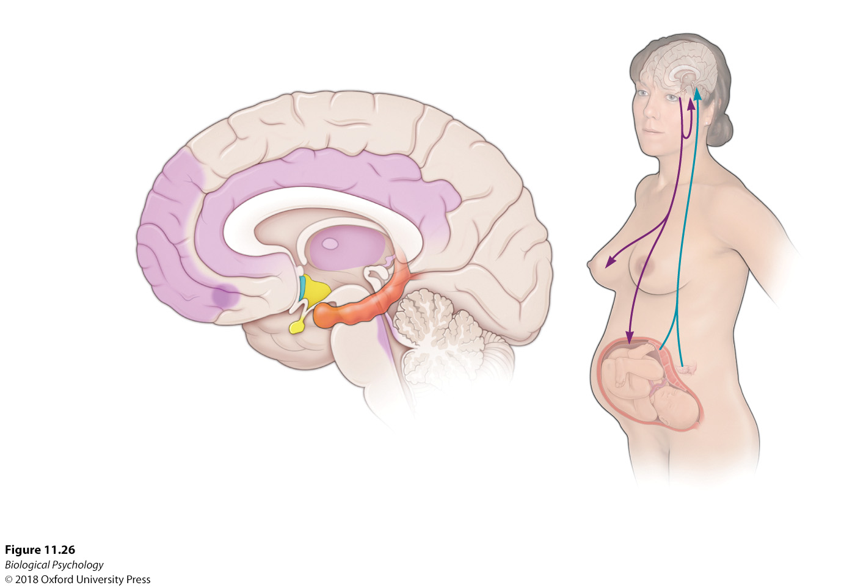
The neurobiology of parental behavior
Notes:
The maternal brain requires activation of multiple brain areas to respond to and care for the offspring.

Slide 37
The neurobiology of parental behavior
Fathers are changed too
  Testosterone
  Prolactin

Slide 38
The neurobiology of parental behavior
For biparental species, not having a father around negatively affects brain and behavior
In humans, 4x more likely to have emotional/behavioral/cognitive problems
  Poor academic performance
  Drug abuse
  Criminal behavior

Slide 39
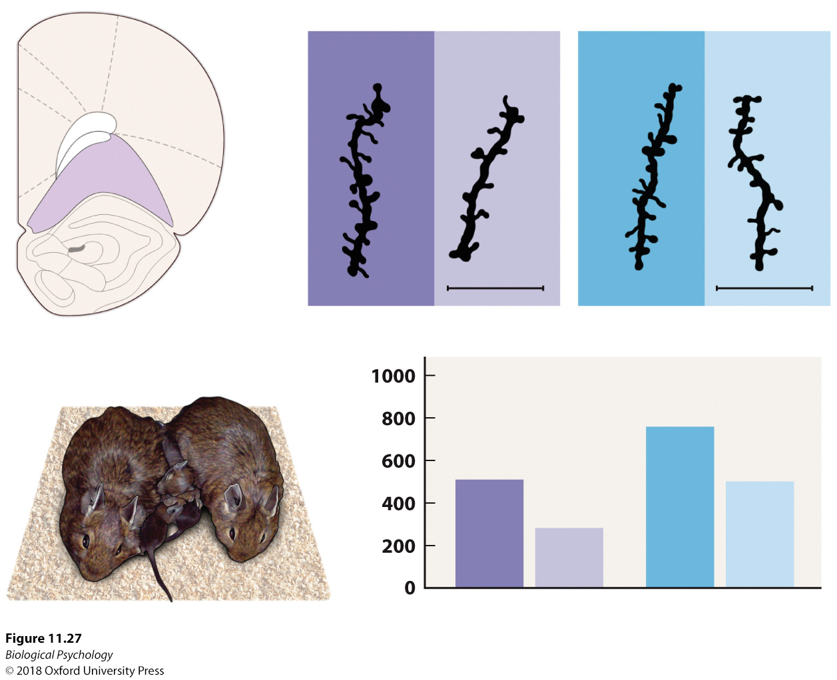
The neurobiology of parental behavior
Notes:
Parenting involvement and the orbitofrontal cortex. Focusing on the effects of both parents in degu offspring, the orbitofrontal cortex exhibits dramatic effects of having both parents; for example, not having father around leads to apical dendrite spines diminished at both postnatal days 21 and 90.

Slide 40
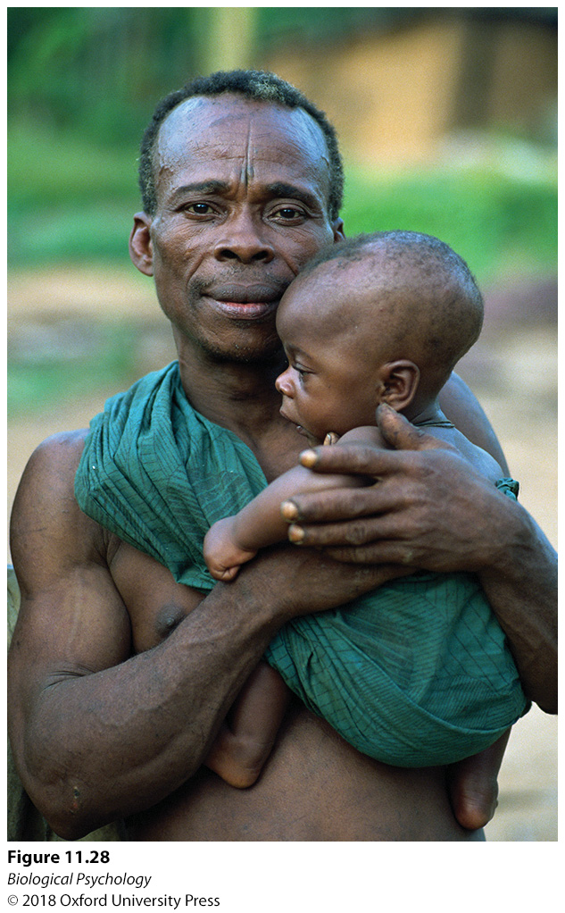
The neurobiology of parental behavior
Large variability across (and within) cultures in parental involvement
Notes:
Aka males exhibit high rates of paternal contact.

Slide 41
The neurobiology of parental behavior
Alloparenting
What would be the advantage of having the village raise a child?
What are the drawbacks?
  Think individual vs. group benefits/drawbacks
Notes:
Aka males exhibit high rates of paternal contact.

Slide 42
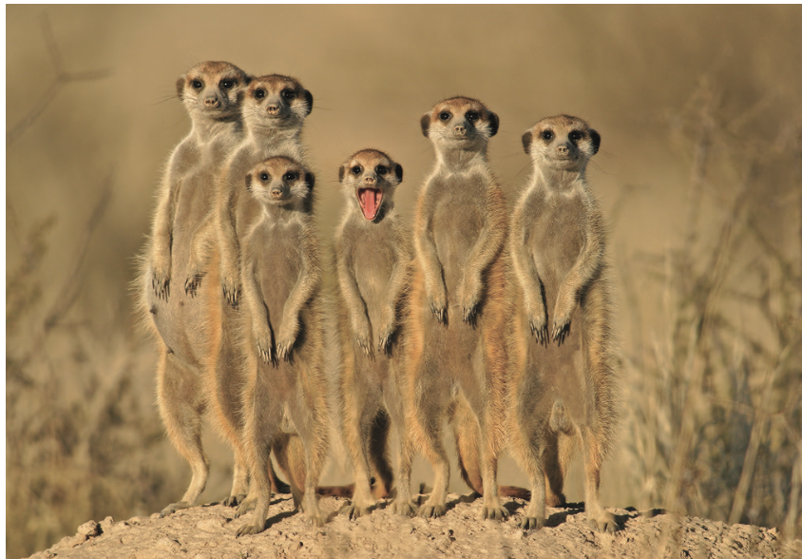
The neurobiology of parental behavior
Notes:
Meerkats use the alloparenting strategy to maximize care for offspring.

Slide 43
The neurobiology of parental behavior
What happens when animals get toward the end of reproductive years?
Terminal investment hypothesis

Slide 44
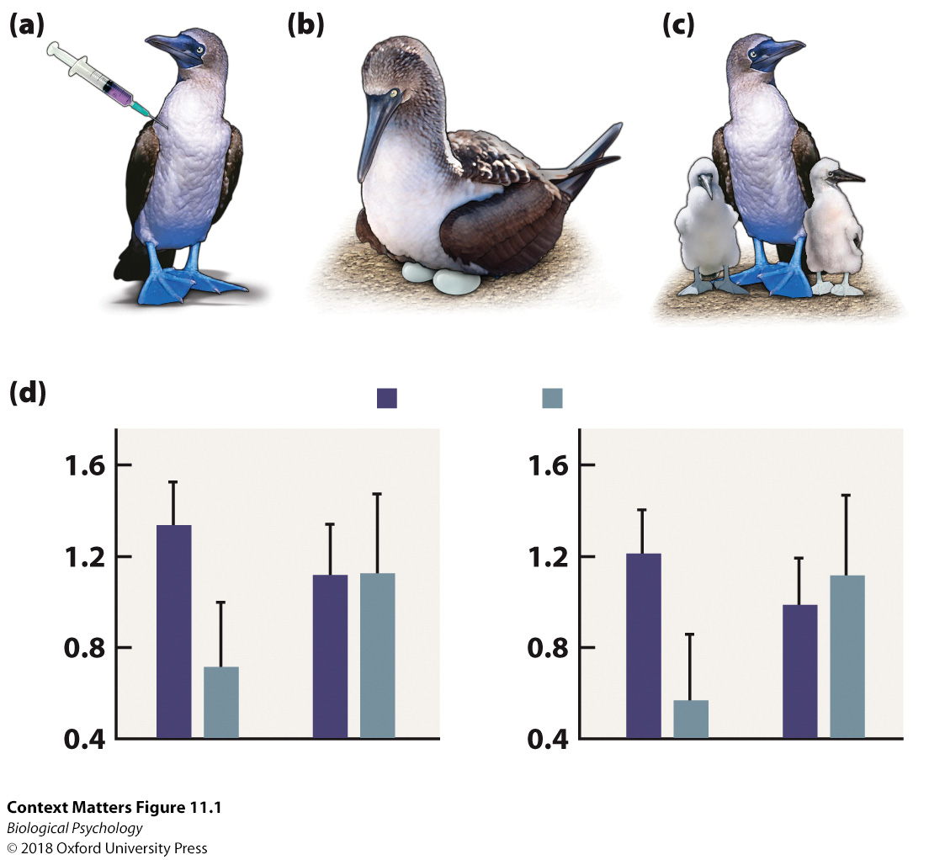
The neurobiology of parental behavior
Compare relative differences and absolute differences
Notes:
Parental investment in blue-footed booby birds. (a) After old and young males received an injection that made them feel ill, (b) their paternal behavior was observed. (c) During the sickness, young birds delivered less care to their offspring, whereas old birds increased their care.

