Slide 2
Chapter 9
Sleep, Wakefulness, and Conscious Awareness

Slide 3

Outline
The Rhythms of Sleep and Wakefulness
The Neurobiology of Sleep
Why Sleep and Dream?
Sleep Patterns: Typical and Atypical Variations
Altered States of Consciousness: Beyond Sleep

Slide 4

Rhythms of sleep/wake
Circadian Rhythms
Stages of Sleep
Extreme Sleep: Hibernation

Slide 5
Rhythms of sleep/wake
Circadian vs. ultradian
Why can’t we just rely on external environment for temporal cues?
How often do we mess up our sleep schedule?

Slide 6
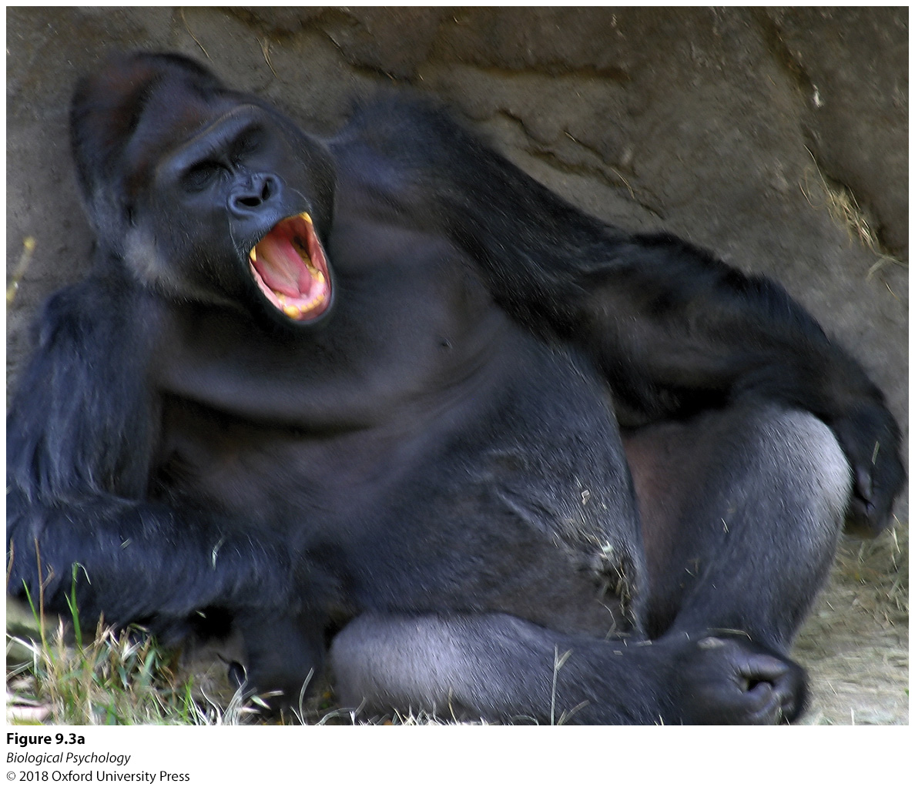
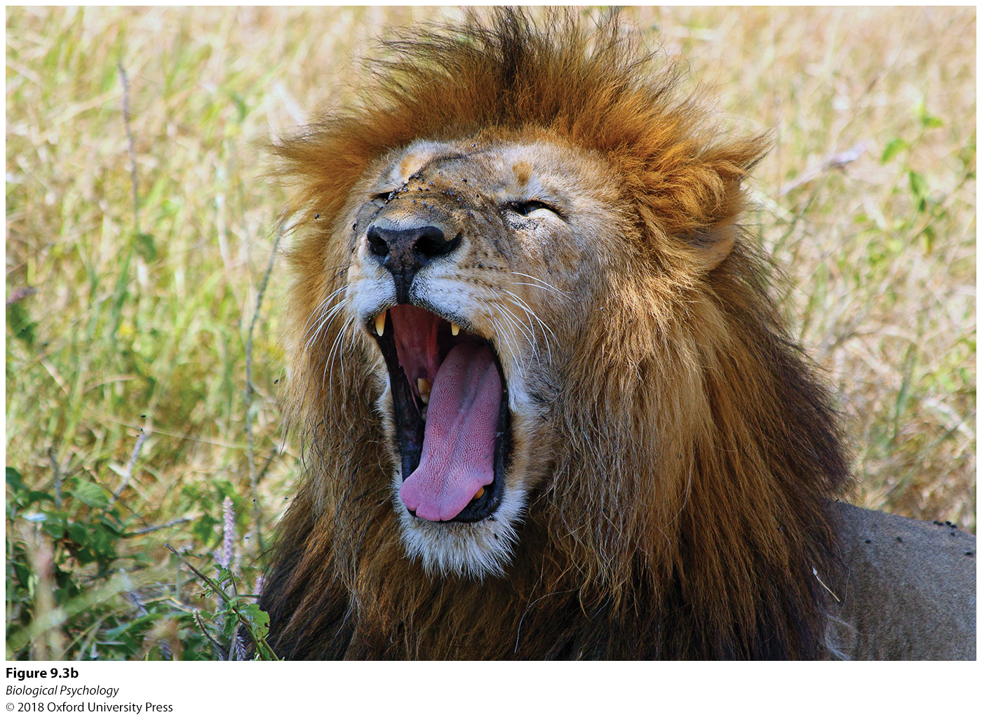
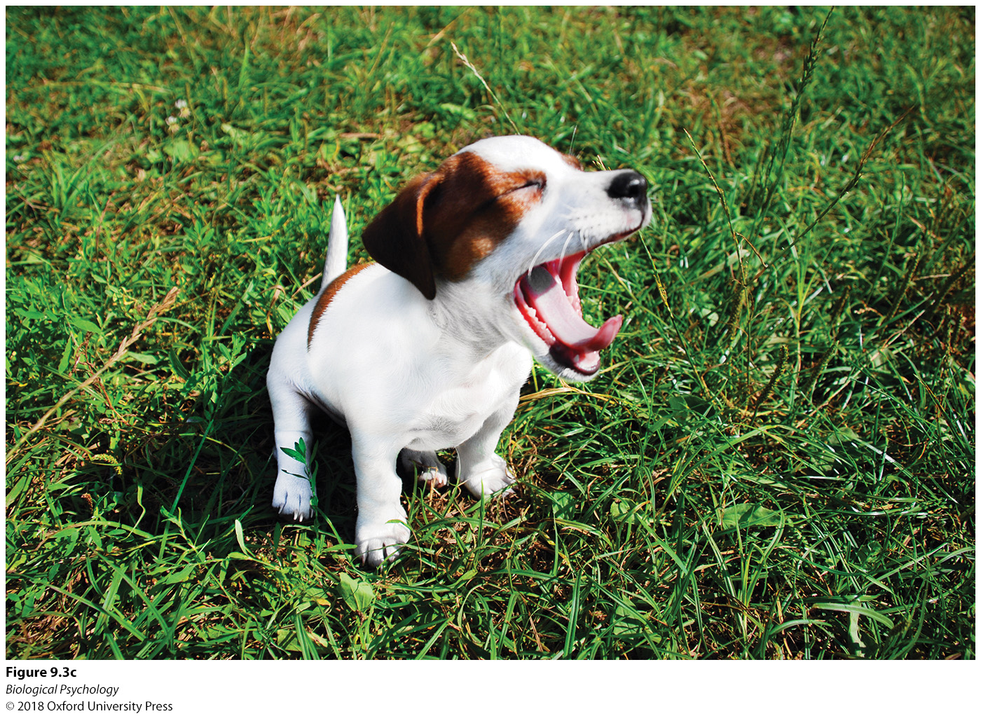

Rhythms of sleep/wake
Why do so many species yawn?
Notes:
Yawning across species. Scientists continue to debate the evolutionary advantage of yawning and why it occurs in many species, including (a) apes, (b) lions, (c) dogs, and
(d) humans.

Slide 7
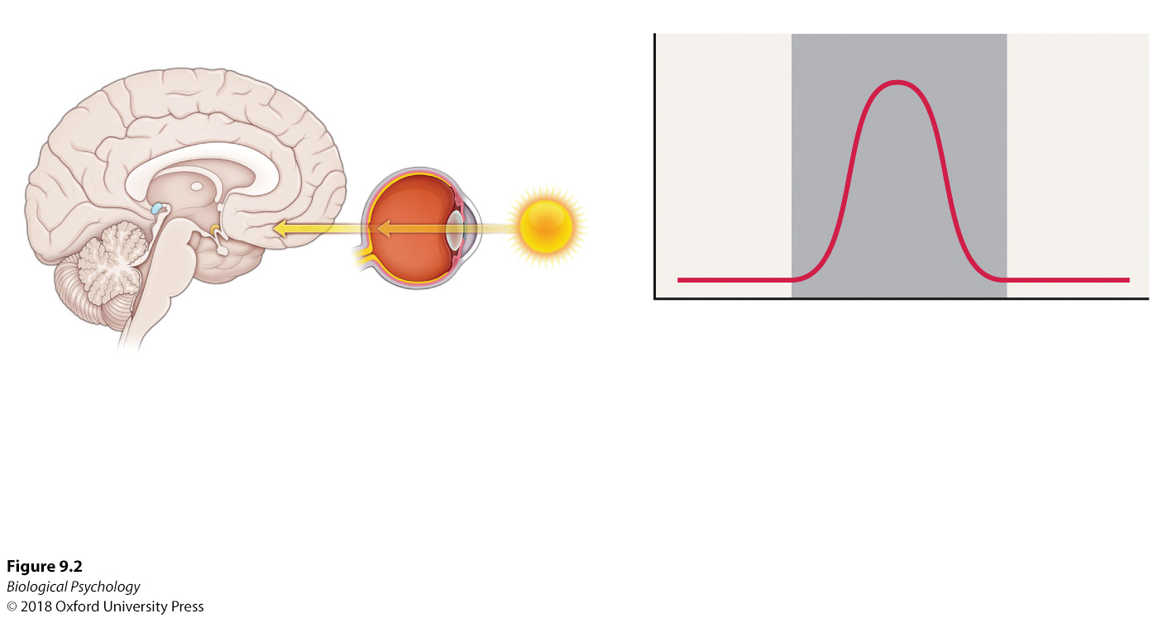
Rhythms of sleep/wake: Melatonin
Figure 9.2
Notes:
Neural circuits involved in circadian rhythms and peak melatonin response. Melatonin appears to be a chemical trigger signaling increased blood flow in distal areas of the body, promoting heat loss and the onset of sleep.

Slide 8
Rhythms of sleep/wake: Sleep
Sleep occurs in stages
Characteristic EEG signals during each stage

Slide 9
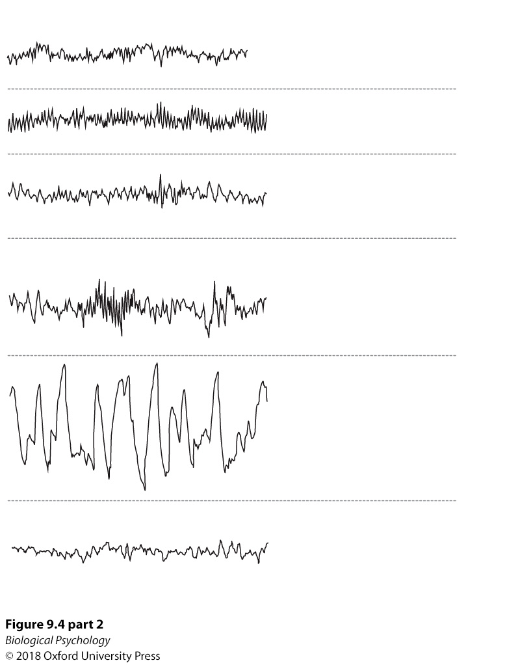
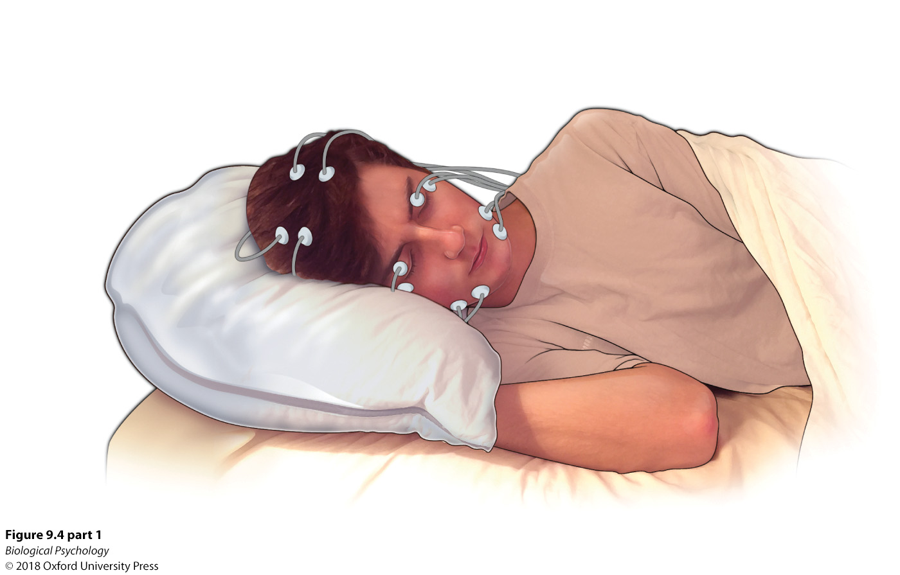
Rhythms of sleep/wake: Sleep
Notes:
Stages of sleep. Over the course of a night, sleeping individuals cycle through several distinct stages: Stages 1 and 2, slow wave sleep, and REM sleep, during which dreams occur. A polysomnograph records the different brain wave patterns that characterize these stages.

Slide 10
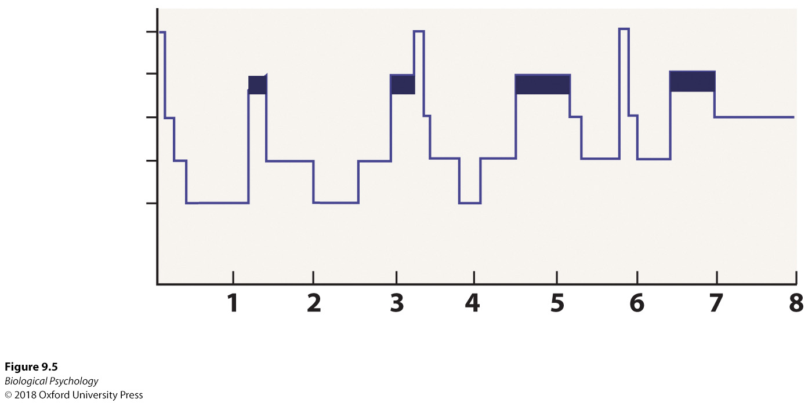
Rhythms of sleep/wake: Sleep
Notes:
A full night’s rest. Slow wave sleep decreases and REM sleep increases as the night progresses.

Slide 11
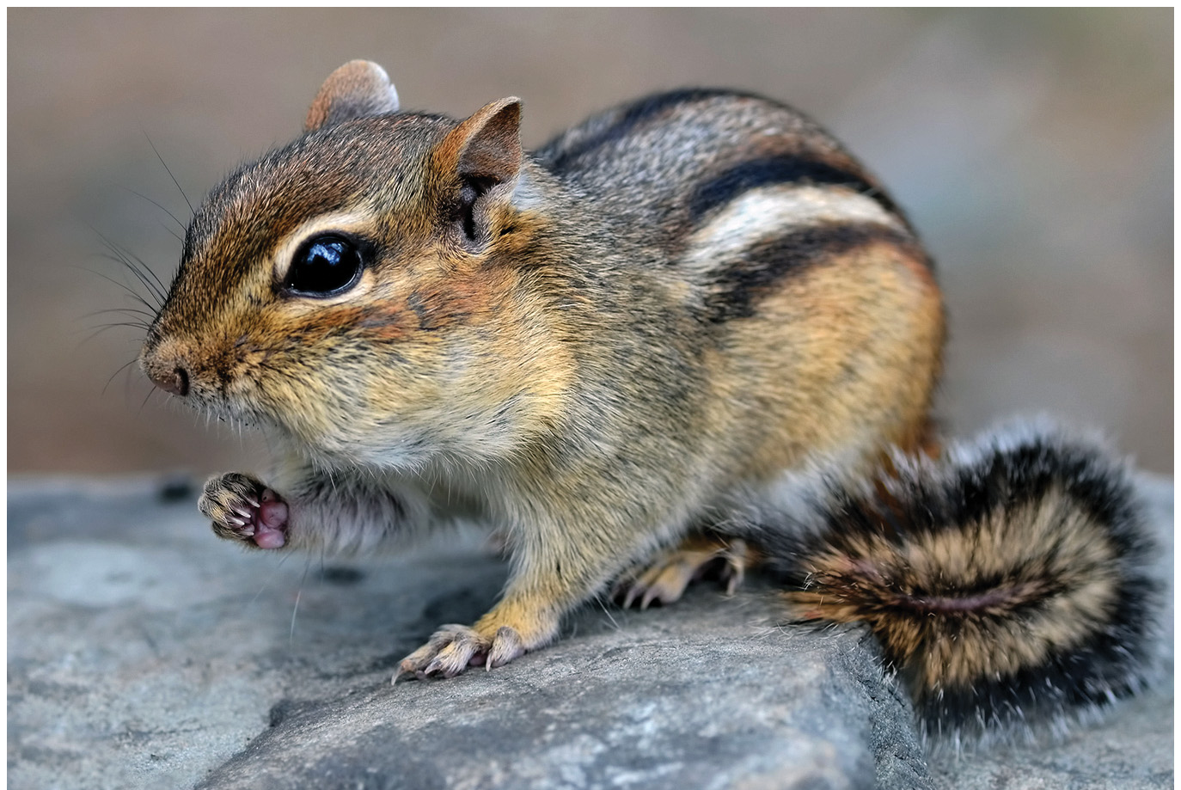
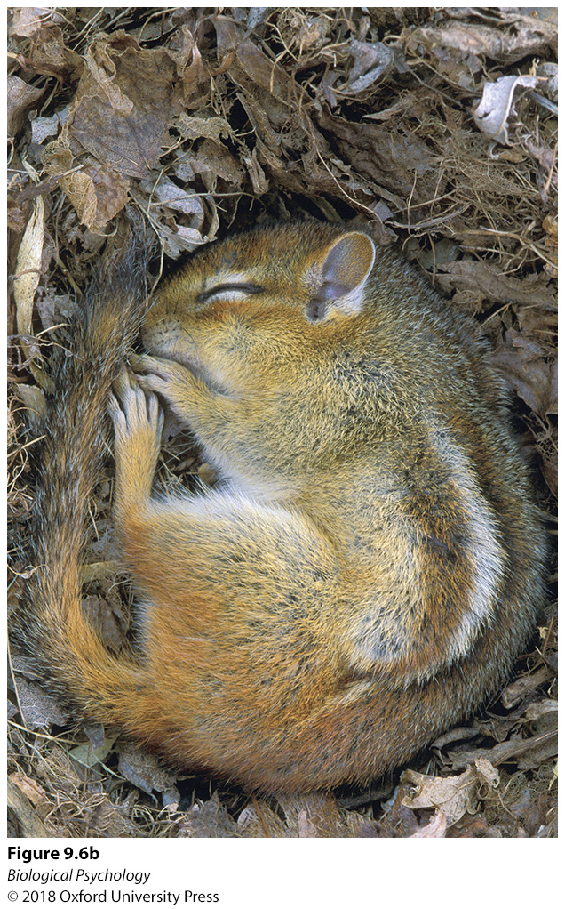
Rhythms of sleep/wake: Hibernation
Why would an animal hibernate?
Are there any obvious downsides to sleeping through the winter?
Notes:
Hibernation. Many animals, such as the (a) chipmunk, enter an extended state of unconsciousness (b) in response to harsh winter weather.

Slide 12
Neurobiology of sleep
Early Neuroanatomical Explorations
  Sleep as lack of sensory input?
  Tests via lesion method on nonhumans
Neuroanatomical / Neurochemical Circuits
  Acetylcholine
  SWS: GABA, galanin, adenosine
  REM: PGO spikes

Slide 13
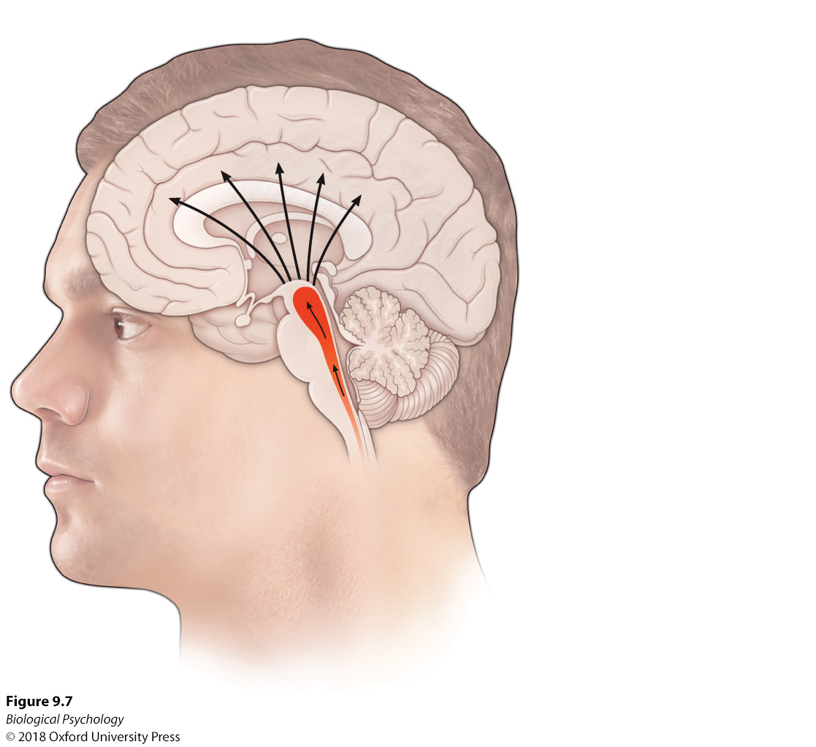
Neurobiology of sleep: ARAS
Notes:
The ascending reticular activating system (ARAS). The ARAS conveys sensory information to other parts of the brain and is essential for maintaining wakefulness.

Slide 14
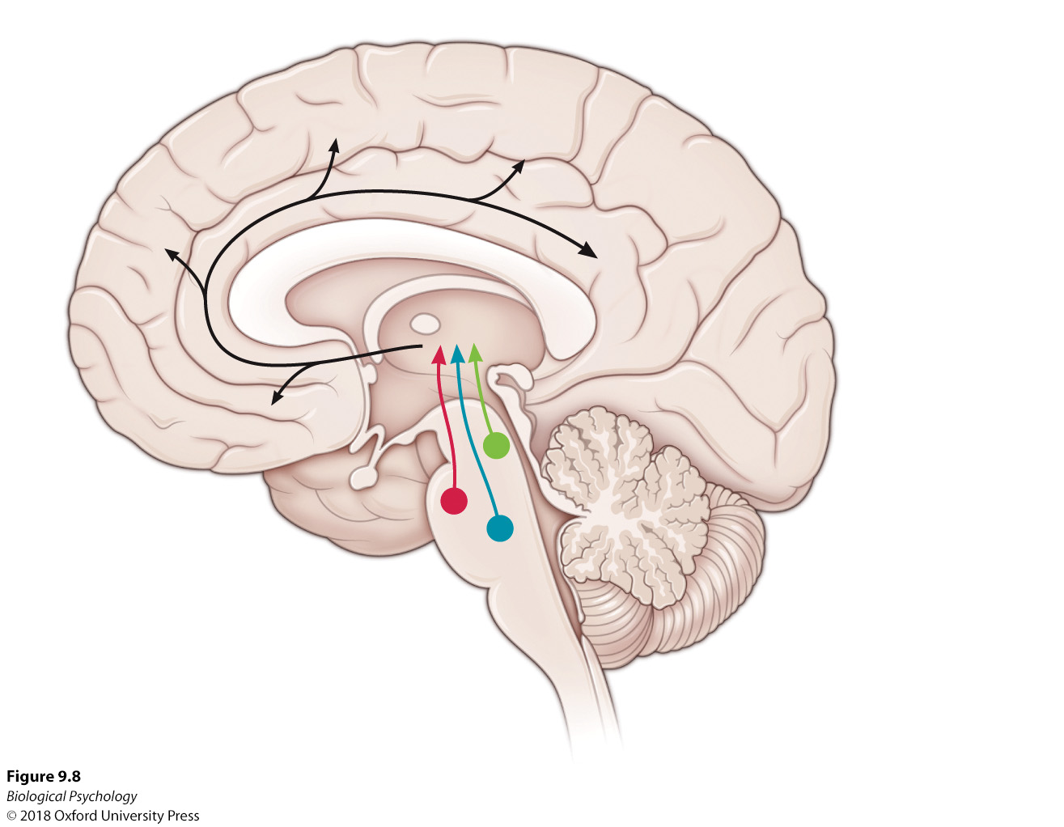
Neurobiology of sleep: Acetylcholine
Notes:
The neurochemistry of wakefulness. tegmental nuclei (LDT) contributes to the maintenance of wakefulness. Acetylcholine from the pedunculopontine tegmental nuclei (PPT) and laterodorsal

Slide 15
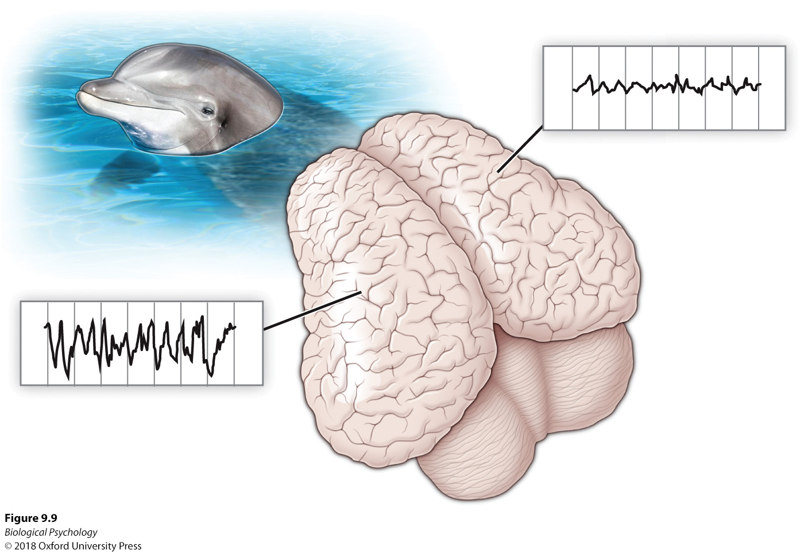
Neurobiology of sleep
Total sleep could be dangerous for some animals
Why not just never sleep?
Notes:
Dolphin sleep. EEG records of dolphins reveal that only one hemisphere sleeps at a time.

Slide 16
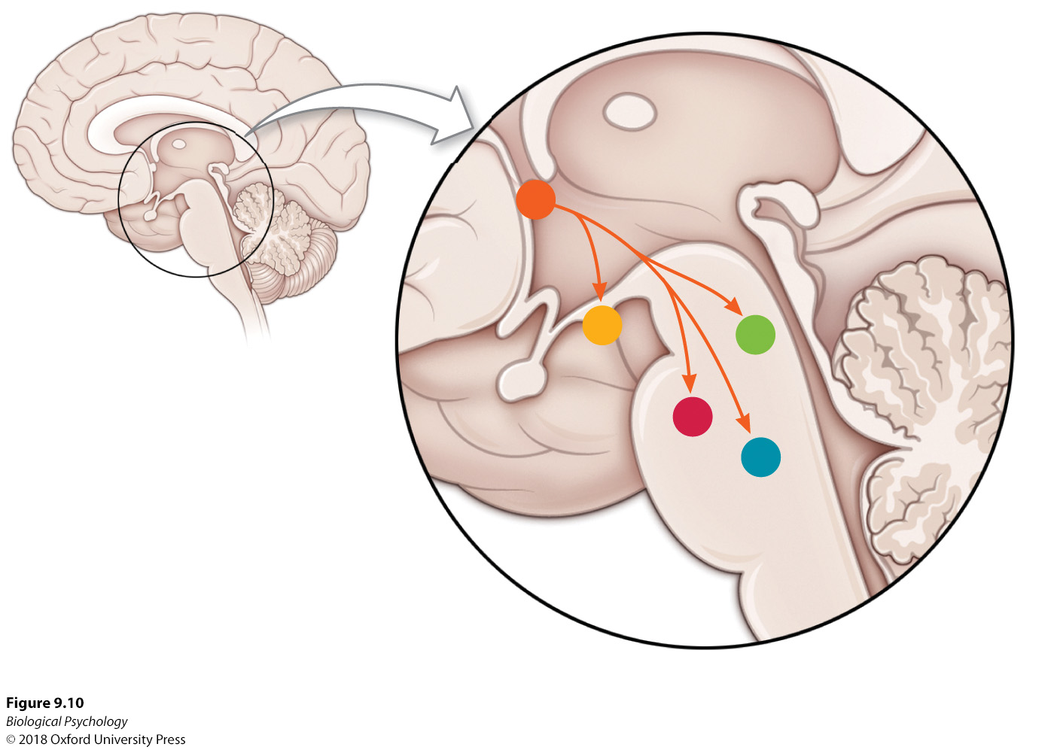
Neurobiology of sleep: SWS
Notes:
Hypothalamic projections from the ventrolateral preoptic area (VLPO) to the tuberomammillary nucleus (TMN) function to diminish wakefulness during slow wave sleep.

Slide 17


Neurobiology of sleep
Which animal is experiencing REM sleep?
Why is loss of muscle tone advantageous during REM sleep?
Notes:
Cat naps. The sleeping posture of animals reveals information about the stage of sleep they are currently in. (a) The ability of the cat to hold its head up indicates that it is in non-REM sleep. (b) This cat has apparently lost muscle tone and entered REM sleep.

Slide 18
Neurobiology of sleep: REM
Why dream?
Activation-synthesis model

Slide 19
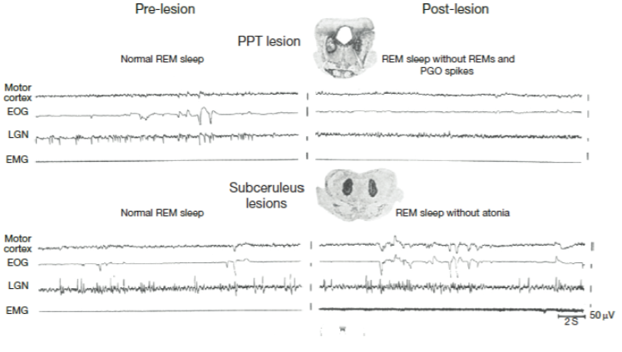
Neurobiology of sleep: REM
Notes:
Pontine nuclei and REM characteristics. Lesions of pontine nuclei diminish specific aspects of REM sleep.

Slide 20
Why sleep and dream?
Homeostatic theory of sleep regulation
Adaptive theory of sleep
Cultural differences in sleep patterns

Slide 21
Why Sleep?
How would you test the role of sleep?
What ethical concerns should we be aware of?

Slide 22
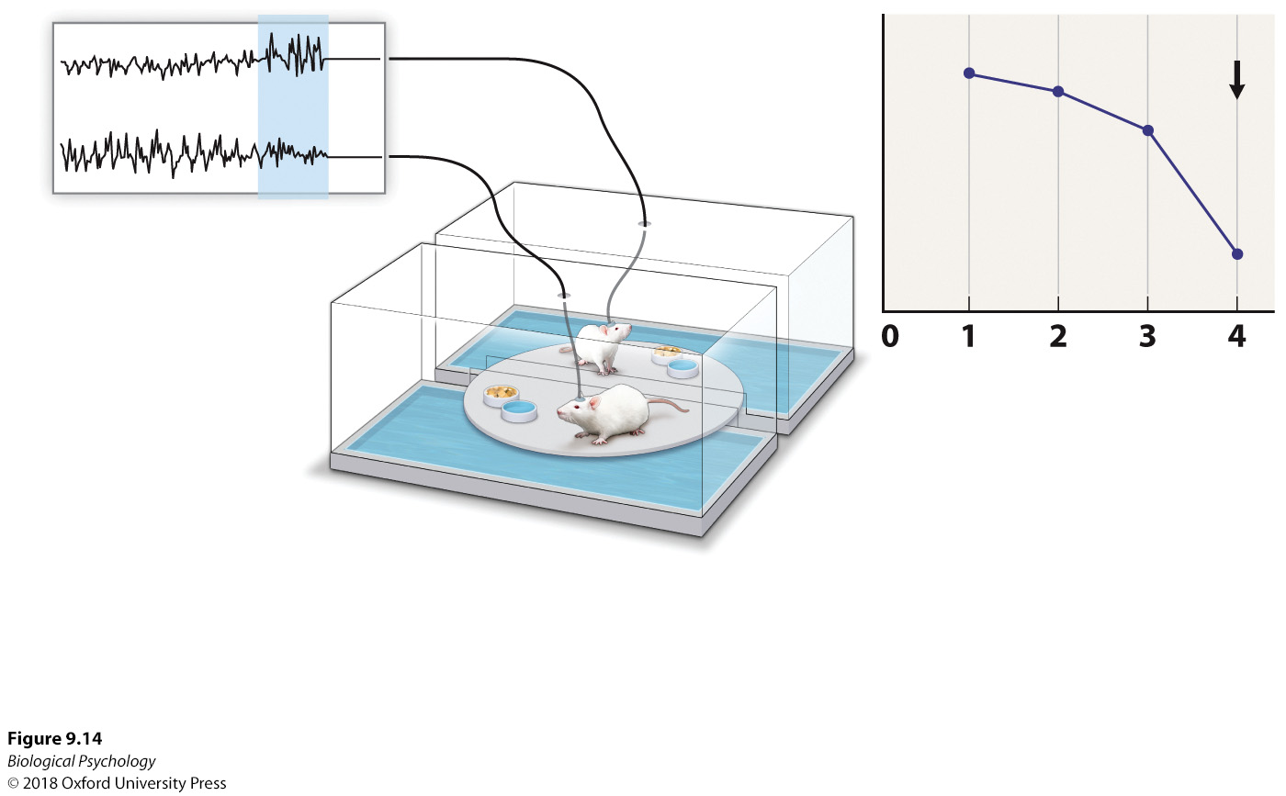
Why Sleep?
Rats kept awake long enough got sick, stopped eating, died
Notes:
Rodent model of sleep deprivation. Electroencephalograms recorded from the experimental animals activate the movement of the platform when the animal sleeps so that the disk movement and threat of falling in the water wake the animal up. The yoked animal also has its sleep patterns disrupted by the platform movement, but, unlike the experimental animal, it can engage in occasional sleep.

Slide 23
Why Sleep? Adaptive theory
Sleep patterns should reflect environmental demands
Different animals show very different sleep patterns
Environment change (e.g., captivity) can change sleep habits
  Maybe we’ve been too hard on sloths

Slide 24
Why Sleep?
Variation exists in human sleep schedules
  Number of sleep periods
  Not all members of community sleep at same time
  Not everyone sleeps same duration

Slide 25
Why Sleep?
Sleep may also play a role in learning and memory
  Memory consolidation
  Sleep replay
  Synaptic homeostasis hypothesis
  Theta rhythms and offline processing

Slide 26
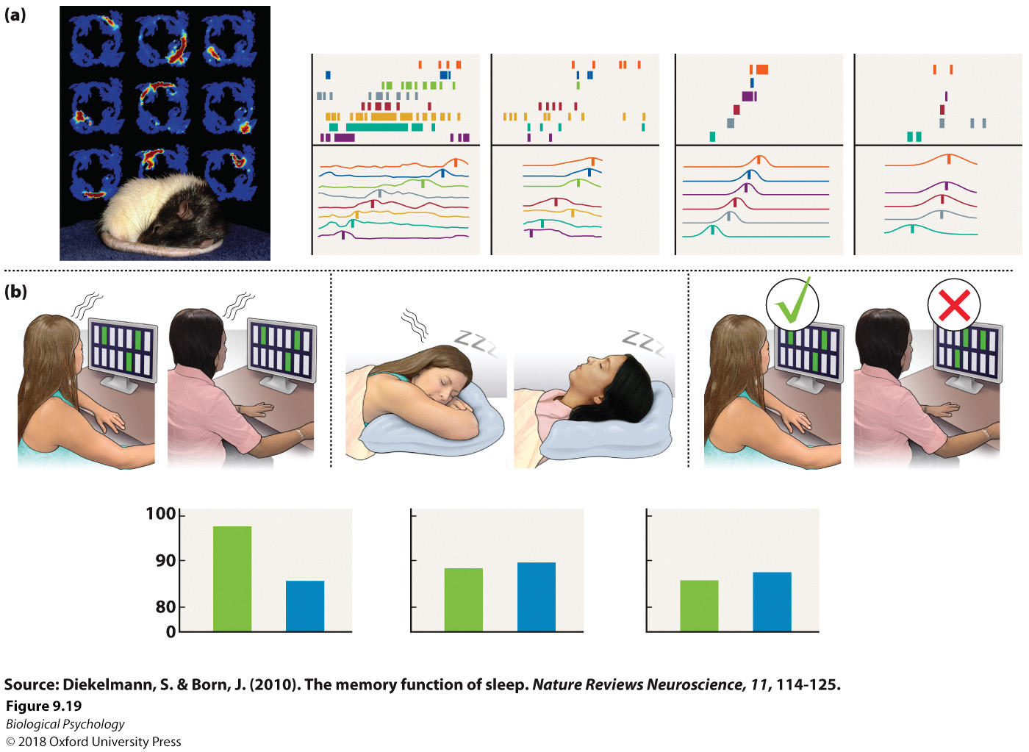
Why Sleep? Sleep Replay
Notes:
Sleep and learning. (a) When a rat sleeps after navigating through a maze, the same neural patterns that the rat displayed while in the maze are reactivated. (b) In humans, presentation of stimuli during a learning task and subsequently when a subject is in slow wave sleep can reactivate neural patterns similar to those active during learning, facilitating consolidation of the information.

Slide 27
Why Sleep? Theta rhythms
Notes:
θ rhythms during REM and waking behaviors. Similar θ rhythms observed during both REM and survival-related behaviors in various mammals suggest that REM brain activity may facilitate these behaviors expressed during waking hours.

Slide 28
Why Sleep? Immune function
Vaccine effectiveness in the sleep deprived?
Sleep efficiency vs. sleep amount
Neurons responsive to immune chemicals are located in sleep/wake regions
  brainstem, hippocampus, hypothalamus
Immune chemicals increase during SWS

Slide 29
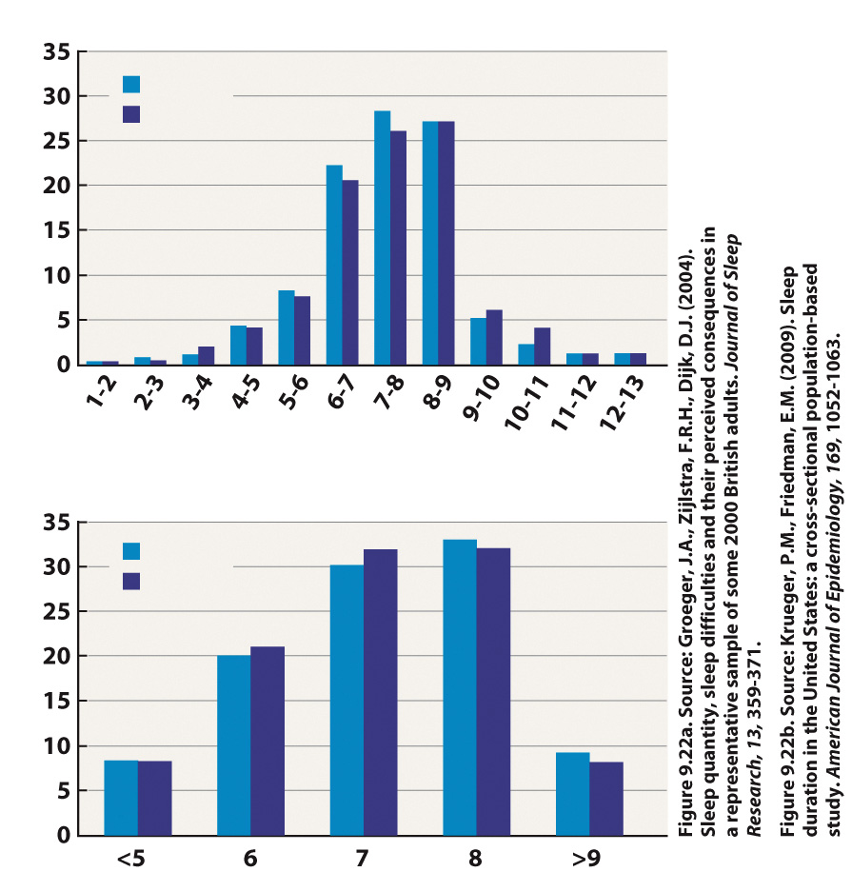
Sleep Patterns: Typical vs. Atypical
How do we define what “normal” sleep is?
Take the average, take the mode?
What if most people are not getting “enough” sleep?
Notes:
Sleep durations in the United Kingdom and the United States. Sleep durations are evenly distributed in (a) the United Kingdom and (b) the United States, with an average nightly sleep of approximately seven hours in both groups.

Slide 30
Sleep Disorders
Insomnia
  GABA implicated
Narcolepsy
  Hypocretin/orexin system implicated
Sleep apnea
  Obstructed airways, associated with obesity

Slide 31
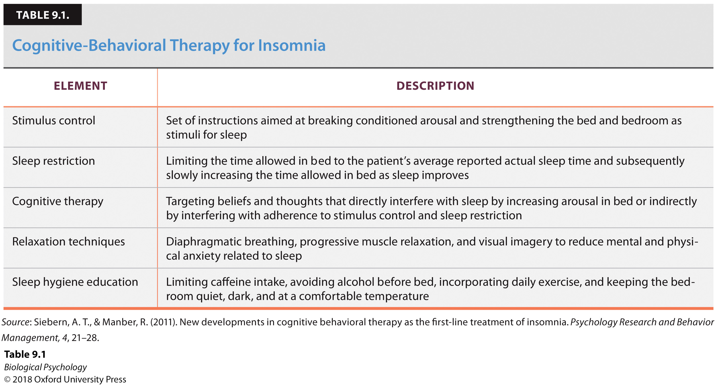
Sleep disorders: Insomnia
No single treatment for Insomnia
Notes:
Cognitive-Behavioral Therapy for Insomnia

Slide 32
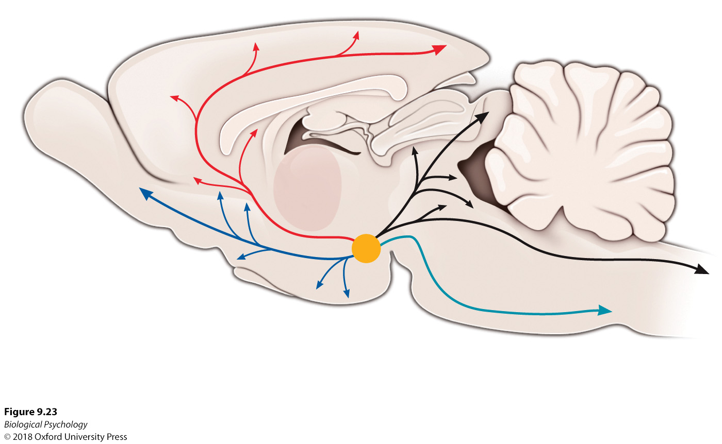
Sleep disorders: Narcolepsy
Notes:
The hypocretin system. Hypocretin/orexin cells are located in the hypothalamus. They project to areas throughout the brain, influencing wakefulness and other functions related to energy expenditure and emotional processes.

Slide 33
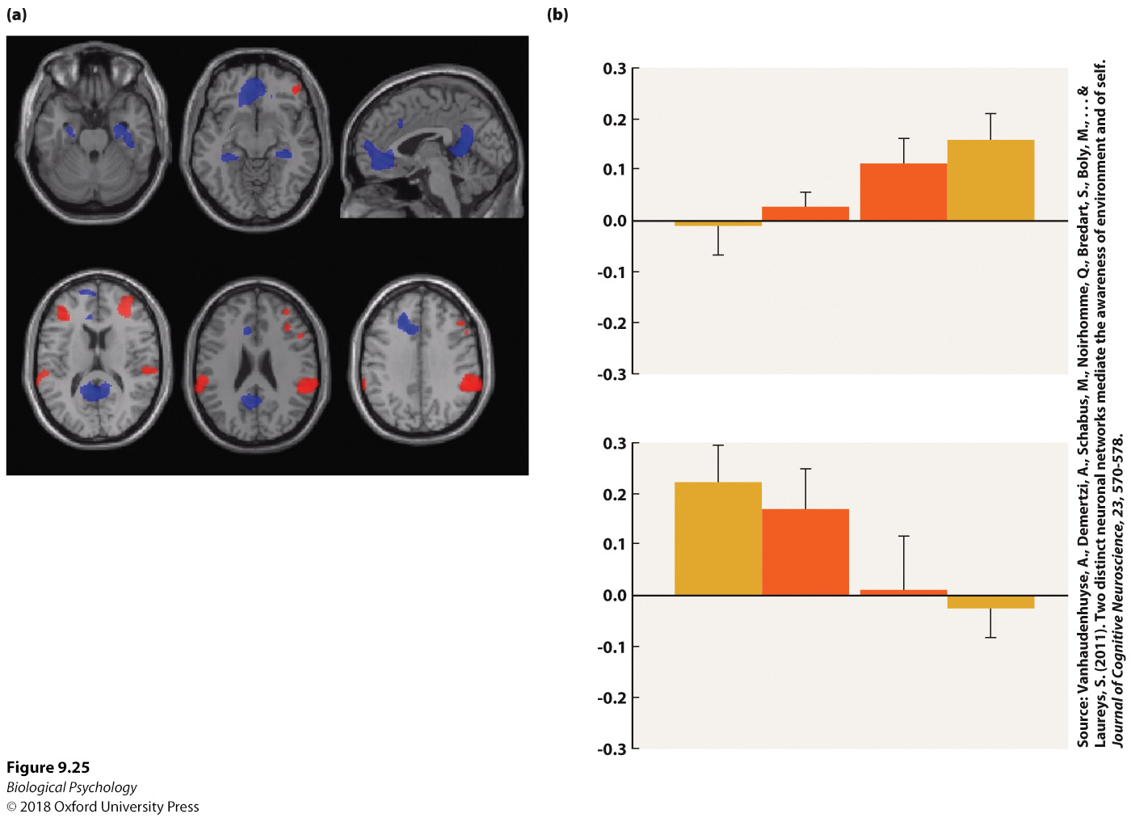
Sleep disorders: Sleep apnea
Notes:
Sleep apnea and brain volume. Postmortem analyses of individuals with obstructive sleep apnea revealed smaller cortical areas (shown in red) compared with healthy control brains.

Slide 34
Altered states of consciousness
Neural networks and conscious awareness
Disorders of consciousness
  Hard to study consciousness, hard to define disorders
Death and the end of consciousness

Slide 35
Conscious Awareness Network
Dissociation in brain regions for internal/external attention
Notes:
Internal and external awareness. Specific brain areas are activated during internal and external conscious awareness. These functional magnetic resonance imaging scans show more activation in the cingulate cortex and parahippocampal cortex (blue) in strong internal awareness and more activation in the dorsolateral prefrontal cortex and inferior parietal lobe (red) during strong external awareness.

Slide 36
Disordered Consciousness
Conditions to keep straight
  Locked-in syndrome
  Vegetative state
  Minimally conscious
  Coma
  Brain death

Slide 37
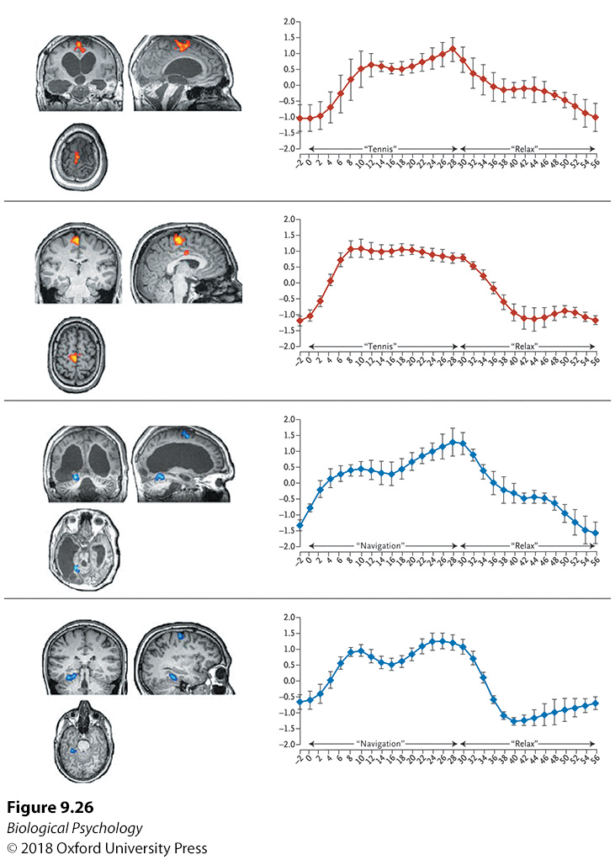
Disordered Consciousness
Minimally conscious patients show brain activity in response to questions
Minimal behavioral response
Notes:
Brain responsiveness of minimally conscious patient. When asked to imagine hitting a ball on a tennis court (A/B) and navigating through a city or their home (C/D), a minimally conscious patient and a healthy individual showed similar brain response patterns.

Slide 38
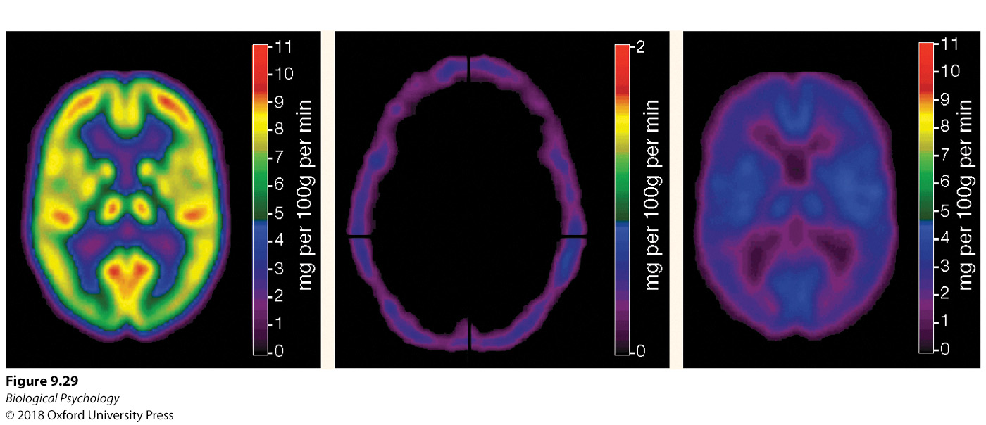
Brain death vs. vegetative state
Notes:
Brain death. There is virtually no observable resting brain activity in positron emission tomography scans of individuals diagnosed with brainstem, or brain, death.

