Slide 2
Chapter 8
Maintenance and Motivation

Slide 3

Outline
The brain’s reward circuitry
Hunger regulation
Thirst regulation
Motivating the brain to work
Grooming
Barbering (Extreme Grooming)

Slide 4

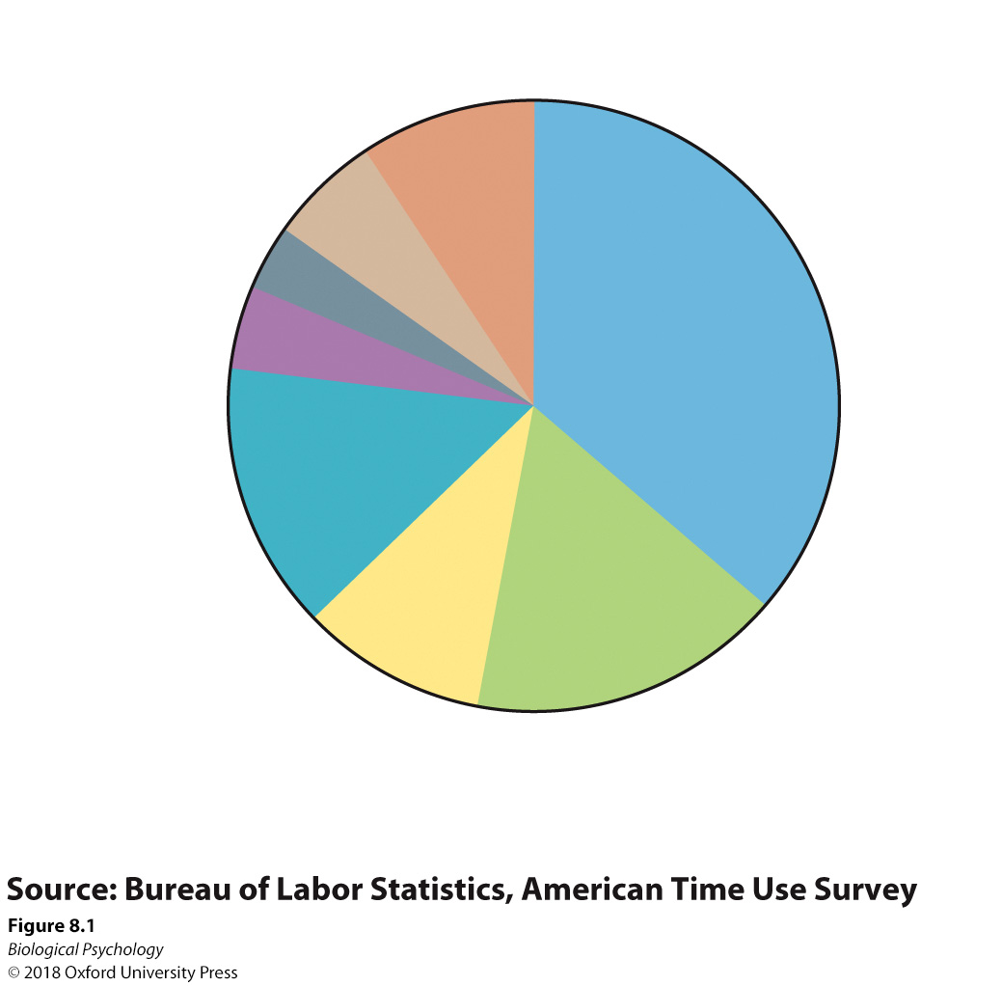
Reward circuitry
Time budgets help us understand what people spend their time doing/find rewarding
How might you experimentally determine the reward center of the brain?

Slide 5
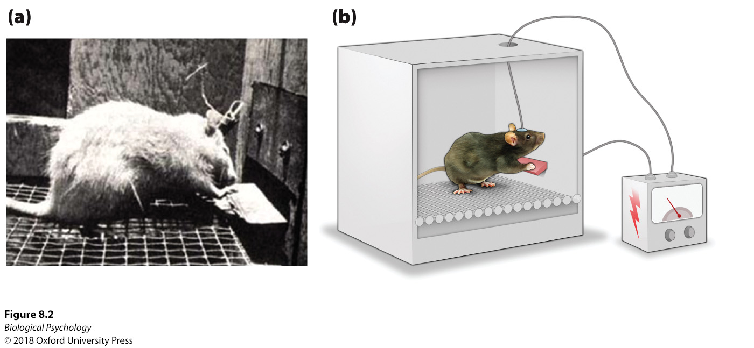
Reward circuitry
Notes:
(a) Rats press a bar to receive electrical stimulation to the mesolimbic dopaminergic pathway. (b) If rats increase bar press responses to obtain stimulation to a specific brain area; this indicates that the stimulation is rewarding.

Slide 6
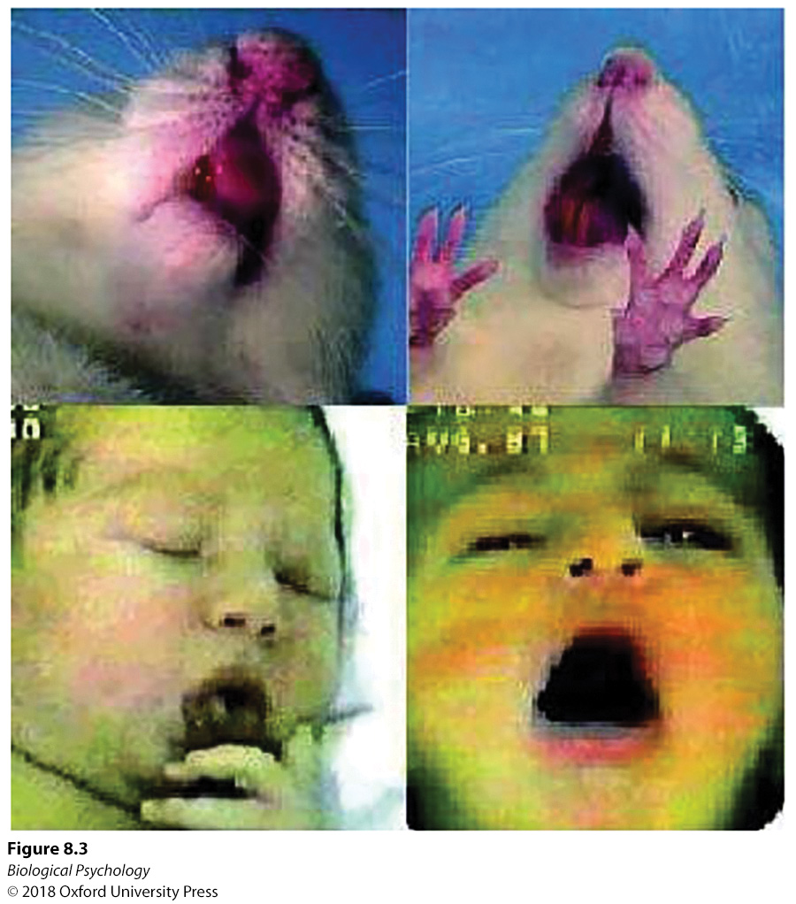
Reward circuitry
We can also measure behavioral responses to particular stimuli
Notes:
Similarities observed between rodents and humans suggest that facial responses to sweet and bitter tastes have been conserved across mammalian species.

Slide 7
Reward circuitry
Critical regions
  mesolimbic dopaminergic pathway
  septal nuclei
  snucleus accumbens

Slide 8
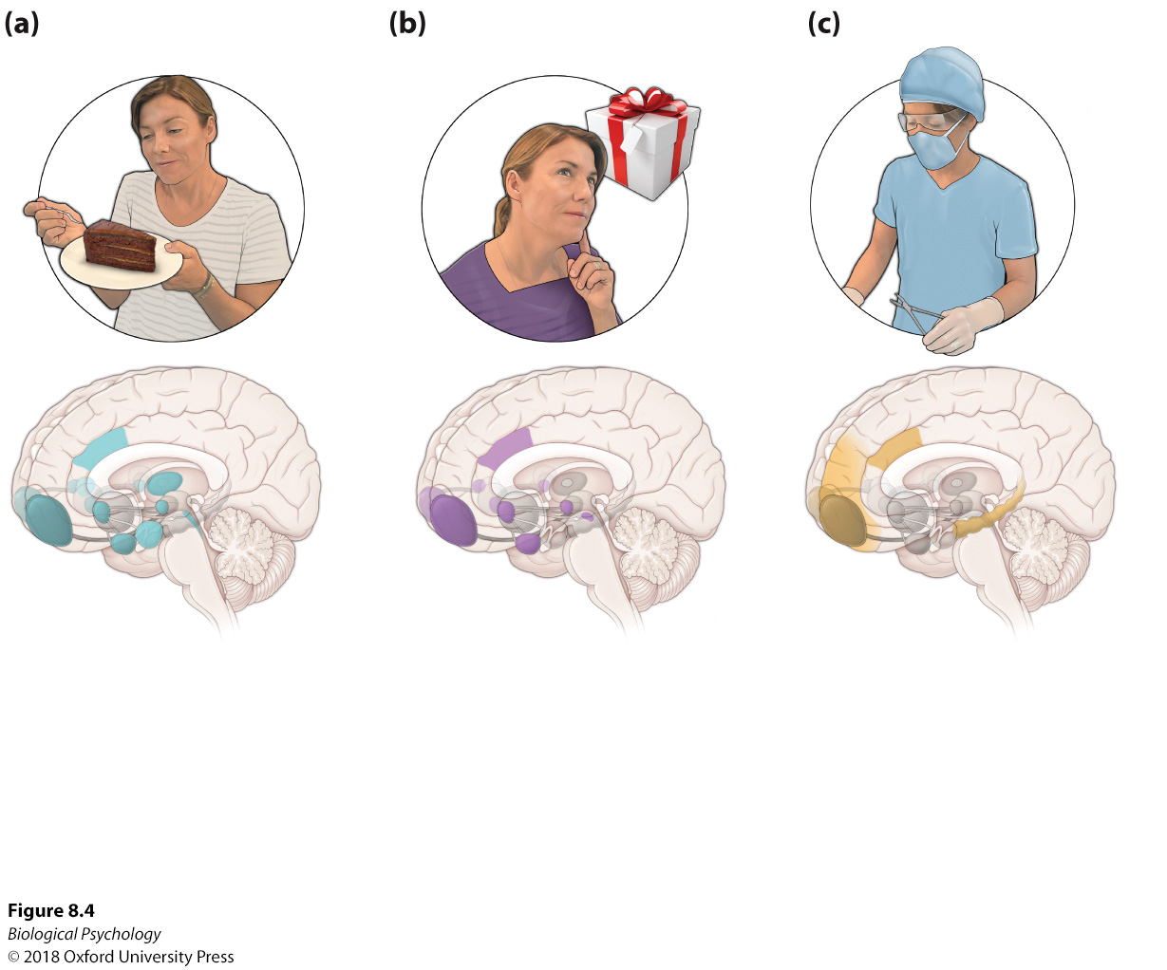
Reward circuitry
Notes:
Various brain areas and neurochemicals guide us to desired outcomes based on how much we enjoy the activity (liking), wish to engage in the activity (wanting), or have come to associate specific stimuli with subsequent desired activities (learning).

Slide 9
Reward circuitry
Liking vs. wanting vs. learning
Notes:
Various brain areas and neurochemicals guide us to desired outcomes based on how much we enjoy the activity (liking), wish to engage in the activity (wanting), or have come to associate specific stimuli with subsequent desired activities (learning).

Slide 10
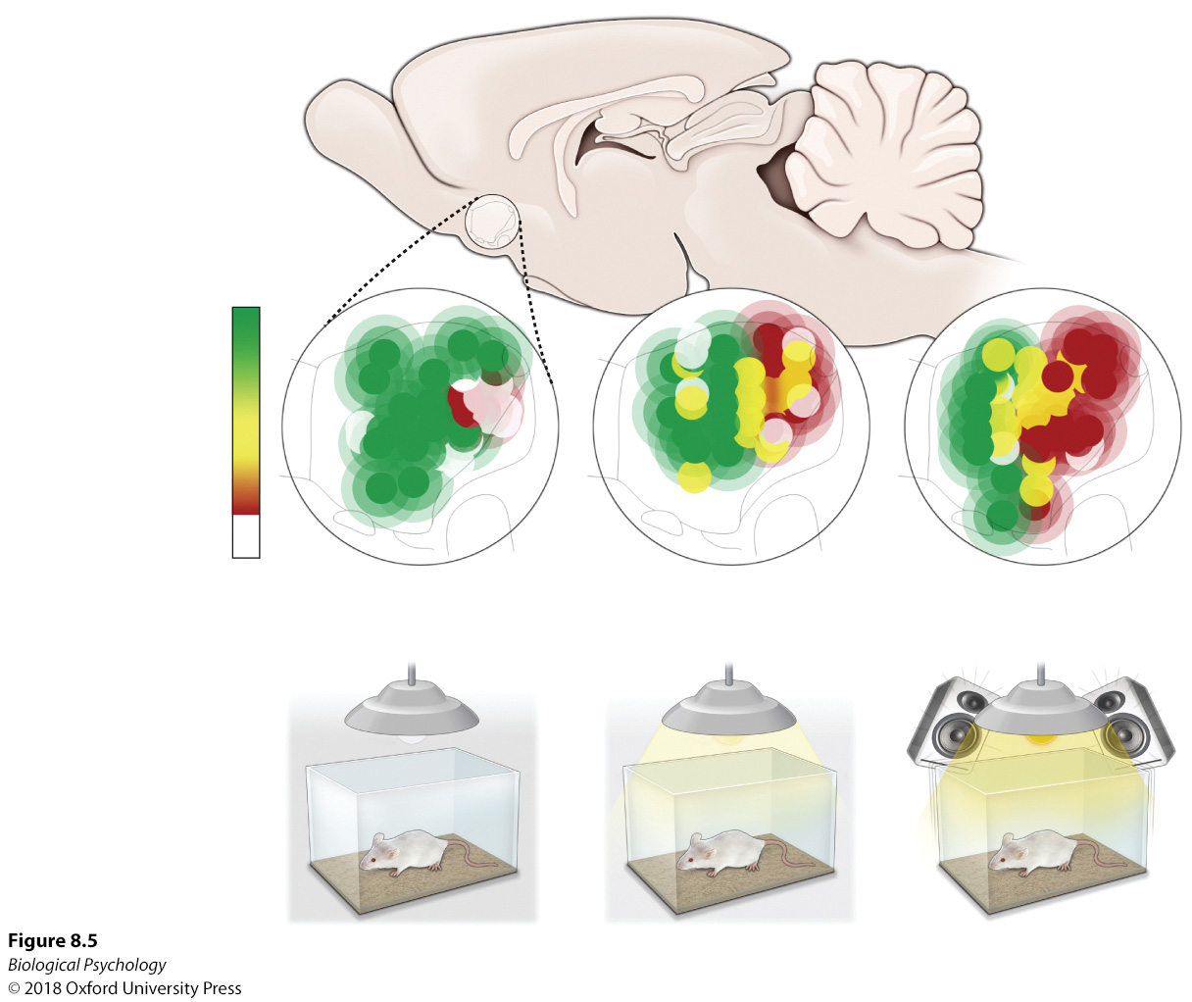
Reward circuitry
The environment can shape how our brain processes stimuli
How could we apply this research?
Notes:
In this study, the rat’s habitat influenced the proportion of the nucleus accumbens shell assigned to positive and negative emotional responses.

Slide 11
Hunger Regulation
We eat to live, so the brain is good at motivating us to eat
How it accomplishes this feat is based in part on our environment
  Brain size and stomach size relate to habitat/food availability

Slide 12
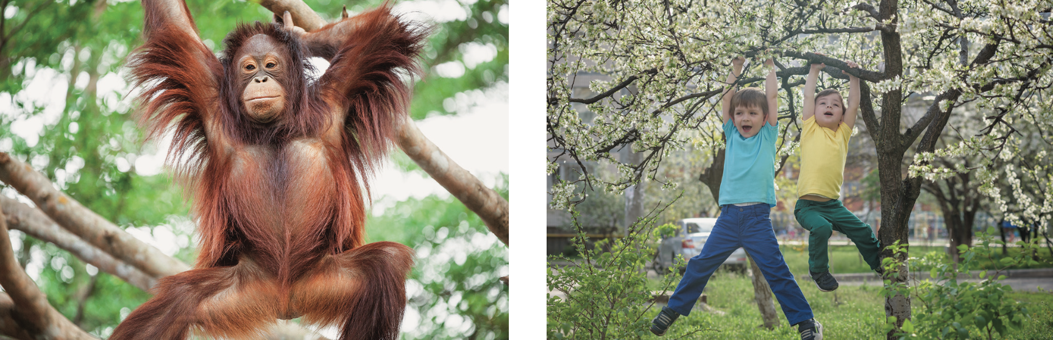
Hunger Regulation
Notes:
Orangutans, who eat only raw foods, require a large stomach for storage. (b) Eating cooked foods enables humans to have smaller stomachs, since we obtain necessary levels of nutrients in smaller volumes of food

Slide 13
Hunger Regulation: Neurobiology
Hyperphagia
Lesions to VMH
Lesions to LH
Sensory-specific satiety
Key players: insulin, leptin, ghrelin

Slide 14
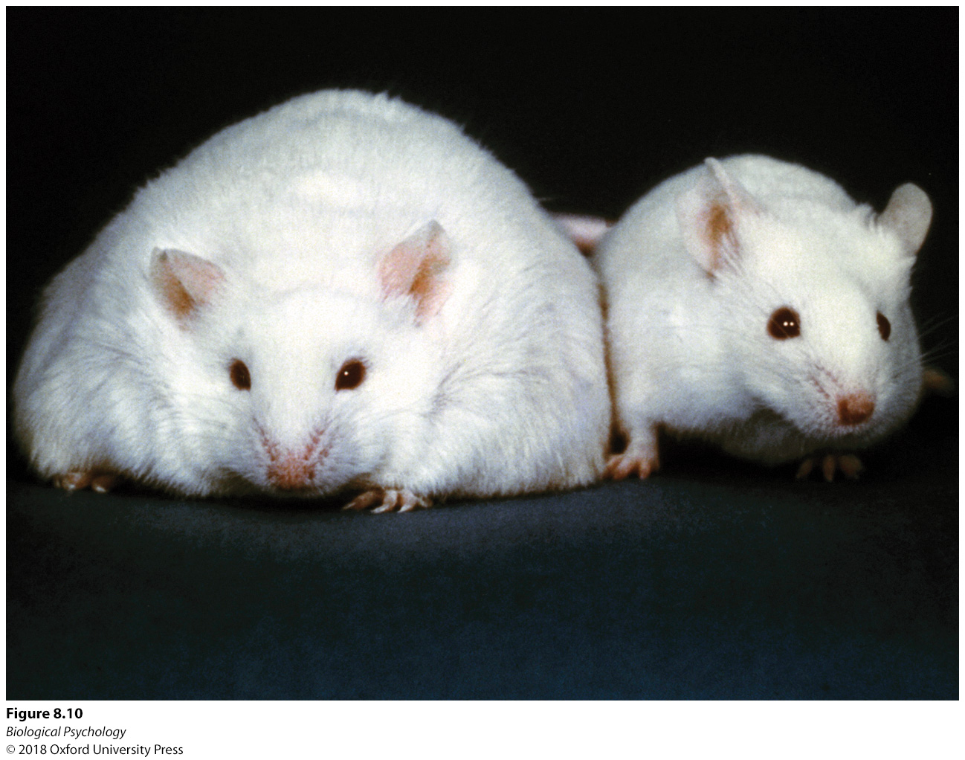
Hunger Regulation: Neurobiology
Notes:
Mice expressing a recessive gene associated with leptin deficiency have more body fat than mice that do not express the recessive gene.

Slide 15
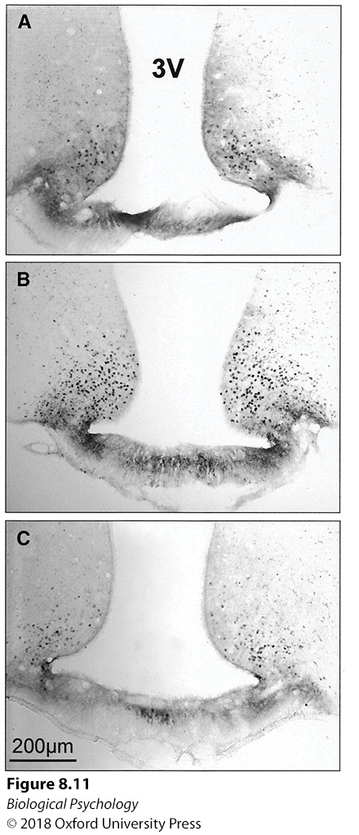
Hunger Regulation: Neurobiology
How can we determine which brain regions are involved in regulating hunger?
Notes:
As indicated by the presence of darkly stained Fos-positive cells, there is less activation in the arcuate nucleus of (a) rats that are fed to satiety and administered saline than in that of (b) rats that are food deprived with a saline infusion. (c) However, if the hungry animals receive an insulin infusion, less Fos activity is observed.

Slide 16
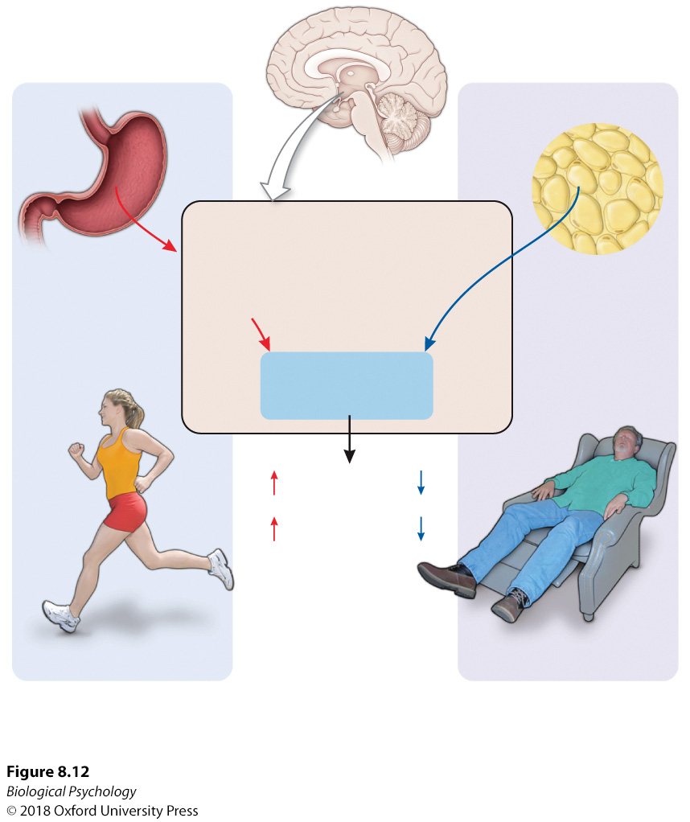
Hunger Regulation: Neurobiology
Notes:
Leptin and ghrelin interact with the arcuate nucleus to affect hunger and energy regulation.

Slide 17
Hunger Regulation: Neurobiology
Can we be addicted to particular kinds of food?
Why is ‘junk food’ so good?
  Is it adaptive to like junk food?

Slide 18
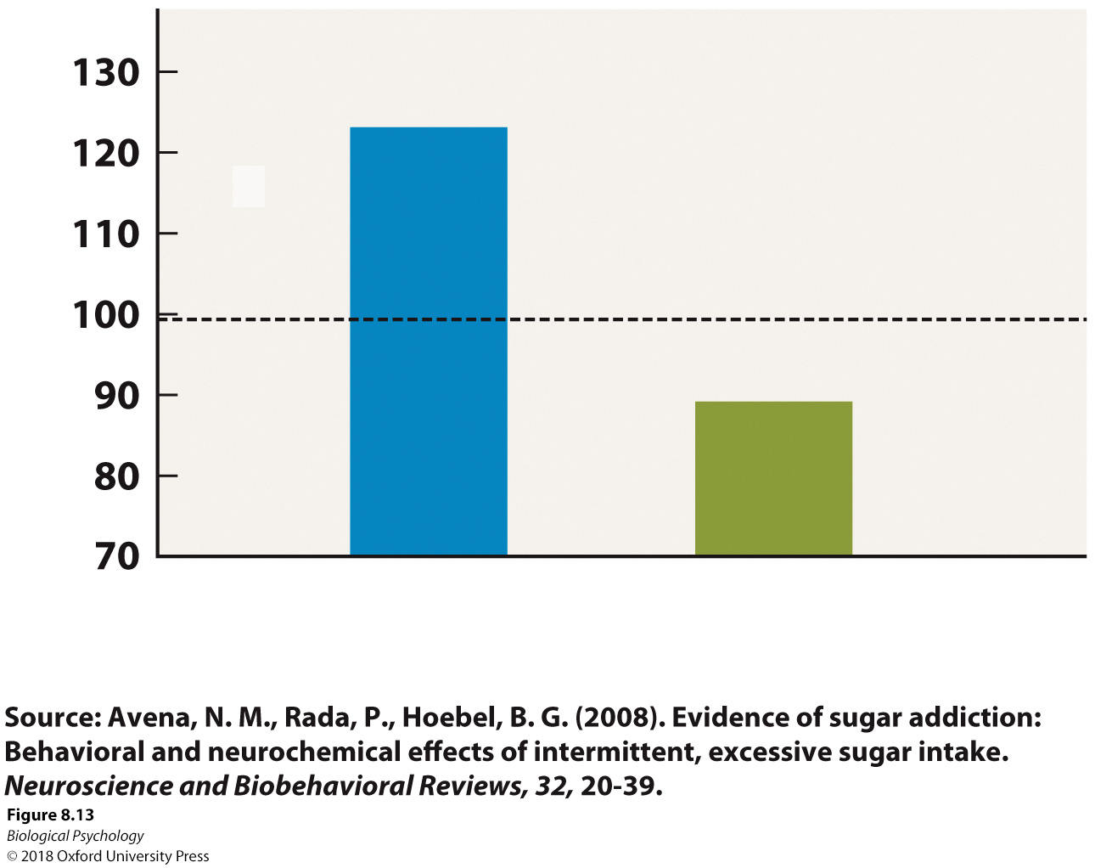
Hunger Regulation: Neurobiology
Sugar “withdrawal” in rats
Notes:
Rats that had experienced greater access to sugar consumed much more sugar after a period of sugar deprivation than did control rats.

Slide 19
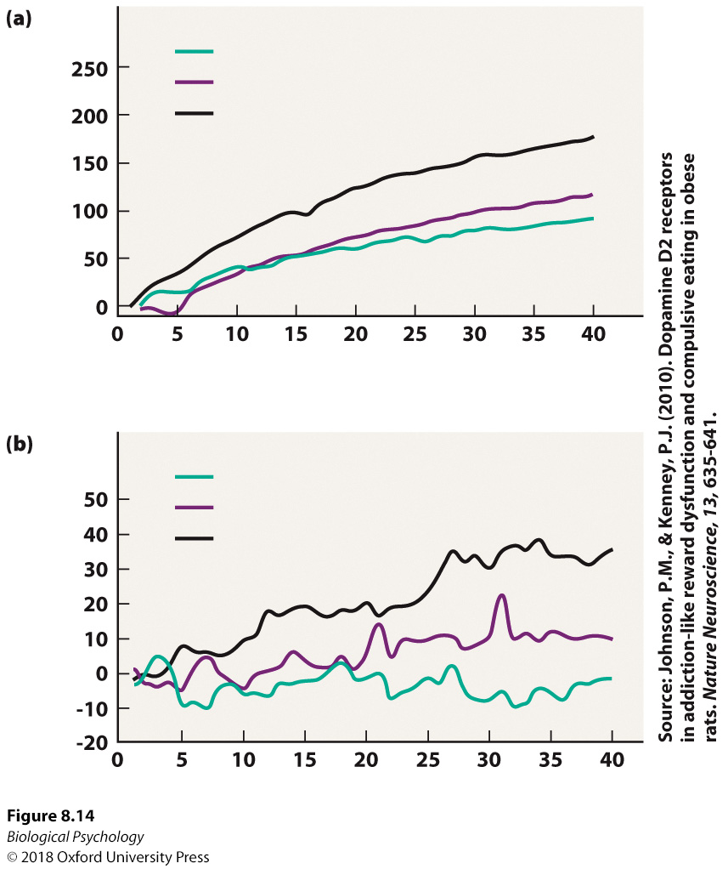
Hunger Regulation: Neurobiology
Extended access to food (buffet style) can raise reward thresholds

Slide 20
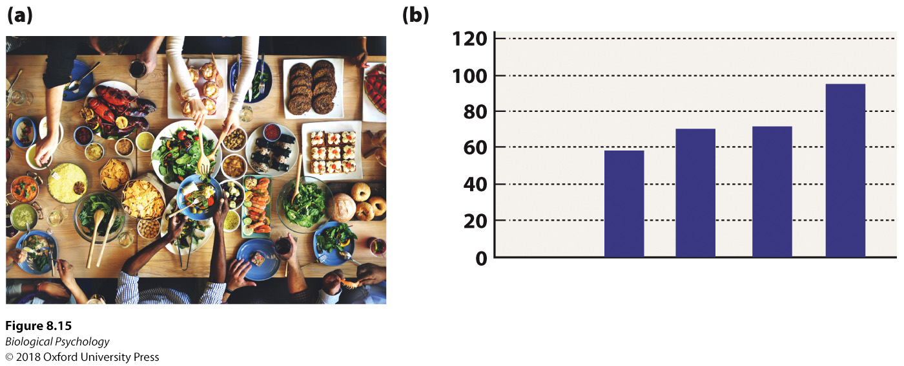
Hunger Regulation: Neurobiology
Having people around also influences eating
Can you think of why?
  Are there possible confounds?
Notes:
(a) Eating with friends may be enjoyable, (b) but it leads us to consume more calories.

Slide 21
Hunger regulation: Eating disorders
Anorexia nervosa
Bulimia nervosa

Slide 22
Hunger regulation: Eating disorders
Anorexia nervosa
Bulimia nervosa
Still a lot of research to be done

Slide 23
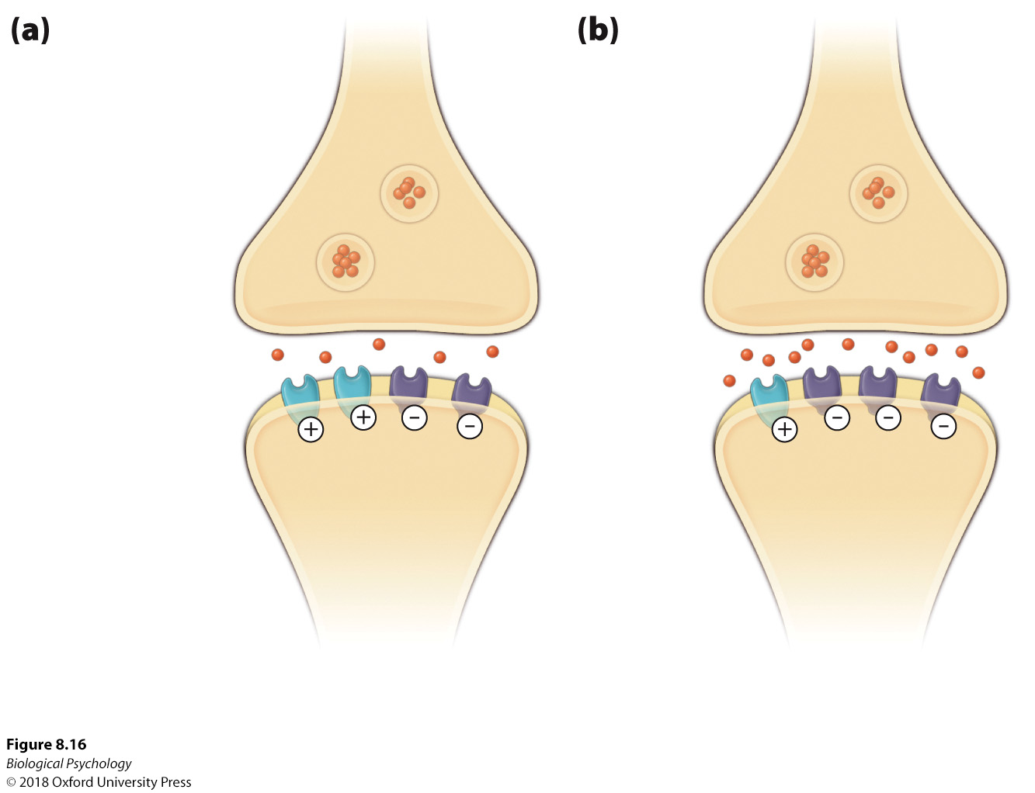
Hunger regulation: Eating disorders
Notes:
Serotonergic receptors and anorexia. Research suggests that the proportion of 5-hydroxyindoleacetic acid 1A and 2A receptors in (a) healthy patients is distorted in (b) patients diagnosed with anorexia

Slide 24
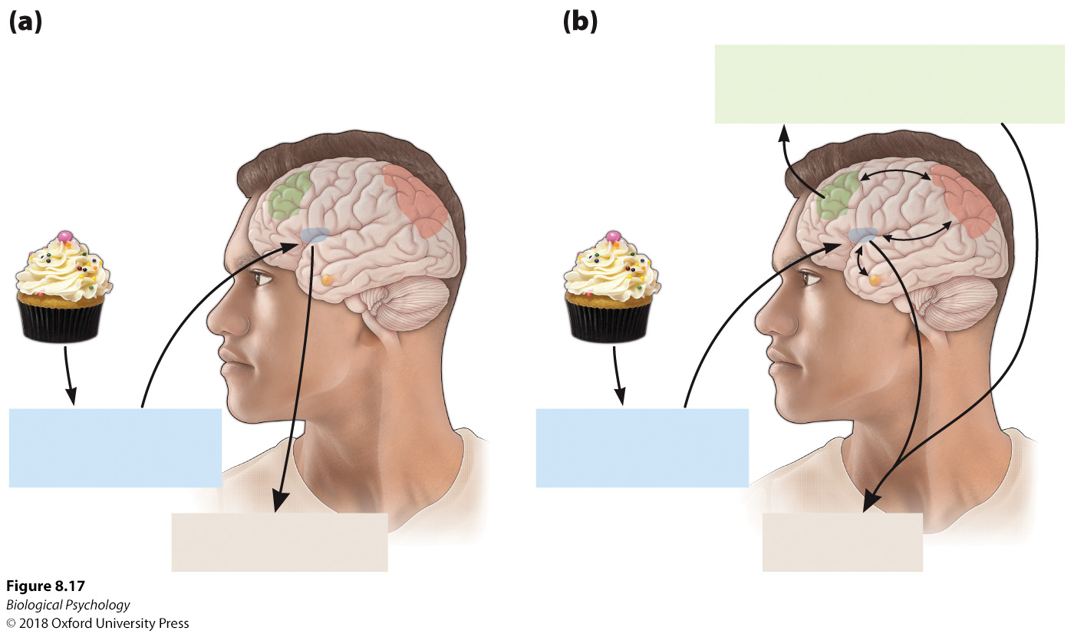
Hunger regulation: Eating disorders
Notes:
The insula plays a role in determining whether food is perceived as positive or negative.

Slide 25
Hunger regulation
Some nutrients that we need for healthy brain function are acquired by our diet
A lot of speculation about the benefits of supplementing these nutrients
More research still to be done

Slide 26
Hunger regulation
Impact of high-fat maternal diet on offspring
Three groups of rats
  HFD: High-fat pups raised by high-fat diet mothers
  HFD-BD: High-fat pups raised by balanced-diet mothers
  BD: Balanced-diet pups raised by balanced-diet mothers
Any predictions?

Slide 27
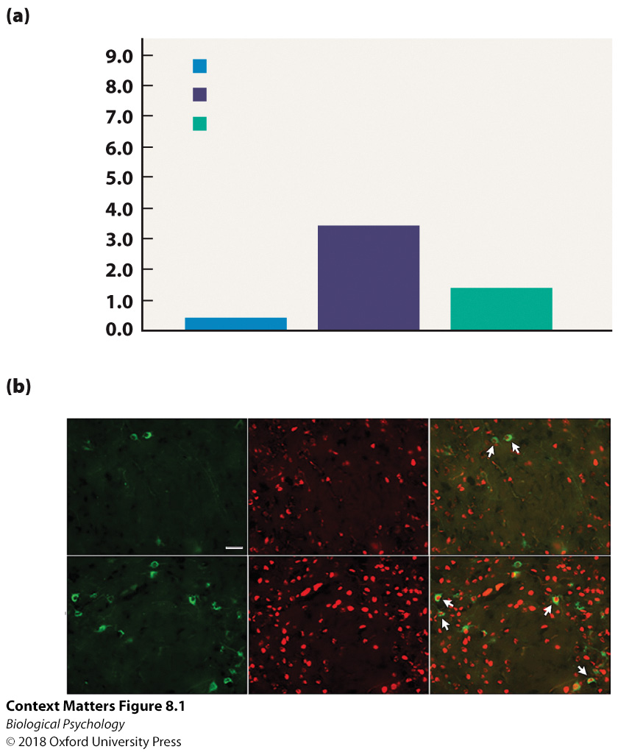
Hunger regulation
Notes:
(a) The pups of rats placed on a high-fat diet during pregnancy developed more orexin-producing neurons than did o spring from mothers kept on a balanced diet during pregnancy, even if these offspring consumed a balanced diet after birth. (b) As indicated by the arrows, more orexin cells were double stained for bromodeoxyuridine in the brain tissue of offspring from the mothers with the high-fat diet than from offspring of mothers with the balanced diet.

Slide 28
Thirst regulation
Osmoregulatory thirst
Hypovolemic thirst

Slide 29
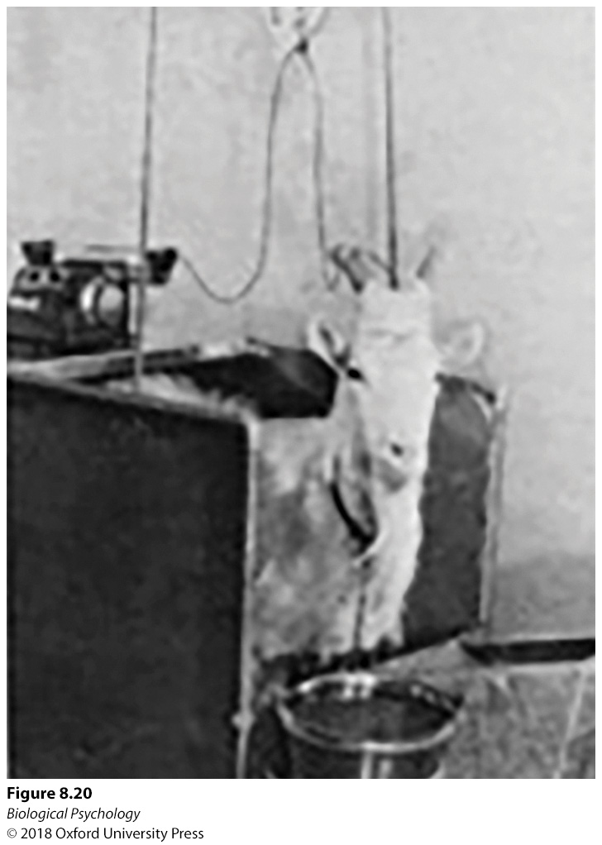
Thirst regulation: Osmoregulartory
Osmoreceptors
Anterior third ventricle
Notes:
When a hypertonic solution was infused into the hypothalamic area of goats, they started drinking water from the bucket.
very sensitive osmoreceptors have been identified in two areas of the anterior third ventricle

Slide 30
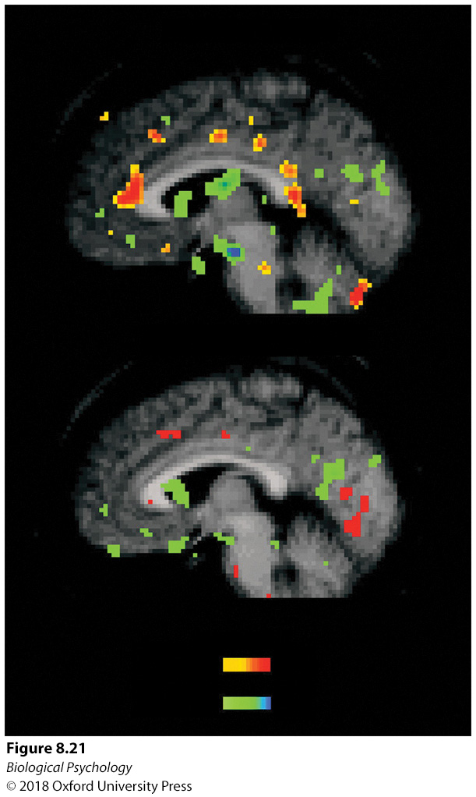
Thirst regulation: Osmoregulartory
Human PET
Anterior and posterior cingulate activity
Insula also involved
Notes:
When human subjects were thirsty, more activity along the cingulate cortex was observed than after the subjects relieved their thirst by drinking water.

Slide 31
Thirst regulation: Hypovolemic
Baroreceptors
Role of vasopressin
Angiotensin II

Slide 32
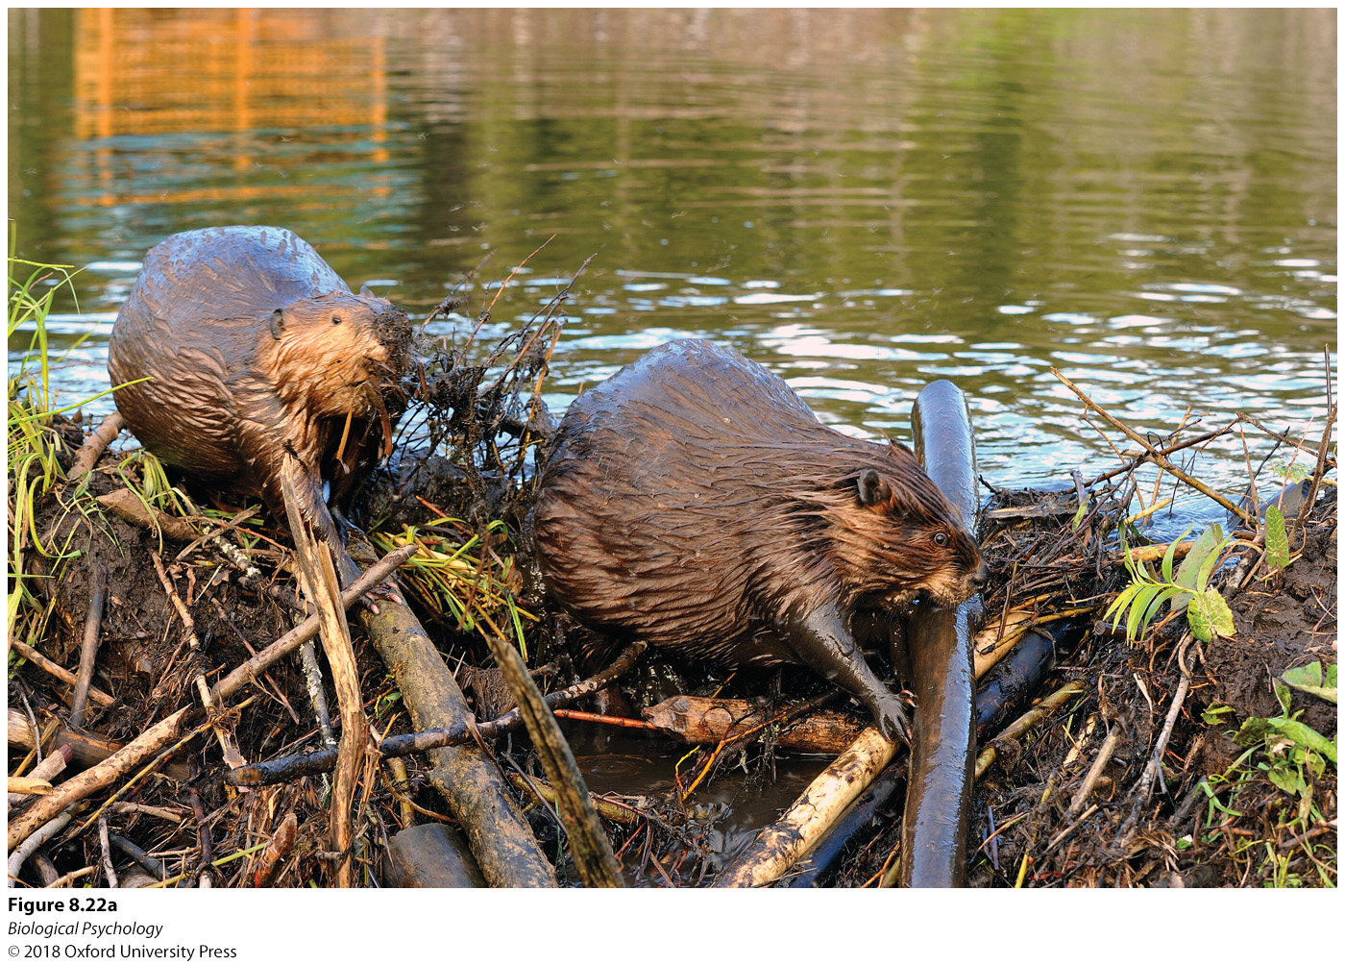

Motivation to work
Many projects require sustained work
Nonhumans have this problem too

Slide 33

Motivation to work: Anatomy
Notes:
brain areas implicated in directing and sustaining work efforts

Slide 34
Motivation to work
Ratio strain
Why does caffeine help us work?

Slide 35
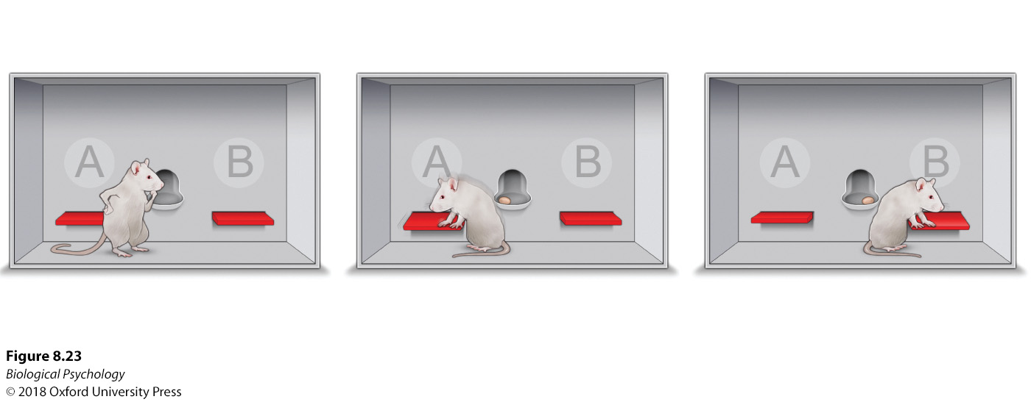
Motivation to work
Role of dopamine
Notes:
Rats are more likely to exert more effort for highly desirable food when their dopaminergic system is intact and functioning normally.

Slide 36
Motivation to work: Plasticity
We learn the relationship between effort and outcome
Learned helplessness
Learned persistence

Slide 37
Grooming as a motivator
Many mammals spend lots of time grooming
Rats as much as 50% of their day

Slide 38
Grooming as a motivator: Neurobiology
Striatum lesions reduces grooming in rats
Parkinson’s patients and patients with depression also show reduced grooming
Grooming in rat models of depression is restored via antidepressants

Slide 39
Barbering
Extreme grooming, usually of a cage mate
No clear adaptive value (unseen in the wild)

Slide 40
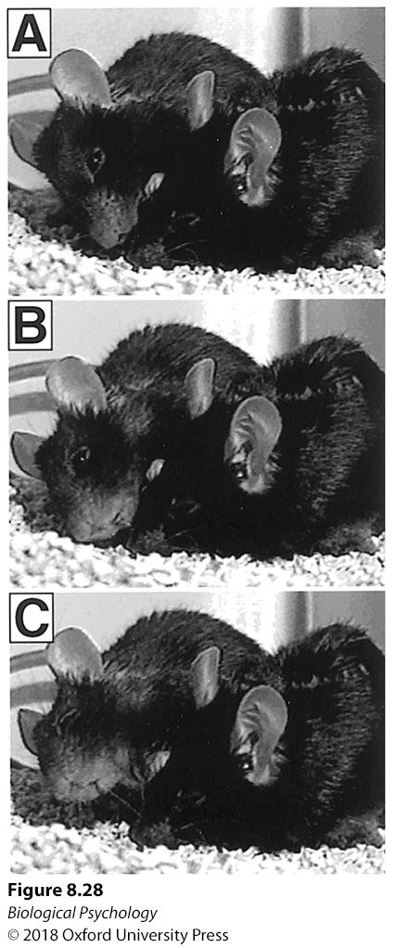
Barbering
  Theories
  Establish dominance
  Cope with stress
  Compensatory action response (increase stimulation in an otherwise boring environment)

Slide 41
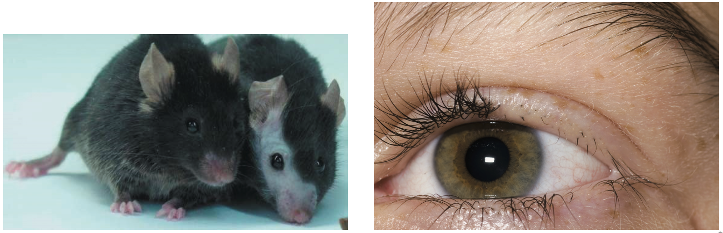
Barbering
Relationship to humans?
Notes:
Barbering patterns in mice resemble the bald patches resulting from hair picking in humans diagnosed with a condition known as trichotillomania

