Slide 1
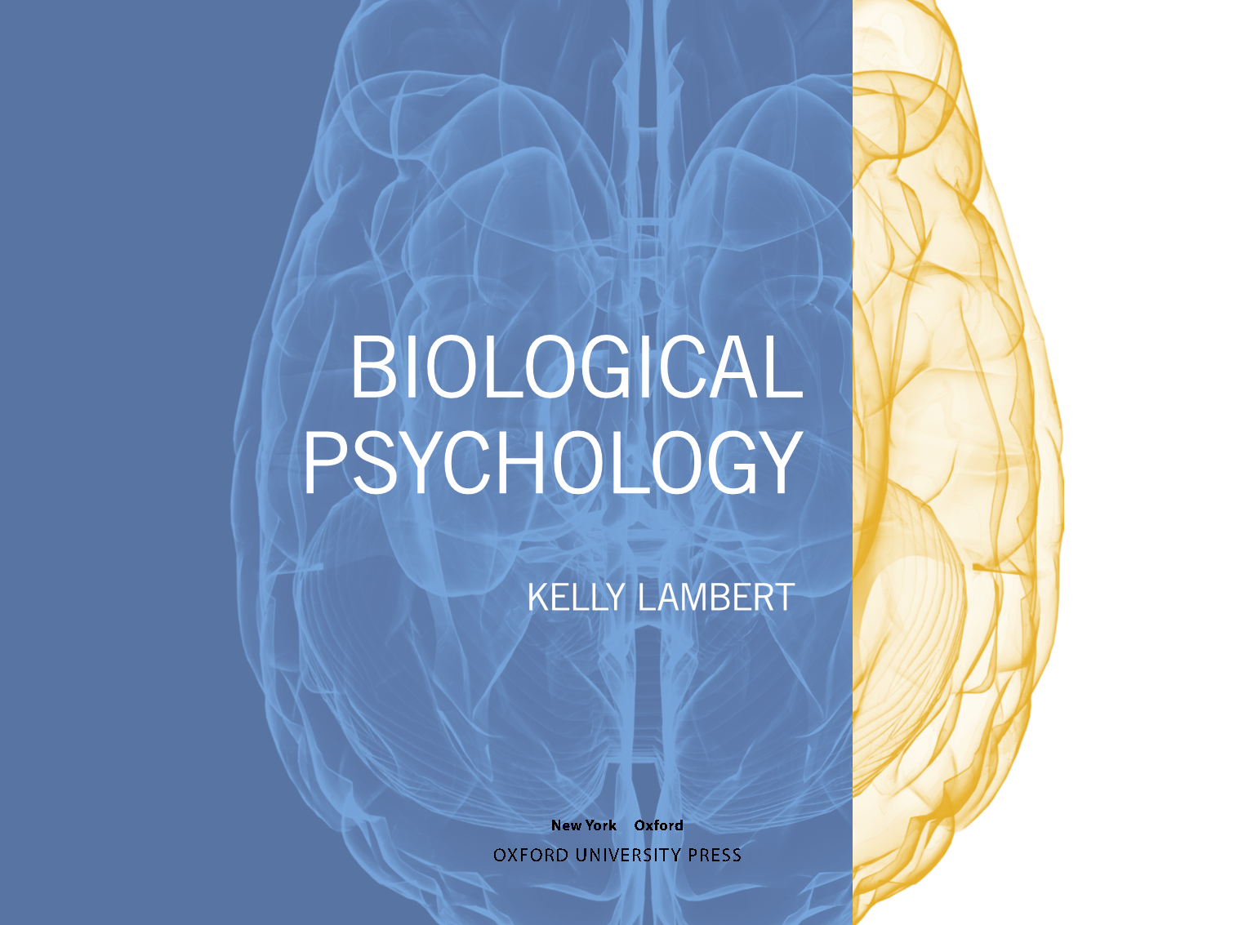

Slide 2
Chapter 6
Sensation, Perception, and Adaptation

Slide 3

Outline
Fundamentals of sensation and perception
Vision
Hearing
Touch
Smell

Slide 4

Fundamentals
Psychophysics
Environmental influence
It’s a multisensory world

Slide 5
Fundamentals: Psychophysics
What is the difference between a sensation and a percept?
Psychophysics establishing a map from stimulus to percept
Two key concepts
  Difference threshold
  Absolute threshold

Slide 6
Fundamentals: Environment
Brain specialization allows an animal to better exploit its environment
What constrains brain size?
Sense receptors detect change, more than constant stimulus

Slide 7
Fundamentals: Multisensory
We experience our world by combining information across multiple senses
What challenges does this present to the brain?

Slide 8
Fundamentals: Multisensory
Think about eating pizza
How many senses are involved?
How does the brain know which sense information is relevant to the pizza vs. the restaurant
  Do these cues become associated?

Slide 9
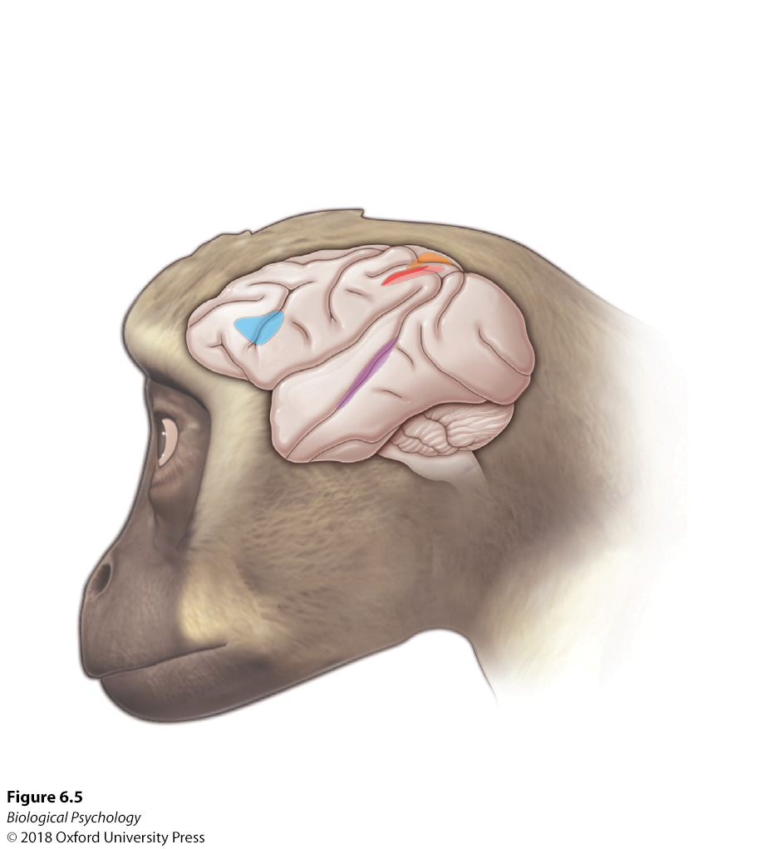
Fundamentals: Multisensory
Superior temporal sulcus is a hub for auditory and visual integration

Slide 10
Vision
How does light get to visual cortex?
Taking context into account
Processing color
Vision like a hawk

Slide 11
Vision
How does light get to visual cortex?
More complex processing each step of the way

Slide 12
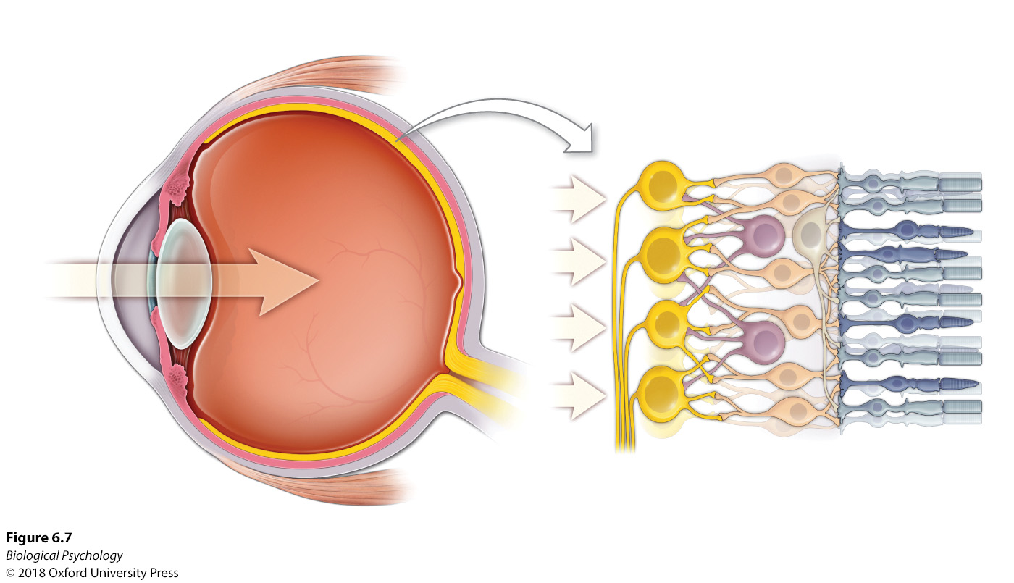
Vision: Transduction

Slide 13
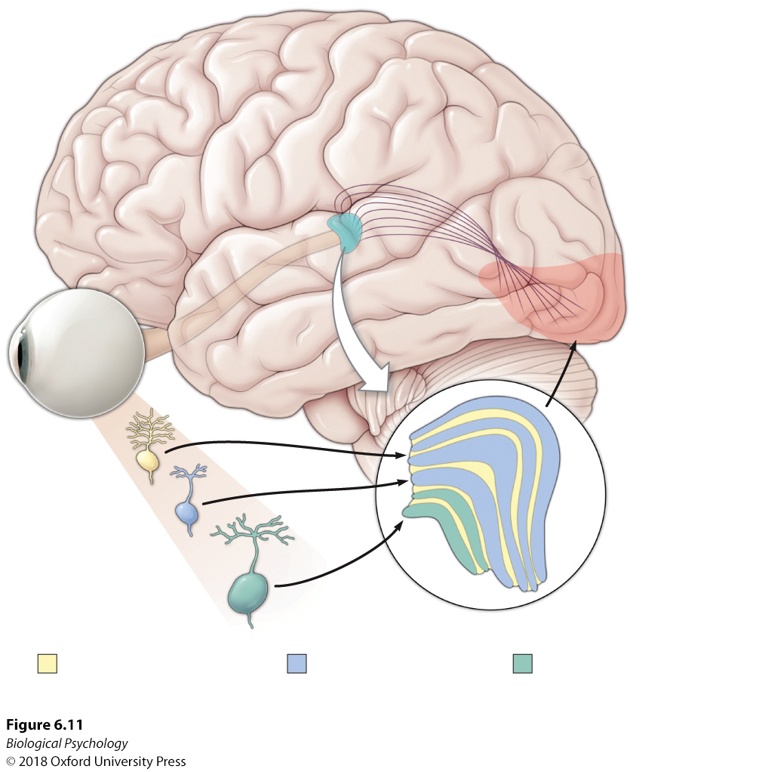
Vision: Eyes->LGN->V1

Slide 14
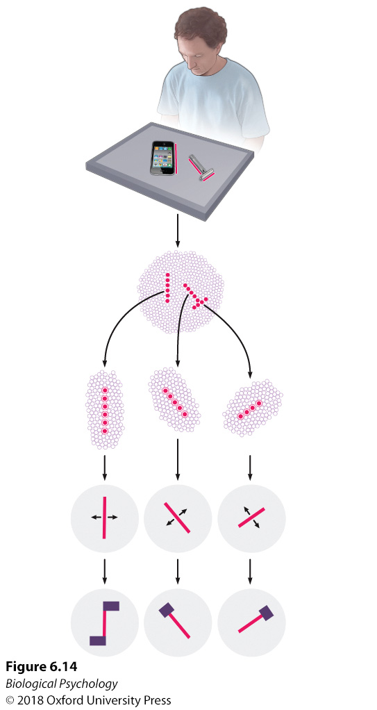
Vision: V1 Cell types

Slide 15
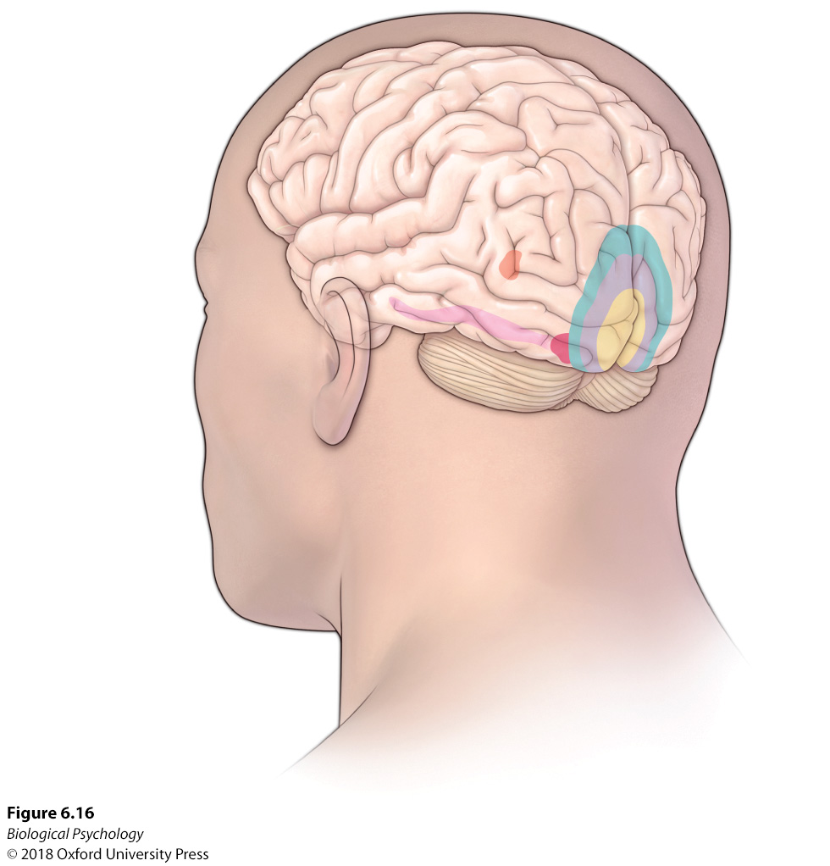
Vision: Higher visual areas

Slide 16
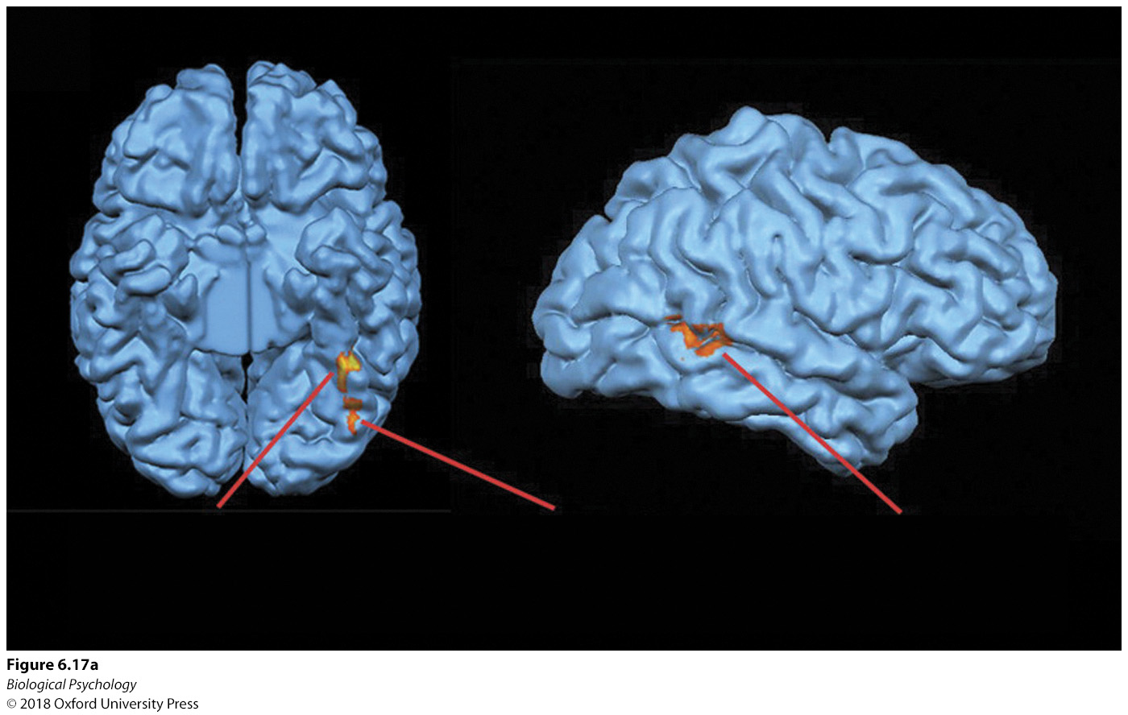
Vision: Face processing network

Slide 17
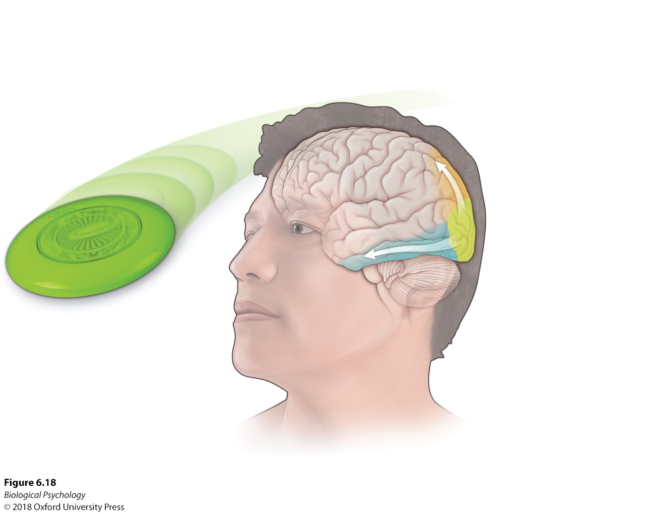
Vision: Dorsal and ventral streams

Slide 18

High-level vision: Power of context

Slide 19
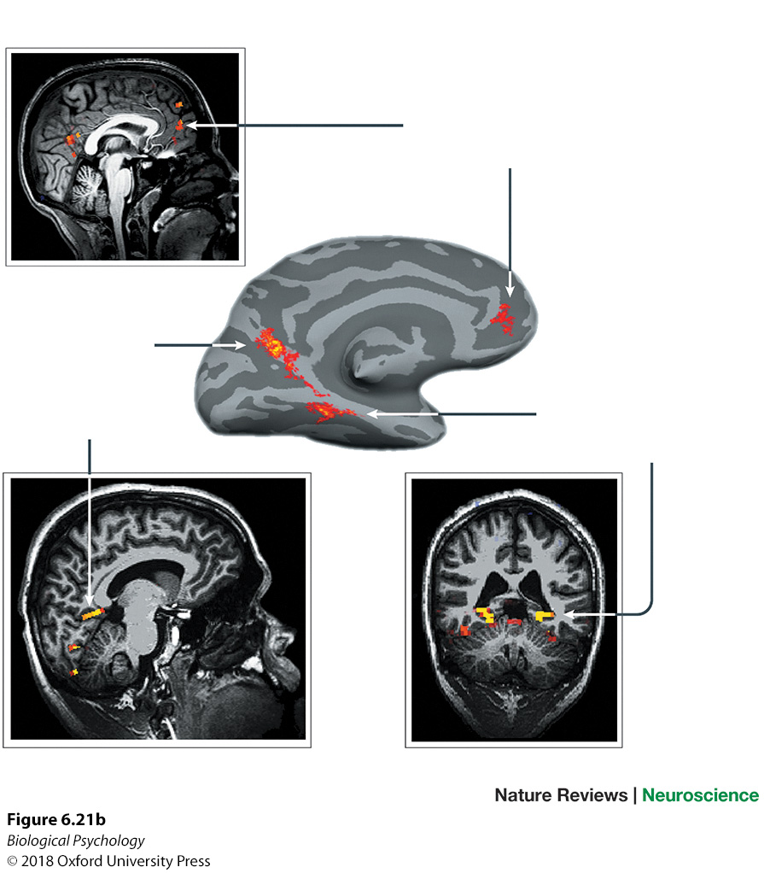
High-level vision: Power of context

Slide 20
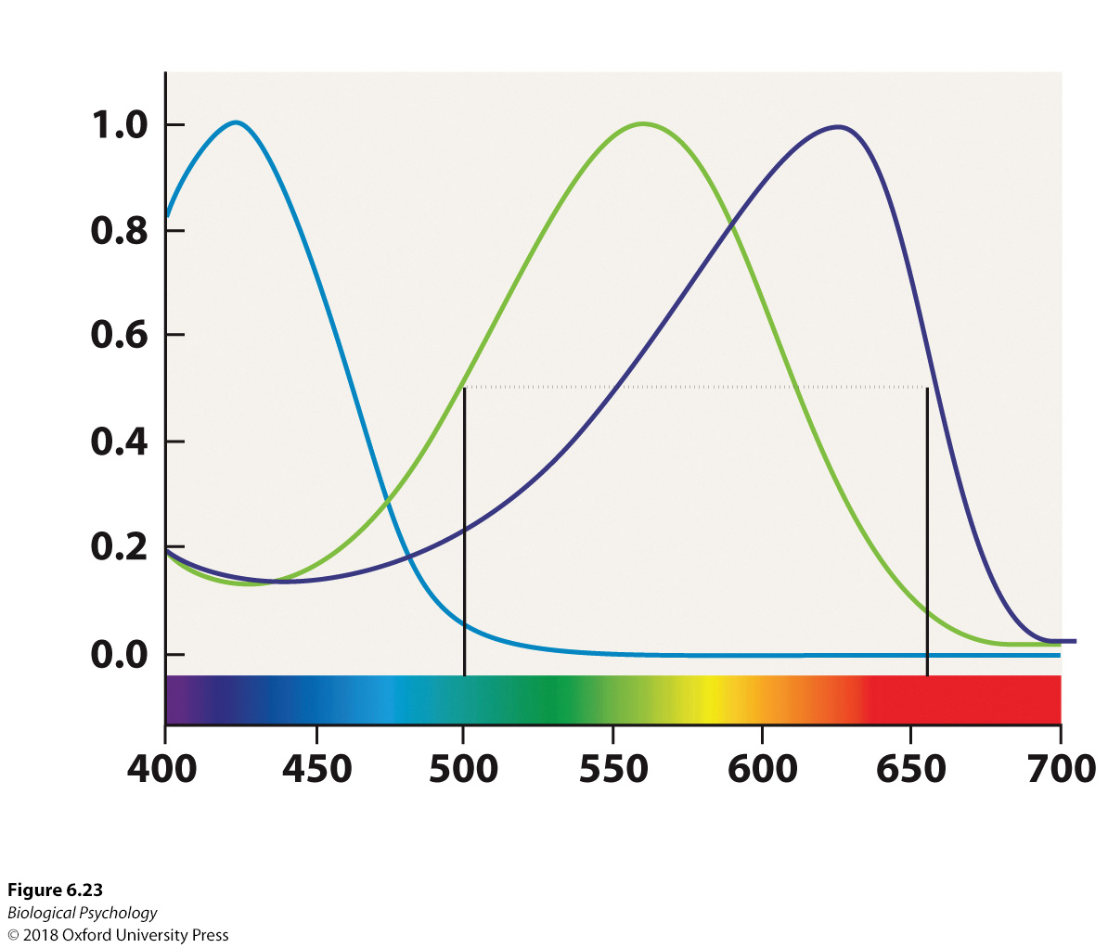
Vision: Color processing
Trichromatic theory
Opponent-process theory

Slide 21
Vision: Color processing
What is the functional value of color?
Are there tasks in our daily environment that require color vision?
What color blindness?

Slide 22
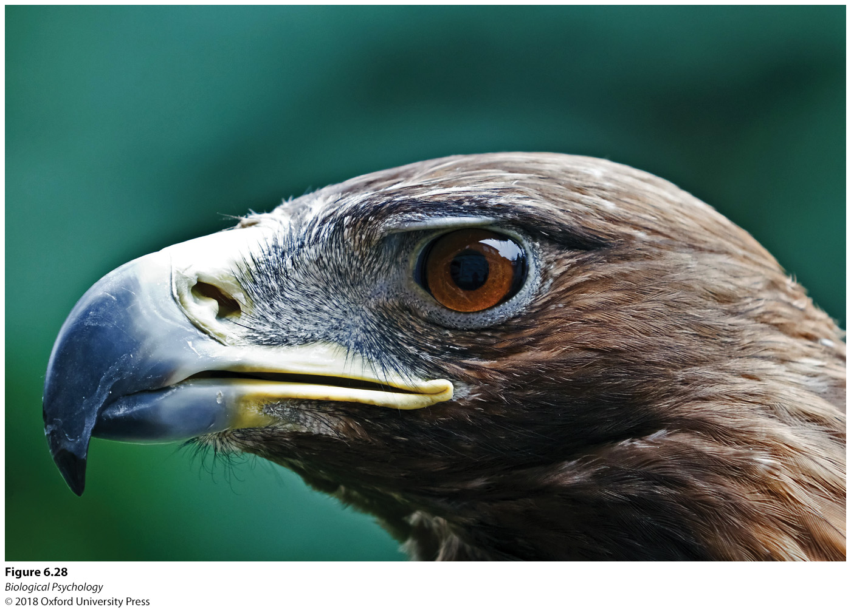
Vision like a hawk
High spatial resolution
High temporal resolution
Why would a predator need such large eyes?
How do prey stand a chance?

Slide 23
Hearing
Stimulus and receptor
Auditory pathway
Echolocation in bats

Slide 24
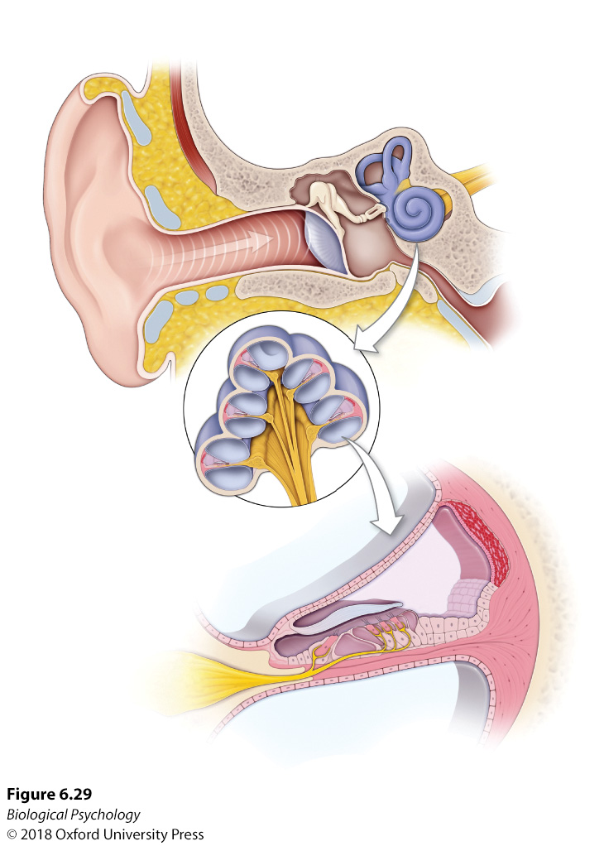
Hearing: Transduction
Notes:
Sound waves are funneled by the pinna and subsequently travel through the ear canal to the middle and inner ear areas.

Slide 25
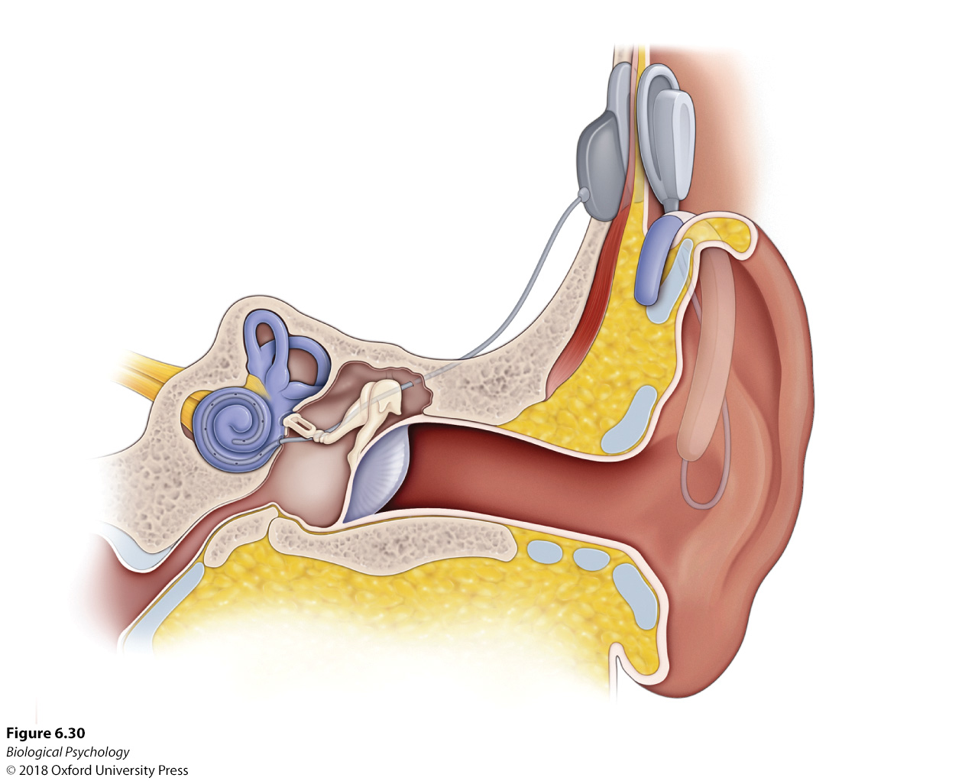
Hearing: Cochlear Implants

Slide 26
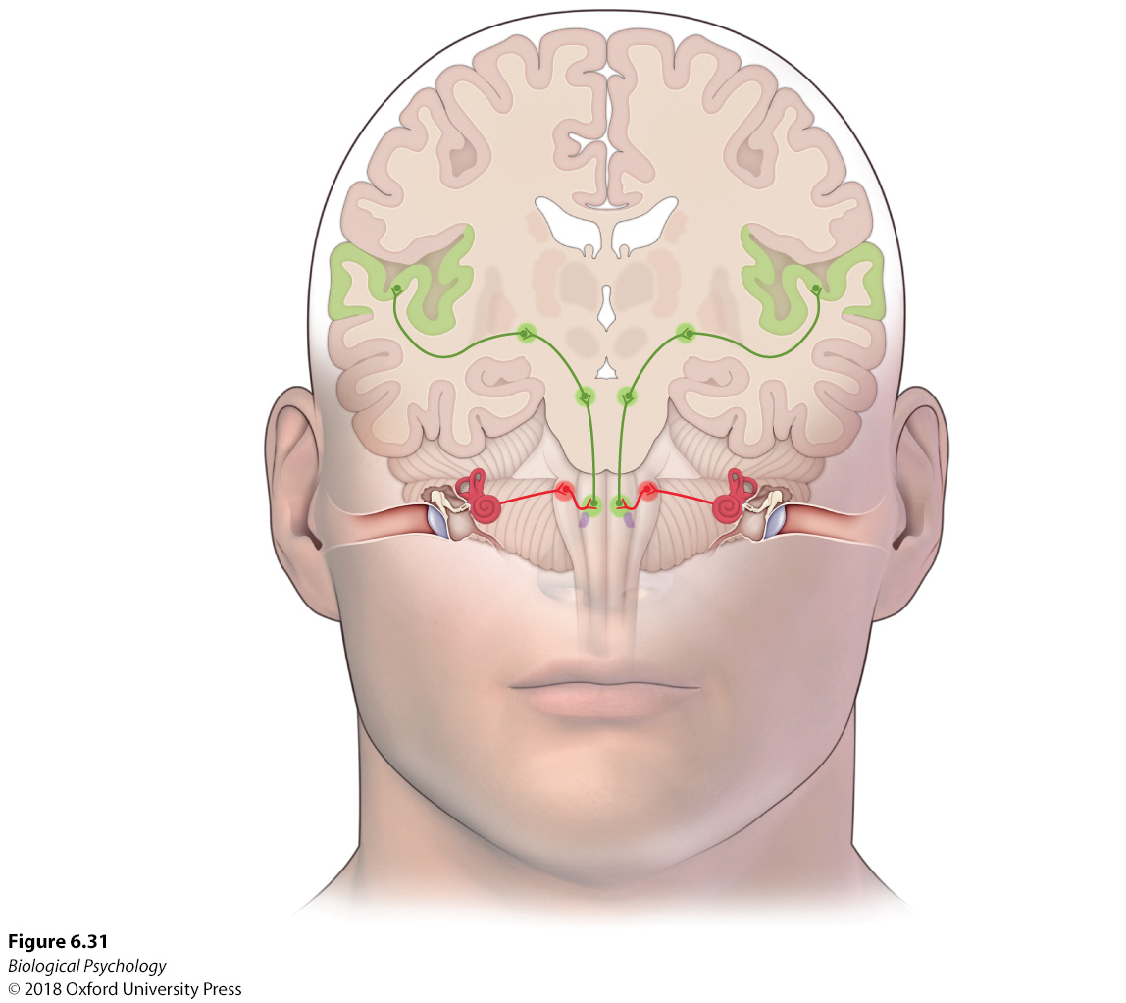
Hearing: Travel to the cortex
Notes:
After leaving the inner ear, auditory information travels through nuclei in the medulla, midbrain, and thalamus on its journey to the auditory cortex.

Slide 27
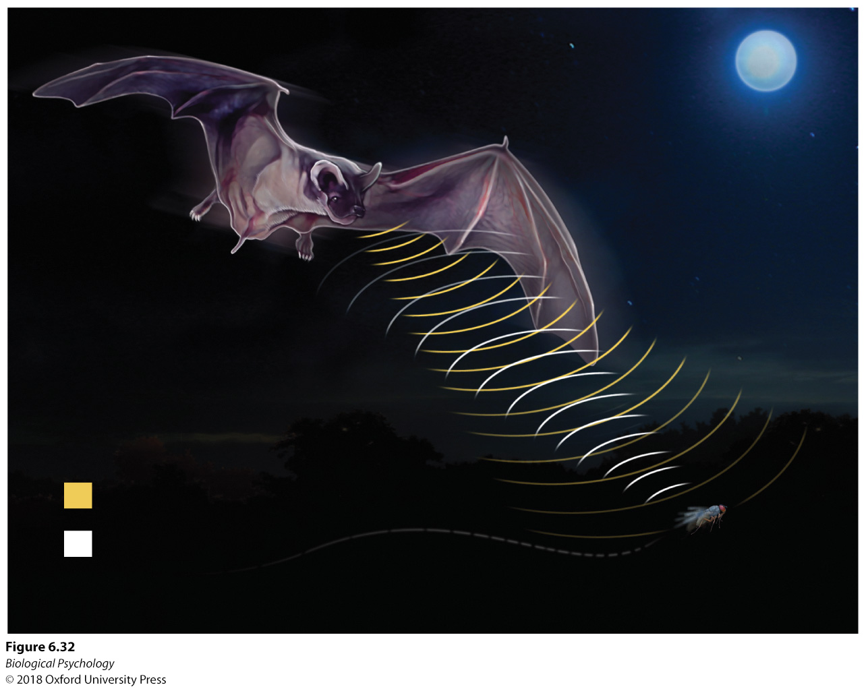
Uber Hearing: Echolocation in Bats
Notes:
Self-generating echoes are emitted by bats so that specialized neurons can perceive the returning sound waves to detect distortions caused by the presence of insects.

Slide 28
Touch
Receptors
Pathway
Uber-touch: Raccoons

Slide 29
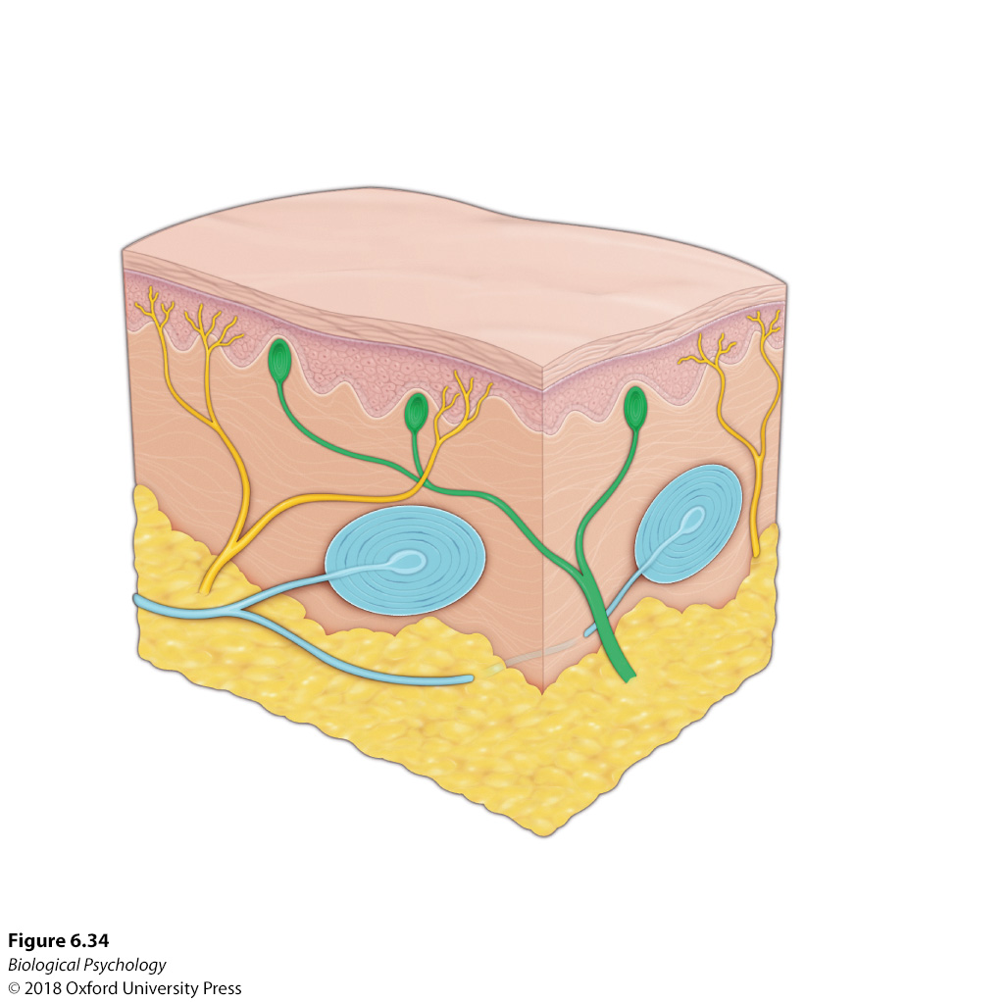
Touch: Receptors
Notes:
Specialized receptors in the skin transmit information about touch and pressure to the central nervous system.

Slide 30
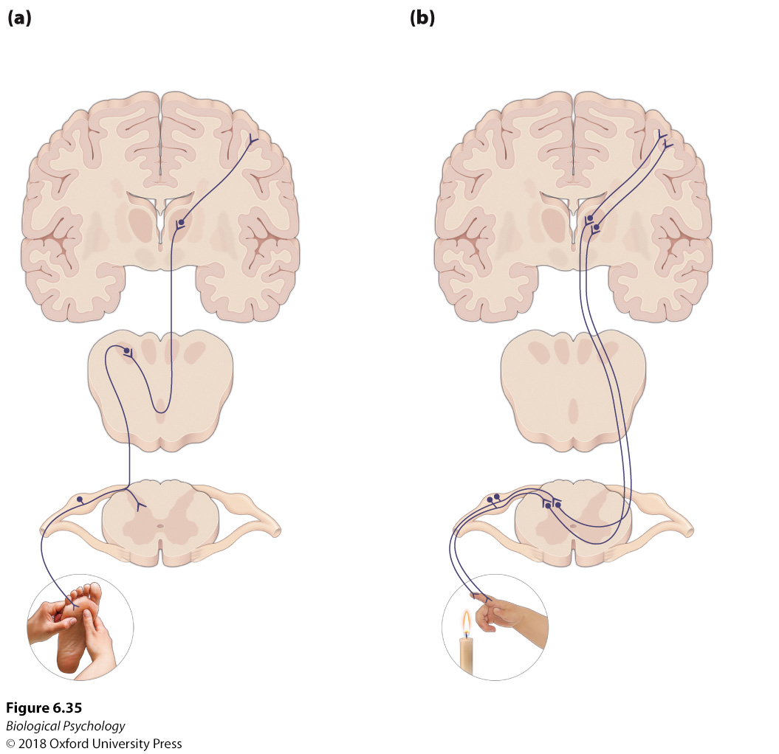
Touch: Pathway
Notes:
The dorsal column–medial lemniscal pathway carries tactile information through the spinal cord and medulla to the somatosensory cortex. (b) The spinothalamic tract that transmits information about tactile pain and temperature follows a similar path.

Slide 31
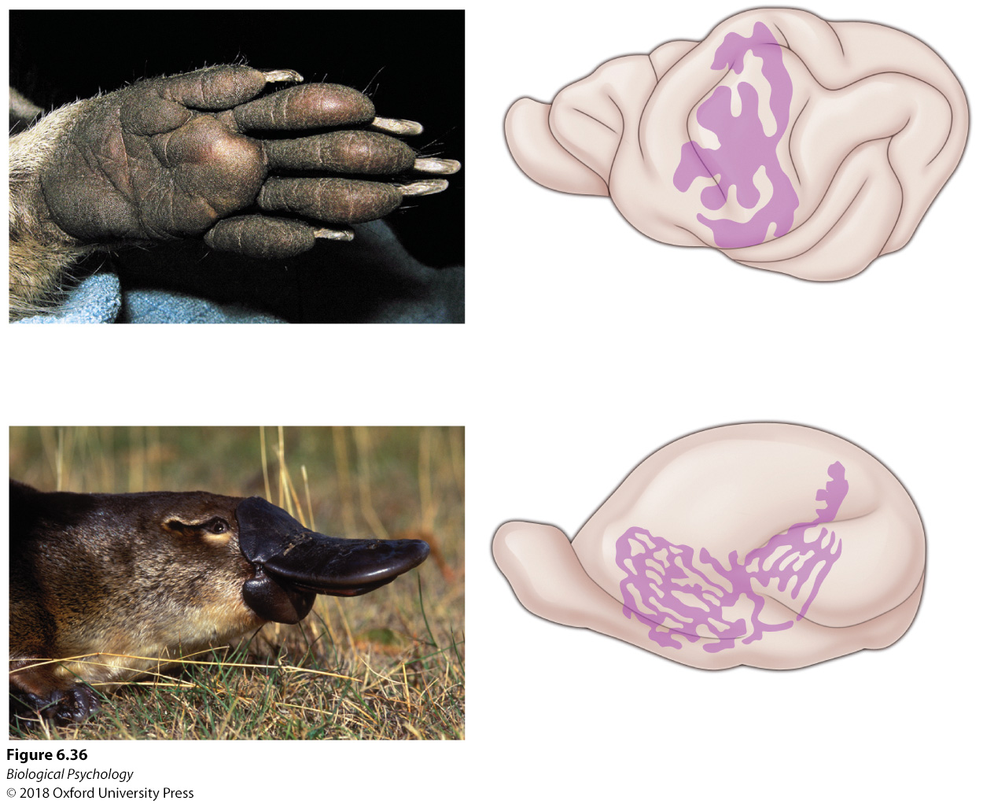
Uber Touch
Amount of cortex dedicated to a particular sense is indicative of the animal’s reliance on that sense
Notes:
The raccoon and platypus have evolved specialized cortical areas to accommodate their impressive use of the forepaw and bill, respectively.

Slide 32
Healing Touch
How does tactile input affect healing?
Three groups:
  Frontal brain lesions and tactile therapy (FTS)
  Frontal brain lesions with no tactile therapy (FNT)
  Sham surgery (Control)

Slide 33
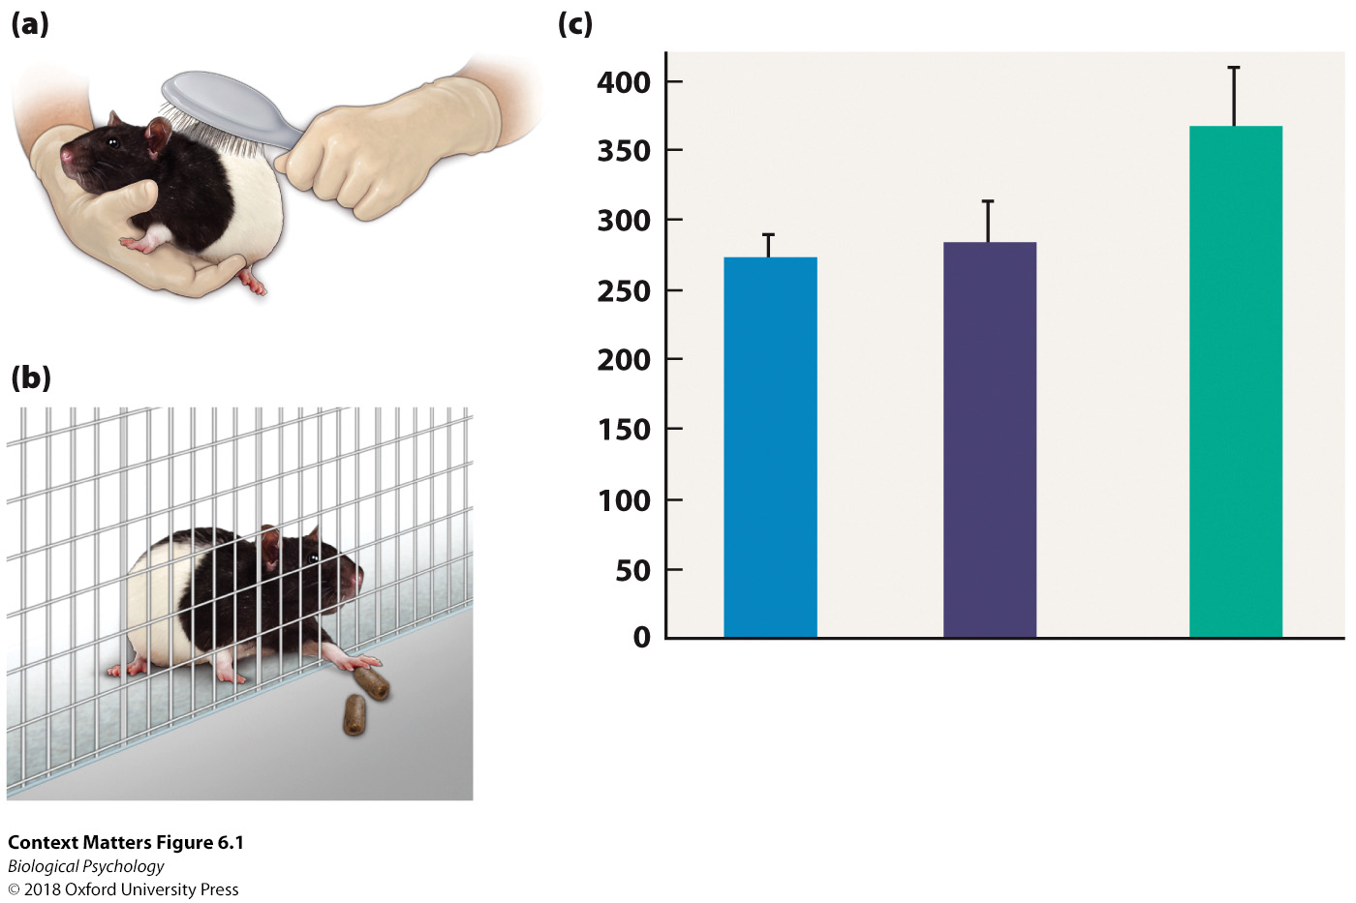
Healing Touch
Notes:
Rats were stroked with a hairbrush for 15 minutes in three daily sessions for a week prior to receiving frontal lesions. (b) Rats in all the groups were trained to reach through the bars of a cage to retrieve food pellets. (c) The animals that received surgery and tactile stimulation exhibited better recovery, defined as successful retrievals of food, than those that received surgery without the tactile stimulation. Additionally, the frontal lesion/tactile therapy group had longer extensions of the cortical apical dendrites.

Slide 34
Smell
Stimulus and receptor
Olfactory neural destinations and emotional connections
Pheromones
Uber-olfaction: Rats

Slide 35
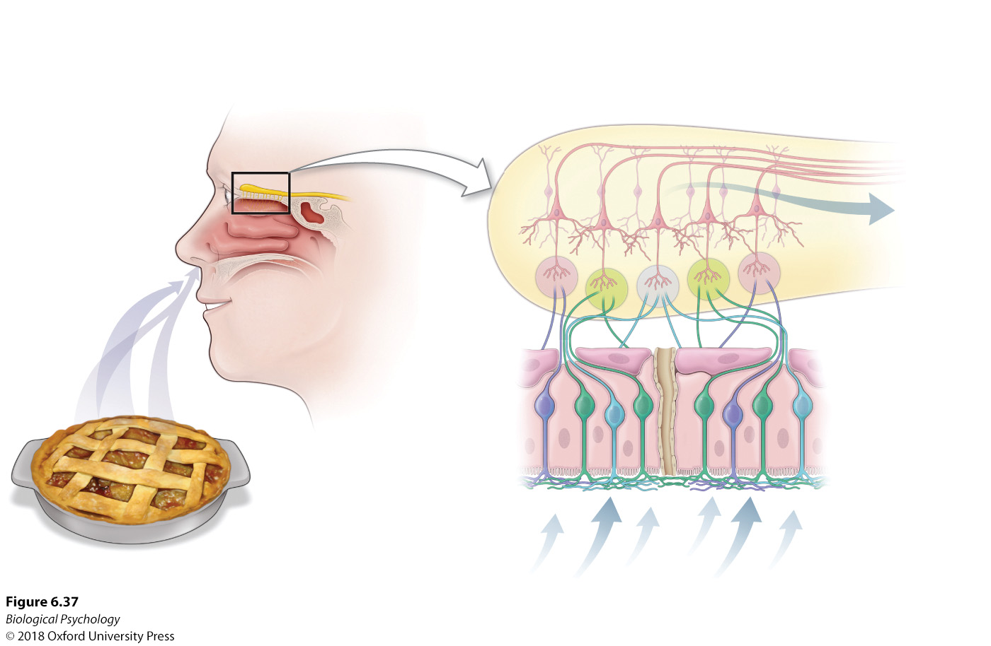
Smell: stimulus and receptor
Notes:
After volatile chemicals are received by nasal receptors, neural messages progress to the olfactory bulb on their path to the olfactory cortex.

Slide 36
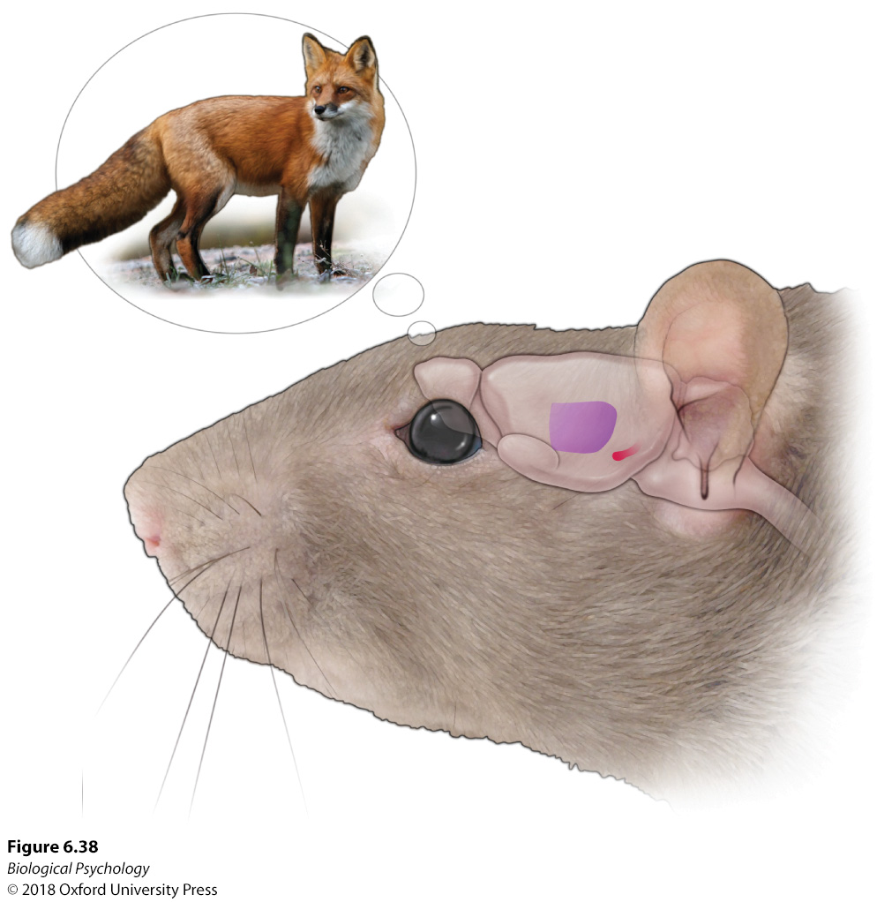
Smell: smelling a predator
Notes:
When this rat sniffs a predator odor, the odorant molecules activate expansive cells in the piriform cortex that alert the animal’s cortical areas to respond appropriately to the threat.

Slide 37
Smell: Pheromones
Chemical signaling
Detected by the VNO before being passed to higher cortical regions

Slide 38
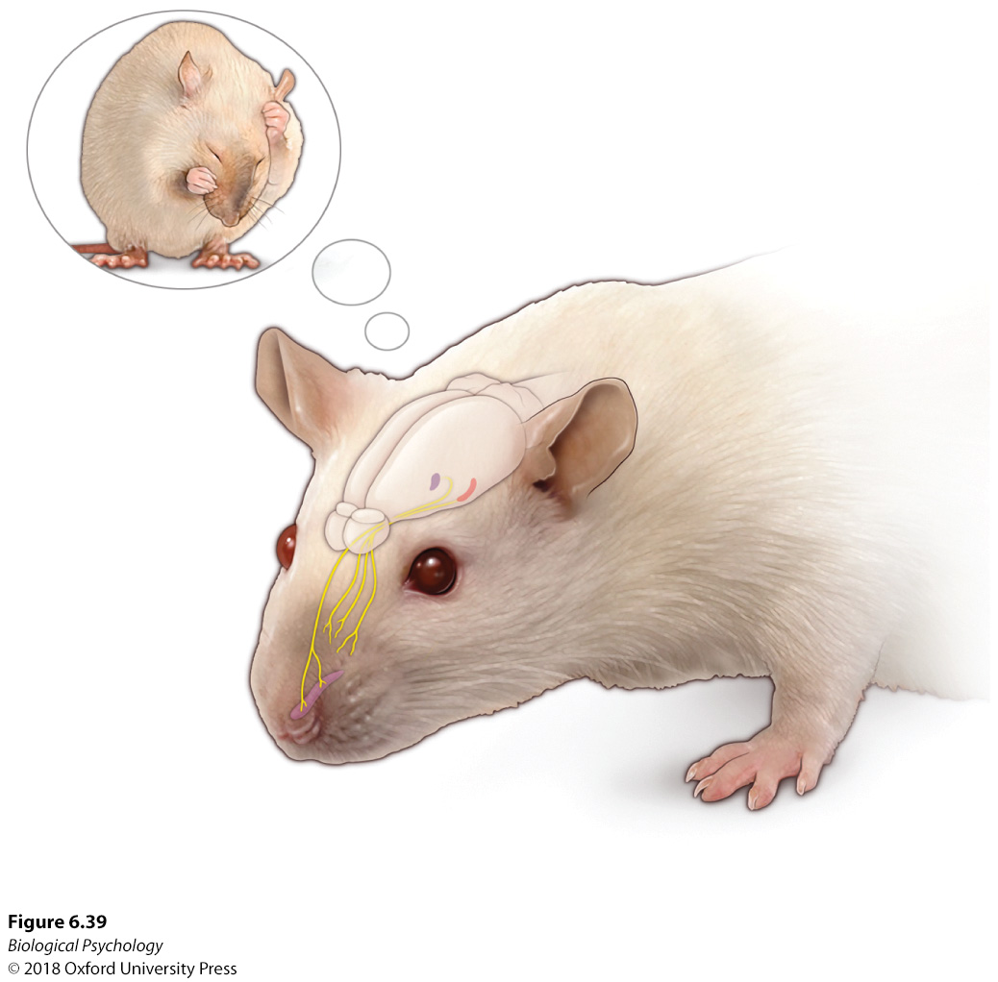
Smell: Pheromones

Slide 39
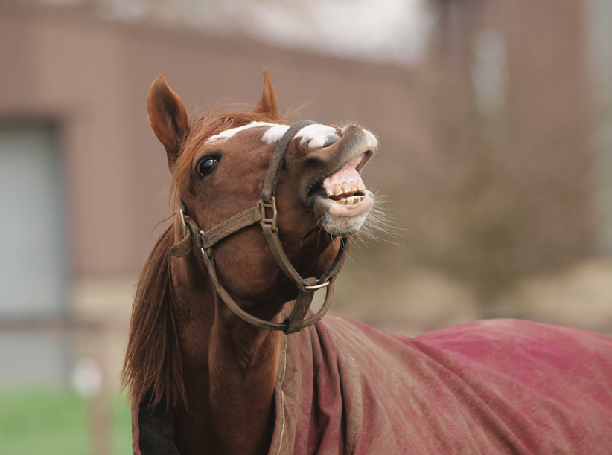
Smell: Pheromones
Flehman response
What are some pros and cons of using chemical signaling vs. auditory communication?

Slide 40
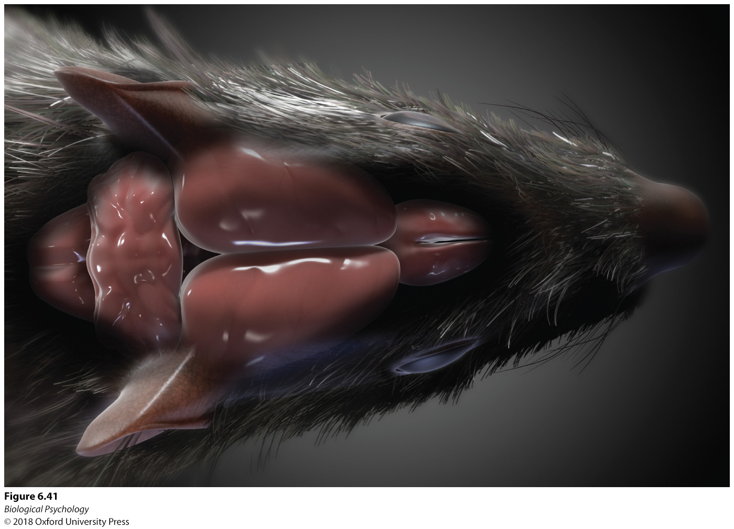
Uber Smell
Huge olfactory bulbs in rats

Slide 41
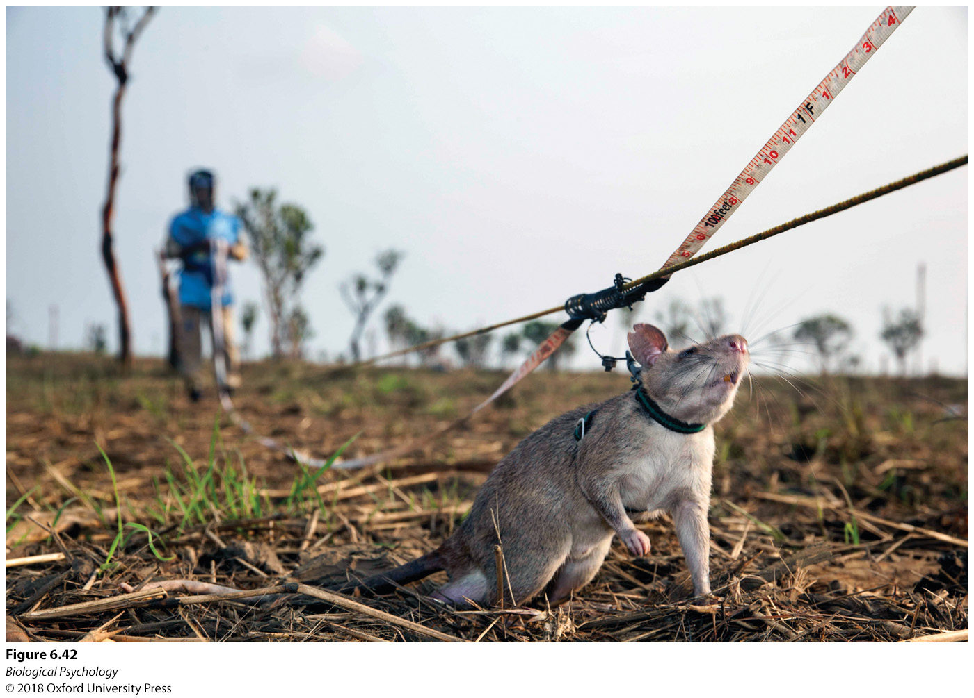
Uber Smell
Hero Rats
What are the benefits of using rats to detect landmines?
Can you think of any drawbacks?

Slide 42
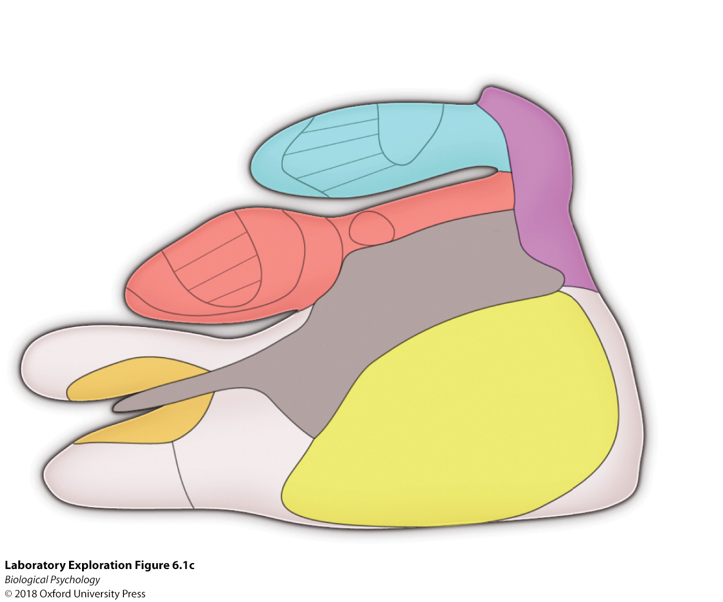
Sensory mapping in the rat
Notes:
Electrophysiological recording is used to determine which areas of the cortex respond to specific sensory stimuli. Body part colors are represented in areas of the primary somatosensory cortex, with similarly colored dots rep- resenting electrode placements. The final somatotopic map indicates the sensory stimuli that are most important for the rat

