Slide 1
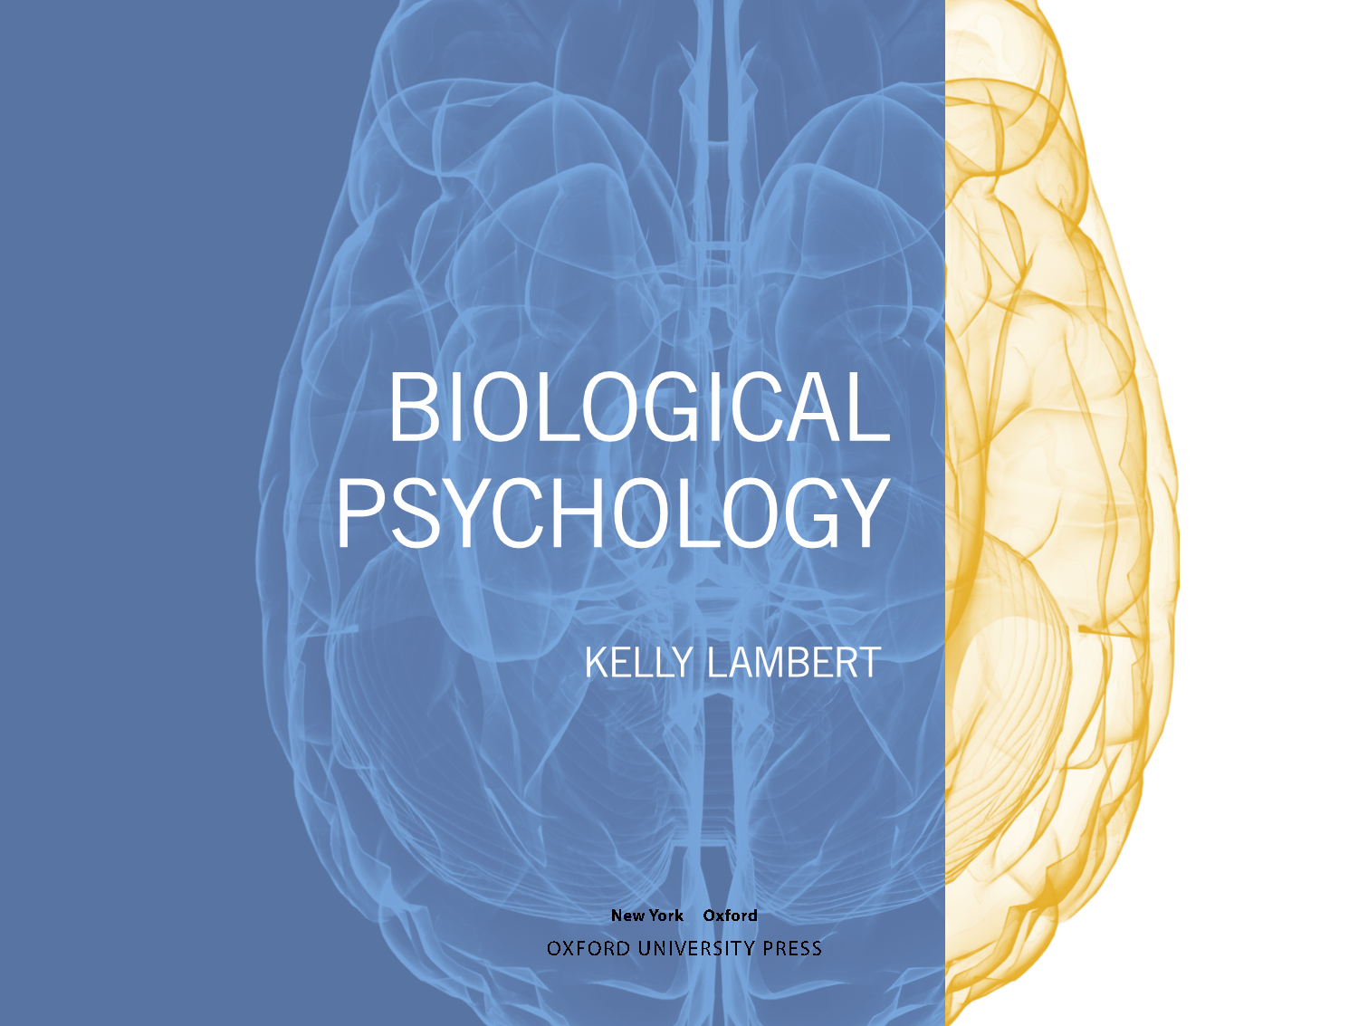

Slide 2
Chapter 5
Evolving Brains: Neural Development, Neuroplasticity, and Recovery of Function

Slide 3

Outline
Building brains
Neural development
Recovering from brain injury

Slide 4

Building Brains
Evolutionary themes
Play
Uniqueness of the human brain
Epigenetics

Slide 5
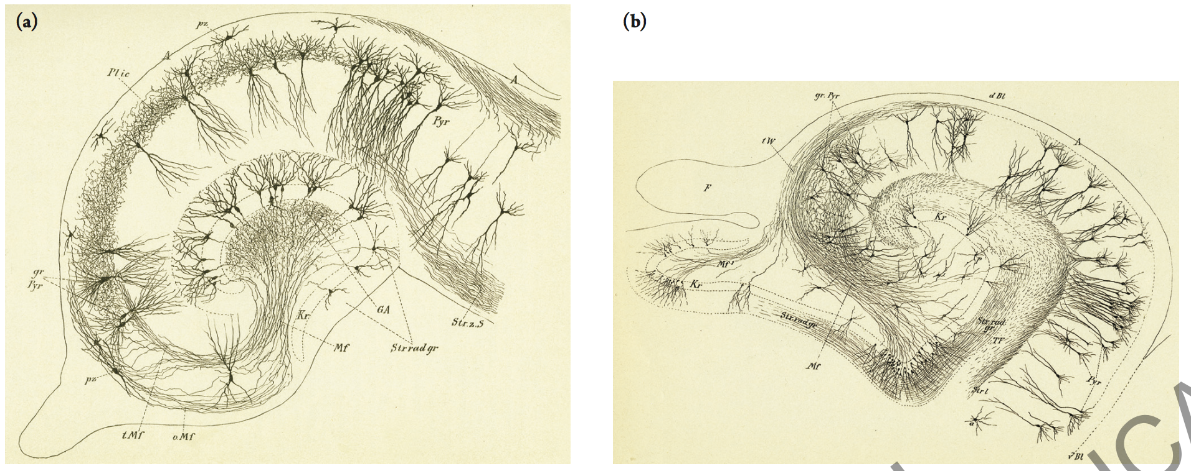
Building Brains
Conservation across vertebrates
Notes:
Hippocampus in (a) kitten and (b) human

Slide 6

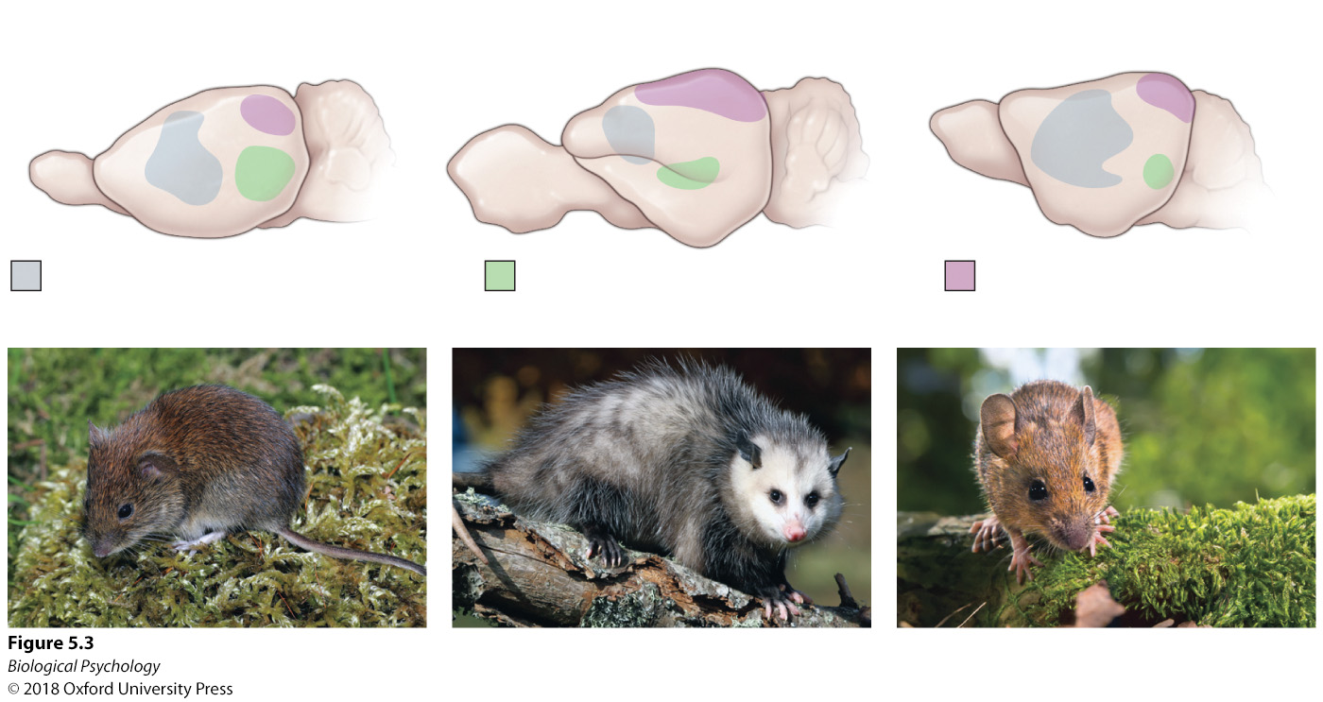
Building Brains
Functional specialization
Notes:
Hippocampus in (a) kitten and (b) human

Slide 7
Play
Why might (young or old) mammals play?
Notes:
Hippocampus in (a) kitten and (b) human

Slide 8
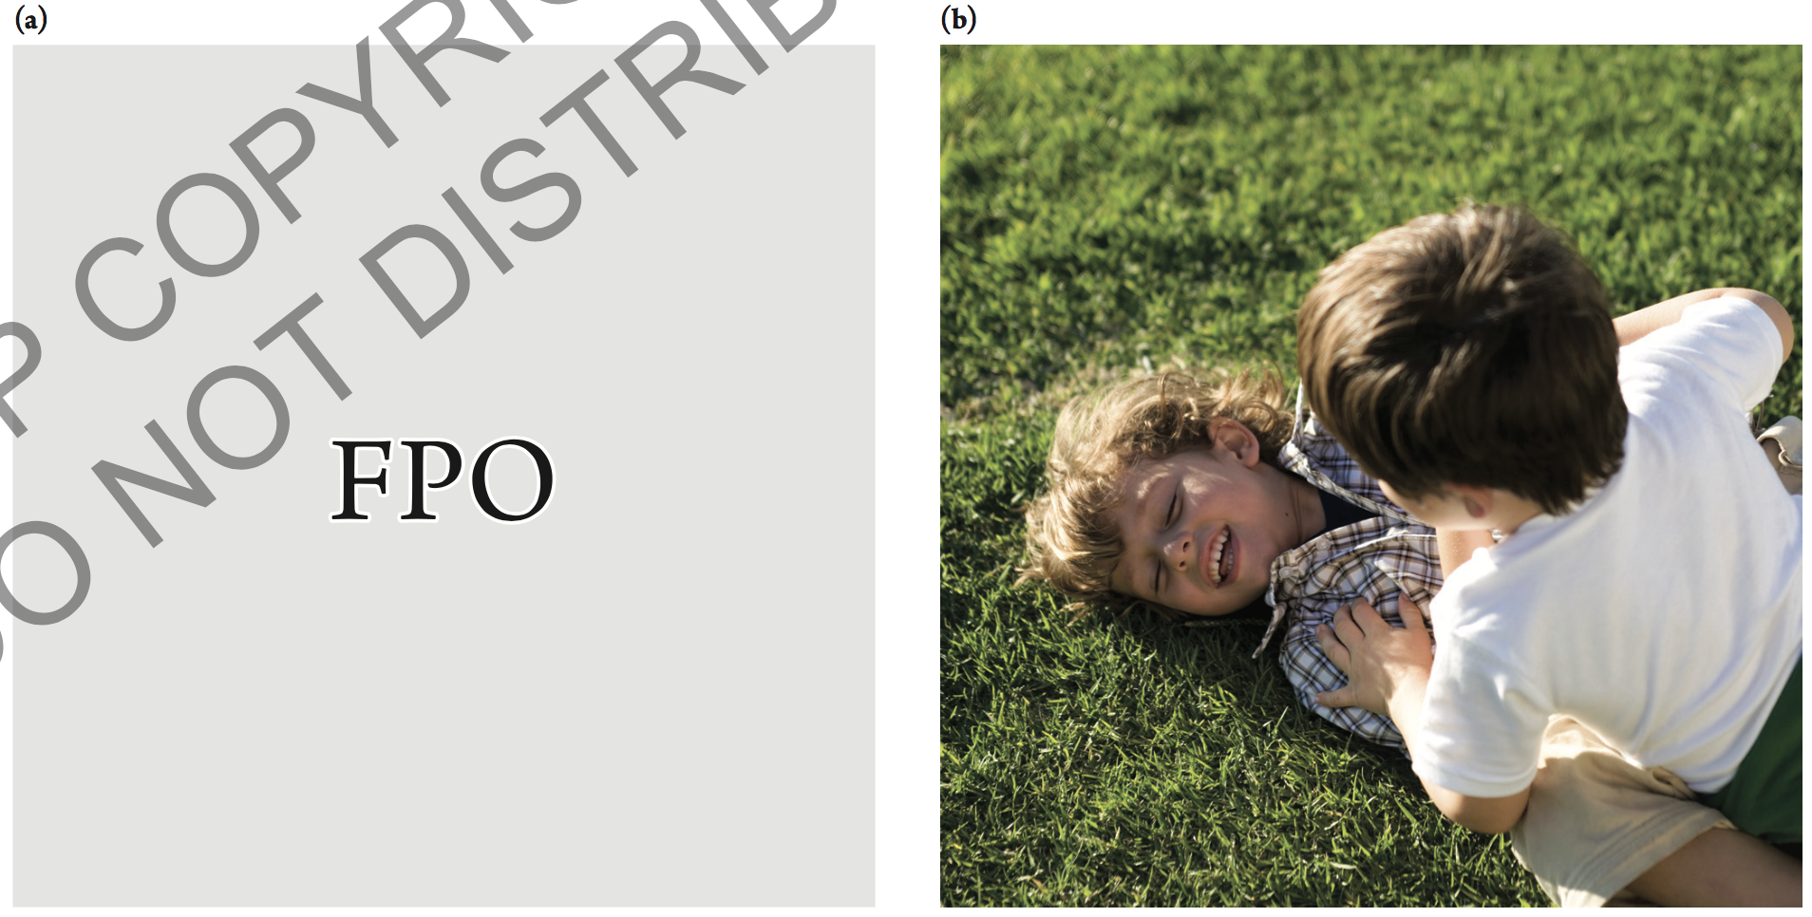
Play
Similar kinds of play
Notes:
Mammalian play responses are similar across species, including behaviors such as running, chasing, and pinning—shown here in (a) rats and (b) children.

Slide 9
Play
What’s the harm in not playing?
  85% of mothers (who responded to a survey) reported that their children play less than they did when they were children.

Slide 10
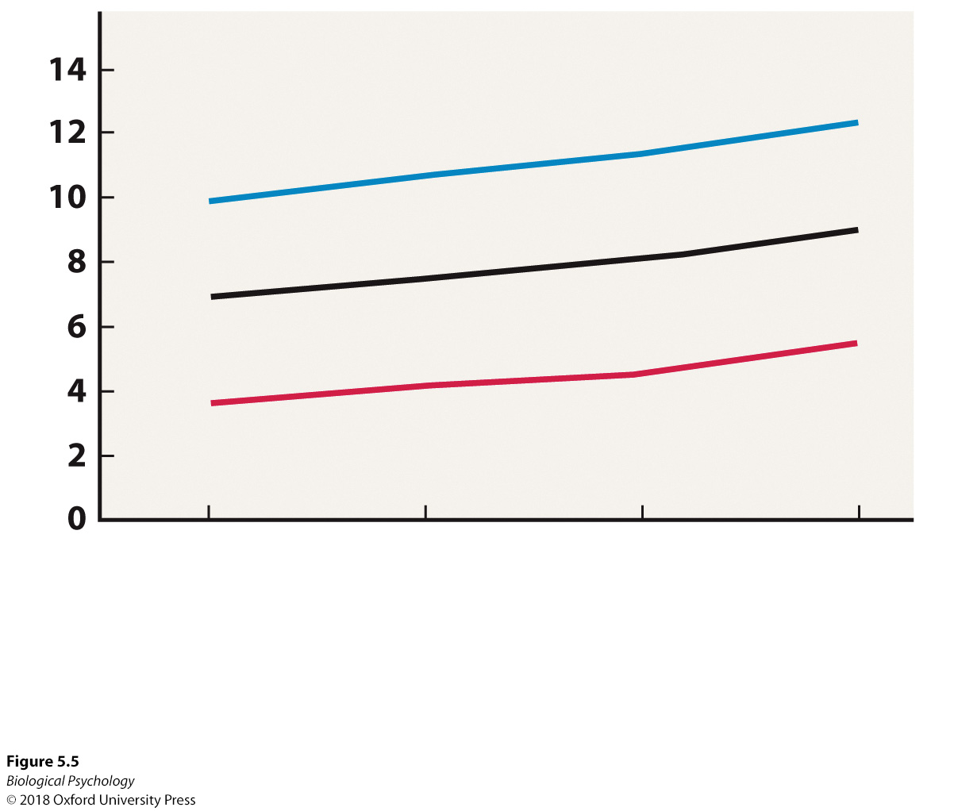
Play
A link with ADHD
Is this correlation or causation?
  How might we decide?
Notes:
Although they are higher in males than in females, rates of a attention-deficit hyperactivity disorder continue to rise in both groups.

Slide 11
Uniqueness of the human brain
How do you compare brains?
  Is it fair to just compare absolute size / absolute number of neurons?
How do you compare what a rat can do vs. what a human can do?

Slide 12
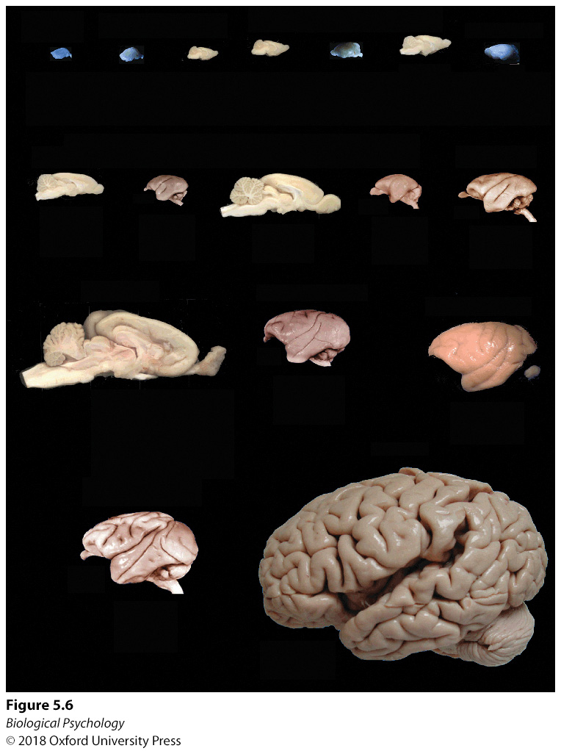
Uniqueness of the human brain
Notes:
The brains of different mammals share similar structural templates but vary greatly in size and number of neurons.

Slide 13
Uniqueness of the human brain
Notes:
The brains of different mammals share similar structural templates but vary greatly in size and number of neurons.

Slide 14
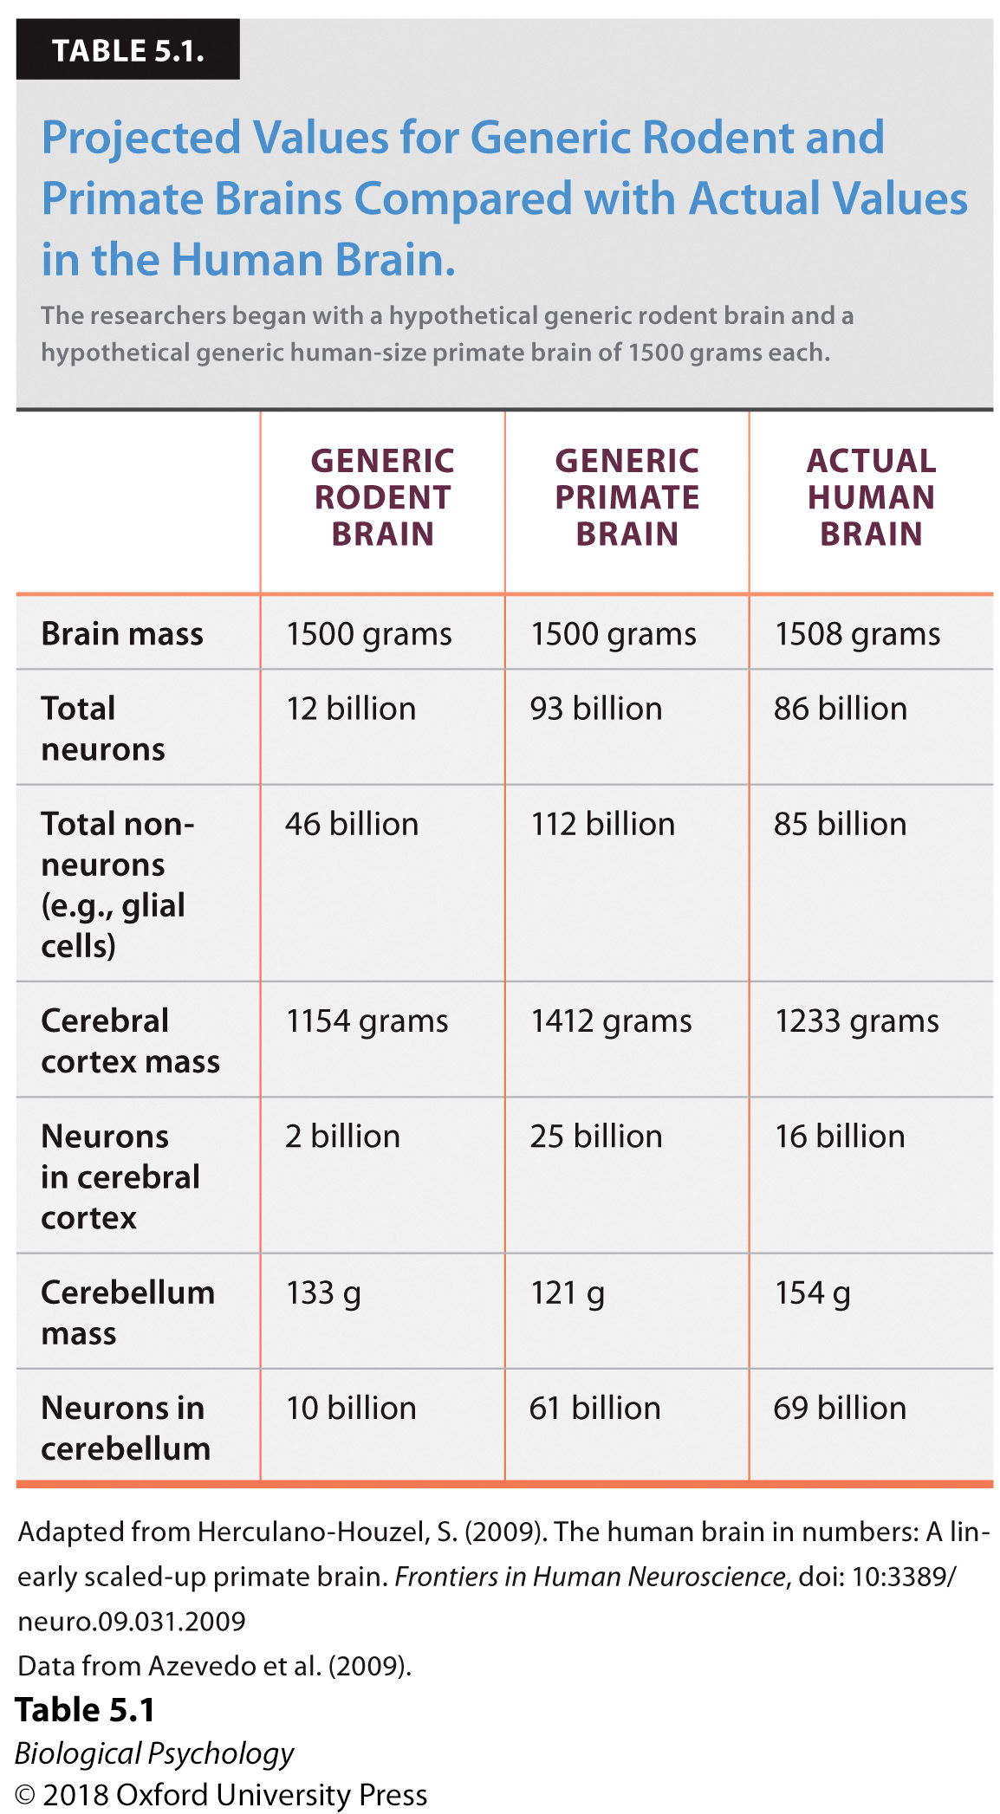
Uniqueness of the human brain
Notes:
Projected values for generic rodent and primate brains compared with actual values in the human brain.
The researchers began with a hypothetical generic rodent brain and a hypothetical generic human-size primate brain of 1500 grams

Slide 15
Uniqueness of the human brain
Are there environmental challenges that might make a bigger/smaller brain more valuable?

Slide 16
Epigenetics
The environment can directly impact genetics
Key Experiment:
  Offspring born to high-licking maternal rats exhibit less anxiety in the elevated plus maze compared with offspring from low-licking maternal rats

Slide 17
Epigenetics
The environment can directly impact genetics
Key Experiment:
  Offspring born to high-licking maternal rats exhibit less anxiety in the elevated plus maze compared with offspring from low-licking maternal rats

Slide 18
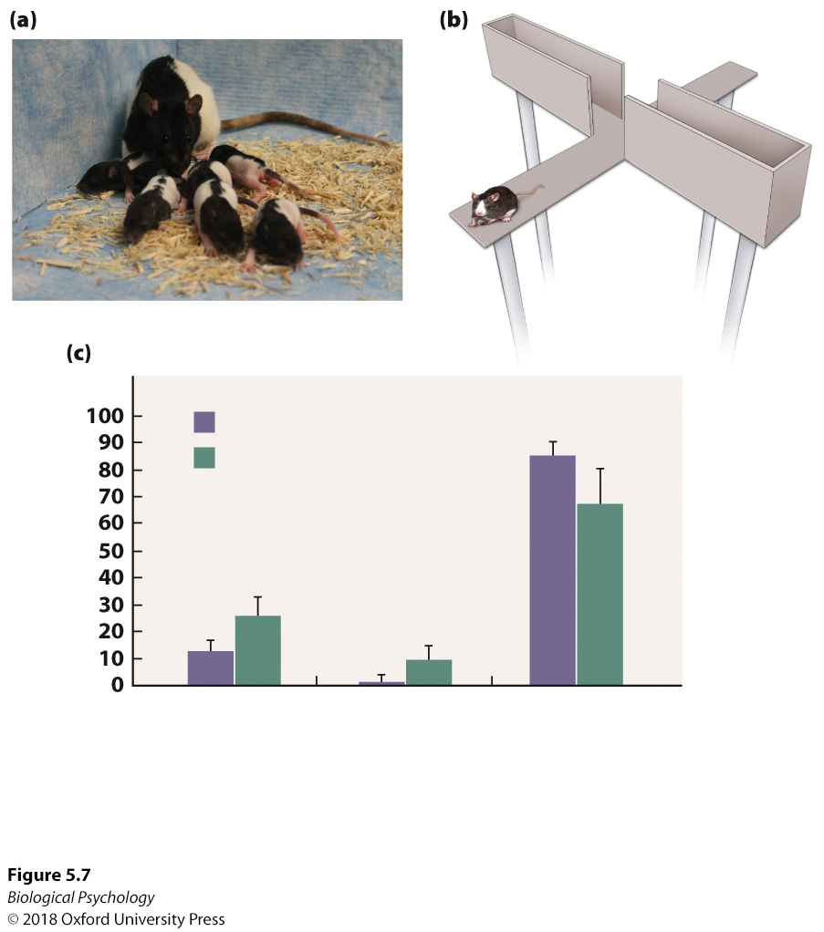
Epigenetics
Notes:
(a) Variation in the amount of maternal contact with the pups can have long-lasting neuronal and behavioral effects. (b) One study of the influence of maternal care on the anxiety of the offspring used an elevated-plus maze. Rats that spent more time in the open arm were considered less anxious, and those that spent more time in the closed arm were considered more anxious. (c) Rats who had been more frequently licked by their mother spent more time in the central area and open arm.

Slide 19
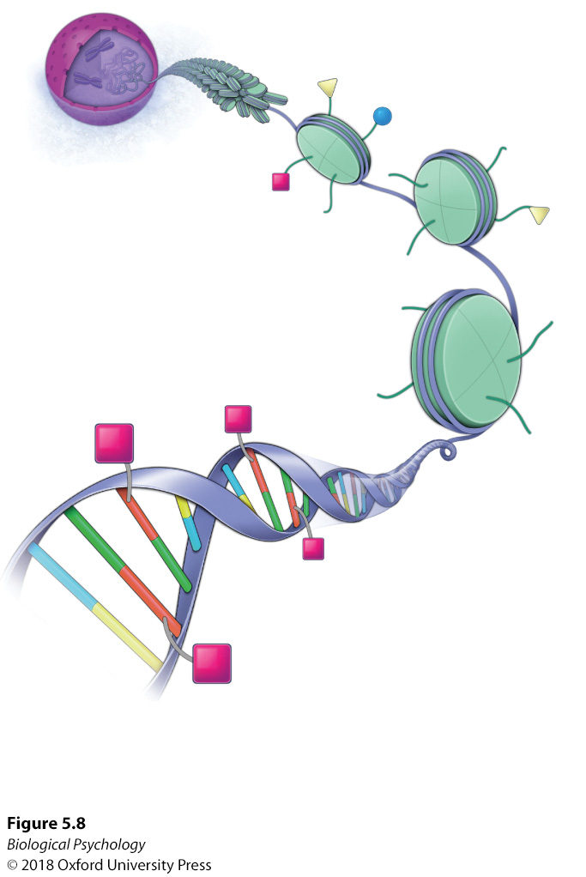
Epigenetics : DNA Methylation
Notes:
DNA methylation is a mechanism in which genes can be modified by the addition of a methyl chemical compound to the cytosine nucleotide base in DNA, usually preventing expression of the gene
Histone modification occurs throughout an organism’s life. Removal of methyl groups occurs at fertilization, during fetal development, and immediately after birth

Slide 20
Neural Development
A brain is born
Neurogenesis
The human adolescent brain
The aging brain

Slide 21
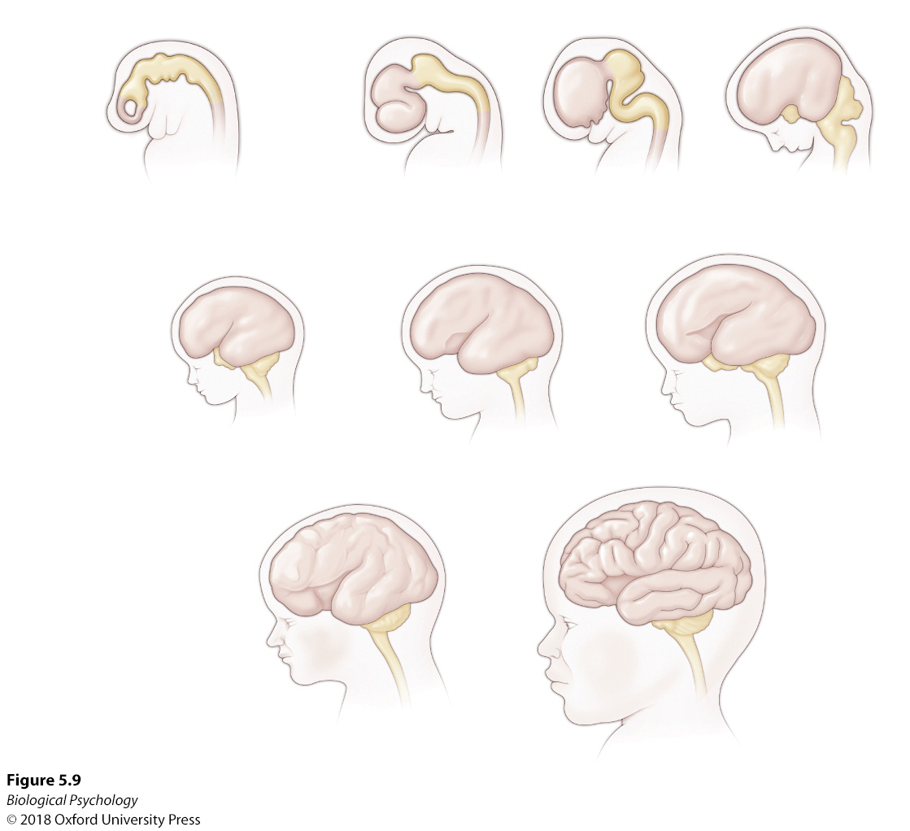
Neural Development
Neural development starts early, really early
Notes:
The development of the human brain occurs at a rapid pace. Early in the process, the overall brain structure is similar to that of other mammals, with more specific differentiation characteristic of the human brain occurring toward the end of gestational development.
In earliest stages of development, new cells are pluripotent
Progenitor cells retain their ability to eventually produce a specific type of cell, they do not have the ability of stem cells to produce pluripotent cells

Slide 22
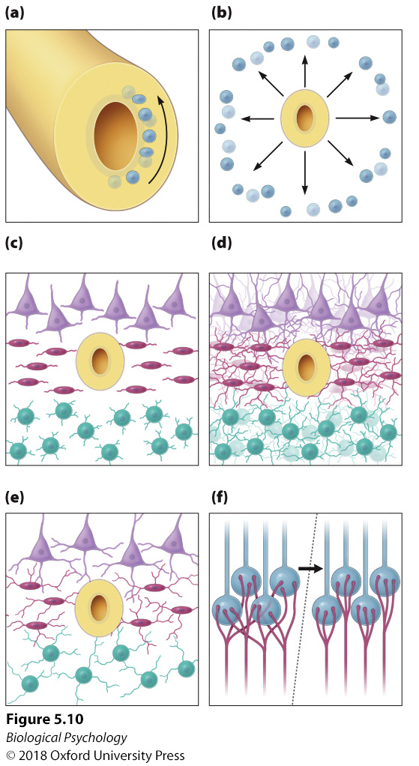
Neural Development
Neuronal development
Notes:
Immature neurons go through several processes that ultimately lead them to their final destination with appropriate neuronal connections.

Slide 23
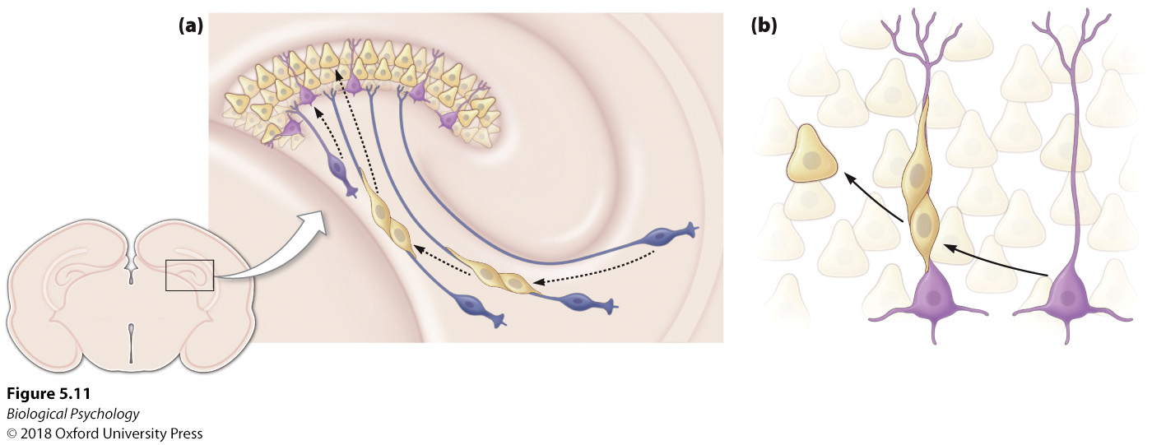
Neural Development
How do neurons get to where they need to go?
  Astrocytes (glial cells)
Notes:
Radial astrocytes serve as guidance paths for immature neurons, marking the way to their final destinations.

Slide 24
Neurogenesis
Subgranular zone of the dentate gyrus (hippocampus)
Subventricular zone of the lateral ventricle
Takes a week for cells to begin to mature
Several weeks/months before the are fully mature and integrated into a neural circuit
  What does the mean for learning/memory?

Slide 25
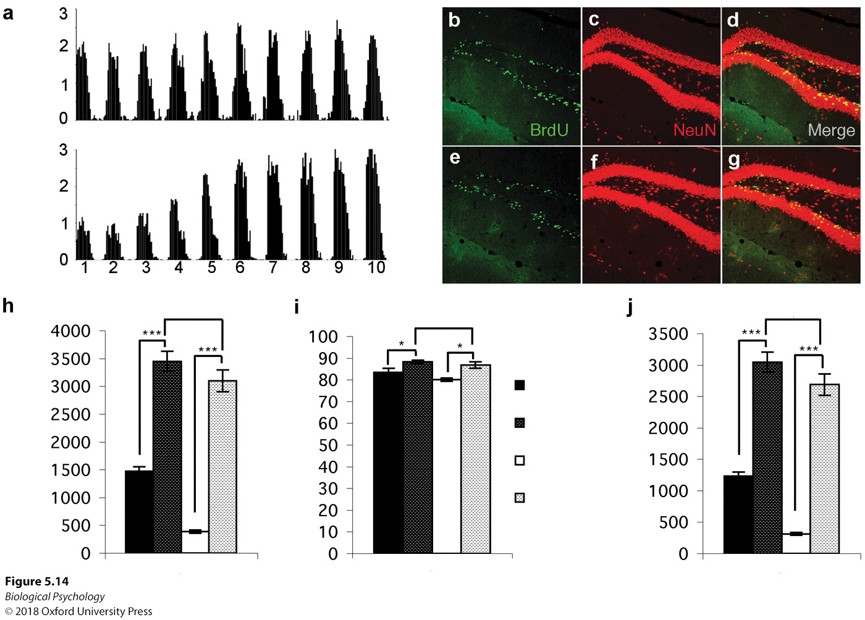
Neurogenesis
Notes:
To determine whether new cells were neurons and not glial cells, (a) mice were injected with BrdU, and the reactive cells were illuminated. (b) All of the neurons were stained. (c) When the new green cells merged with all of the new neurons, the yellow cells were known to be new neurons.

Slide 26
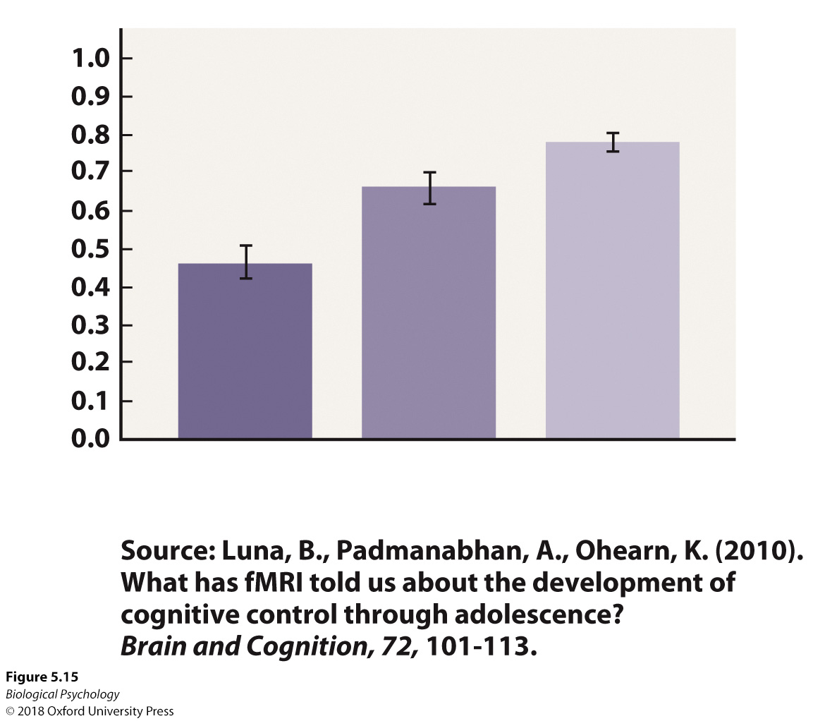
The human adolescent brain
Impulsive
  Lack of response inhibition
Notes:
Throughout human development, the ability to inhibit inappropriate responses increases with age.

Slide 27
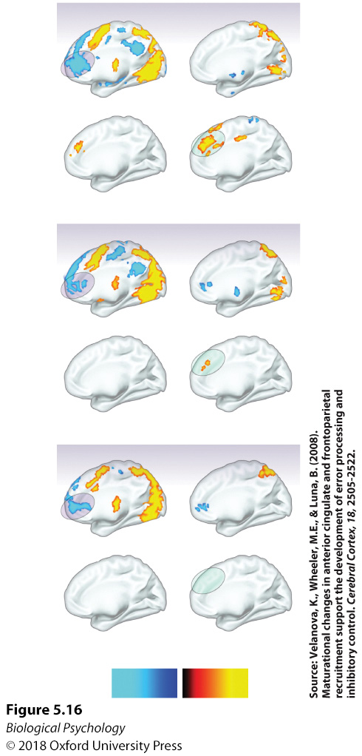
The human adolescent brain
What are the major features we see in these group fMRI maps?
Can we think of alternative explanations for the differences in activity between the groups?
Notes:
When asked to perform a visual task during a fMRI scan, it was observed that adults and adolescents decreased activity in the rostral anterior cingulate cortex when responding correctly. Only the adults exhibited in- creased activation in the dorsal anterior cingulate when responding incorrectly. In this figure, blue colors indicate decreased activity, and yellow/red colors indicated increased activity.

Slide 28
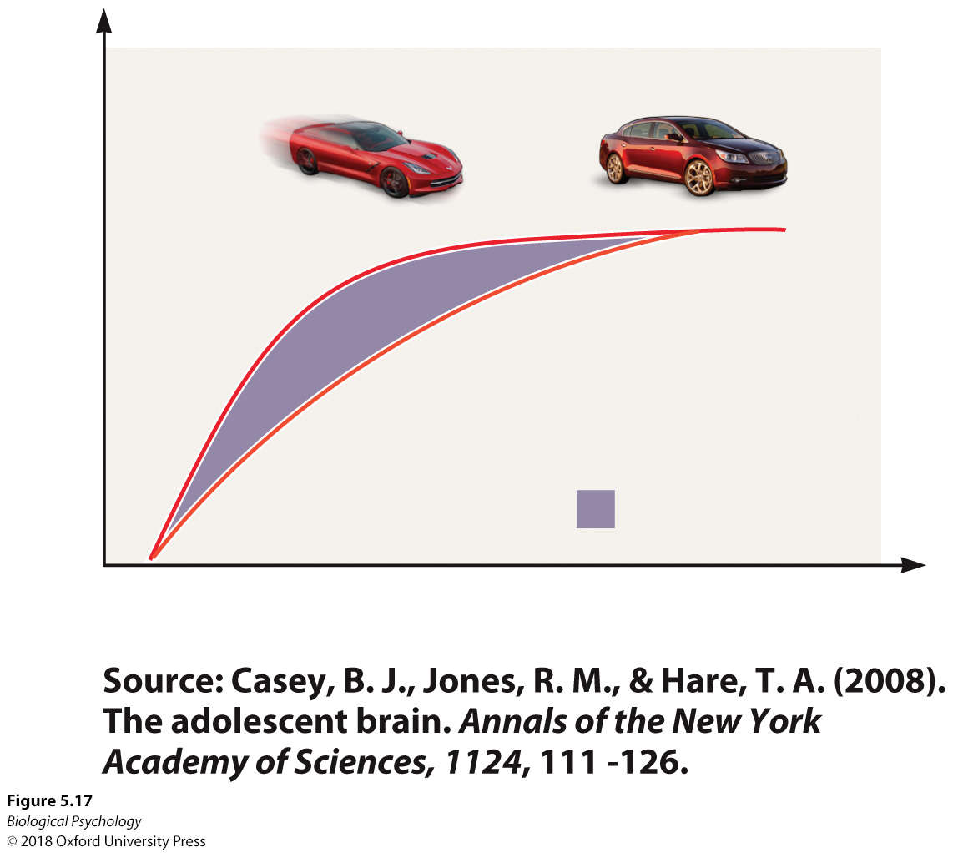
The human adolescent brain
How can we make sense of adolescent risk taking?
Notes:
The limbic regions of the brain mature at a faster rate than the pre- frontal cortical areas during adolescence. Consequently, without the prefrontal regions to regulate the emotional and reward functions of the limbic areas, high levels of risk-taking are observed during this time.

Slide 29
The aging brain
Why might it be good for the brain to remain plastic vs. static?
How much plasticity is possible after initial development?

Slide 30
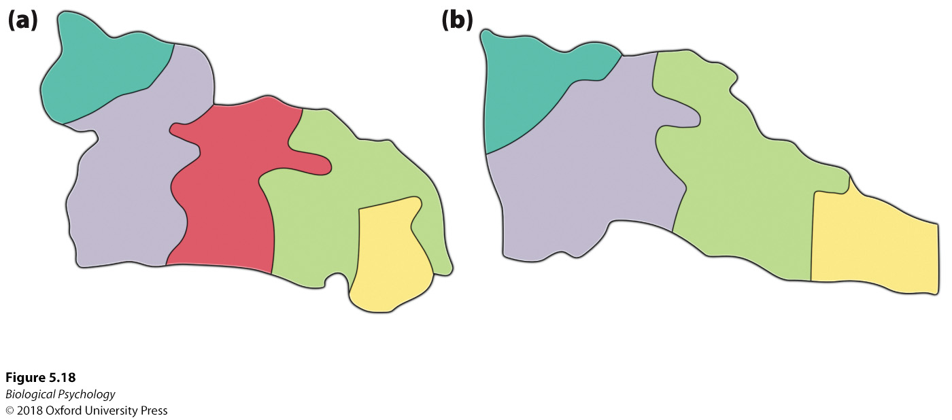
The aging brain
Change in hand representation after surgical amputation
Notes:
2 months after having a digit surgically removed, the owl monkey’s cortical area representing each digit reorganizes to compensate for the lost incoming sensory information from the lost digit, maximizing responsiveness of the remaining digits.

Slide 31
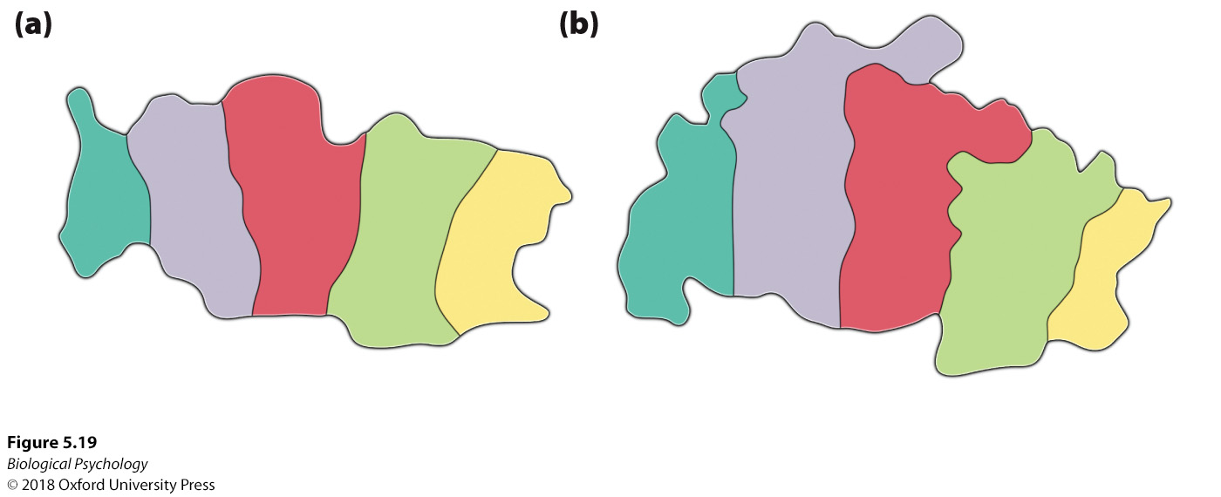
The aging brain
Change in hand representation after training
Notes:
Training in digits 2, 3, and 4 produces larger cortical areas for these digits in comparison with the digits that were not trained.

Slide 32
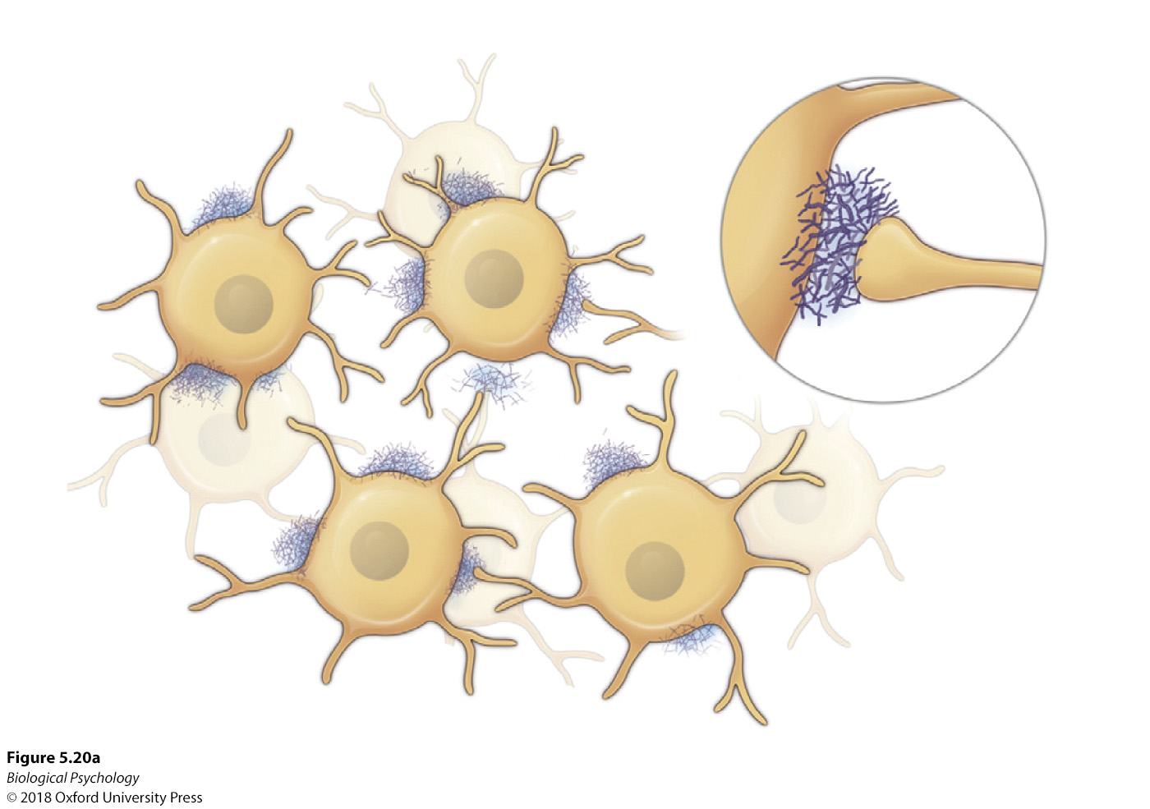
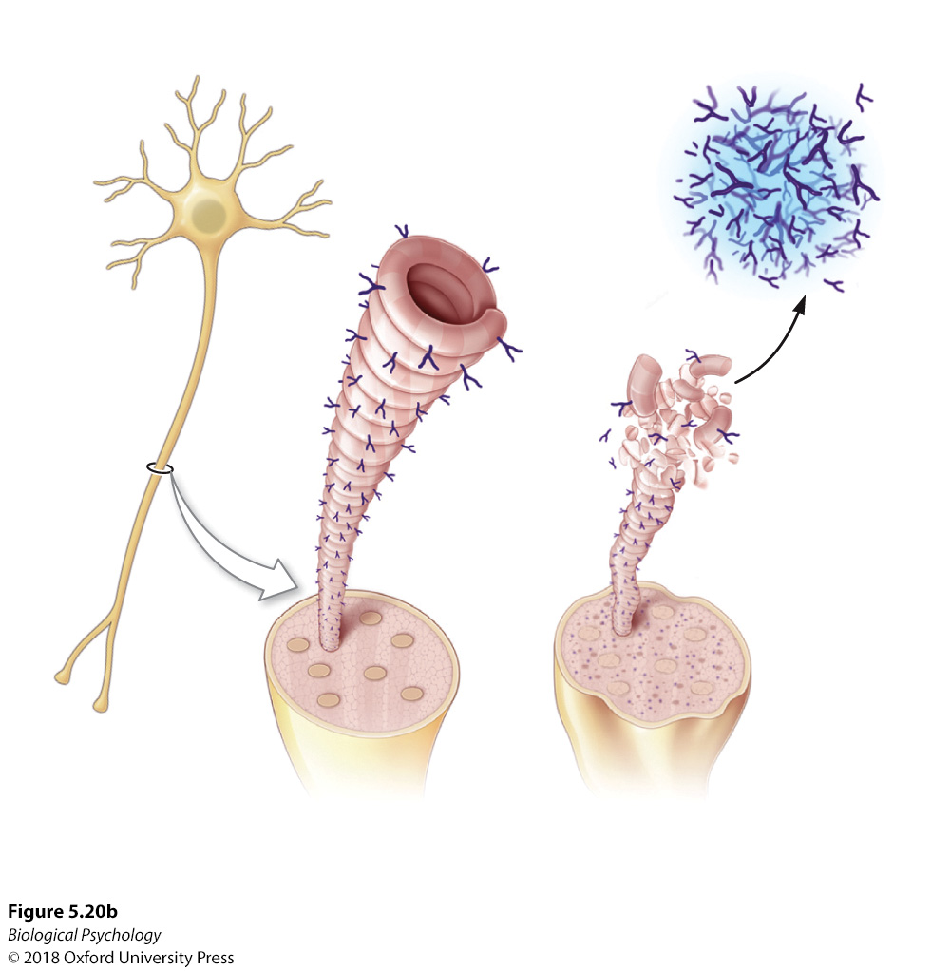
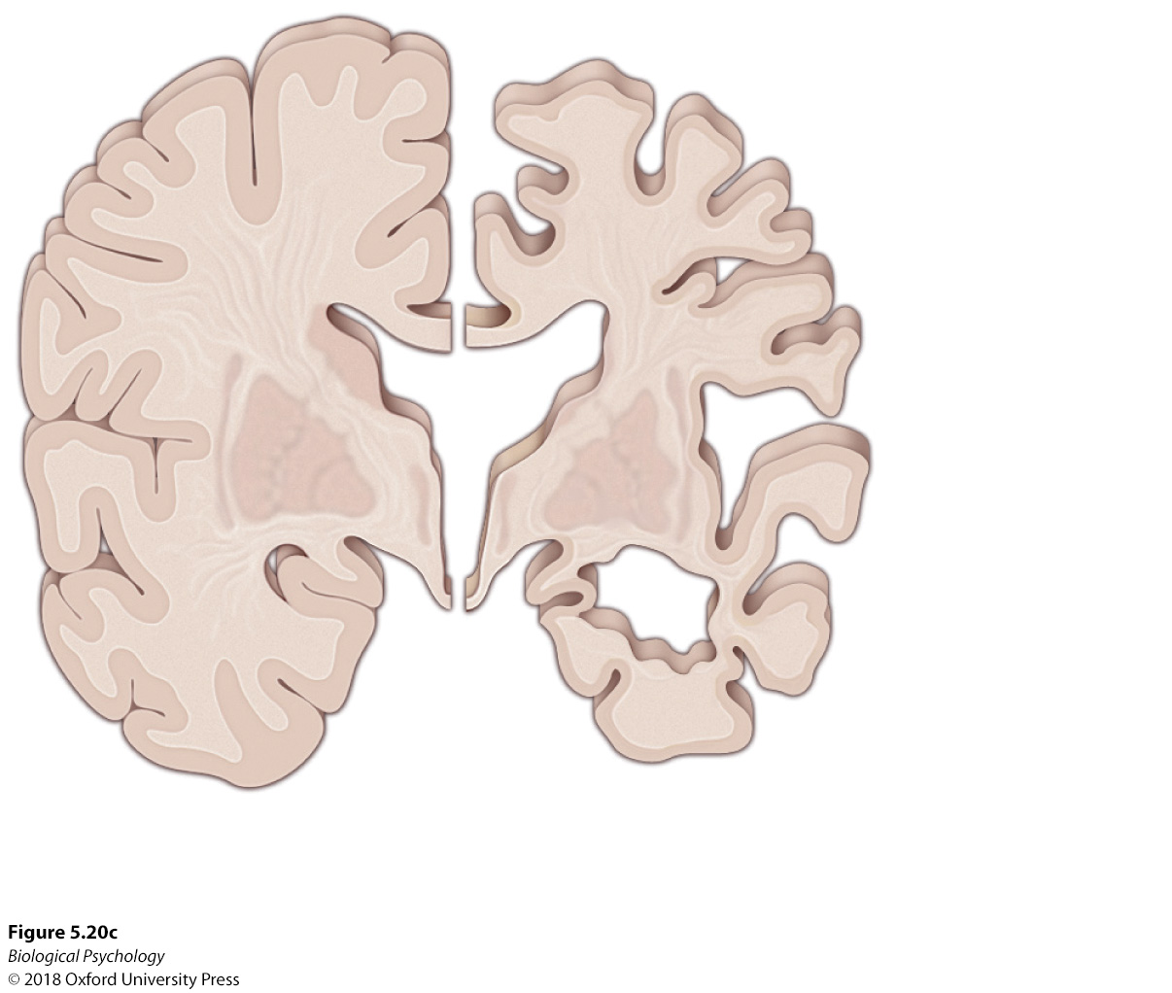
The aging brain
Not all changes are good
Notes:
(a) Alzheimer’s disease is characterized by amyloid plaques interrupting neuronal functioning, especially in the hippocampal area. (b) Normally, tau works to stabilize microtubules, but in Alzheimer’s disease τ destabilizes microtubules, leading to neurofibrillary tangles and diminished neuronal processing and communication (c) Patients with Alzheimer’s also show enlarged ventricles tubules, and significant shrinkage of the cortical and hippocampal areas.

Slide 33
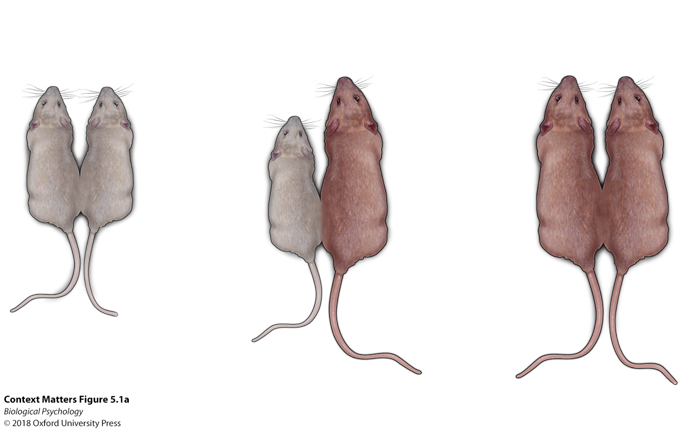
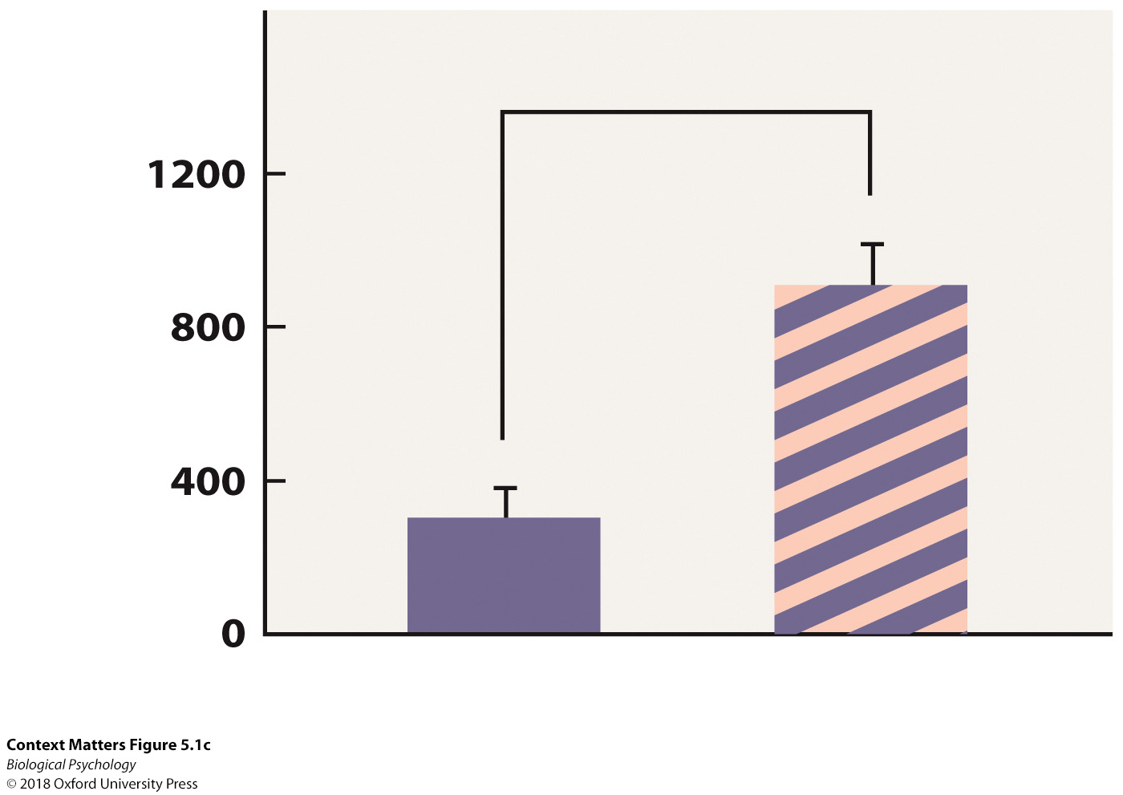
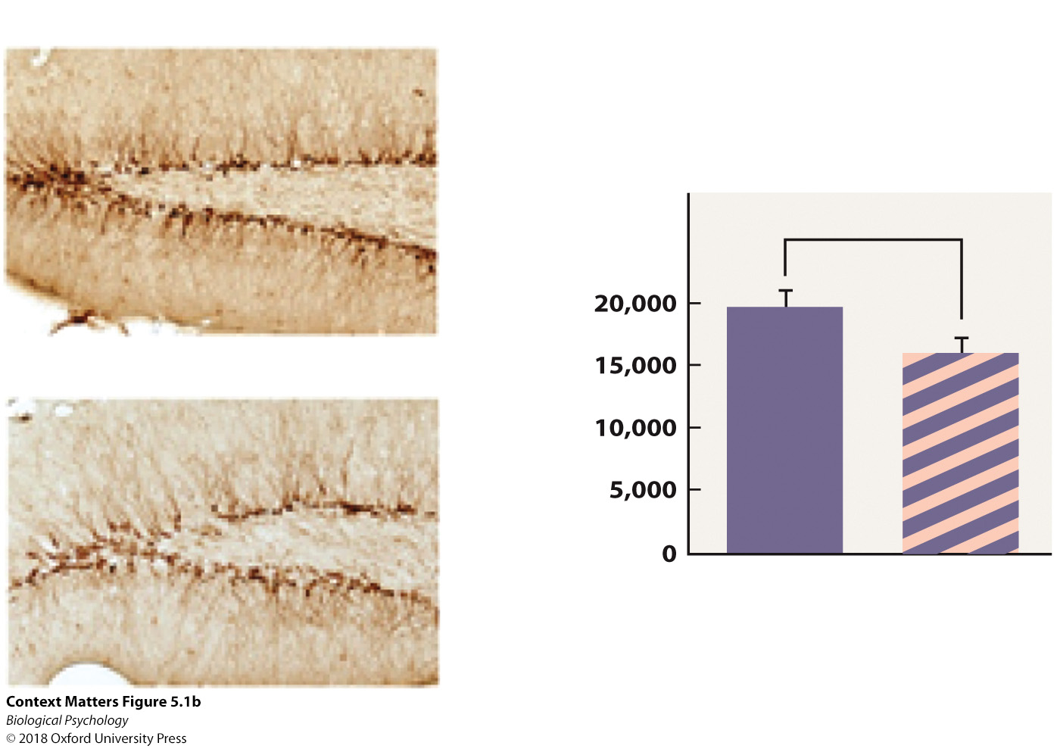
The aging brain: Blood
Notes:
When the blood of old mice was transfused into younger mice in a heterochronic preparation (a), neurogenesis declined to a level closer to that of the old mice (i.e., fewer stained developing cells) (b); alternatively, when the blood from young mice was transfused into old mice, neurogenesis rates increased to a level closer to that of young mice (c).

Slide 34
Recovery from injury
Traumatic brain injury
  1.7 million a year in the USA
Axons twist and tear, blood clots may form, blood flow disrupted, cells start to die
  Astrocytes try to help clean up the mess

Slide 35
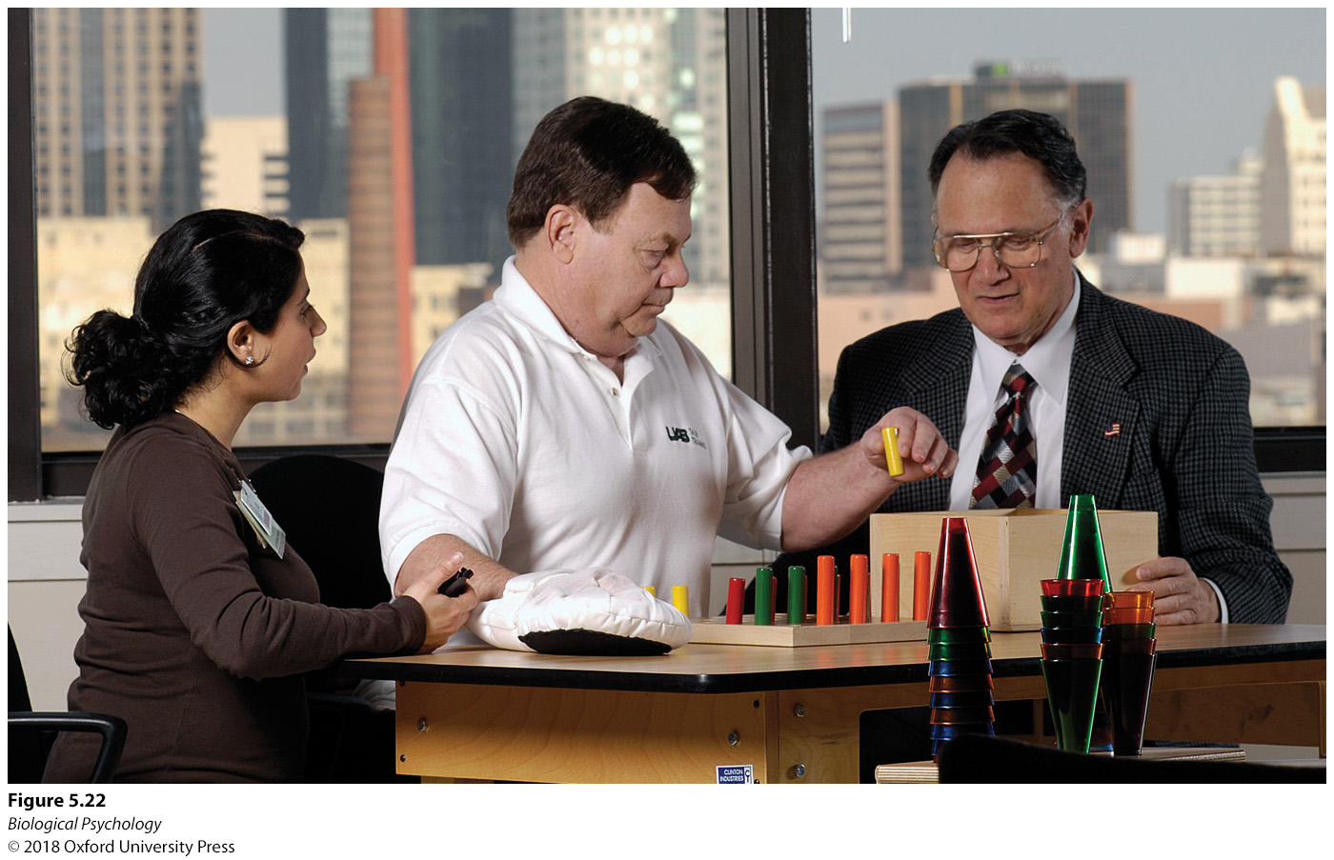
Recovery from injury
Training is critical to recovery
Constraint-induced therapy
  Require patients to use the affected limb(s) rather than providing a work around

Slide 36
Recovery from injury
Younger brains may cope better than older brains

Slide 37
Recovery from injury: CTE
Small brain injuries can accumulate
Chronic Traumatic Encephalopathy
  Atrophy to several brain regions
  Behavioral/personality changes
  Movement difficulties

Slide 38
Recovery from injury: CTE
What are the ethics involved in youth sports?
Who gets to decide what risks are worth taking?

