Slide 1


Slide 2
Chapter 4
Neurochemistry, Neuropsychopharmacology,
and Drug Addiction

Slide 3

Outline
Neurotransmitters: A brief introduction
Overview of Neuropsychopharmacology
Psychoactive Drugs: Precursors to Drug Addiction
Drug Addiction

Slide 4

Neurotransmitters
Monoamine
Amino Acid
Peptide
“other”

Slide 5
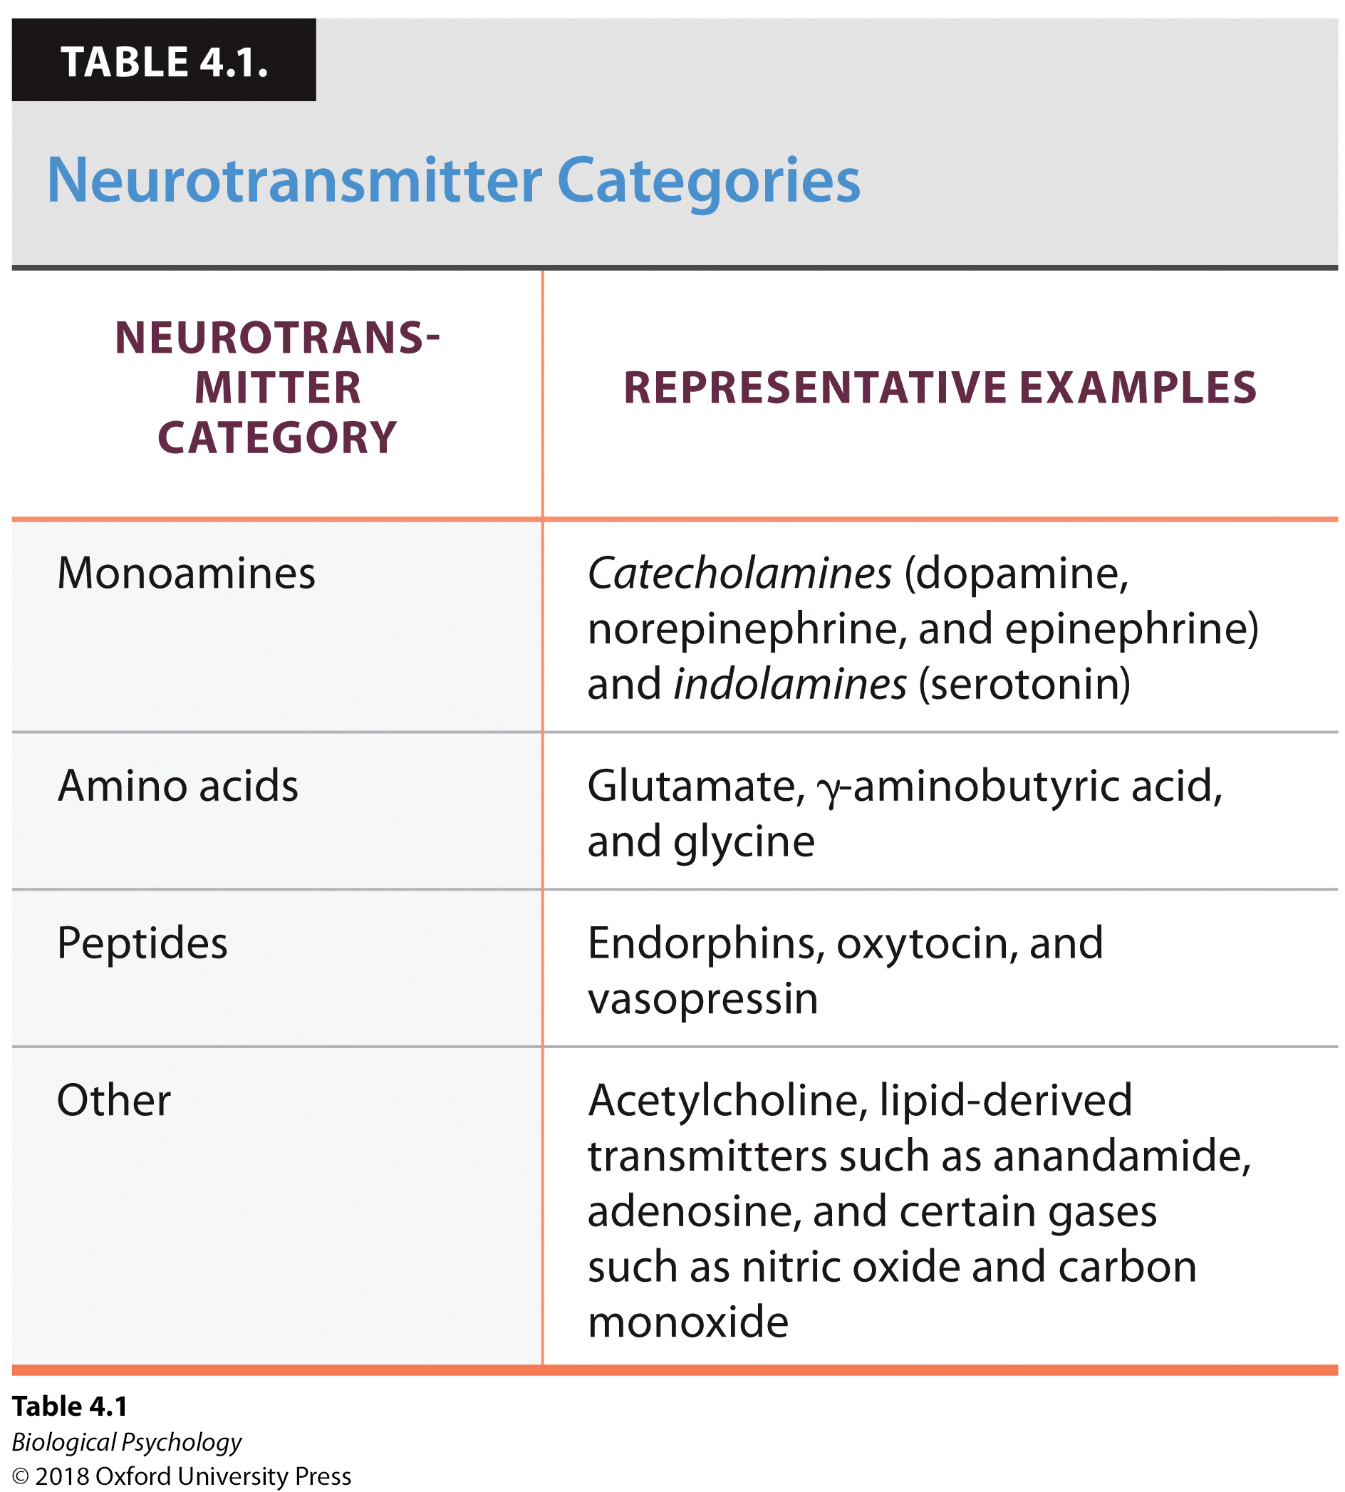
Neurotransmitters
Monoamine
Amino Acid
Peptide
“other”

Slide 6
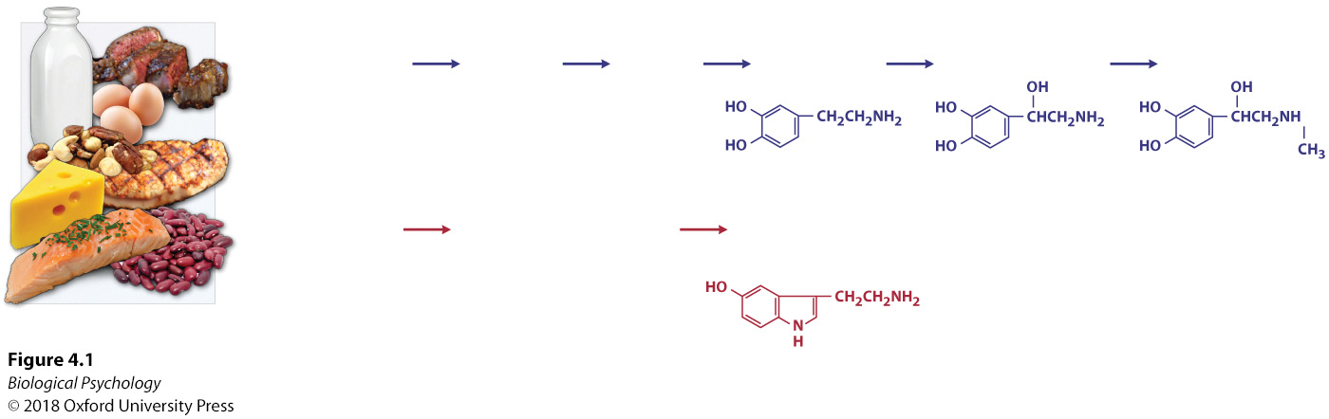
Neurotransmitters
Neurotransmitters require assembly

Slide 7
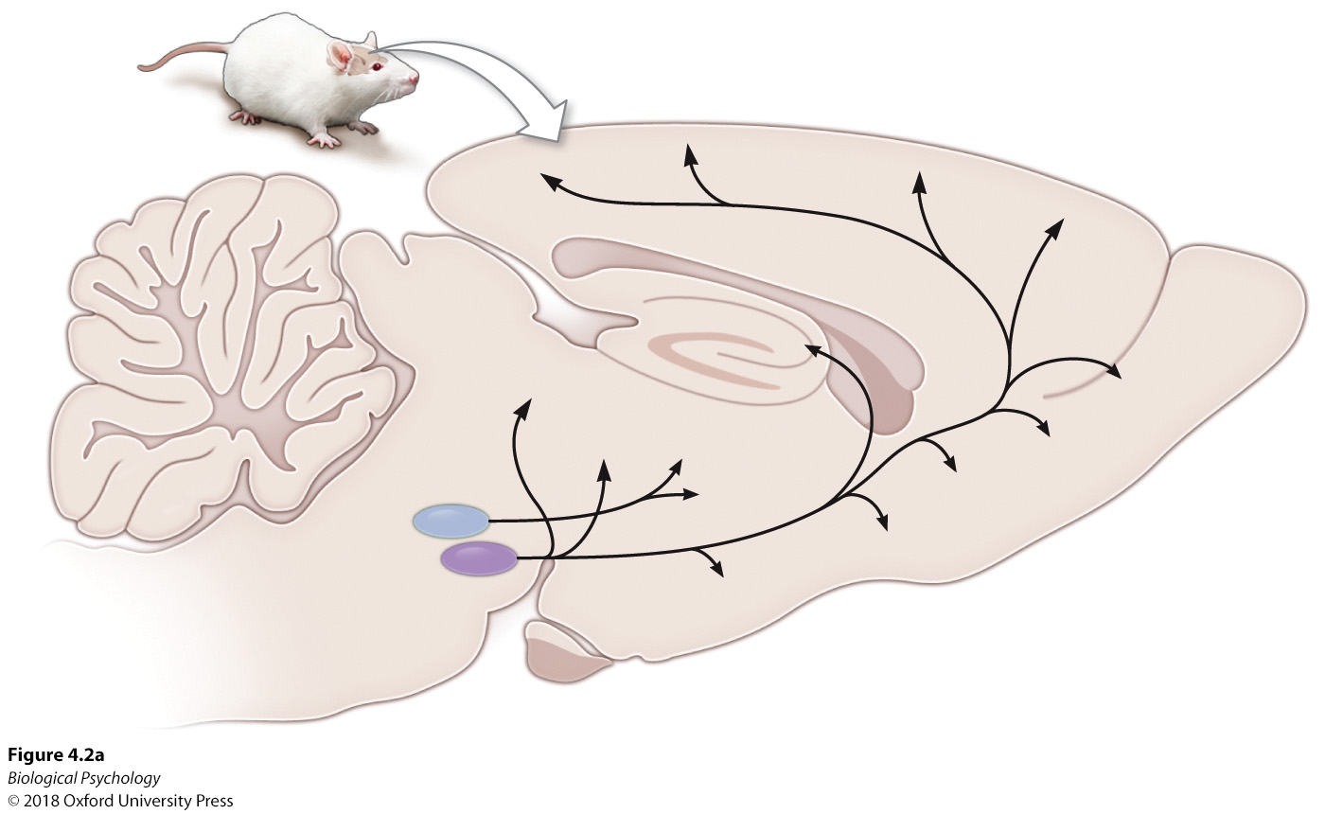
Neurotransmitters
After assembly, they are sent to particular regions (shown for dopamine)

Slide 8
Neurotransmitters: Monoamine
Dopamine
  movement, reward systems, increased vigilance
Norepinephrine
  increased vigilance, focused attention, enhanced energy
Epinephrine
  response to acute stress
Serotonin
  mood regulation, sleep/wake cycles, temperature regulation, sexual activity, aggression

Slide 9
Neurotransmitters: Amino Acid
Glutamate
  excitatory signaling
Gamma (γ)-aminobutyric acid (GABA)
  Principal inhibitory neurotransmitter in the brain
Glycine
  Inhibitory neurotransmitter in the spinal cord and brainstem.

Slide 10
Neurotransmitters: Peptide
Endorphins
  Pain and reward processing
Oxytocin and vasopressin
  Social behaviors
  More on these later in the course

Slide 11
Neurotransmitters: Other
Acetylcholine
  Memory & cognition in the CNS
  Motor and parasympathetic functions in the PNS
Nitric oxide (a gas!)
  Retrograde neurotransmitter

Slide 12
Overview of neuropsychopharmacology (NPP)
Psychoactive drugs affect neural transmission by enhancing (agonists) or blocking (antagonists) the actions of natural transmitters in the synapse

Slide 13
NPP Goals
Develop a drug that has an affinity for the targeted neurotransmitter’s natural receptors in the brain.
How do we test a drug’s effectiveness?
Double-blind studies
  Why is it important patients/doctors are unaware which patients are in the experimental vs. control group?

Slide 14
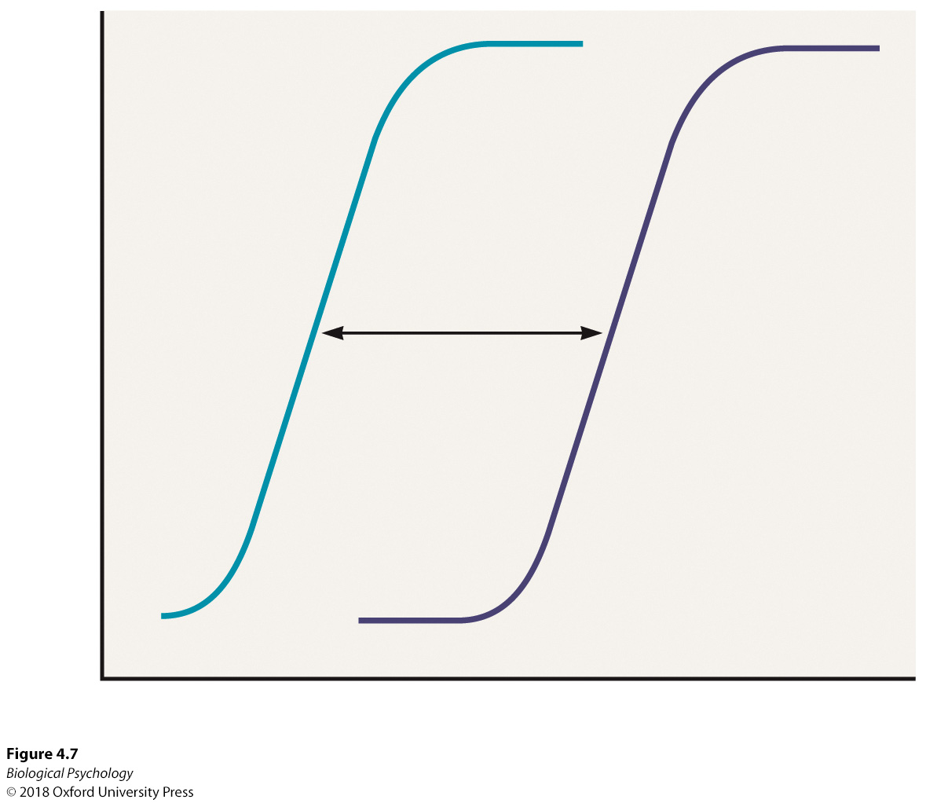
NPP Goals : Dose response curves
How do we obtain dose-response curves?
How do we interpret them?

Slide 15
Questions to answer
Route of administration
Absorption and distribution
Binding
Inactivation
Excretion

Slide 16
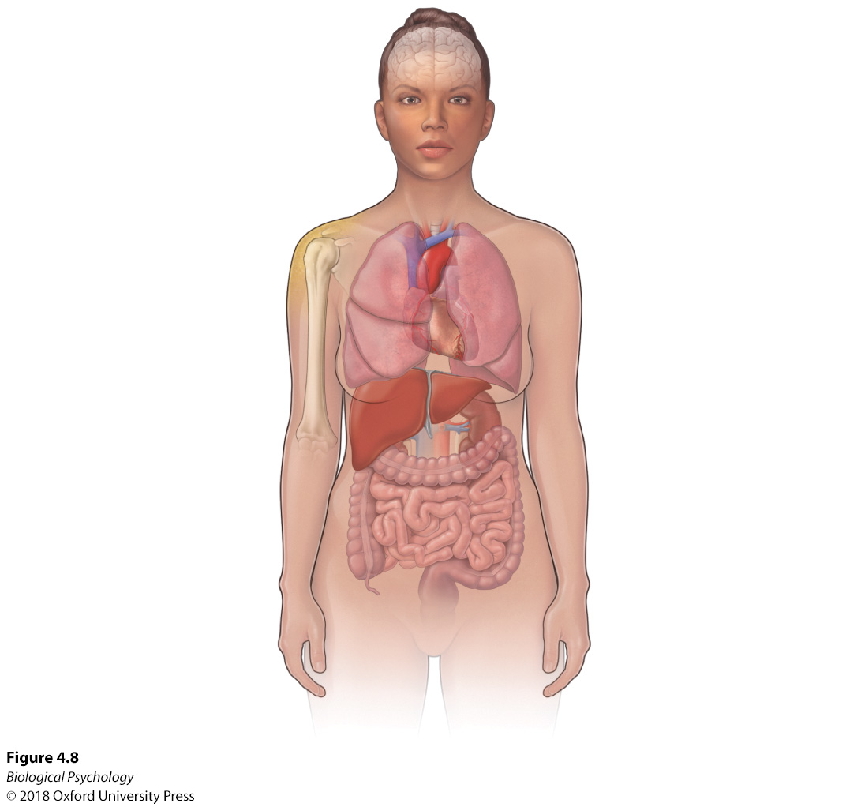
Pharmacokinetics

Slide 17
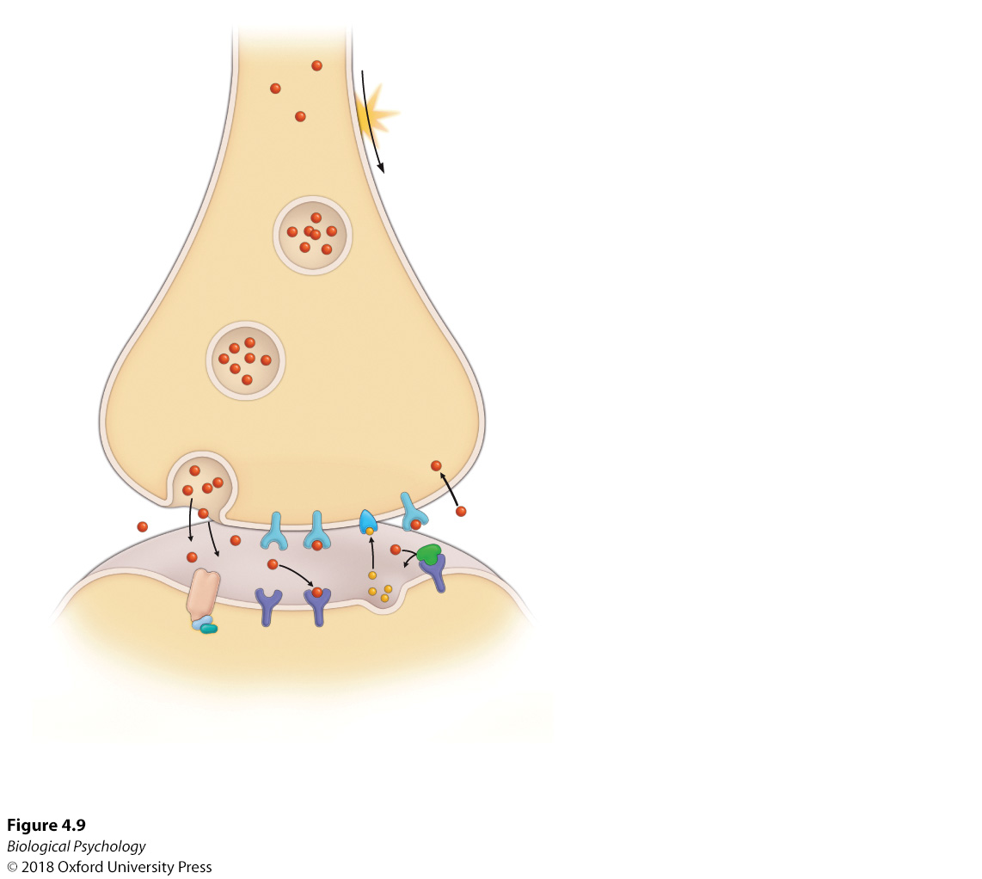
Developing new drugs
Many, many possible ways to affect neurotransmission

Slide 18
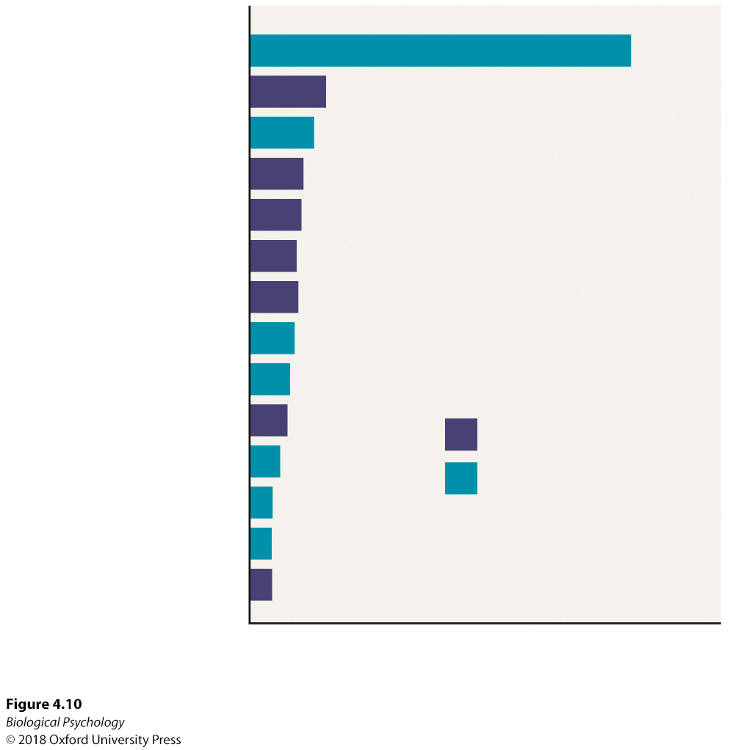
Psychoactive drugs: precursors to addiction
Lots of psychoactive
drugs, some legal
some illegal

Slide 19
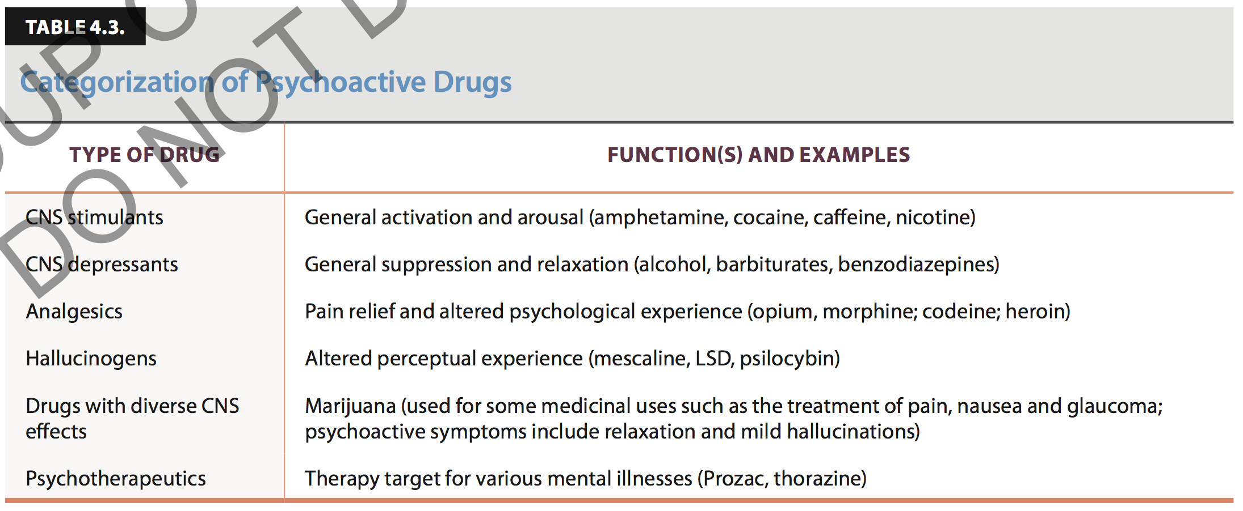
Classifying psychoactive drugs

Slide 20
Classifying psychoactive drugs
CNS Stimulants
  Caffeine
    blocks adenosine receptors
  Nicotine
    activates nicotinic cholinergic receptors
  Cocaine
    Blocks reuptake of dopamine, norepinephrine, and serotonin

Slide 21
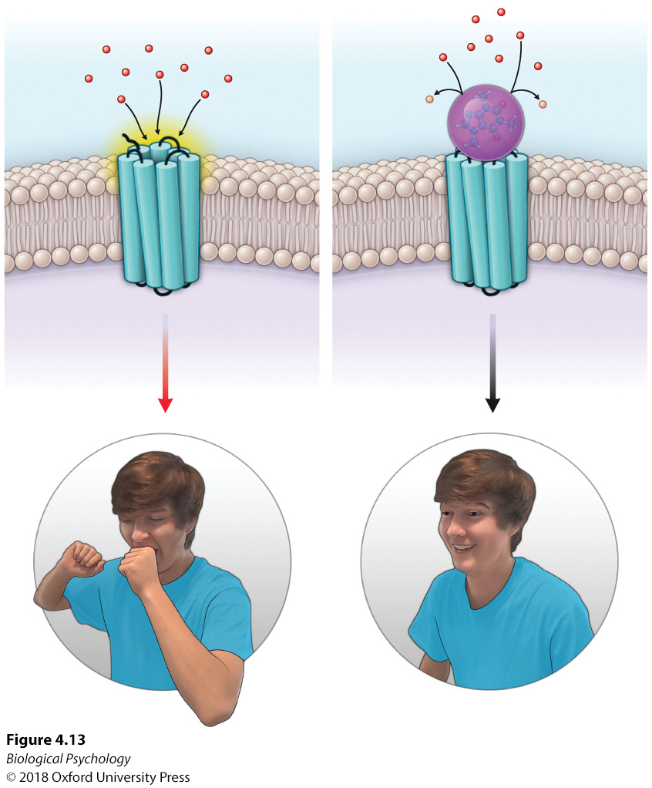
What does caffeine do?

Slide 22
CNS Depressants
Alcohol
  Low doses
    improved mood and increased confidence
    Drowsiness, impaired judgment and muscle coordination
  High doses can lead to alcohol poisoning
  Systemic use can lead to cognitive decline
Societal cost of alcohol abuse?

Slide 23
CNS Depressants
Alcohol
  Inhibits glutamate transmission
  Chronic use leads to increase in glutamate receptors
  Compensatory glutamate release may be cause of hyperexcitability associated with alcohol (despite it being a depressant)
  Enhances effect of GABA

Slide 24
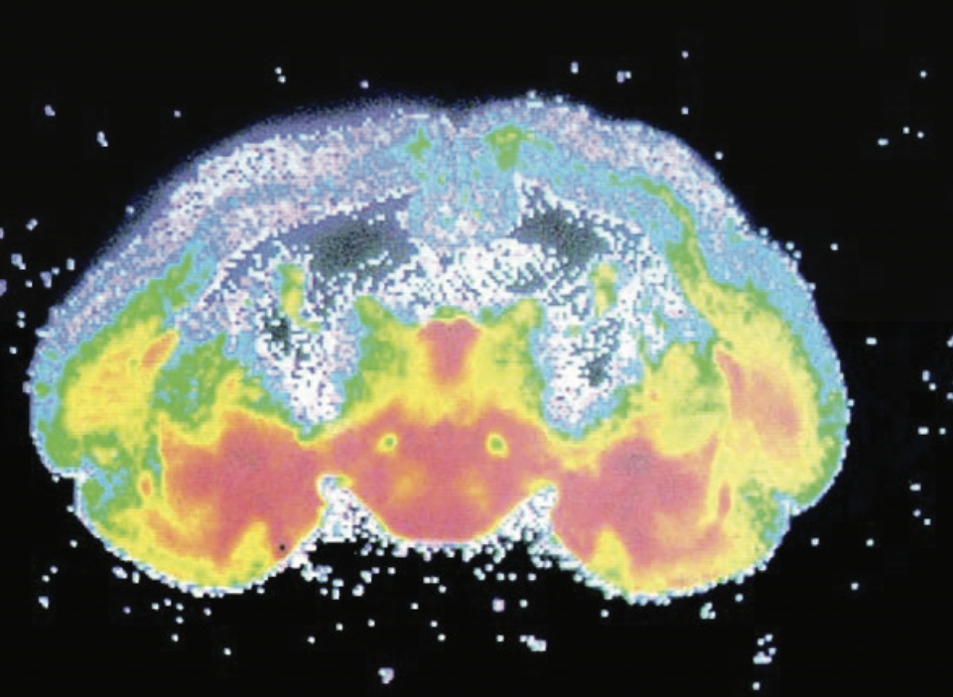
Analgesics: Opium
Opium
  Morphine
  Heroin
Can cause a sense
of euphoria
Highly addictive
Severe withdraw
Notes:
Areas of the highest density of opiate receptors (shown in red) are located in the nucleus accumbens and surrounding areas associated with reward functions.

Slide 25
Thinking about opioids
Why do we have receptors for opioids?
Are there natural opioids?
How do we release them?

Slide 26
Hallucinogens: LSD
Created in a lab
  Ethical issues with self-experimentation of psychoactive drugs?
Can lead to hallucinations, illusions, alterations in perception of time and space
Serotonin agonist

Slide 27
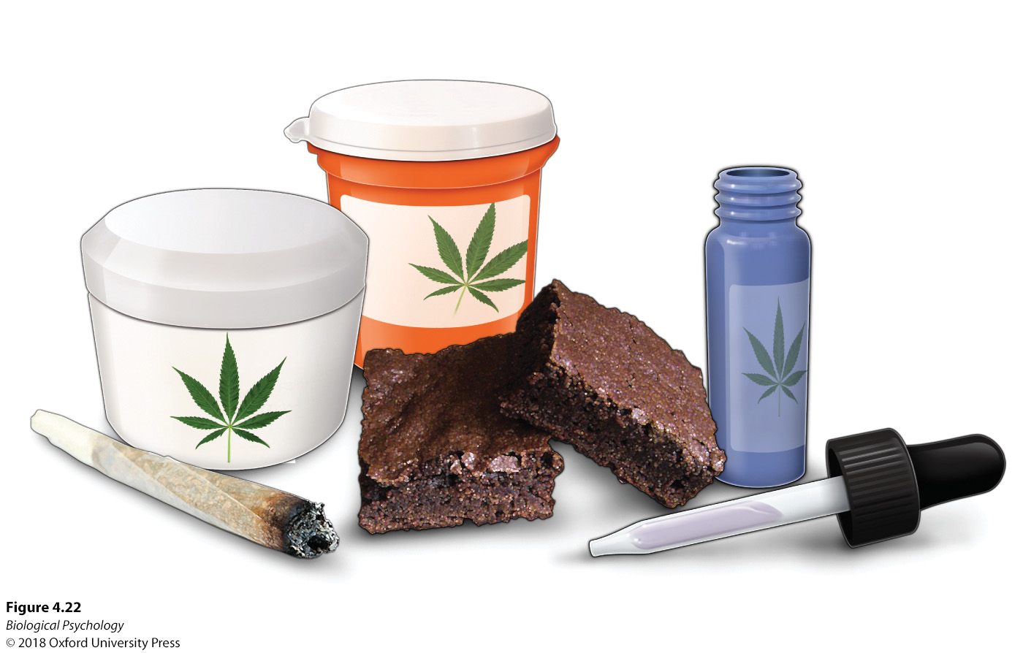
Cannabis
Around for thousands of years
Cannabinoid receptors found in the 1980s

Slide 28
Cannabis
Alters coordination, memory, locomotor activity
Can inhibit dopamine, norepinephrine, acetylcholine, glutamate, and GABA

Slide 29
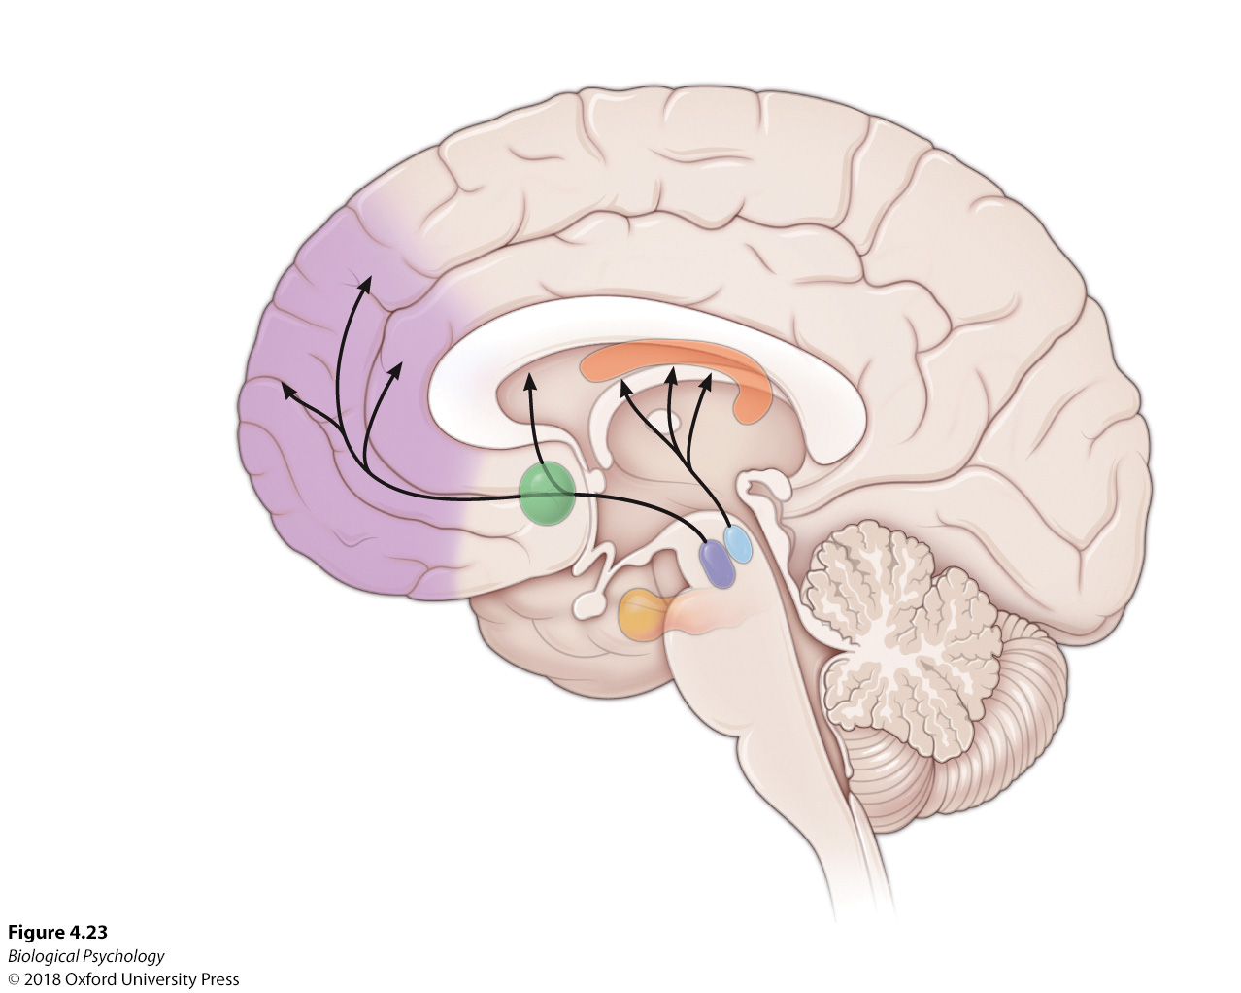
Drug Addiction
Drugs of abuse hijack motivational pathways

Slide 30
Drug Addiction
Behavioral tolerance
  Involves learning and memory
  Sensitive to behavioral and environmental manipulations (taking drug in new context ameliorates tolerance)
Pharmacodynamic tolerance
  Results from exposure to high drug doses (not directly impacted by environment)

Slide 31
Drug Addiction
Drug addiction cycle
  Compulsion to seek/consume
  Inability to control intake
  Negative emotional state when not taking drug
  Chronic relapse
Fine line between controlled use and drug addiction

Slide 32
Drug Addiction
Different stages
  Binge/intoxication stage
  Withdrawal/negative affect stage
  Preoccupation/anticipation (craving) stage

Slide 33
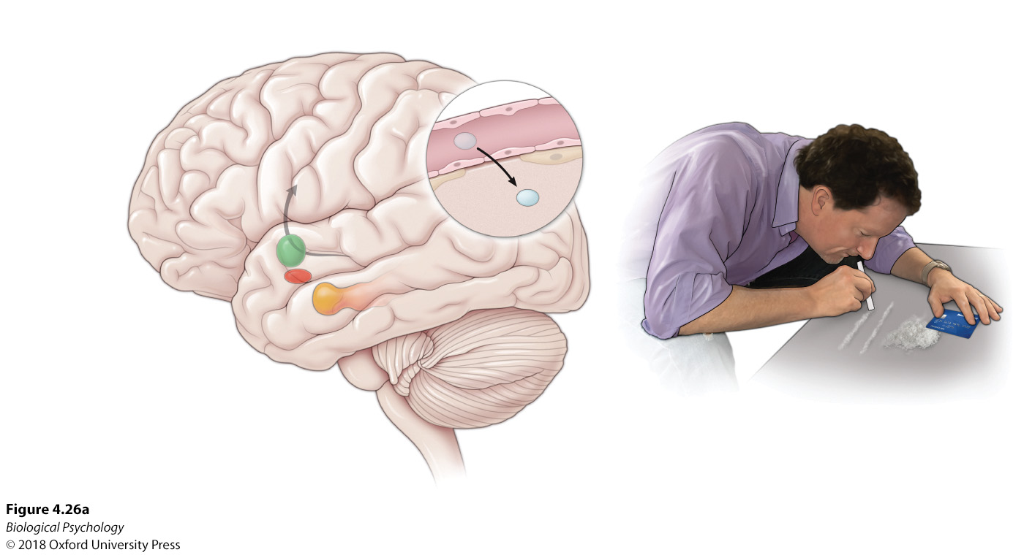
Drug Addiction
Notes:
During the initial stage of addiction, the nucleus accumbens and associated areas are activated to reinforce the positive effects of the drug.

Slide 34
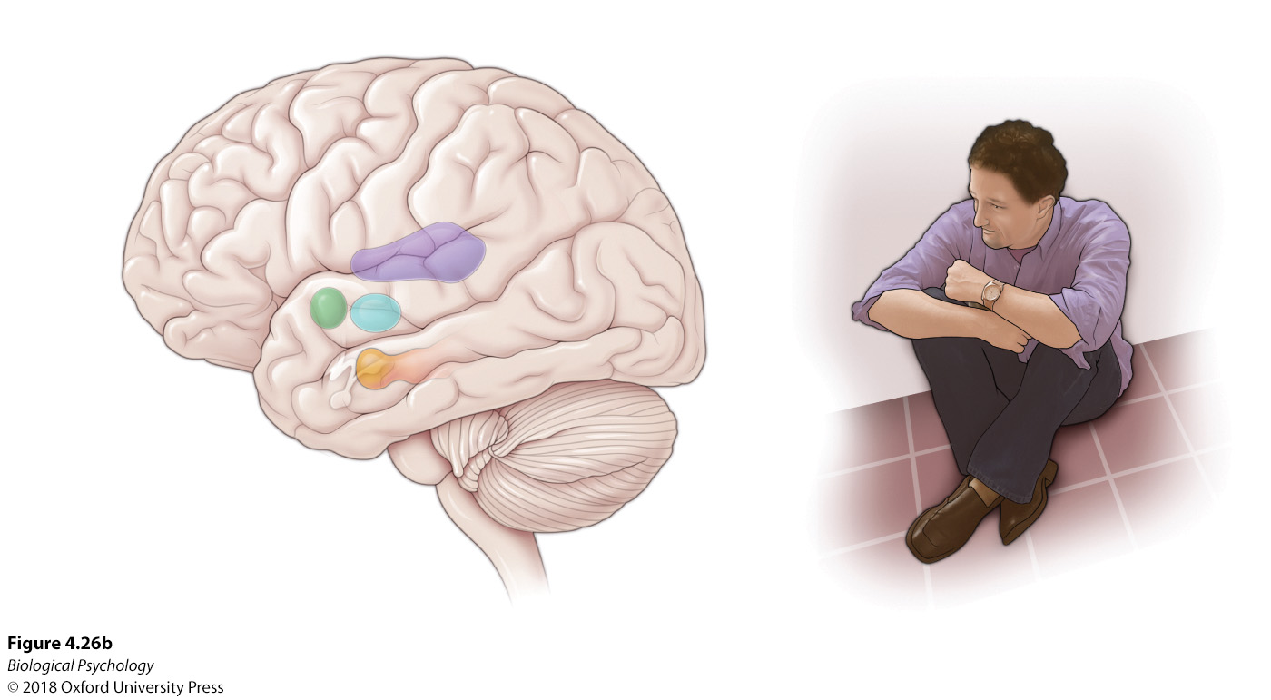
Drug Addiction
Notes:
When the drug is no longer present, the brain areas involved in processing negative emotions, such as the amygdala, are disproportionately activated, as well as the stress hormone system (corticotropin-releasing hormone)

Slide 35
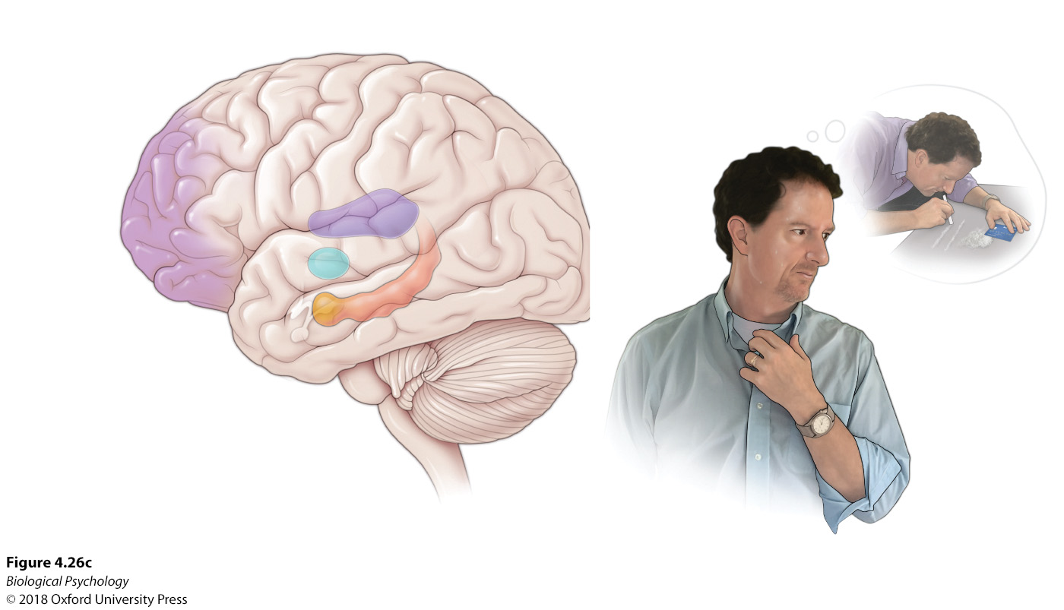
Drug Addiction
Notes:
Following detoxification, drug-associated environmental cues activate brain areas involved in memory and distress, such as the hippocampus and amygdala.

Slide 36
Drug Addiction
Triggering relapse
  Priming effects (from re-exposure to the drug)
  Conditioned environmental cues
  Acute stress

Slide 37
Fighting addiction with environmental enrichment
If drug use is reinforcing, can we replace it with another reinforcer? (one without all the downsides)

Slide 38
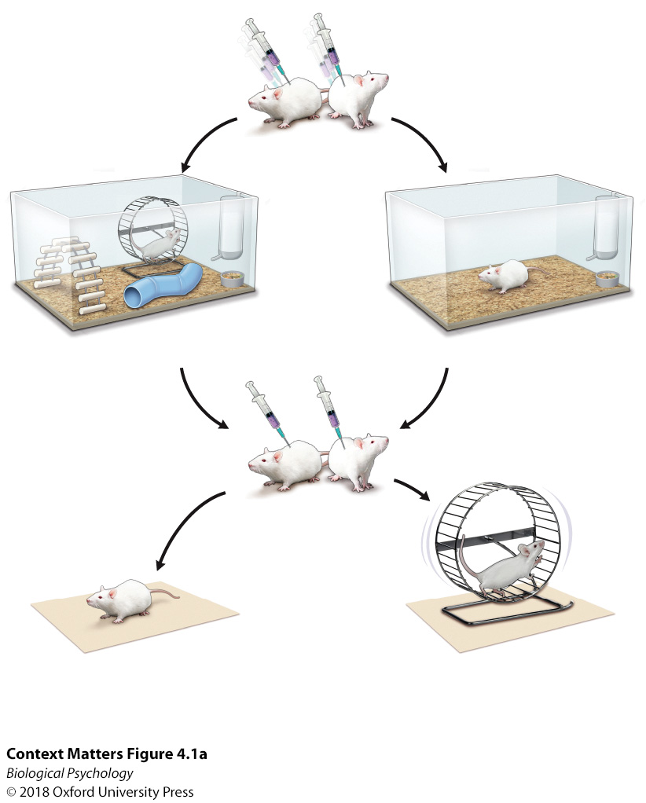
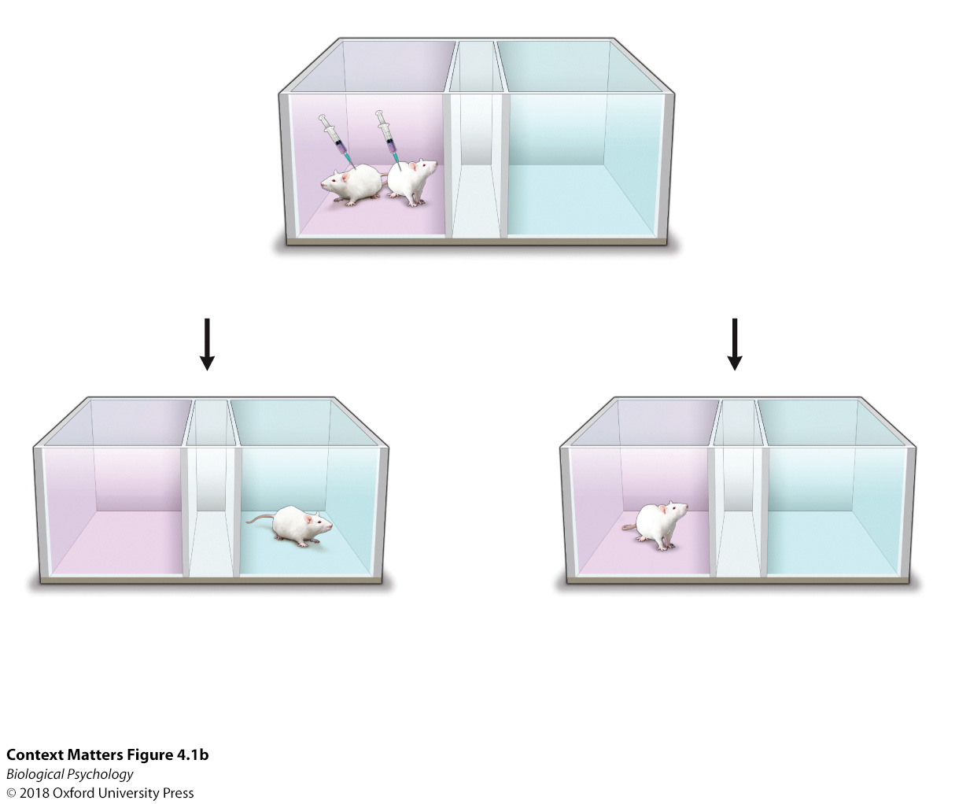
Fighting addiction with environmental enrichment
Notes:
After exposing mice to either a standard or an enriched environment, their memory of cocaine administration was assessed after 1, 7, or 30 days by being placed in a place preference box. After 30 days of exposure to an enriched environment, cocaine sensitization (preference of the side of the box where the drug was administered), was no longer present. Thus, the enriched environment functioned as a treatment for cocaine sensitization.

Slide 39
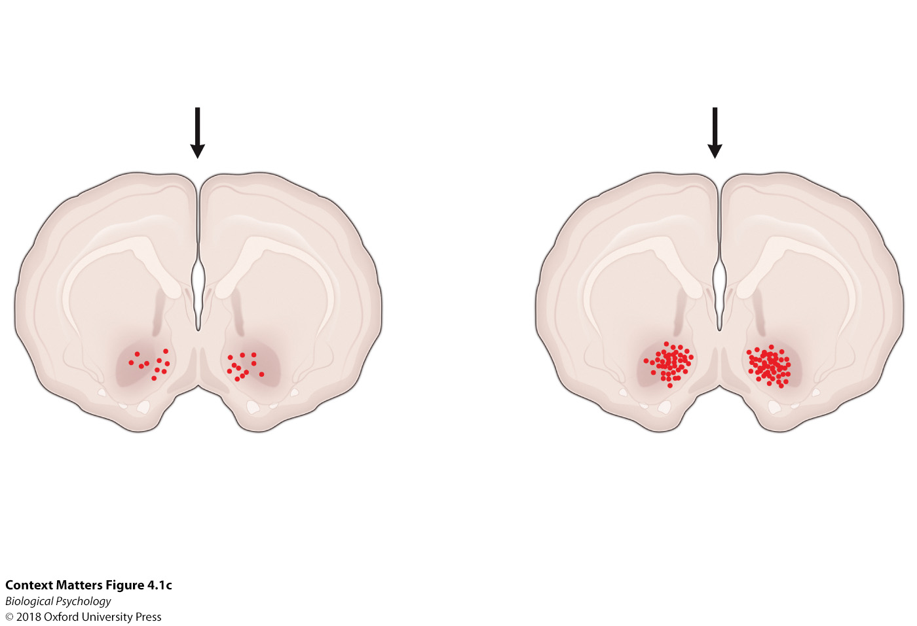
Fighting addiction with environmental enrichment

Slide 40
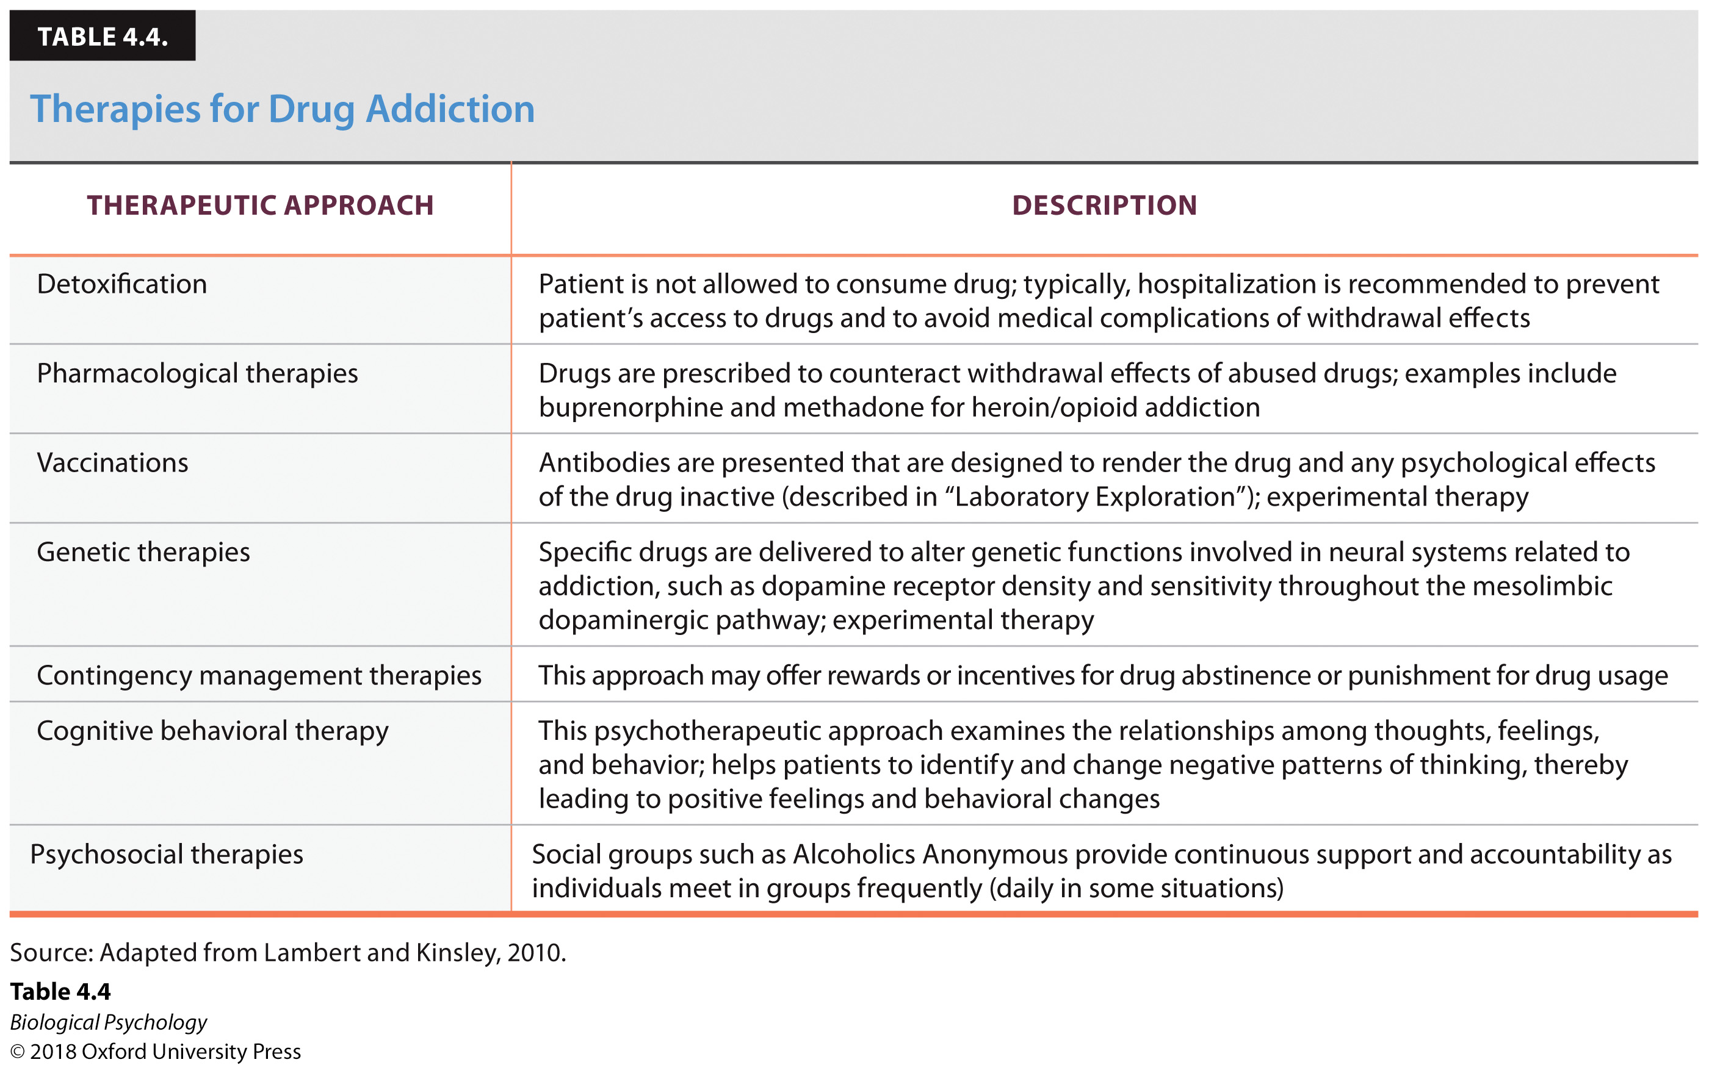
Drug addiction therapies

Slide 41
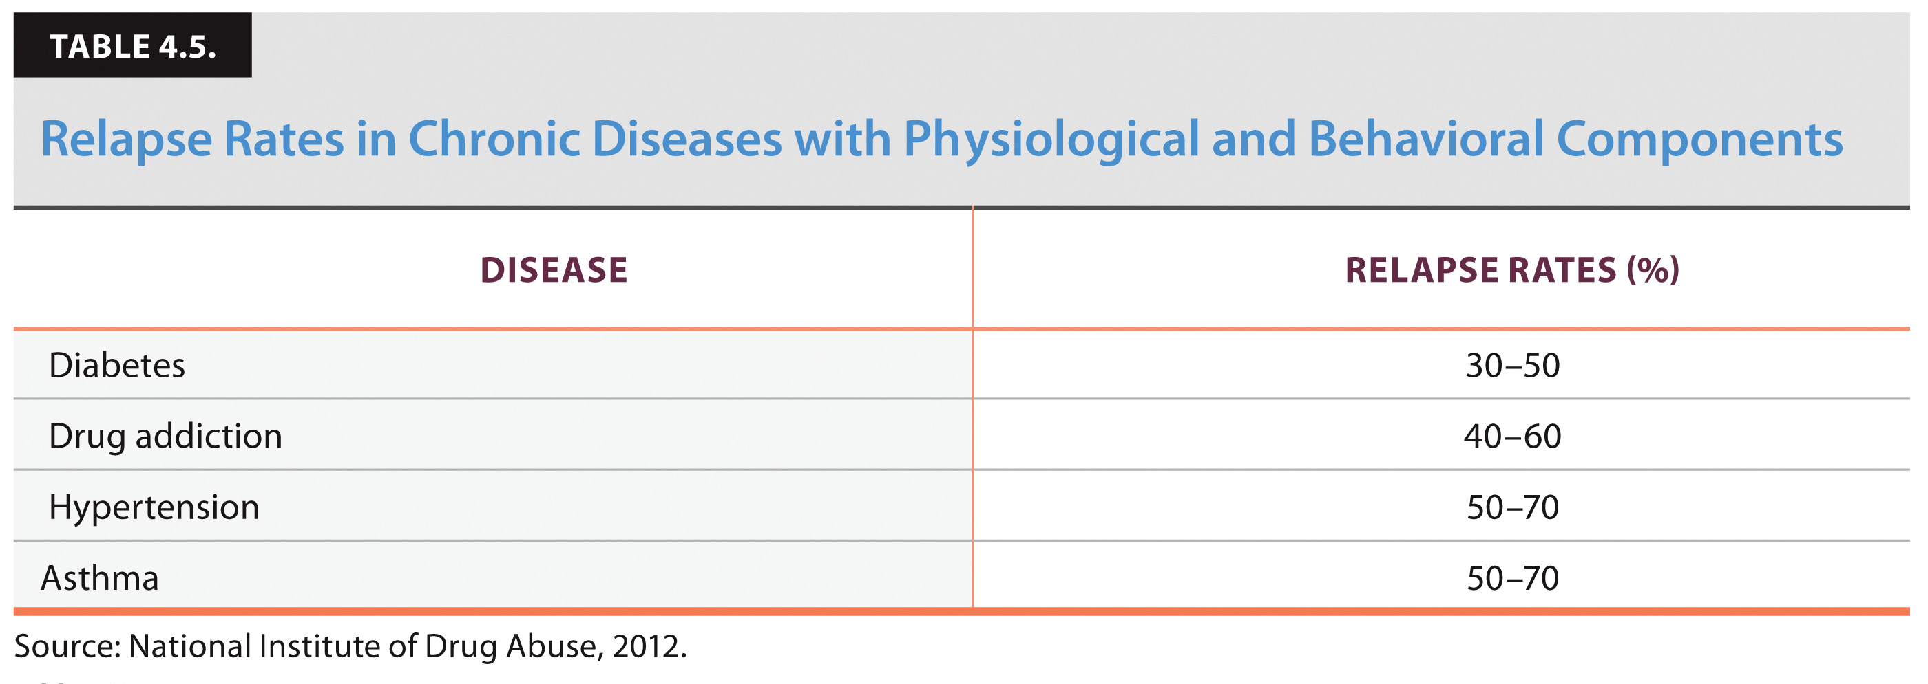
Relapse rates compared

Slide 42
Laboratory Exploration: A vaccine for nicotine
What are the ethics of vaccinating for addiction?
Who would decide who gets vaccinated?
Notes:
The concept of the nicotine vaccine involves the binding of the nicotine with the antibody so that the new complex is too large to cross the blood–brain barrier.

Slide 43
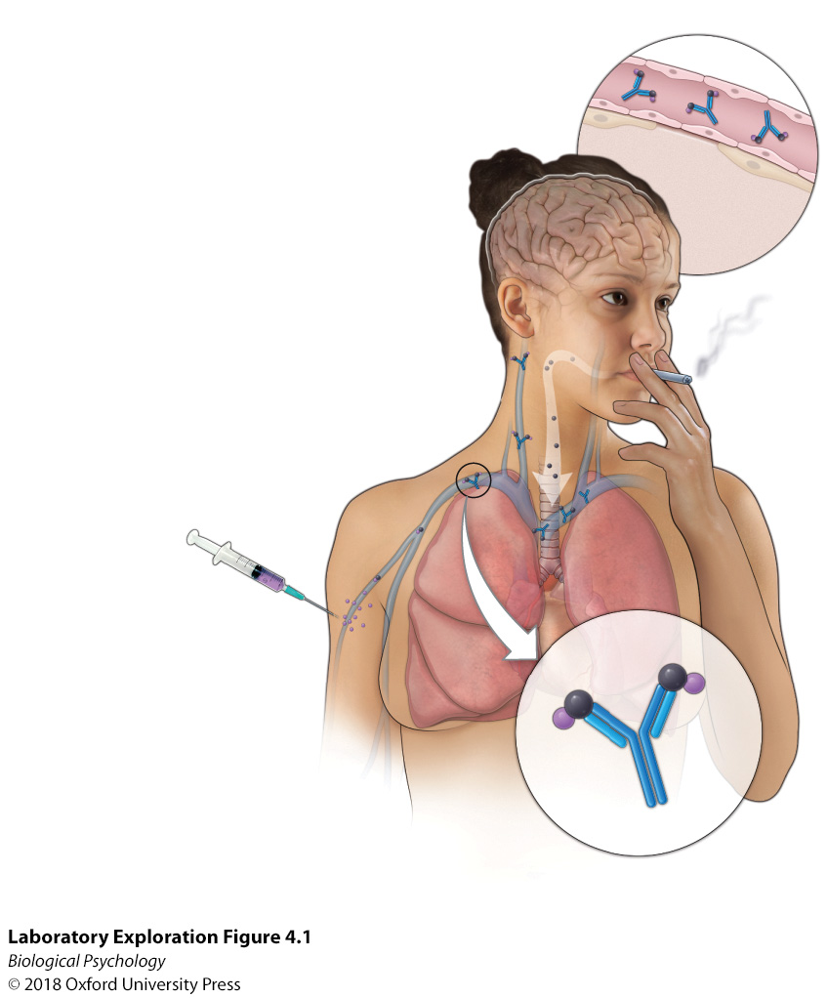
How would the vaccine work?
Notes:
The concept of the nicotine vaccine involves the binding of the nicotine with the antibody so that the new complex is too large to cross the blood–brain barrier.

