Slide 1


Slide 2
Chapter 3
Cells and circuits

Slide 3

Outline
Neurons: Structure and function
Neurons and glial cells: Collaborations
Lessons from Epilepsy: Neural transmission in review
Mirror neurons, specialized neural circuits, and investigations into ASd

Slide 4

Neurons: Structure and function
Microstructure
Resting membrane potential
Action potentials
Synaptic transmission

Slide 5
Neurons: Structure and function
Microstructure
  Axons
  Cell membranes
  Dendritic spines

Slide 6
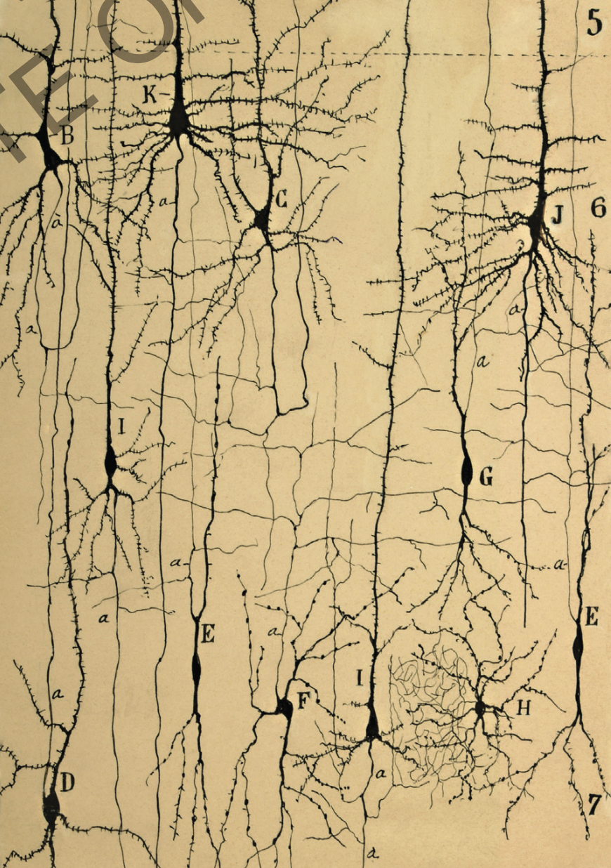
Neurons: Structure and function
Early drawings from Cajal
Notes:
Cajal’s drawings

Slide 7
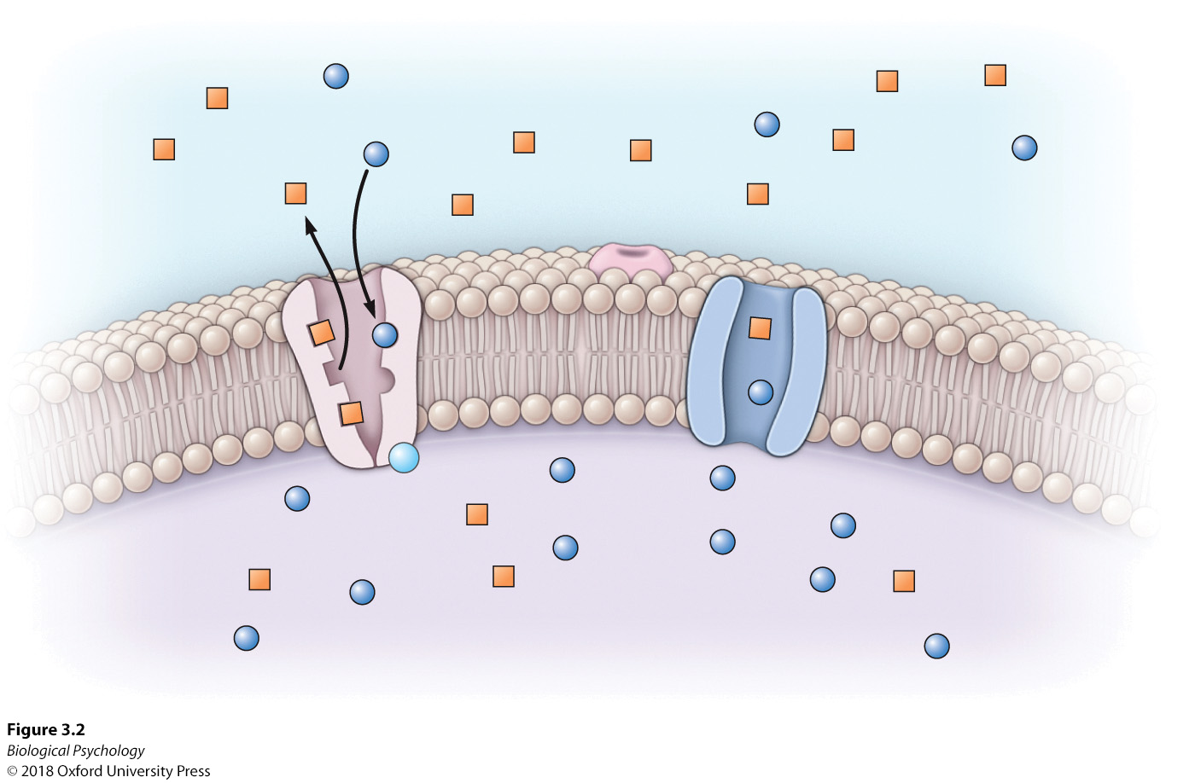
Neurons: Structure and function
Cell membrane
Notes:
The semipermeable cell membrane composed of a double layer of phospholipids and strategically placed sodium–potassium pumps contribute to the unequal distribution of sodium ions (Na+) and potassium ions (K+) inside and outside the cell.

Slide 8
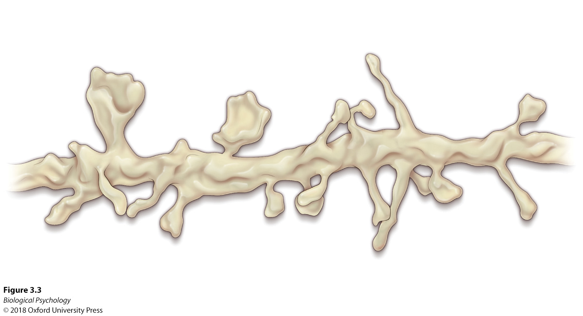
Neurons: Structure and function
Dendritic Spines
Notes:
Dendritic spines come in varied forms, most often categorized as stubby, thin, or mushroom shapes.

Slide 9
Neurons: Structure and function
How does stress affect neuronal structures?
Bystander Stress vs. actual stress
  The mere presence of another animal that had experienced stress
Notes:
Dendritic spines come in varied forms, most o en categorized as stubby, thin, or mushroom shapes.

Slide 10
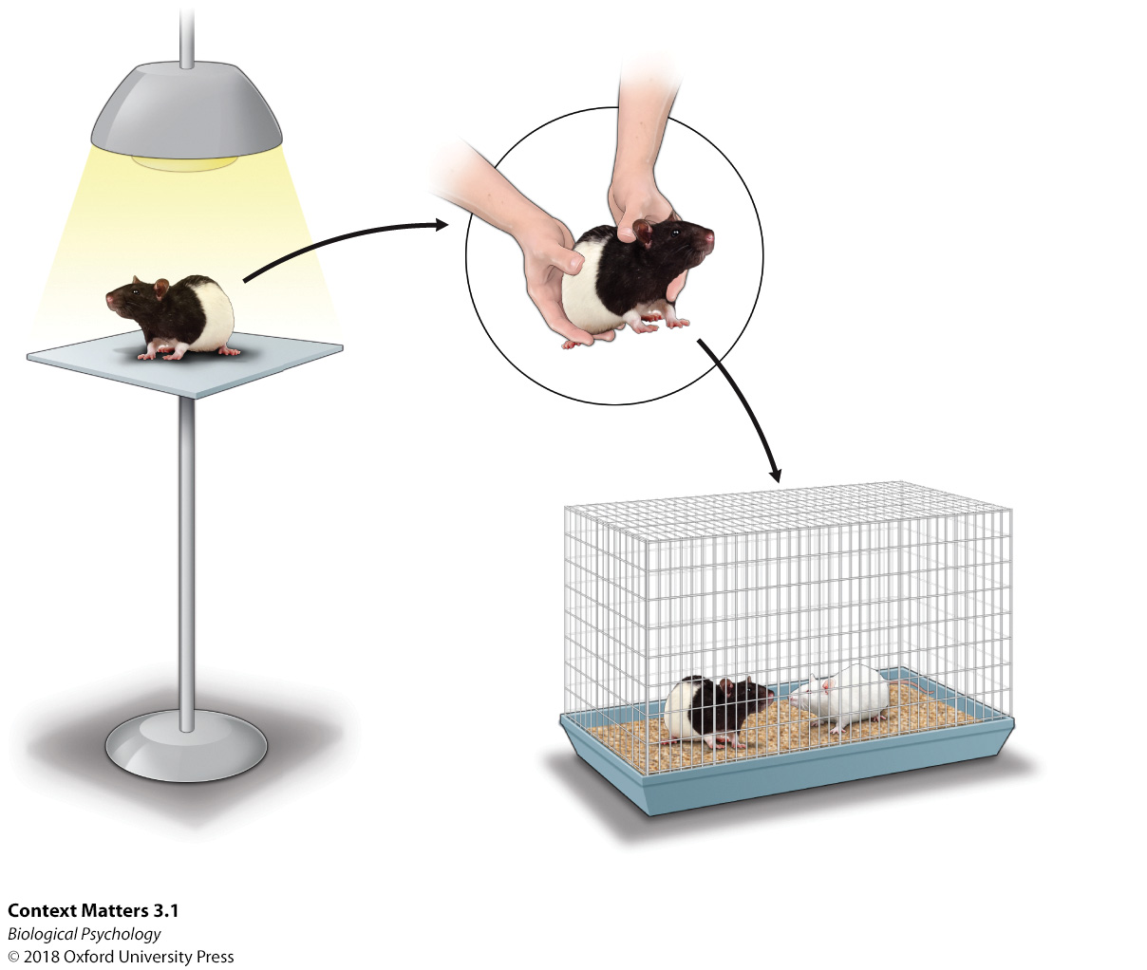
Neurons: Structure and function
Notes:
In this study, a rat was stressed by being placed on a small elevated platform under a bright light for two 30-minute sessions daily before
being placed back in the home cage with a pregnant cage-mate.

Slide 11
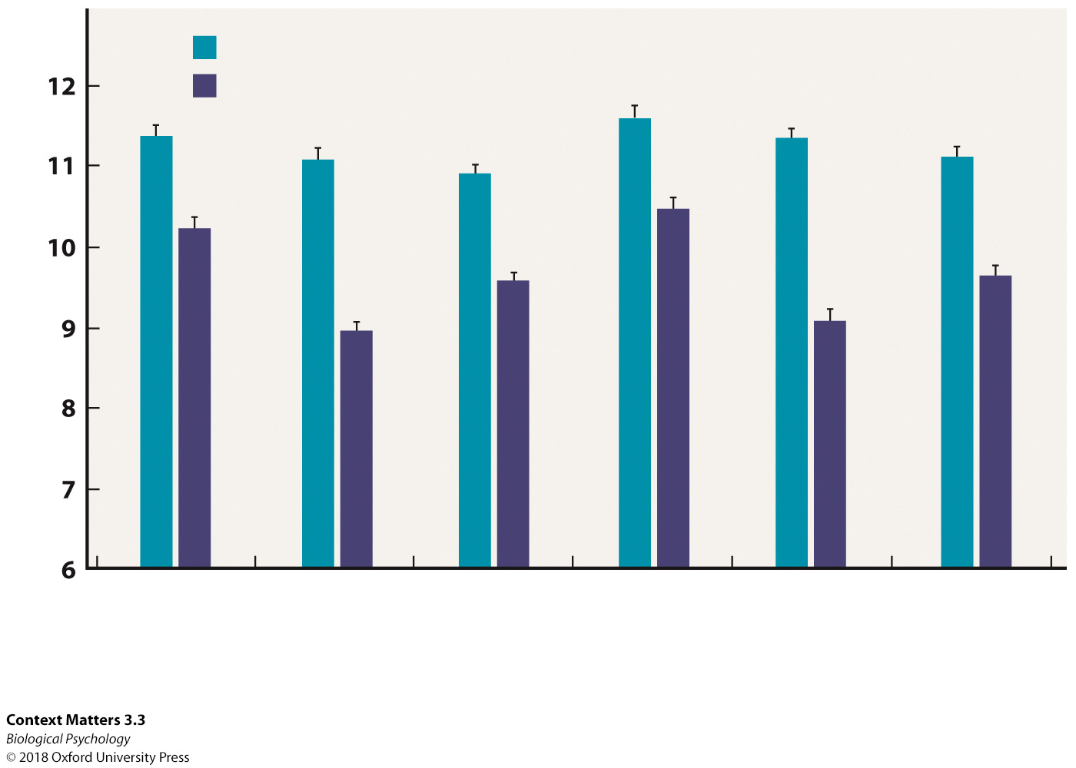
Neurons: Structure and function
Notes:
The bystander stress experienced by the pups’ mothers during pregnancy increased dendritic spines in the orbital prefrontal cortex, medial prefrontal cortex, and hippocampus in all groups, potentially increasing sites for synapses and altering the stress neural circuits.

Slide 12
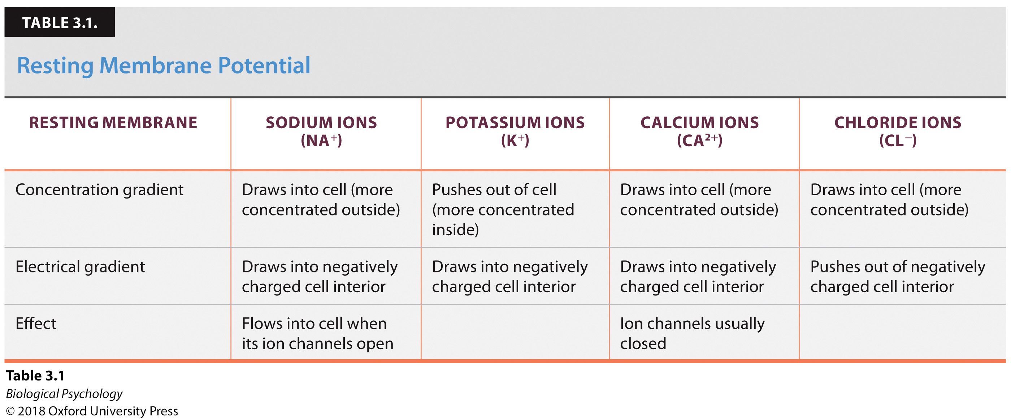
Neurons: Structure and function
Membrane resting potential
  -50 to -80 millivolts

Slide 13
Neurons: Structure and function
Membrane resting potential
  -50 to -80 millivolt
How is this balance maintained?

Slide 14
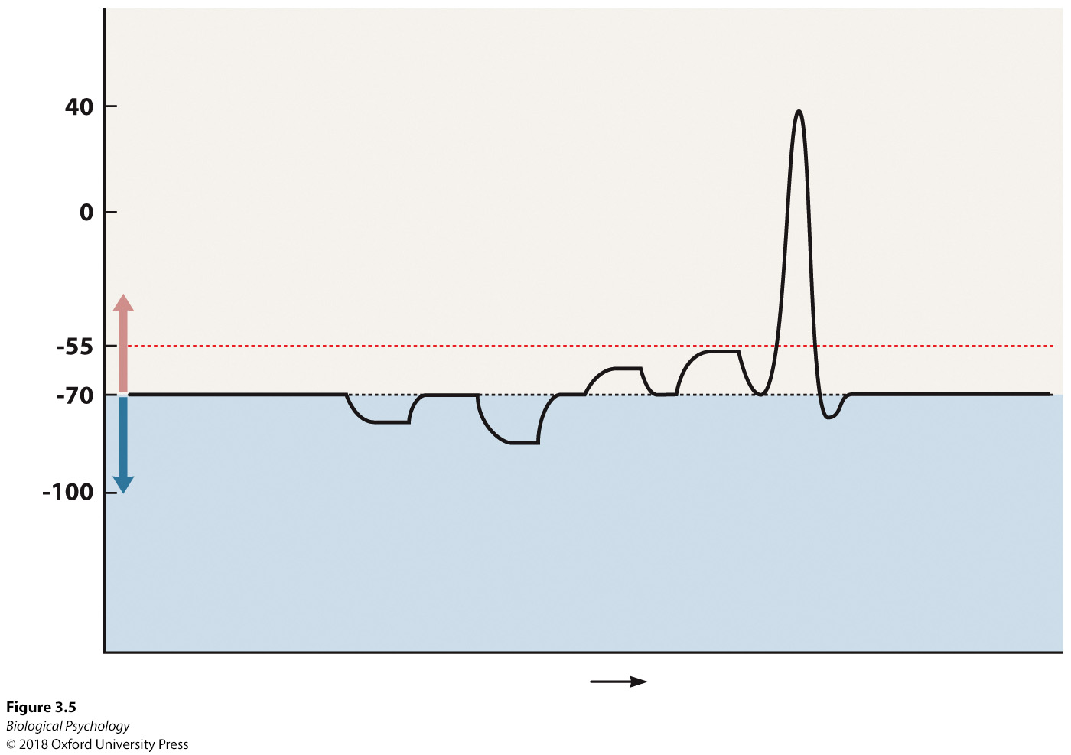
Neurons: Structure and function
Action Potential (nerve impulse)
  All or none
Notes:
The membrane potential must depolarize to a specific threshold level before an action potential is activated

Slide 15
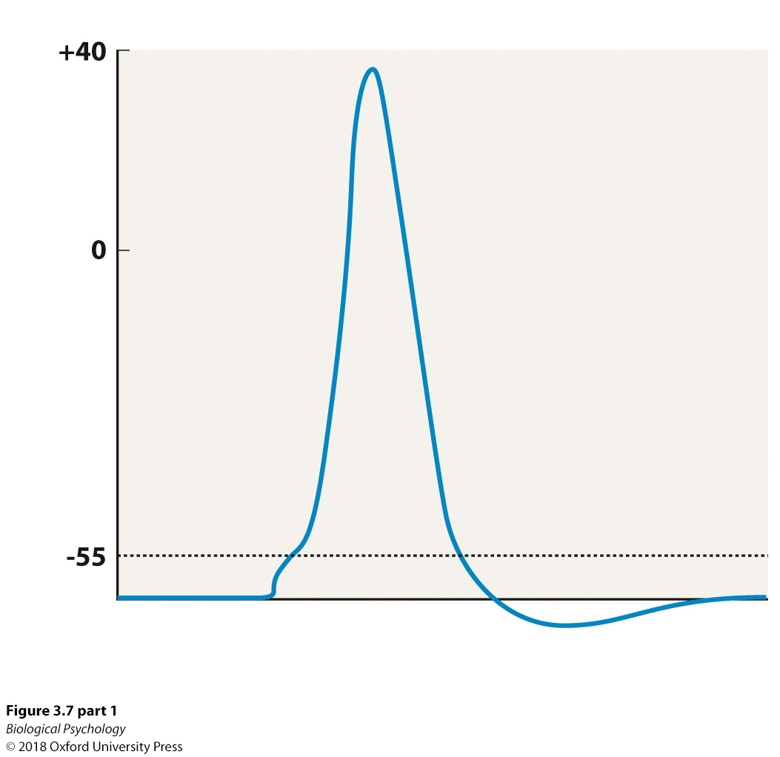
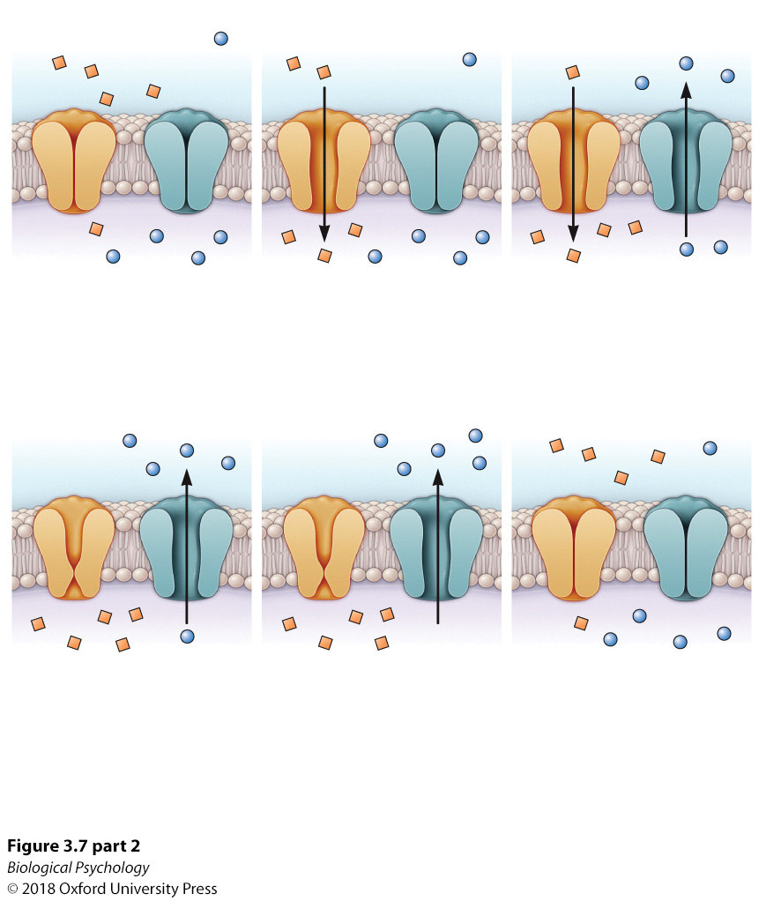
Neurons: Structure and function
Notes:
Stages during action potential

Slide 16
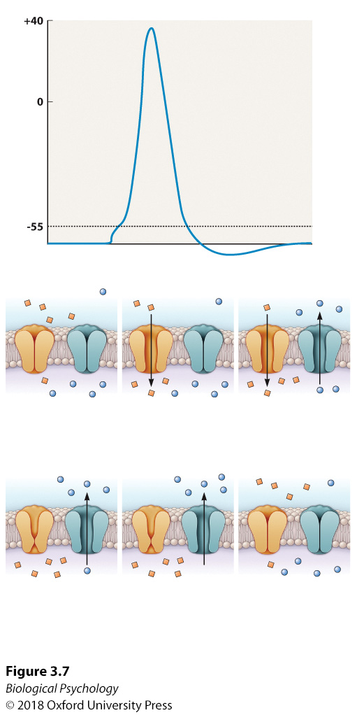
Neurons: Structure and function
Notes:
Stages during action potential

Slide 17
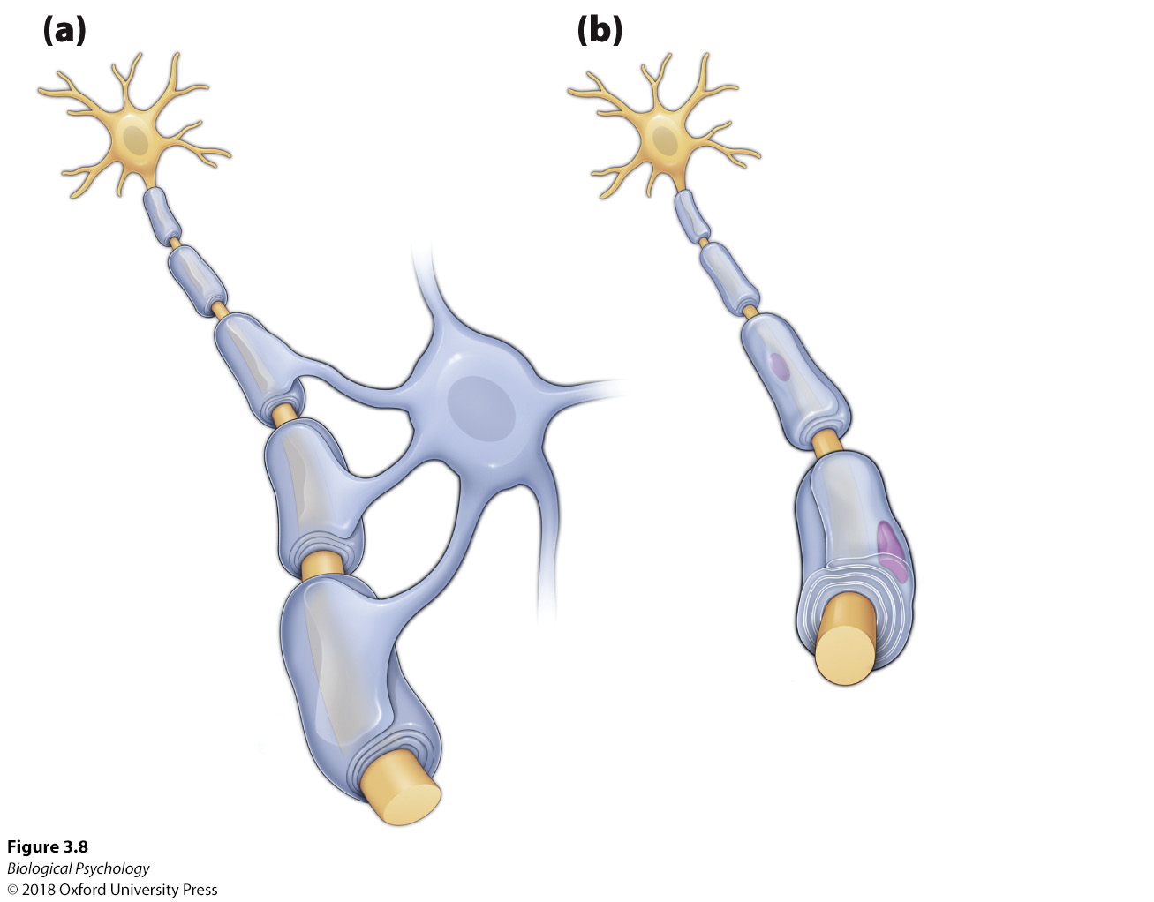
Neurons: Structure and function
Myelin sheath structure
Notes:
Specialized glial cells form the myelin sheath. (a) Oligodendroglia processes create segments of the central nervous system myelin sheath. (b) Schwann cells wrap around the neural processes to form individual segments of the peripheral nervous system myelin sheath.

Slide 18
Neurons: Structure and function
How does information transfer between neurons?
  Six easy steps
Notes:
Specialized glial cells form the myelin sheath. (a) Oligodendroglia processes create segments of the central nervous system myelin sheath. (b) Schwann cells wrap around the neural processes to form individual segments of the peripheral nervous system myelin sheath.

Slide 19
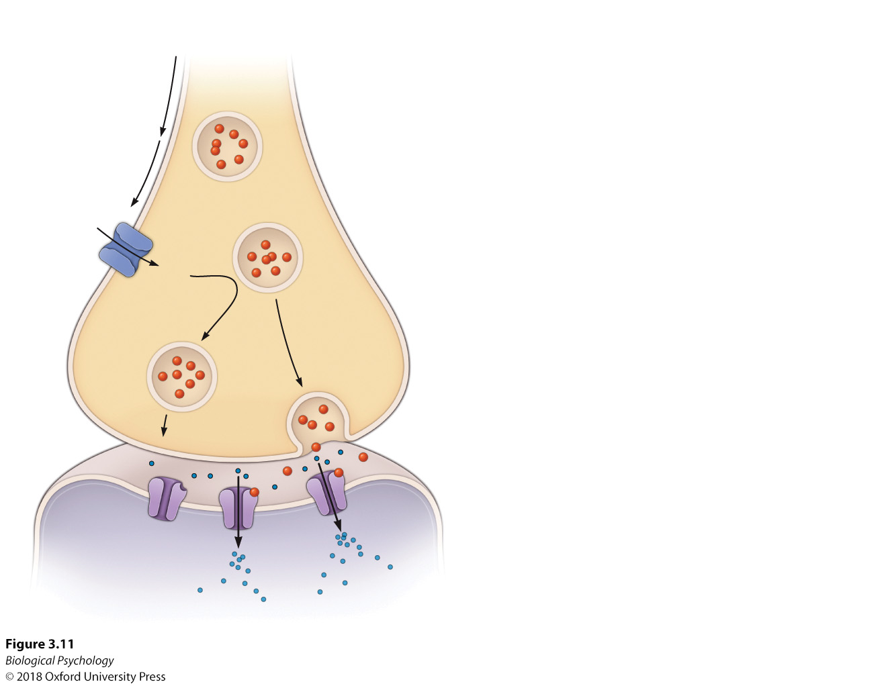
Neurons: Structure and function
Notes:
Specialized glial cells form the myelin sheath. (a) Oligodendroglia processes create segments of the central nervous system myelin sheath. (b) Schwann cells wrap around the neural processes to form individual segments of the peripheral nervous system myelin sheath.

Slide 20
Neurons: Structure and function
How do we get depolarized in the first place?
  Temporal summation
  Spatial summation

Slide 21
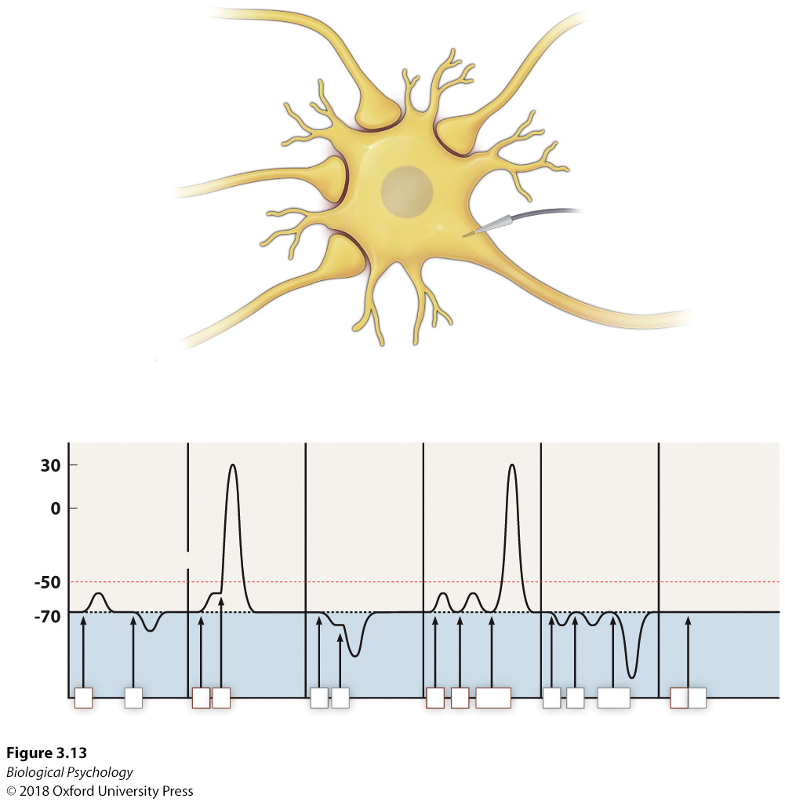
Neurons: Structure and function
Notes:
Spatial summation requires multiple presynaptic neurons each altering the membrane potential. Temporal summation involves rapid firing of presynaptic neurons that build on graded potentials to depolarize toward the action potential threshold. Spatial / temporal summation can either depolarize (EPSP) or hyperpolarize (IPSP) the membrane

Slide 22
Neurons & Glial Cells: Collaborations
Astrocytes
  Monitor and control levels of ions in the extracellular space
  Possess receptors for many neurotransmitters
  Facilitate synaptogenesis
Schwann cells
  Axonal regrowth in PNS
Oligodendrocytes
  Role in major depression

Slide 23
Epilepsy as synchronized excitability
Persist from seconds to minutes.
Partial seizures originate in a localized area
Generalized seizures originate in distributed area

Slide 24
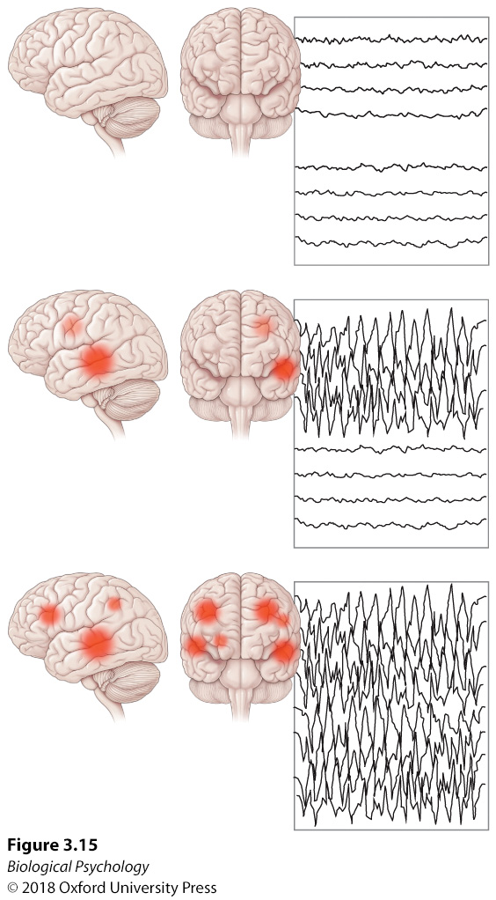
Epilepsy: EEG
Notes:
In partial and generalized seizures, desynchronized brain waves are prevalent in either specific or global brain areas.

Slide 25
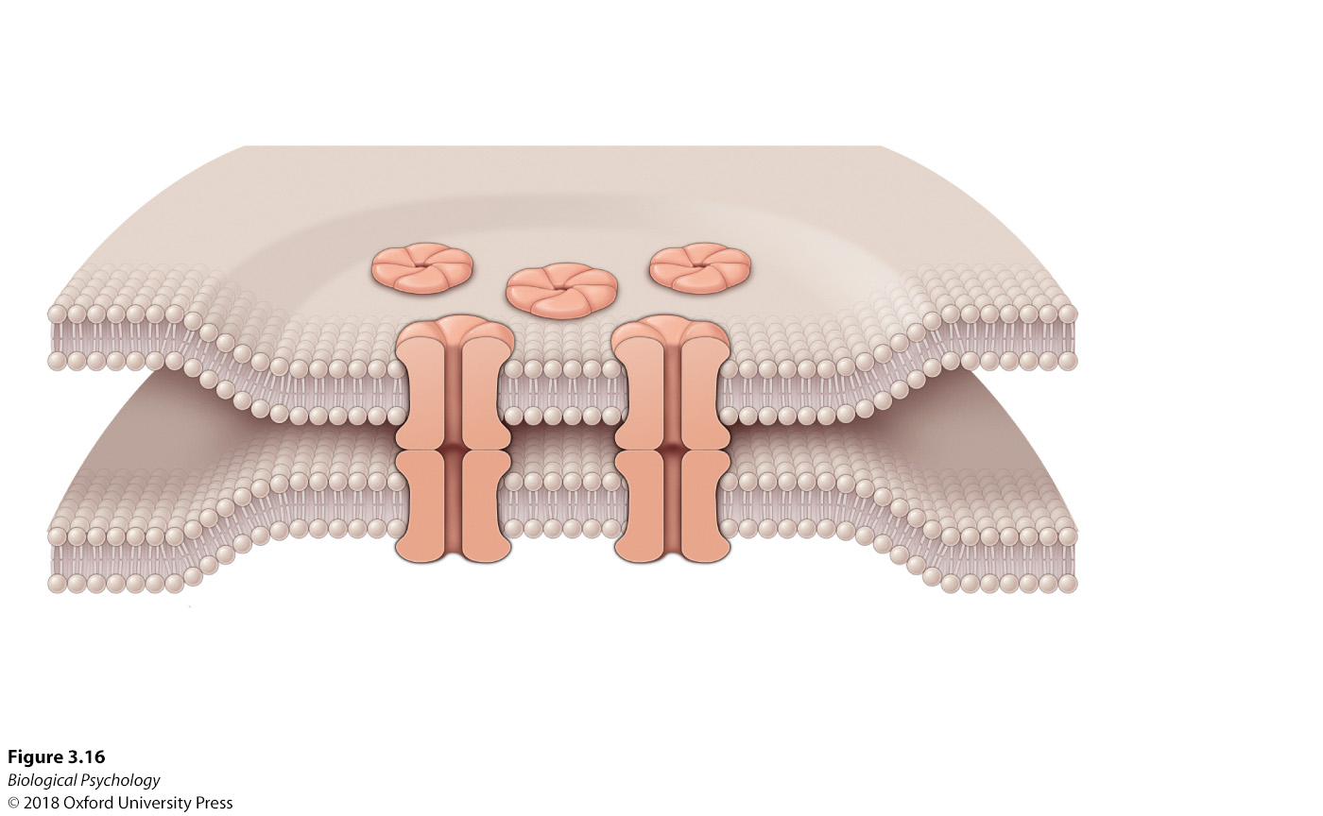
General synchronization mechanism
Gap junctions
Notes:
Electrical currents are exchanged through gap junctions, resulting in alterations in membrane potential.

Slide 26
How to treat epilepsy
Drugs to dampen excitability
  Which neurotransmitter(s) should be targeted?
Surgery
  Stop activity from spreading
  Remove affect region (small or large)

Slide 27
Mirror Neurons
Neurons that respond when engaging in a behavior and when observing that behavior

Slide 28
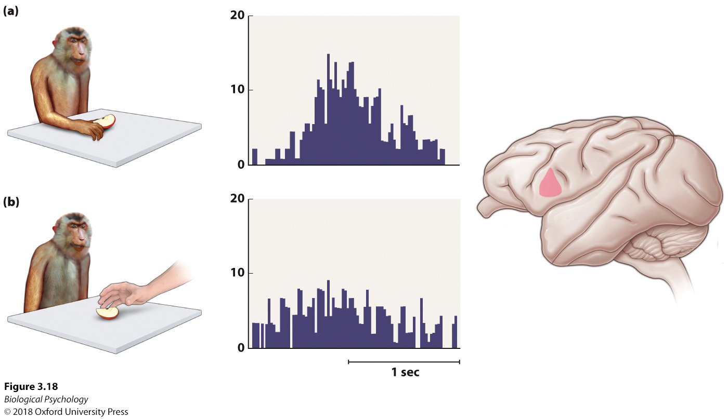
Mirror Neurons: non-human primates
Notes:
Similar neuronal activation is seen in the inferior frontal cortex in two situations. (a) the monkey grabs food itself. (b) the monkey watches an experimenter grasp food.

Slide 29
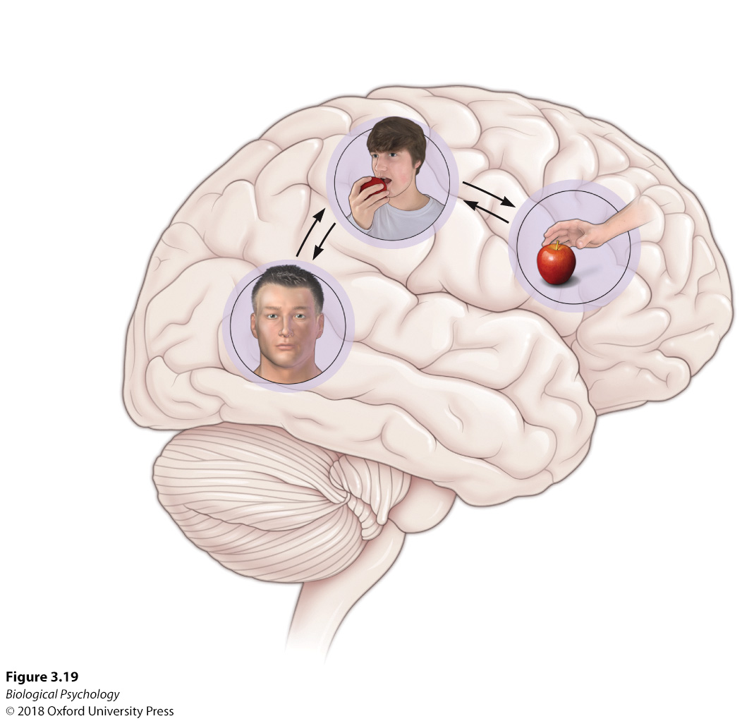
Mirror Neurons: Humans
Notes:
Specific components of the proposed mirror neuron system contribute to the perception of the actor’s movements and intentions in the observer’s brain.

Slide 30
Mirror Neurons: associative sequence learning model
Infants see their parents’ faces and imitate the expressions
Co-activation of sensory and motor neurons
Mirror neurons then fire to either sensory or motor

Slide 31
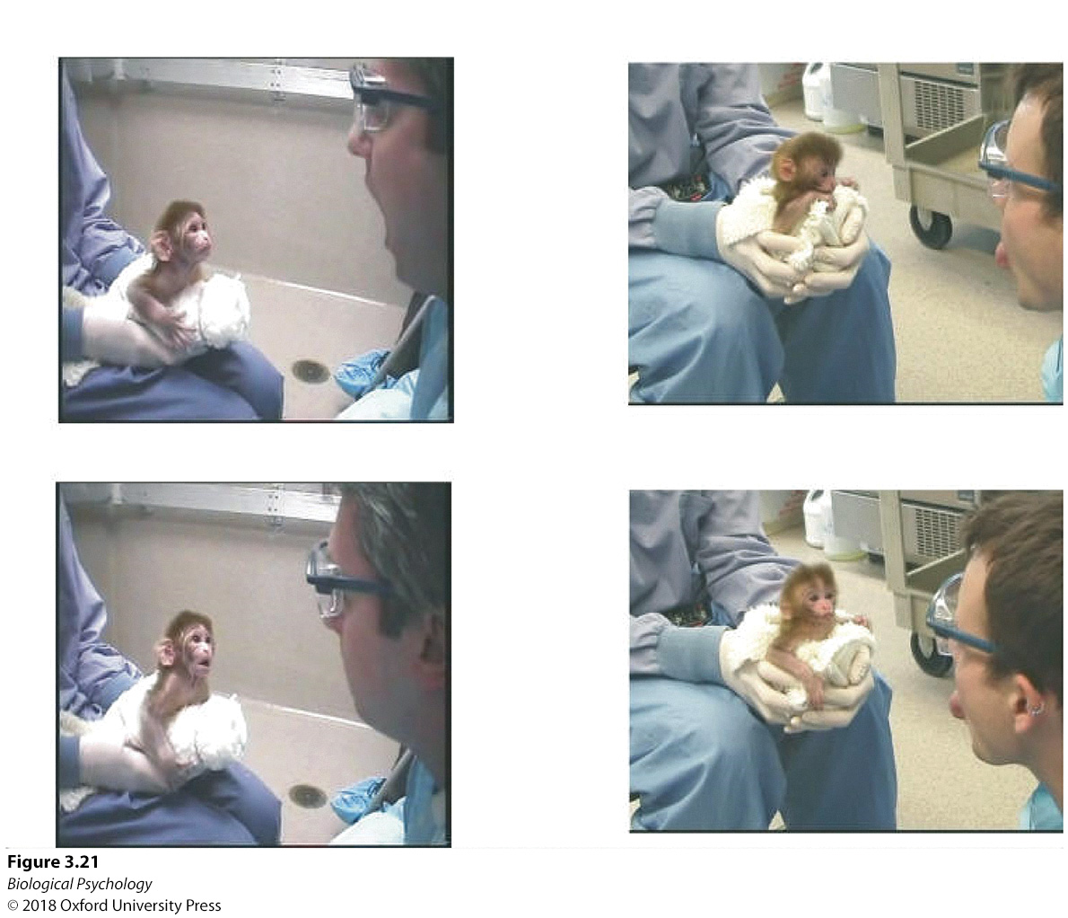
Mirror Neurons: associative sequence learning model
Notes:
The young monkey imitates the facial expressions of the human experimenter, including (a) open mouth and (b) tongue protrusion.

Slide 32
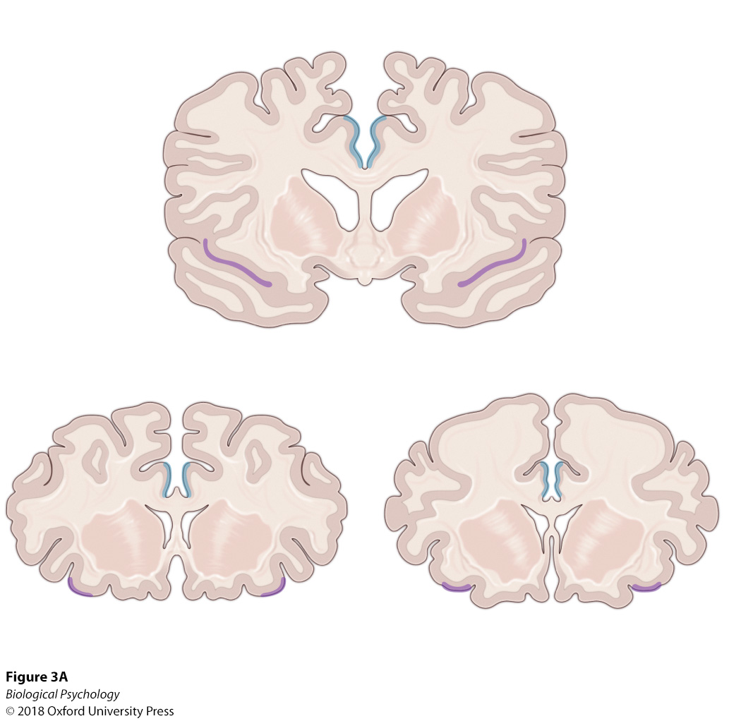
Mirror Neurons
Sensitivity to “intention” (context)
Notes:
The mirror neuron system is sensitive to varying intentions accompanying similar motor actions. The orange juice in the glass is associated with the intention of drinking, whereas the empty glass is associated with cleaning.

Slide 33
Mirror Neurons
What about developmental disorders that show deficits in “perspective taking” or “theory of mind” ?
Could mirror neurons play a role?
How would you test this hypothesis?

Slide 34
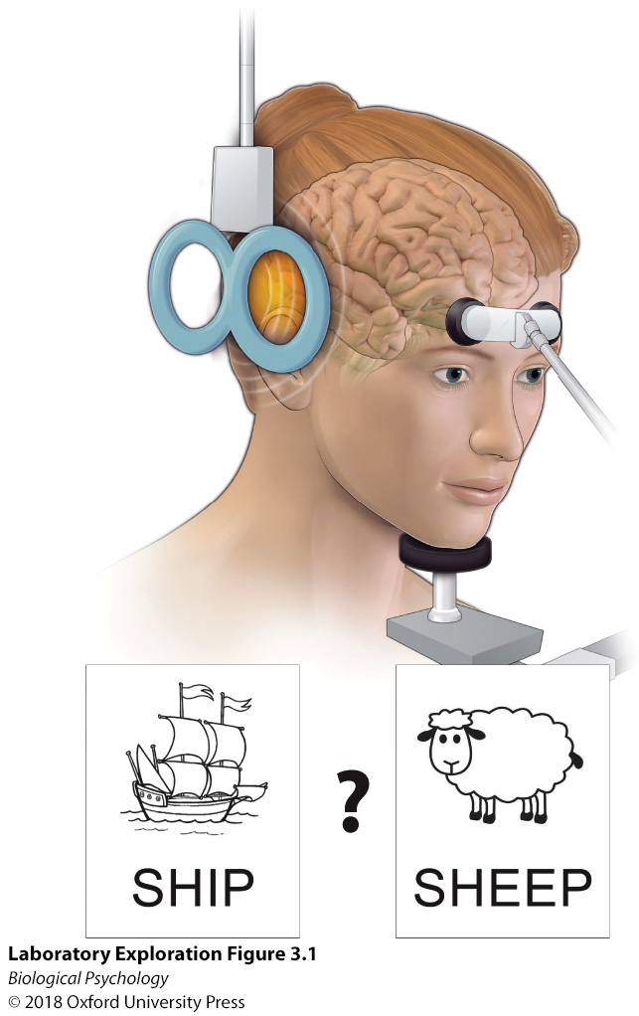
Transcranial magnetic stimulation
Passing electrical current through the coil causes a strong magnetic wave to enter the cortex under the coil, disrupting processing.
How might a researcher use TMS to test the causal relationship between motor areas of the brain involved in speaking and the sensory regions involved in hearing?

