Slide 1
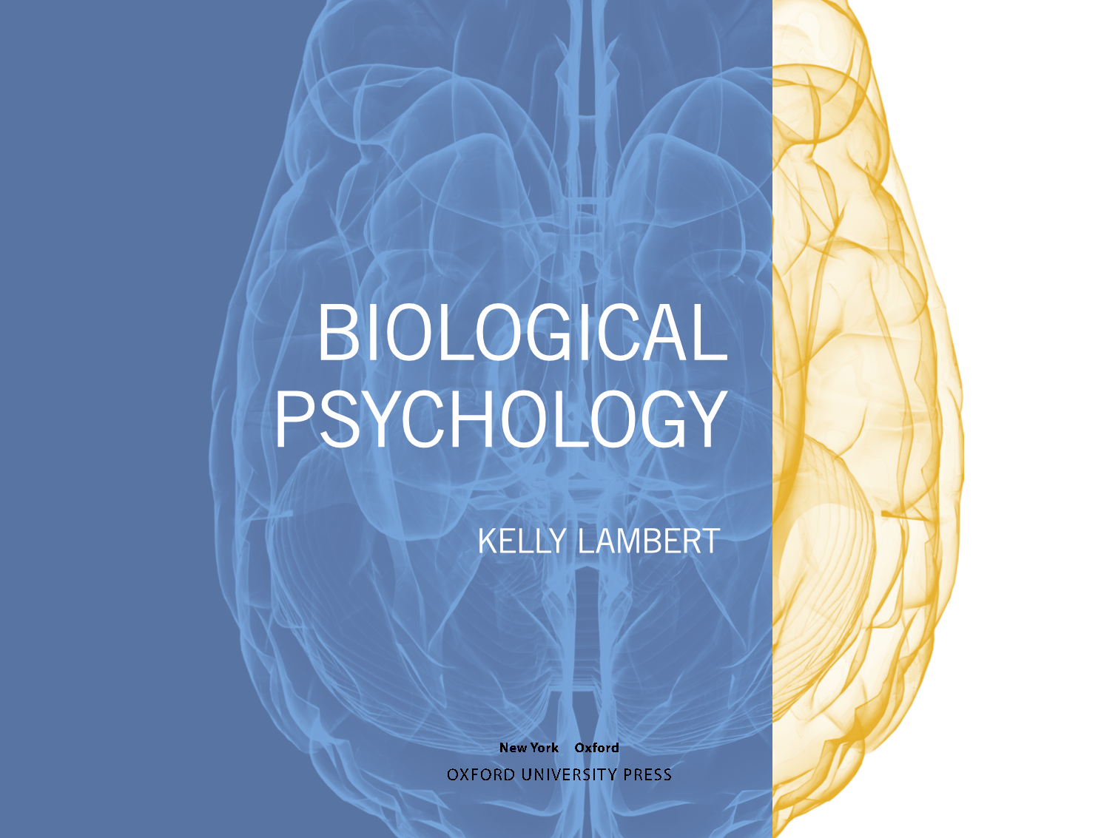

Slide 2
Chapter 2
The Nervous System: Structure and Function

Slide 3

Outline
The building blocks of the nervous system
Divisions of labor in the nervous system
The brain’s geography
Brain lateralization
CNS security systems

Slide 4

Building Blocks
Neurons: fundamental unit of the nervous system
Glial cells: typically relegated to a support role

Slide 5
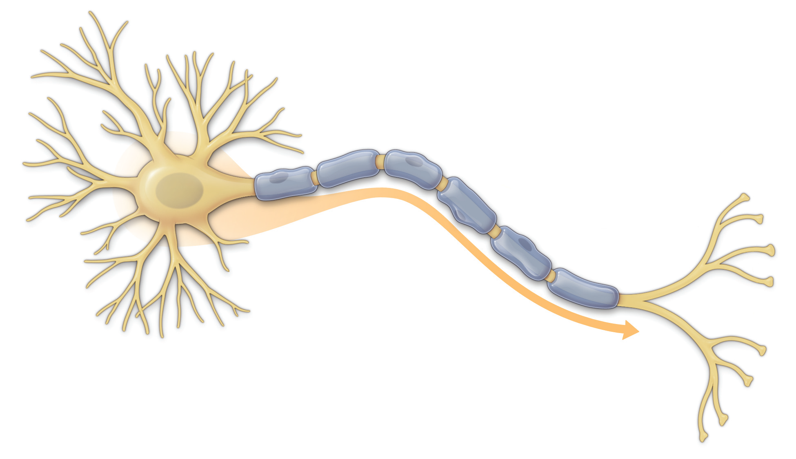
Building Blocks: Neurons
Notes:
The neural impulse travels from the dendrites of the cell body down the axon and from the terminal branches of the axon to neighboring neurons. The myelin sheath covering the axon helps speed the progress of the neural impulse.

Slide 6
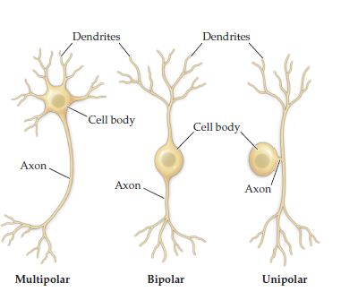
Building Blocks: Neurons
Not all neurons look the same
Notes:
The number of processes extending from the cell body determine whether the neuron is unipolar, bipolar, or multipolar.

Slide 7
Building Blocks: Glial Cells
Astrocytes (transporter/protector)
Microglia (first responders)
Oligodendrocytes (CNS myelin)
Schwann cells (PNS myelin)

Slide 8
Building Blocks: Glial Cells
Notes:
neuronal cell bodies are shown in red and astrocytes in green.

Slide 9
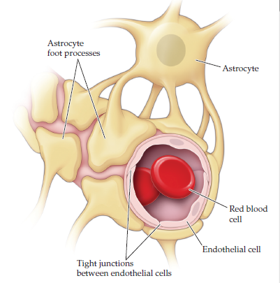
Building Blocks: Glial Cells
Astrocytes help with the blood-brain barrier
Notes:
Astrocytes and endothelial cells with tight junctions are positioned on blood vessels in the nervous system to prevent the blood and any accompanying substances from reaching the cells of the nervous system

Slide 10
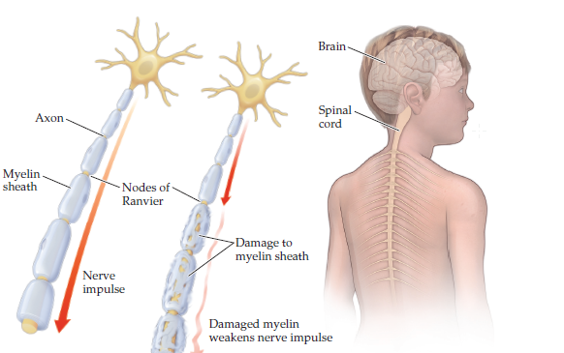
Building Blocks: Glial Cells
Notes:
The myelin sheath is damaged in patients with multiple sclerosis, an effect that compromises neural functions.

Slide 11
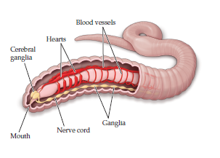
Divisions of labor in the nervous system
Vertebrates have a more centralized nervous system

Slide 12
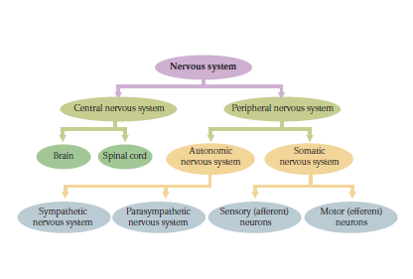
Divisions of labor in the nervous system

Slide 13
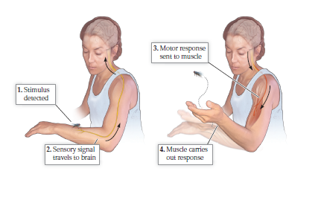
Divisions of labor in the nervous system
Central vs. peripheral nervous system
Afferent vs. efferent nerves

Slide 14
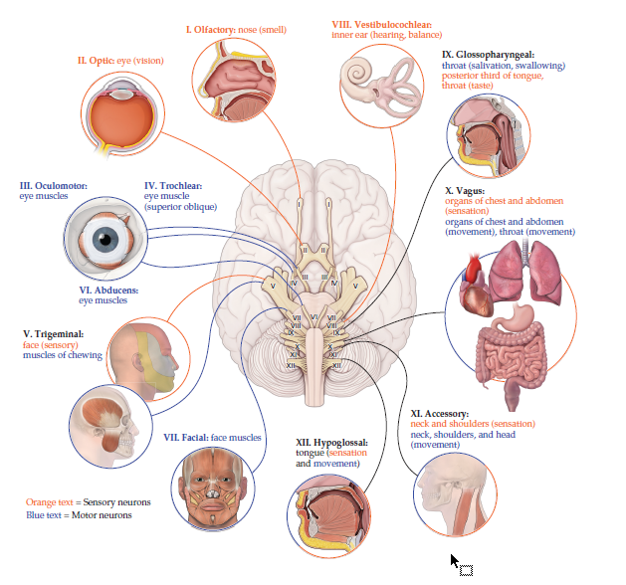
Divisions of labor in the nervous system: Cranial Nerves
Notes:
Cranial nerves are primarily involved with functions associated with the head, neck, and shoulders. The vagus nerve extends further

Slide 15
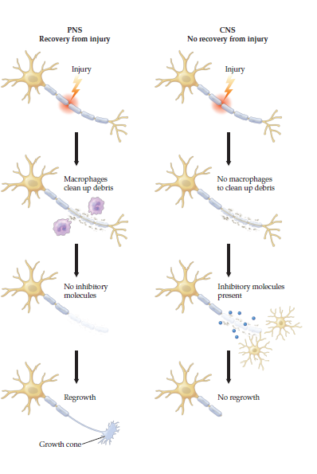
Divisions of labor in the nervous system
Notes:
Regrowth of damaged axons occurs in the peripheral nervous system (PNS) but not in the central nervous system (CNS); research is focused on identify- ing aspects of PNS recovery that may be applied to CNS recovery.

Slide 16
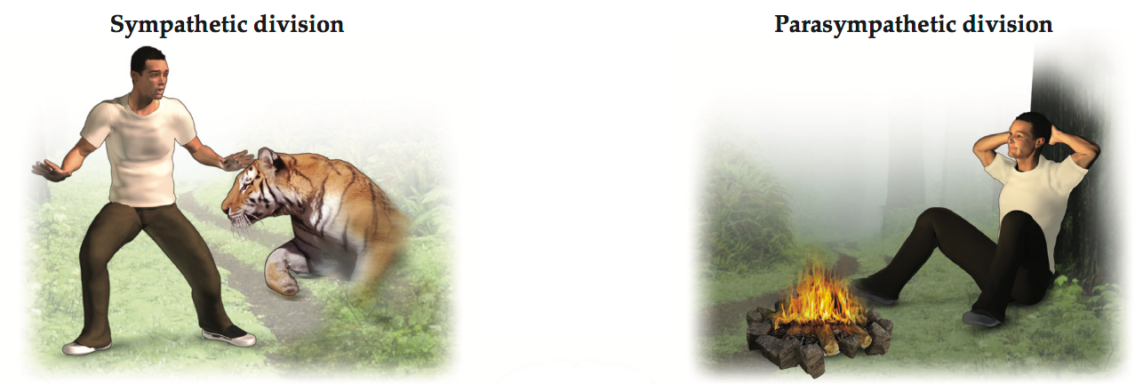
Divisions of labor in the nervous system: PNS
Fight or flight
Rest and digest
Think of equal and opposite physiological responses for each system

Slide 17
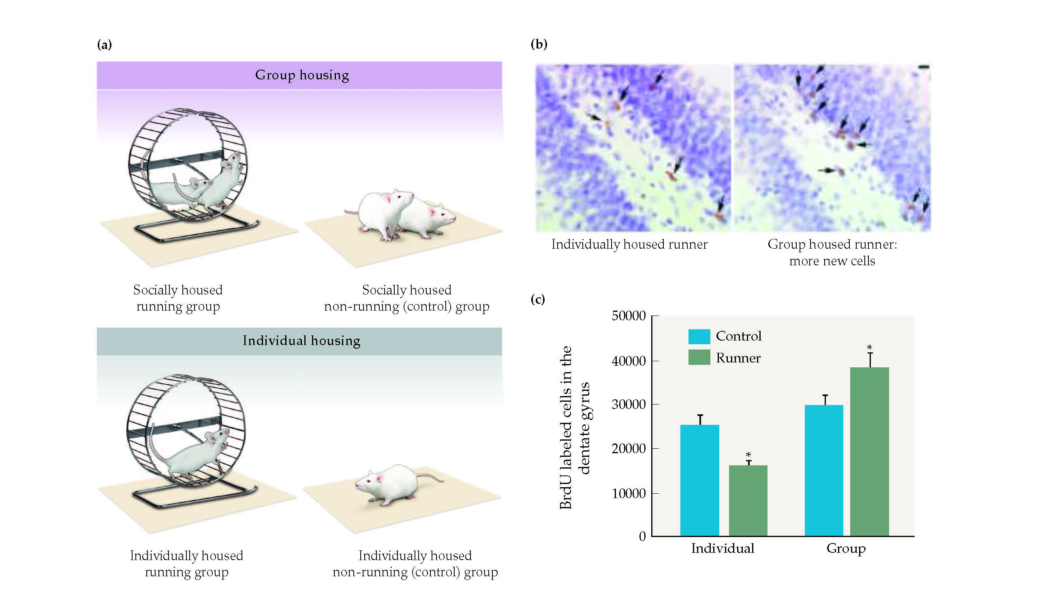
Making new neurons?
Can the presence of others impact neurogenesis?
Notes:
(a) Rats were initially assigned to either a social or an isolated group and then assigned to a running or control group. (b) Following bromodeoxyuridine injections that marked new neurons, the brains of the rats were examined for the presence of newly divided cells, or neurogenesis. (c) e results indicated that the social runners experienced the highest rates of neurogenesis

Slide 18
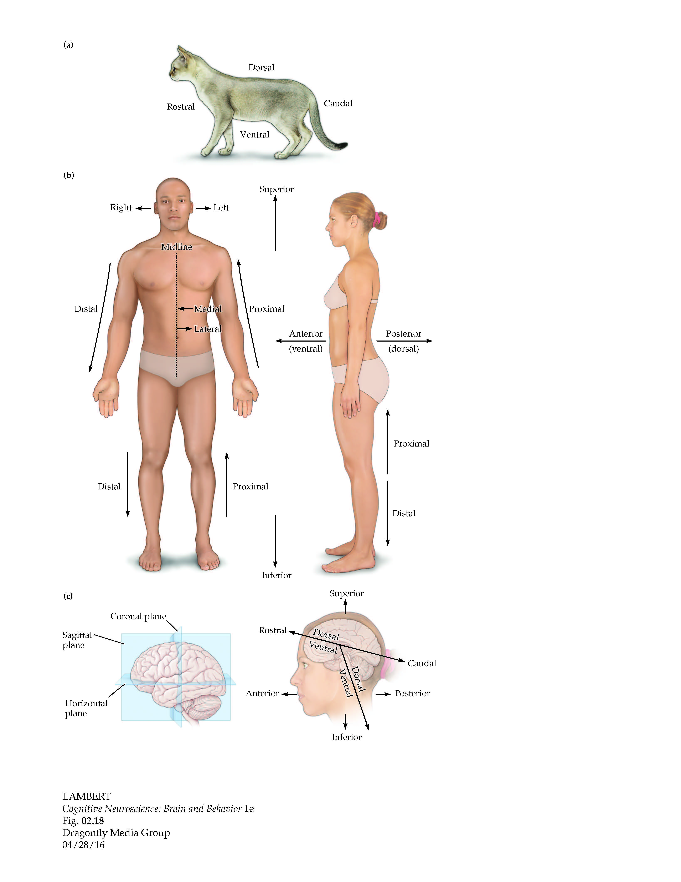
The brain’s geography

Slide 19
The brain’s geography

Slide 20
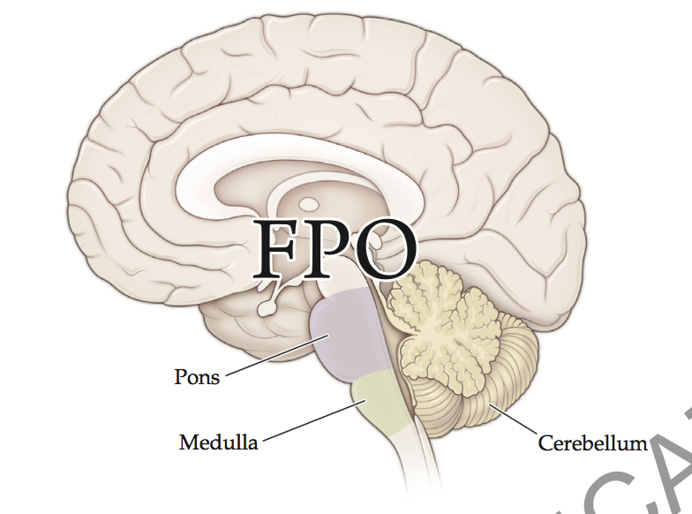
The brain’s geography: Hindbrain
Glandular secretions
Breathing
Arousal
Muscle tone

Slide 21
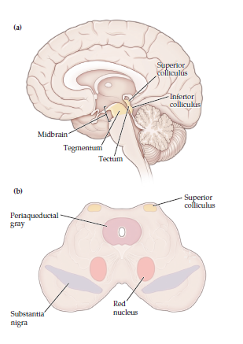
The brain’s geography: Hindbrain
Interaction between sensory and motor information

Slide 22
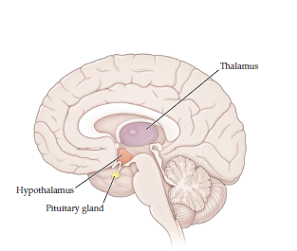
The brain’s geography: Diencephalon
Thalamus (sensory input)
Hypothalamus (motivational systems)
Pituitary gland (hormone release)

Slide 23
The brain’s geography: Diencephalon
Thalamus (sensory input)
Hypothalamus (motivational systems)
Pituitary gland (hormone release)

Slide 24
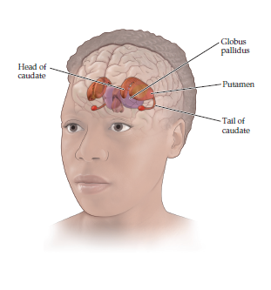
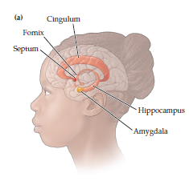
The brain’s geography: Telencephalon
Basal ganglia: motor functions
Limbic system: emotional regulation
Subcortical telencephalon
Notes:
basal ganglia are primarily involved in motor functions
Limbic system: mo- tional regulation

Slide 25
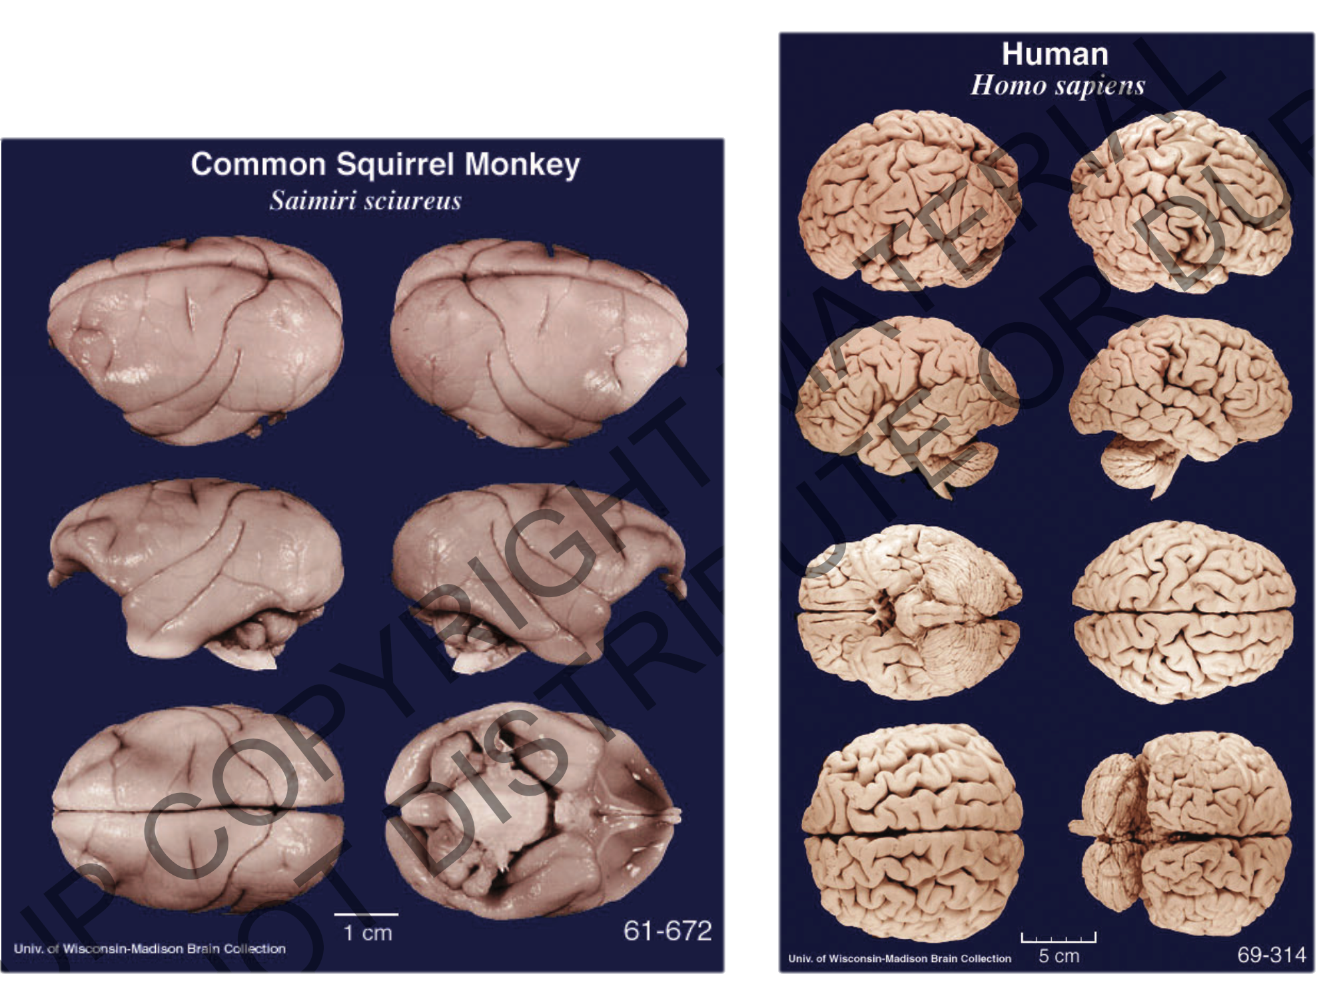
The brain’s geography: Telencephalon
Cerebral cortex
Notes:
humans have a disproportionately large cerebral cortex.

Slide 26
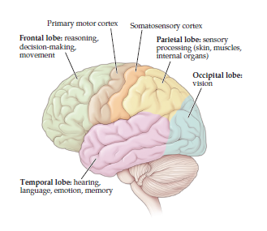
The brain’s geography: Telencephalon

Slide 27
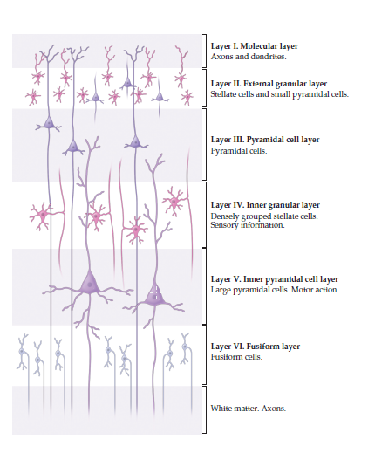
The brain’s geography: Telencephalon
Notes:
6 layers of the cortex

Slide 28
The brain’s geography: Telencephalon
Notes:
6 layers of the cortex

Slide 29
Brain lateralization
There are two hemispheres, they look structurally similar
How can we test for functional differences?
Key term: contralateral control

Slide 30
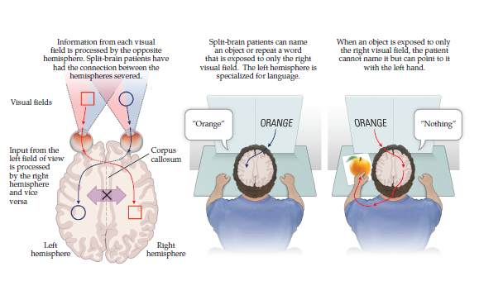
Brain lateralization

Slide 31
Brain lateralization
Left hemisphere may be more dominant language
Right hemisphere may be more dominant for moral reasoning
How might you test these claims in nonhuman animals?

Slide 32
CNS Security Systems
How can the brain
  Regulate its internal environment?
  Protect against outside threats? (both in the external environment and the internal one!)
  Determine what is an outside threat?

Slide 33
CNS Security Systems
How can the brain
  Regulate its internal environment?
  Protect against outside threats? (both in the external environment and the internal one!)
  Determine what is an outside threat?

Slide 34
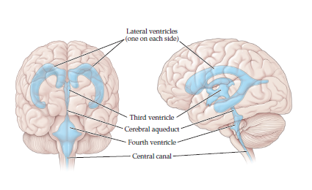
CNS Security Systems
Notes:
CSF helps provide the appropriate chemical environment for the brain’s cells

Slide 35
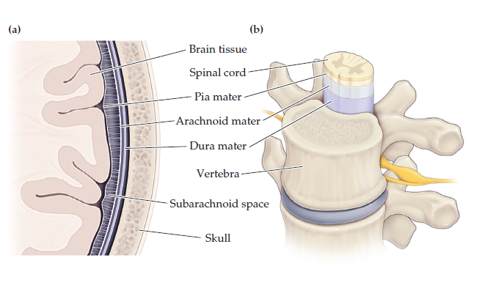
CNS Security Systems
Notes:
The brain is protected by the meninges and cerebrospinal fluid filling the space between the meninges and skull
The vertebrae provide further protection for the spinal cord

Slide 36
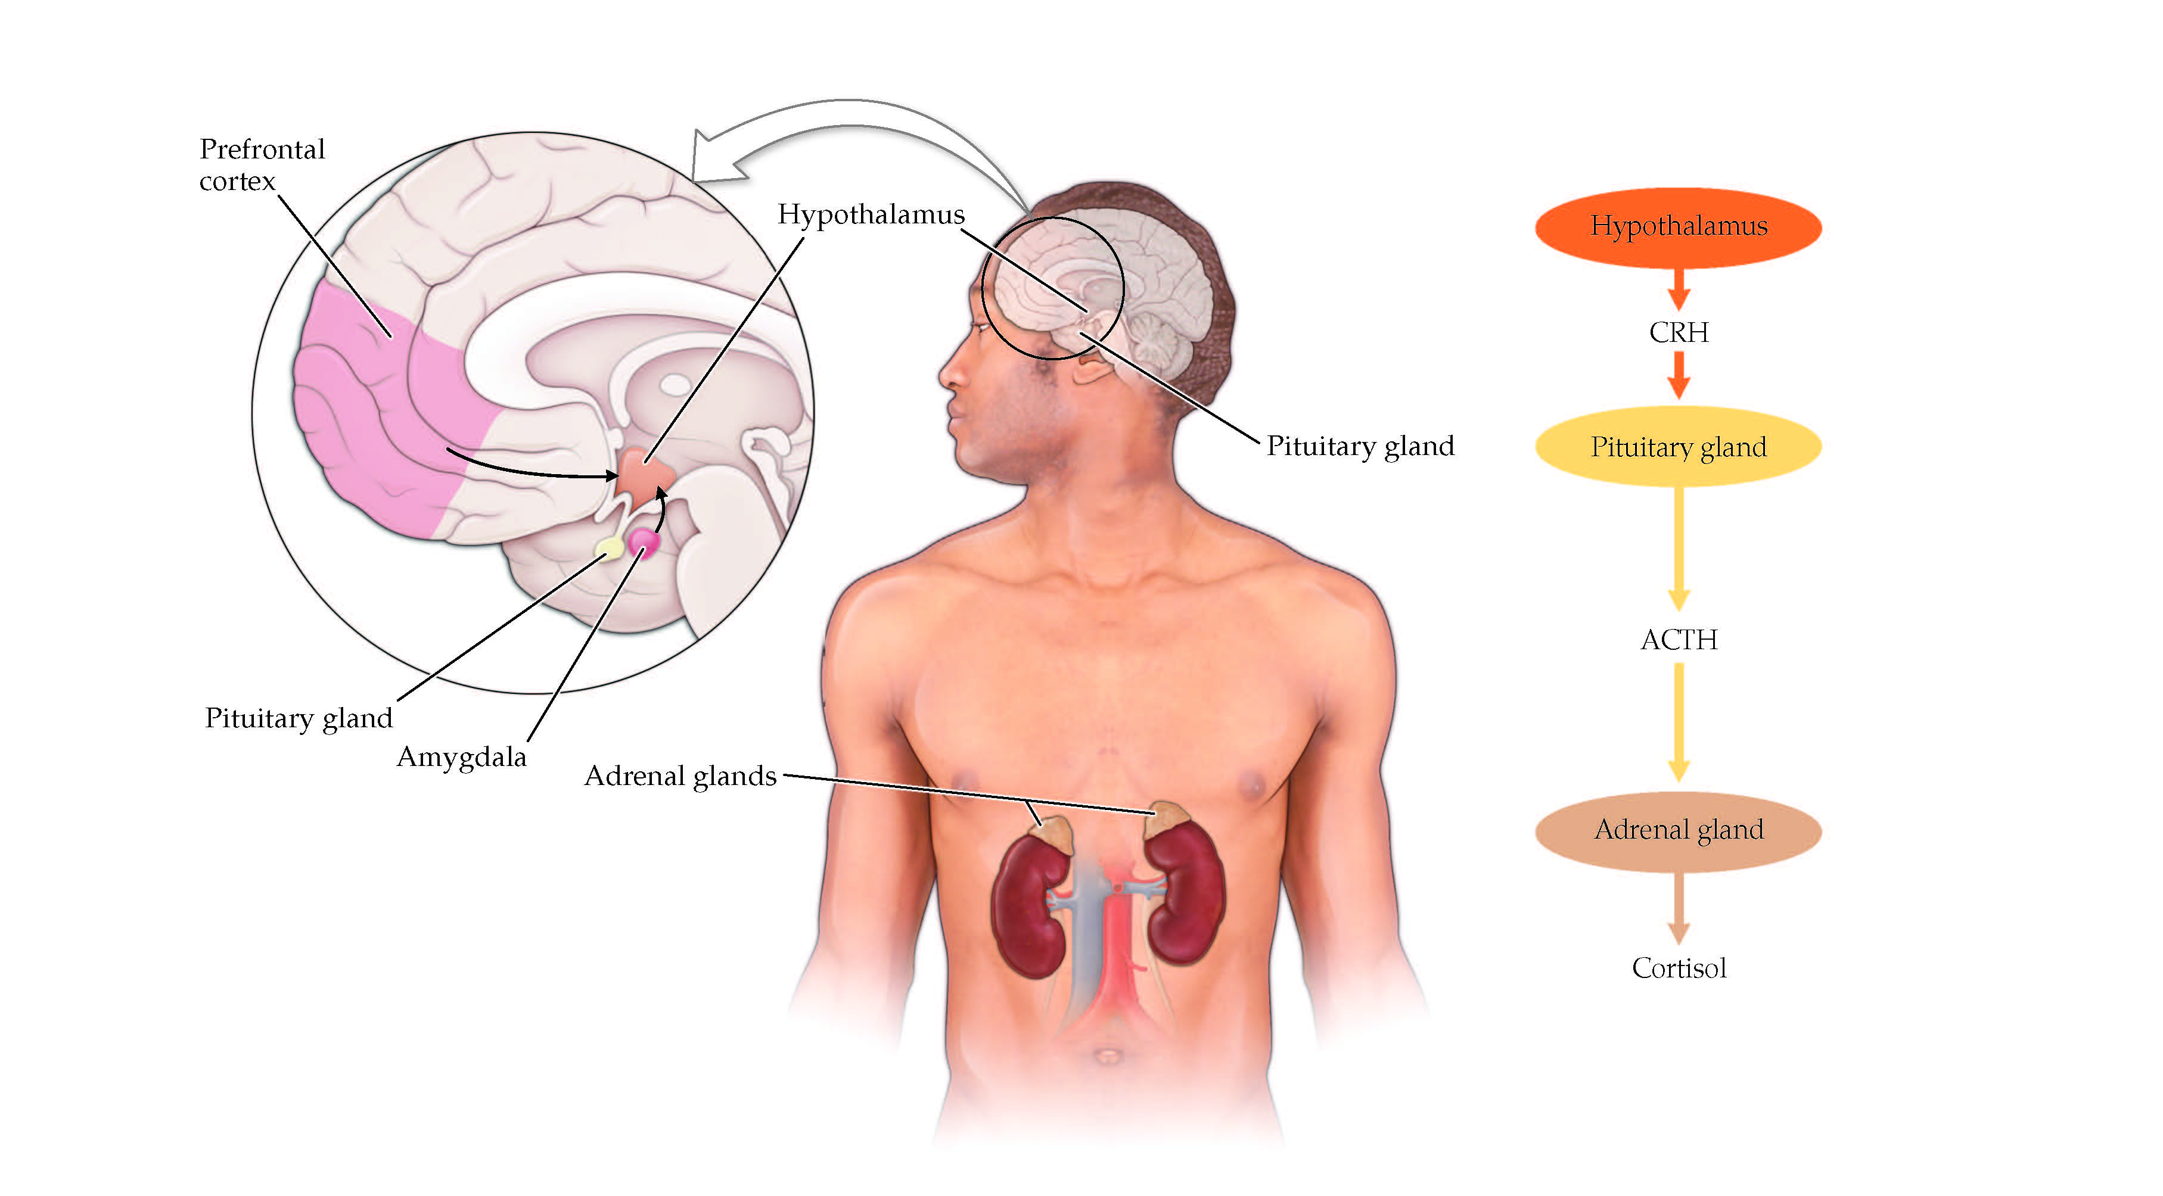
CNS Security Systems
hypothalamic–pituitary–adrenal axis
Notes:
Stress response pathway

Slide 37
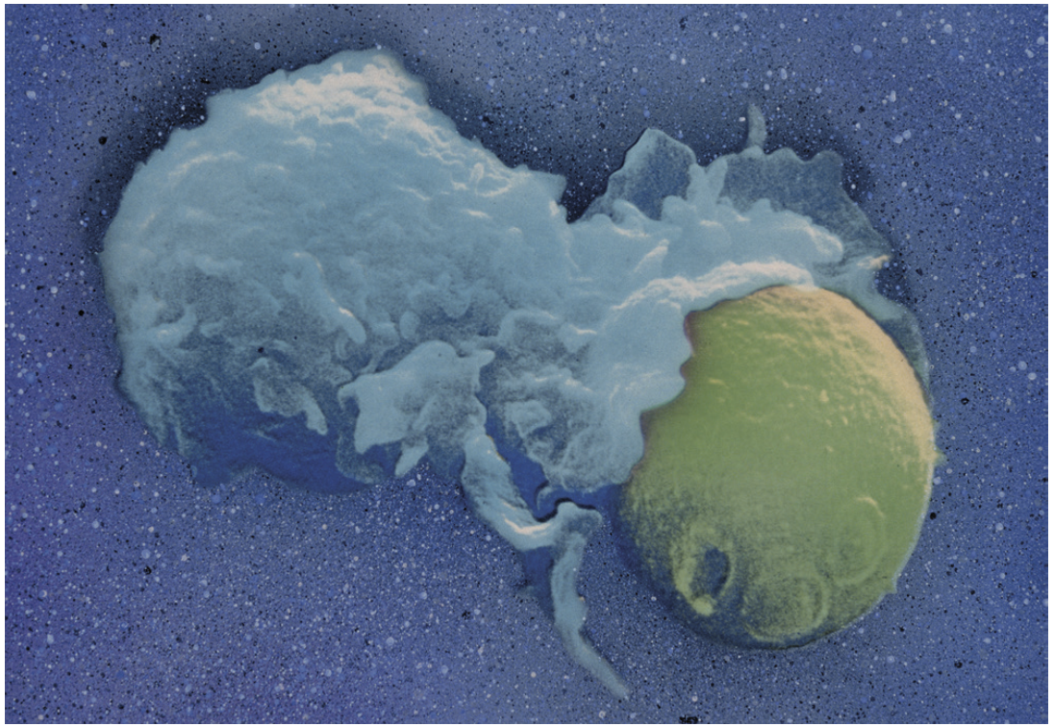
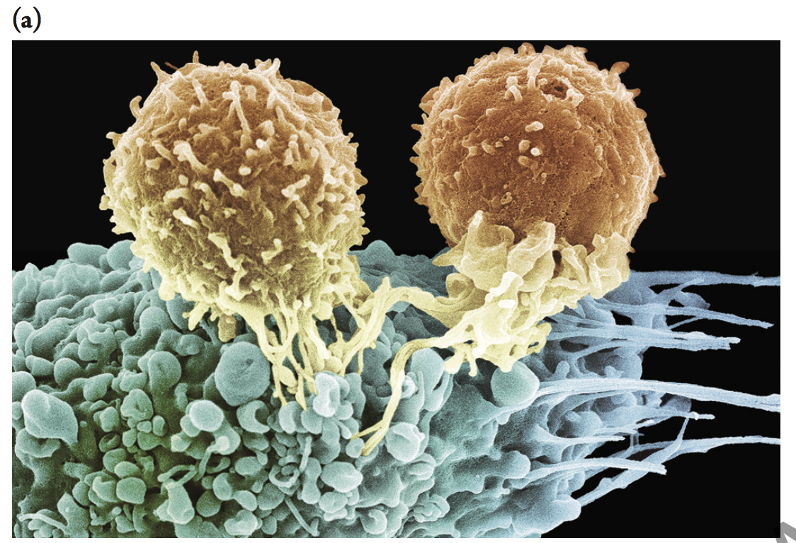
CNS Security Systems: Immune Systems
Innate: Phagocytes
Adaptive: T-cells and B-cells
Notes:
Phagocytes engulf and digest pathogens
T cells detect and eliminate pathogens
B cells secrete antibodies into the bloodstream that tag pathogens so that T cells can eliminate them
Representative immune cells from the body also migrate into the brain to aid in surveillance.

Slide 38
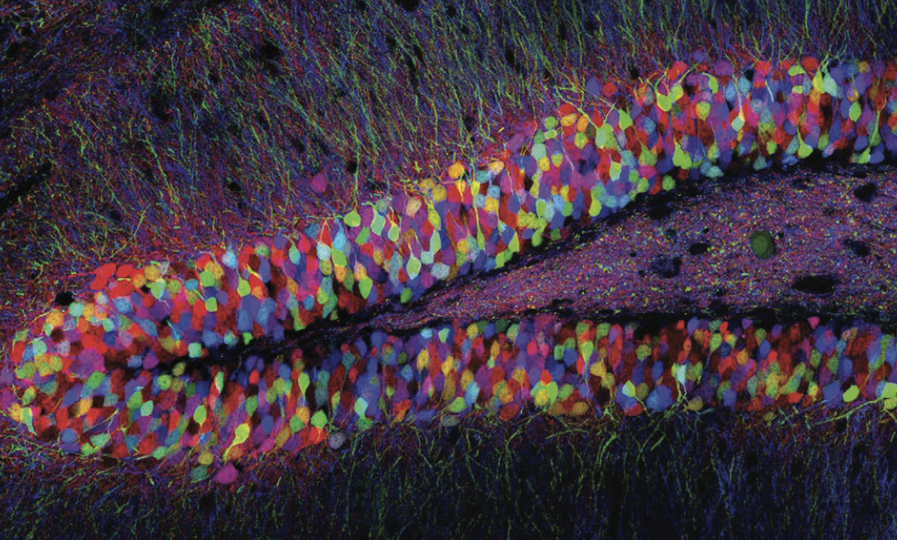
Laboratory Exploration
Brainbow mice
Now that we can see all these neurons at once, how can understand them?
Notes:
Brainbow staining technique allows scientists to examine dense clusters of neurons in the brain.

