Slide 1
Chapter Sixteen
Balancing the Competing Demands of Work and Family

Slide 2
Tables

Slide 3
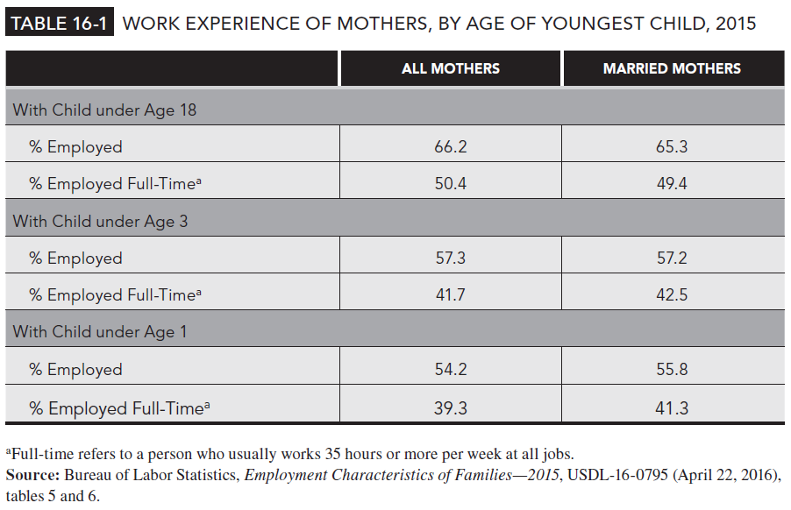
Table 16-1

Slide 4
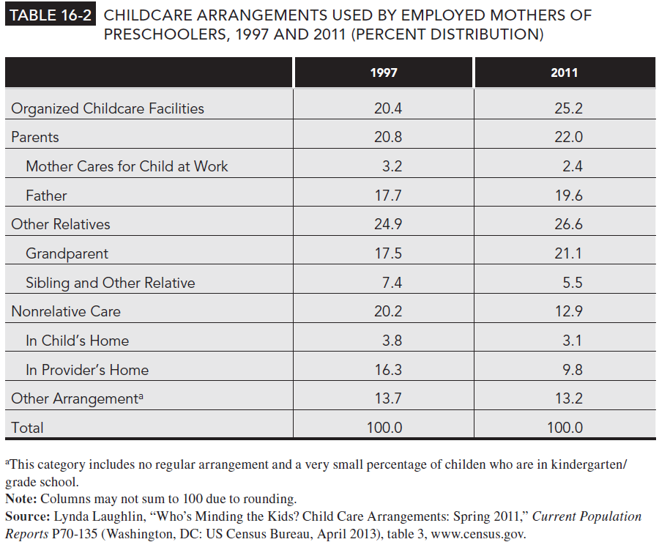
Table 16-2

